Slide 1
SC Links
Point 7
4th Joint HiLumi LHC-LARP Annual Meeting
November 17-21, 2014
KEK
Status Integration 7.10.2014
Jean-Pierre Corso EN-MEF-INT
Speaker Yvon Muttoni EN-MEF-INT
EDMS ; No. 1419773

Slide 2
Outline
Remind of requirements
Overview of Point 7 ; Remind
Routings
      TZ76 → UJ76 → R771 → RR77
Tricky Points
Open Points

Slide 3
Remind of requirements
Relocate DFBA (80% of powering) and their power convertors from RR73 & RR77 inside the TZ76 gallery
Replace DFBA by a DFA with same bulkiness, keeping current leads for Quench protection

Slide 4
Remind of requirements
Connect DFA in RR73 & RR77 to two DFHA inside the TZ76 gallery via LSS7 & UJ76 by the mean of a ∅200mm semi-rigid pipe (supra link)
Connect DFM to DFA (size to be defined)
Connect DFA to the DFHA with a DN80 rigid warm pipe (Helium)

Slide 5
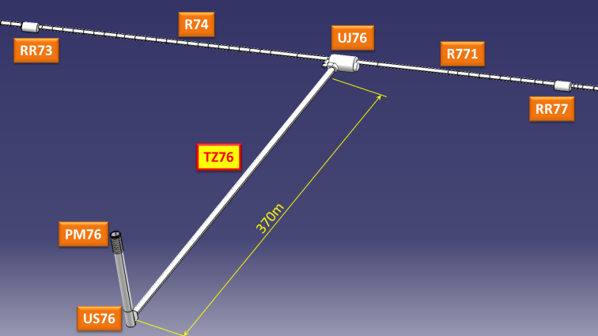
Overview of Point 7 : Remind
DFAM position
DFAN position
IP7
SC links
DFHA positions

Slide 6
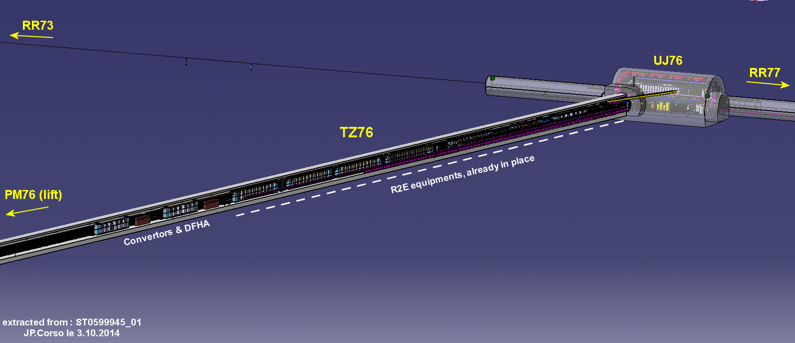
Routing along TZ76
Position of DFHAN & DFHAM into the TZ76

Slide 7
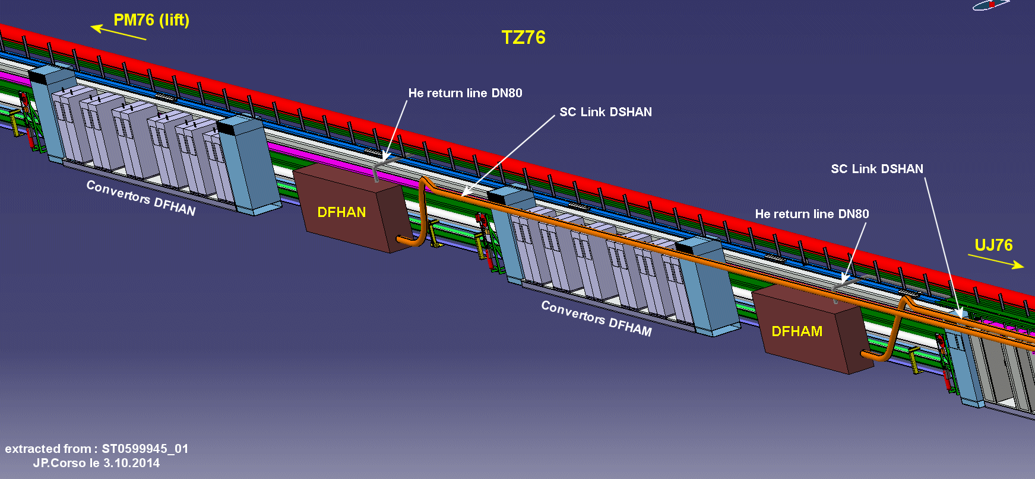
Routing along TZ76
Connection to the DFHA’s grouped with their corresponding power converters

Slide 8
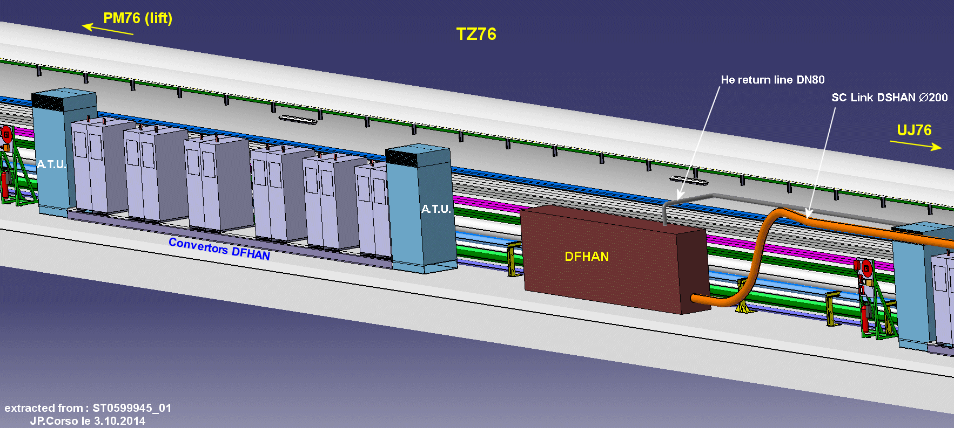
Routing along TZ76
Detailed view on the DFHAN and its converters

Slide 9
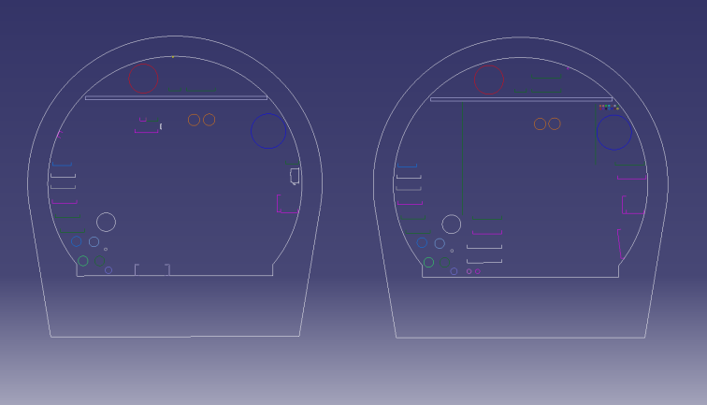
Routing along TZ76
Only one practical solution: under existing cable trays
SC links
Racks
Racks
Racks
Links during installation ?

Slide 10
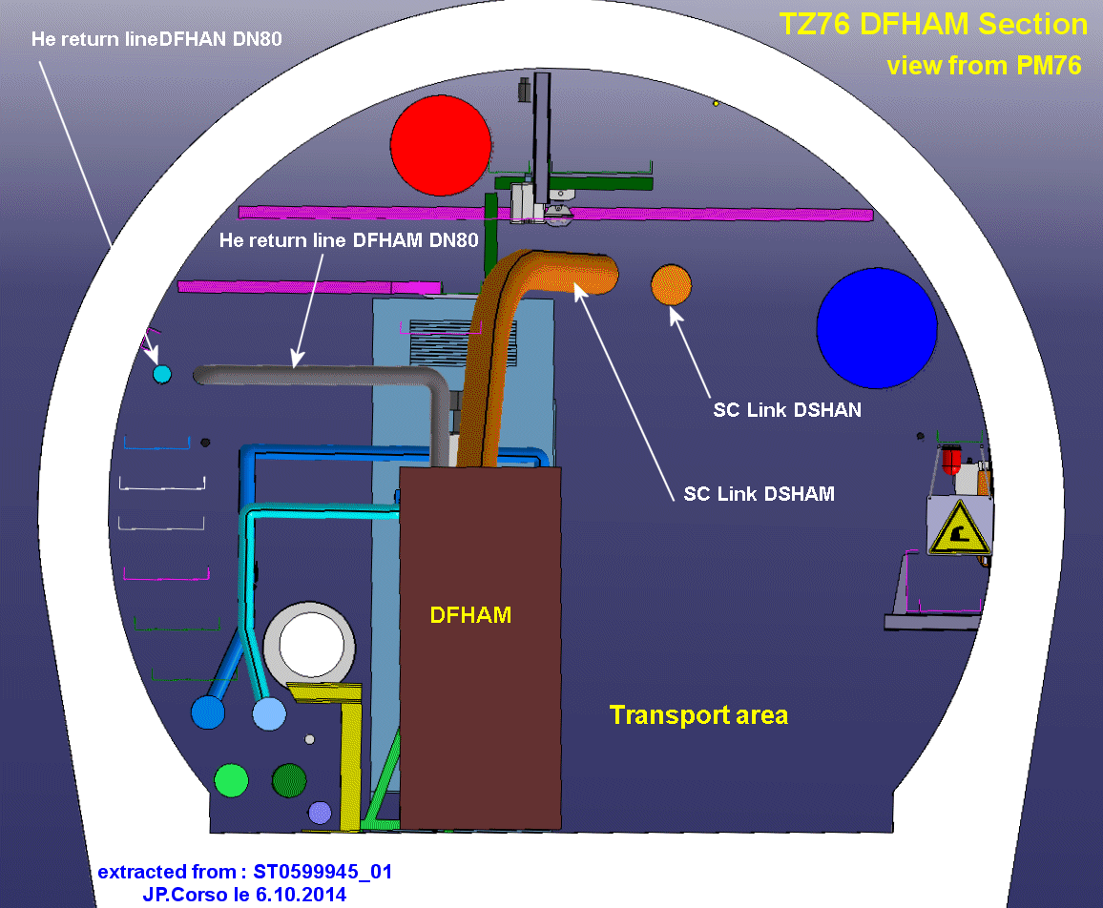
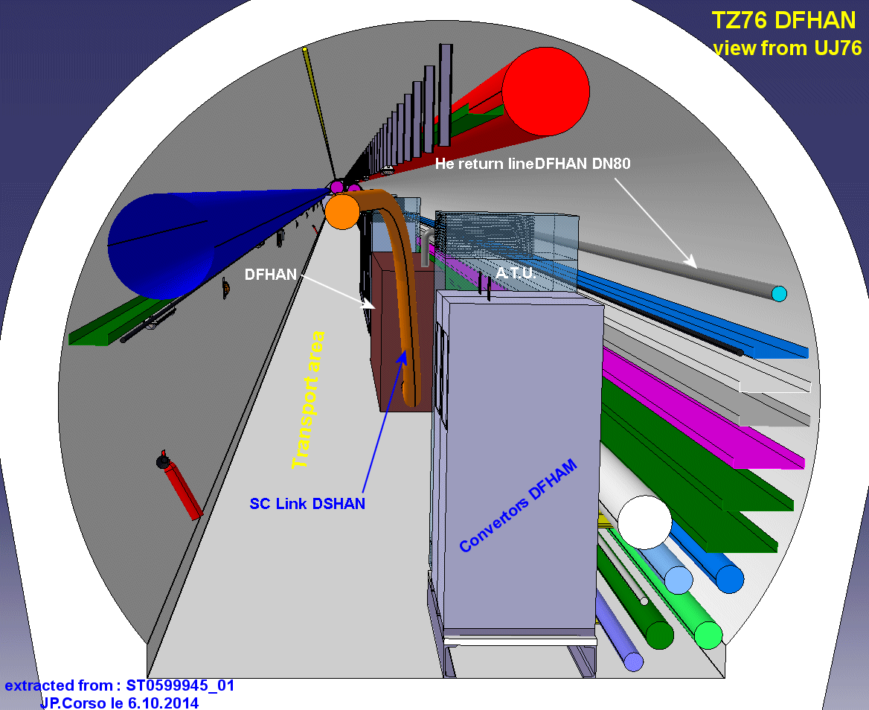
Routing along TZ76
Detailed view and Section on the DFHAN

Slide 11
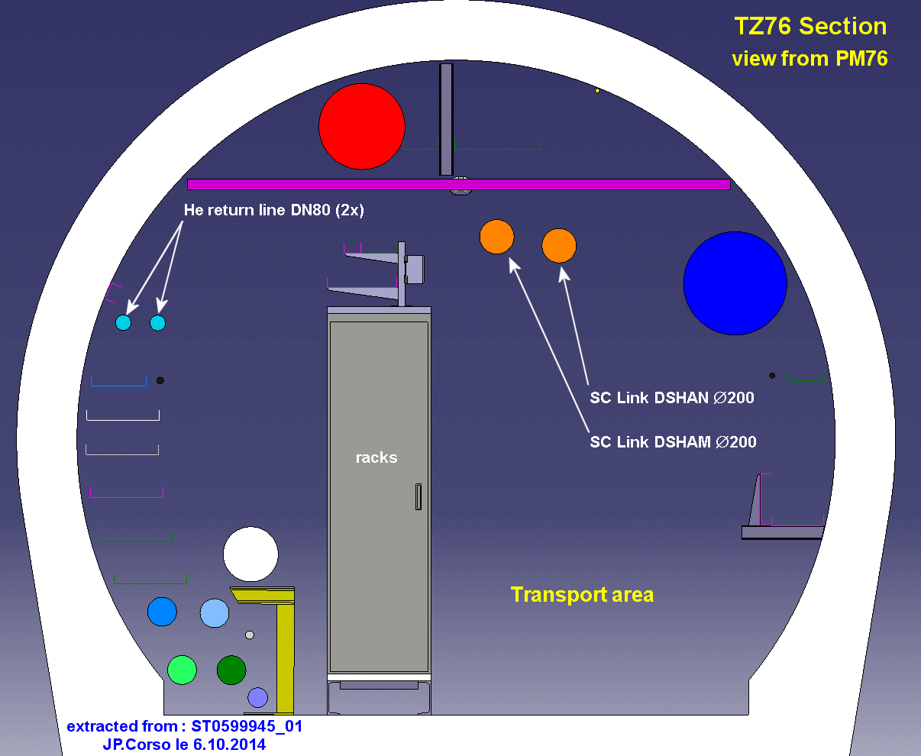
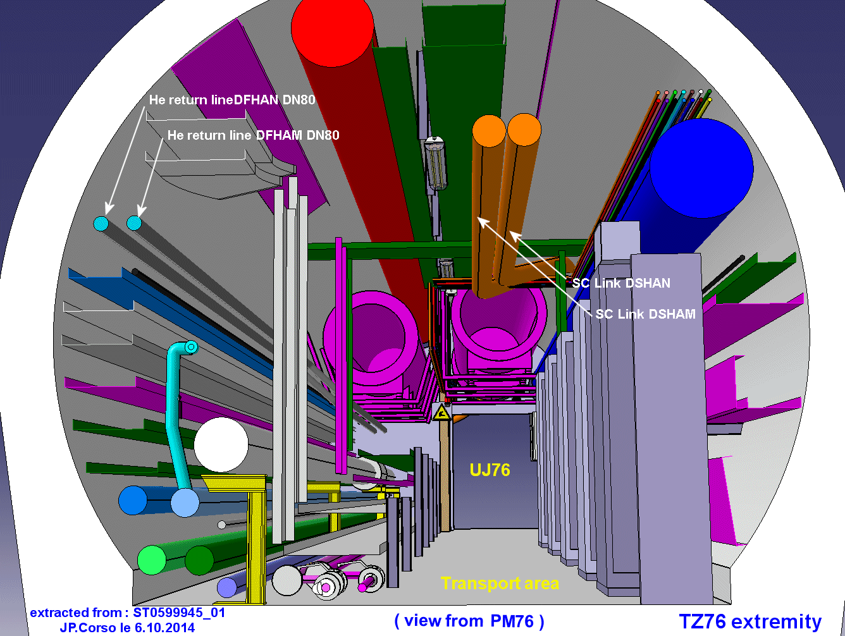
Routing along TZ76
Section along TZ76 and detailed view of the exit UJ76

Slide 12
Routing UJ76 junction - Options
Tunnel to UJ76 service area: existing ducts are full!
    2 “small” ducts ∅400mm must be drilled
    Between 2m & 3m long, depends on the angle…
UJ76 to TZ76 gallery: 2 main options
    without long ducts, along UJ76 bottleneck…
    with 2 new long ducts ( ̴19m each)

Slide 13
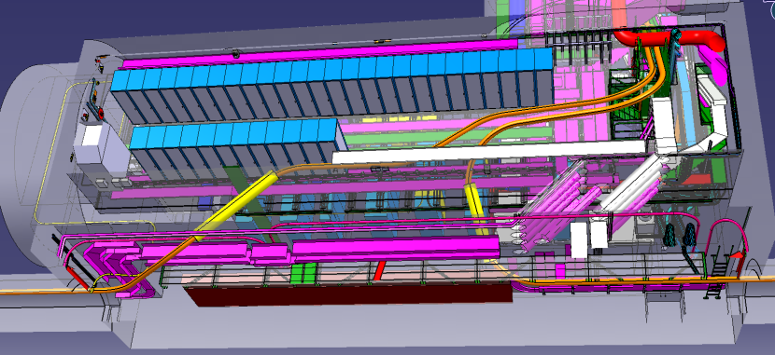
Routing UJ76 – Option 1
2 shorts ducts from LHC tunnel to service area
NO new long ducts
SC Links
UJ76

Slide 14
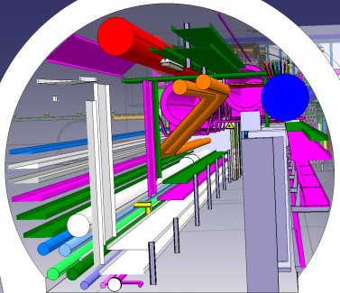
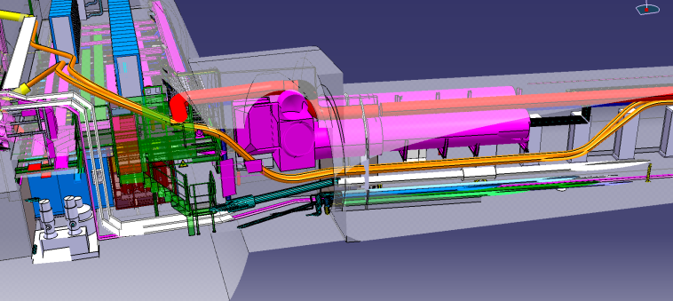
Routing UJ76 – Option 1
Along UJ76 bottleneck
TZ76
SC Links
SC Links
View
TZ76
UJ76

Slide 15
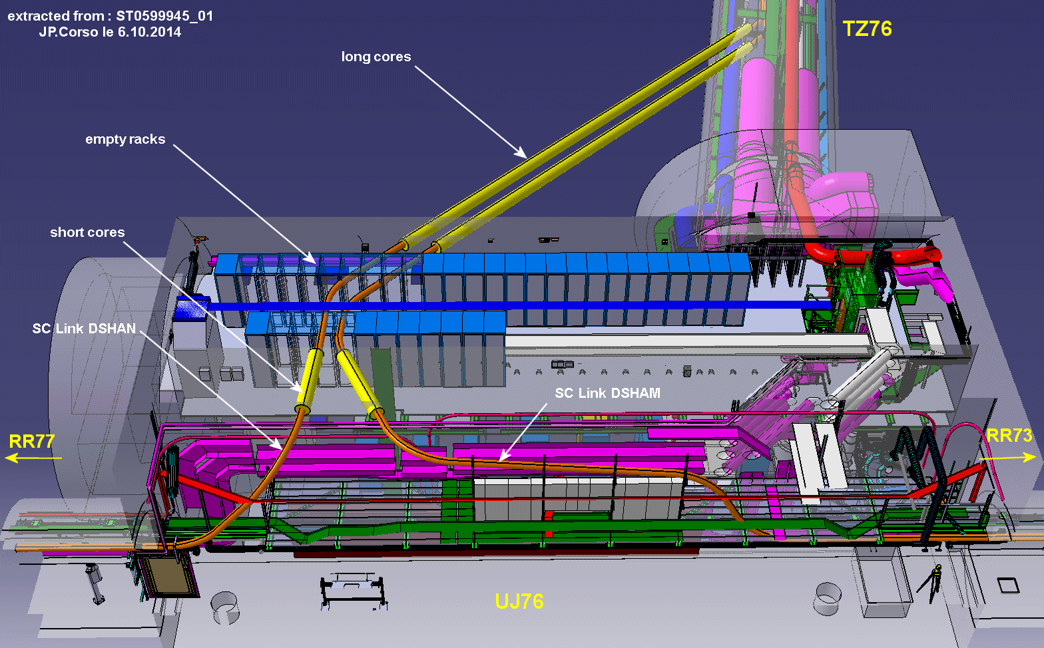
Routing UJ76 – Option 2
2 shorts ducts from LHC tunnel to service area
With 2 new long ducts from UJ76 to the TZ76 gallery

Slide 16
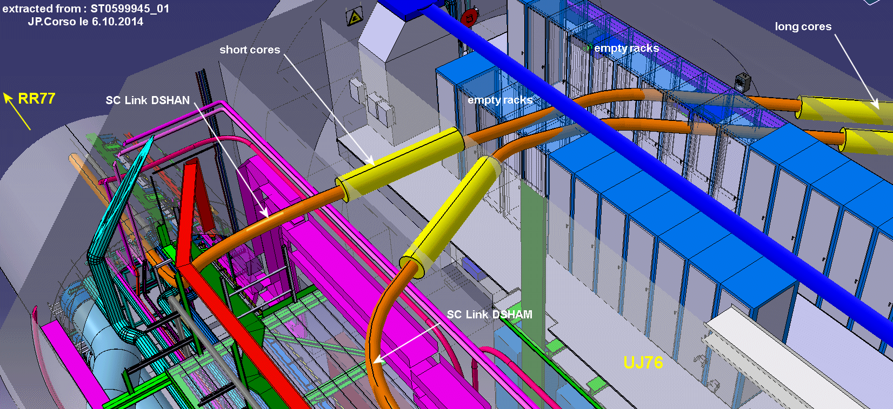
Routing UJ76 – Option 2
Detailed view on DSHAN link (R7)

Slide 17
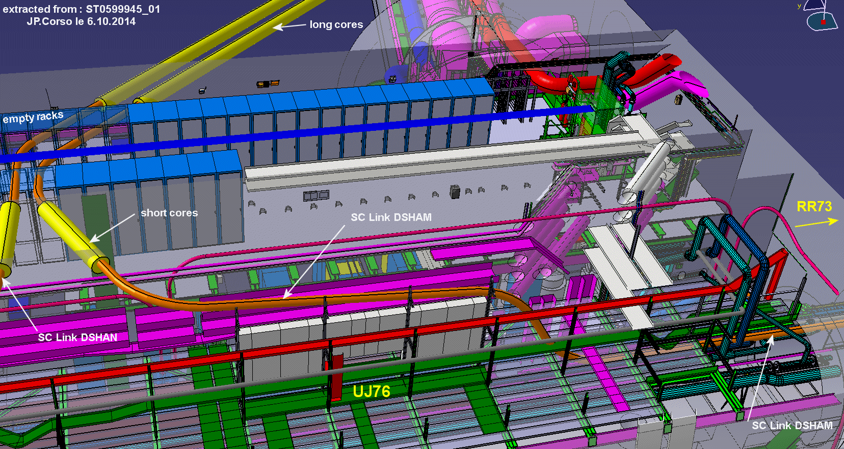
Routing UJ76 – Option 2
Detailed view on DSHAM link (L7)

Slide 18
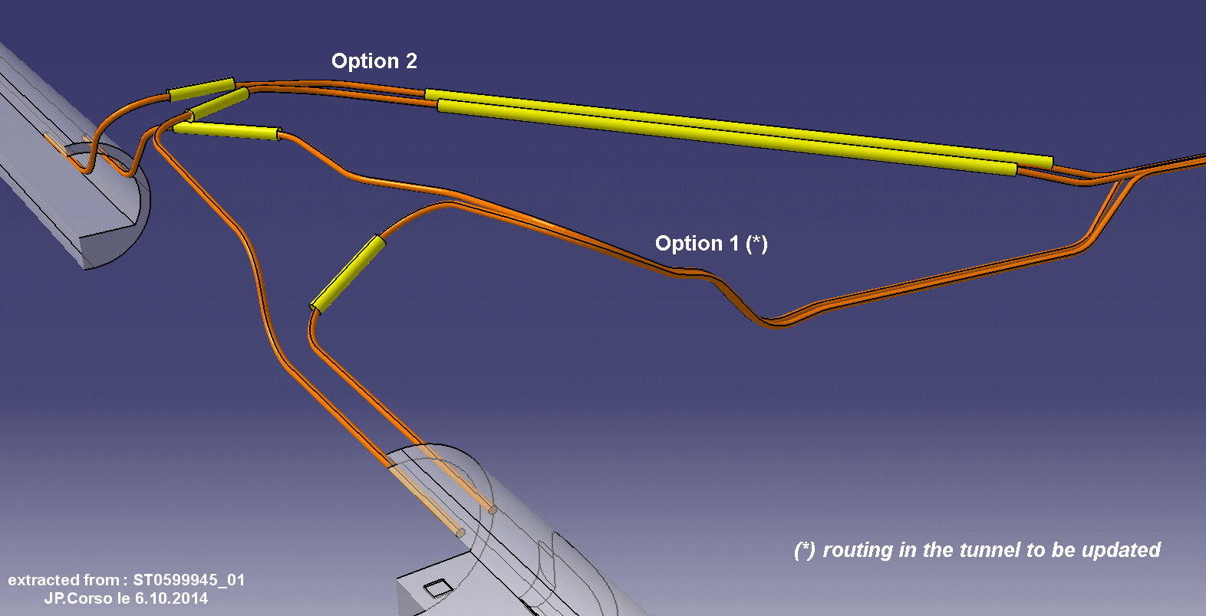
Routing Options – UJ76
Overview of the two options: 1st option (no long ducts) requires more bends and smaller bending radius

Slide 19
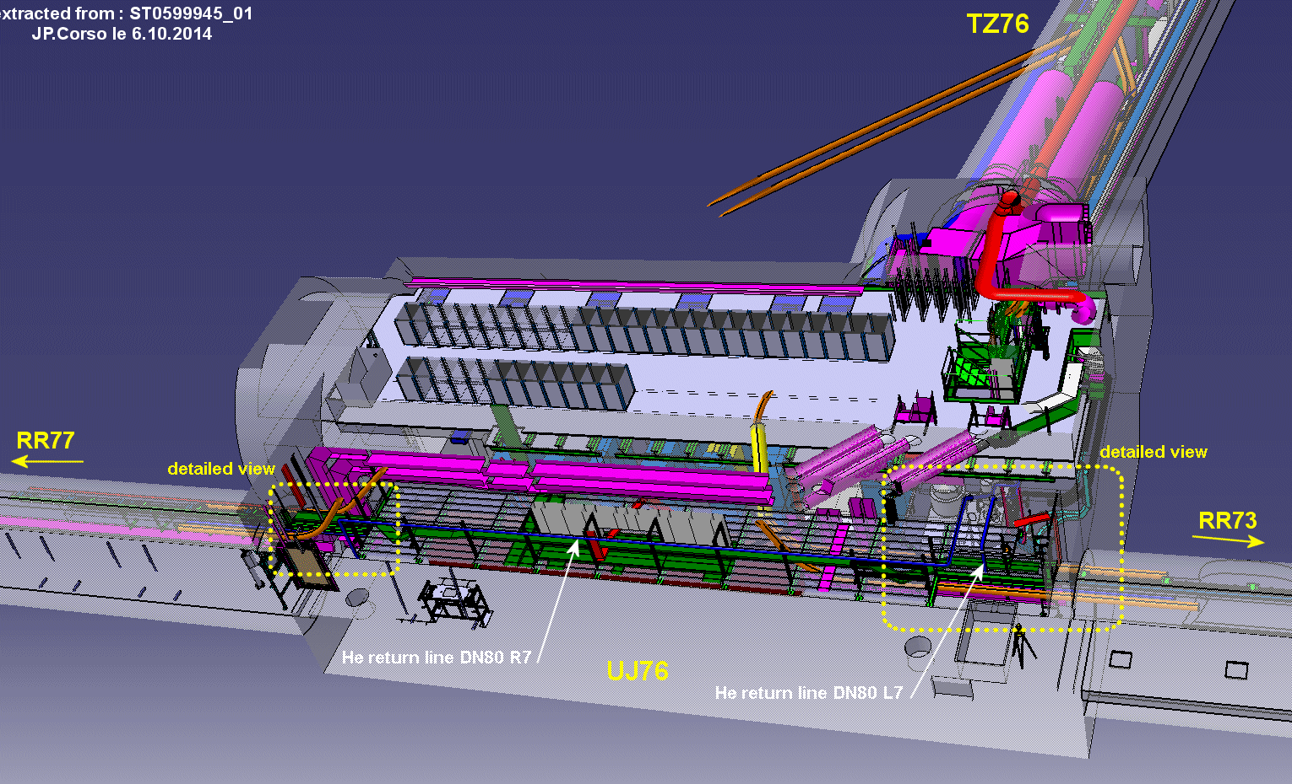
Routing He.Re pipes DN80 into UJ76

Slide 20
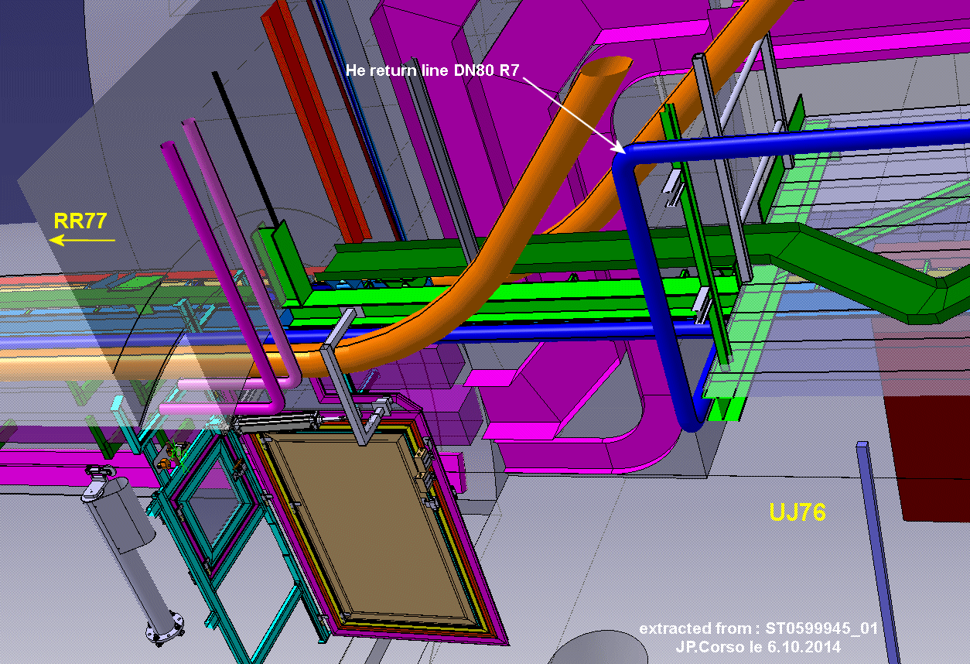
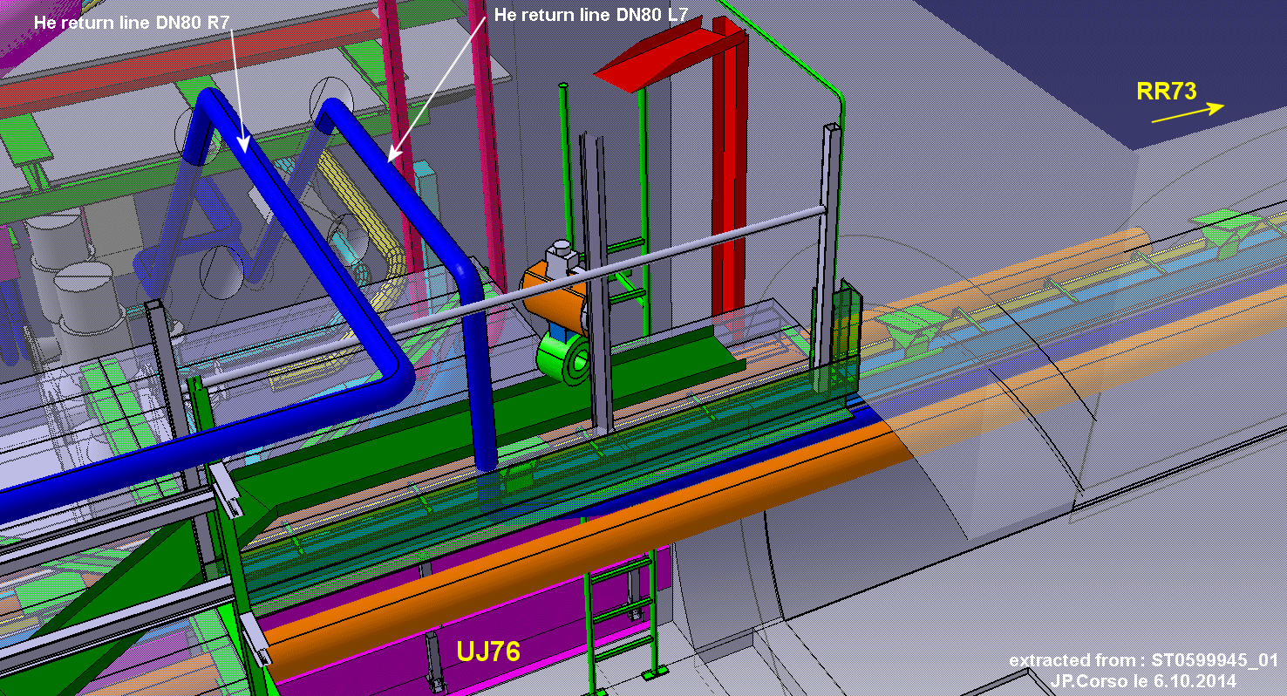
Routing He.Re pipes DN80 into UJ76
Detailed views right and left side

Slide 21
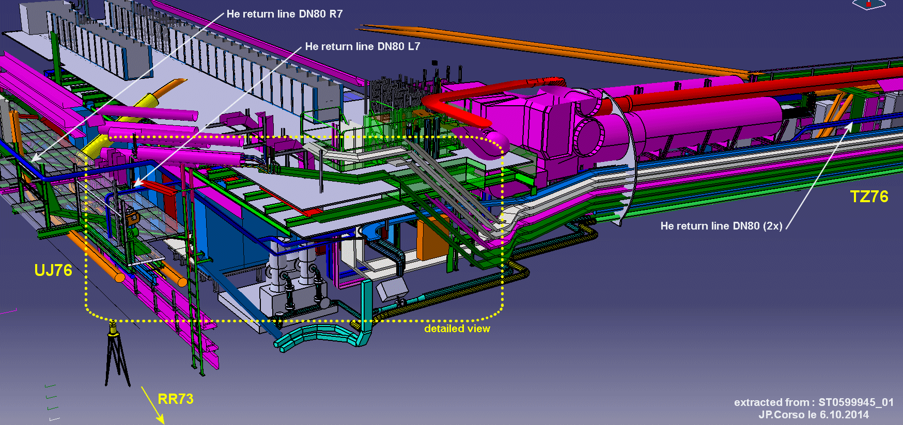
Routing He.Re pipes DN80 into UJ76
View from L7 side

Slide 22
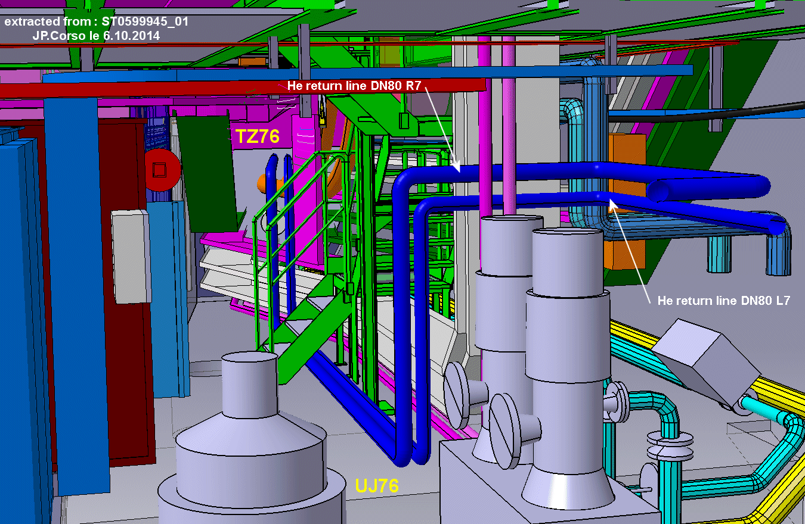
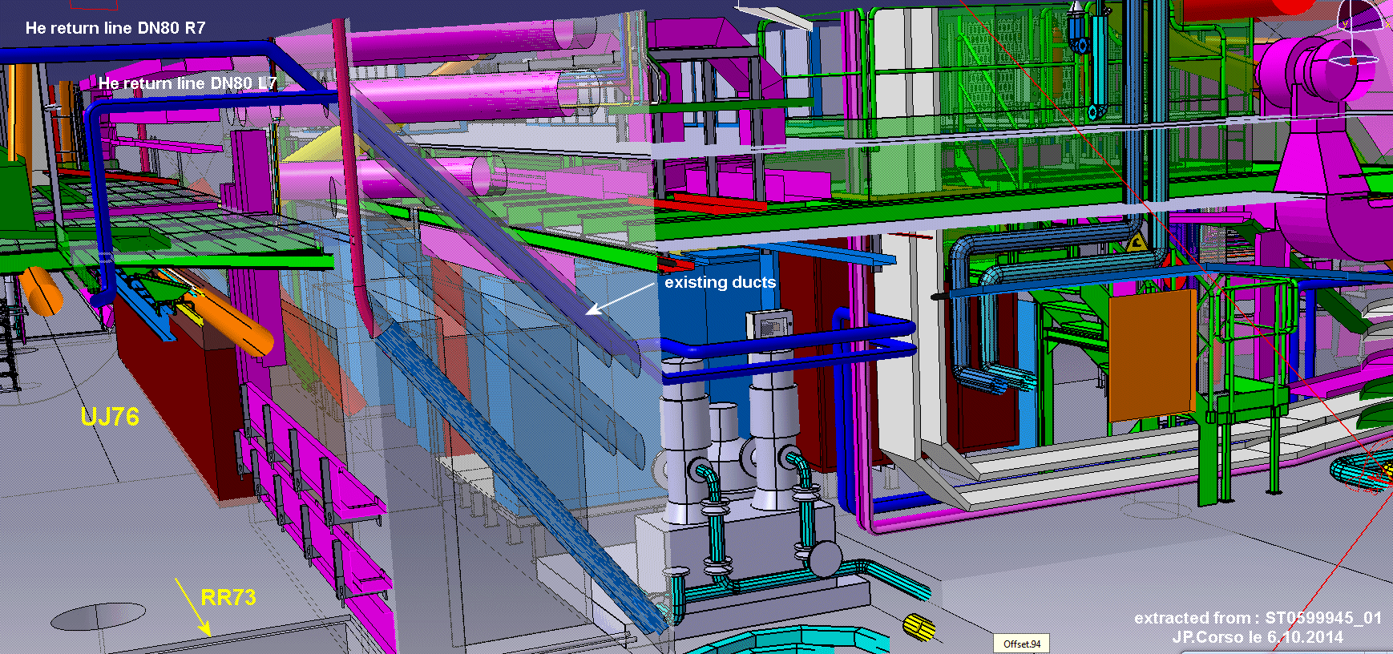
Routing He.Re pipes DN80 into UJ76
Detailed views

Slide 23
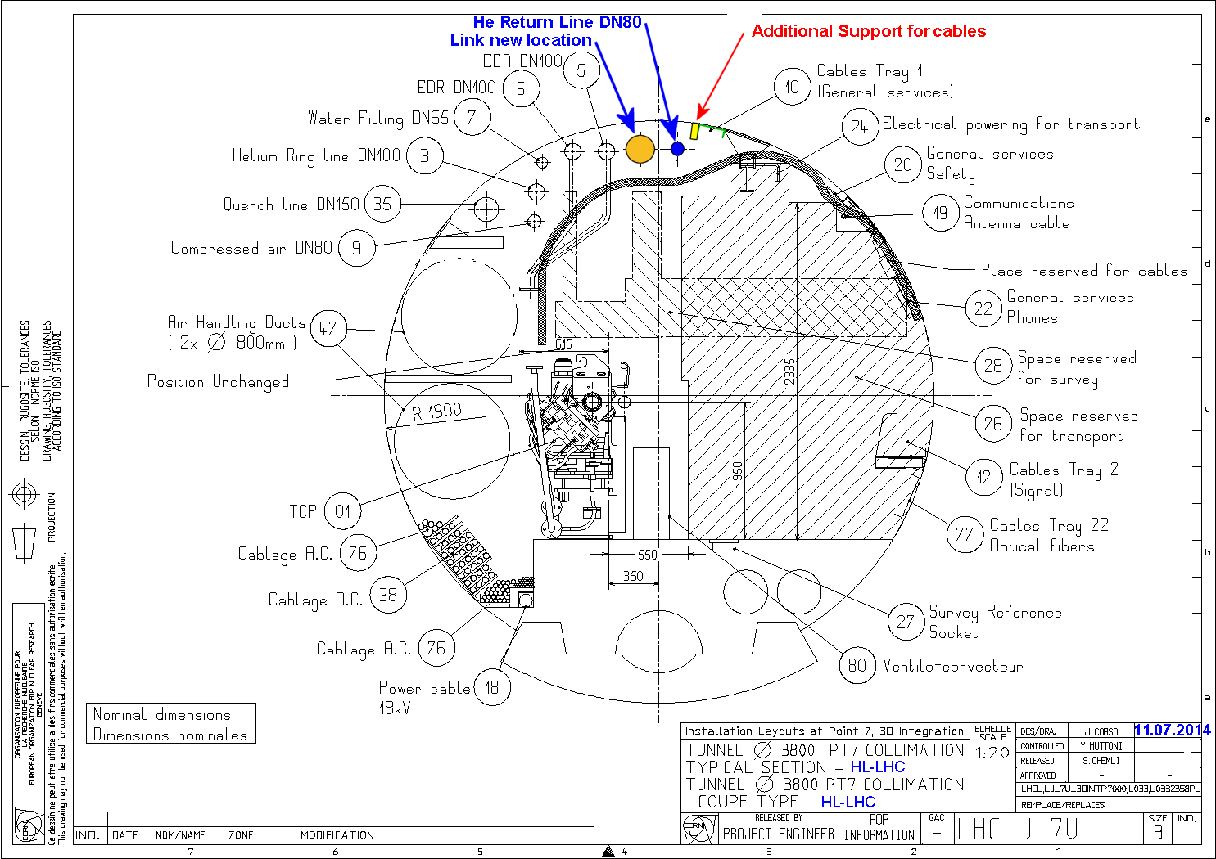
Routing R771 – Typical Section

Slide 24
Routing R771 towards RR77
Principle is similar for R74 and RR73

Slide 25
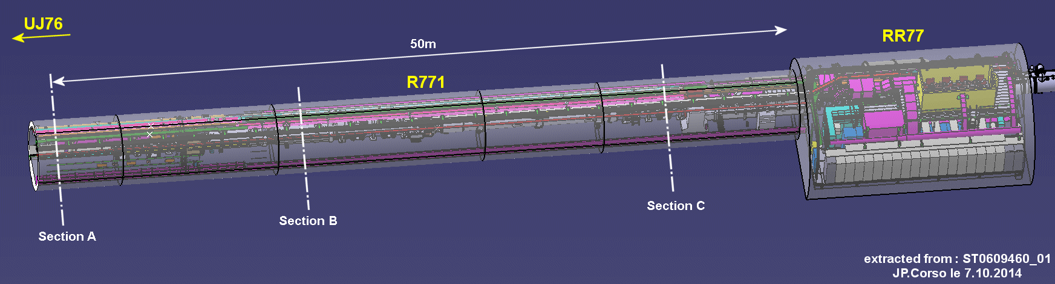
Routing R771 towards RR77
design of DFAN module in stand-by
Characteristics of DSLMN to be defined
General view of the area : Sections next slide

Slide 26
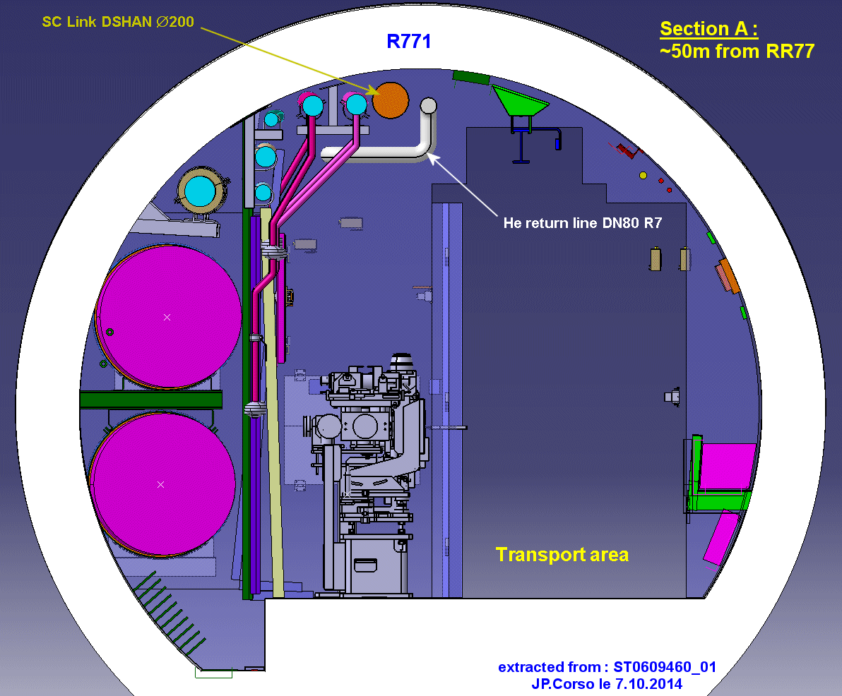
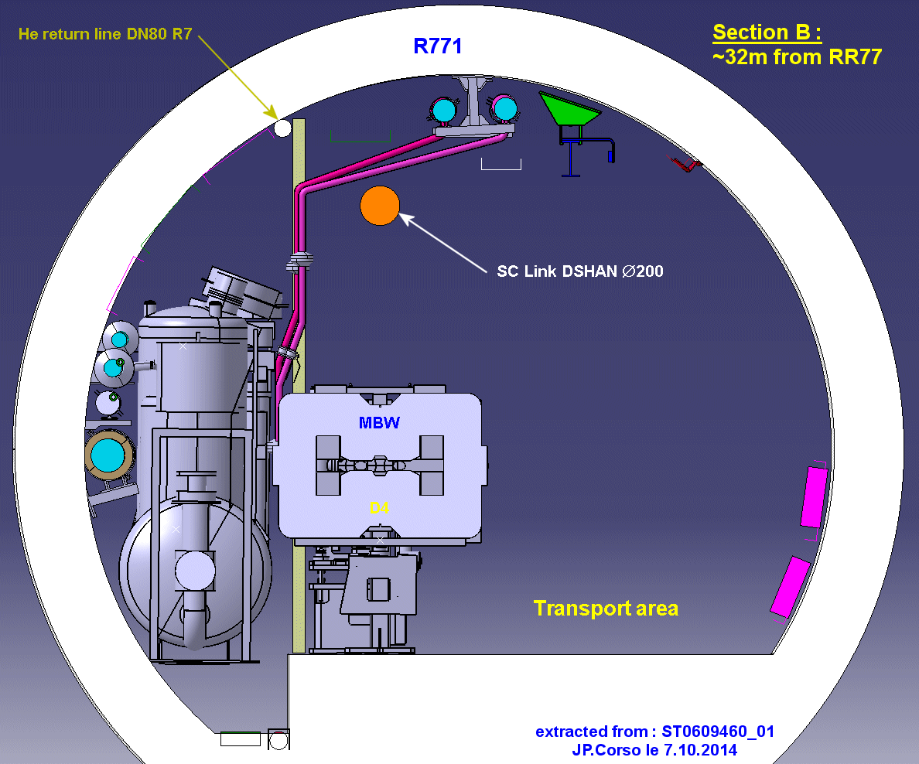
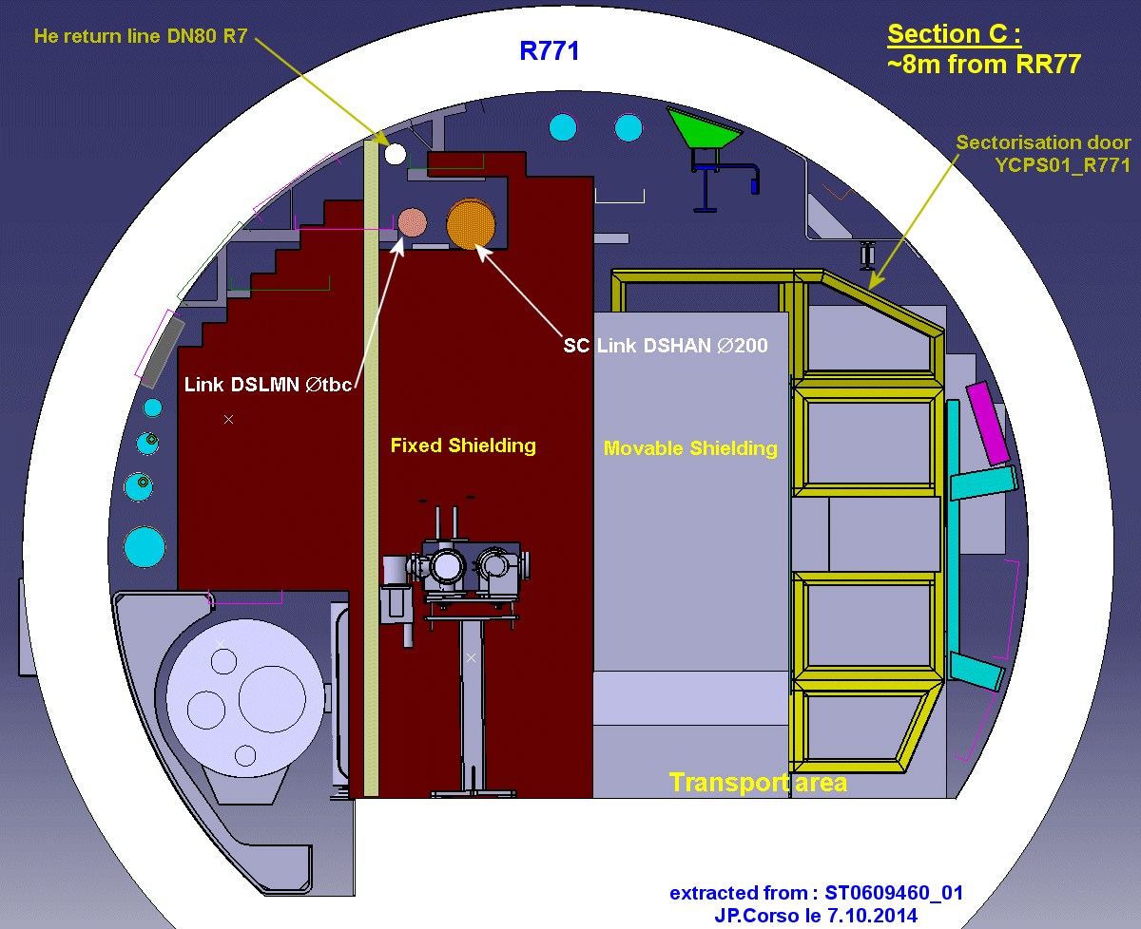
Routing R771 towards RR77
3 Sections with various positions of the link & pipe

Slide 27
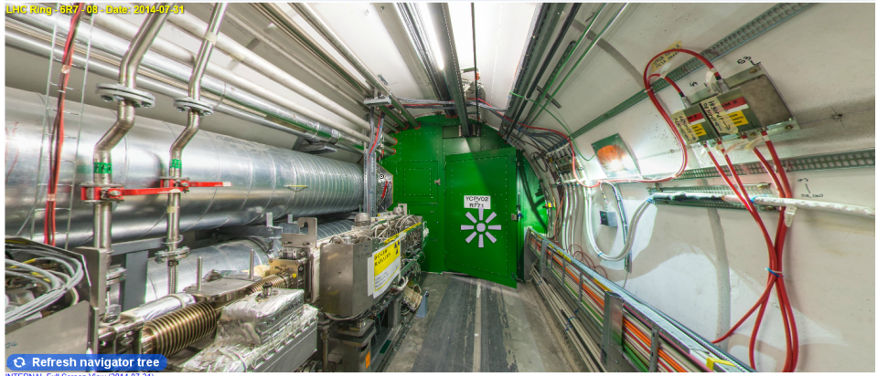
Click on the image and click on C4R7 on ICL website

Slide 28
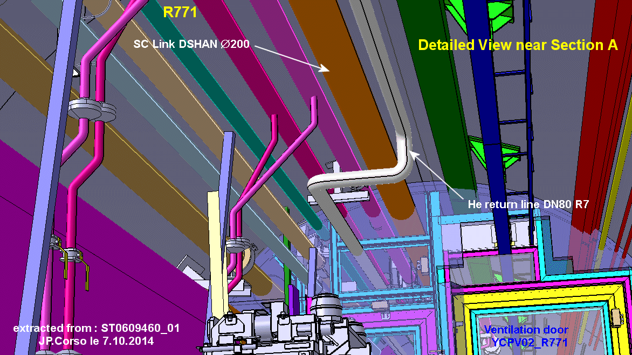
Routing R771 towards RR77
First change of disposition to cross ventilation door

Slide 29
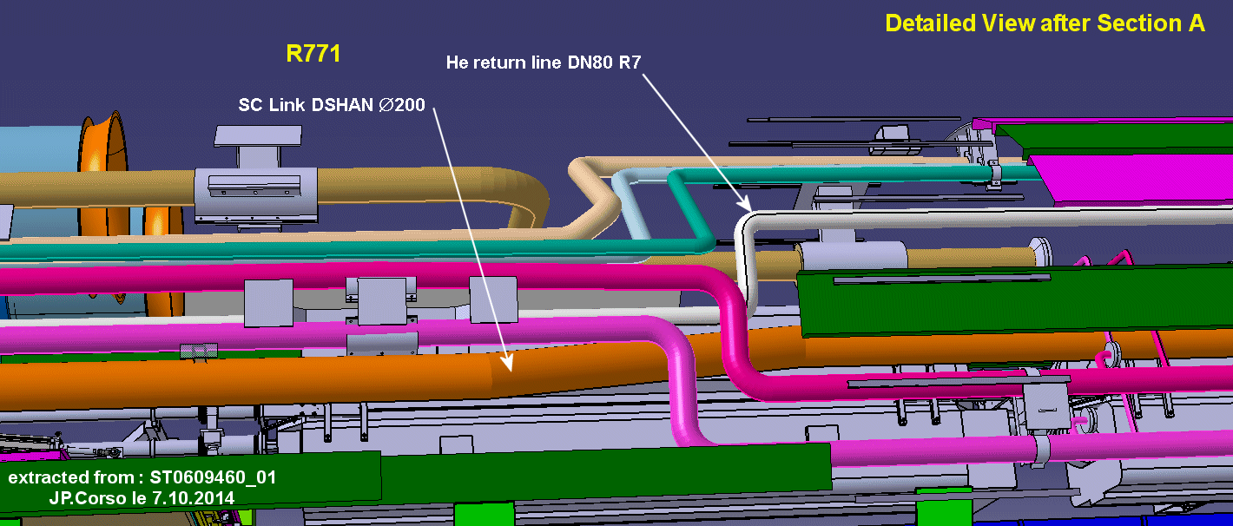
Routing R771 towards RR77
Second change of disposition after ventilation door, to fit with pipes’ change of position ; top view

Slide 30
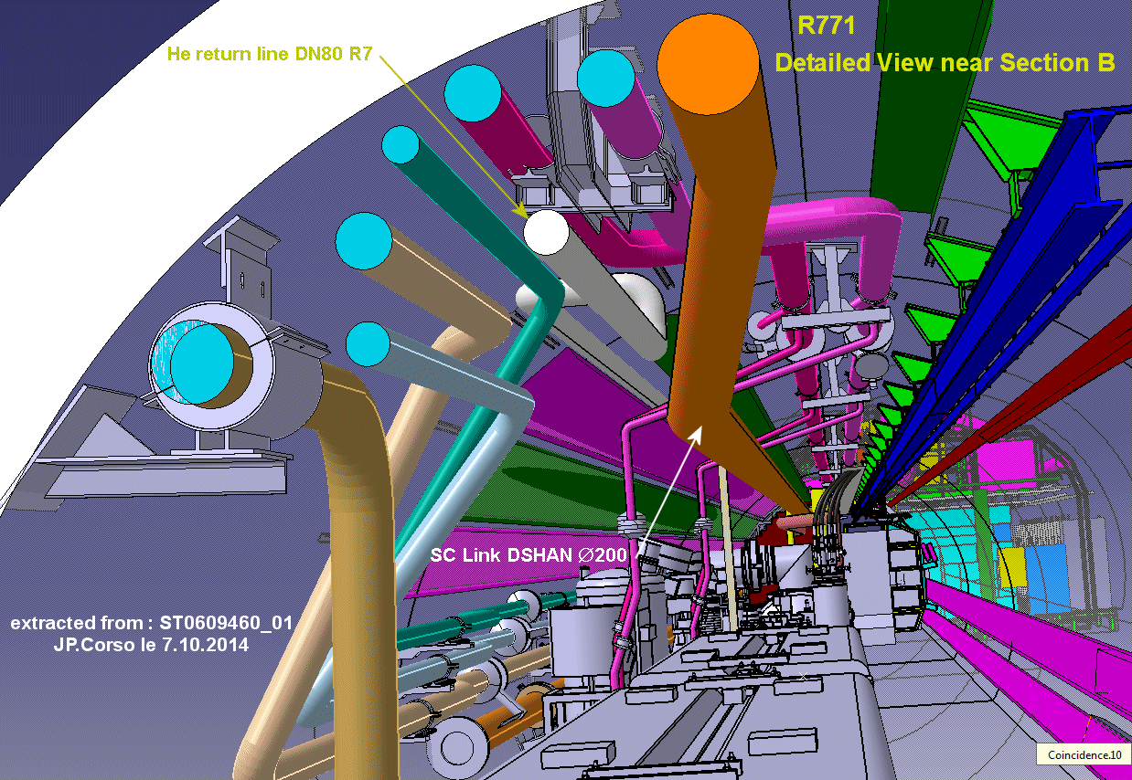
Routing R771 towards RR77
Second change of disposition after ventilation door ; left view

Slide 31
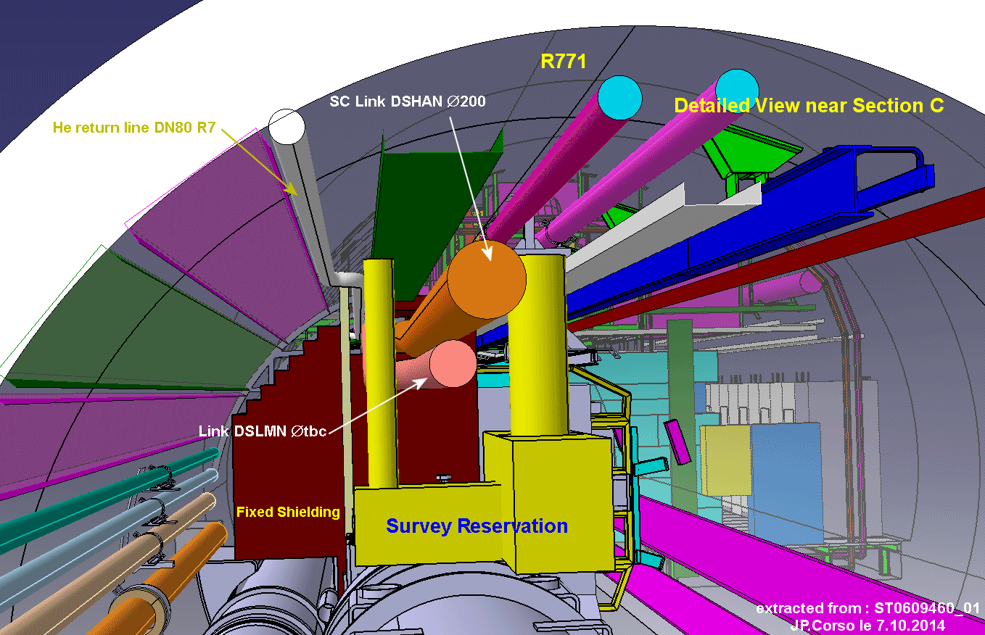
Routing R771 towards RR77
Third change of disposition to cross shielding

Slide 32
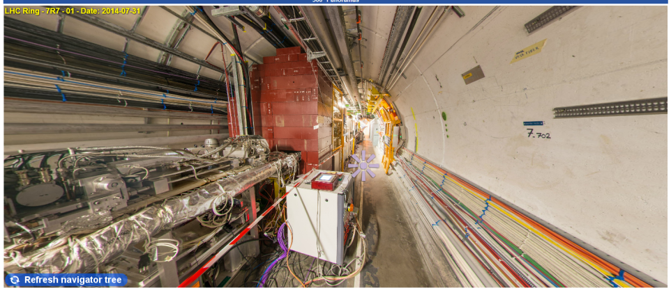
Click on the image and click on C7R7 on ICL website

Slide 33
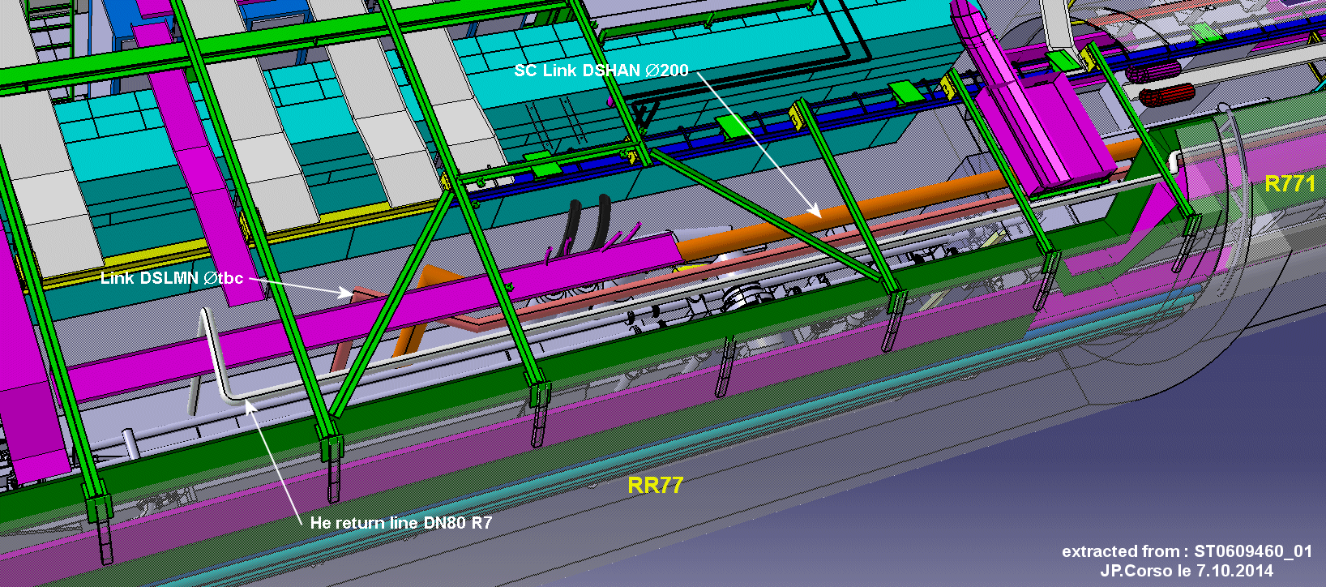
Routing inside RR77
General view

Slide 34
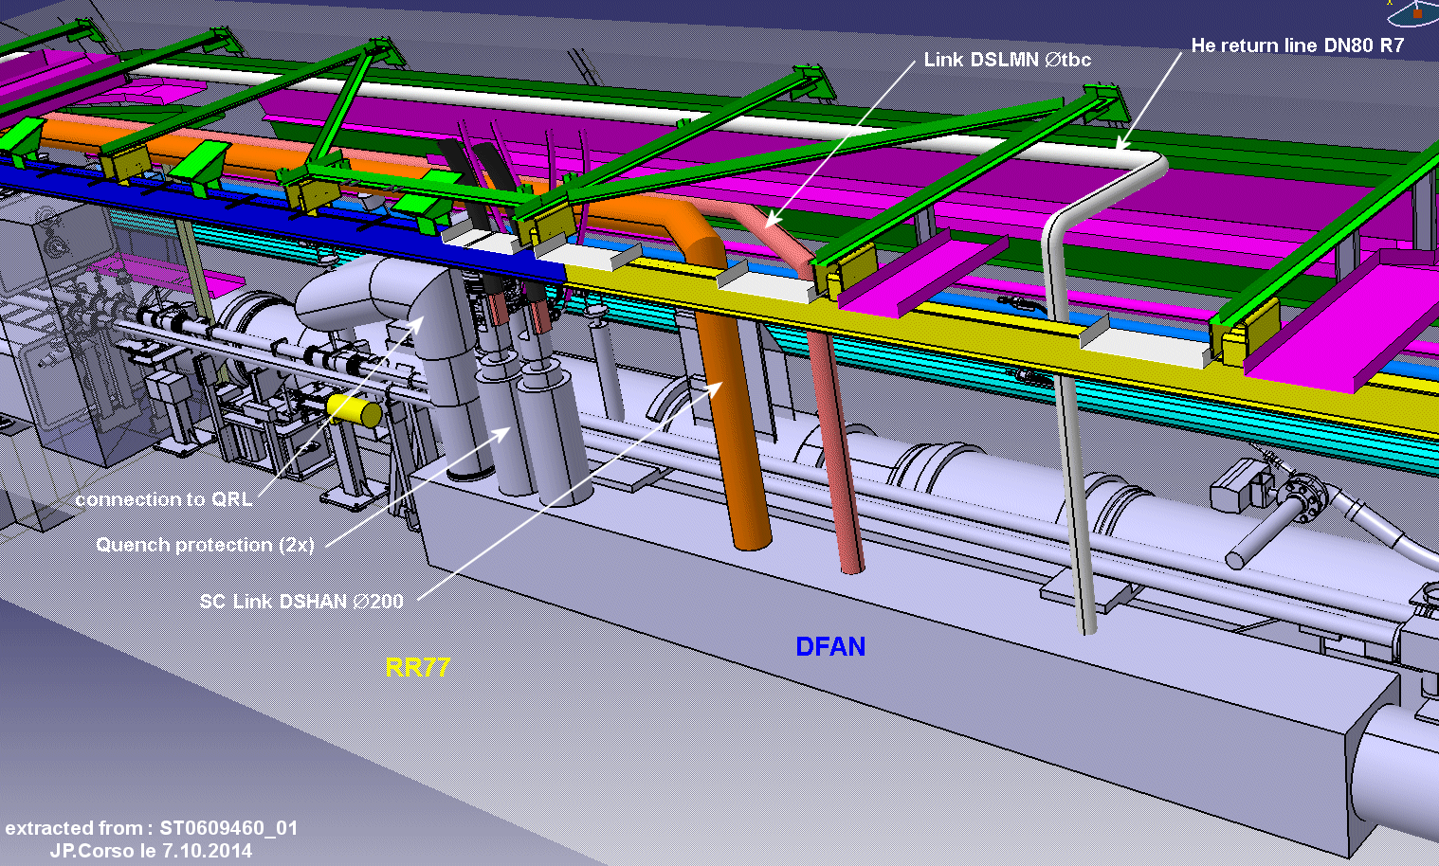
Routing inside RR77
View from passage

Slide 35
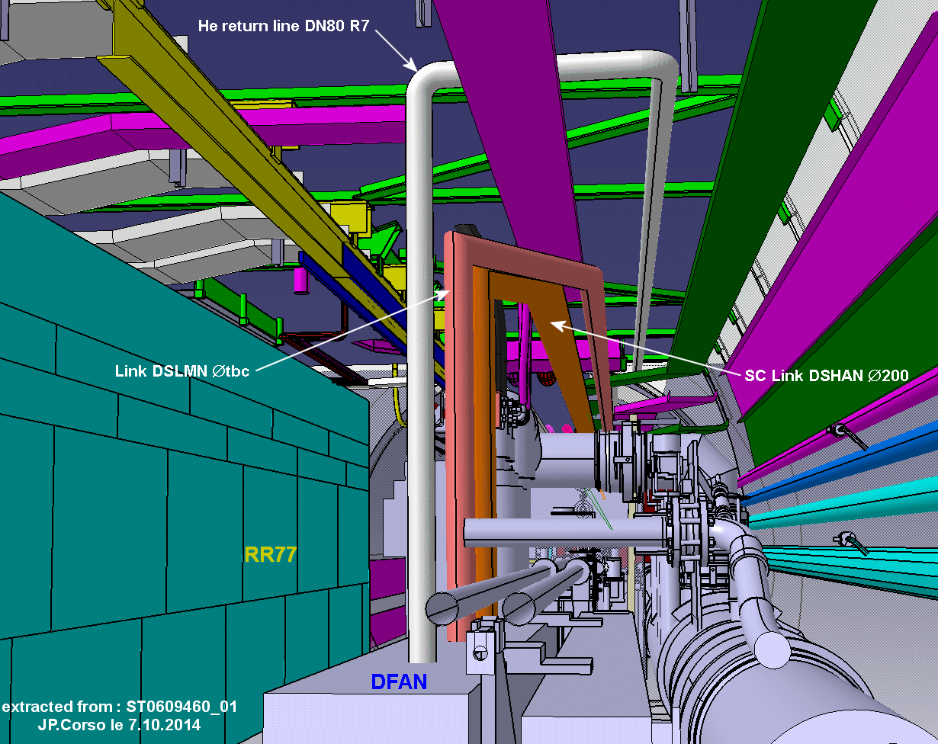
Routing inside RR77 ; lateral view

Slide 36
Routing R74 → RR73
Remind: the principle for routing of all the links and pipes shown in the previous slides is similar for R74 and RR73 as for R771 and RR77 !

Slide 37
Tricky Points
RR73/77 to LHC tunnel:
    Many constraints due to shieldings, metallic structures and supports to avoid and cross
UJ76 crossing: many bends in multiple directions

Slide 38
Open Points
How to connect the link to the service module ?
    Vertically ? Horizontally ?
Constraints on the SC link ?
    Supporting? Fixed points? Limited space for that

Slide 39
Open Points
“Accessories” on the link inside the tunnel:
    Instrumentation?
    Services (controls, etc…)?
RR devices to be relocated in TZ76 ?
    Inventory under progress (converters, lead control, etc… )
Size of DFH elements to be transported? Space required for assembly and maintenance?

Slide 40
Thanks for your attention

Slide 42
Annex

Slide 43

Access to Point 7 for SC links
Point 7
Point 8
~3,3 km
~3,3 km
Point 6

Slide 44
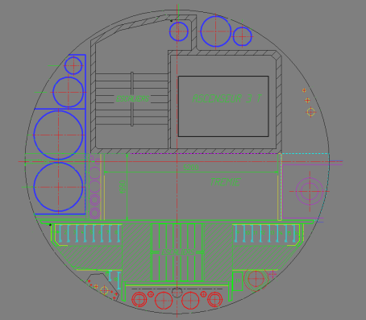
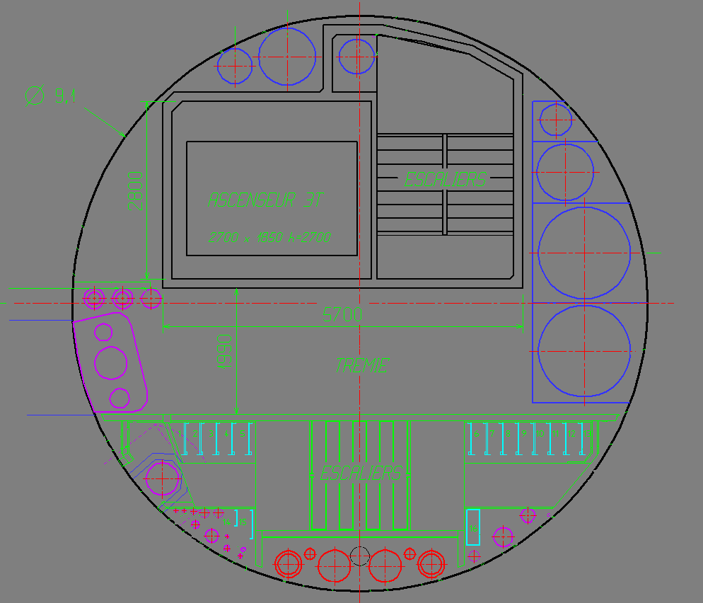
Access to Point 7 for SC links
Access Pit PM 65
Access Pit PM 85

Slide 45
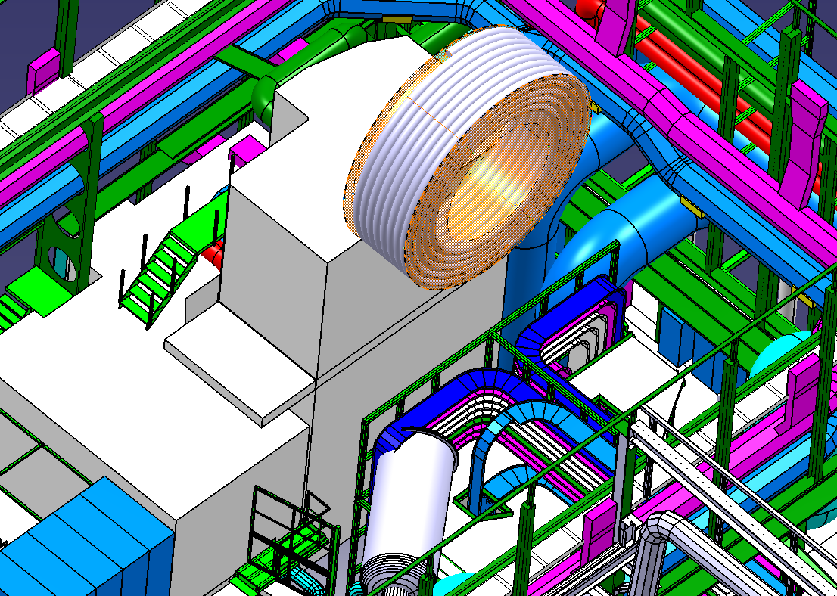
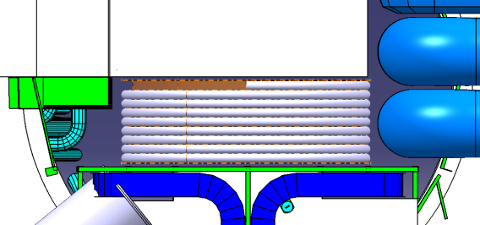
Access to Point 7 for SC links
500m link ready for handling
Space inside PM 85
Surface Building
SD8
1,8
5,5

