Slide 1
Radiological impact of available inner triplet design option
C. Adorisio and S. Roesler

Slide 2
Outline
Rules and regulations
      Limitation
      Optimization/ALARA
Optimization during design
      Methodology
      Design options
Dose rate outlook
      A step in the “pre” HL-LHC era
      HiLumi era evolution
Summary and Conclusions
A reminder

Slide 3
Rules and regulations a reminder

Slide 4
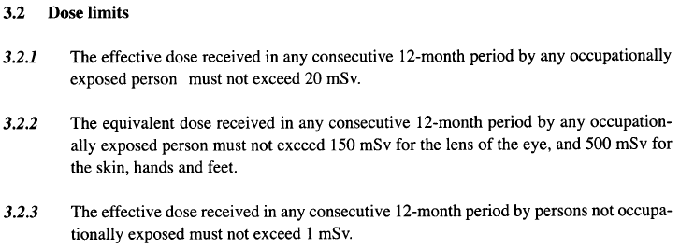
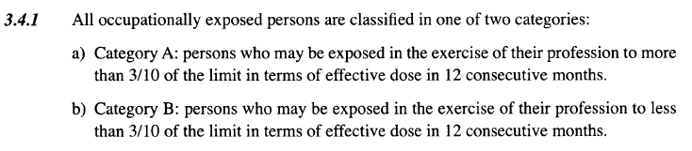
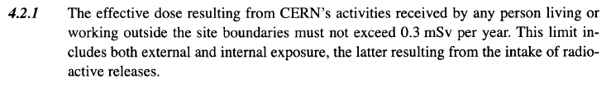
Safety Code F
Limitation
Design and operation !
Radiation Workers
Category A: 20 mSv/y
Category B: 6 mSv/y
Not occupationally exposed workers
1 mSv/y
Environment
0.3 mSv/y

Slide 5
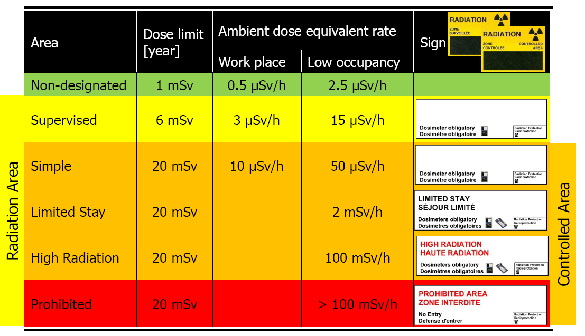
Safety Code F
Limitation
Total number of working hours per year: 2000 hours
(example: Supervised Area 3 µSv/h × 2000 h = 6 mSv)
Low-occupancy: < 20% of working time

Slide 6
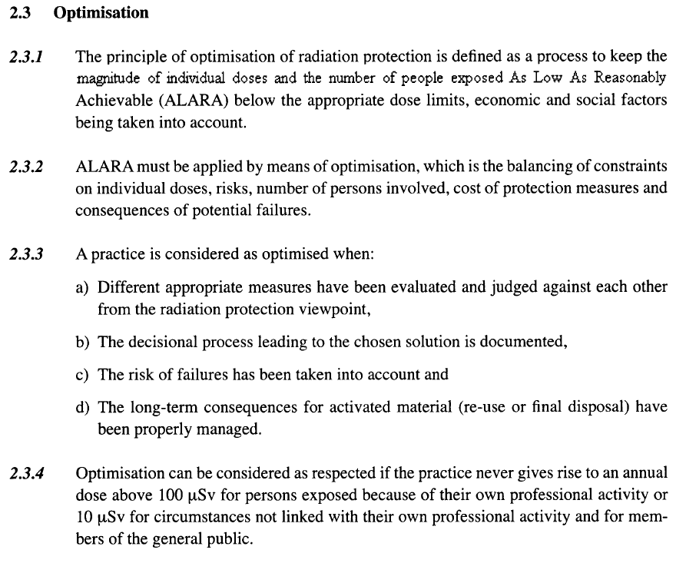
Safety Code F
Optimization (ALARA)
Design and operation !
Workers on CERN site
100 µSv/yr
Outside of CERN (environment)
10 µSv/yr

Slide 7
Safety Code F
Limitation / Optimization
6/20 mSv/yr 1 mSv/yr 300 μSv/yr
Radiation Workers
Other workers
Population outside CERN
On CERN site
On CERN site
On CERN site
Limits
Optimization / ALARA to be demonstrated
Optimization Thresholds
100 μSv/yr 100 μSv/yr 10 μSv/yr
Optimized (by definition)

Slide 8
Optimization during operation
ALARA procedure
CERN dose objectives
Operational Periods
2 mSv/yr
Long Shutdowns
3 mSv/yr
ALARA categories for individual interventions
Primary criteria
Individual Dose
Collective Dose
Secondary criteria
Ambient dose equivalent rate
Airborne activity
Surface contamination
Level I
Level II
Level III
100 μSv
1 mSv
500 μSv
5 mSv
50 μSv/h
2 mSv/h
5 CA
200 CA
10 CS
100 CS
100 μSv / intervention
Detailed work-and-dose planning
ALARA committee

Slide 9
Optimization during design

Slide 10
Intervention doses
Methodology
1. Calculation of residual dose rate maps
→ for cooling times typical for interventions on the respective component
→ based on nominal operational parameters
→ definition of geometry and materials as detailed as needed (and available)
2. Calculation of individual and collective intervention doses
→ based on as realistic as possible work scenarios, including locations, duration, number of persons involved,..
→ identification of cooling times below which work will be impossible
design criterion:
2 mSv/intervention/yr
→ communication of results and constraints to equipment groups
3. Revision of design and/or work scenario
→ start with work steps that give highest individual or collective doses
→ consider optimization measures (distance, tooling, material choices, etc.)
→ identify if remote handling is possible
New design?
Step 1
Start of iteration
Revised working scenario?
Step 2

Slide 11
Optimization during design
Design options
Material choice
Low activation properties to reduce residual doses and minimize radioactive waste (optimization with ActiWiz code, Web-site: https://actiwiz.web.cern.ch)
Avoid materials for which no radioactive waste elimination pathway exists (e.g., highly flammable metallic activated waste)
Optimized handling
Provisions for fast installation/ maintenance/ repair, in particular, around beam loss areas (e.g., plugin systems, quick-connect flanges, remote survey, remote bake-out)
Limitation of installed material
Install only components that are absolutely necessary, in particular in beam loss areas
Reduction of radioactive waste
Radiation resistant
Foresee easy dismantling of components
Easy access to components that need manual intervention or complex manipulation

Slide 12
Dose rate outlook

Slide 13
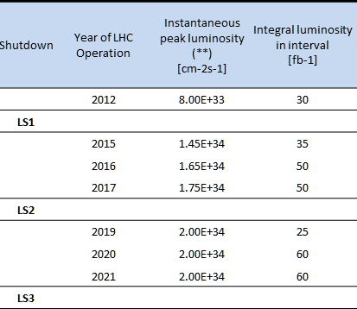
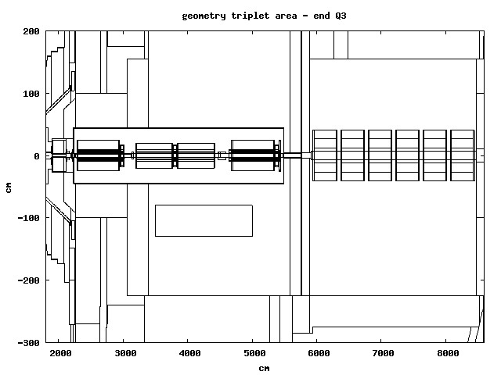
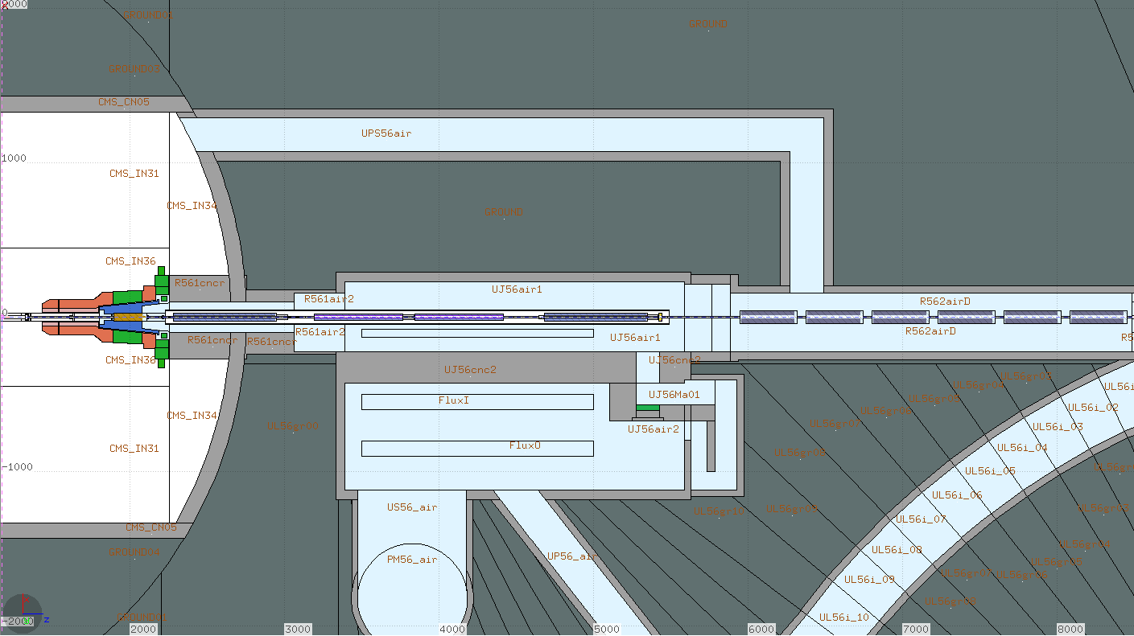
Pre HL-LHC era (LS2 and LS3)
IR5 LHC Fluka geometry
Inner triplet area ^{(courtesy Fluka team)}
Q1
Q2
Q3
D1
TAS
Total integrated luminosity: 310 fb⁻¹

Slide 14
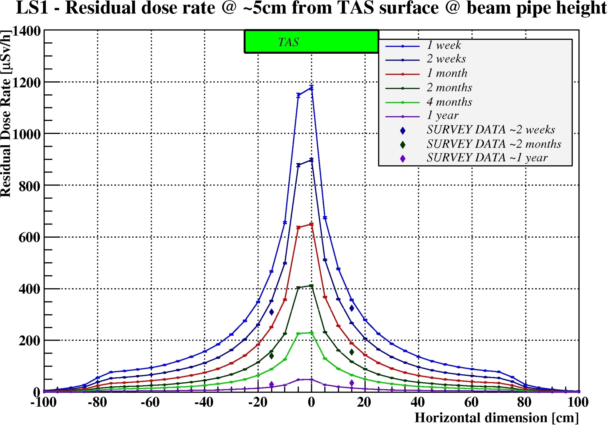
LS1 Ambient Dose Equivalent Rates
Comparison with measurements
c.t. | Scaling factor
1w | 1.6 / 2.0
1m | 1.0
4m | 0.4
1y | 0.2

Slide 15
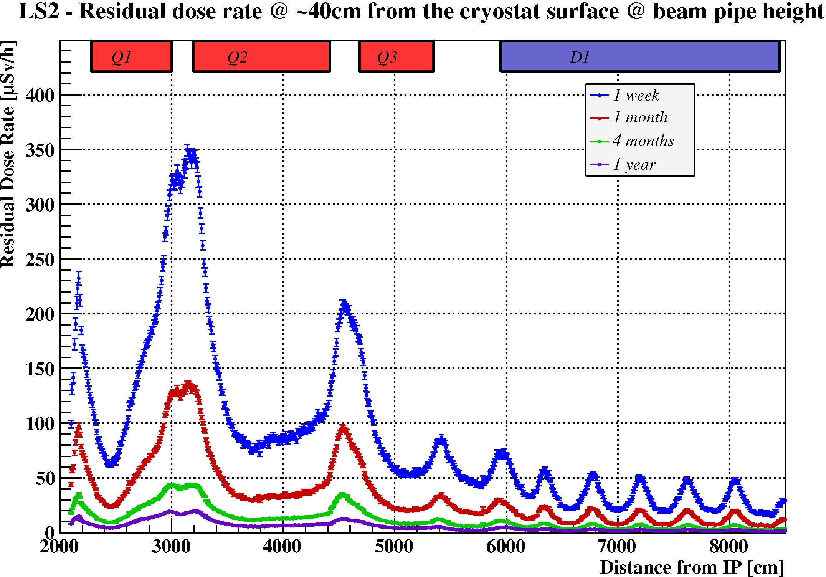
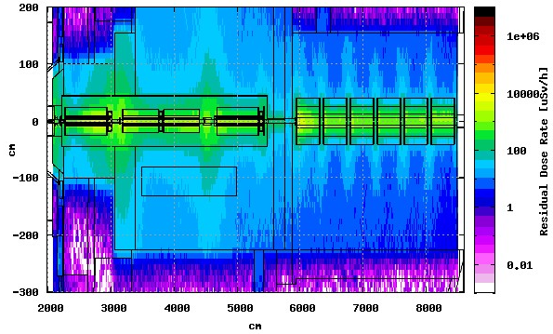
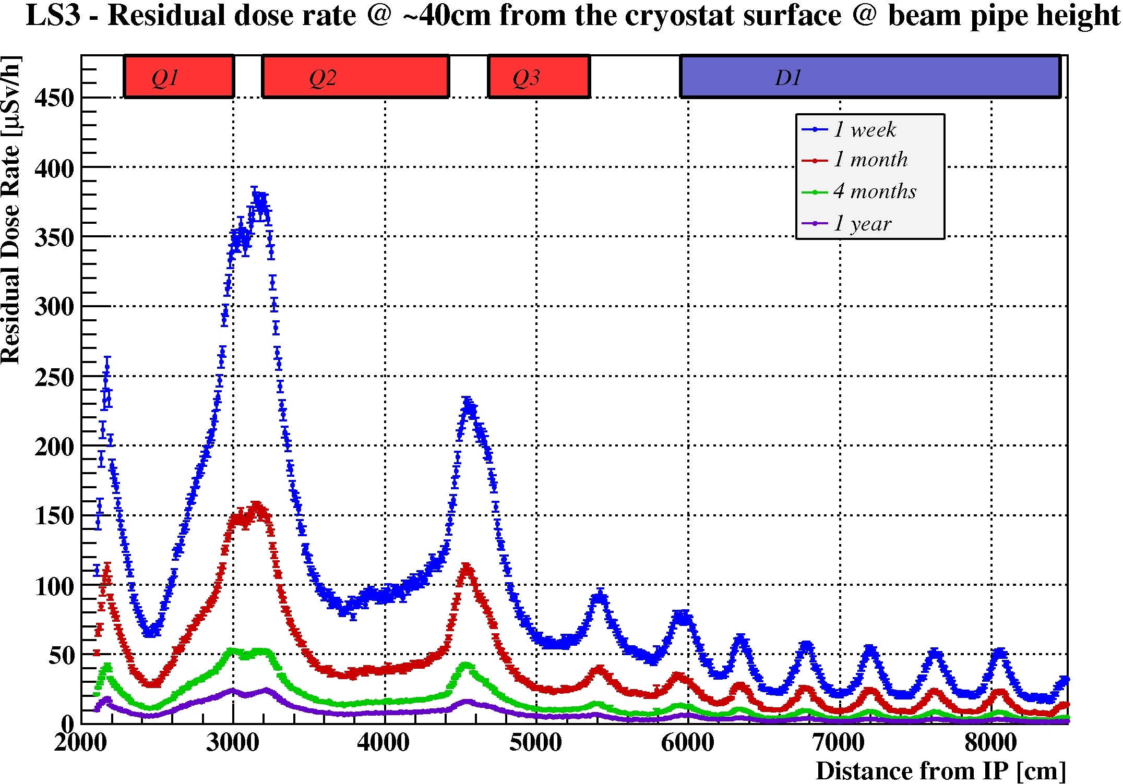
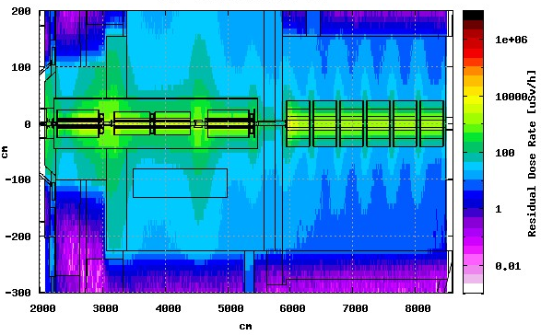
Ambient Dose Equivalent Rates
Cooling time dependence
LS2 – 1 month cooling time
Total integrated luminosity 165 fb⁻¹
@ 40 cm
LS3 – 1 month cooling time
Total integrated luminosity 310 fb⁻¹

Slide 16
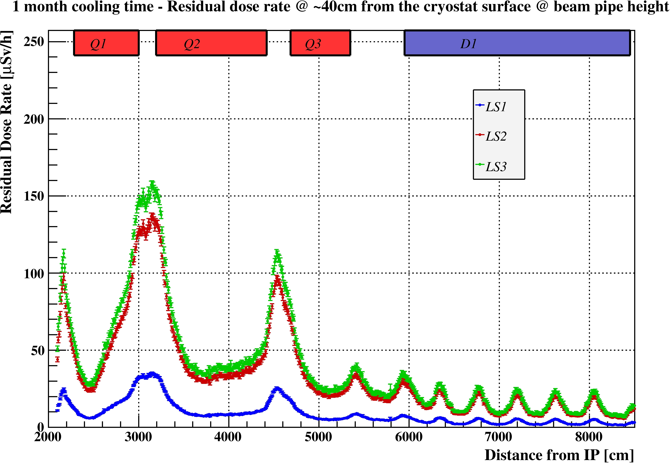
Ambient Dose Equivalent Rates
Time evolution
1 month cooling time, dose rates at 40 cm from the cryostat
Instantaneous peak
luminosity 1.65 ∙ 10³⁴ cm⁻²s⁻¹
Total integrated luminosity 165 fb⁻¹
Instantaneous peak
luminosity 2.00∙10³⁴ cm⁻²s⁻¹
Total integrated luminosity 310 fb⁻¹
~1.2
~4.6
~3.9

Slide 17
HL-LHC Operational scenarios
Ultimate scenario
Nominal scenario
 | Year of LHC Operation | Instantaneous luminosity [cm⁻²s⁻¹] | Integrated luminosity [fb⁻¹]
LS3
 | 2026 | 7.50E+34 | 300
 | 2027 | 7.50E+34 | 300
 | 2028 | 7.50E+34 | 300
LS4
 | 2030 | 7.50E+34 | 300
 | 2031 | 7.50E+34 | 300
 | 2032 | 7.50E+34 | 300
LS5
 | 2034 | 7.50E+34 | 300
 | 2035 | 7.50E+34 | 300
 | 2036 | 7.50E+34 | 300
LS6
 | 2038 | 7.50E+34 | 300
 | 2039 | 7.50E+34 | 300
 | 2040 | 7.50E+34 | 300
 | Year of LHC Operation | Instantaneous luminosity [cm⁻²s⁻¹] | Integrated luminosity [fb⁻¹]
LS3
 | 2026 | 5.00E+34 | 250
 | 2027 | 5.00E+34 | 250
 | 2028 | 5.00E+34 | 250
LS4
 | 2030 | 5.00E+34 | 250
 | 2031 | 5.00E+34 | 250
 | 2032 | 5.00E+34 | 250
LS5
 | 2034 | 5.00E+34 | 250
 | 2035 | 5.00E+34 | 250
 | 2036 | 5.00E+34 | 250
LS6
 | 2038 | 5.00E+34 | 250
 | 2039 | 5.00E+34 | 250
Total integrated luminosity up to LS3: 310 fb⁻¹
Total integrated luminosity up to LS3: 310 fb⁻¹
Total integrated luminosity 3060 fb⁻¹
Total integrated luminosity 3910 fb⁻¹

Slide 18
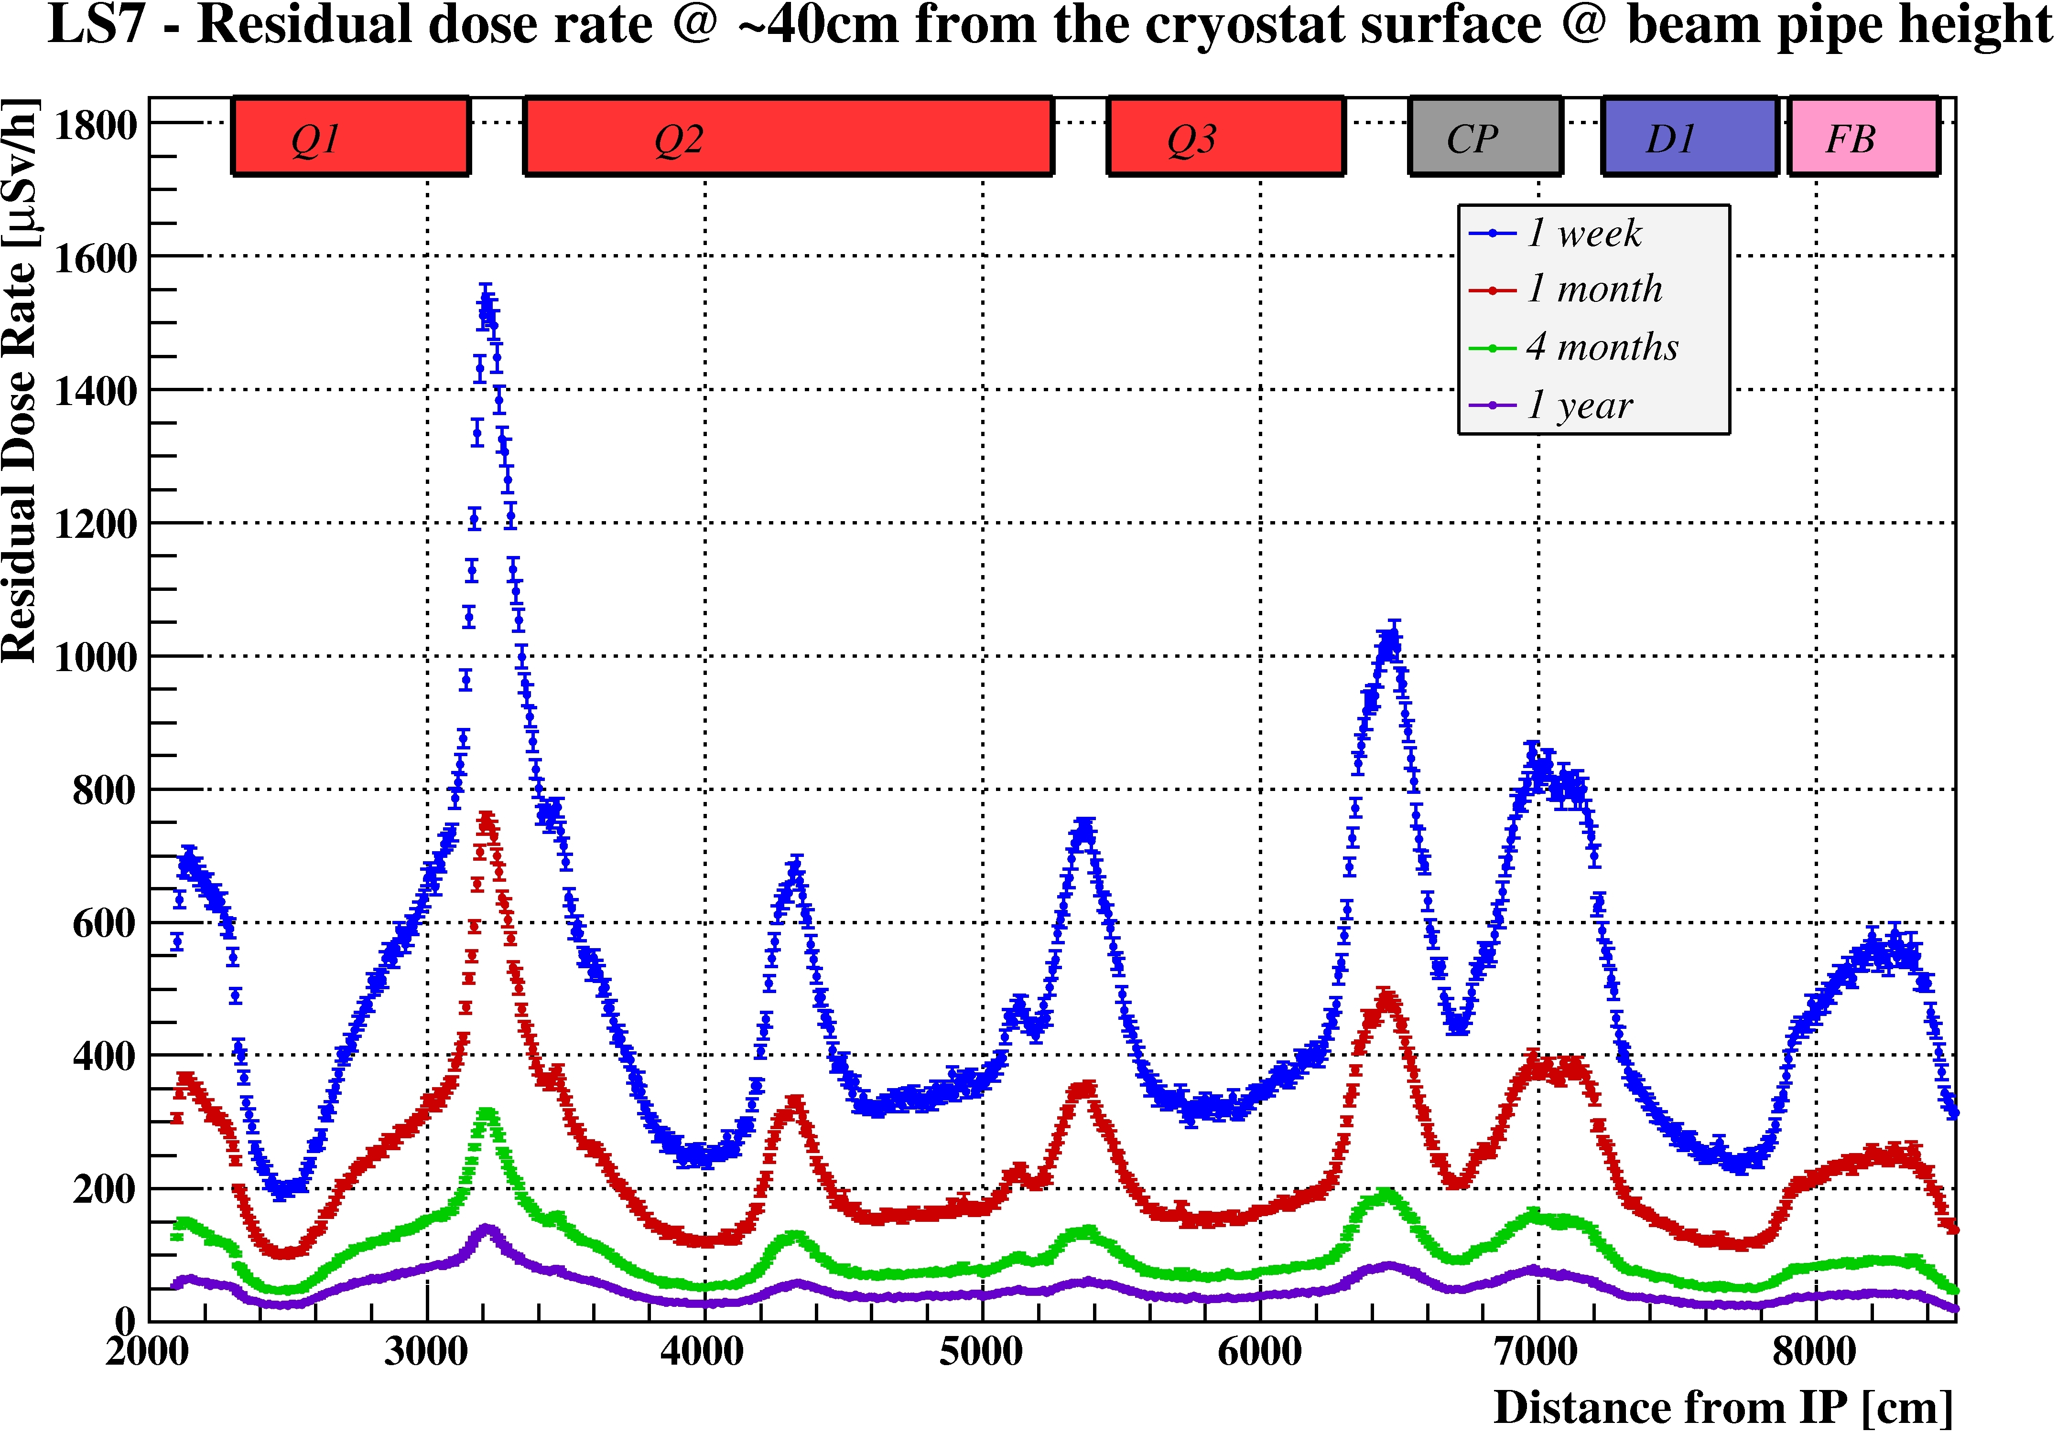
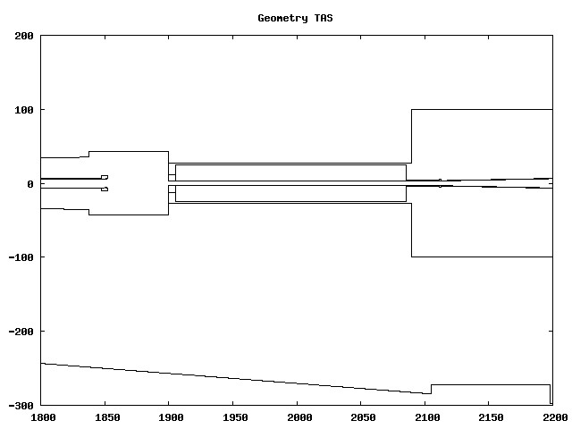
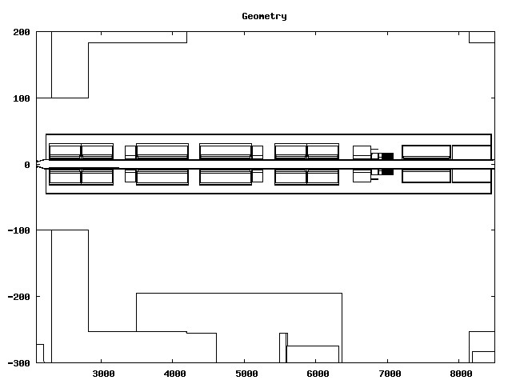
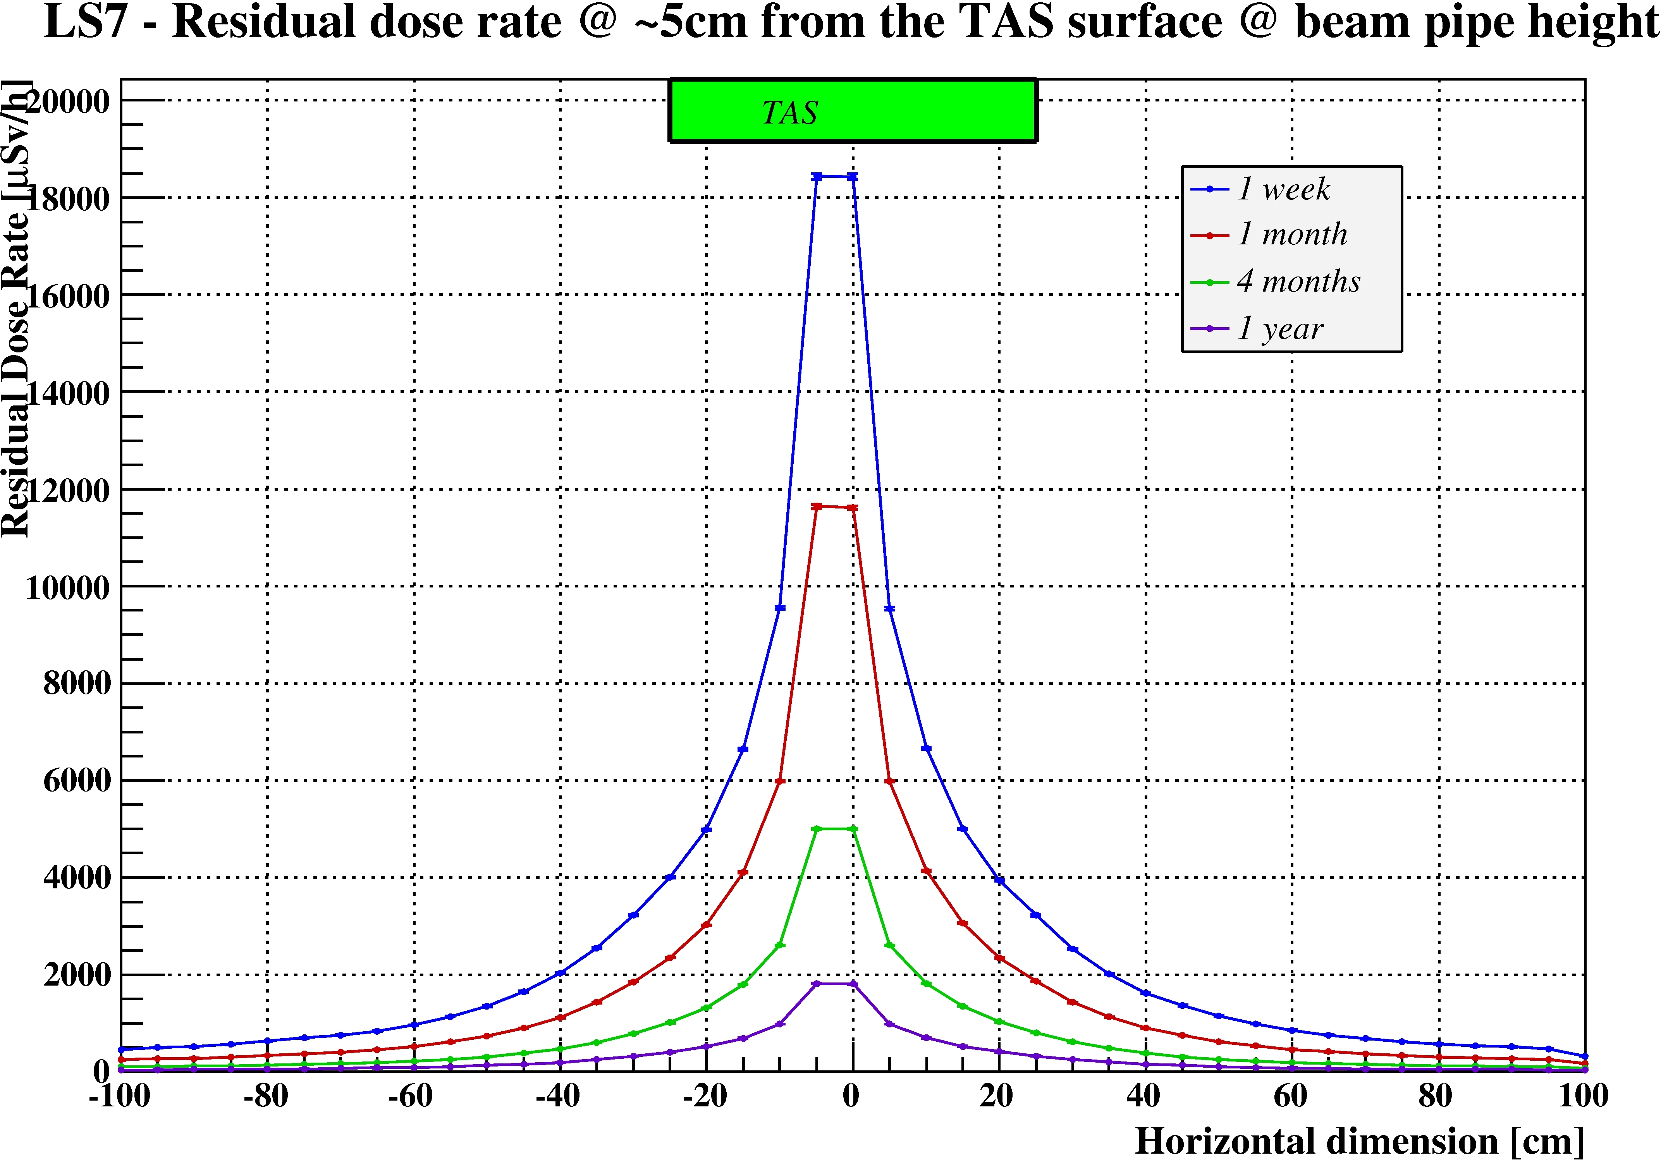
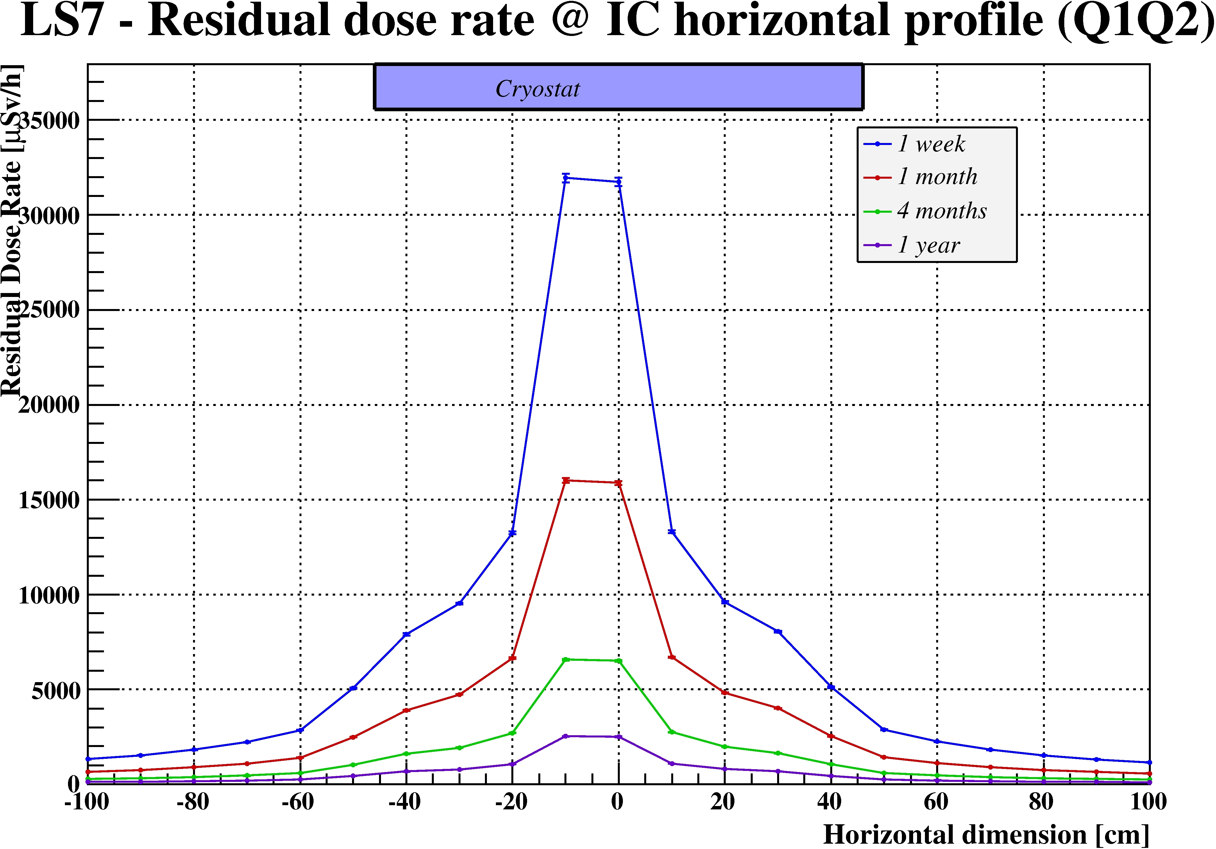
Ambient Dose Equivalent Rates
Cooling time dependence
Ultimate scenario
Total integrated luminosity 3910 fb⁻¹
@ 40 cm
IR5 LHC Fluka geometry
Inner triplet area ^{(courtesy Fluka team)}
TAS
Q1
Q2
Q3
CP
D1
FB
@ contact
across IC

Slide 19
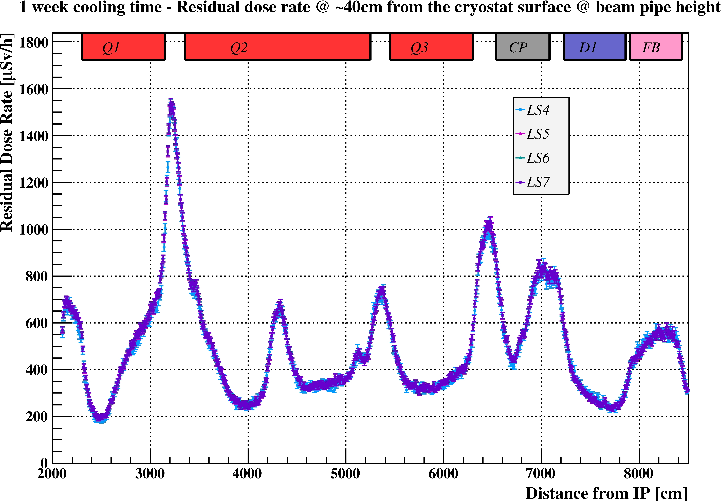
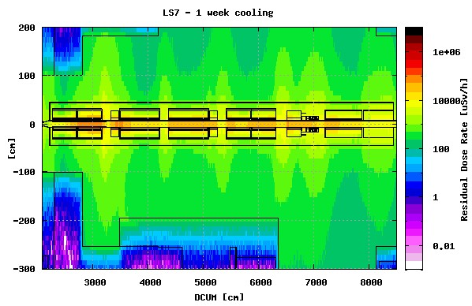
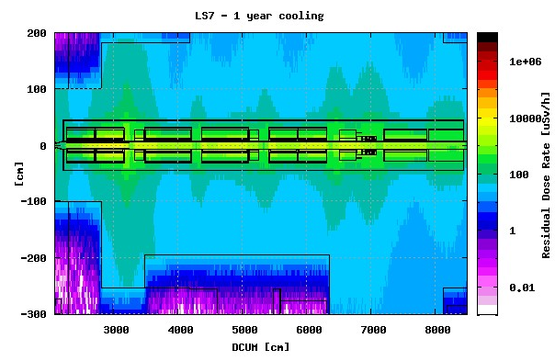
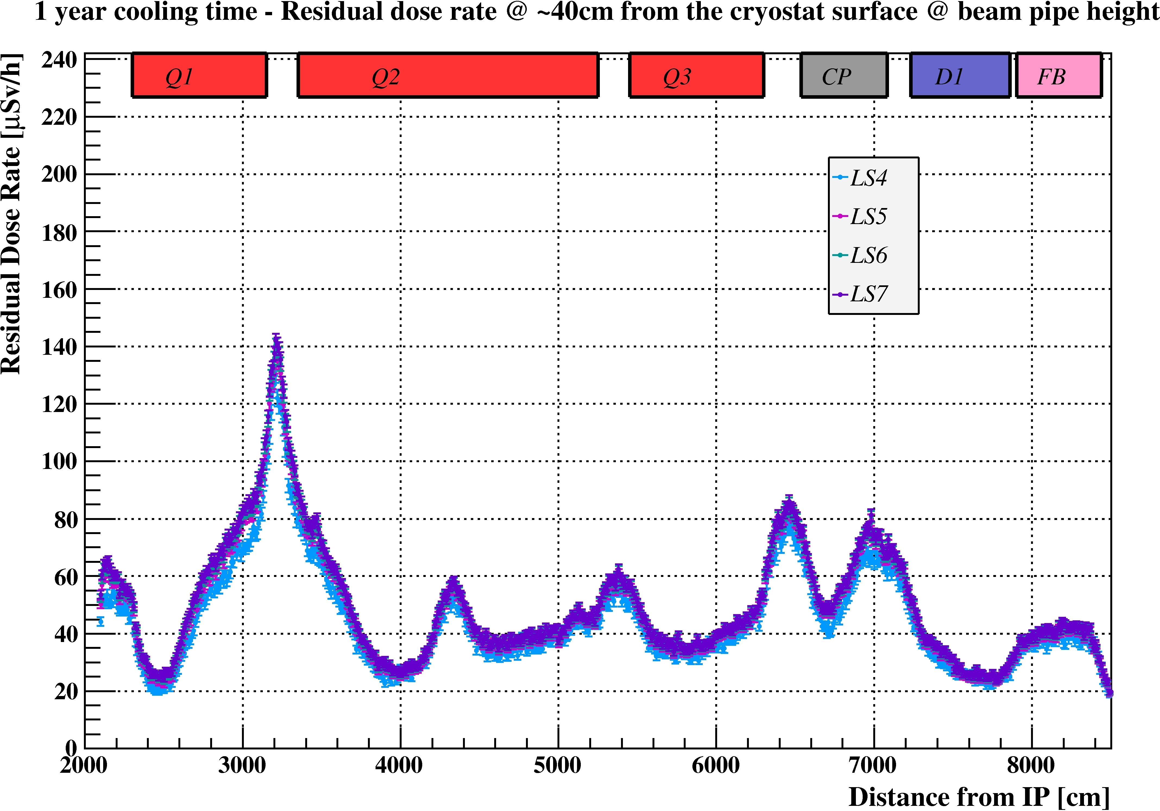
Ambient Dose Equivalent Rates
Time evolution
Ultimate scenario
@ 40 cm

Slide 20
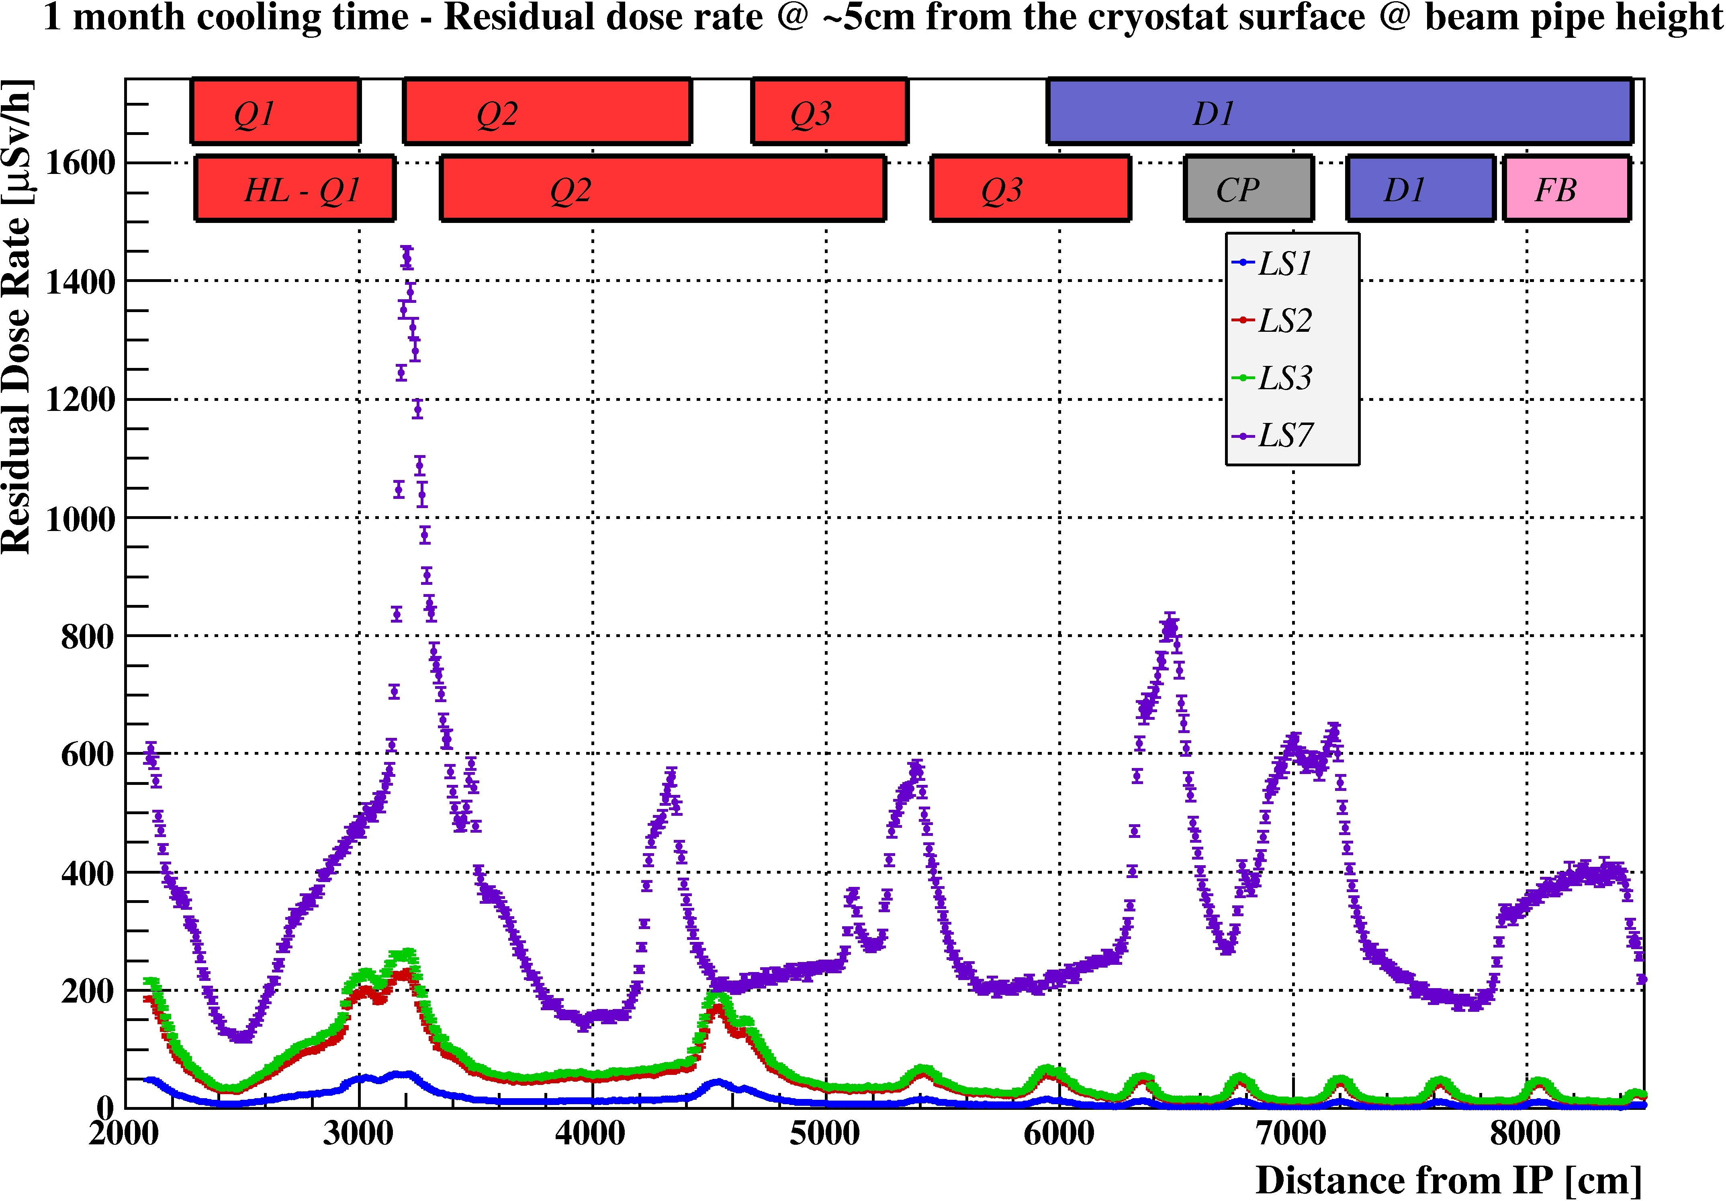
Ambient Dose Equivalent Rates
Time evolution
1 month cooling time, dose rates at contact of the cryostat
Total integrated luminosity 310 fb⁻¹
Ultimate scenario
Representing any LS after LS3
~25
~5.6

Slide 21
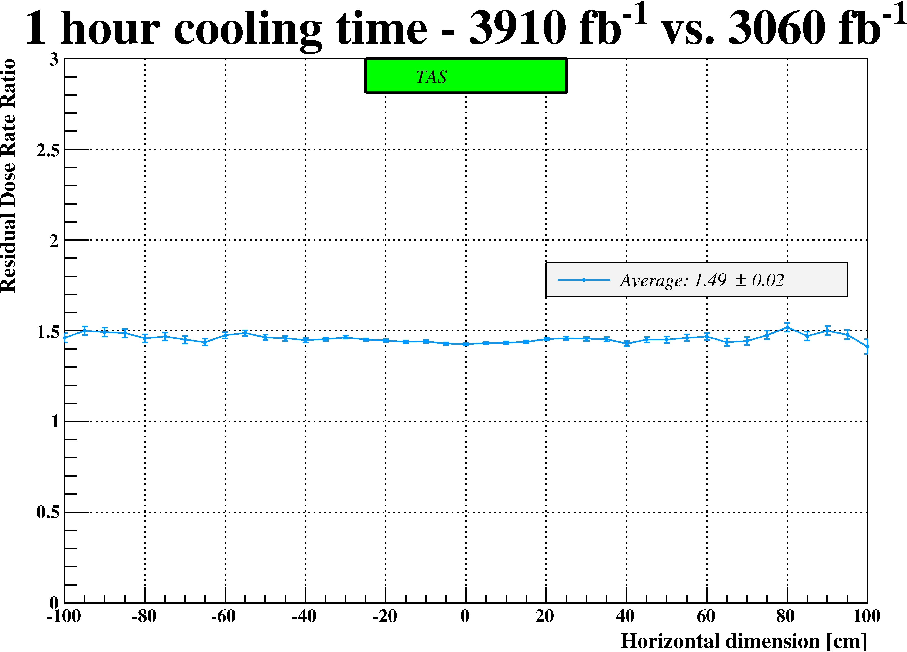
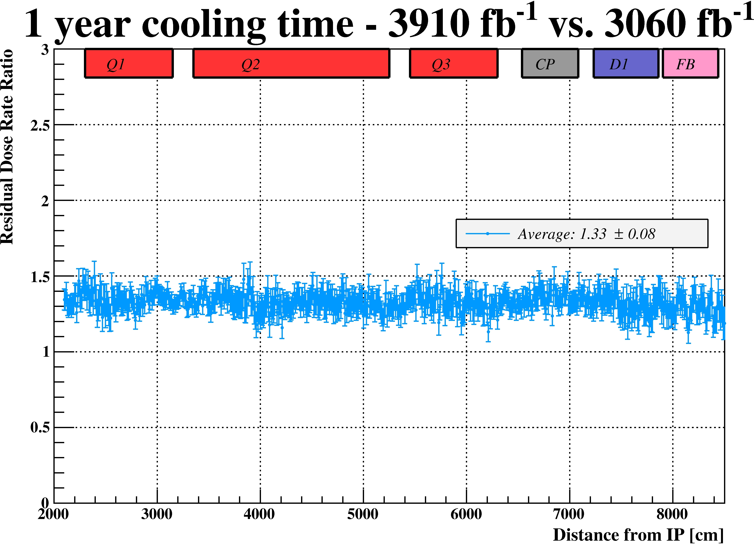
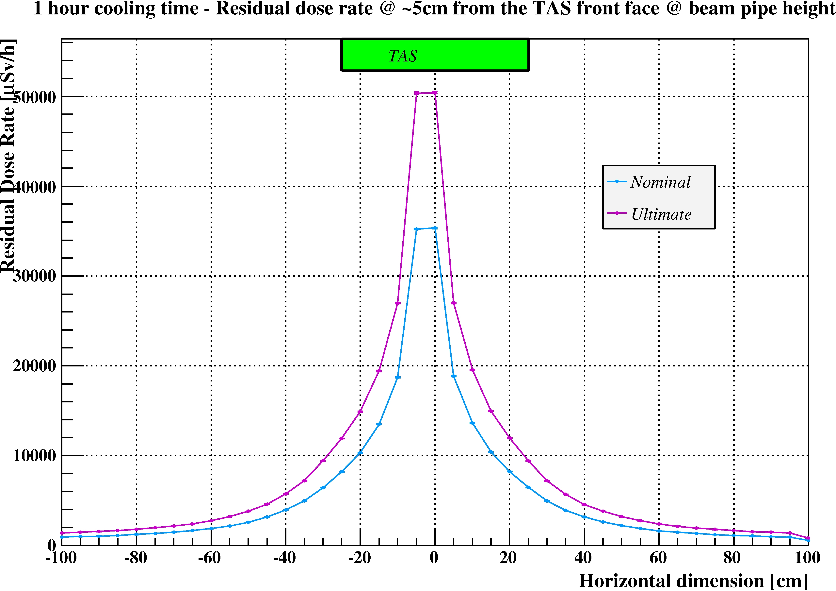
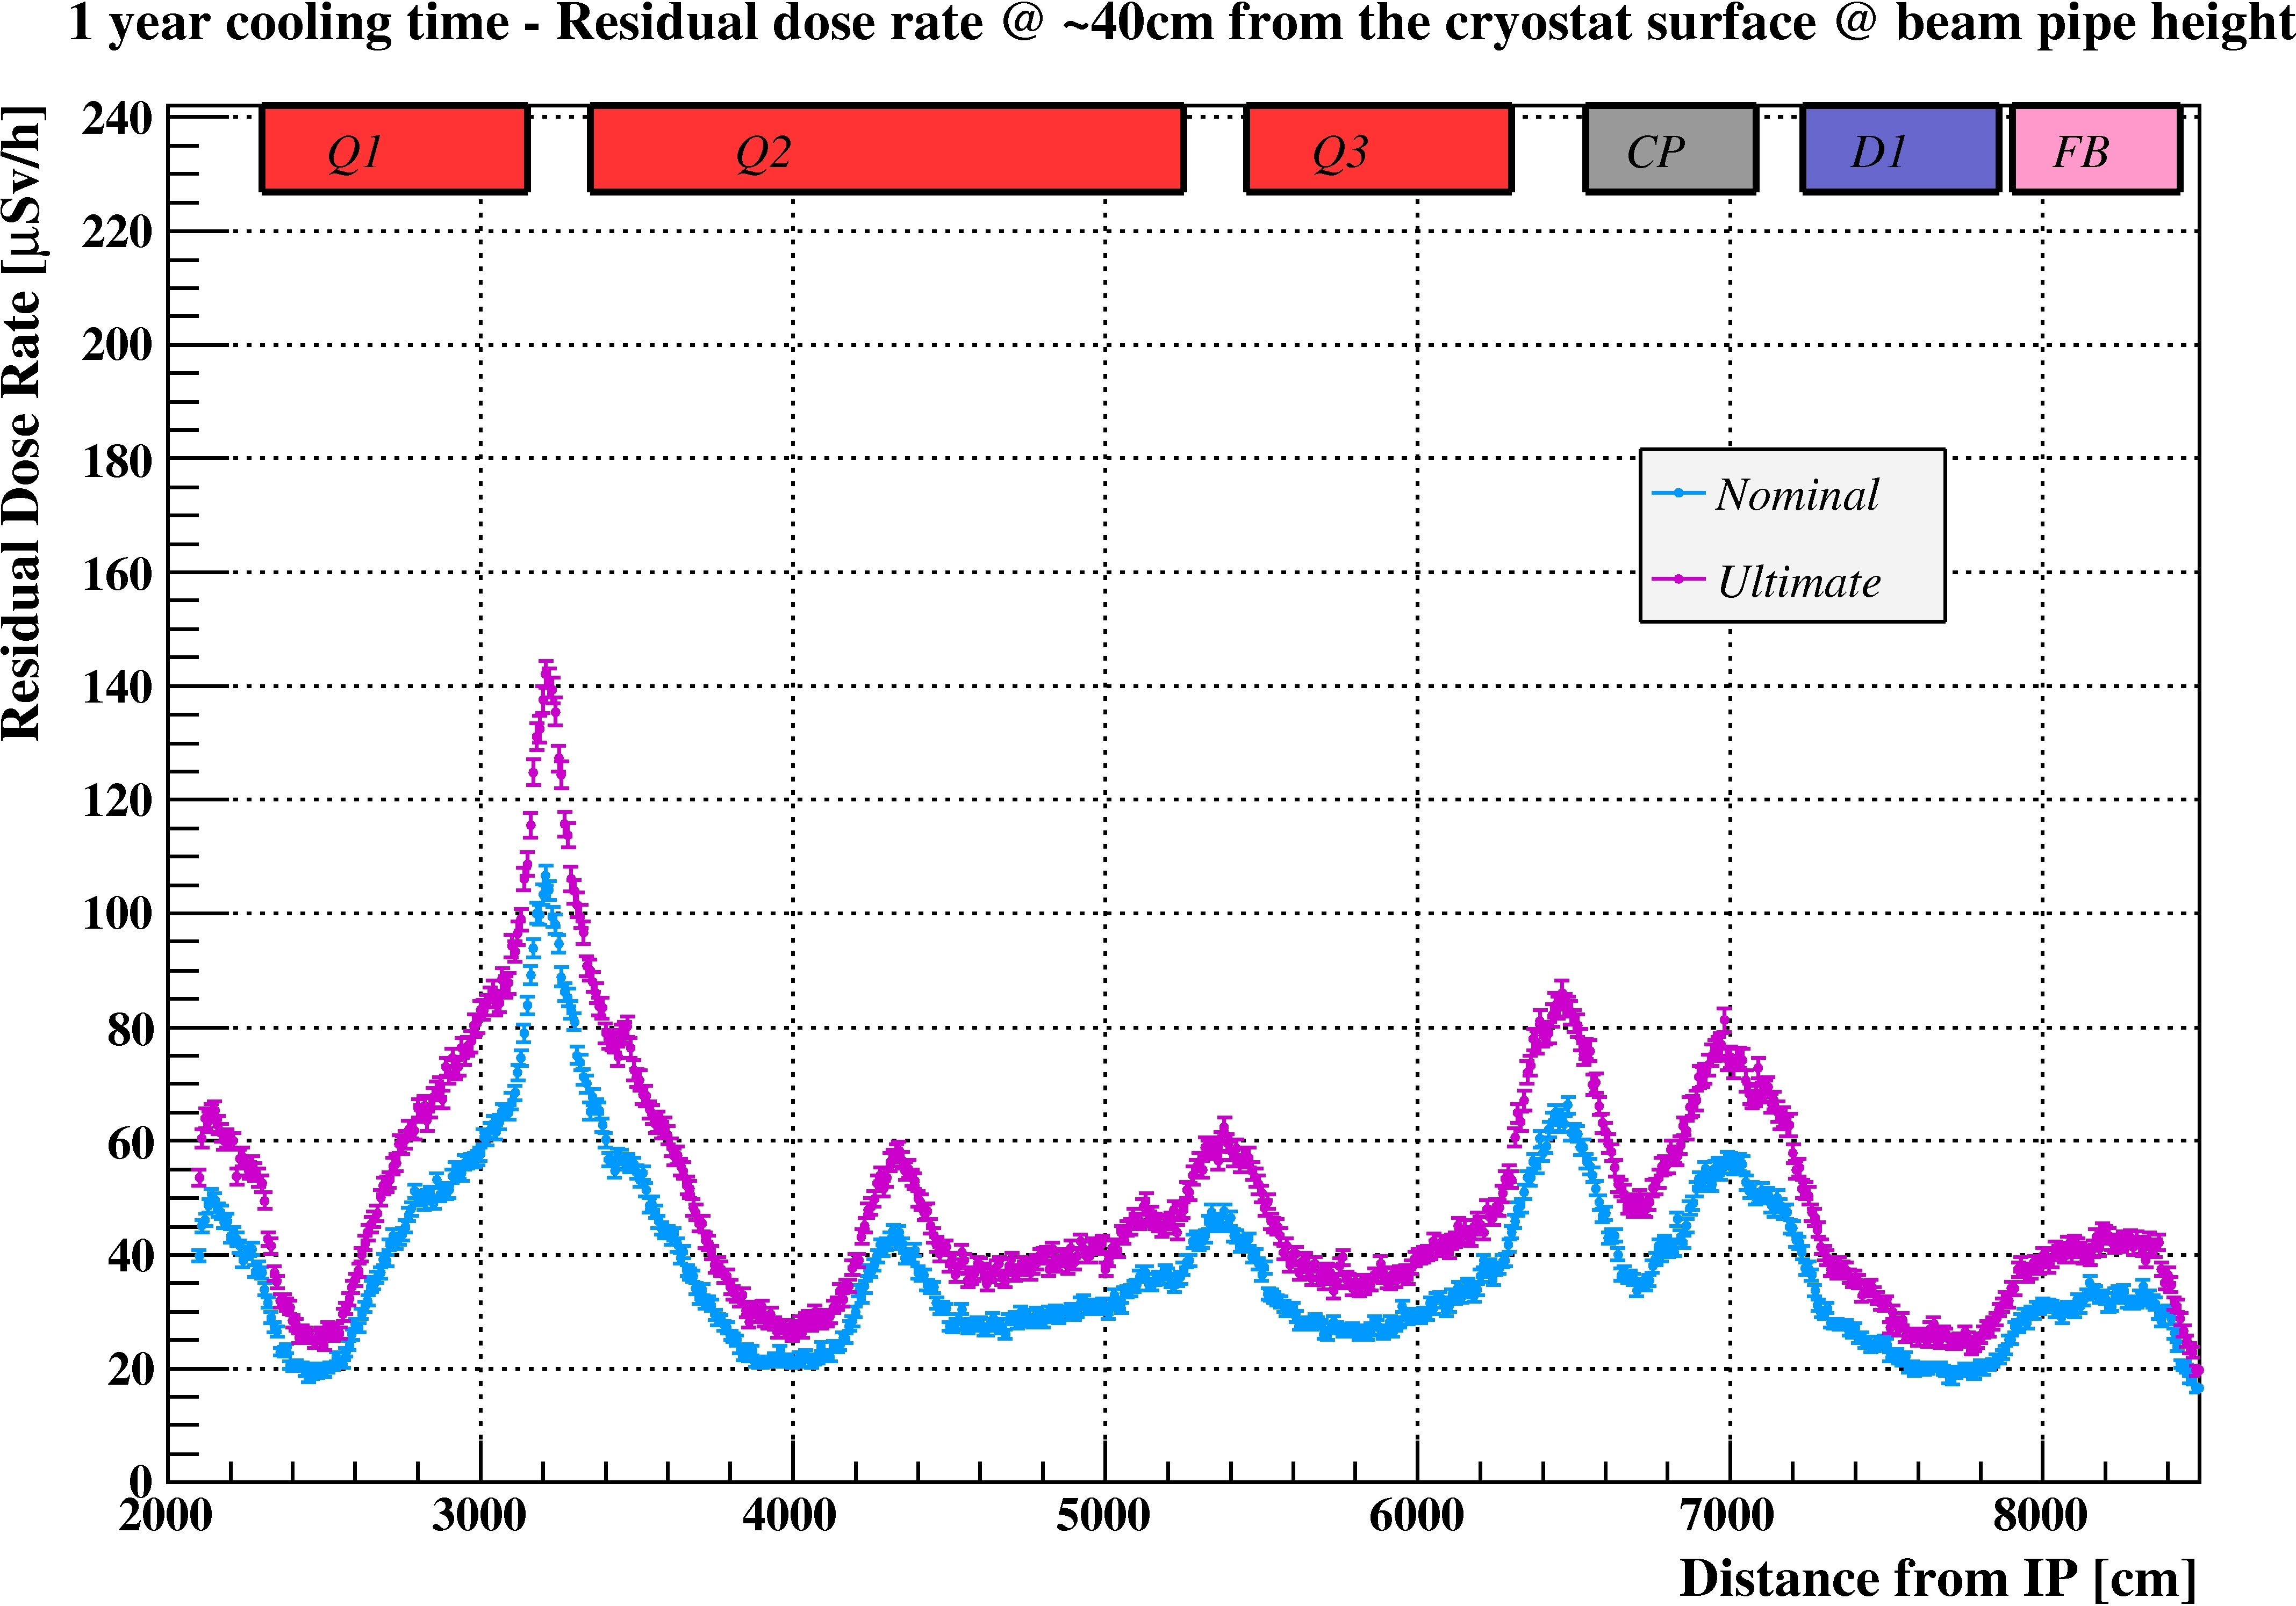
Ambient Dose Equivalent Rates
Nominal vs Ultimate
1 hour cooling time @ contact
1 year cooling time @ 40cm from cryostat surface

Slide 22
Summary and Conclusions 1/2
The residual dose rate increase until LS3 depends on operational scenario, cooling time and material and is about a factor of 4 to 6
The residual dose rate increase until HL-LHC era depends on operational scenario, cooling time and material and is about a factor of 15 to 30
  Short cooling times: no differences among the LSs after LS3
  Longer cooling time: slightly increasing (but not evident along the triplet)
  HL vs LS3: a factor 4 to 6 higher
  HL vs LS1: a factor 15 to 30 higher
HL-LHC Ultimate vs Nominal: a factor 1.2 to 1.5 higher, depending on the cooling time (mainly driven by the instantaneous luminosity)

Slide 23
Summary and Conclusions 2/2
Residual dose rate maps from TAS up to 82m from the IP are available for any future Long Shutdown
  to calculate intervention doses in order to plan the dismantling of the old installations and
  to optimize the design of the new installations
Fruitful collaboration with the FLUKA team
  the use of the same geometry model they developed
  the consistency with the energy deposition study
Optimization / ALARA is a legal requirement and starts with the design of a facility. A wide range of options, tools and models is available to achieve this goal

