Slide 1
Specific QXF cold-mass requirements to ensure a robust cooling by superfluid helium
4th Joint HiLumi LHC-LARP Annual Meeting: 17-21.11.2014
R. van Weelderen, G. Bozza

Slide 2
Overview
Global layout
Local layout
Main - longitudinal - heat extraction
Secondary – radial – extraction
1st evaluation of inner layer quench heaters impact
Summary of cold-mass cooling requirements
Conclusions

Slide 3
Global Layout (schematic on next slide)
The cooling principle is an evolution of the one proposed for the LHC-Phase-I Upgrade:
New dedicated refrigerators (placed at the surface)
Cold masses cooled in a pressurized static superfluid helium (HeII) bath at 1.3 bar and at a temperature of about 1.9 K – 2.1 K.
The heat in the cold masses is conducted through the pressurized HeII to bayonet heat exchangers (HX), protruding the magnet yokes.
In these HX's the heat is extracted by vaporization of superfluid helium which travels as a low pressure two-phase flow through them.
The low vapour pressure inside the HX's is maintained by a cold compressor system (placed underground), with a suction pressure of 15 mbar, corresponding to a saturation temperature of 1.776 K.
The bayonet Hx's can be made to be continuous only through the [quadrupole magnets] or through the [corrector package and dipole].

Slide 4
Global layout (schematic)
Schematic architecture of the cooling using superfluid helium

Slide 5
Local Layout (schematic on next slide)
The bayonet HX's carry two-phase flow→ they must be in-line throughout the magnets, including their interconnects, that they service.
Because of the in-line constraint the HX's circuits are naturally divided between the [Q1, Q2a, Q2b, Q3 & interconnects] and through [CP, D1 & interconnects].
Installation of, internal to the cryostats, phase separators & low-pressure pumping will be slope dependent.
The quadrupole HX's need additional pumping, and possible phase separators, at the Q2a-Q2b interconnect.

Slide 6
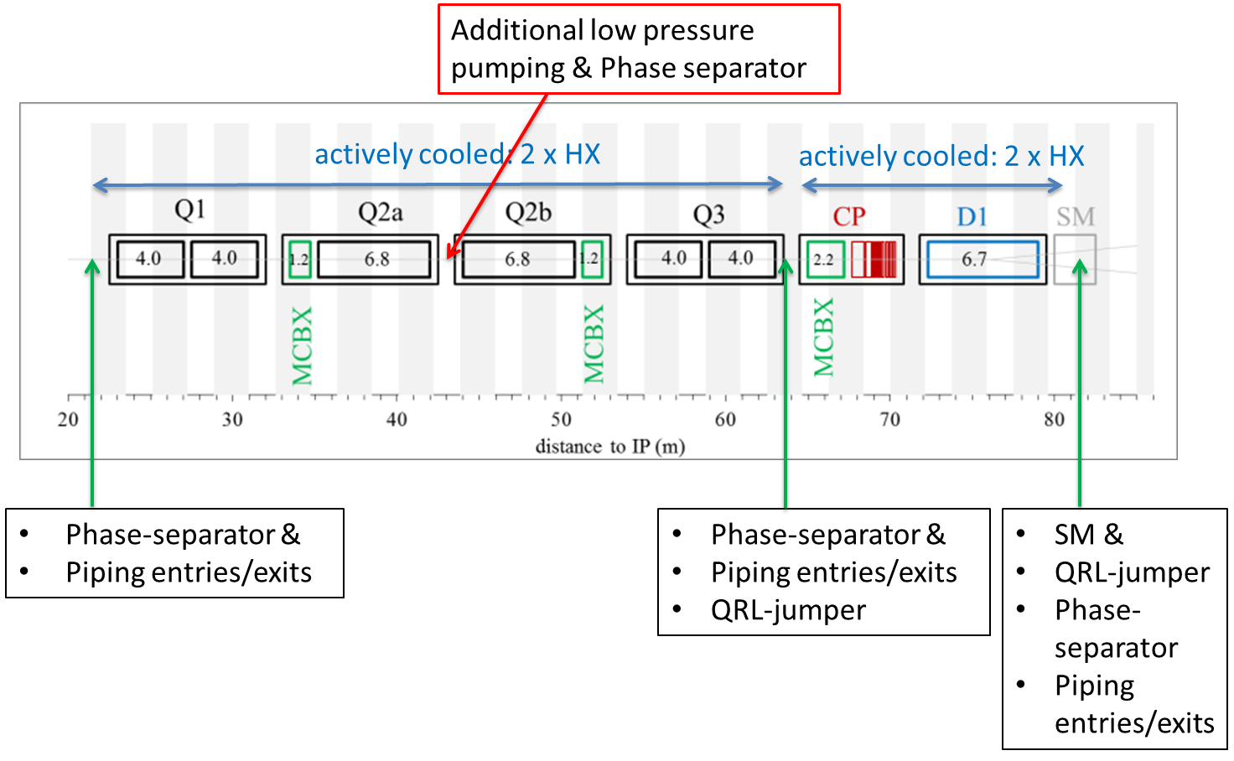
Local Layout (schematic)
schematic placement of external interfaces (QRL-jumpers) over the magnet chain needed for the cryogenic services

Slide 7
Main – longitudinal – heat extraction
Optimization (-requirements) for maximum heat extraction capacity
(1050 W@7.5x10³⁴ cm² s⁻¹) giving rise to:
Size and # of HX's determined by vapour velocity ≤ 7 m/s (above which the HX's do not function anymore) & the total available heat exchange area, when wetted over their full length.
Quadrupole HX's yoke hole size is limited to 77 mm and should not be increased, otherwise one would need to increase as well the overall diameter of the cold mass.
≥ than 2 parallel HX's compromises the interconnects, busbar routing and free conduction areas.
An annular space of 1.5 mm between the HX and the yoke to allow contact area of the pressurized superfluid helium on the coil-side.
The heat exchangers are to be made of high thermal conductive copper to assure proper heat conduction across the walls.
A wall thickness of about 3 mm is required to sustain the external design pressures of 20 bar.

Slide 8
Main – longitudinal – heat extraction
The aforementioned optimization leads to:
Quadrupoles:
2 parallel heat exchangers 68 mm ID, yoke holes 77 mm.
Additional low pressure pumping between Q2a and Q2b.
With this configuration about 800 W can be safely extracted.
Coping with the remaining 250 W done via active cooling of the other magnets, D1 and CP:
D1 & CP:
2 parallel bayonet heat exchangers of 51 mm ID, yoke holes 60 mm.
With this configuration about 250 W can be safely extracted.
Heat must be given some freedom to redistribute along the length of the cold-masses. This is no hard criterion:
≥ 150 cm² through the Q1, Q2a, Q2b, Q3, and their interconnections.
≥ 100 cm² through D1, CP and their interconnections.

Slide 9
Secondary – radial – extraction
The Nb₃Sn quadrupole coils are fully impregnated, without any helium penetration.
The heat loads from the coils and the beam-pipe area can only evacuate to the two heat exchangers by means of the static pressurized HeII.
To this end the cold mass design incorporates the necessary radial helium passages.

Slide 10
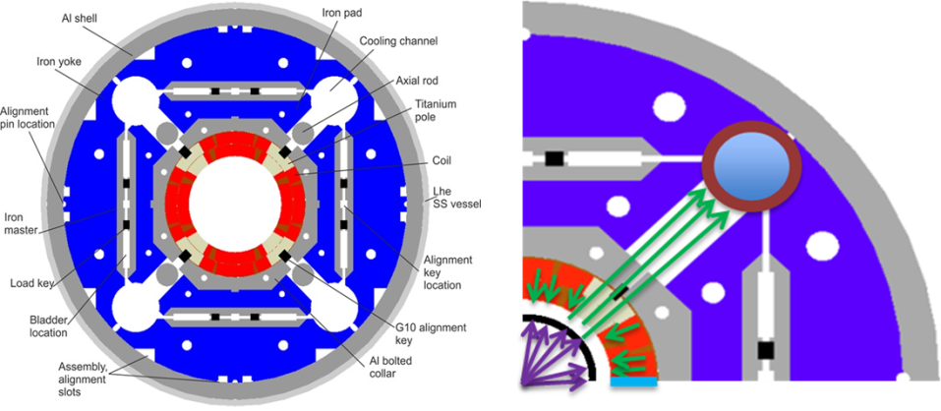
Secondary – radial – extraction
Heat: coil → insulation → (inner layer quench heaters?) → along annular space inner layer-beampipe (here we add heat from beam-pipe as well) → through Titanium pole piece → through alignment keys → around axial rods → HX

Slide 11
Secondary – radial – extraction
Annular space between cold bore and inner coil block: 1.5 mm
Free passage through the Titanium insert and G10-alignment key is given by: “8 mm holes repeated every 50 mm along the length of the magnet”. (The exact repetition rate and size of the radial passages need further refinement in order to find a compromise between the cooling margin obtainable and the mechanical feasibility of integrating these holes.)
Freedom to install the 2 heat exchangers in any 2 of the 4 available cooling channel holes in the yoke and to limit asymmetric cooling conditions, some free helium paths interconnecting these 4 cooling channel holes are to be implemented in the cold mass design.

Slide 12
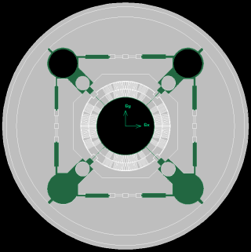
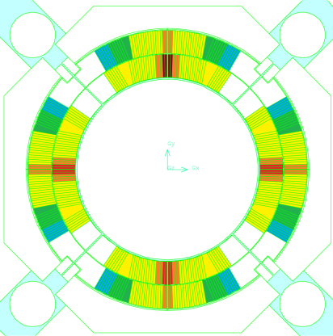
1st evaluation of inner layer quench heaters impact
Geometry for the simulations
Overall geometry as modelled for OpenFOAM – In green the helium channels
E1 = 5670 W/m³
E2 = 3969 W/m³
E3 = 2268 W/m³
E4 = 1134 W/m³
E5 = 567 W/m³
E6 = 226.5 W/m³
Energy deposition map (exaggerated, based on thin tungsten & coil area only) used for the evaluation (will be moved to up to date values in coming weeks)

Slide 13
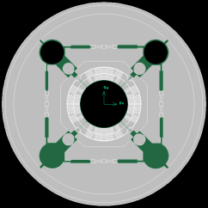
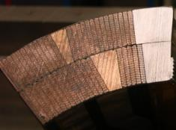
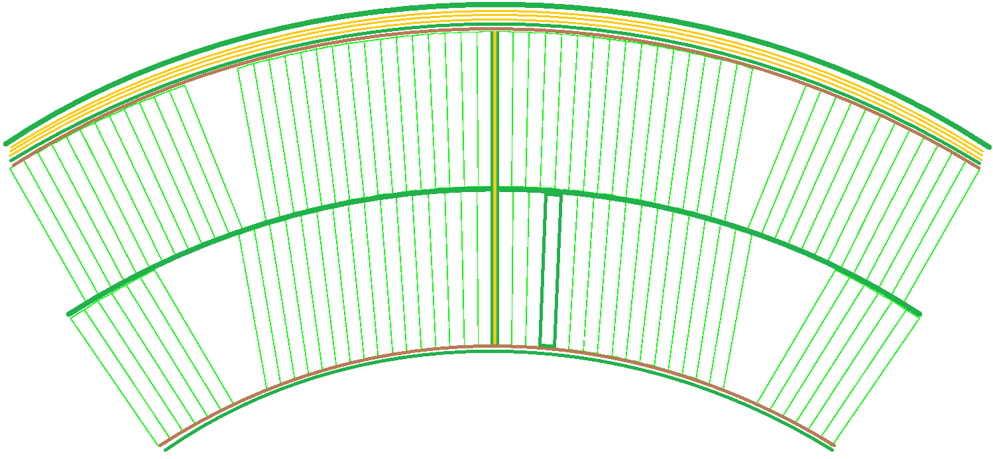
1st evaluation of inner layer quench heaters impact
Geometry for the simulations
A photo of the coils
150 μm G10
100 μm non-perforated trace (Quench Heaters) of which
50 μm Kapton
25 μm stainless steel
25 μm cyanate ester epoxy
3 x 125 μm Kapton ground insulation
1000 μm G10
500 μm G10
Data provided by Paolo Ferracin
100 μm perforated trace (Quench Heaters) of which
50 μm Kapton (50% surface area)
25 μm stainless steel (18% surface area)
25 μm cyanate ester epoxy (36% surface area)
150 μm G10 electrical insulation all around each cable
125 μm G10
125 μm G10
150 μm G10
250 μm Kapton

Slide 14
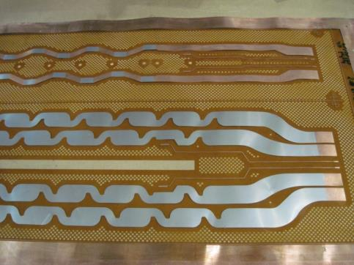
1st evaluation of inner layer quench heaters impact
Inner Layer Quench Heaters
100 μm thick Kapton containing a stainless steel resistor, Kapton perforated (perforations end-up filled with epoxy).
Photo of perforated-Kapton quench heaters

Slide 15
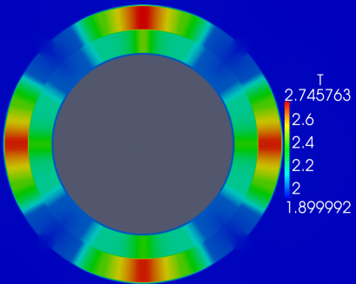
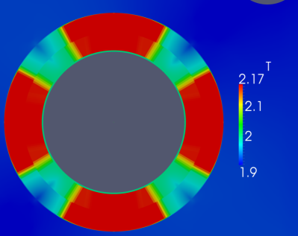
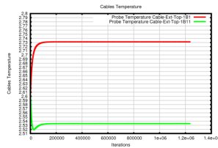
1st evaluation of inner layer quench heaters impact
No Quench Heaters
Diametrically opposite cold source heat exchangers
40 mm Holes Spacing
Conservative (thin tungsten) luminosity
1.9K cold source heat exchangers
Cable temperatures
Plot showing where T < 2.17K
Iteration temperature probe: the results reached convergence

Slide 16
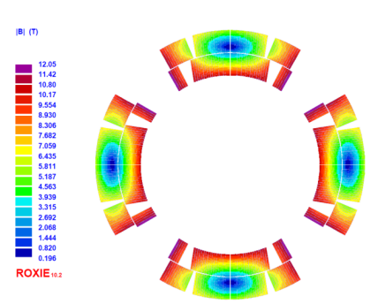
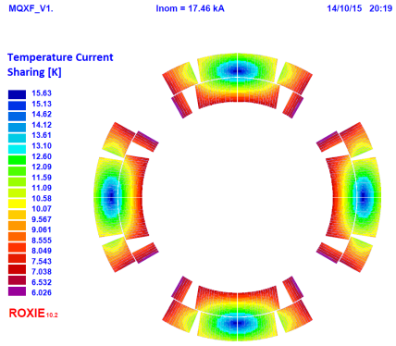
1st evaluation of inner layer quench heaters impact
Magnetic field B(T)
T current sharing
Courtesy of Susana Izquierdo Bermudez
The lowest T_{cs} is located in proximity of the winding poles, however we will pay special attention to the mid-plane region which has the highest heat loads (will change according to updated energy deposition maps).

Slide 17
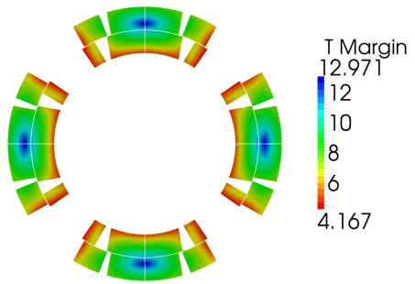
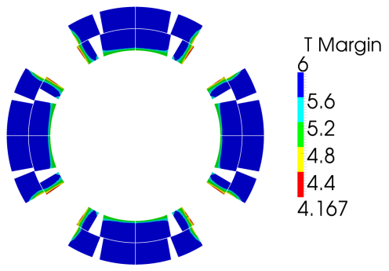
1st evaluation of inner layer quench heaters impact
T-margin
No Quench Heaters
Diametrically opposite cold source heat exchangers
40 mm Holes Spacing
Conservative (thin tungsten) luminosity
1.9K cold source heat exchangers

Slide 18
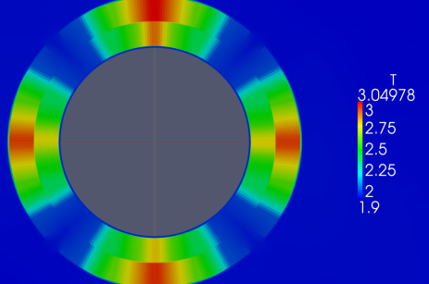
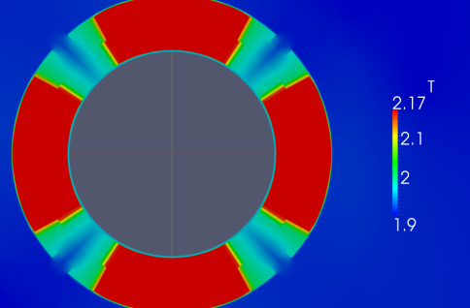
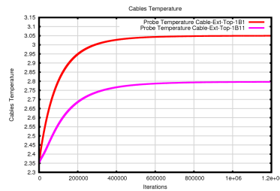
1st evaluation of inner layer quench heaters impact
Quench Heaters
Diametrically opposite cold source heat exchangers
40 mm Holes Spacing
Conservative (thin tungsten) luminosity
1.9K cold source heat exchangers
Cable temperatures
Plot showing where T < 2.17K

Slide 19
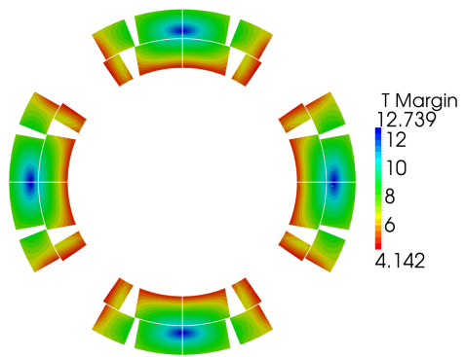
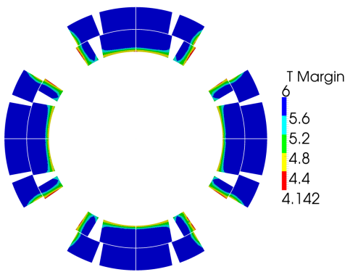
1st evaluation of inner layer quench heaters impact
T-margin
Quench Heaters
Diametrically opposite cold source heat exchangers
40 mm Holes Spacing
Conservative (thin tungsten) luminosity
1.9K cold source heat exchangers
Whole T range
T range up to 6K (most critical zones)

Slide 20






1st evaluation of inner layer quench heaters impact
Comparison between coils with Quench Heaters and coils without Quench Heaters
vs | T Margin where T current sharing is minimum (near the winding poles) | T Margin where the heat load is maximum | T Margin on the outer coils – Top | T Margin at the outer coils - Bottom
Case
No Quench Heaters Diametrically opposite Heat Exchangers 40 mm Holes Spacing 5e34 cm-2s⁻¹ luminosity 1.9K cold source heat exchangers | 4.167 K | 4.98 K | 11.15 K | 11.08 K
Quench Heaters Diametrically opposite Heat Exchangers 40 mm Holes Spacing 5e34 cm-2s⁻¹ luminosity 1.9K cold source heat exchangers | 4.142 K (-0.6%) | 4.50 K (-9.64%) | 10.84 K (-2.78%) | 10.80 K (-2.53%)
Notes: the quench heaters reduce mostly ~(500 mK) the T margin where the heat load is maximum (2nd column), while a factor 2 less (~25 mK) in winding pole cables (1st column)
With
Without
N.B. heat load map conservative (based on thin tungsten, to be up-dated)

Slide 21
Summary of cold-mass cooling requirements

Slide 22
Conclusions (1/2)
The requirements to be imposed on the cold mass design to enable cooling the inner triplets by HeII are integrated in the magnet design since the early stage of the design study.
With the present baseline, they fall within the scope of integration in the magnet and cryostat design.
Since very recently we have the completed the (OpenFOAM-based) toolset for calculating heat deposition dependent cooling maps and the resulting T-margin.
Using the toolset it has been conservatively shown that:
  T-margin is around 4.2 K (winding-poles) – 5.0 K (mid-plane)
  Impact of inner layer quench heaters is to lower mid-plane T-margin by ~500 mK and at the winding poles by ~25 mK

Slide 23
Conclusions (2/2)
Future plans:
Detailed cooling schemes & pipe sizings
Evaluation of available global heat extraction margins with the aforementioned cold-mass sizing and cold-source T at 2.1 K.
Inclusion of cross-channel connections
Finalization of heat-load induced T-maps and T-margins wrt heat-load maps based on thick Tungsten absorbers
Evaluation of weak points in the radial extraction path
Extension to D1
(+ Follow-up of beam-screen cooling @ 40 K – 60 K, Transients ….)

