Slide 1
LARP Collimation Activities
20 November 2014
Hi-Lumi/LARP CM23 Annual Meeting
KEK, Tsukuba, Japan
T. Markiewicz/SLAC

Slide 2
Outline
LHC Collimation Materials Irradiation Damage Study at BNL
  Slides and update material submitted by Nick Simos, BNL
Hollow Electron Lens Collimator
  Material from Giulio Stancari’s presentation at 2014-10-31 4-hour long HEBC-devoted COLUSM meeting
Rotatable Collimator
  Update of status of tests performed at CERN over the last years drawing on material prepared by several CERN technical groups

Slide 3

LHC Collimation Materials Irradiation Damage Study at BNL
N. Simos
IRRADIATION
200 MeV proton irradiation at BNL Linear Isotope Producer (BLIP) of 4 candidate materials (Molybdenum, Glidcop, Mo-Graphite and Cu-CD (copper-diamond). Irradiation parameters: 8-weeks at 110 uA
Neutron irradiation of Cu-CD from 118 MeV protons
28-MeV proton irradiation of Mo (including spallation neutron irradiation of Mo, Glidcop, Cu-CD and Mo-GR)
Thermo-Physical & Mechanical Characterization
X-ray diffraction studies at NSLS X17B1/X17A beamlines (completed)
X-ray diffraction studies at NSLS II XPD beamline (proposed)
Comprehensive macroscopic analysis at BNL Isotope extraction facility (initiated)
Spectral Analysis (initiated)
Nano- micro-structural characterization at Center of Functional Nanomaterials (initiated)

Slide 4
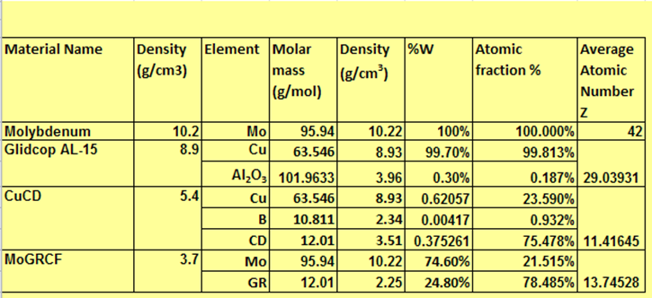
Irradiated LHC HiLuMi Collimation materials
Preliminary Assessment:
200 MeV heavily bombarded LHC array is still in cool-down mode due to high dose
One of the two Molybdenum (Mo) capsules has been opened for visual examination. Mo samples appear to be fully intact.
In coming weeks the proton irradiated array will be opened and examined (followed by transport to the PIE hot cells for sorting and studies)
Neutron irradiated Cu-CD has seen no structural degradation
28 MeV protons and spallation neutrons at Tandem have not affected the structural integrity of the LHC HiLuMI array

Slide 5
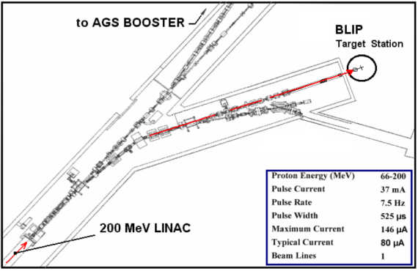
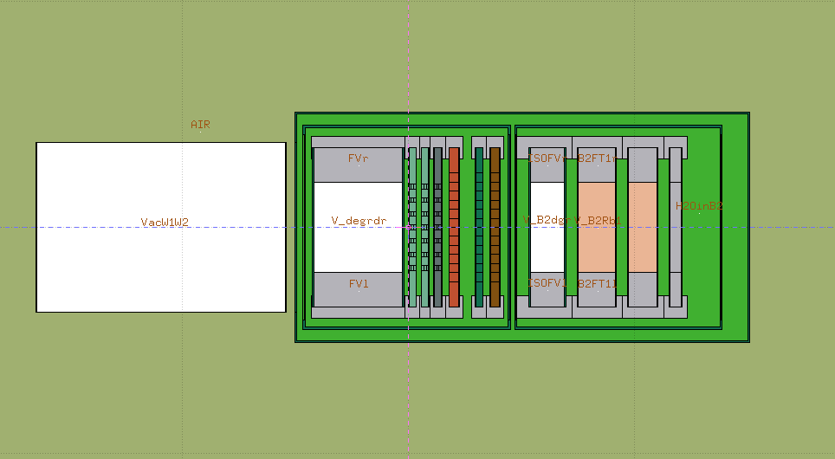
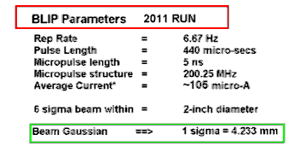
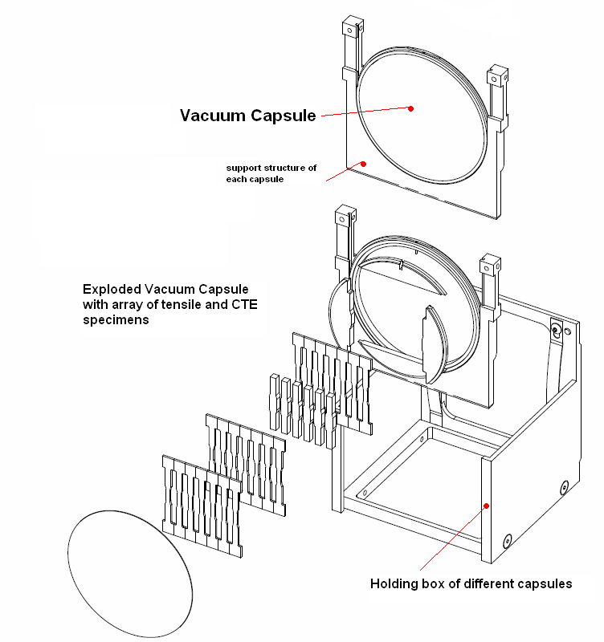
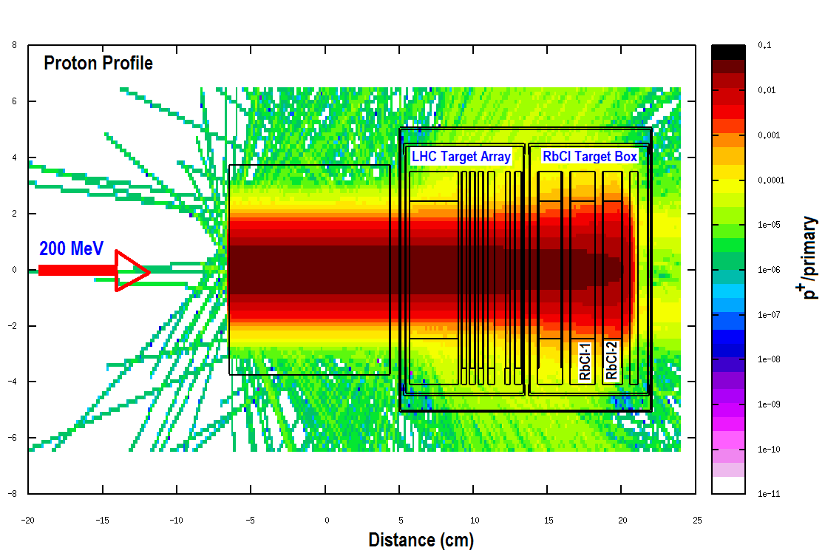
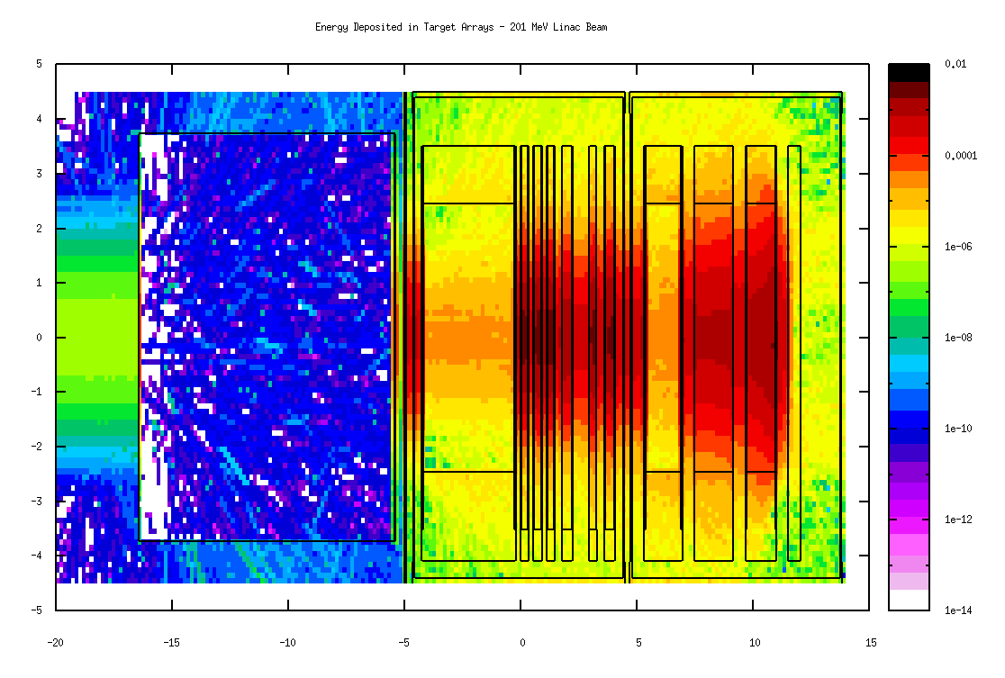
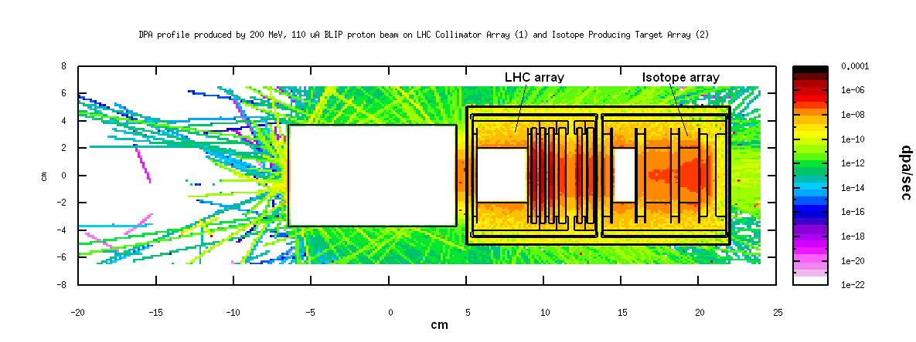
200 MeV Proton Irradiation

Slide 6
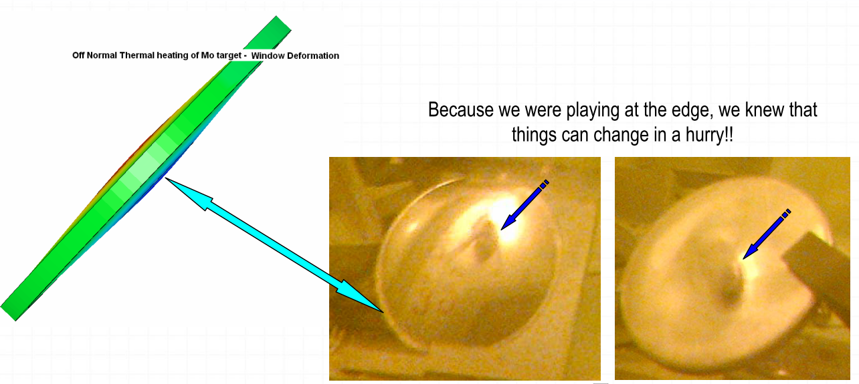
Status of Irradiation Study (as of May 2014)
Capsule with Mo-Gr failed due to thermal stress & adjacent Cu-CD capsule damaged
2013 run halted to extract target box
Damaged capsules replaced by SS degrader with a new capsule support that allowed larger water channels
Irradiation continued in 2013 up to 60% of required exposure
Final 3.5 week irradiation BLIP NOW underway
After cool down, post irradiation study of physical properties of the 5 of 7 remaining samples
Neutron irradiation of a collection of new samples in a new target holder (downstream of the isotope production target)

Slide 7
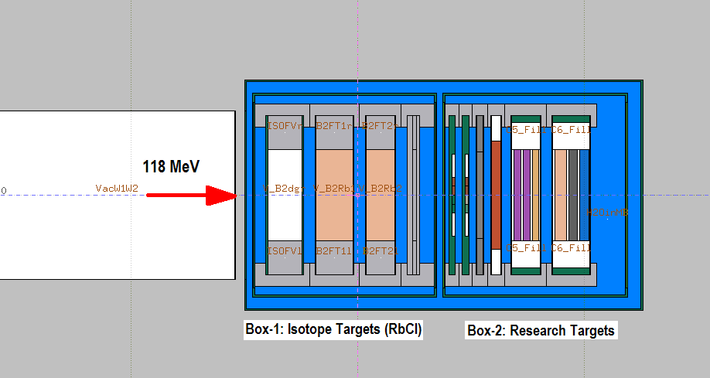
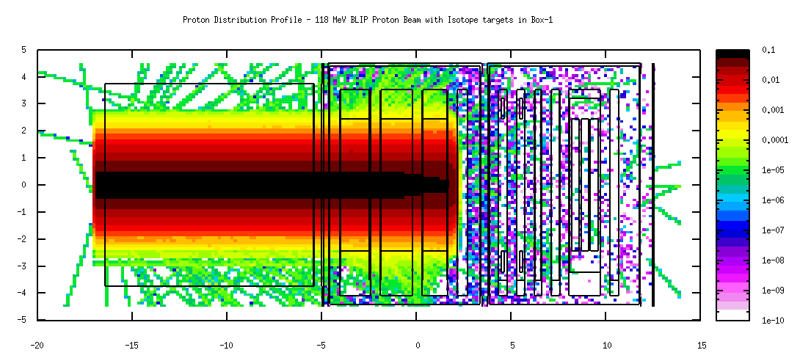
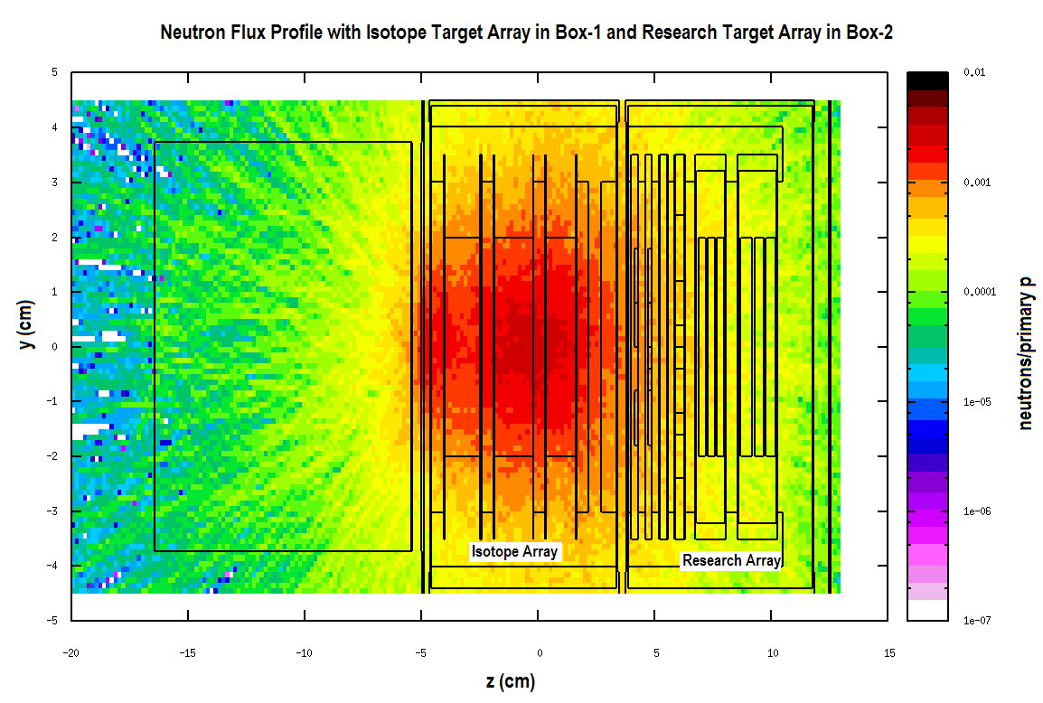
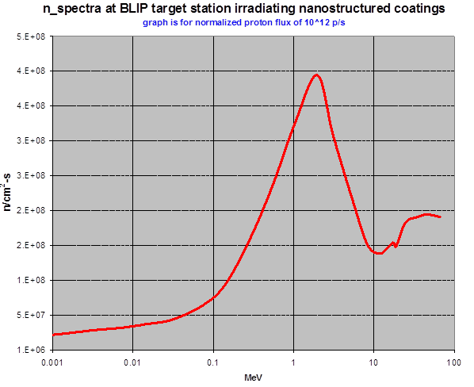
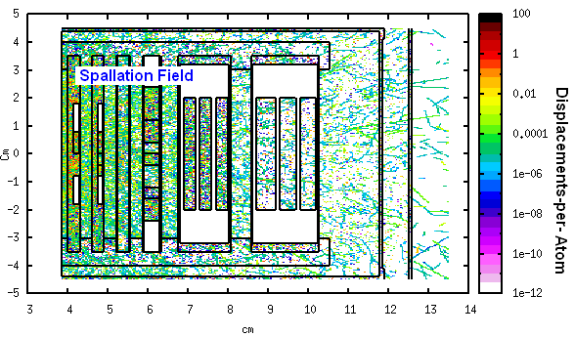
Spallation Neutron Irradiation
Neutron spectrum downstream of isotope target array

Slide 8
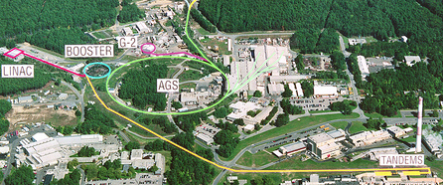
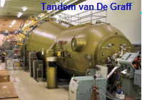
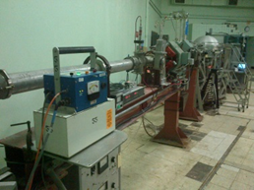
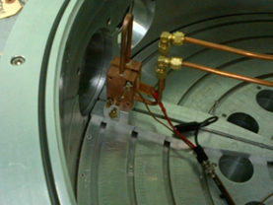
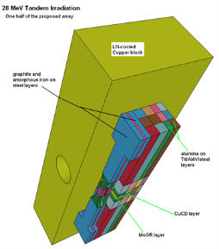
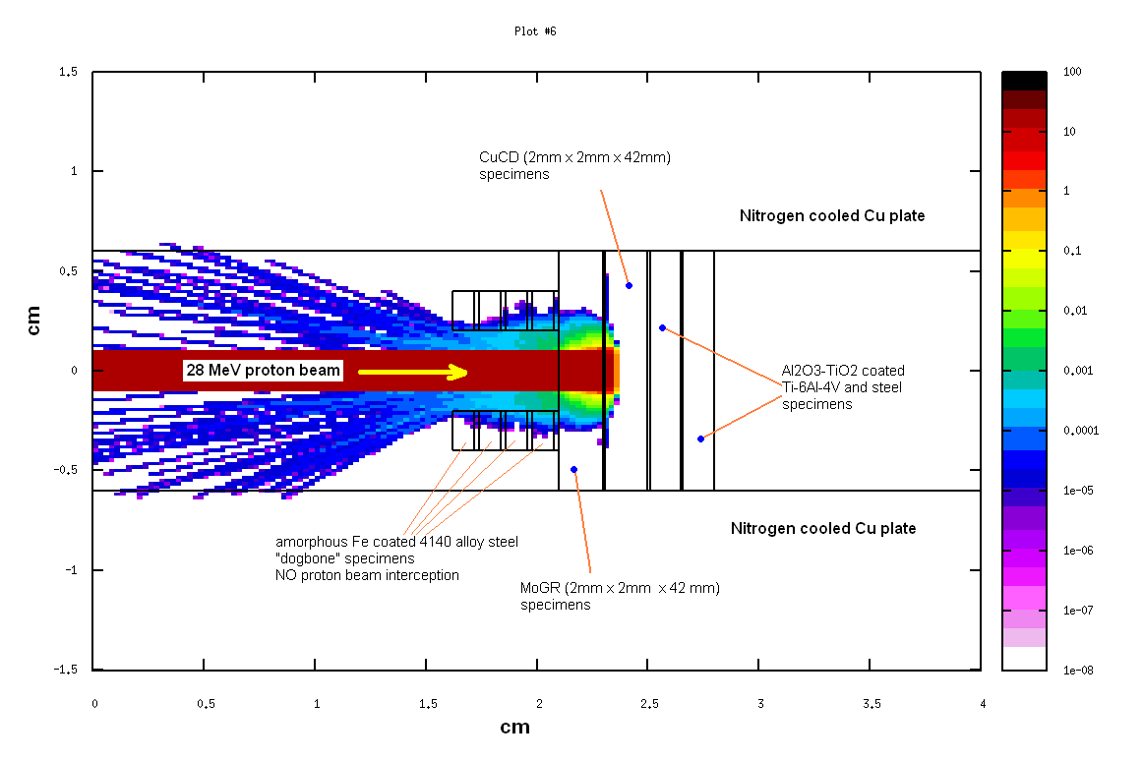
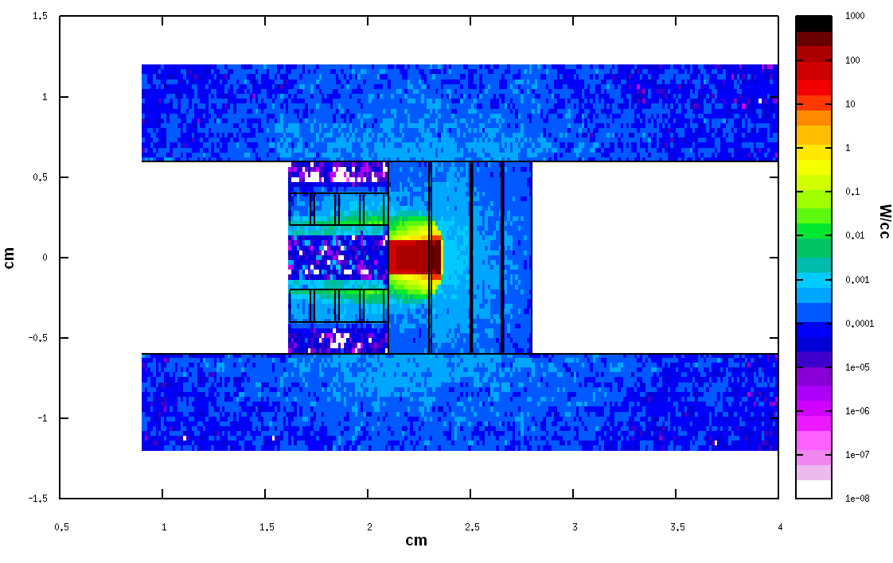
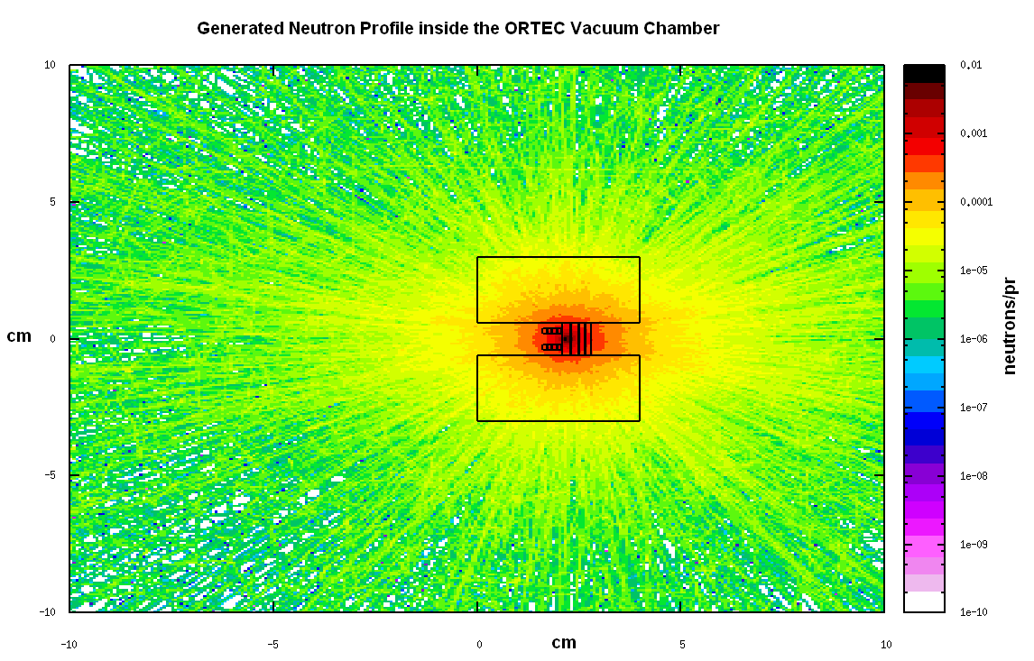
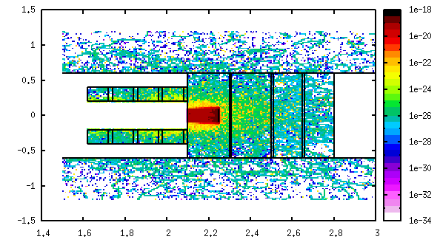
28 MeV Proton (plus spallation neutron) irradiation at Tandem
28 MeV (1 uA, 200 x 200 um x um) protons
Mo – direct 28 MeV protons
Mo/MoGR/CuCD/Glidcop: spallation neutrons

Slide 9
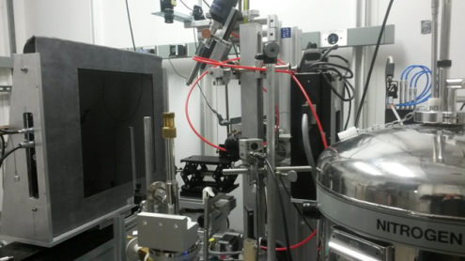
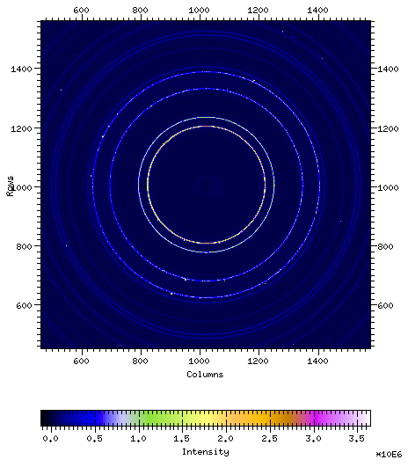
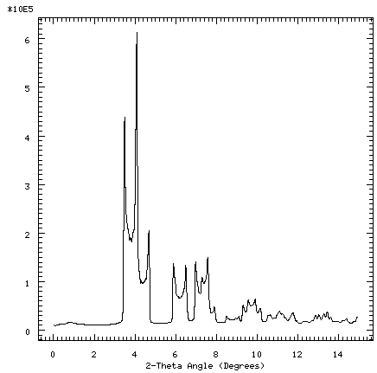
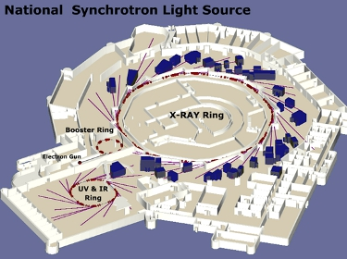
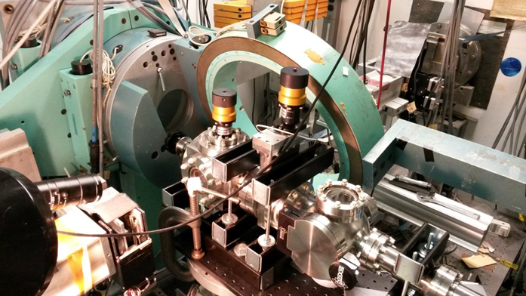
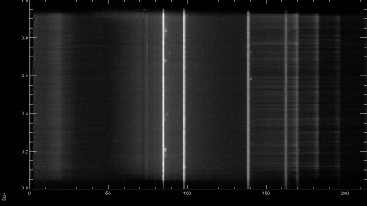
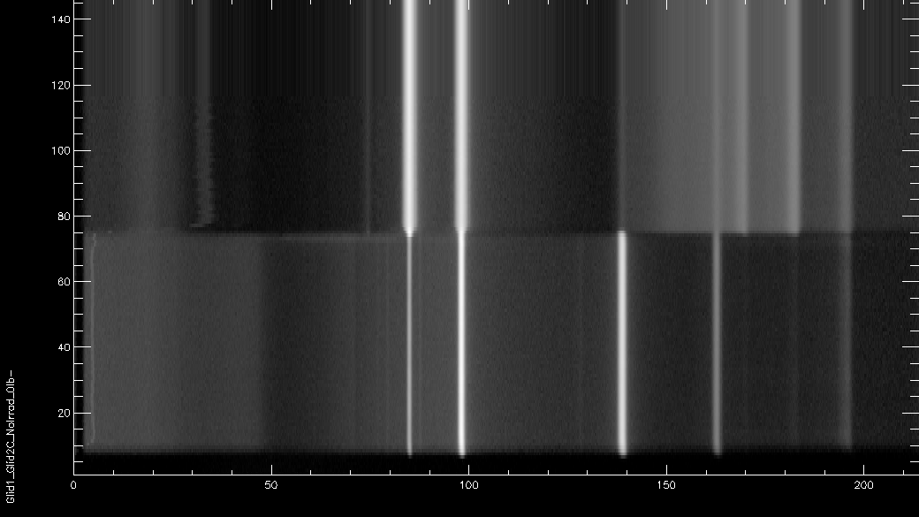
X-ray diffraction studies at NSLS
Monochromatic 70 KeV beam (X17A beamline)
White beam 200 KeV, X17B1 beamline
Tandem Irardiated CuCD
X17A (monochromatic x-rays)
X-Ray ring
(3 GeV)
X17B1
Mo-GR
Glidcop (SLAC LHC rotating collim)
Glidcop (HiLuMI)

Slide 10
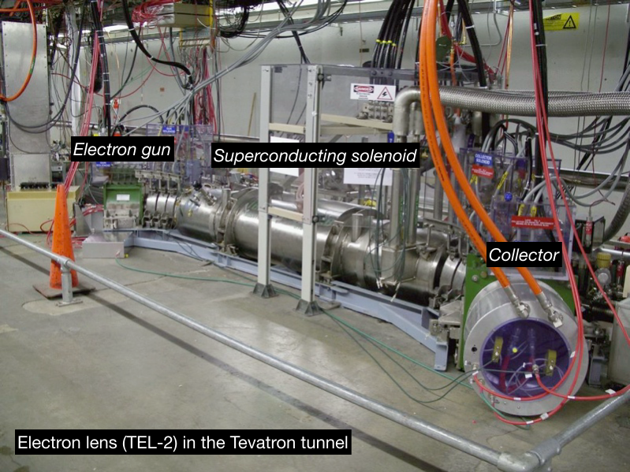
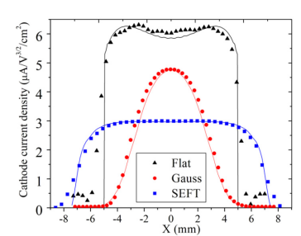
Collimation with Hollow Electron Beams
Giulio Stancari, A. Valishev (Fermilab)
R. Bruce, S. Redaelli, A. Rossi, B. Salvachua Ferrando (CERN)
Electron beam current profile shaped by cathode geometry and maintained by strong solenoid ﬁeld
In Tevatron used for:
Beam-Beam compensation
Betatron Tune correction
Abort Gap Cleaning

Slide 11
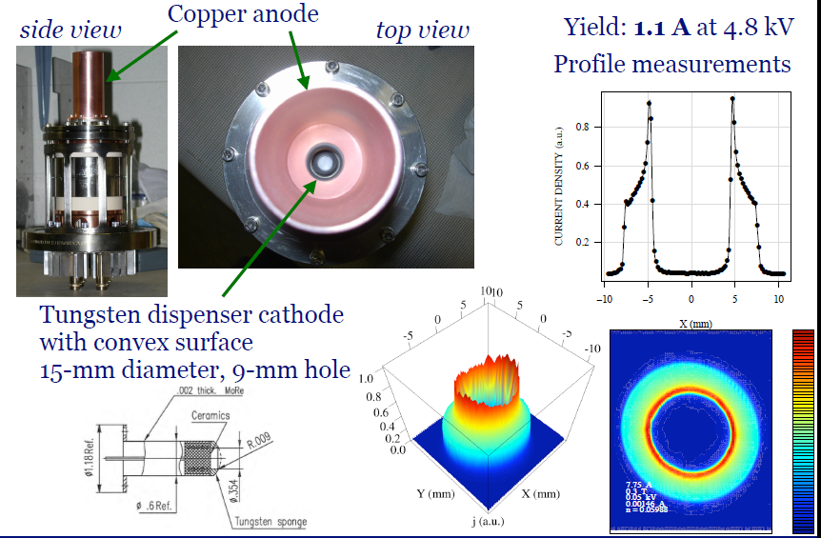
~2009: Develop Cathode for 15mm Hollow Electron Profile to use E-Lens as a Halo Scraper

Slide 12
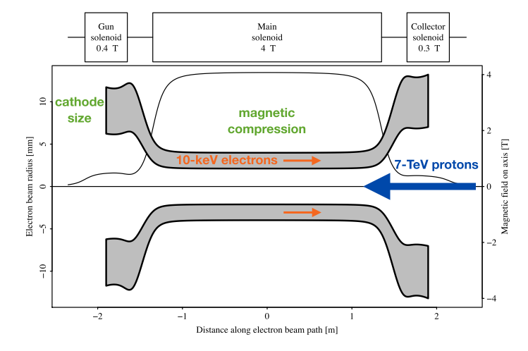
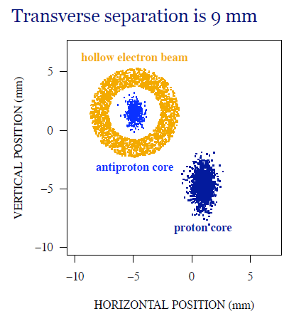
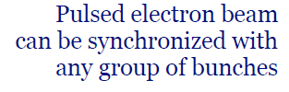
Hollow Electron Beam Gun in Tevatron
Main solenoid controls diameter of electron ring
18 experiments 2010.10-2011.06
  Tail of selected bunch depopulated
  Control bunches & core of selected bunch unaffected

Slide 13
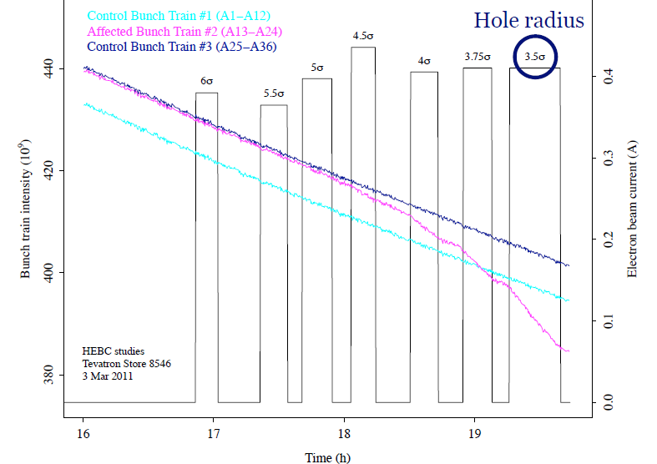
Example HEBC Result:
Selected & Control Bunch Intensity vs. Beam Size
Excellent progress in understanding of hollow beam collimation
Many new observations: halo removal rates, effects on core,
diffusion, fluctuations in losses, collimation efficiencies, ...
Pulse Gun for synched to one bunch train and look at Intensity decrease as diameter of the electron current ring decreases
Stancari et al., Phys. Rev. Lett. 107, 084802 (2011)
Stancari et al., IPAC11 (2011)
Stancari, APS/DPF Proceedings, arXiv:1110.0144

Slide 14
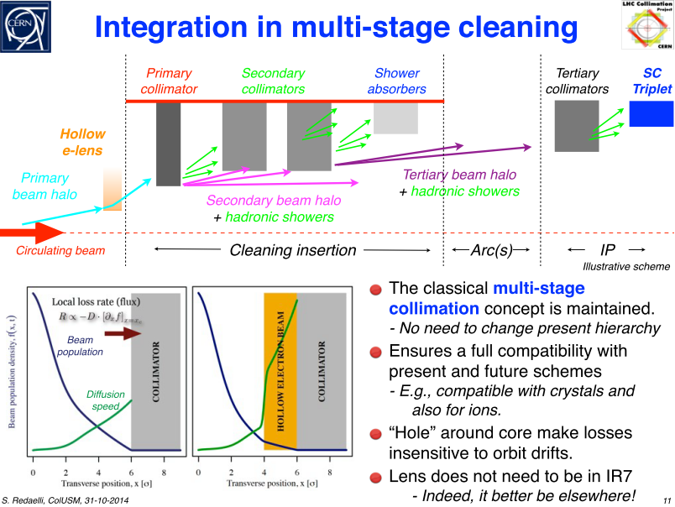

Slide 15
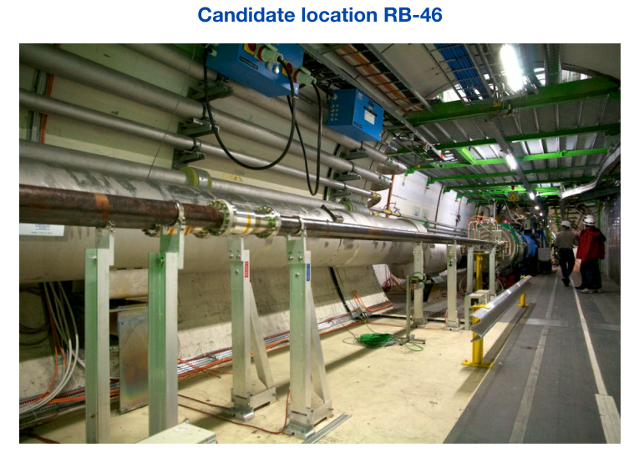
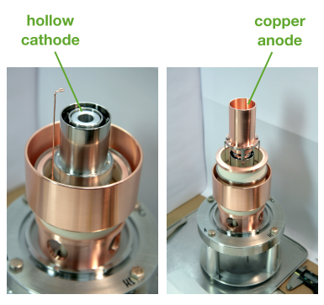
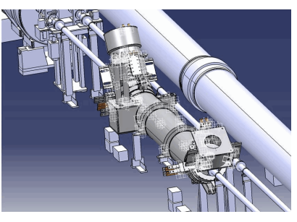
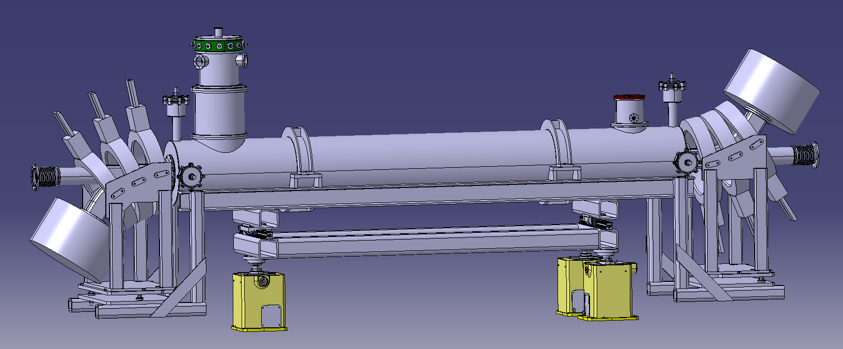
Feasibility for LHC Studied & Conceptual Design Report Written
LHC E- Gun Prototype
Mechanical Integration
Gun & Collector Opposite to Minimize Inj./Ext. Effects

Slide 16
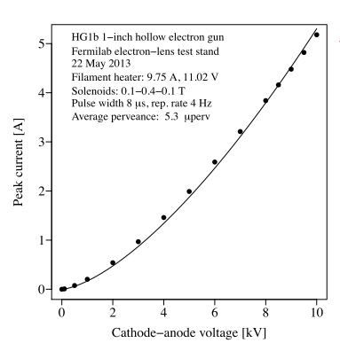
LHC E-Gun Tests at Fermilab

Slide 17
Goals of the Numerical Simulations
Would hollow electron beam collimation be eﬀective in the LHC?
  The kicks are nonlinear, with a small random component. Halo removal rates are expected to depend on magnetic rigidity of the beam, machine lattice, and noise sources. Nontrivial extrapolation from Tevatron to LHC.
Which modes of operation would be useful?
  continuous: same electron current every turn
    most of Tevatron experiments done in this mode
  resonant: current modulated to excite betatron oscillations (sinusoidal or skipping turns)
    used for clearing abort gap in Tevatron
  stochastic: random on/oﬀ, or constant with random component
Would there be any adverse eﬀects on the core, such as lifetime degradation or emittance growth?
  No eﬀects were seen in the Tevatron in continuous mode. Eﬀects of asymmetries in resonant operation?
Previtali et al., FERMILAB-TM-2560-APC (2013)
Valishev, FERMILAB-TM-2584-APC (2014)

Slide 18
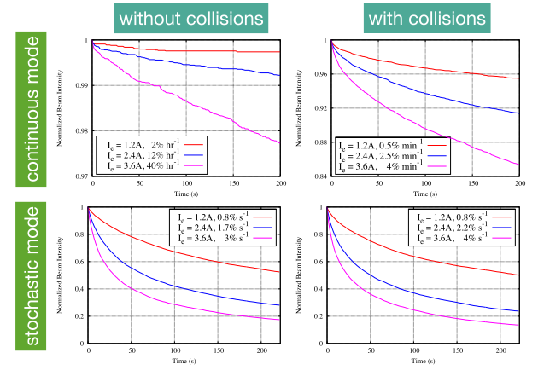
Calculated Halo Removal Rates vs. Electron Current

Slide 19
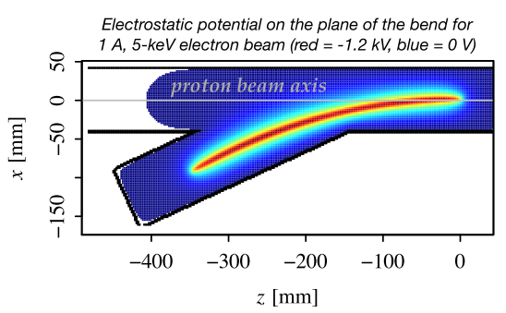
Eﬀect of injection/extraction bends
In continuous mode, no impact on emittances or luminosity
In stochastic mode, with U-layout (gun and collector on same side), dipole kick generates emittance growth (e.g., 10% modulation, 0.3 um/h)
In stochastic mode, with S-layout (gun and collector on opposite sides of ring), small contribution to luminosity lifetime (90 h, or 1%/h)
If pulsed operation is required, then S-layout is necessary

Slide 20
Outlook for a Hollow Electron Beam Scraper for LHC
Next steps
  technical design
  electron-lens test stand at CERN
  beam halo in LHC: machine studies and monitoring techniques
  electron lens and diagnostic studies at RHIC
  alternative schemes
  US LARP and US-HL-LHC contributions
  collaborations, personnel exchanges
Resources required if decision to implement is made
  Construction cost of 2 devices for the LHC (1 per beam) is about 5 M$ in materials and 6 M$ in labor
  Construction in 2015-2017 and installation in 2018 is technically feasible
    Info from this meeting: Hi-Lumi Steering Committee looking for new collaborators who may want to fabricate (Russia?)
  Reuse of some Tevatron equipment is possible (superconducting coil,
  resistive solenoids, electron guns, ...)

Slide 21
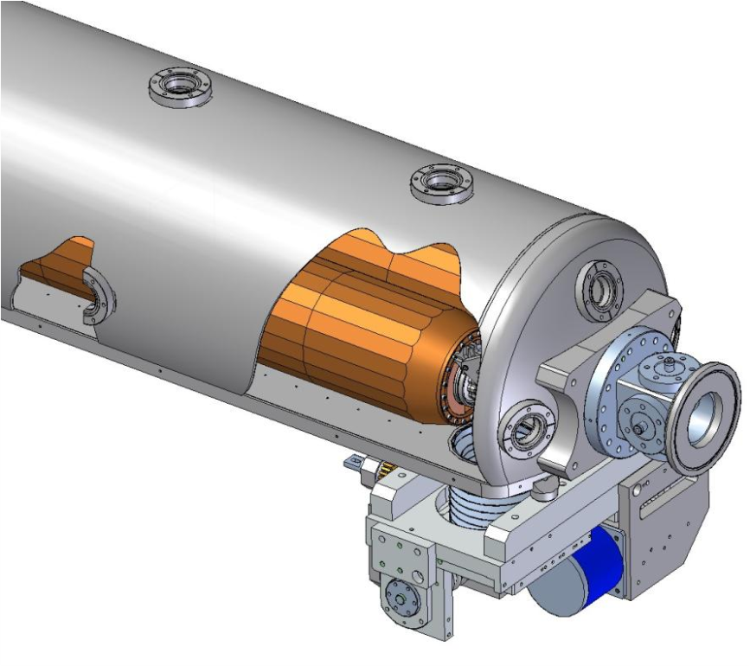
The LARP Rotatable Collimator Prototype
Candidate for a Phase II Secondary Collimator
Two jaw collimator made of Glidcop
  Rotate jaw after 1MJoule beam abort failure accident occurs
Each jaw is a cylinder with an embedded brazed cooling coil
  No vacuum-water braze; 12kW/jaw cooling; minimal thermal distortion
  Maximum radius cylinder possible given beam pipe separation
  BPMs integrated on ends of tank
Advantages:
  Not exotic material
  High Z for better collimation efficiency & more debris absorption
  Low resistance for better impedance
  Elemental for high radiation resistance
Disadvantages:
  Glidcop WILL be damaged in asynchronous beam abort

Slide 22
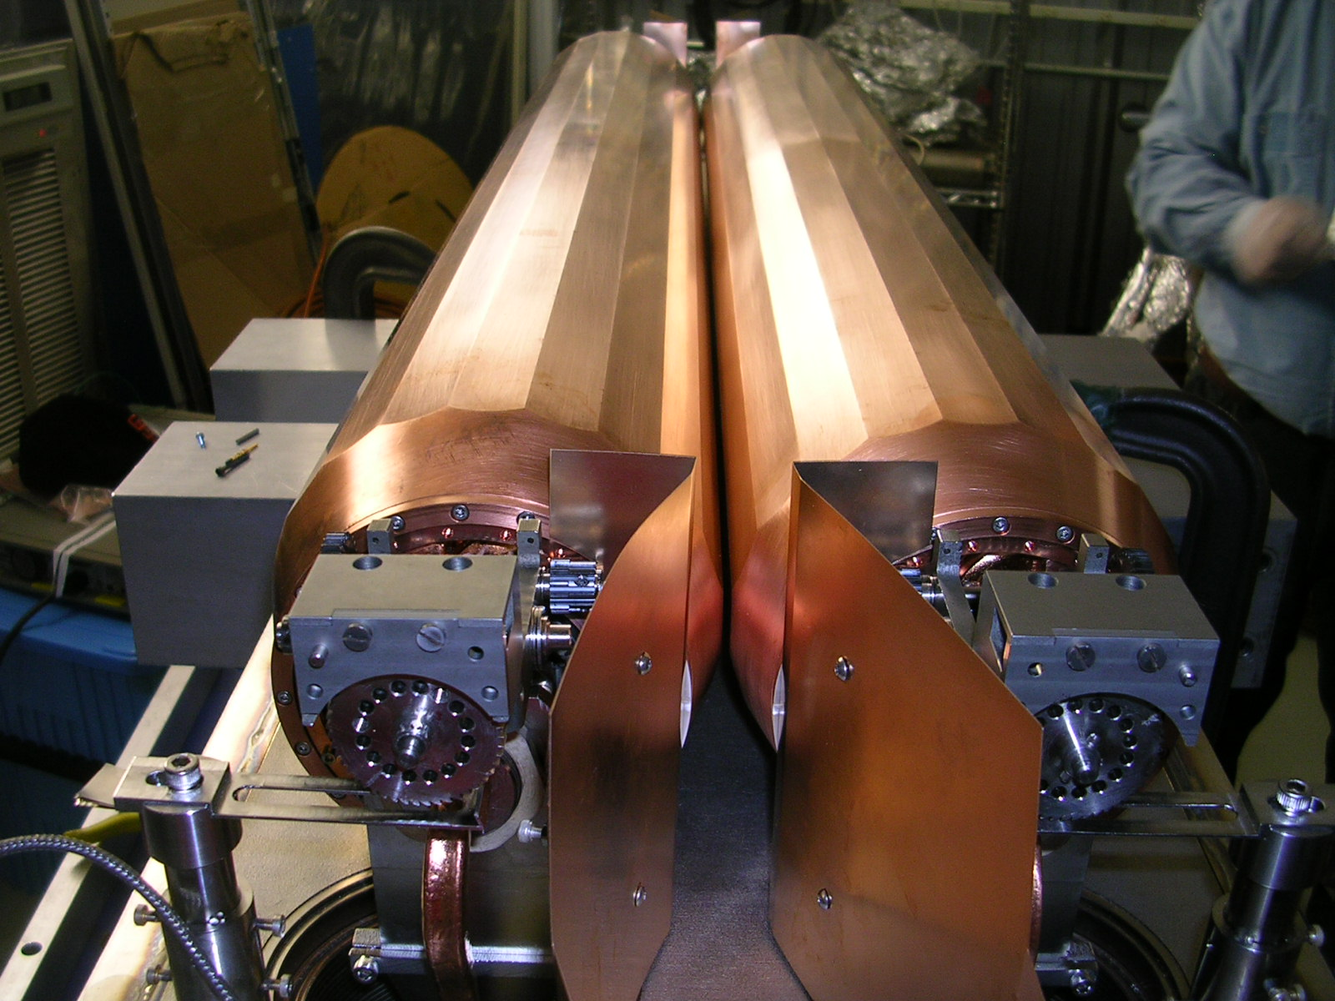
Prototype Collimator Assembled 18-Sept-13
Mechanical & Resistance Tests Good

Slide 23

SLAC Rotatable Collimator
The SLAC RC was built as part of the US-LARP collaboration
Objective: produce a machine-ready prototype for beam tests in SPS/LHC
Rotatable jaw concept: offers up to 20 collimating surfaces in case of beam damage
Test Timeline
➡ 11.2013: SLAC collimator received at CERN
➡ 02.2014: Tank opened
➡ 03.2014: first leakage test
➡ 03.2014: First jaw movement tests
➡ 03.2014: First wire impedance tests
➡ 04.2014: Controls (rotation, LVDT, …) tests
➡ 07.2014: Found UHV compliant
➡ 08.2014: Additional controls tests
➡ 11.2014: Metrology tests (for positioning)
From Federico Carra’s talk 19 Nov

Slide 24
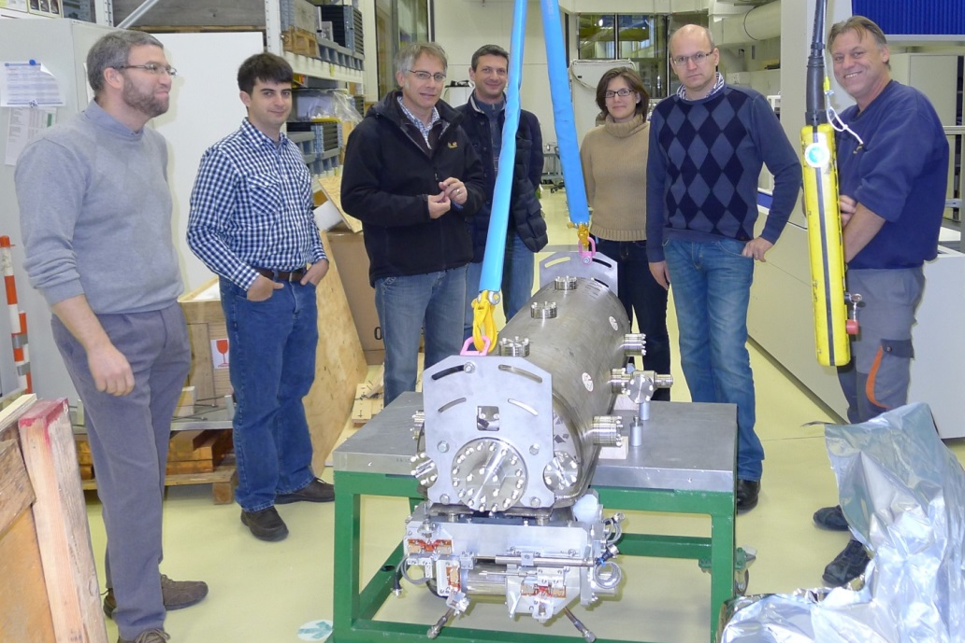
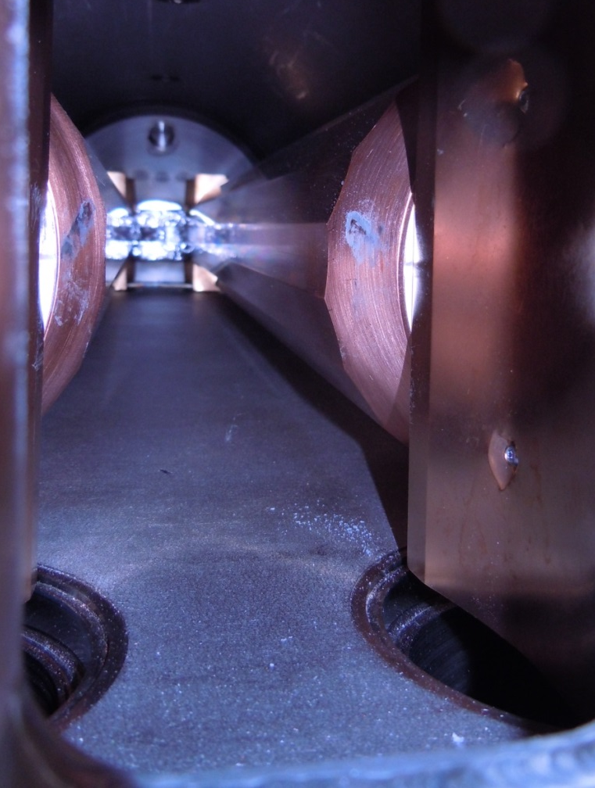
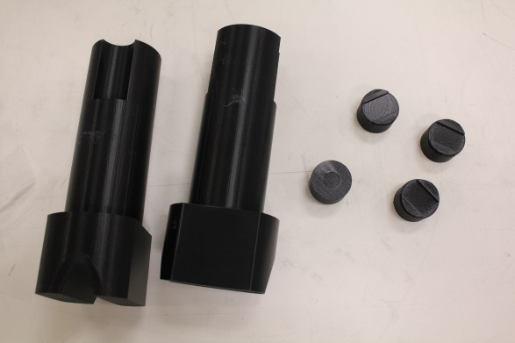
RC Testing at CERN
Reception, Unpacking, Visual Inspection

Slide 25




Impedance Measurements at CERN
Measuring the S12 with a single wire, attenuators and matching resistors.
Consistent with SLAC Calculations

Slide 26

Status of CERN Impedance Measurements

Slide 27



Drive Mechanism Tests Before and After Bakeout
Drive Mechanism tested 22-23 April 2014 and August 2014 after bakeout
  384 “ratchets” to rotate 1 more “facet”
  In April, required adjustment of actuator w.r. to toothed drive wheel
    Presumed due to tight tolerance & transport jolts

Slide 28
Vacuum test Results: 07.2014
Outgassing test cycle (with bake-out ramped up to 180° C and slow cool-down)

Slide 29

HRMT-21 SLAC Rotatable Collimator: Goals
To assess damage limits in case of accident scenarios
To test rotation mechanism functionality to beam impacts with increasing intensity
From Federico Carra’s talk 19 Nov
Test 1: To assess Glidcop onset of damage (6 shots between 25% and 150% of the expected damage limit (0.14 MJ) followed by 1-3 facet rotation to distinguish damage extension)
Test 2: To assess functionality after HL-LHC asynchronous beam dump (82b for a total of 1.39e¹³ at 440 GeV or 1.0 Mjoule=8 7-TeV LHC bunches @ 1.15E11p/bunch)
Test 3: To assess functionality after HL-LHC injection error (288b for a total of 4.90e¹³p at 440GeV or 3.5 MJ)

Slide 30
Schedule and Actions
SLAC RC is proposed for installation in the SPS for MD in 2015:
  Vacuum and impedance compliant with SPS requirements
  ECR prepared and to be circulated soon
Test of SLAC RC in HiRadMat likely in 2016 (HRMT-21 experiment)
  Exact details flexible at this point
From Federico Carra’s talk 19 Nov

Slide 31
The End

