Slide 1
Collimation status and layout for IR1 and IR5
R. Bruce, S. Redaelli
on behalf of the WP5 team
R. Bruce, 2014.11.18
1
Notes:
1
1
1540 -> 1609

Slide 2
Many contributors…
CERN : A. Bertarelli, F. Carra, F. Cerutti, L. Esposito, P. Hermes, J. Jowett, A. Lechner, D. Mirarchi, E. Quaranta, A. Rossi, B. Salvachua, W. Scandale, M. Schaumann, E. Skordis, G. Steele, G. Valentino
Royal Holloway, University of London: S. Gibson, H. Garcia-Morales, R. Kwee-Hinzmann, L. Nevay
SLAC : T. Markiewicz
University of Huddersfield: R. J. Barlow, H. Rafique, A. Toader
University of Manchester and Cockcroft Institute: R.B. Appleby, J. Molson, M. Serluca
Team members who recently left: L. Lari, A. Marsili

Slide 3
Outline
Introduction: Collimation in the present LHC
Challenges for HL-LHC
Proposed collimator layout
  IR7
  IR1/5 incoming beam
  IR1/5 outgoing beam
  Outgoing beam for heavy-ion operation: IR2, IR1, IR5
Summary

Slide 4
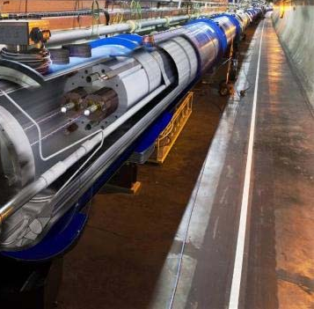
Introduction
Very high stored energy in LHC (nominal: 362 MJ, HL: 675 MJ). Maximum specified loss rate from nominal beam was 500 kW, while design quench limit was 8.5 W/m.
Need a very efficient collimation system to intercept unavoidable
beam losses that otherwise might quench superconducting
magnets!
Challenge of
nominal LHC
< 8.5 W/m
500 kW
Collimation

Slide 5
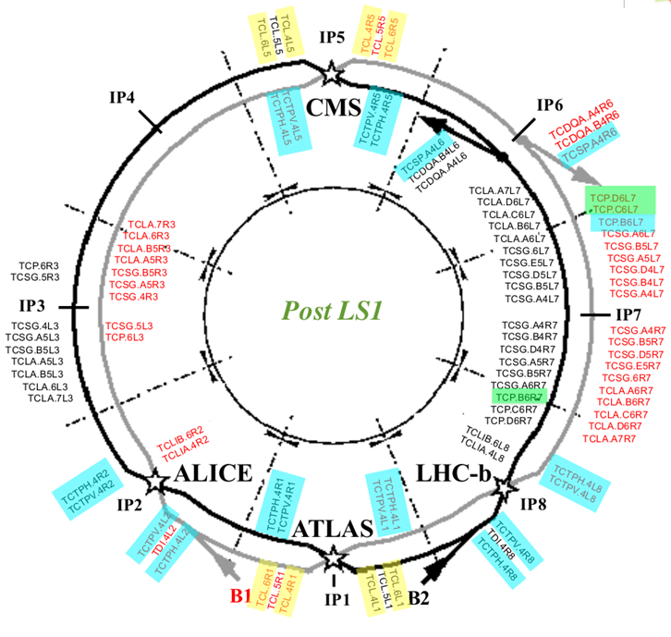
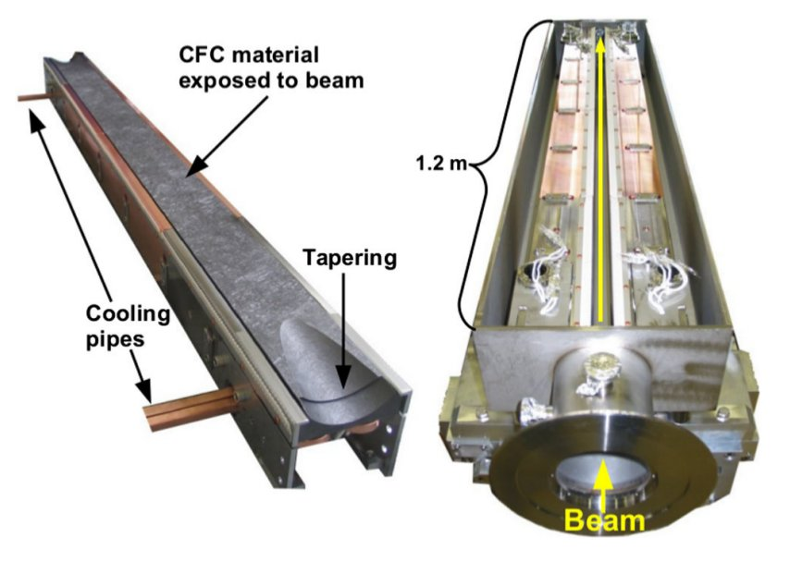
LHC collimation system
LHC Run 2 collimation system: > 100 movable devices
Betatron cleaning: IR7,
momentum cleaning: IR3
Momentum cleaning
Betatron cleaning

Slide 6
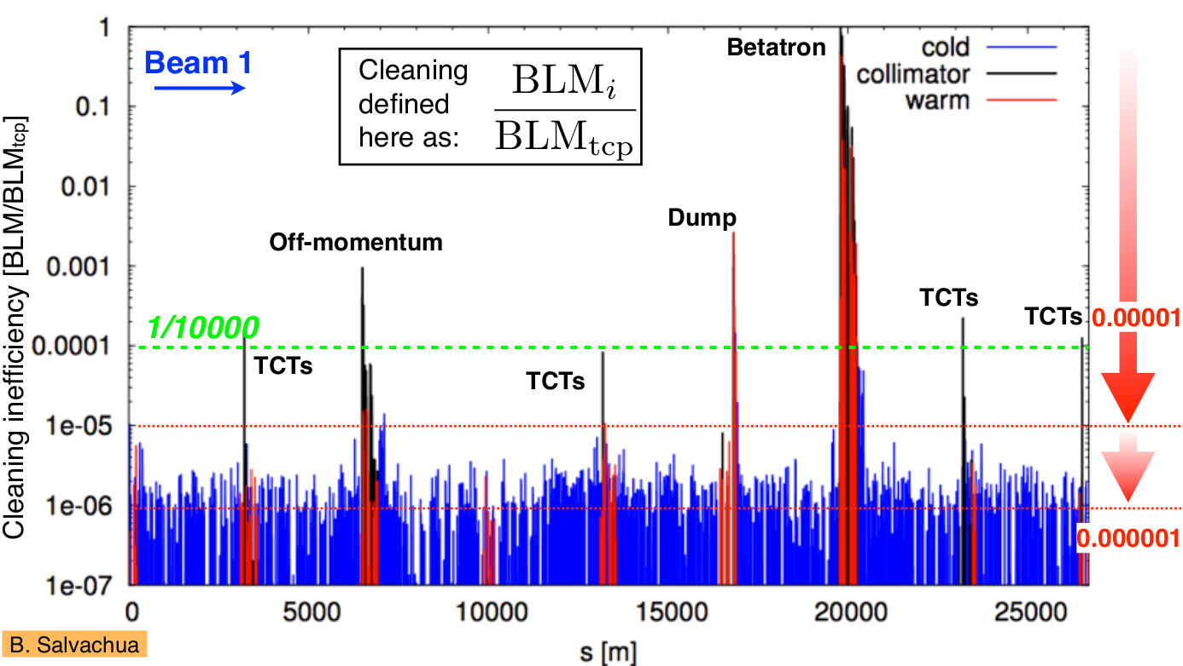
Achieved performance in Run 1
Highest losses in cold magnets: factor ~10⁴ lower than losses on the primary collimator

Slide 7
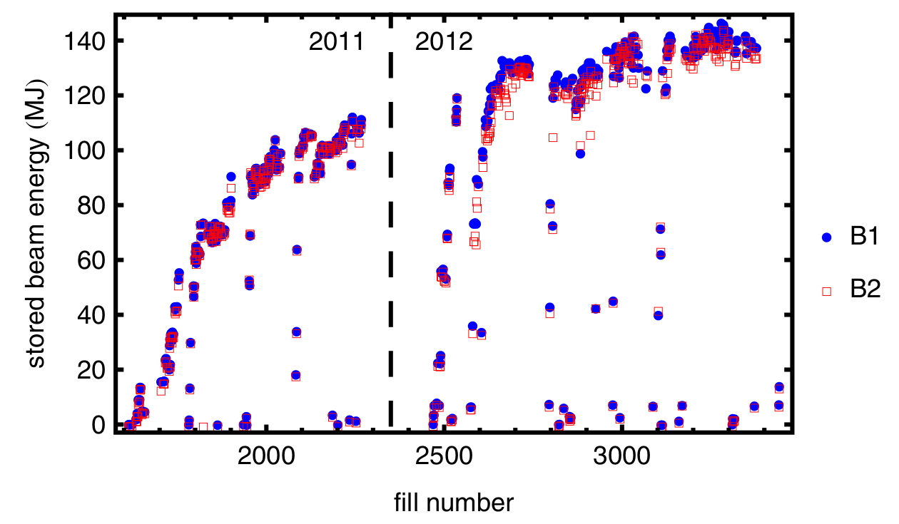
Stored energy in Run 1
Routinely stored ~140 MJ beams over hours
No quenches with circulating beam

Slide 8
Challenges for HL
Collimation working very well in Run 1. Why upgrade?
Higher stored energy (nom: 362 MJ -> HL: 675 MJ) =>
  For given beam lifetime, higher loss rates on collimators and cold magnets but same quench and damage limits
Different IR optics and layout =>
  Potentially new aperture bottlenecks that need local protection
Higher luminosity =>
  Higher fluxes of physics debris (protons and heavy ions)
Higher bunch intensity (nom: 1.15e11 -> HL: 2.2e11) =>
  Worse beam stability for same collimator openings - impedance
In addition: radiation, wear etc.

Slide 9
HL collimation upgrades
Several upgrades studied to meet the challenges
Today: not all upgrades discussed. Focus on major layout changes
Topics not covered in today’s talk:
  Low-impedance collimators
  More robust collimators
  Operational efficiency, setup time
  Mechanical and radiation wear
  Advanced collimation concepts under study (not yet part of HL baseline): active halo control, crystals, rotatable collimator design

Slide 10
Outline
Introduction: Collimation in the present LHC
Challenges for HL-LHC
Proposed collimator layout
  IR7
  IR1/5 incoming beam
  IR1/5 outgoing beam
  Outgoing beam for heavy-ion operation: IR2, IR1, IR5
Summary

Slide 11
IR7 limitation, Run 1
Location in ring with highest cold beam-cleaning losses in Run 1: IR7 DS
To cope with higher primary loss rates: decrease leakage to DS
IR7 DS expected to be limiting loss location also in HL-LHC

Slide 12
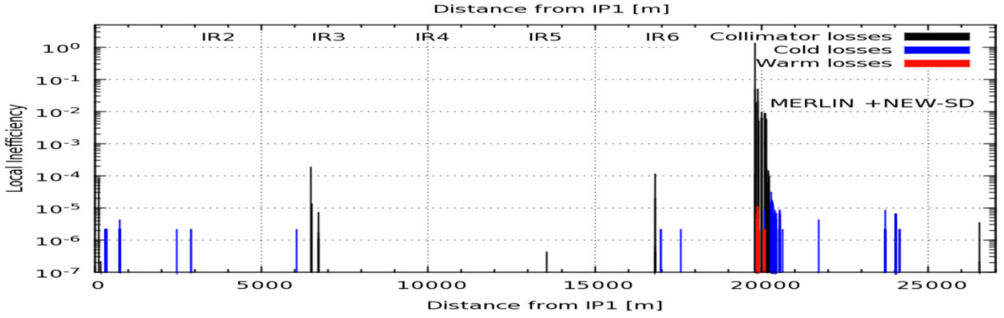
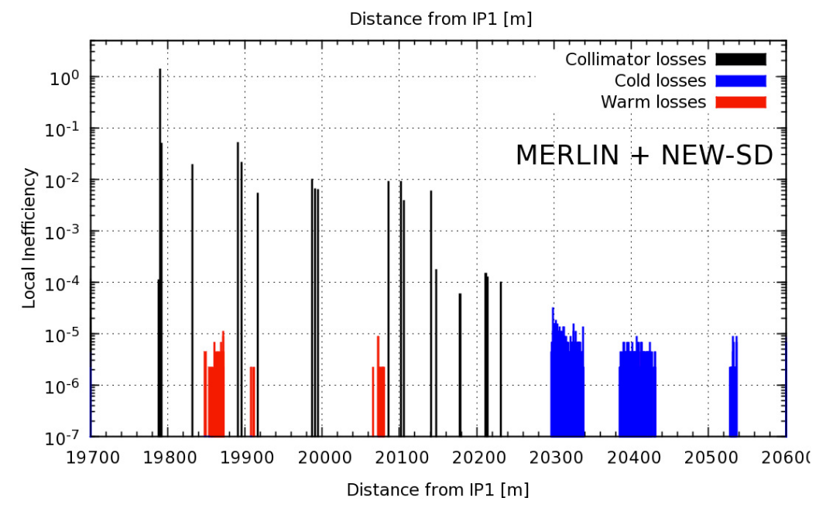
IR7 limitation for HL
Example: pre-squeeze simulated with MERLIN (M. Serluca et al.)
M. Serluca et al., Manchester
MOPRI077, IPAC14

Slide 13
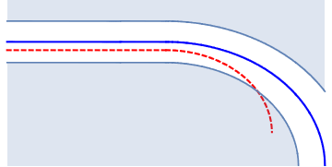

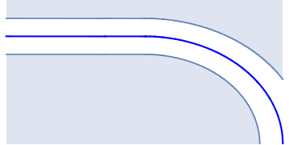
DS collimators
Out-scattered off-energy protons have different bending radius
than main beam
Start deviating significantly only in first bends, downstream of
collimators
Idea: Install new collimators (TCLD) in front of exposed magnets, where there is already separation from main beam
Collimators
Main beam
dp/p<0

Slide 14
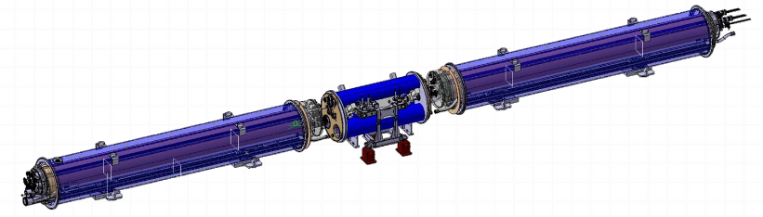
Design of TCLDs
Integration: Replace main dipole by two 11T dipoles (WP11) and TCLD (WP5) in between
Mechanical design and integration under study
More details: Talk F. Carra
L. Gentini,
D. Ramos et al.

Slide 15
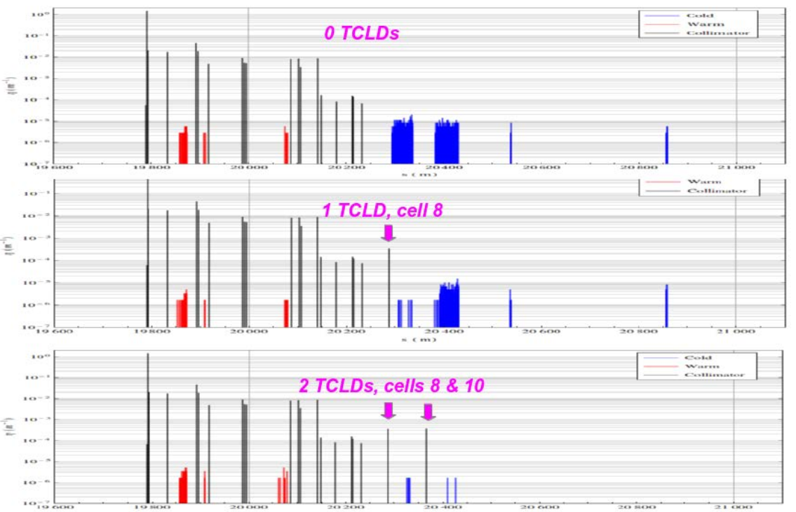
Performance with DS collimators
Simulations SixTrack + FLUKA with 2 TCLDs in cells 8 and 10 (0.8 m W jaws): Gain factor ~10 in peak power in superconductors
Final decision for installation should be based on Run 2 experience
IR7
IR7
Deliverable 5.4

Slide 16
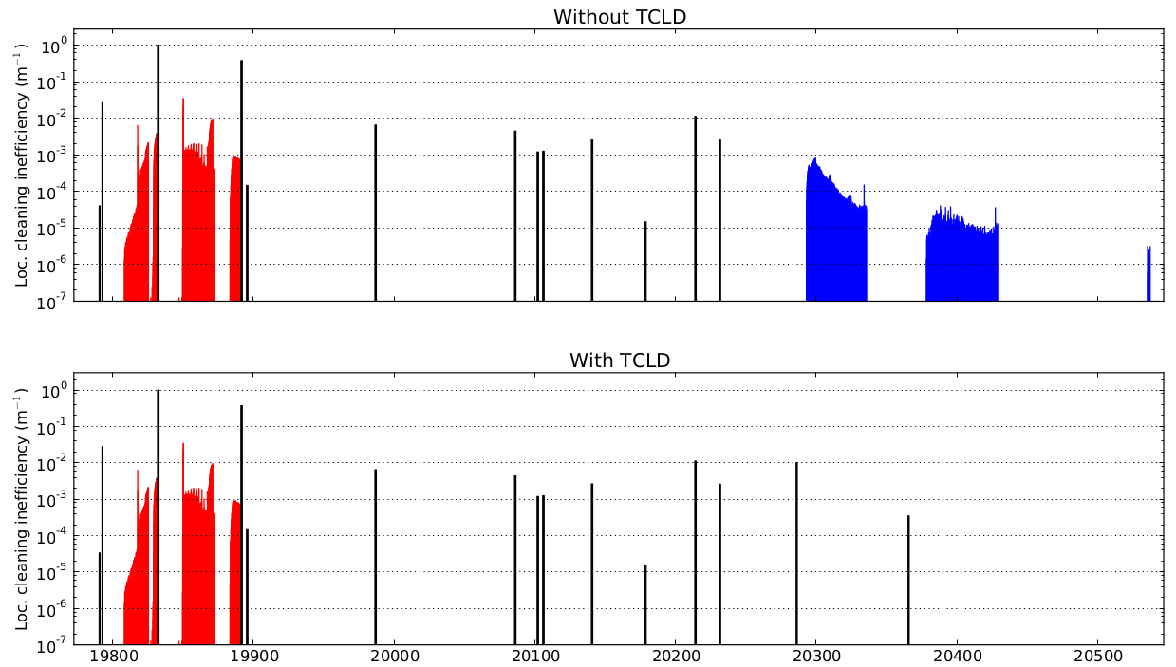
IR7 DS collimation for heavy ions
Heavy-ion collimation: nuclear fragmentation in primary collimator creates ions with changed magnetic rigidity. Lost in DS
Preliminary simulation: 2 TCLDs alleviate all losses for Pb⁸²⁺
To be re-confirmed: Improved simulation code under development
0 TCLDs
IR7
2 TCLDs, cells 8 & 10
P. Hermes

Slide 17
Outline
Introduction: Collimation in the present LHC
Challenges for HL-LHC
Proposed collimator layout
  IR7
  IR1/5 incoming beam
  IR1/5 outgoing beam
  Outgoing beam for heavy-ion operation: IR2, IR1, IR5
Summary

Slide 18
Incoming beam, IR1/5
Presently: pair of horizontal / vertical tertiary collimators (TCT) in cell 4 protects triplet (global aperture bottleneck) against
  Cleaning losses
  Fast losses during asynchronous beam dumps
HL: potentially new bottlenecks in Q4/Q5, upstream of present TCT
  Could be exposed to both cleaning losses and fast losses during asynchronous dumps
Solution: Introduce additional TCT in cell 5

Slide 19
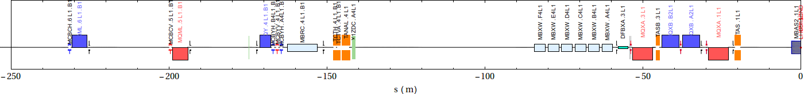
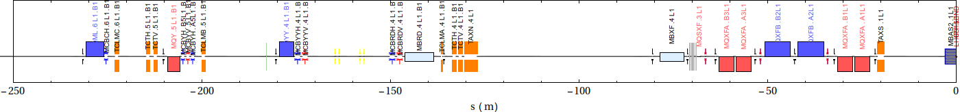
IR1/5 layout, incoming beam
Proposal: add TCT5 in front of Q5, in space of missing dipole
TCT4
Q5
Q4
D2
D1
triplet
IP1
Beam
Nominal LHC
TCT5
TCT4
Q5
Q4
D2
D1
triplet
IP1
Beam
HL-LHC

Slide 20
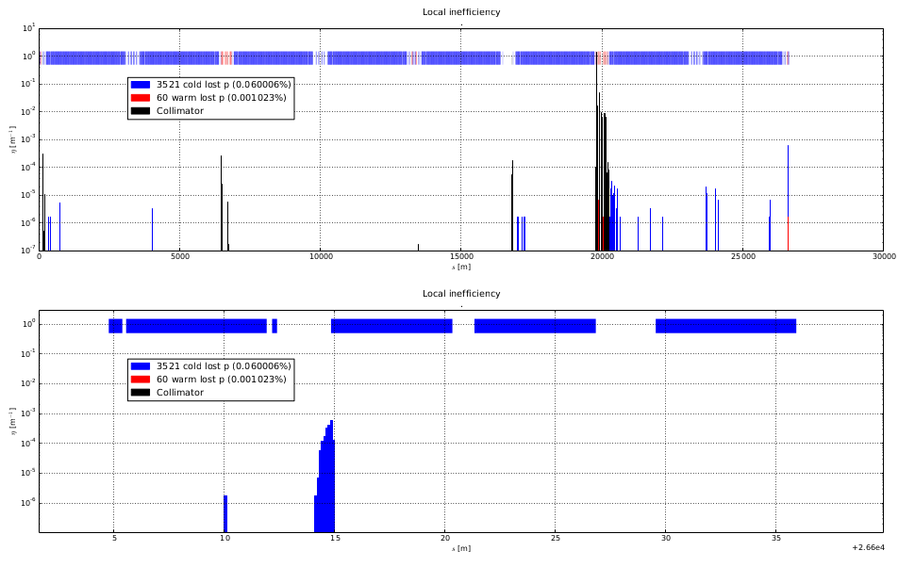
Cleaning simulations
To quantify need for upgrade: Simulating with SixTrack beam cleaning in HL without TCTs (H. Garcia, Royal Holloway)
Vary aperture of magnets in experimental IRs, study IR losses
H. Garcia

Slide 21
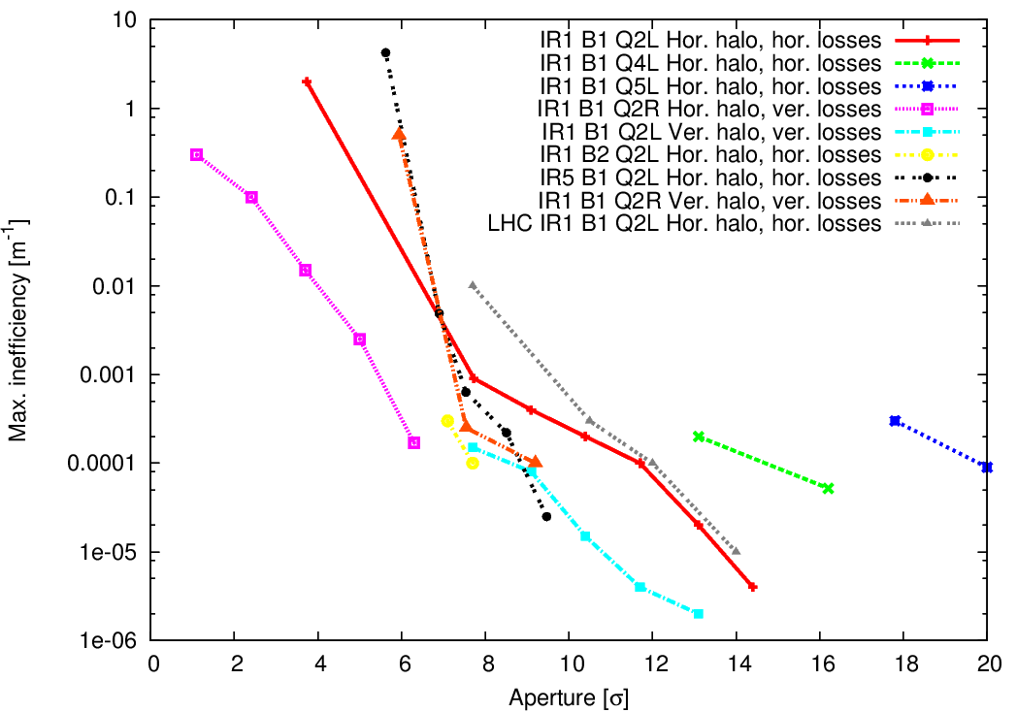
Cleaning losses in triplets and Q4/Q5 without TCTs
Cleaning simulations with variations of IR magnet apertures
With imperfections, apertures down to 12 σ allowed
Simulated losses at A>12 σ: possible need of TCTs for cleaning
More details: Talk H. Garcia, Thursday AM
H. Garcia

Slide 22
IR losses during asynchronous dumps
Asynchronous beam dump: fast one-turn failure where one or several bunches could be kicked directly onto the aperture and cause damage
Examine IR aperture losses during asynchronous beam dumps
  Simulation with SixTrack, with and without TCTs (E. Quaranta, CERN)
  Take most critical failure mode: single-module pre-fire
  Sum hits on IR apertures over all impacting bunches
  Normalize by HL-LHC bunch population 2.2e11
  Sensitivity study of aperture in Q4/Q5 (upstream of present TCT)

Slide 23
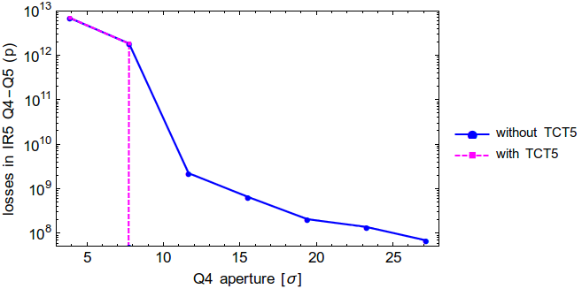
Asynchronous dump with TCT5
E. Quaranta
Even at the nominal aperture, impacts seen at Q4/Q5 and triplet
  Possibly enough to quench at 7 TeV
TCT5 efficiently blocks all aperture losses if inside the aperture

Slide 24
IR collimation on incoming beam
Cleaning losses without TCTs:
  No cleaning losses on perfect aperture
  With imperfect apertures, losses appear also at > 12σ
Asynchronous beam dumps without TCTs:
  Losses on triplet and Q4/Q5 aperture even with perfect aperture, possibly enough to quench
Local protection needed. Propose to add TCT in front of Q5 for increased protection

Slide 25
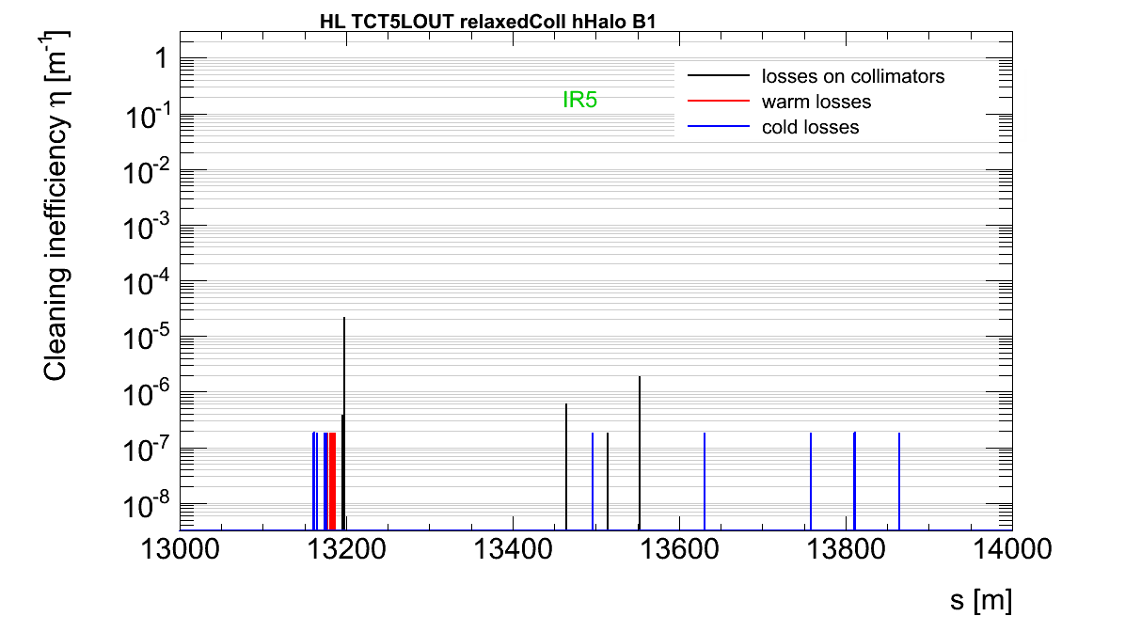
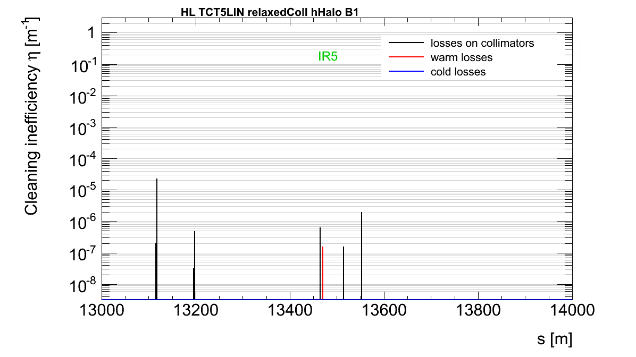
Background reduction with TCT5?
Additional advantage: Potentially lower experimental background
TCT5 (further from experiment) takes over losses from TCT4 (R. Kwee, Royal Holloway)
Shower calculations planned to quantify effect
TCT4
only
TCT5
TCT4
R. Kwee

Slide 26
Outline
Introduction: Collimation in the present LHC
Challenges for HL-LHC
Proposed collimator layout
  IR7
  IR1/5 incoming beam
  IR1/5 outgoing beam
  Outgoing beam for heavy-ion operation: IR2, IR1, IR5
Summary

Slide 27
Outgoing beam IR1/5
Present layout (upgraded in LS1) : 3 collimators (TCLs) in cells 4,5,6 to intercept physics debris
To assess protection of magnets in HL: FLUKA simulations of energy deposition from physics debris (L. Esposito et al., CERN, collaboration WP10 and WP2)
Present layout with added fixed masks seems to give sufficient protection for high-luminosity proton operation. Under study in WP10/WP2/WP5:
  Some integration issues
  Possibility to change TCL design and have thicker jaws – increase protection and remove fixed mask to gain space
  More details: talk L. Esposito, Thursday AM

Slide 28
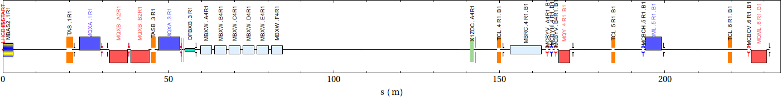
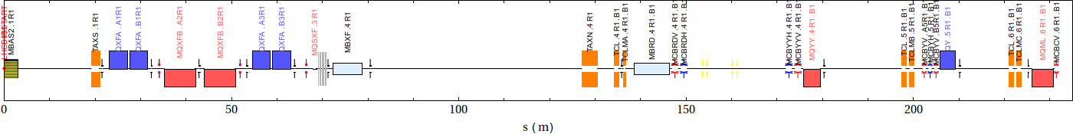
Layout: Outgoing beam IR1/5
Same collimators as for Run II, but some longitudinal shifts
Conceptual design with known integration issues. Detailed design work required
TCL4
TCL5
TCL5
IP1
triplet
D1
D2
Q4
Q5
Q6
Beam
Nominal LHC
TCL4
TCL5
TCL6
IP1
triplet
D1
D2
Q4
Q5
Q6
Beam
HL-LHC

Slide 29
Outline
Introduction: Collimation in the present LHC
Challenges for HL-LHC
Proposed collimator layout
  IR7
  IR1/5 incoming beam
  IR1/5 outgoing beam
  Outgoing beam for heavy-ion operation: IR2, IR1, IR5
Summary

Slide 30
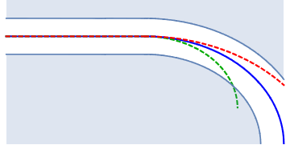
Outgoing beam, heavy ions
During Pb⁸²⁺ heavy-ion collisions, large cross section for:
  Bound-free pair production (BFPP) : electron acquired by outgoing ion(s)
  Electromagnetic dissociation (EMD): Loss of 1 or 2 neutrons (dominant)
Changed ratio charge / mass gives different bending radius
  Losses on aperture when bending starts in DS. Analogue to IR7
  At upgraded ALICE Pb-Pb
  luminosity 6e27cm⁻²s⁻¹,
  estimated heat load >
  quench limit (deliv. 5.3)
Power density reduced by
factor ~100 with TCLD =>
no quench expected
TCLD
`
BFPP
EMD
Main beam

Slide 31
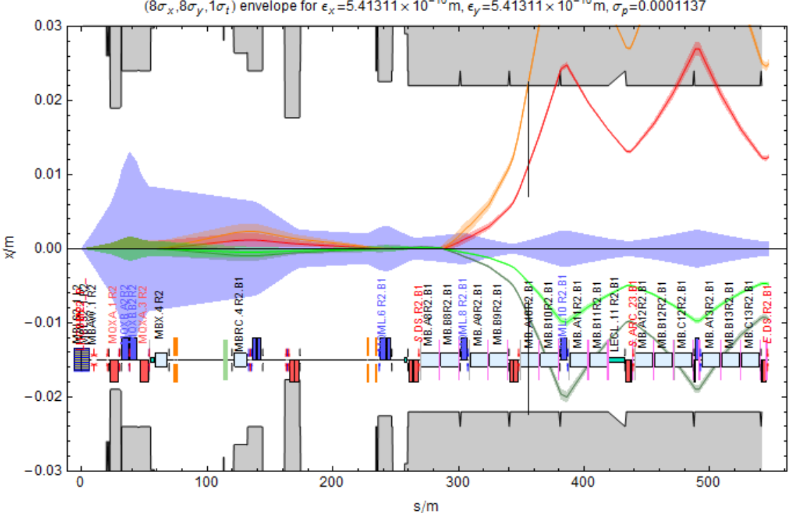
Outgoing beam, IR2, Pb⁸²⁺ ions
TCLD in cell 10
IP2
triplet
Q4
Q6
Q8
Q10
J. Jowett, M. Schaumann
Deliverable 5.4

Slide 32
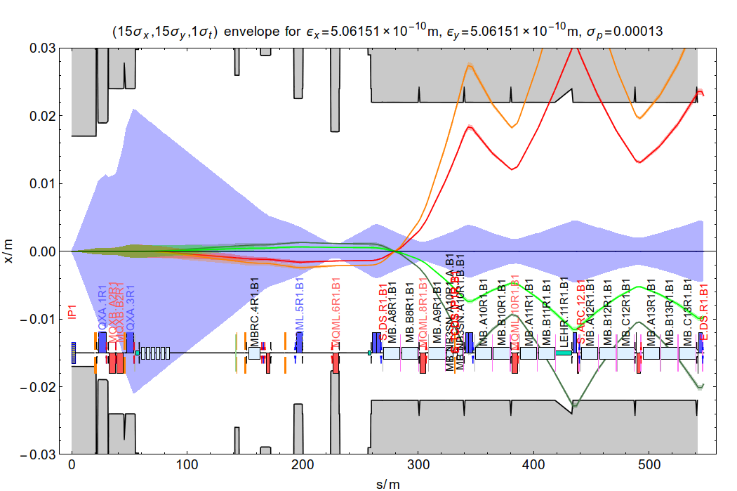
Outgoing beam, IR1/5, Pb⁸²⁺ ions
To be studied: Can TCL6 setting for protons be relaxed if using TCLD in IR1/5?
TCLD in cell 9
IP1
triplet
Q4
Q6
Q8
Q10
J. Jowett, M. Schaumann
Deliverable 5.5

Slide 33
Outline
Introduction: Collimation in the present LHC
Challenges for HL-LHC
Proposed collimator layout
  IR7
  IR1/5 incoming beam
  IR1/5 outgoing beam
  Outgoing beam for heavy-ion operation: IR2, IR1, IR5
Summary

Slide 34
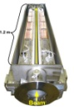


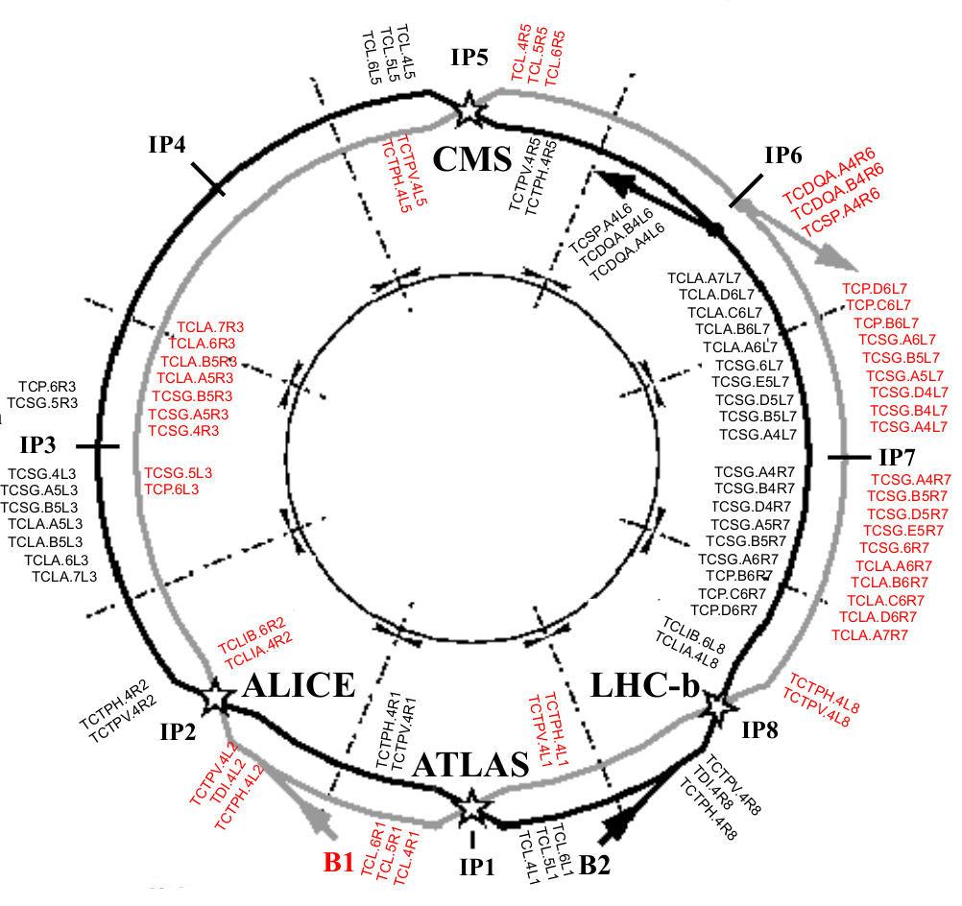
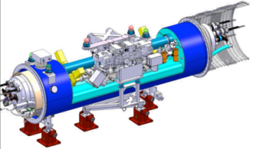
Summary of major layout changes
TCT5 (1 on each incoming beam)
Ion physics debris: DS coll. + 11T dipoles (1 per beam)
Cleaning: DS coll. + 11T dipoles, 2 units per beam
Final decision on installation to be taken based on
Run 2 experience
Ion physics debris:
DS coll. + 11T dipoles
1 per beam
Other baseline upgrades:
Advanced materials
  Better TCT robustness
  Better impedance
TCT5 (1 on each incoming beam)
Ion physics debris: DS coll. + 11T dipoles (1 per beam)
Advanced additional studies:
Halo control (hollow e-lens etc)
Crystal collimation
Rotatory collimator design

Slide 35
Backup

Slide 36
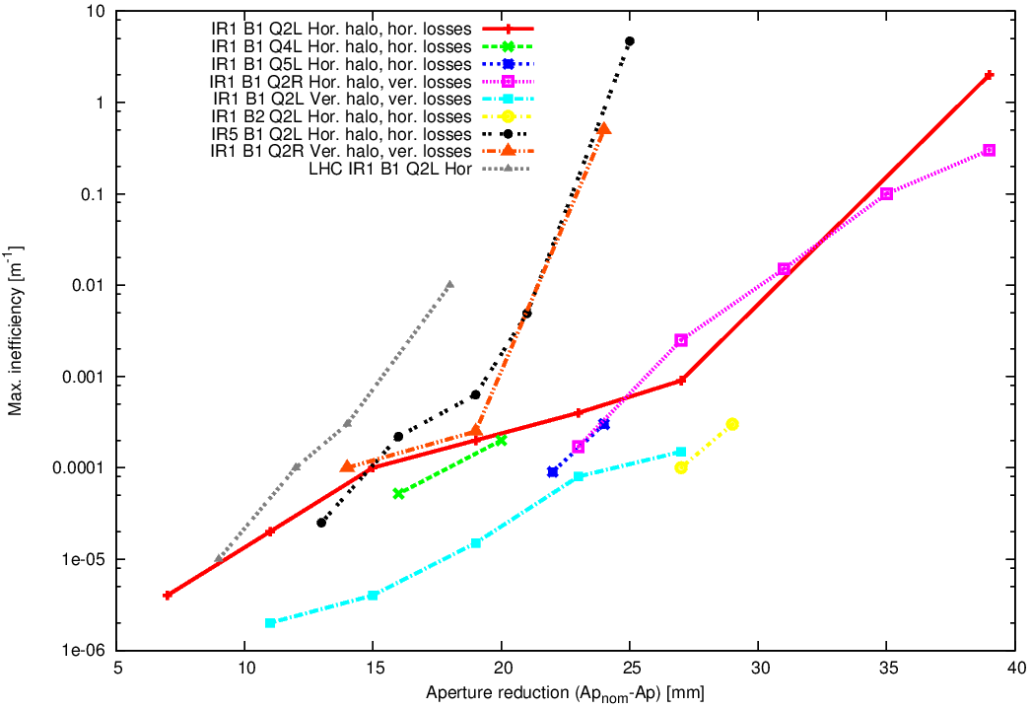
Losses vs aperture reduction
Cold cleaning losses start appearing at reductions >5mm
H. Garcia

