Slide 1
HL-LHC Preliminary Design Report
(PDR)
I. Bejar Alonso – HL-LHC Technical coordinator
on behalf of the HL-LHC PDR editorial board

Slide 2
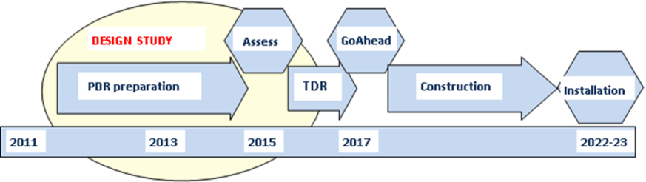
Background
The HL-LHC Preliminary Design Report is Deliverable 1.5 of the FP7 Hilumi program. His scope originally was limited to the first six HL-LHC workpackages and was after extended to cover the complete Upgrade of the LHC machine becoming one of the first key milestones of the project
2023-2025

Slide 3
Background
FP7 Hilumi D 1.5 Preliminary Design report – October 2014
FP7 Hilumi D 1.10 Technical Design Report v 1.0
Technical Design report v 2.0 End 2017
2023-2025

Slide 4
Scope and purpose
The PDR expands from WP1 to WP16
In each chapter is described clearly each one of the systems included in the HL-LHC Baseline and the nature of the different options still under evaluation.
It should be considered as the future reference document for the different systems.

Slide 5
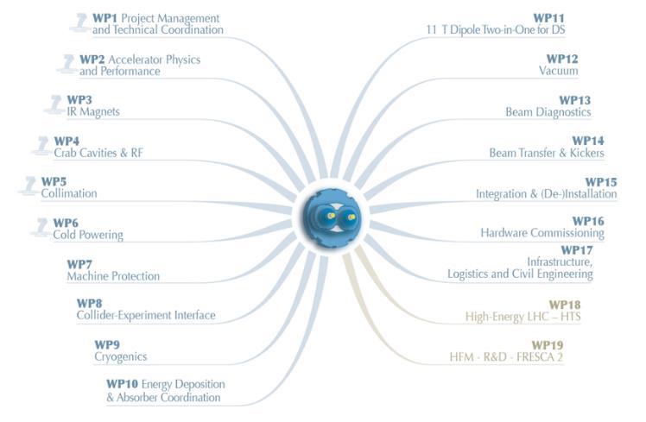
HL-LHC PDR Contents

Slide 6
Editorial Board/ Link authors
Editorial Board:
Giorgio Apollinari
Isabel Bejar Alonso (executive editor)
Oliver Bruning
Mike Lamont
Lucio Rossi
Link authors
WPs Leader and Deputy

Slide 7
HL-LHC PDR guidelines
 |  | Guideline | Final
HL-LHC | G. Apollinari, O. Bruning, L. Rossi | 23 | 25
Machine layout and performance | G. Arduini, A. Wolski | 19 | 41
Insertion magnets | E. Todesco, GL. Sabbi | 21 | 20
RF systems | R. Calaga, G. Burt, A. Ratti | 10.5 | 29
Collimation system and Cleaning | S. Redaelli, R. Appleby | 15 | 25
Cold powering | A. Ballarino, F. Broggi | 13.5 | 16
Machine protection and interlock | D. Wollmann, R. Schmidt | 13.5 | 11
Interface with Experiments | H. Burkhardt, I. Efthymiopoulos | 9.5 | 5
Cryogenics | S. Claudet, R. Van Weelderen | 11.5 | 9
Energy deposition and R2E | F. Cerutti, N. Mokhov | 15 | 17
11 T DS Magnets | F. Savary, A. Zlobin | 6 | 7
Vacuum system | V. Baglin, R. Kersevan | 12.5 | 11
Beam instrumentation | R. Jones, H. Schmickler | 14 | 15
Inyection and dumping systems | J. Uythoven, B. Goddard | 10.5 | 8
Integration & (De-)installation | P. Fessia | 9 | 10
Commissioning and operation | M. Lamont | 13 | 12
Total |  | 216.5 | 261

Slide 8
HL-LHC PDR Contents
It also includes
List of machine and beam parameters
    Nominal beam parameters
    Main machine parameters
    Main insertion region magnet parameters
    Field error specification for the new insertion region magnets
HL-LHC Acronyms
Glossary and definitions
List of contributors

Slide 9
HL-LHC PDR not included/Option
Existing layout drawings
Naming convention for new systems
Preliminary schedule
Systems architecture
List of Baseline and optional equipment

Slide 10
HL-LHC PDR not included
The Technical infrastructures (WP17) will be described in the TDR
KTT strategy an outcome (covered by FP7 Deliverables)
Dismantling
Detailed Environmental studies
Physics expectations

Slide 11
Chapter structure
The chapter numbering respects the WP numbering
They are conceived to be not only part of the PDR but also independent CERN-ACC notes
Each chapter has a:
  contact author (CERN link person)
  list of contributors listed in alphabetic order.
  reference list

Slide 12
Review process
Version | Status
0.1 | Input received from the link author
0.2 | Version sent to the reviewers (2)
0.3 | Version sent back to the author containing the questions from the reviewers and where minor grammatical and formatting changes have been already integrated
0.4 | Version from the authors containing the text integrating the answers to the questions/comments from the reviewers
0.5 | Version 0.4 where the different comments have been accepted (elimination of track changes and comments)
0.6 | Check on cross references (internal and to other chapters)
0.7 | Version integrating the comments from the SC and the management
0.8 | Version with comments accepted sent to the Yellow report editor
0.9 | Last version check
https://espace2013.cern.ch/project-HL-LHC-Technical-coordination/PDR/_layouts/15/start.aspx#/SitePages/Home.aspx

Slide 13
Review process
Version | Sep | Sep | Oct | Oct | Nov | Nov | Dec | Dec | Jan | Jan
0.1
0.2
0.3
0.4
0.5
0.6
0.7
0.8
0.9
The first draft version has been sent to the SC last week and will be sent this week to the management.
The SC is requested to give their comments for the 27th Nov and the management for the 4th December

Slide 14
Status Chapters
HL-LHC | G. Apollinari, O. Bruning, L. Rossi | V03
Machine layout and performance | G. Arduini, A. Wolski | V04 -> v6
Insertion magnets | E. Todesco, GL. Sabbi | V05 -> v6
RF systems | R. Calaga, G. Burt, A. Ratti | V04 + V01
Collimation system and Cleaning | S. Redaelli, R. Appleby | V06
Cold powering | A. Ballarino, F. Broggi | V02 –> V03
Machine protection and interlock | D. Wollmann, R. Schmidt | V02 – >V03
INTERFACE WITH EXPERIMENTS | H. Burkhardt, I. Efthymiopoulos | V03
Cryogenics | S. Claudet, R. Van Weelderen | V04
Energy deposition and R2E | F. Cerutti, N. Mokhov | V06
DS MAGNETS | F. Savary, A. Zlobin | V06
Vacuum system | V. Baglin, R. Kersevan | V03
Beam instrumentation | R. Jones, H. Schmickler | V05 – >V06
Inyection and dumping systems | J. Uythoven, B. Goddard | V05 – >V06
Integration & (De-)installation | P. Fessia | V06
Commissioning and operation | M. Lamont | V02 ->v04

Slide 15
Open questions - Authoring
Required a common approach to the contributors list for the chapters
“writers” of the chapter
Main contributors to the chapter
All contributors to the chapter
Author list at the beginning of the PDR
Σ “writers” of the chapter
Σ Main contributors to the chapter
Σ All contributors to the chapter

Slide 16
Open questions. Distribution
WP Leaders can distribute version 0.6 so to receive comments (non only from own WP) from other members of the WP
Version 0.6 will be sent as D1.5 to the EU
Version 0.8 will be posted in the HL intranet
Version 1.0 will be available from the public HL-LHC WWW page and distribute electronically to all contributors and to the management
The HL-LHC PDR will be a CERN Yellow Report and will be distributed by the library as such
Who should also receive a copy of the PDR?

Slide 17
Other points to be addressed?

