Slide 1

QXF Progress & Recent Results
G. Ambrosio
on behalf of the MQXF team
4th Joint HiLumi LHC-LARP Annual Meeting
November 17-21, 2014
KEK

Slide 2
Outline
Main features
Design Progress
Short Models status
Long Prototypes status
  LHQ coil test results
Conclusions

Slide 3
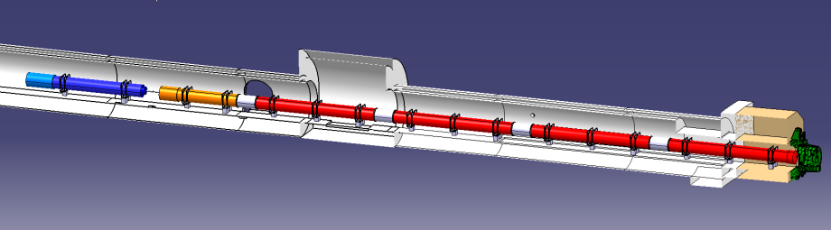





MQXF Main Parameters
140 T/m in 150 mm coil aperture
Q1/Q3 length: 8 m
Q2 length: 6.8 m
Max outer diameter: 630 mm
1.9 K operating temperature
Radiation strength: > 33 MGy
Field quality: see WP3 page at https://espace.cern.ch/HiLumi/WP3/SitePages/Home.aspx
ATLAS
CMS

Slide 4
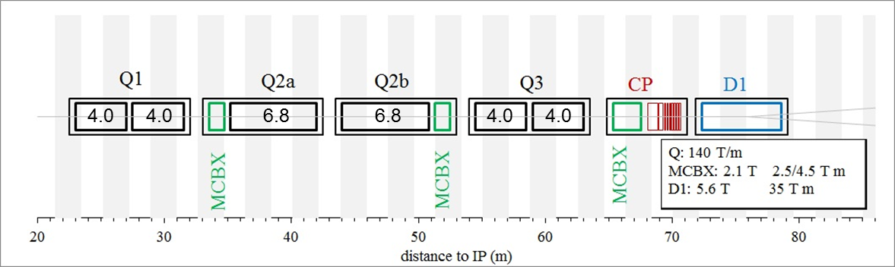
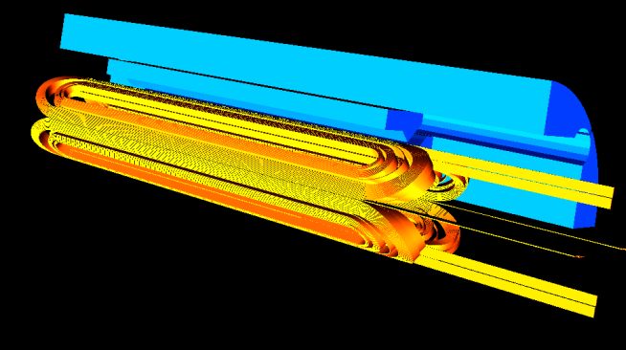
MQXF Lengths
 | Short model | Q1/Q3 (half unit) | Q2
Magnetic length [m] | 1.2 | 4.0 | 6.8
“Good” field quality [m] | 0.5 | 3.3 | 6.1
Cable unit length per coil [m] | 150 | 450 | 710
Strand per coil [km] | 6.5 | 18.9 | 30
E. Todesco, et al., “A First Baseline for the Magnets in the High Luminosity LHC Insertion Regions”, IEEE Trans. Appl. Supercond., Vol. 24, No. 3, pp. 4003305, June 2014

Slide 5
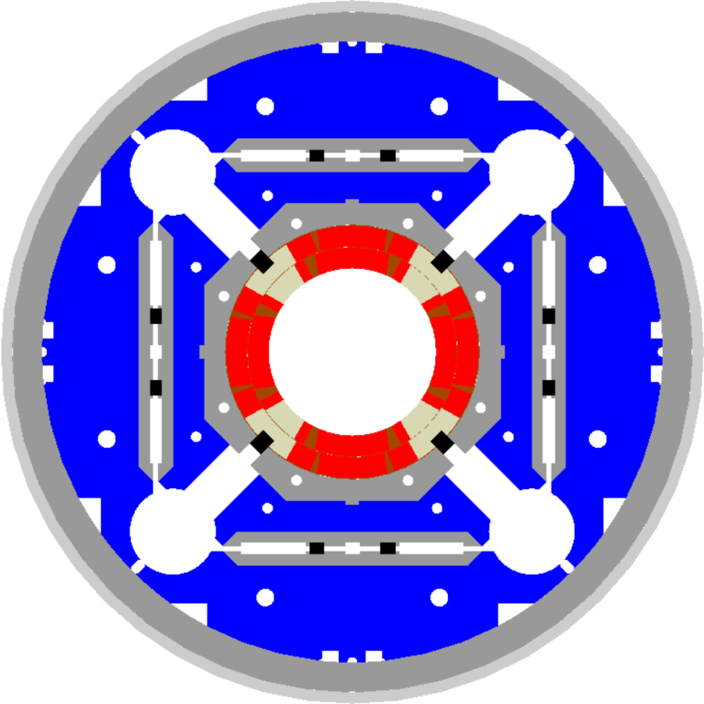
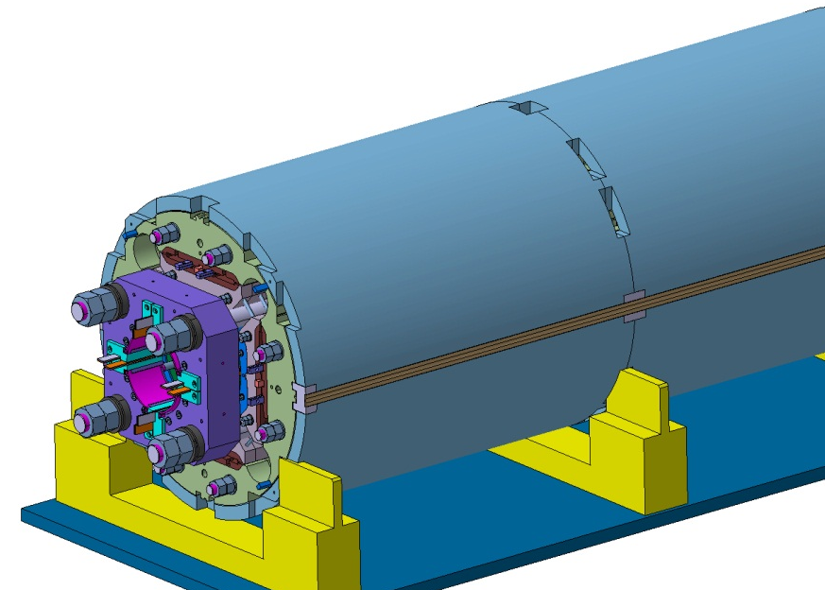
MQXF Main Design Features
Same design for Q1/Q3 and Q2s:
Two-layer coils
  Without internal splice
  With one wedge per layer
Al shell structure preloaded by bladders and keys
  Segmented Al shell
Axial preload by tie-rods
Quench protection by active heaters
  and possibly CLIQ
P. Ferracin, et al., “Magnet design of the 150 mm aperture low-β quadrupoles for the high luminosity LHC,” IEEE Trans. Appl. Supercond., vol. 24, no. 3, p. 4002306, Jun. 2014

Slide 6


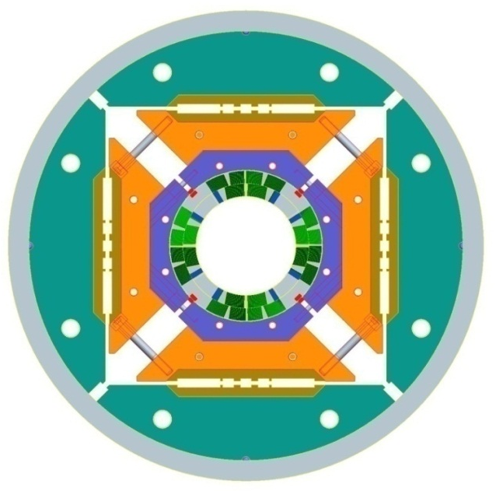
High Field Quadrupole (HQ)
Goal: demonstrate all performance requirements for Nb₃Sn IR Quads in the range of interest for HL-LHC (magnetic, mechanical, quench protection etc.)
Main design parameters and features in the latest models tested (HQ02a/b):
Conductor and cable
Strand diam. (mm) | 0.778
Cu/Sc | 1.2
No. strands | 35
Cable width (mm) | 14.8
Cable thickness (mm) | 1.375
Keystone angle (deg.) | 0.75
Al shell
Iron yoke
Coil
Al
collar
Short Sample Performance
Param. | 4.5K | 1.9K
I_{ss} [kA] | 16.4 | 18.2
B_{pk} [T] | 12.9 | 14.2
G_{ss} [T/m] | 186 | 205
Bladder
locations
Alignment key

Slide 7
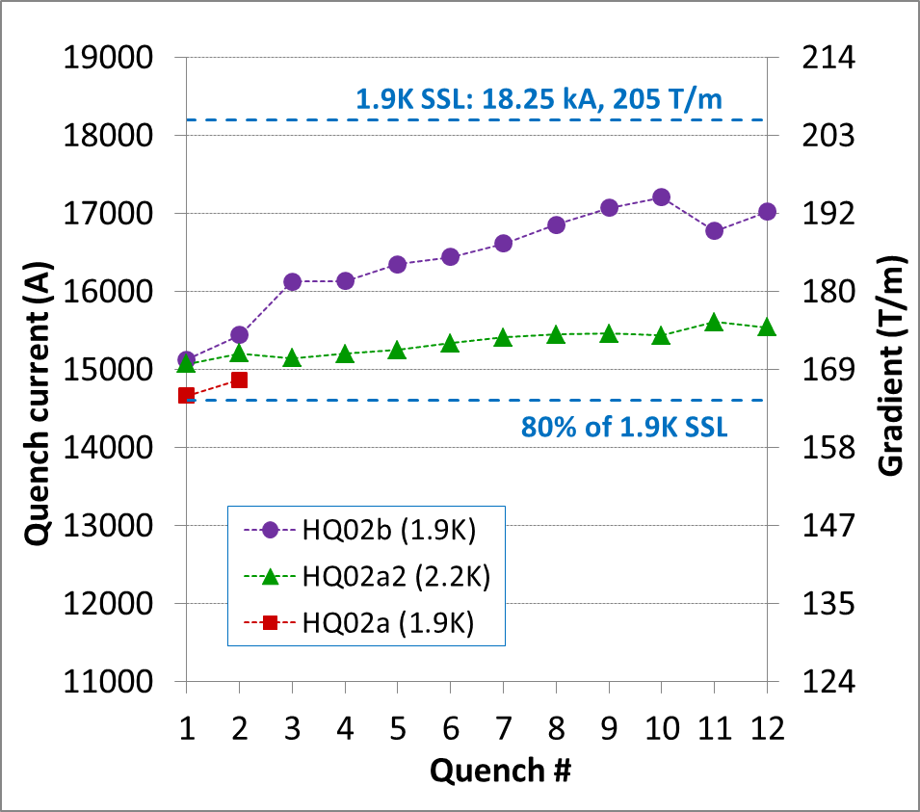
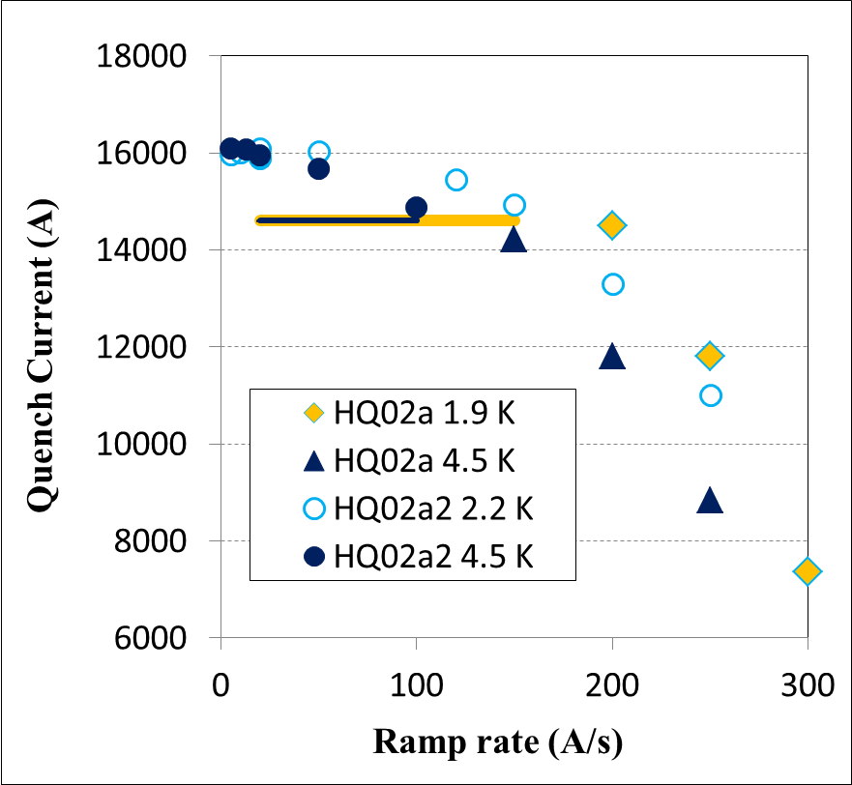
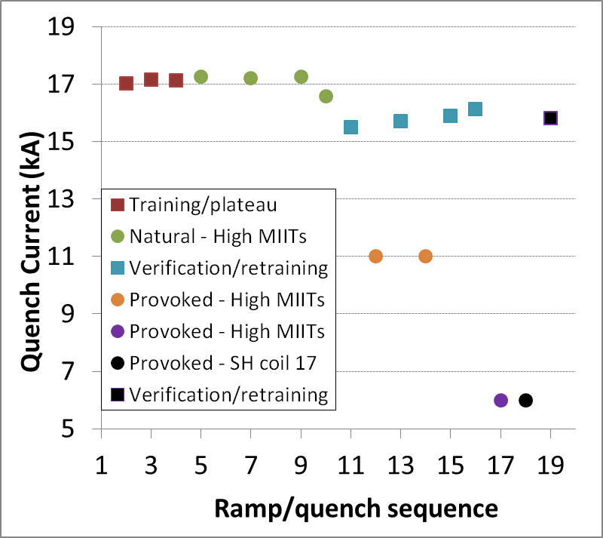
HQ02 Results
Quench performance
HQ02: 98% at 4.5K
HQ02b: 95% at 1.9K with 200 MPa pre-load
Accelerator Quality
Order of magnitude reduction of dynamic effects (ramp rate, field quality) with cable core
Quench protection
380K quench temperature without degradation
Successful first test of the CLIQ system in Nb₃Sn
250K
320K
380K
H. Bajas, et al., “Cold Test Results of the LARP HQ02-b magnet at 1.9 K”,
to be published in IEEE Trans. Appl. Supercond., 2015.

Slide 8
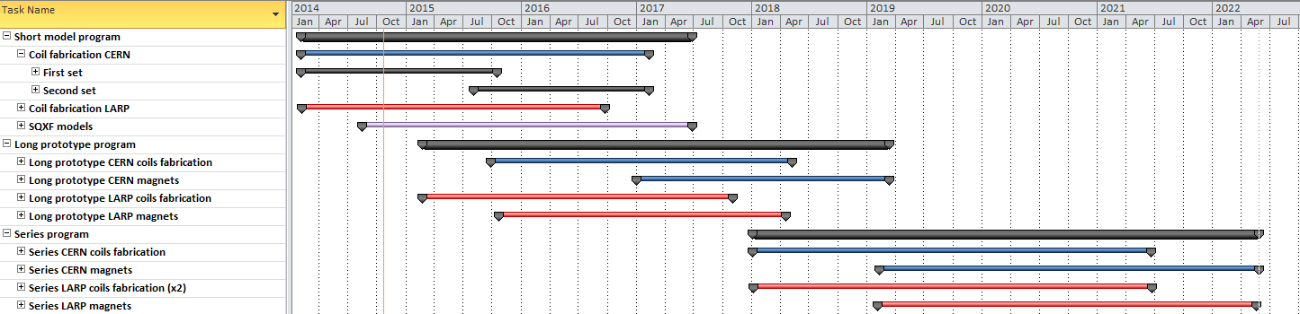
MQXF Schedule
Short model program: 5 CERN-LARP models, 2014-2017
  Coil fabrication started in 03/2014
  First magnet test (MQXFS1) in 07/2015 (3 LARP coils, 1 CERN coil)
Long prototype program: 2 (CERN) + 3 (LARP) models, 2015-2018
  Coil fabrication starts in 2015: 02 (LARP), 10 (CERN)
  First magnet test in 11/2016 (LARP) and 07/2017 (CERN)
Series production: 10 (CERN) + 10 (LARP) cold masses, 2018-2022
  Coil fabrication starts in 01/2018
  First magnet test in 10/2019

Slide 9
Recent design progress

Slide 10
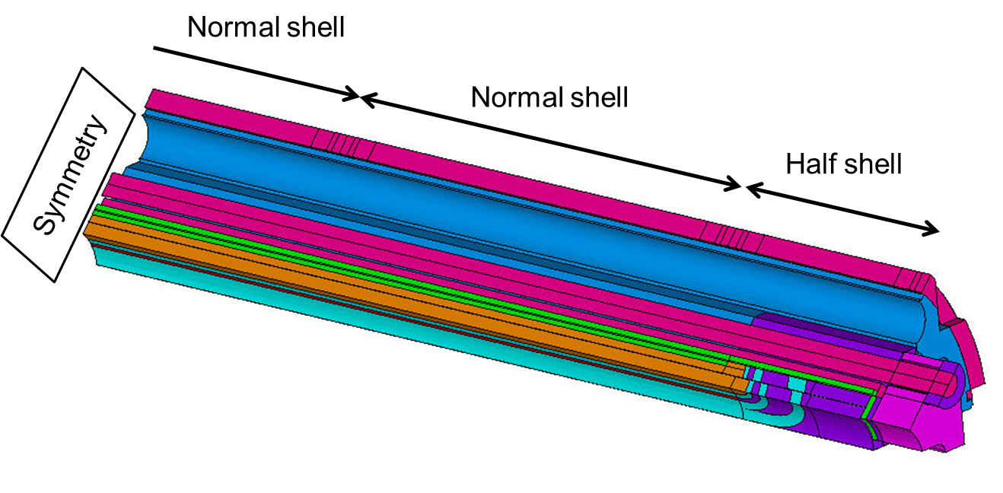
Structural Design
3D model used for optimization of structure
  Design adjustments in order to reduce stress variations due to segmented shell and assembly features
  Stress variation from +/-20 MPa to +/-10 MPa
M. Juchno
M. Juchno, et al., “Support Structure Design of the Nb3Sn Quadrupole for the High Luminosity LHC”, to be published in IEEE Trans. Appl. Supercond., 2015.

Slide 11
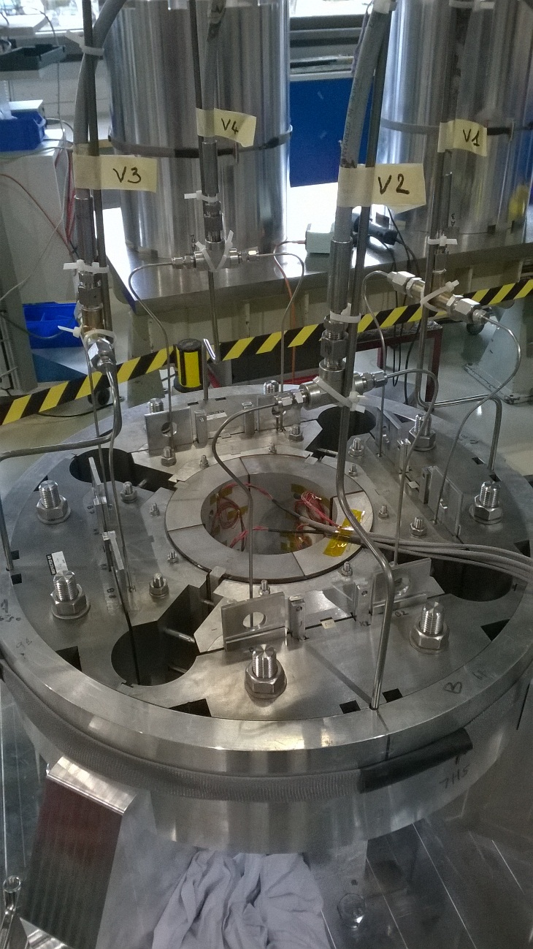
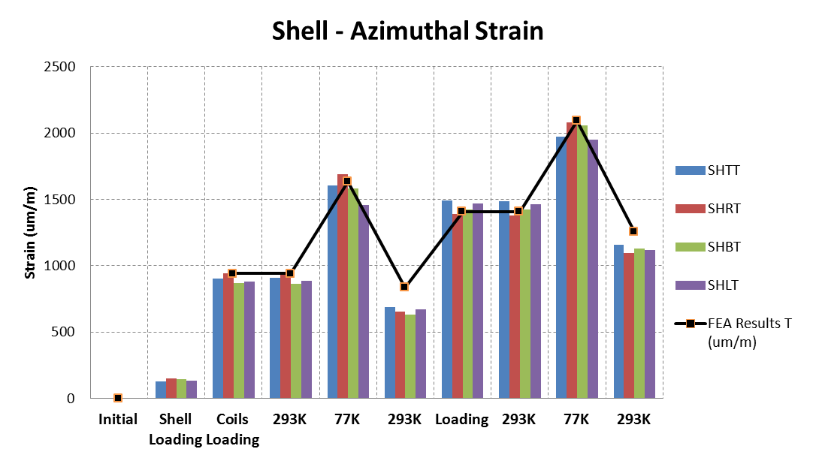
Design Verification: Mock-up
Short mock up, 150 mm long
Full assembly done
Preload with the bladders at different pressures
Cool down at LN
➔ Good agrement between FEM and shell gauges
E. Cavanna, N. Bourcey, P. Ferracin, S. Izquierdo Bermudez, J. Mazet, J. C. Perez, F-O. Pincot X. Sarasola

Slide 12
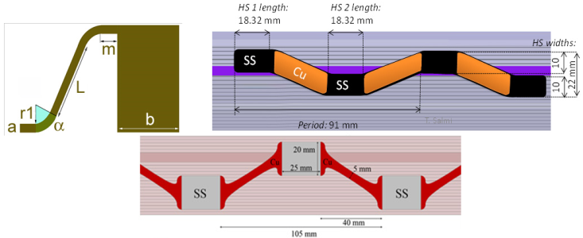
Quench Protection Improvements
Understanding “dynamic effects” = energy extraction and quench propagation caused by inter-filament losses
Development of heaters with copper-cladding
Development of heaters for inner layer (to be demo.)
T_{hot-spot} ~ 270 K with all heaters
T_{hot-spot} < 300 K with half heaters
Courtesy J. C. Perez
Courtesy M.Marchevsky, E.Todesco, D.Cheng, T.Salmi
V. Marinozzi, et al., “Study of quench protection for the Nb3Sn low-beta quadrupole for the LHC luminosity upgrade (HiLumi-LHC)”, to be published in IEEE Trans. Appl. Supercond., 2015.

Slide 13
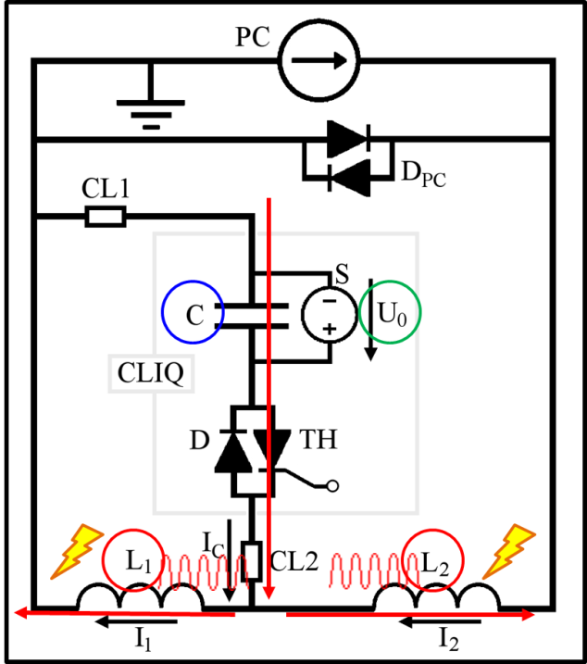
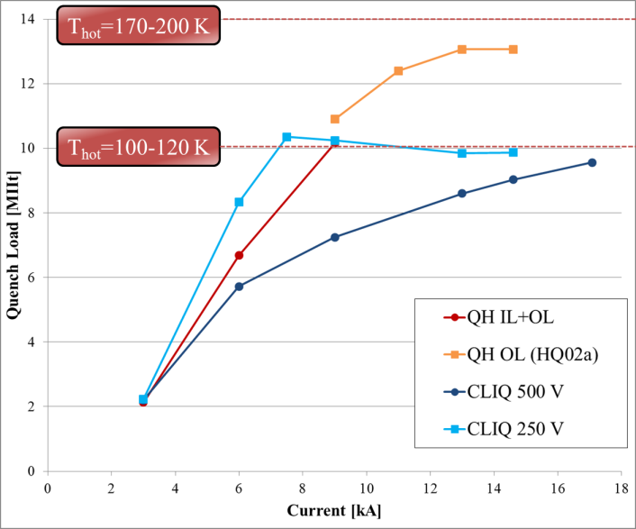
CLIQ
Coupling-Loss Induced Quench System
Very effective on HQ02 test
To be demonstrated for long magnets
Could provide perfect redundancy with heaters on outer layer
Courtesy of E. Ravaioli
E. Ravaioli, et al., “First Test of CLIQ, the New Coupling Loss Induced Quench Protection System, on a Nb3Sn Magnet”, to be published in IEEE Trans. Appl. Supercond. 2015.

Slide 14

Integrated Field Harmonics
$\overline{b_{n}}=\frac{\int{B_{n}(I,z)dz}}{{B_{2}}^{∞}l_{mag}(I)}$
By S. Izquierdo Bermudez
 | b6 | b10 | b14 | a2 | a6
2D | 0.32 | -0.40 | -0.66 | 0.00 | 0.00
3D-SQXF | 9.05 | -0.54 | -0.70 | -8.90 | 0.60
3D-LQXF – 4 m | 2.94 | -0.44 | -0.67 | -2.67 | 0.18
3D-LQXF – 6.8 m | 1.86 | -0.42 | -0.67 | -1.57 | 0.10
main field in the straight section
Splice &
Current leads
Layer jump

Slide 15
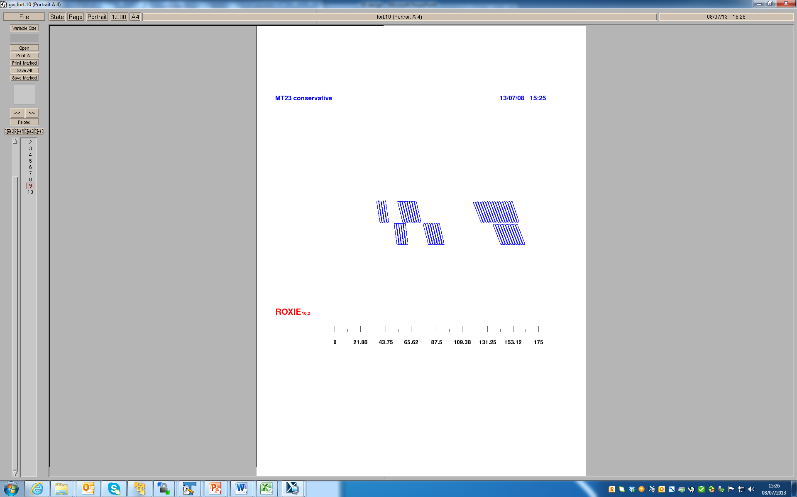






Sensitivity analysis
By S. Izquierdo Bermudez
Δβ = 0.5˚/turn
Integral only in the return end (over 400 mm length)
Block 4.b
Block 4.a
Block 3
$$\overline{{\text{Δ}b}_{6}} return<0.5 units$$
$$\overline{{\text{Δ}b}_{10}} return<0.1 units$$
Block 2
Block 1.b
Block 1.a
Δz = 2 mm/block
Block 4.b
Block 4.a
Block 3
$$\overline{{\text{Δ}b}_{6}} return=−3.6 units$$
$$\overline{{\text{Δ}b}_{10}} return=−0.1 units$$
Block 2
Block 1.b
Block 1.a
$$\overline{{\text{Δ}b}_{6}} return=1.1 units$$
$$\overline{{\text{Δ}b}_{10}} return=−0.1 units$$

Slide 16
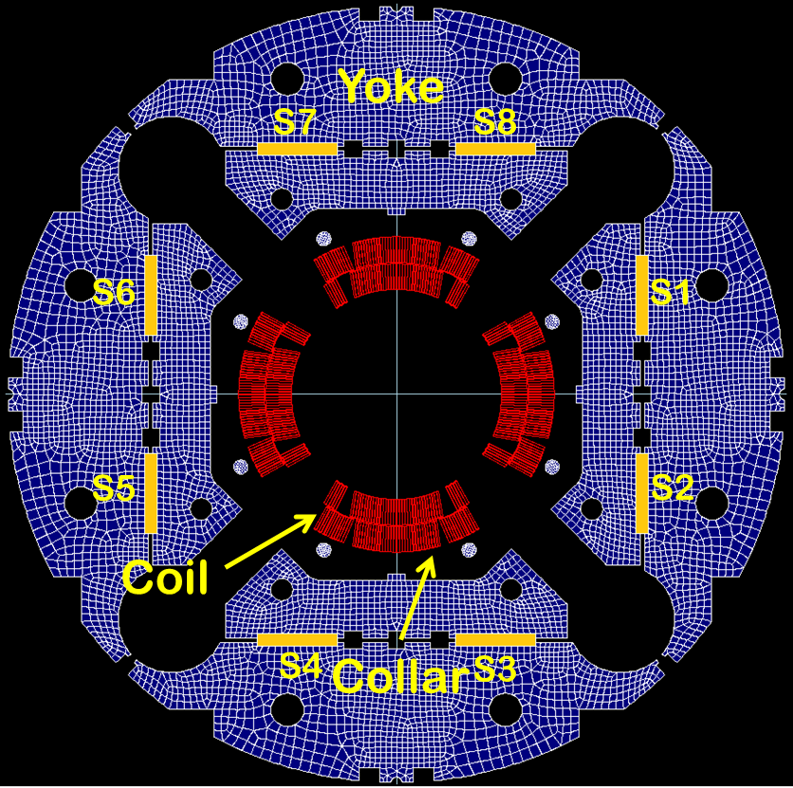
Magnetic Design – Field Quality Adjustment
Magnetic shims in bladder slots can be used to correct low order harmonics
  To be demonstrated by HQ03 (120 mm quad.)
P. Hagen and P. Ferracin, LARP-HiLumi Collab Mtg, 2014

Slide 17
conductor

Slide 18
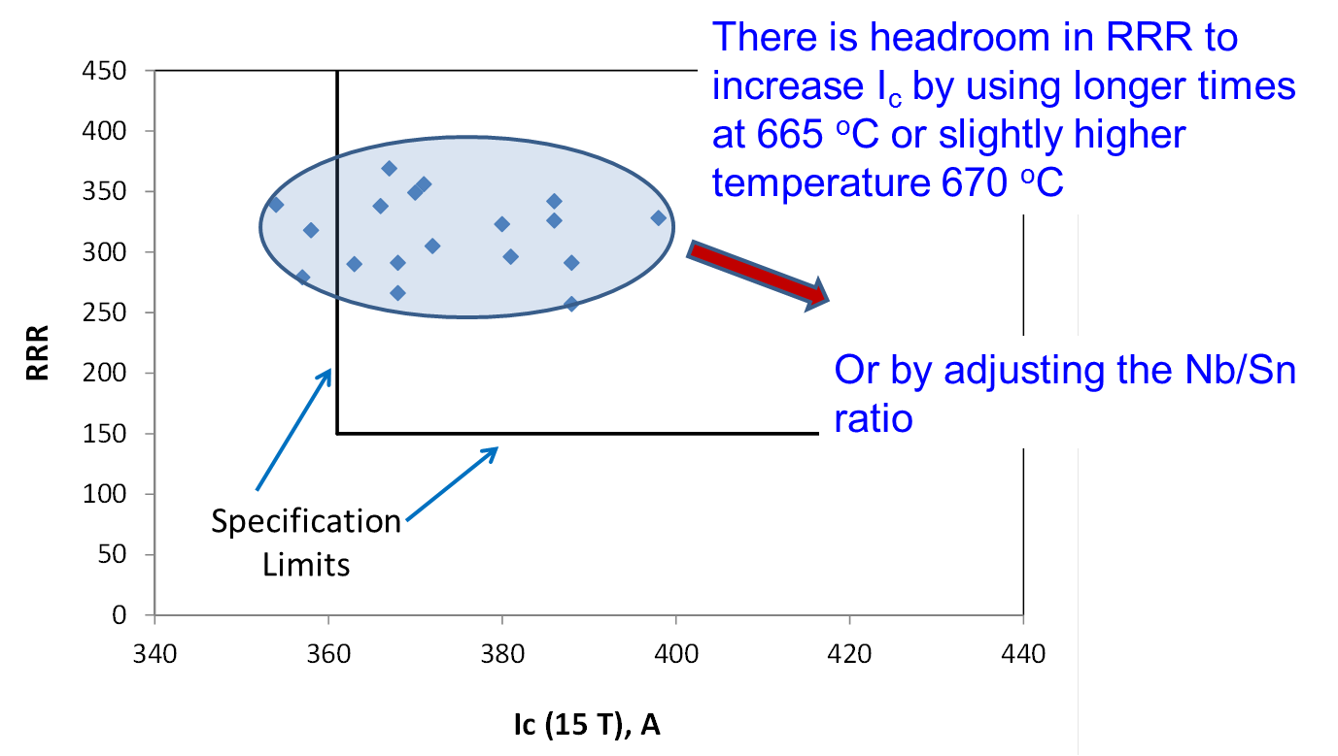
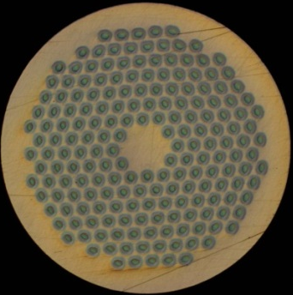
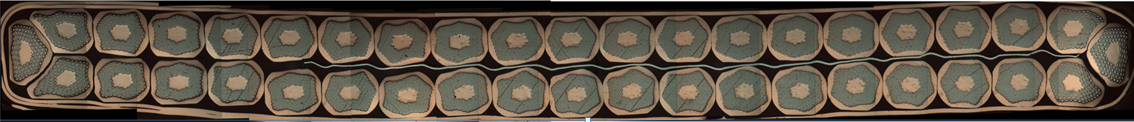
Baseline Conductor
STRAND
0.85 mm strand
Filament size <50 μm
Cu/Sc: 1.2 ± 0.1 → 55% Cu
Critical current at 4.2 K and 15 T
  361 A at 15 T (632 A at 12 T)
CABLE
40-strand cable
Mid thickness: 1.525 mm
Width: 18.150 mm
Keystone angle: 0.55 deg.
SS core 12 mm wide and 25 μm thick
Bruker PIT strand, 192
OST RRP strand, 132/169
A.Ghosh
A. Ballarino
RRP cable
D. Dietderich

Slide 19
Recent & Upcoming Reviews
HL-LHC-LARP International Review of MQXF Cable:
(CERN November 5-6, 2014)
I_{c} target not completely reached, try increasing margin (longer magnets)
Relate conductor requirements to magnet performance
Reduce keystone angle of PIT cable, consider it for RRP cable
Keep two vendors and increase support if one is late
HL-LHC-LARP International Review of the Inner Triplets Quadrupole (MQXF) Design
(CERN, December 10-12, 2014)
  We plan to discuss recommendation about margin at this review, and then address the comments and recommendations of both reviews

Slide 20
Short model status
- Coils
- structure

Slide 21
Coil Fabrication Status
LARP:
  #1 (practice coil): completed
  #2 (for mirror test): instrumentation in progress
    Test start by end of February
  #3 (for MQXFS1): prep for potting in progress
  #4 (for MQXFS1): winding in progress
CERN:
  001 (Cu practice coil): post potting
  101 (low Nb3Sn practice): prep for potting in progress
  102 (for MQXFS1): prep for reaction in progress
  103 (for MQXFS1): prep for winding in progress

Slide 22
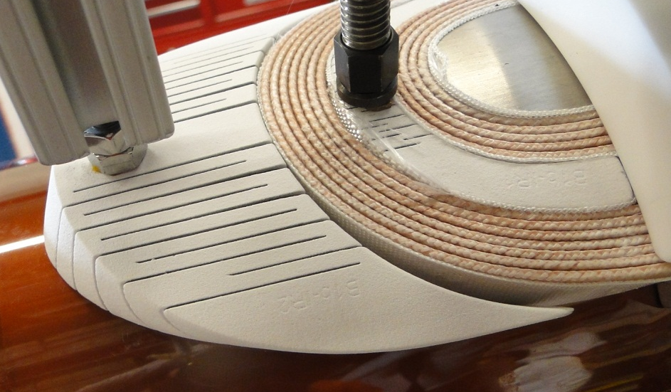
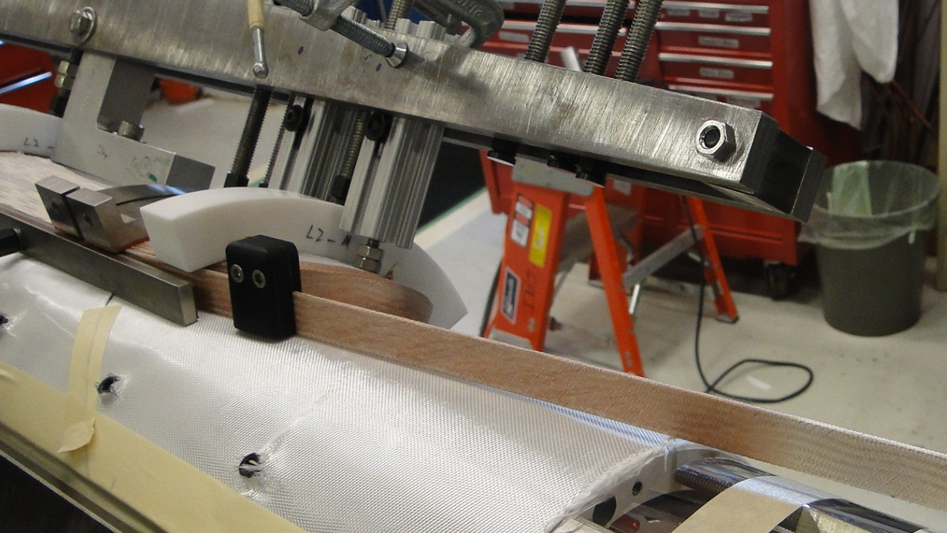
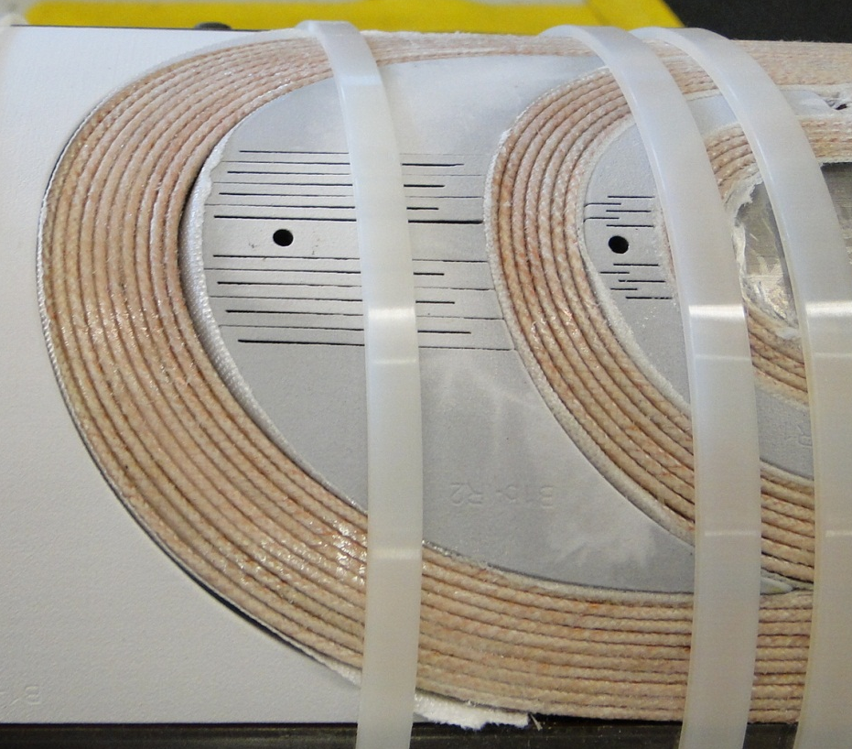
Feedback from Winding & Curing
No popped strands during winding
Flexible features of end parts are working well

Slide 23
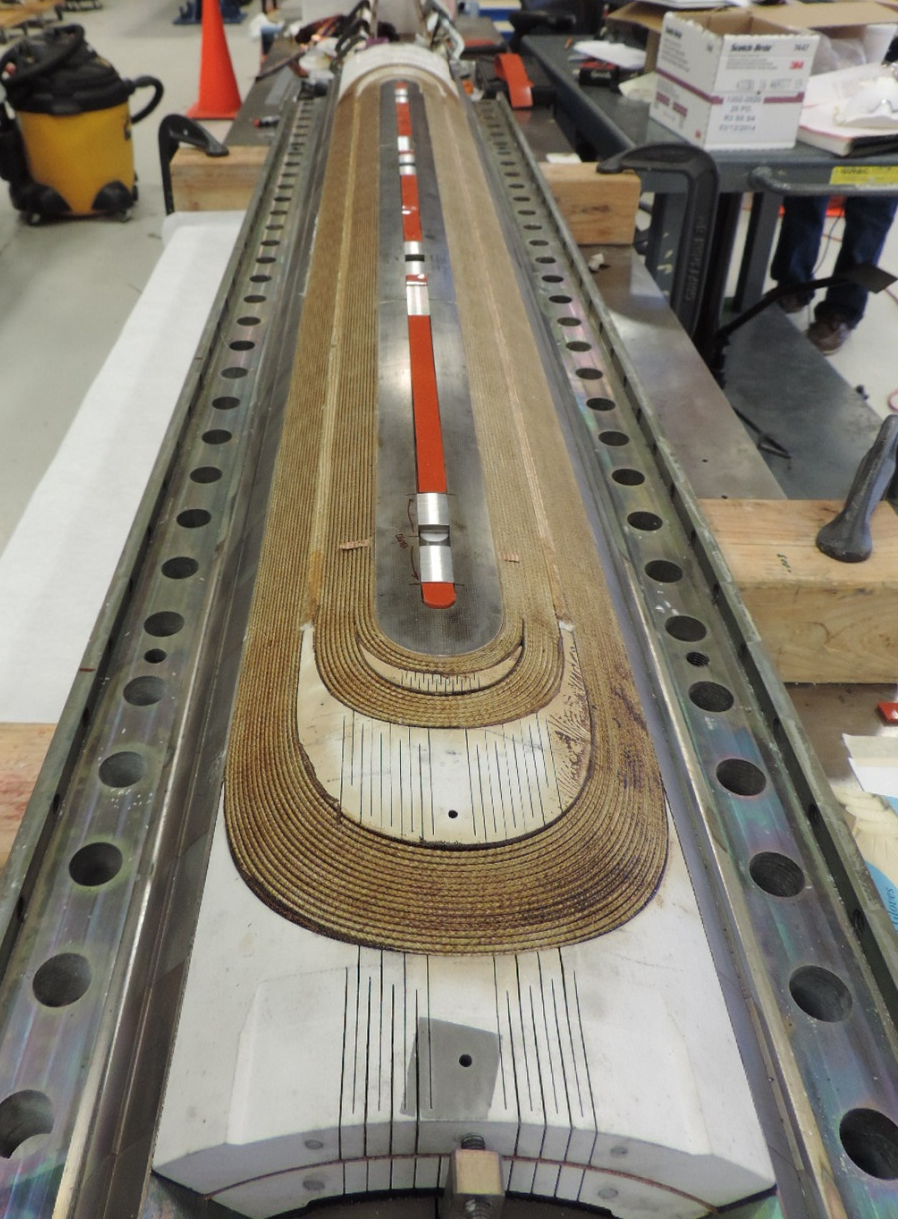
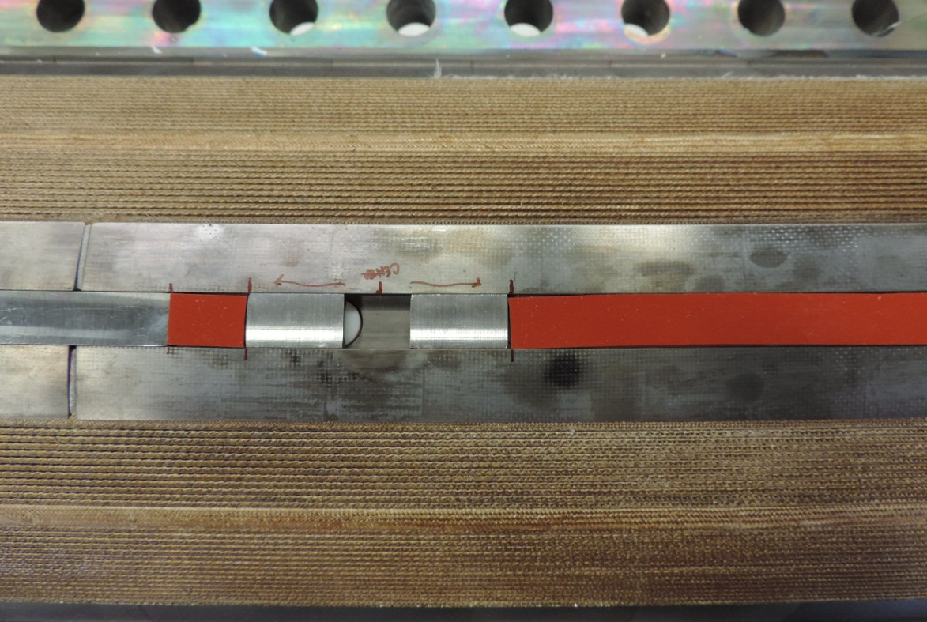
Feedback from Reaction
Coils look very nice
Pole gaps are almost closed

Slide 24
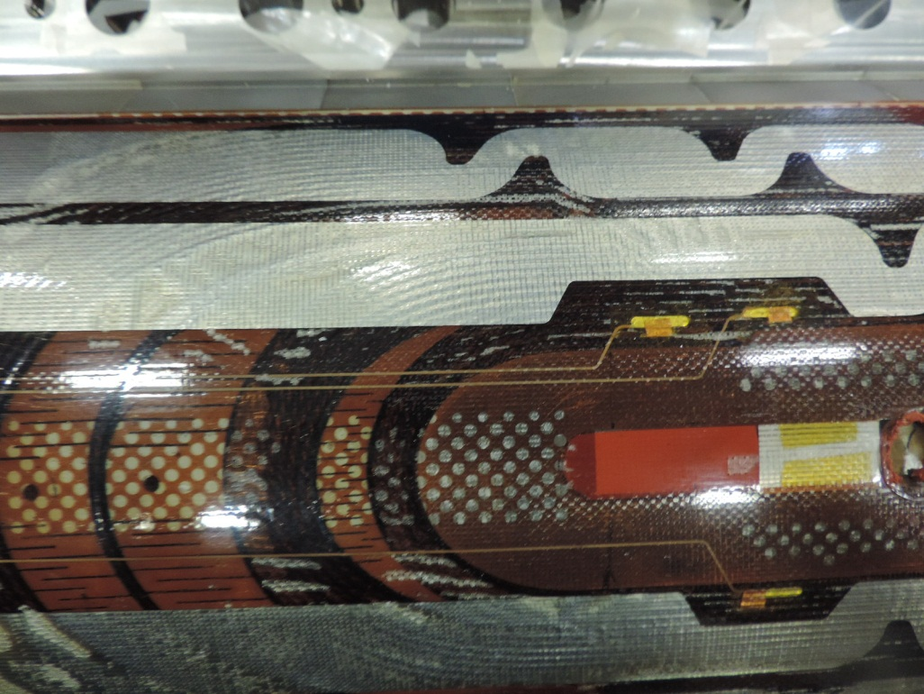
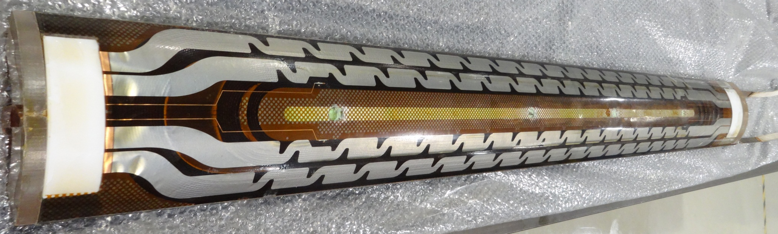
Feedback from Potting
A few small issues found:
  Adjustments implemented to equipment and procedures
Overall coils look nice
  Coil #1 inside was very good
  CMM in progress

Slide 25
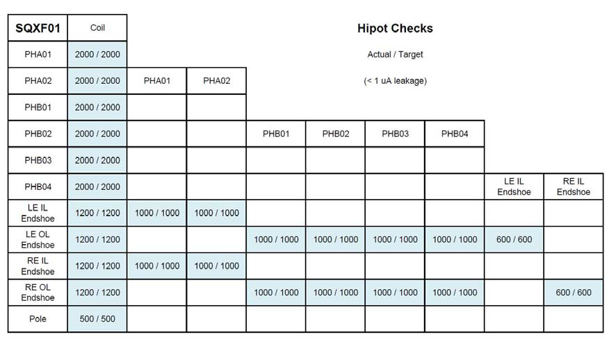
Electrical QC Tests
All standard test (up to 2 kV) – passed
Heaters-to-coil up to 5 kV – passed
Impulse test up to 5 kV – passed up to 4.6 kV

Slide 26
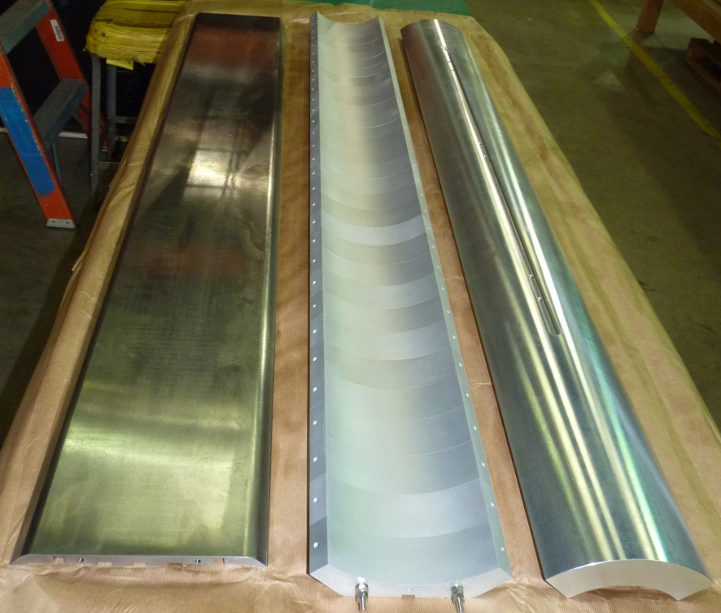
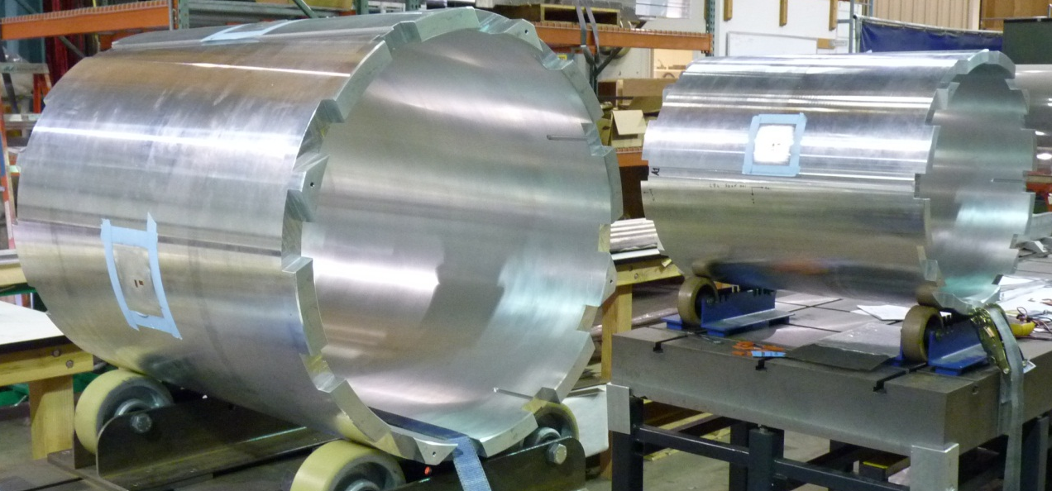
Structure Procurement
Procurement in progress:
QC:
Two sets of support structures fabricated, including dummy aluminium coils
Shell out of tolerance
  Inner perimeter ok, but shape and pins not within spec.
  Decision to proceed with current shells, but fabrication of 2 additional sets launched
No major issue in other components
Consistent CMM measurements at CERN and LBNL

Slide 27
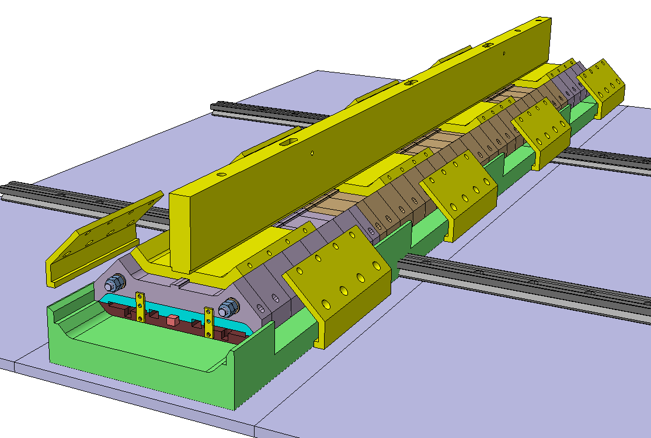
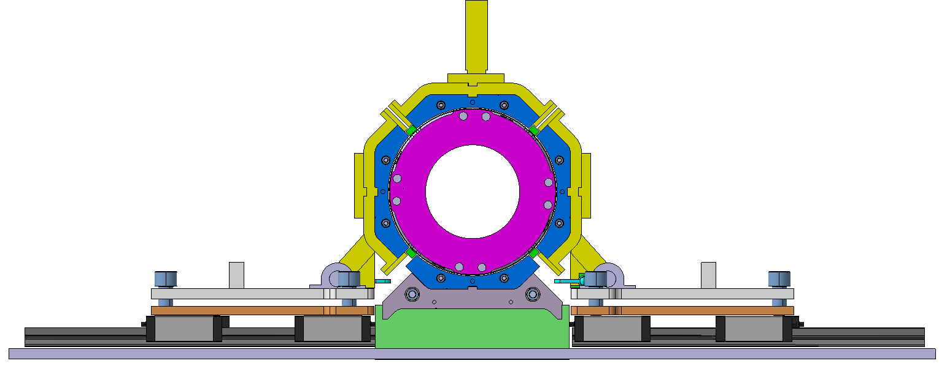
Assembly Procedures
Assembly procedures are being finalized
Small differences btw CERN and LARP
  Short models and prototypes will be used to fine tune assembly procedures
J. C. Perez, 07/22/14 LARP Mtg

Slide 28
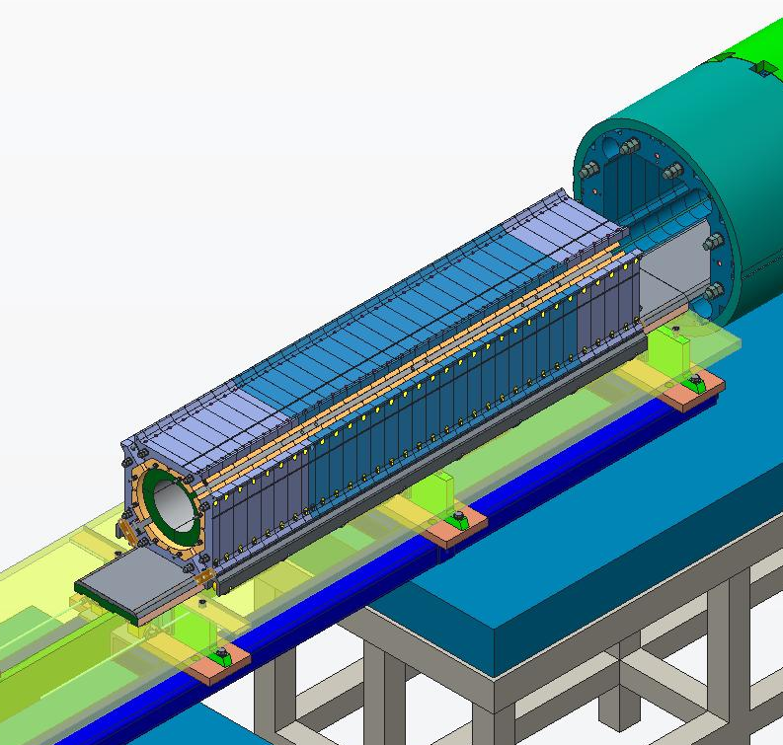
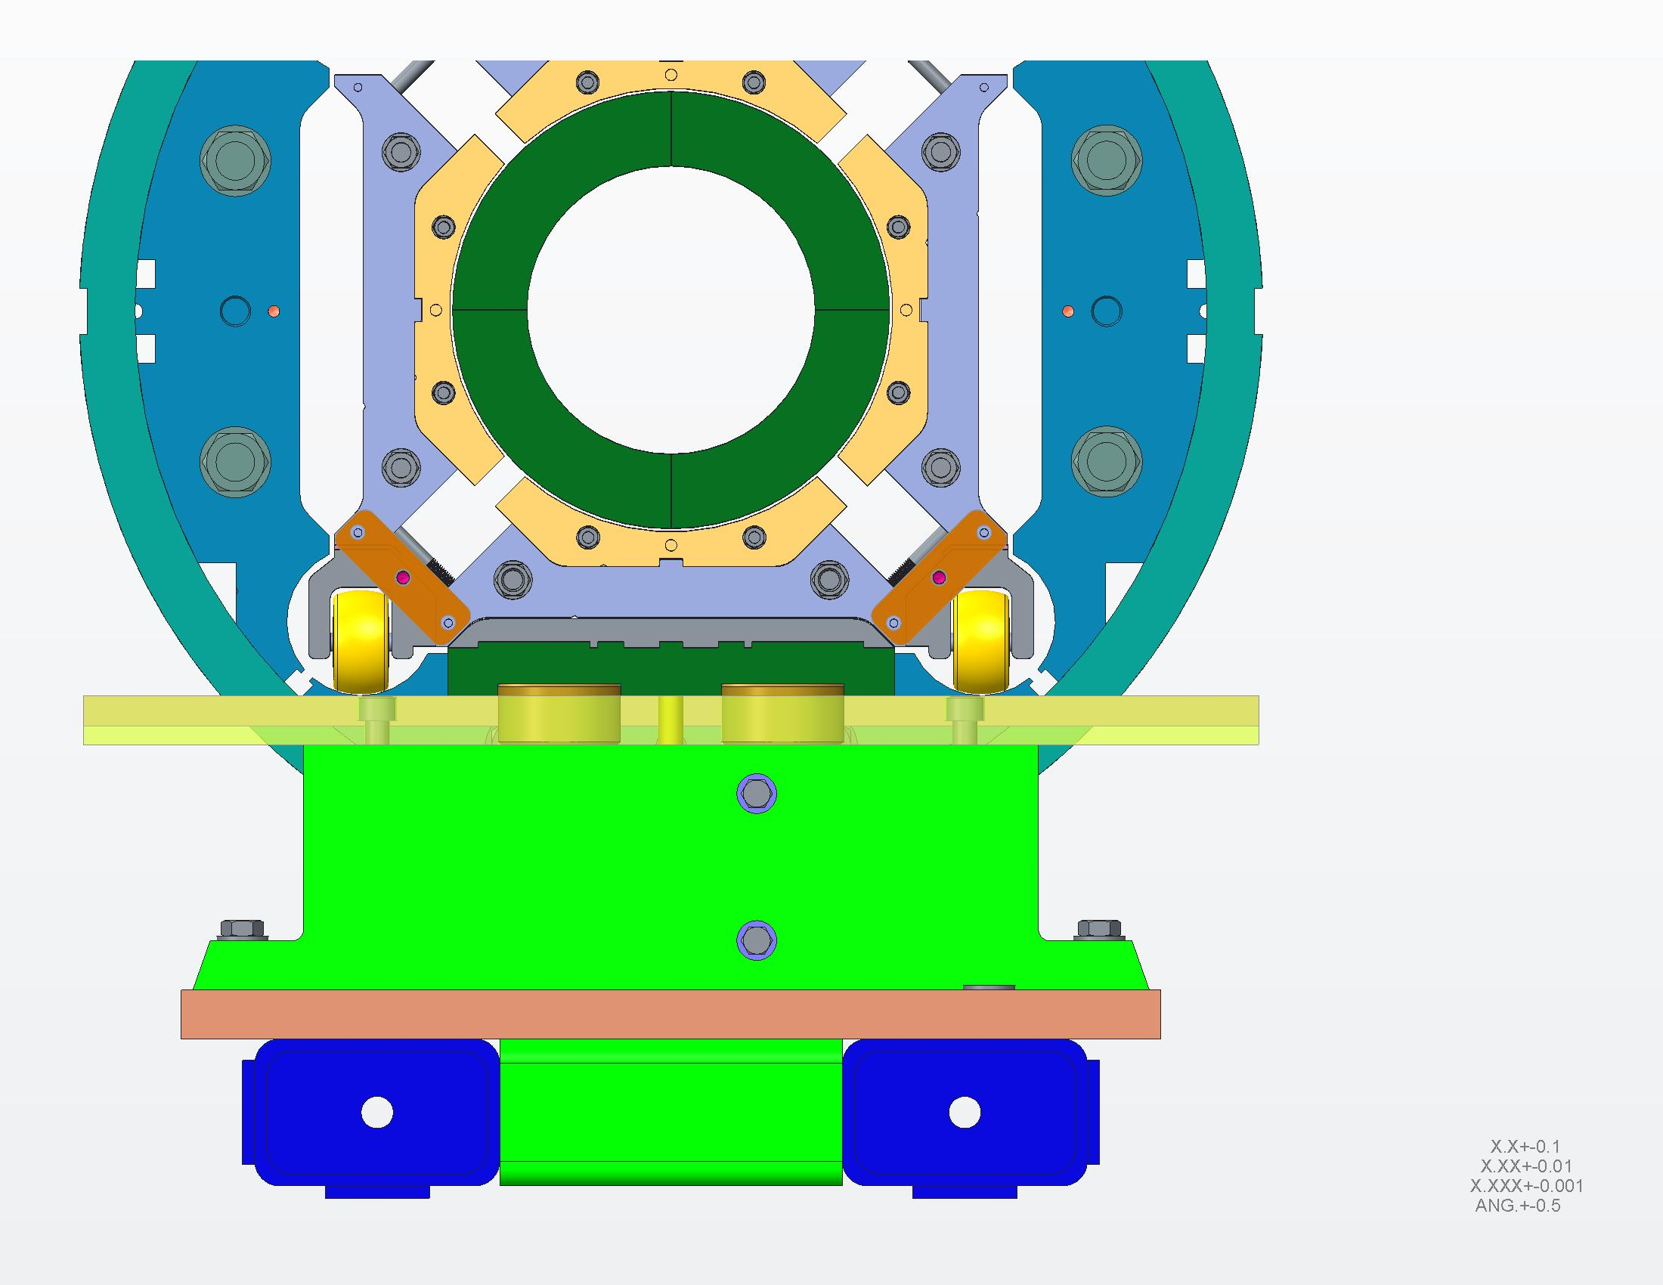
Assembly Procedures
D. Cheng, 11/07/14 LARP Mtg
Assembly with Al-dummy coils: March 2015
Cold test with Al-dummy coil: April 2015
Assembly of MQXFS1 start: May 2015
Cold test of MQXFS1: August 2015

Slide 29
prototypes

Slide 30
Tooling & Equipment
LARP is taking the lead with 4m coil fabrication starting in February 2015.
Equipment upgrades in progress:
  Automatic (Selva) winder (FNAL)
  Curing mold (FNAL)
  Vertical test facility (BNL)
Coil tooling is under procurement
Structure assembly tooling under design

Slide 31
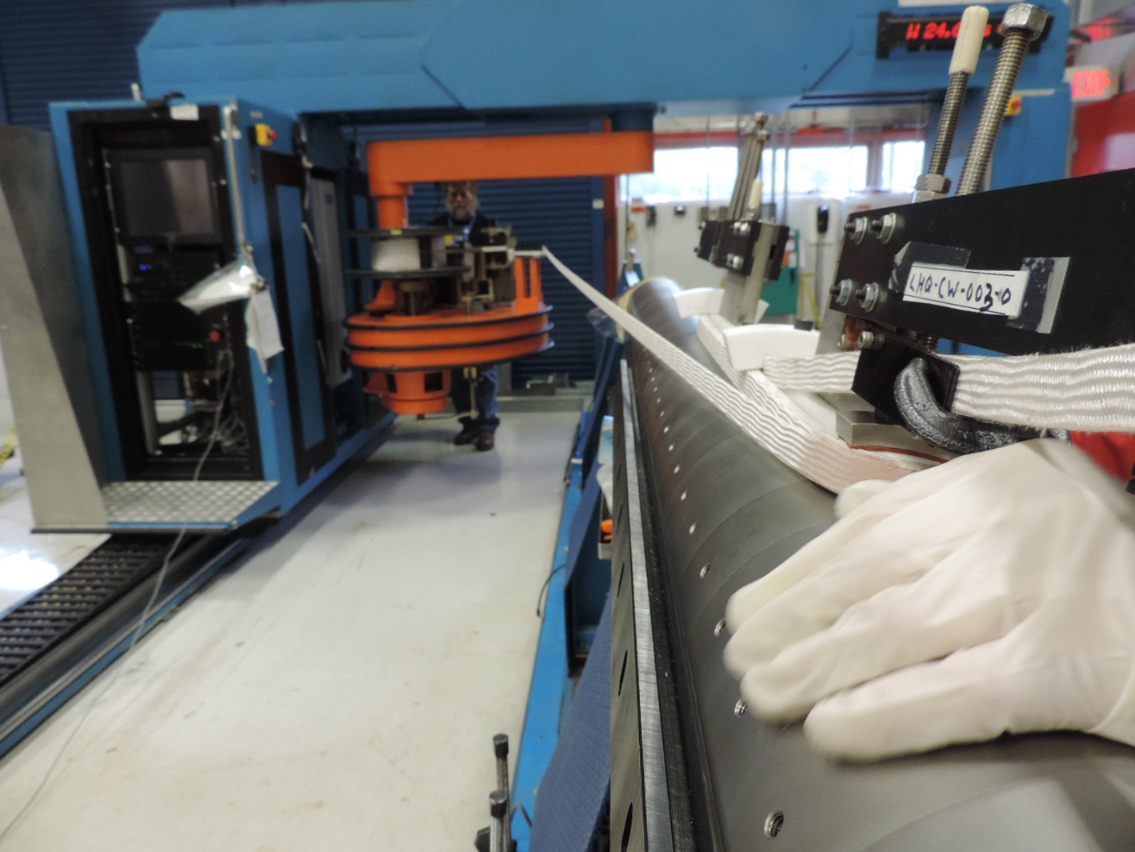
Winding Tests
Short QXF coil successfully wound in manual mode
No popped strands

Slide 32
Plans and Risk Mitigation
Start practice coil fabrication: February 2015
First coil test in mirror: March 2016
MQXFL1 test: November 2016
Risk mitigation:
LHQ coil (120 mm ap., 3 m magnetic length) has been tested in mirror structure

Slide 33
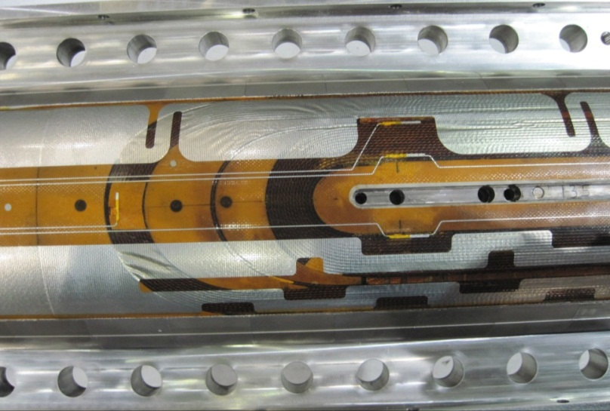
LHQ Coil
LHQ coil #3 has all the features of MQXF coils not tested in previous long coils (90 mm, 3 m)
  Ti ternary RRP strands
  Stainless steel core (25 um thick)
  Braided insulation
  Stainless steel end parts
  Use of tool and binder during winding
  Flexible features in saddles
Different protection heaters for MQXF optimization

Slide 34
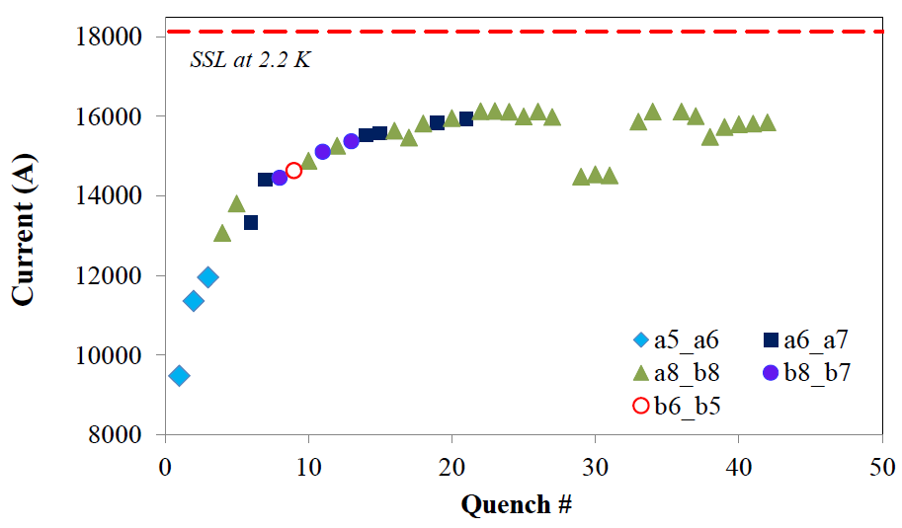
LHQM01 Quench Training
Quench training at 20 A/s
89% of SSL
90% of SSL
QP study
2.2 K
4.5 K
2.2 K
G. Chlachidze, 11/14/14 LARP Mtg

Slide 35
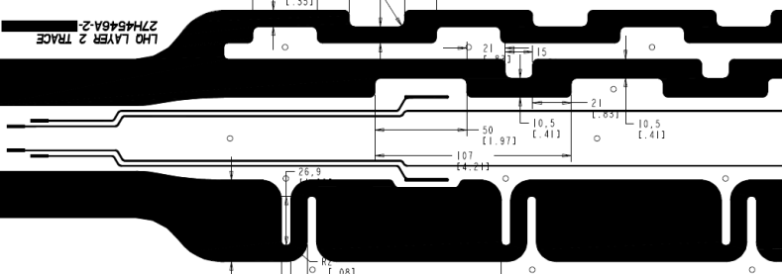
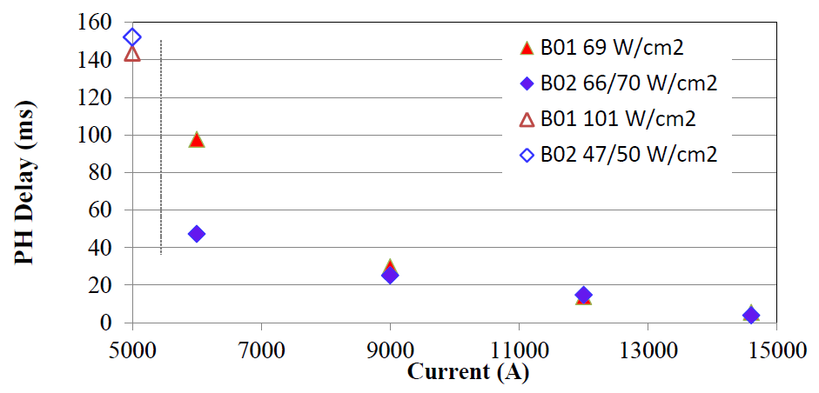
Protection Heater Studies
G. Chlachidze, 11/14/14 LARP Mtg
Both heaters are very efficient (delay < 10 ms) at operating current
Similar performance under similar conditions
B02
Analysis in progress
B01

Slide 36
Conclusions
The MQXF design has successfully addressed previous concerns:
  Quench protection, 3D stress analysis, …
The short model program is at full speed
  Coils fabrication, structure procurement and QC, …
  At next Hi-Lumi Collab Mtg we will discuss test results
The long prototype program is starting soon
  The 120mm magnets/coils have provided risk reduction
Test of QXF coils is starting in a few months
The demonstration of MQXF magnets for HL-LHC upgrade is getting closer and closer!

Slide 37
Back up splides

Slide 38

Past Experience - Risk Reduction
Conductor and magnet parameters have been selected taking into account many years of conductor development and magnet R&D in the US and at CERN

Slide 39
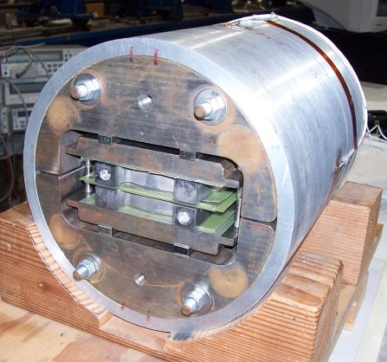
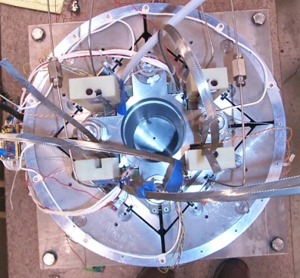
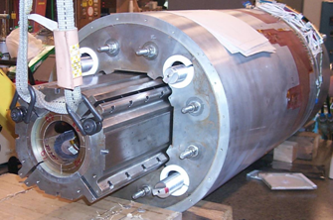
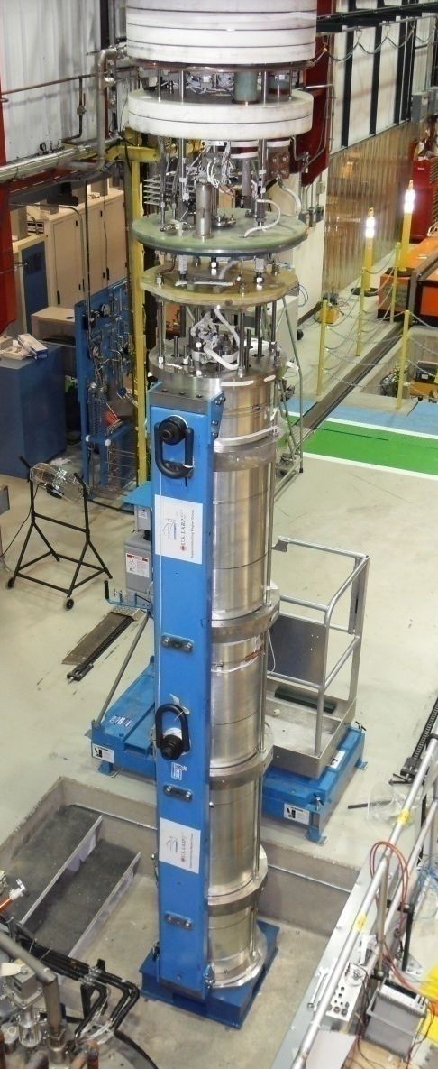
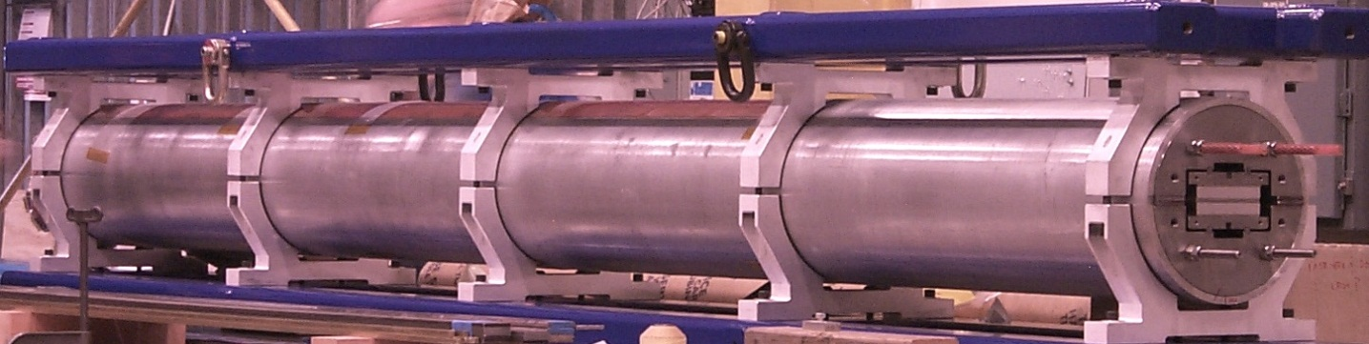
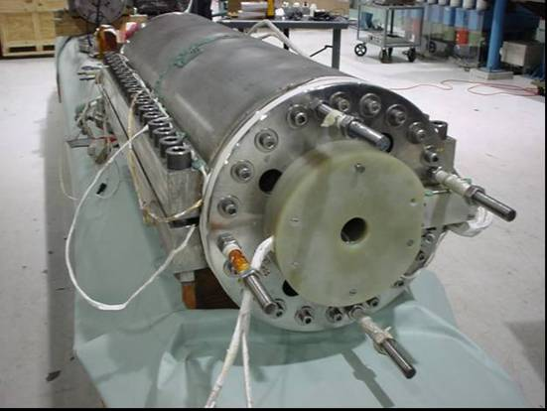
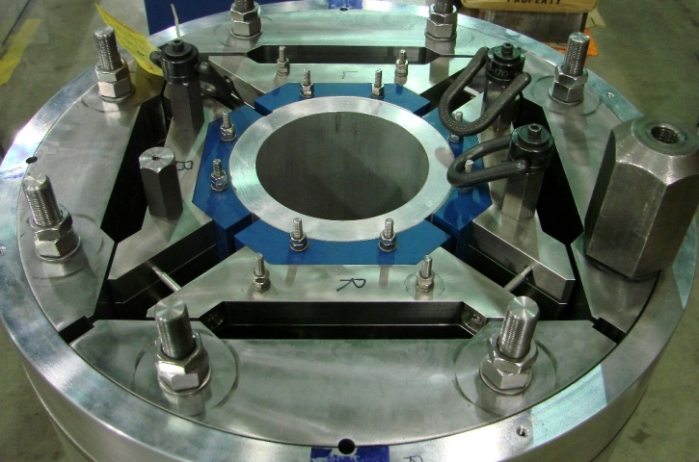
Overview of LARP Magnets
SM
SQ
TQS
LQS
LR
TQC
HQ

