Slide 1
ATLAS/CMS/LCD
RD53 collaboration:
Pixel readout integrated circuits for extreme rate and radiation
LHCC status and outlook report
June 4 2014
Jorgen Christiansen on behalf of RD53

Slide 2
Reminder RD53
Focussed R&D program to develop pixel chips for ATLAS/CMS phase 2 upgrades and LCD vertex
Extremely challenging requirements (ATLAS/CMS):
  Small pixels: 50x50um² (25x100um²)
  Large chips: >2cm x 2cm ( ~1 billion transistors)
  Hit rates: ~2 GHz/cm²
  Radiation: 1Grad, 10¹⁶ neu/cm² (unprecedented)
  Trigger: 1MHz, 10us (~100x buffering and readout)
  Low power - Low mass systems
Baseline technology: 65nm CMOS
Full scale demonstrator pixel chip in 3 year R&D program

Slide 3
Organisation issues
19 Institutes (2 new institutes have joined)
  Bari, Bergamo-Pavia, Bonn, CERN, CPPM, Fermilab, LBNL, LPNHE Paris, Milano, NIKHEF, New Mexico, Padova, Perugia, Pisa, Prague IP/FNSPE-CTU, PSI, RAL, Torino,
  UC Santa Cruz.
  ~100 collaborators
  2 institutes requesting to join: LAL/OMEGA, Seville
  Spokes persons: Maurice Garcia-Sciveres, LBNL (ATLAS), Jorgen Christiansen, CERN (CMS)
  2 year terms
Institute Board
  IB chair: Lino Demaria, Torino
  Regular IB meetings
  MOU drafted and ready to be signed
Management board: Spokes persons, IB chair, WG conveners
  Monthly meetings
Mailing lists, INDICO, CDS, TWIKI: http://twiki.cern.ch/RD53 , etc. set up
Technical Working Groups have started
  WG conveners
  Regular WG meetings
First official RD53 collaboration meeting (pre-RD53 meeting in Nov. 2012)
  CERN April 10-11, 64 participants: https://indico.cern.ch/event/296570

Slide 4
Radiation WG
Radiation test and qualification of baseline 65nm technology for radiation levels of 1Grad and 10¹⁶ neu/cm²
WG convener: Marlon Barbero, CPPM
Activities and Status:
  Defining radiation testing procedure
  Test of 65nm transistors to 1Grad
    NMOS: Acceptable degradation
    PMOS: Severe radiation damage above 300Mrad (next slide)
      Not yet a clear understanding of effects seen at these unprecedented radiation levels
      ESD damage from manipulation and test systems ?
    Systematic radiation/annealing studies required to be verified with pixel detector operation
  Test of circuits to 1Grad
    Ring oscillators, Pixel chips ( CERN, LBNL)
    Some digital circuits remains operational up to 1Grad, depending on digital library used.
    (better than indicated by tests of individual transistors)
  Critical to confirm if 65nm is OK for inner layers of pixel detectors
    Alternative foundries/technologies or replacement of inner layers after a few years ?
Plans
  Systematic radiation and annealing studies of 65nm basic devices and circuits
  Hadron/neutron radiation tests for NIEL effects
  Radiation test of basic transistors/structures in alternative technologies (for comparison/understanding)
  Simulation models of radiation degraded transistors (if possible)
CERN, CPPM, Fermilab, LBNL, New mexico, Padova

Slide 5
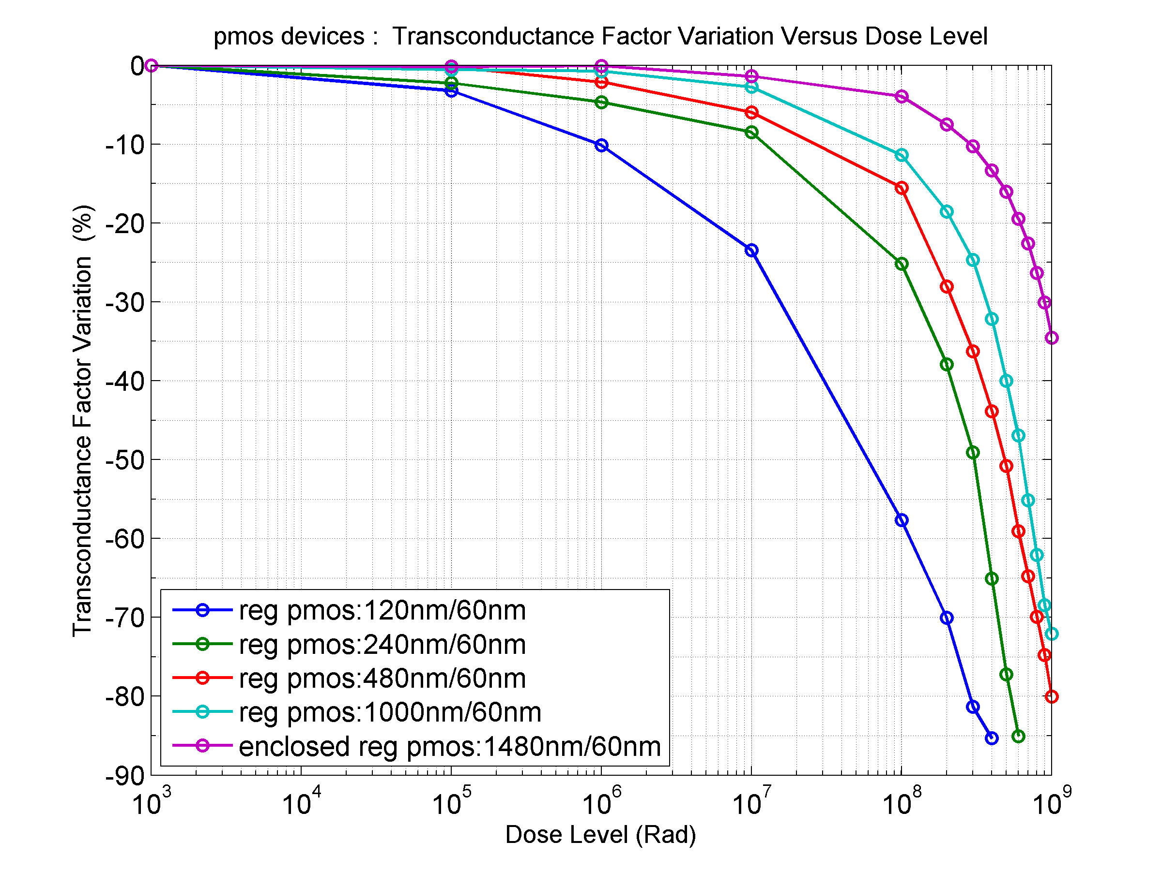
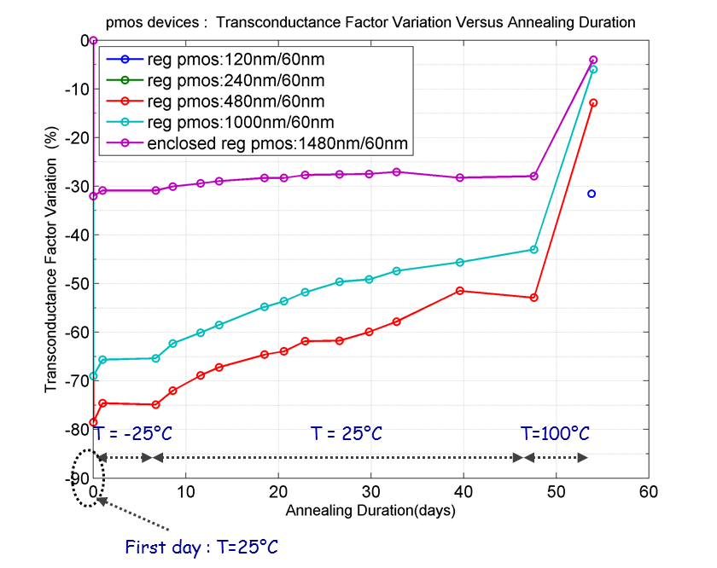
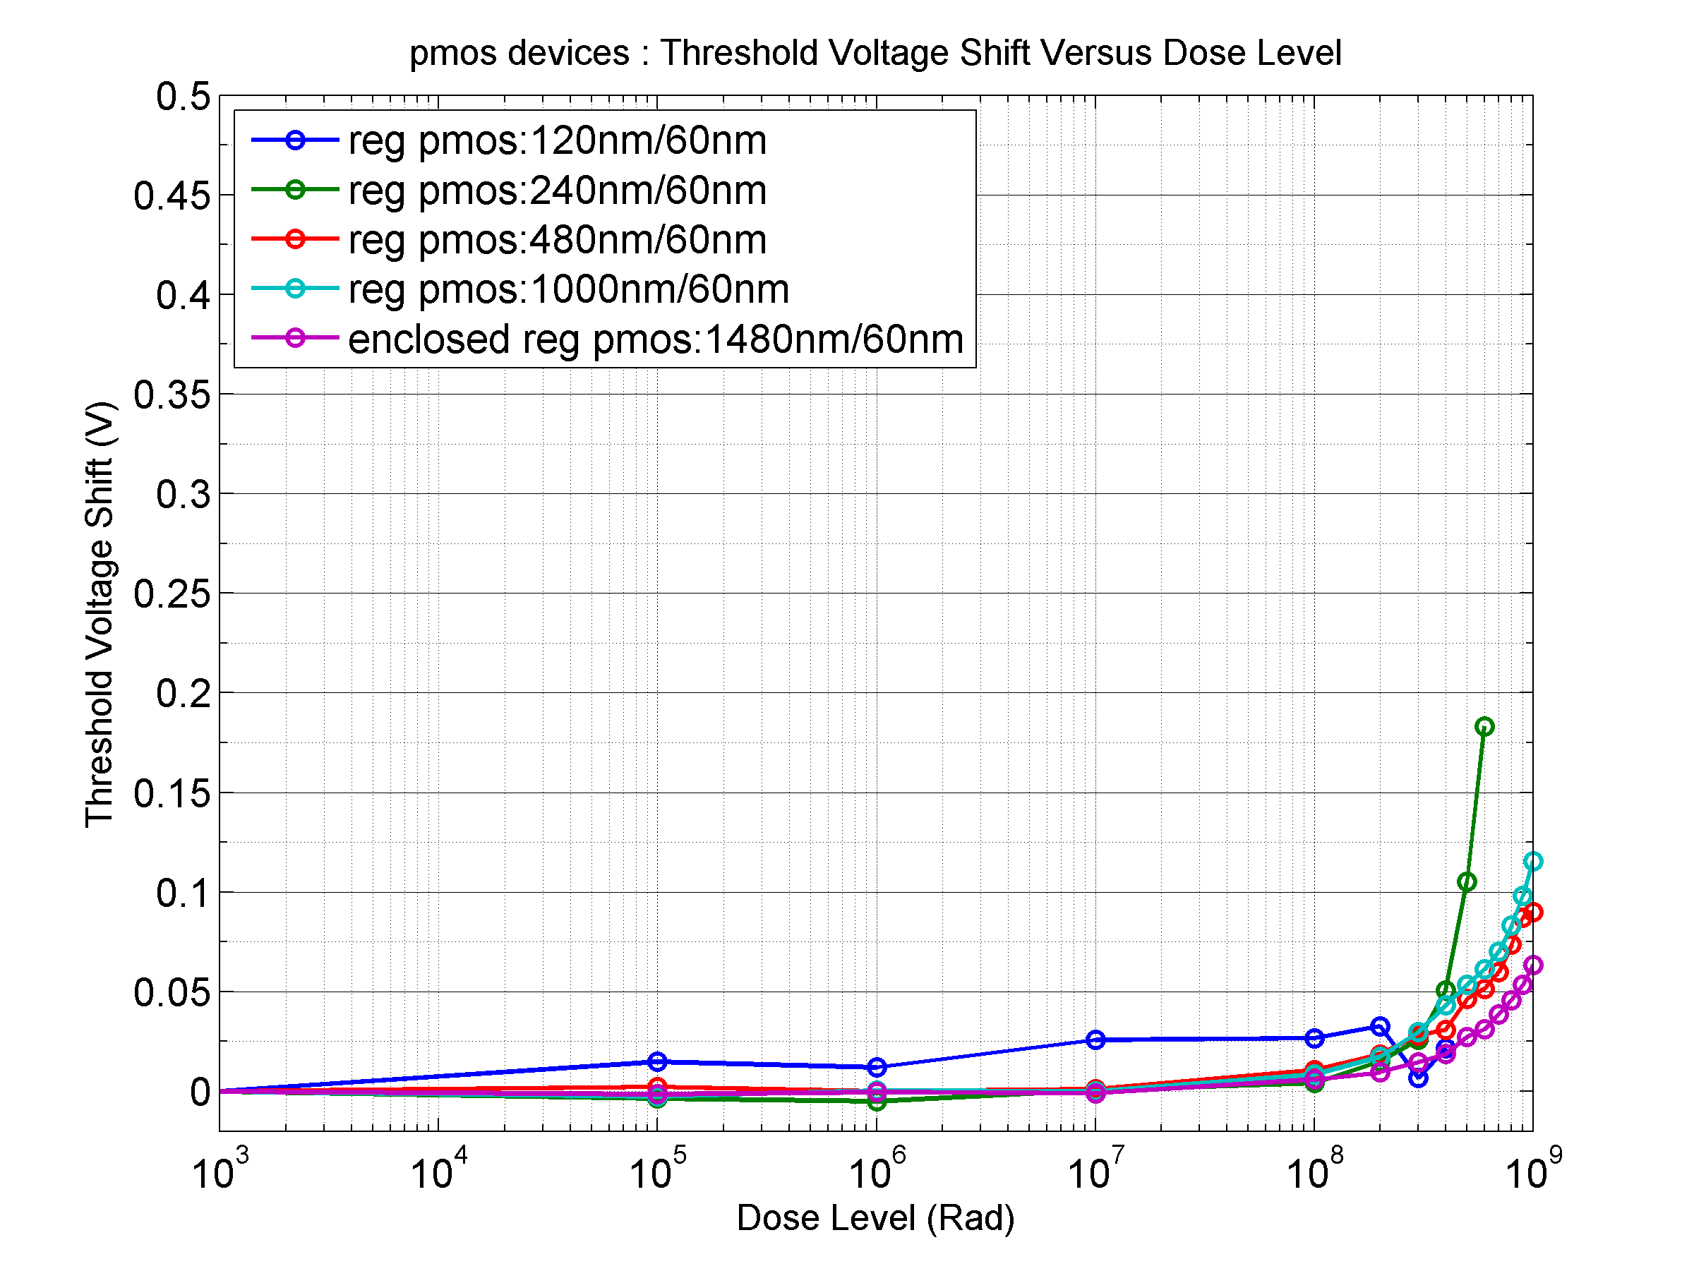
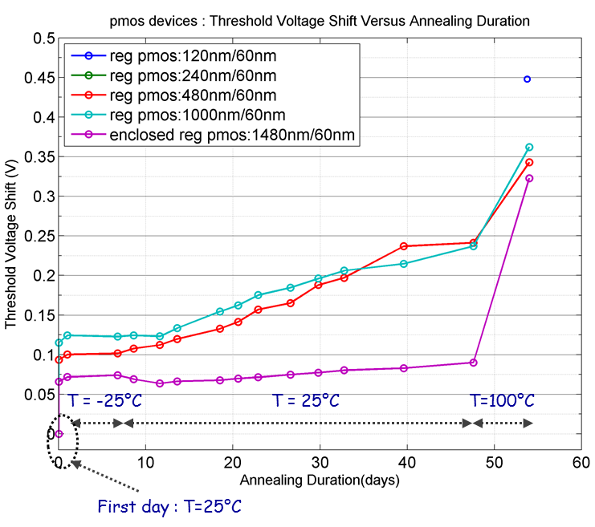
PMOS Radiation effects 65nm
Transconductance
Vt shift

Slide 6
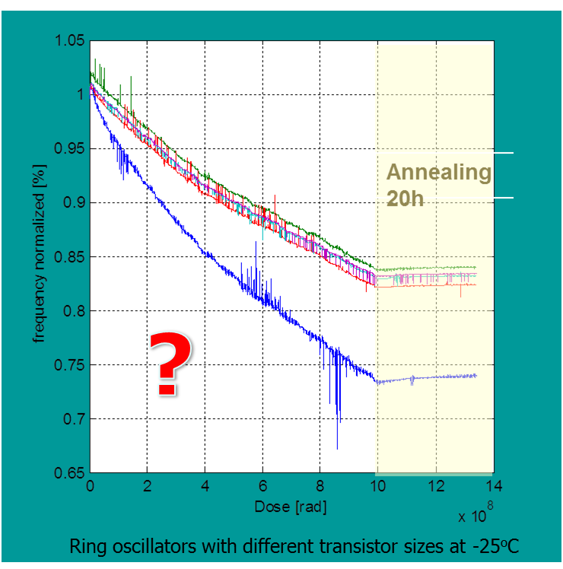
PMOS Radiation effects 65nm
Transconductance
Vt shift

Slide 7
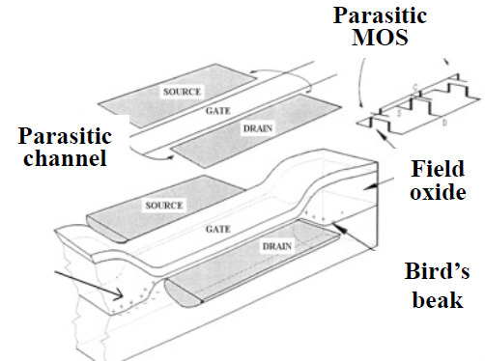
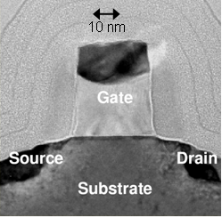
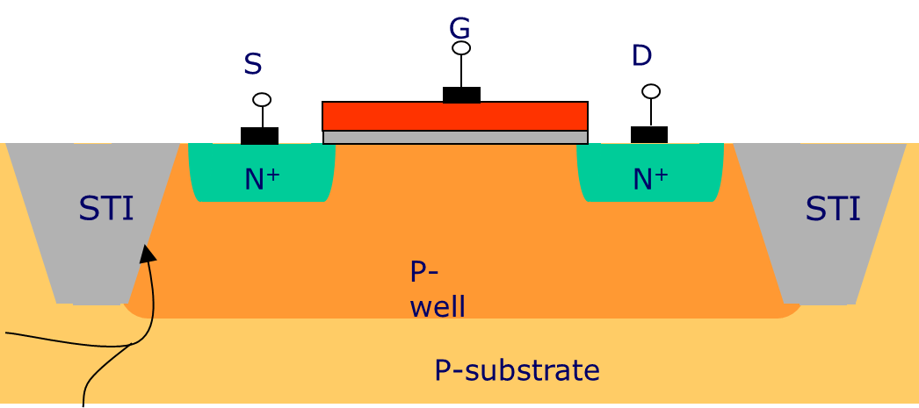
Radiation effects
Birds beak parasitic device
Spacer dielectrics may be radiation-sensitive
Charge buildup in gate oxide and interface states affects Vt
Thick Shallow Trench Isolation Oxide (~ 300 nm); radiation-induced charge-buildup may turn on lateral parasitic transistors and affect electric field in the channel)
Doping profile along STI sidewall is critical; doping increases with CMOS scaling, decreases in I/O devices
Increasing sidewall doping makes a device less sensitive to radiation (more difficult to form parasitic leakage paths)

Slide 8
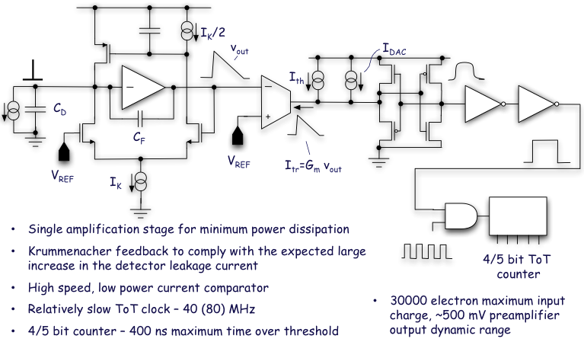
Analog WG
Krummenacher – TOT examples
Evaluation, design and test of appropriate low power analog pixel Front-Ends
Convener: Valerio Re, Bergamo/Pavia
Activities and status
  Analog front-end specifications
    Planar, 3D sensors, capacitance, threshold, charge resolution, noise, deadtime, ,
  Alternative architectures –implementations to be compared, designed and tested by different groups
    TOT, ADC, Synchronous, Asynchronous, Threshold adjust, Auto zeroing, etc.
  Design / prototyping of FE’s ongoing
Plans
  Prototyping and test (with radiation) different FEs
    Some FEs have already been prototyped
    Others will be prototyped after the summer
  Test, comparison and choice of most appropriate FE(s)
Bergamo-Pavia, Bonn, CERN, CPPM, Fermilab, LBNL, Prague IP/FNSPE-CTU, Torino.

Slide 9
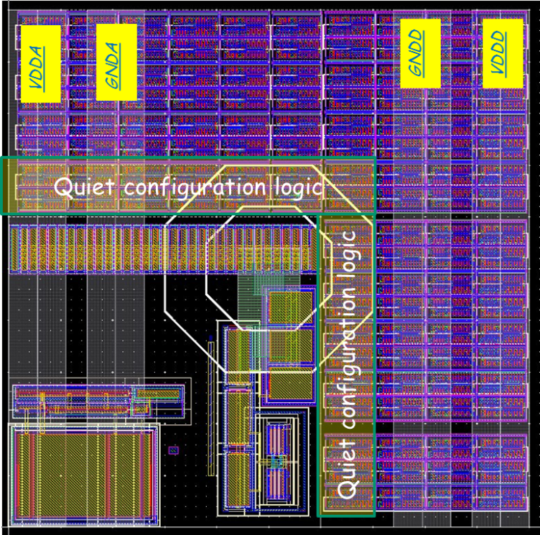
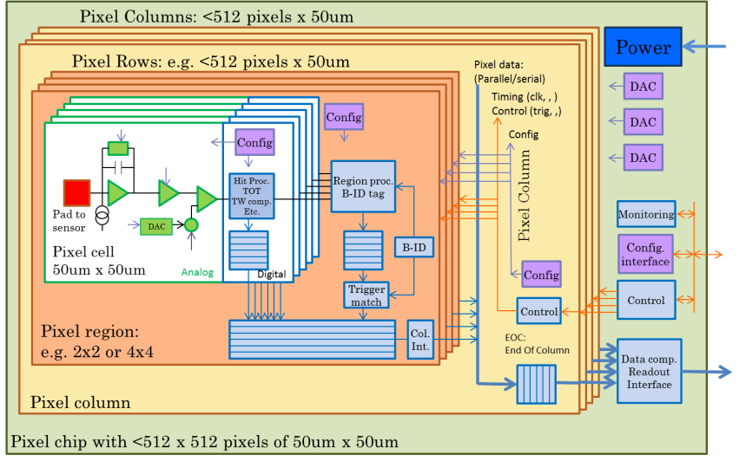
Top level WG
Global architecture and floor-plan issues for large mixed signal pixel chip
Convener: Maurice Garcia-Sciveres, LBNL
Activities and status
  Global floorplan issues for pixel matrix
    50x50um² – 25x100um² pixels with same pixel chip
      ATLAS – CMS has agreed to initially aim for this
    Global floor-plan with analog and digital regions
  Appropriate design flow
  Column bus versus serial links
  Simplified matrix structure for initial pixel array test chips
Plans
  Submission of common simplified pixel matrix test chips
  Evaluation of different pixel chip (digital) architectures
    Using simulation frameworks from simulation WG.
  Final integration of full pixel chip
Bonn, LBNL, , , ,

Slide 10
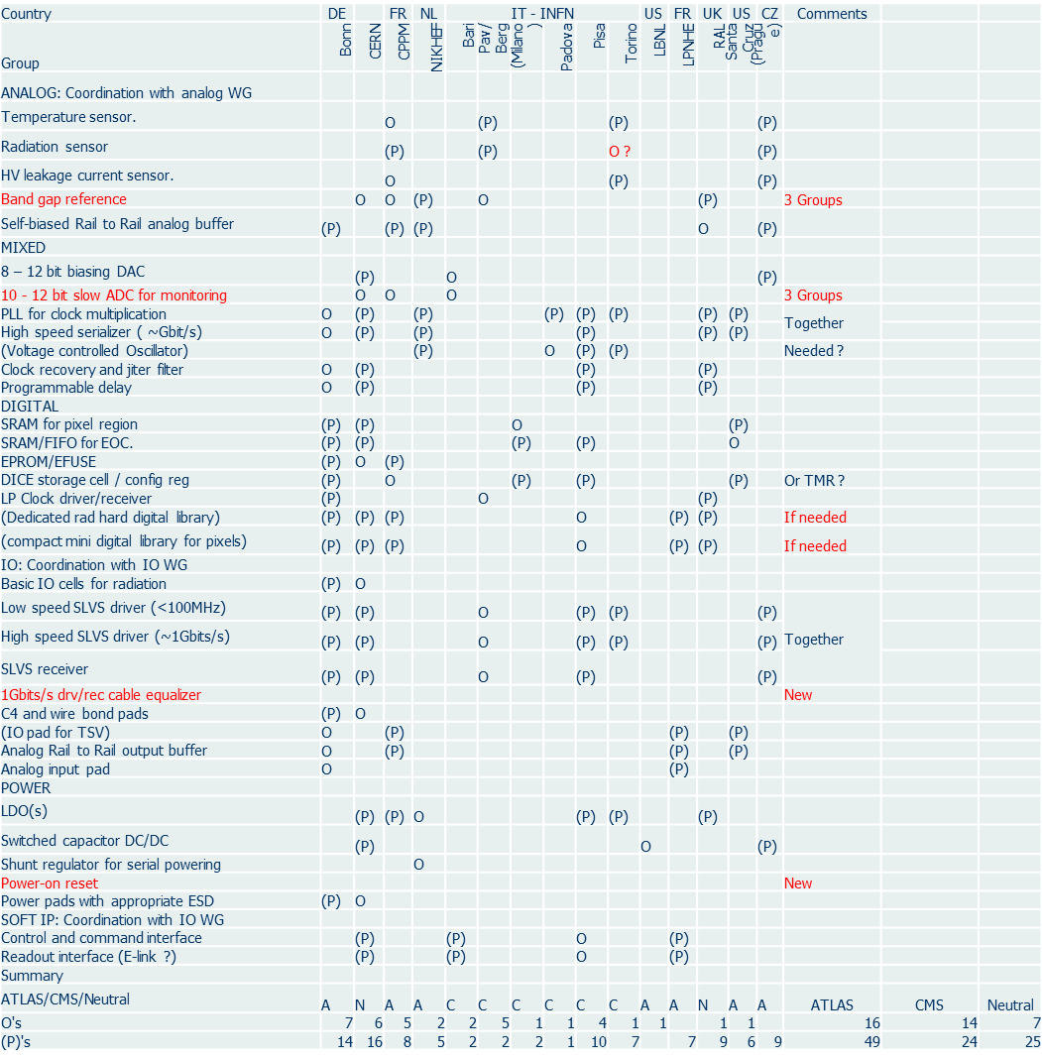
IP WG
Make IP blocks required to build pixel chips
Convener: Jorgen Christiansen, CERN
Activities and status
  List of required IPs (30) defined and assigned to groups
    Review of IP specs June 2014
  Defining how to make IPs appropriate for integration into mixed signal design flow for full/final pixel chips
    IP expert panel
    CERN design flow
  Design of IP blocks have started
Plans
  Common IP/design repository
  Prototyping/test of IP blocks 2014/2015
  IP blocks ready 2015/2016
~All RD53 institutes

Slide 11
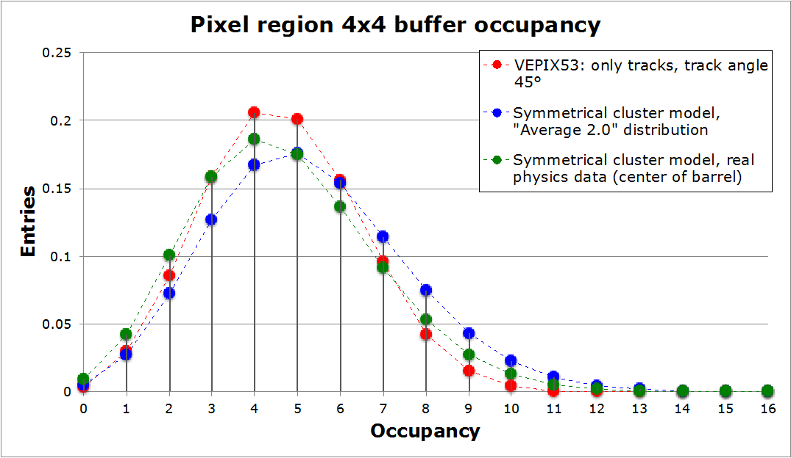
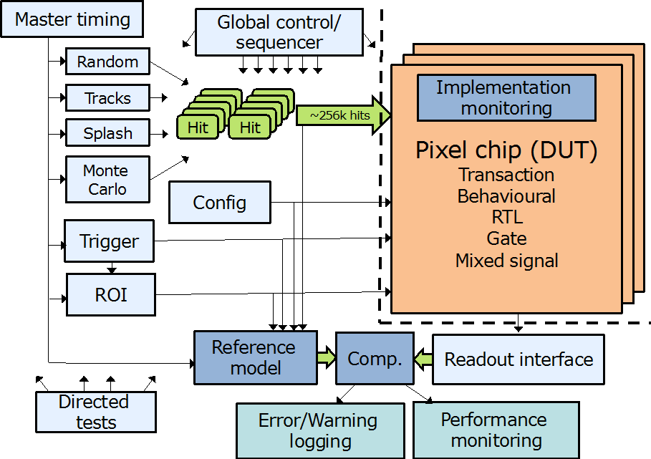
Simulation/verification WG
Simulation and verification framework for complex pixel chips
Convener: Tomasz Hemperek, Bonn
Activities and status
  Simulation framework based on system Verilog and UVM
  (industry standard for ASIC design and verification)
    High abstraction level down to detailed gate/transistor level
    Benchmarked using FEI4 design
  First basic version of framework available on common repository
    Internal generation of appropriate hit patterns
    Used for initial study of buffering architectures in pixel array
  Integration with ROOT to import hits
  from detector simulations and for
  monitoring and analysing results.
Plans
  Refine/finalize framework with detailed
  reference model of pixel chip
  Import pixel hit patterns from
  detector Monte-Carlo simulation
  Modelling of different pixel chip
  architectures and optimization
  Verification of final pixel chip
Bonn, CERN, Perugia
Buffer occupancy comparison between
simulation and analytical statistical model

Slide 12
RD53 Outlook
2014:
  Release of CERN 65nm design kit. RD53 eagerly awaiting NDA issues to be resolved.
  Detailed understanding of radiation effects in 65nm
    Radiation test of few alternative technologies.
    Spice models of transistors after radiation/annealing
  IP/FE block responsibilities defined and appearance of first FE and IP designs/prototypes
  Simulation framework with realistic hit generation and auto-verification.
  Alternative architectures defined and efforts to simulate and compare these defined
  Common MPW submission 1: First versions of IP blocks and analog FEs
2015:
  Common MPW submission 2: Near final versions of IP blocks and FEs.
  Final versions of IP blocks and FEs: Tested prototypes, documentation, simulation, etc.
  IO interface of pixel chip defined in detail
  Global architecture defined and extensively simulated
  Common MPW submission 3: Final IPs and FEs, Initial pixel array(s)
2016:
  Common engineering run: Full sized pixel array chip.
  Pixel chip tests, radiation tests, beam tests , ,
2017:
  Separate or common ATLAS – CMS final pixel chip submissions.

Slide 13
Summary
RD53 has gotten a good start
  Organization structure put in place
  Technical work in WGs have started
  The development of such challenging pixel chips across a large community requires a significant organisation effort.
Radiation tolerance of 65nm remains critical
  Design work has started in 65nm (FEs, IPs)
  Annealing effects/scenario to be understood
  Backup: Inner layer replacement versus alternative technology
RD53 is now a recognized collaboration requested to report in relevant HEP/pixel meetings, conferences and workshops:
  ATLAS/CMS meetings
  ACES2014: https://aces.web.cern.ch/aces/aces2014/ACES2014.htm
  Front-end electronics workshop: http://indico.cern.ch/event/276611/overview
  Pixel/Vertex
Funding for RD53 work starts to materialize in institutes
CMS and ATLAS rely fully on RD53 for their pixel upgrades

Slide 14
Backup slides

Slide 15
IO WG
Defining and implementing readout and control interfaces
Convener: To be assigned
  Not (yet) urgent
Plans
  Defining readout and control protocols
  Implement/verify IO blocks for pixel chip
  Standardized pixel test systems

Slide 16
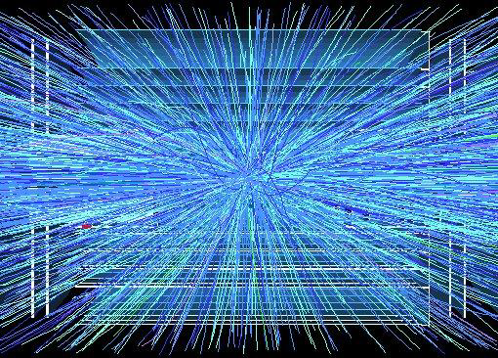
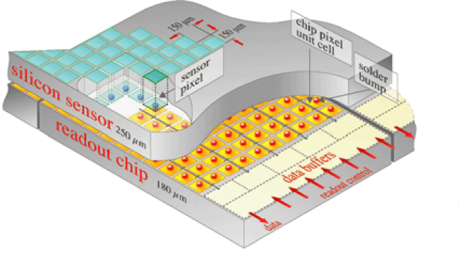
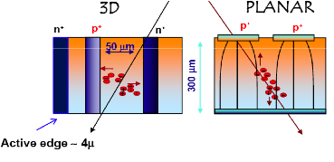
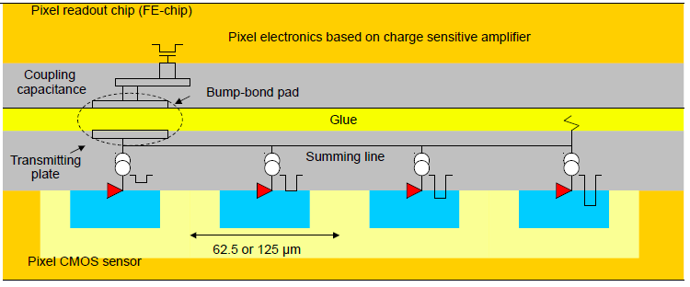
Phase 2 pixel challenges
ATLAS and CMS phase 2 pixel upgrades very challenging
  Very high particle rates: 500MHz/cm²
    Hit rates: 1-2 GHz/cm² (factor 16 higher than current pixel detectors)
  Smaller pixels: ¼ - ½ (25 – 50 um x 100um)
    Increased resolution
    Improved two track separation (jets)
  Participation in first/second level trigger ?
    40MHz extracted clusters (outer layers) ?
    Region of interest readout for second level trigger ?
  Increased readout rates: 100kHz -> 1MHz
  Low mass -> Low power
  Very similar requirements (and uncertainties) for ATLAS & CMS
Unprecedented hostile radiation: 1Grad, 10¹⁶ Neu/cm²
  Hybrid pixel detector with separate readout chip and sensor.
  Phase2 pixel will get in 1 year what we now get in 10 years
Pixel sensor(s) not yet determined
  Planar, 3D, Diamond, HV CMOS, , ,
  Possibility of using different sensors in different layers
  Final sensor decision may come relatively late.
Very complex, high rate and radiation hard pixel readout chips required
ATLAS HVCMOS program

Slide 17
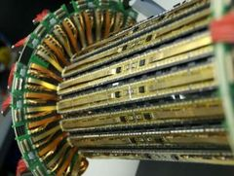
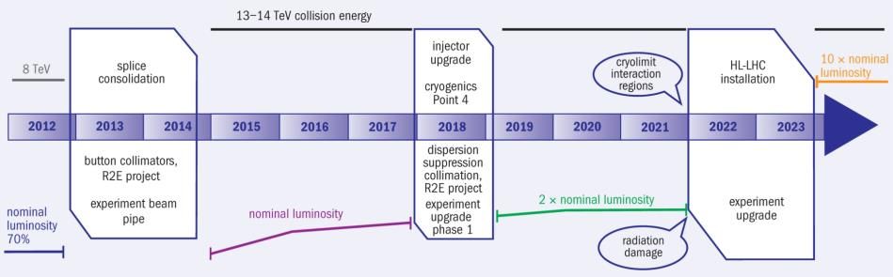
Pixel upgrades
Current LHC pixel detectors have clearly demonstrated the feasibility and power of pixel detectors for tracking in high rate environments
Phase1 upgrades: Additional pixel layer, ~4 x hit rates
  ATLAS: Addition of inner B layer with new 130nm pixel ASIC (FEI4)
  CMS: New pixel detector with modified 250nm pixel ASIC (PSI46DIG)
Phase2 upgrades: ~16 x hit rates, 2-4 x better resolution, 10 x readout rates,
16 x radiation tolerance, Increased forward coverage, less material, , ,
  Installation: ~ 2022
  Relies fully on significantly improved performance from next generation pixel chips.
ATLAS Pixel IBL
CMS & ATLAS phase 2 pixel upgrades
CMS Pixel phase1
100MHz/cm²
400MHz/cm²
1-2GHz/cm²

Slide 18
Pixel chip
Pixel readout chips critical for schedule to be ready for phase 2 upgrades
  Technology: Radiation qualification
  Building blocks: Design, prototyping and test
  Architecture definition/optimization/verification
  Chip prototyping, iterations, test, qualification and production
  System integration
    System integration tests and test-beams
  Production and final system integration, test and commissioning
Phase 2 pixel chip very challenging
  Radiation
  Reliability: Several storage nodes will have SEUs every second per chip.
  High rates
  Mixed signal with very tight integration of analog and digital
  Complex: ~256k channel DAQ system on a single chip
  Large chip: ~2cm x 2cm, ½ - 1 Billion transistors.
  Very low power: Low power design and on chip power conversion
Both experiments have evolved to have similar pixel chip architectures and plans to use same technology for its implementation.
Experienced chip designers for complex ICs in modern technologies that most work in a extremely harsh radiation environment is a scarce and distributed “resource” in HEP.

Slide 19
Pixel chip generations
Generation | Current FEI3, PSI46 | Phase 1 FEI4, PSI46DIG | Phase 2
Pixel size | 100x150um² (CMS) 50x400um² (ATLAS) | 100x150um² (CMS) 50x250um² (ATLAS) | 25x100um² ?
Sensor | 2D, ~300um | 2D+3D (ATLAS) 2D (CMS) | 2D, 3D, Diamond, MAPS ?
Chip size | 7.5x10.5mm² (ATLAS) 8x10mm² (CMS) | 20x20mm² (ATLAS) 8x10mm² (CMS) | > 20 x 20mm²
Transistors | 1.3M (CMS) 3.5M (ATLAS) | 87M (ATLAS) | ~1G
Hit rate | 100MHz/cm² | 400MHz/cm² | 1-2 GHz/cm²
Hit memory per chip | 0.1Mb | 1Mb | ~16Mb
Trigger rate | 100kHz | 100KHz | 200kHz - 1MHz
Trigger latency | 2.5us (ATLAS) 3.2us (CMS) | 2.5us (ATLAS) 3.2us (CMS) | 6 - 20us
Readout rate | 40Mb/s | 320Mb/s | 1-3Gb/s
Radiation | 100Mrad | 200Mrad | 1Grad
Technology | 250nm | 130nm (ATLAS) 250 nm (CMS) | 65nm
Architecture | Digital (ATLAS) Analog (CMS) | Digital (ATLAS) Analog (CMS) | Digital
Buffer location | EOC | Pixel (ATLAS) EOC (CMS) | Pixel
Power | ~1/4 W/cm² | ~1/4 W/cm² | ~1/4 W/cm²

Slide 20
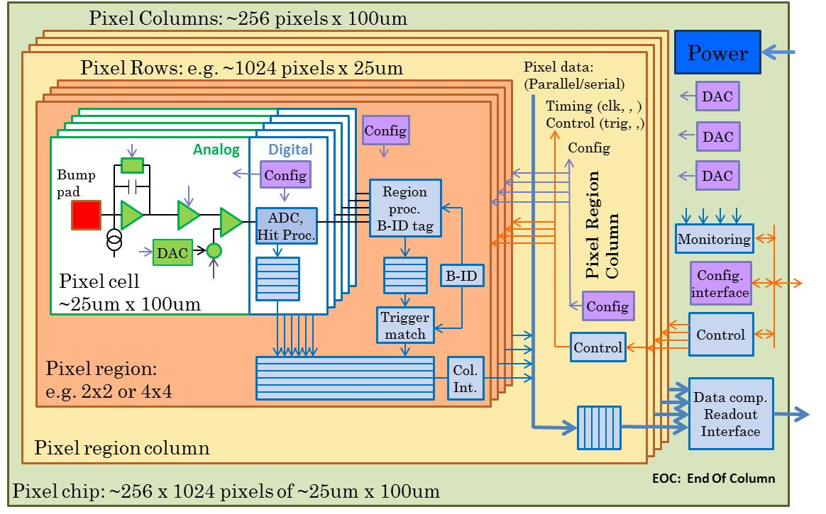
3rd generation pixel architecture
95% digital (as FEI4)
Charge digitization
~256k pixel channels per chip
Pixel regions with buffering
Data compression in End Of Column

Slide 21
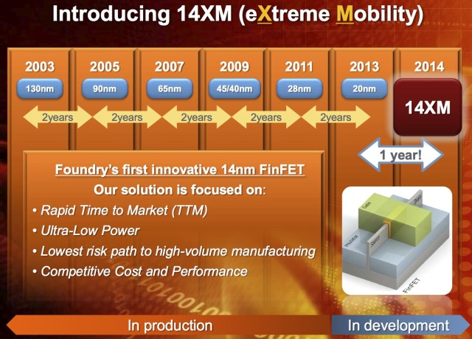
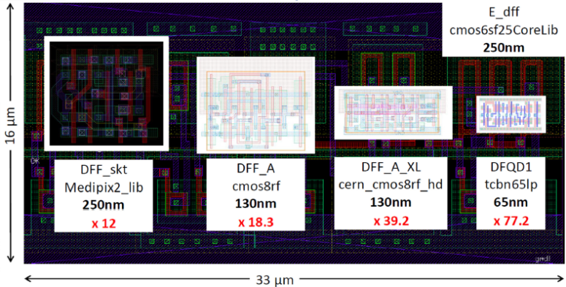
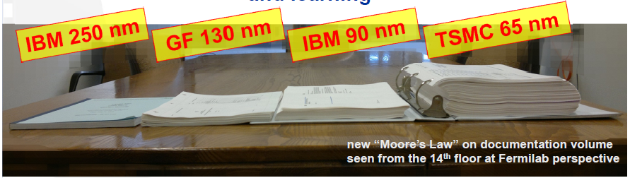
Why 65nm Technology
Mature technology:
  Available since ~2007
High density and low power
Long term availability
  Strong technology node used extensively for industrial/automotive
Access
  CERN frame-contract with TSMC and IMEC
    Design tool set
    Shared MPW runs
    Libraries
    Design exchange within HEP community
Affordable (MPW from foundry and Europractice, ~1M NRE for full final chips)
Significantly increased density, speed, , ,
and complexity !
X. Llopart CERN
G. Deptuch, Fermilab

Slide 22
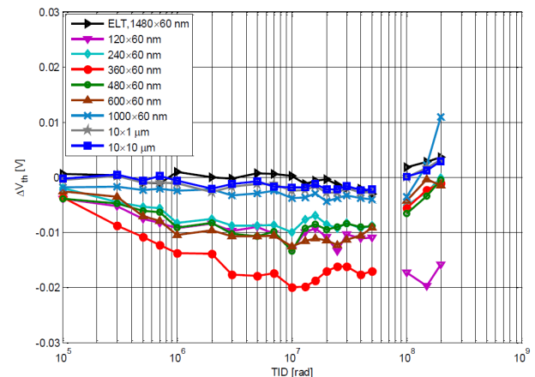
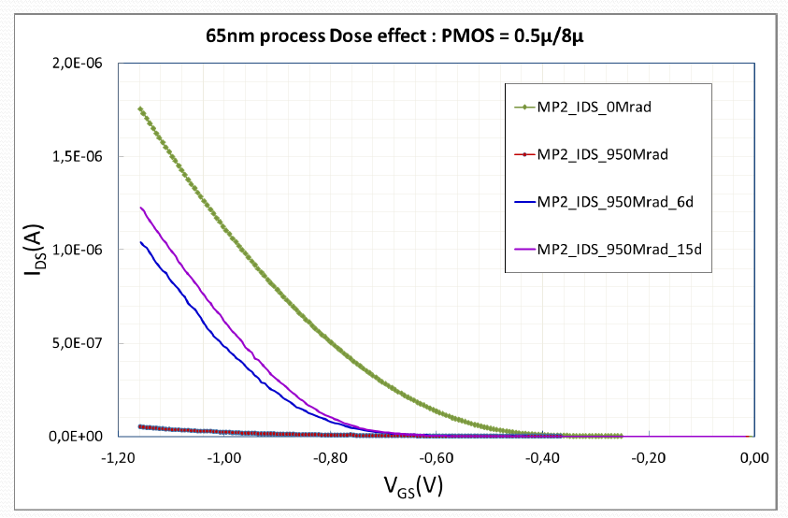
65nm Technology
Radiation hardness
  Uses thin gate oxide
    Radiation induced trapped charges removed by tunneling
    More modern technologies use thick High K gate “oxide” with reduced tunneling/leakage.
  Verified for up to 200Mrad
  To be confirmed for 1Grad
    PMOS transistor drive degradation, Annealing ?
    If significant degradation then other technologies must be evaluated and/or a replacement strategy must be used for inner pixel layers
  CMOS normally not affect by NIEL
    To be confirmed for 10¹⁶ Neu/cm²
    Certain circuits using “parasitic” bipolars to be redesigned ?
  SEU tolerance to be build in (as in 130 and 250nm)
    SEU cross-section reduced with size of storage element, but we will put a lot more per chip
  All circuits must be designed for radiation environment ( e.g. Modified RAM)
S. Bonacini, P. Valerio CERN
No radiation
after annealing
950Mrad
M. Menouni, CPPM

Slide 23
ATLAS – CMS RD collaboration
Similar/identical requirements, same technology choice and limited availability of rad hard IC design experts in HEP makes this ideal for a close CMS – ATLAS RD collaboration
  Even if we do not make a common pixel chip
Initial 2day workshop between communities confirmed this.
  Workshop: http://indico.cern.ch/conferenceDisplay.py?confId=208595
Forming a RD collaboration has attracted additional groups and collaborators
  Synergy with CLIC pixel (and others): Technology, Rad tol, Tools, etc.
Institutes: 17
  ATLAS: CERN, Bonn, CPPM, LBNL, LPNHE Paris, NIKHEF, New Mexico, RAL,
  UC Santa Cruz.
  CMS: Bari, Bergamo-Pavia, CERN, Fermilab, Padova, Perugia, Pisa, PSI, RAL, Torino.
Collaborators: 99, ~50% chip designers
Collaboration organized by Institute Board (IB) with technical work done in specialized Working Groups (WG)
Initial work program covers ~3 years to make foundation for final pixel chips
  Will be extended if appropriate:
    Common design ?,
    Support to experiment specific designs

Slide 24
Working groups
WG | Domain
WG1 | Radiation test/qualification
Coordinate test and qualification of 65nm for 1Grad TID and10¹⁶ neu/cm² Radiation tests and reports. Transistor simulation models after radiation degradation Expertise on radiation effects in 65nm
WG2 | Top level
Design Methodology/tools for large complex pixel chip Integration of analog in large digital design Design and verification methodology for very large chips. Design methodology for low power design/synthesis. Clock distribution and optimization.
WG3 | Simulation/verification framework
System Verilog simulation and Verification framework Optimization of global architecture/pixel regions/pixel cells
WG4 | I/O + (Standard cell)
Development of rad hard IO cells (and standard cells if required) Standardized interfaces: Control, Readout, etc.
WG5 | Analog design / analog front-end
Define detailed requirements to analog front-end and digitization Evaluate different analog design approaches for very high radiation environment. Develop analog front-ends
WG6 | IP blocks
Definition of required building blocks: RAM, PLL, references , ADC, DAC, power conversion, LDO, , Distribute design work among institutes Implementation, test, verification, documentation

Slide 25
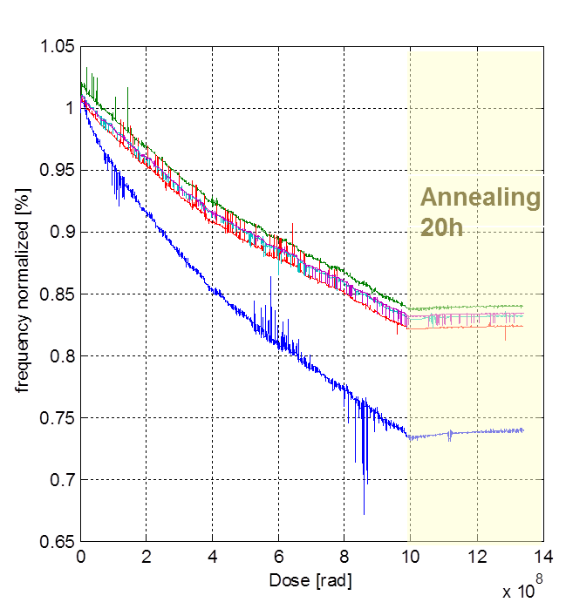
?
Ring oscillators with different transistor sizes at -25ºC

