Slide 1


LIEBE:
Design of a molten metal target based on a Pb-Bi loop at CERN-ISOLDE
T. De Melo Mendonca, M. Delonca, D. Houngbo, C. Maglioni, L. Popescu, P. Schuurmans, T. Stora

Slide 2
Outline
Proposed design
  Detailed design
  Beam impact
  Power equilibrium
  Heat Exchanger (HEX)
  Integration within the Isolde environment
Conclusion & next steps

Slide 3
Proposed design…
… detailed design

Slide 4
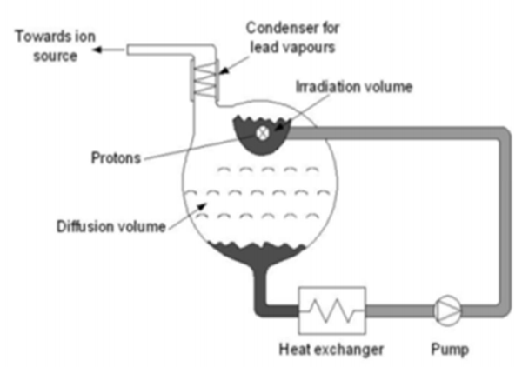
Proposed design – detailed design (1)
Proposed by EURISOL
Condenser for lead vapours
Toward Ion source
Irradiation volume
Protons
Diffusion volume
Heat Exchanger
Pump

Slide 5
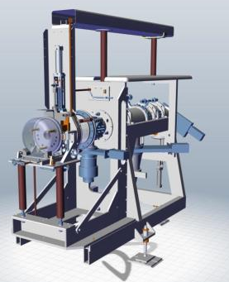
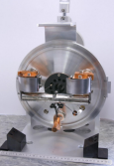
Proposed design – detailed design (2)
Current layout @ Cern-Isolde
Current target unit
Current front end + target

Slide 6
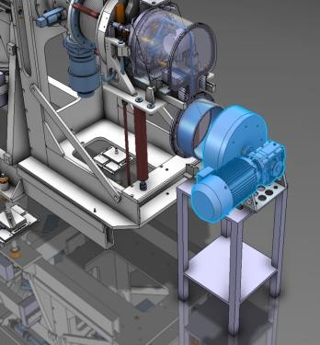
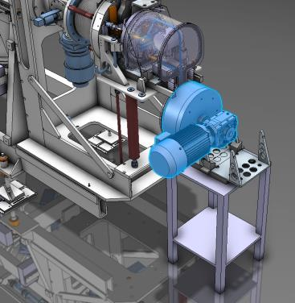
Proposed design – detailed design (3)
Proposed LIEBE target design: a “two parts plugged” principle
Main loop part
Pump/engine part
Unplugged position
Plugged position

Slide 7
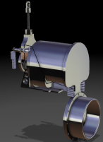
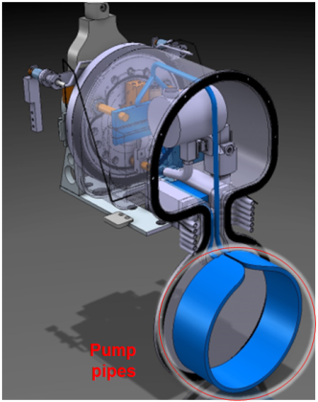
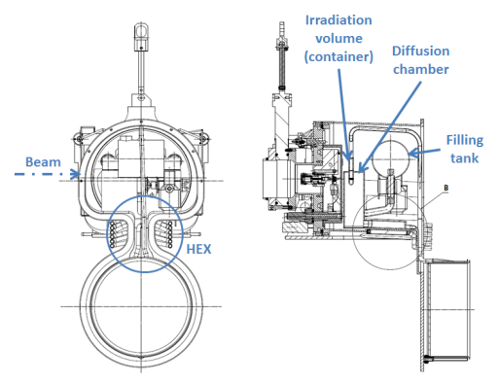
Proposed design – detailed design (4)
Main loop part in details
+ heating elements all along the loop

Slide 8

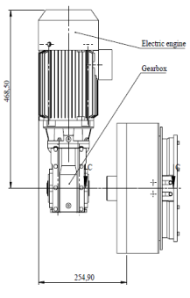
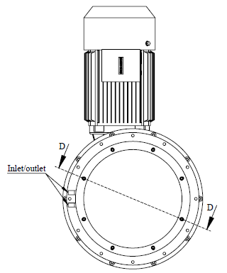
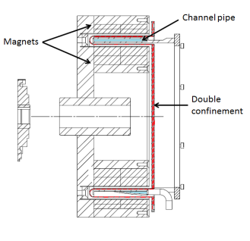
Proposed design – detailed design (5)
Pump

Slide 9
Proposed design…
… beam impact

Slide 10
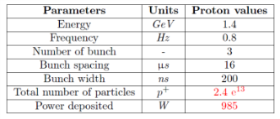
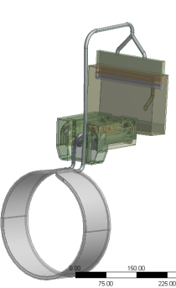
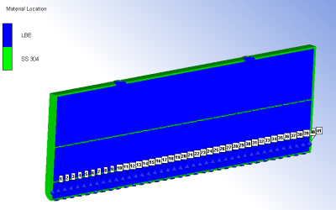
Proposed design – Beam impact (1)
Assessment of beam impact with Ansys
Autodyn – preliminary results
Half geometry considered
Isolde beam parameters – staggered mode
Grids
Container: Stainless Steel 304, solid part, Lagrangien part
Liquid: LBE, SPH elements
Use of 40 gauges along beam axis

Slide 11
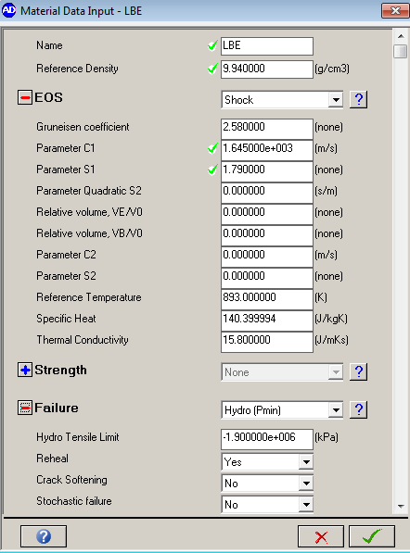


Proposed design – Beam impact (2)
Standard variables @ 600 ºC.
  ρ, Cp, k
Shock EOS (Linear model)
Gruneisen model
  U_{s} = shock velocity, $Г$ = Gruneisen coefficient, $μ_{p}$= particle velocity, C₀ and S = fitting parameters
  Failure mechanism
    Hydrodynamic tensile limit
    2 values considered: -150 kPa⁽¹⁾ and -1.9 Gpa ⁽²⁾ (no value available for LBE) @ ambiant T
Material definition
$$U_{S}=C_{0}+S∗μ_{p}$$
$$S=\frac{1}{2}∗\left(1+Г\right)$$
$$Г=\frac{α∗K_{S}}{ρ∗C_{p}}$$
⁽¹⁾ E. Noah, L. Bruno, R. Catherall, J. Lettry, T. Stora, Nucl. Instrum. Meth. B 266 (2008) 4303
⁽²⁾ G.A. Carlson, J. App. Phys, Vol 46, Issue 9 (1975) 4069-4070

Slide 12
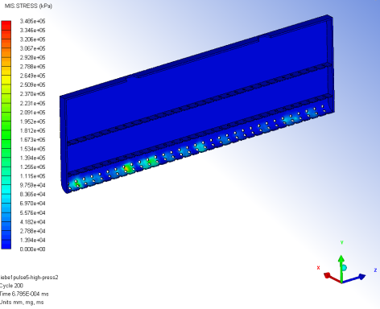
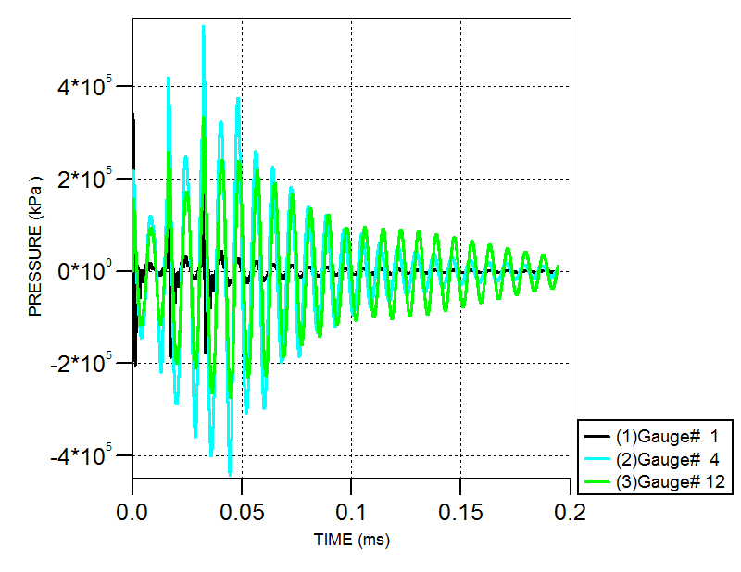
Proposed design – Beam impact (3)
Analysis for 200 µs (1 pulse = 32.6 µs) – hydrodynamic tensile limit of 1.9 GPa
Von Mises stresses
Repercussion of shock waves onto the weakest point of the container (grid part).
Stresses over the yield limit for SS304L @ 600 deg C (Yield = 260 MPa) in less than 1 µs. Possible problem of fatigue rupture -> change of SS type?

Slide 13
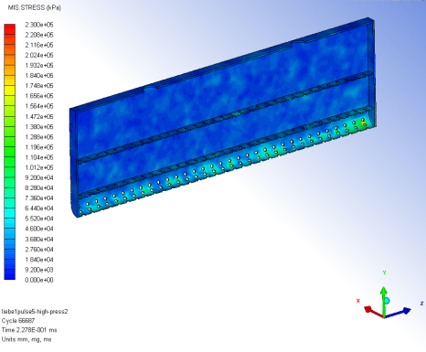
Proposed design – Beam impact (4)
Analysis for 200 µs (1 pulse = 32.6 µs) – hydrodynamic tensile limit of 1.9 GPa
Von Mises stresses
Repartition of stress onto the full irradiation chamber over time

Slide 14
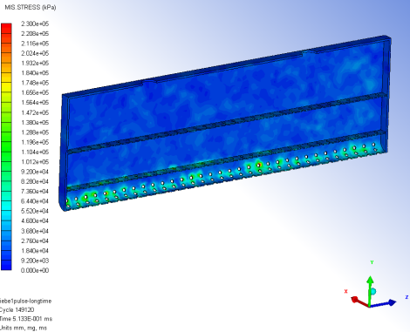
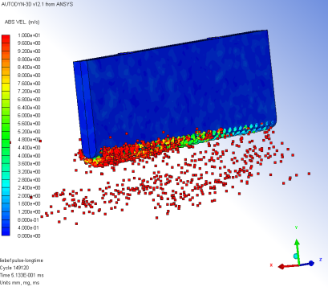
Proposed design – Beam impact (5)
Analysis for 500 µs (1 pulse = 32.6 µs) – hydrodynamic tensile limit of 150 kPa
Von Mises stresses
Exit velocity
Cavitation in the liquid will induce splashing of the LBE and projection of droplets with very high velocity in the diffusion chamber.
The stresses remain under the yield limit.

Slide 15
Numerical results – Beam impact (6)
Conclusions & Outlook
  Preliminary analysis suggests that the geometry might need optimizations in order to avoid resonant shock waves
  Better quality Stainless Steel to be used
  Impact of beam onto the container should be further investigated:
    Negligible impact expected
    Need more detailed simulation to prove it
  Simulation must be computed for longer time (possibly by coupling with CFD analysis)

Slide 16
Proposed design…
… power equilibrium

Slide 17


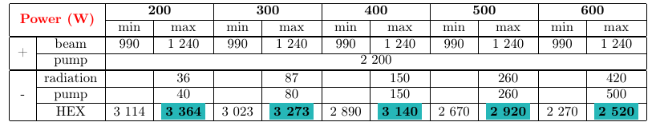
Proposed design – power equilibrium
  Need to keep the target at the desired working temperature while temperature range goes from 200 ºC till 600 ºC
Power contributions:
Pump power extraction
+ | -
Beam | Pump
Pump | Radiation
- | HEX
Radiation power extraction
Beam | 990 to 1 240 W
Pump | 2 200 W

Slide 18
Proposed design…
… heat exchanger

Slide 19
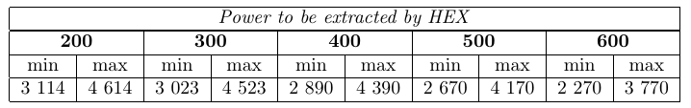
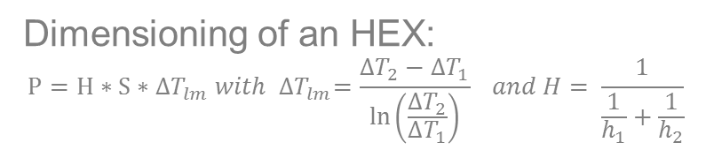
Proposed design – HEX (1)
Proposed design
Dimensioning of an HEX:
$$P=H∗S∗{∆T}_{lm}{ with ∆T}_{lm}=\frac{{∆T}_{2}−{∆T}_{1}}{\ln\left(\frac{{∆T}_{2}}{{∆T}_{1}}\right)} and H= \frac{1}{\frac{1}{h_{1}}+\frac{1}{h_{2}}}$$
 | Water | LBE
Flow rate (l/s) | 0.22 | 0.23
T _{inlet} (ºC) | 27 | Variable
T _{outlet} (ºC) | < 90 | Variable
Problem: The HEX must extract less power @ 600 ºC than @ 200 ºC BUT power extracted depend on the surface of exchange, the average heat exchange coefficient and the temperature of both fluids involved -> need of a variable HEX!

Slide 20
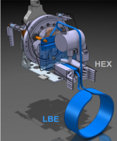
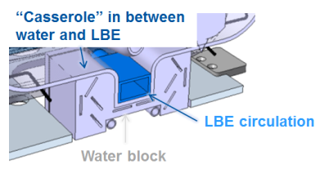
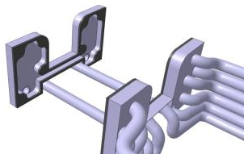
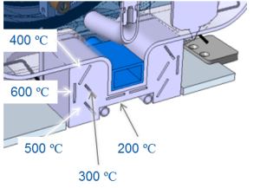
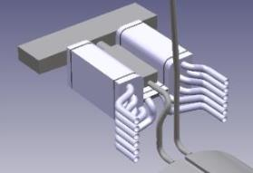
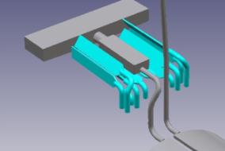
Proposed design – HEX (2)
Assessment of HEX behavior with CFX

Slide 21
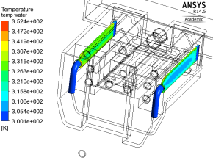
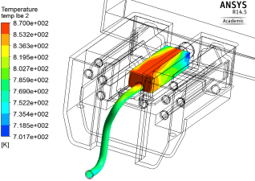
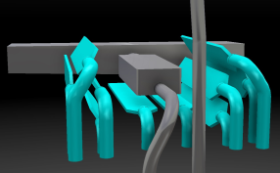
Proposed design – HEX (3)
Summary of results:
Example @ 600 ºC
 | T _{max} water (ºC) | P _{extracted} (W)
200 ºC | 83 | 3 480
300 ºC | 87 | 3 350
400 ºC | 76 | 3 240
500 ºC | 72 | 3 010
600 ºC | 79 | 2 750
T_{max} water = 79 ºC
T_{max} LBE = 597 ºC

Slide 22
Proposed design – HEX (4)
Conclusions
  Temperature controlled with the heating elements installed all along the loop
  Temperature and power extracted are in the proper range (values have been checked over the full range of temperature, from 200 ºC up to 600 ºC)
  Further analysis must be computed considering bad thermal contact between the different parts
  Thermal expansion and induced stresses must be assessed
  Prototype to be done before to validate of the design

Slide 23
  Integration within the Isolde environment…

Slide 24
Integration within the Isolde environment (1)
Constraints due to the Isolde environment:
  Compatibility with the Isolde front end
  Installation in the Faraday cage -> polarization at 30 kV for beam extraction
  Double confinement of the LBE
  Compatibility with the Isolde robot

Slide 25
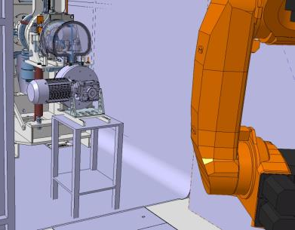
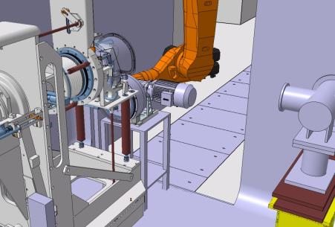
Integration within the Isolde environment (2)
Compatibility with the Isolde front end & installation in the Faraday cage:

Slide 26
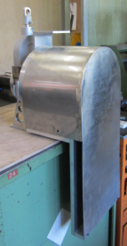
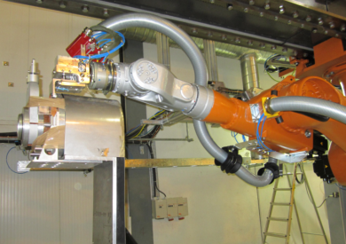
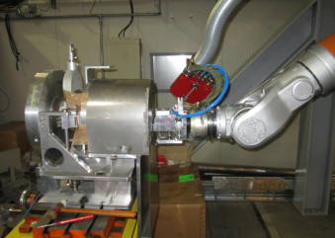
Integration within the Isolde environment (3)
Compatibility with the Isolde robot:
60 kg
Target mock-up and his installation on the test front-end
+ use of demineralized water for HEX and insulation of holding table.

Slide 27
Conclusion & next steps…

Slide 28
Conclusion & next steps
Preliminary design is available, phase of optimization remaining
Test of the Heat Exchanger foreseen
Further study required to assess the impact of the beam onto the container
Campaign of test will be started soon to validate the design

Slide 29
Thank you for your attention!

Slide 30
Thanks to all the contributors…
V. Barozier
A. P. Bernardes
K. Kravalis
F. Loprete
S. Marzari
R. Nikoluskins
F. Pasdeloup
A. Polato
H. Znaidi
… (and many others…)

Slide 31
Back up slides…

Slide 32
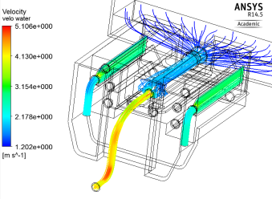
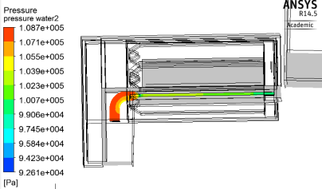
Numerical results – HEX (3)
Example @ 600 ºC
T_{max} water = 79 ºC
Velocity in water and LBE
T_{max} LBE = 597 ºC
Pressure in water for case LBE @ 200 ºC

Slide 33

Numerical results – HEX (4)
Summary of results:
 | T _{max} water (ºC) | P _{extracted} (W)
200 ºC | 78 | 3 180
300 ºC | 83 | 3 050
400 ºC | 73 | 2 890
500 ºC | 68 | 2 820
600 ºC | 79 | 2 650
200 ºC
300 ºC
400 ºC
500 ºC
600 ºC

Slide 34
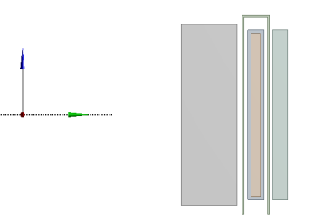
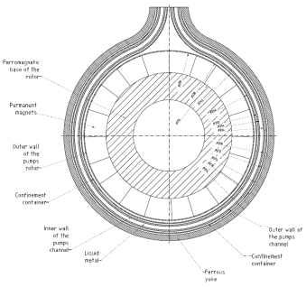
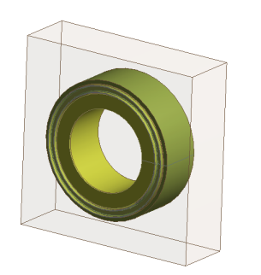
Thermal equilibrium (2)
Power sources and extractions:
1. Pump
+ | -
Beam | Pump
Pump | Radiation
- | HEX
2D model
To estimate the power extracted
To evaluate the heat exchange transfer coefficient h
3D model

Slide 35
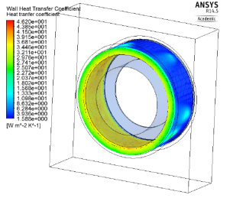
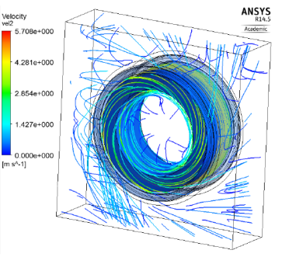
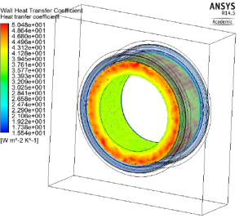
Thermal equilibrium (3)
1. Pump
h _{average} ≈ 38 W/m².K
Heat exchange transfer coefficient for the casserole
h _{average center} ≈ 35 W/m².K
h _{average external and side} ≈ 49 W/m².K
Velocity streamlines of air for rotor speed of 8 rev/sec.
Heat exchange transfer coefficient for the rotor/magnet part

Slide 36
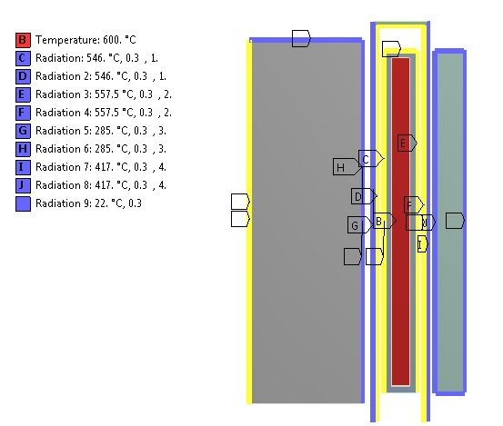
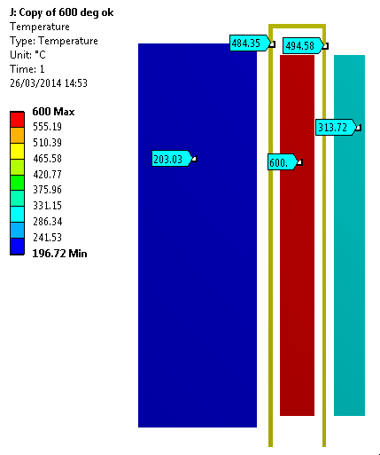
Thermal equilibrium (4)
1. Pump
With low pressure gases.
Similar results with isolating elements!
Yellow: convection
Yellow + “flag”: convection + radiation
Temperature of system when LBE @ 600 deg C
Power extracted
Magnet should remain below 100 deg C!! -> Ipul is currently cross-checking theses results.

Slide 37
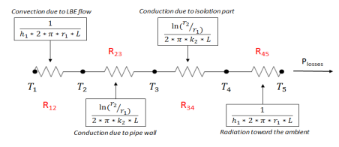


Thermal equilibrium (4)
Power sources and extractions:
2. Radiation
+ | -
Beam | Pump
Pump | Radiation
- | HEX
Equivalent thermal circuit
$$P_{losses}=\frac{T_{1}−T_{amb}}{R_{tot}} and R_{tot}=R_{12}+R_{23}+R_{34}+R_{45}$$
Geometry considered for power losses model

Slide 38


Thermal equilibrium (5)
2. Radiation
Without pump part!
Power losses = f(T loop), emissivity = 0.1

