Slide 1
SC cavities: performance as a function of frequency and temperature
S. Calatroni, F. Gerigk, W. Weingarten

Slide 2
Outline
Choice of accelerating gradient
  Remarks concerning β < 1 cavities
  Simulation of Q(E_{a})
    Deterministic parameters
  Stochastic parameters
  Look towards other laboratories
    CERN (1985)
    DESY
    ORNL/JLAB
Choice of operating temperature T_{b} and frequency ω
  Power grid – beam transfer efficiency (T_{b}, ω)
  Remarks concerning cryostat
Concluding remarks

Slide 3
Choice of accelerating gradient
Remarks concerning β < 1 cavities
TM waves in waveguides of arbitrary cross section
  Electromagnetic waves guided along a uniform system in z direction
  Transverse magnetic waves
  Cylindrical symmetry
  Pillbox resonator with
  metallic wall at r = R :
  E_{z} = 0

Slide 4
Choice of accelerating gradient
Remarks concerning β < 1 cavities
Definition of accelerating gradient
The unavoidable beam tube opening is considered to be small compared to λ
B
B_{p}
beam
E₀
R
E_{p}
L
Notes:
4

Slide 5
Choice of accelerating gradient
Remarks concerning β < 1 cavities
Peak fields
The peak surface electric and magnetic fields constitute the ultimate limit for the accelerating gradient => minimize the ratio E_{p}/E_{a} and B_{p}/E_{a}.
B
B_{p}
beam
E₀
R
E_{p}
L
Notes:
5

Slide 6
Choice of accelerating gradient
Remarks concerning β < 1 cavities
Radial field distribution of β < 1 resonator
For an accelerating cavity (π – mode, β = 1):
and for β < 1):
B
beam
E₀
R
L
Notes:
6

Slide 7
Choice of accelerating gradient
Remarks concerning β < 1 cavities
Comparison pillbox resonator – acc. cavity
 | Differential equation in the vicinity of the rotational symmetry axis Solution for fundamental transverse magnetic mode | Graph of solution
TM010 | Bessel function J₀
Acc. Cavity | Modified Bessel function I₀
β = .6, .7, .8, .9, 1.0, ∞ (TM010)

Slide 8
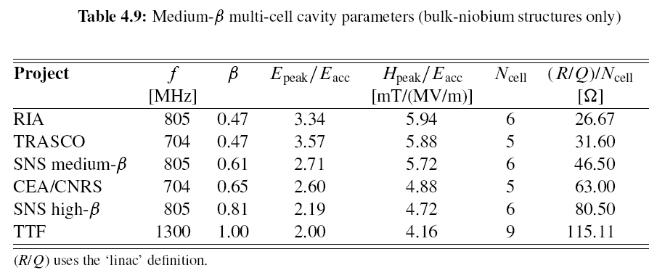
Choice of accelerating gradient
Remarks concerning β < 1 cavities
Technically realized peak fields for β < 1 resonator
B_{p}/E_{a} =[mT/(MV/m)] =7.48-3.38β
E_{p}/E_{a} = -1.02+1.84/β+1.17 β
Notes:
8

Slide 9
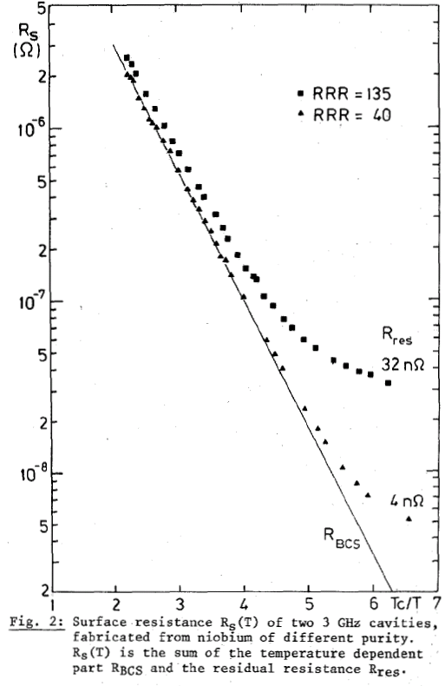
Choice of accelerating gradient
Simulation of Q(E_{a})
Deterministic parameters – The BCS surface resistance R_{s}
CW operation, using Mathematica with
  fix parameters:
    wall thickness = 3 mm
    Nb (RRR = 100)
    geometrical length β = 1
    residual resistance R_{res}
  with T-dependent
    surface resistance R_{s} (T_{c}/T)
    thermal conductivity λ
    nucleate boiling heat transfer coefficient α
    Kapitza resistance in HeII
  under the constraints of
    max. magnetic field of
      B_{p} = 200 mT∙[1-(T/T_{c})²]
    max. nucleate boiling heat flux in He of 0.5 W/cm²
    max. heat flux in HeII of 0.5 W/cm²

Slide 10
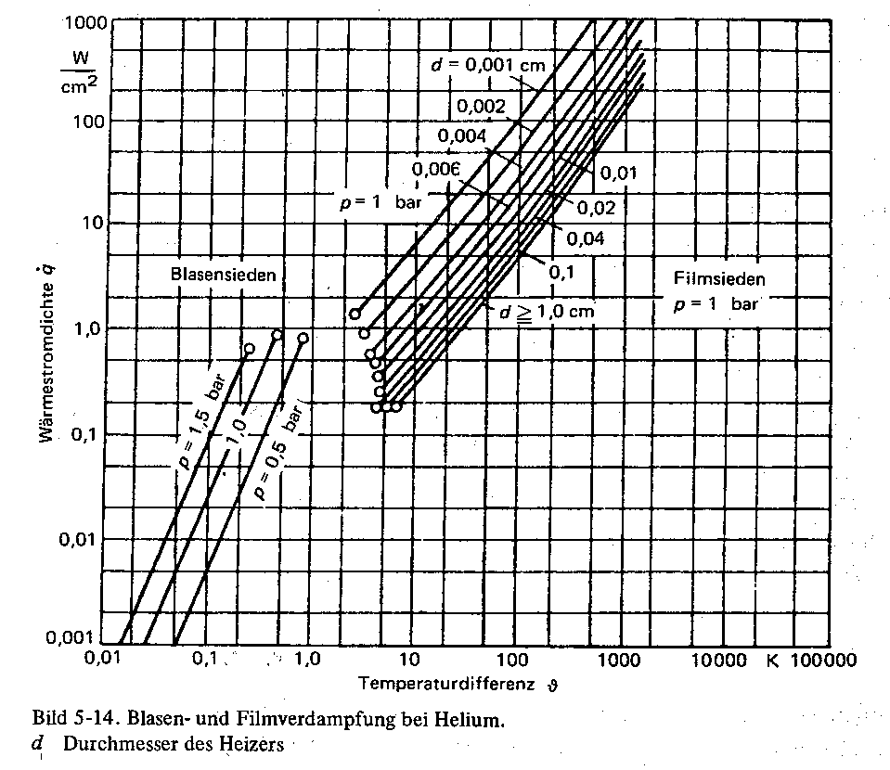
Choice of accelerating gradient
Deterministic parameters
Nucleate boiling heat transfer – Kapitza resistance
H. Frey, R. A. Haefer, Tieftemperaturtechnologie, VDI-Verlag, Düsseldorf 1981
J. Amrit and M. X. Francois, Journal of Low Temperature Physics 119 (2000) 27

Slide 11
Choice of accelerating gradient
Deterministic parameters
Thermal conductivity
A. W. Chao, M. Tigner, Handbook of Accelerator Physics, World Scientific, Singapore 1999
H. Lengeler, W. Weingarten, G. Müller, H. Piel, IEEE TRANSACTIONS ON MAGNETICS MAG-21 (1985) 1014

Slide 12
Choice of accelerating gradient
Deterministic parameters
Results of simulation : Q(E_{a})/10⁹, 704 MHz
Superfluid helium T = 1.5, 1.8, 2.1 K Kapitza resistance heat transfer RRR = 90 3 mm wall thickness | Normal helium T = 2.2, 3.3, 4.5 K Nucleate boiling heat transfer RRR = 90 3 mm wall thickness

Slide 13
Choice of accelerating gradient
Deterministic parameters
Results of simulation : Q(E_{a}) )/10⁹, 1408 MHz
Superfluid helium T = 1.5, 1.8, 2.1 K Kapitza resistance heat transfer RRR = 90 3 mm wall thickness | Normal helium T = 2.2, 3.3, 4.5 K Nucleate boiling heat transfer RRR = 90 3 mm wall thickness

Slide 14
Choice of accelerating gradient
Other deterministic parameters (2nd order importance)
Influencing quantity | Impact quantity | Physical explanation | Cure
External static magnetic field B_{ext} | Residual surface resistance | Creation of vortices | Shielding of ambient magnetic field by Mu-metal / Cryoperm
Residual resistivity ratio RRR | BCS surface resistance | Mean free path dependence of R_{res} | Annealing steps during ingot production/after cavity manufacture
Ratio peak magnetic field to accelerating gradient B_{p}/E_{a} | Max. accelerating gradient | Critical magnetic field as ultimate gradient limitation | Optimization of cavity shape
Nb-H precipitate | Q-value / acc. gradient (Q-disease) | Lowering of T_{c}/B_{c} at precipitates of Nb-H | T-control during chemical polishing Degassing @ 700 °C Fast cool-down

Slide 15
Choice of accelerating gradient
Stochastic parameters - CERN results (1985)
E_{a}= 4.9 ± 1.8 MV/m
H. Lengeler, W. Weingarten, G. Müller, H. Piel, IEEE TRANSACTIONS ON MAGNETICS MAG-21 (1985) 1014
E_{a}= 5.5 ± 2.1 MV/m

Slide 16
Choice of accelerating gradient
Stochastic parameters
DESY results
No significant degradation of cavity performance between acceptance tests and full system tests.

Slide 17
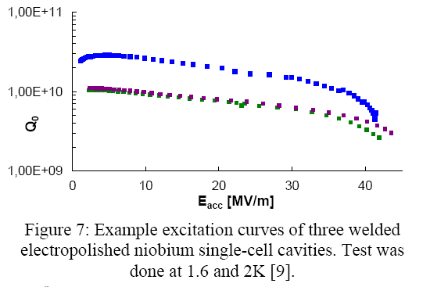
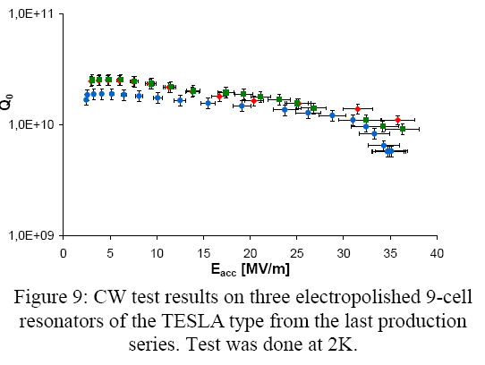
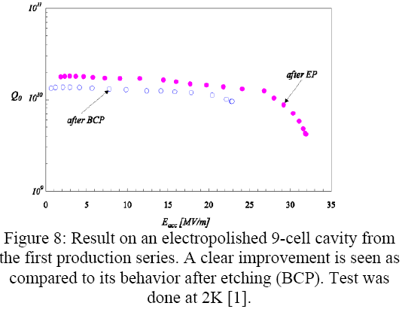
Choice of accelerating gradient
Stochastic parameters - DESY results
Q (Ea)
A residual surface resistance corresponding to a Q-value of 10¹⁰ at the operating gradient presents a challenge.

Slide 18
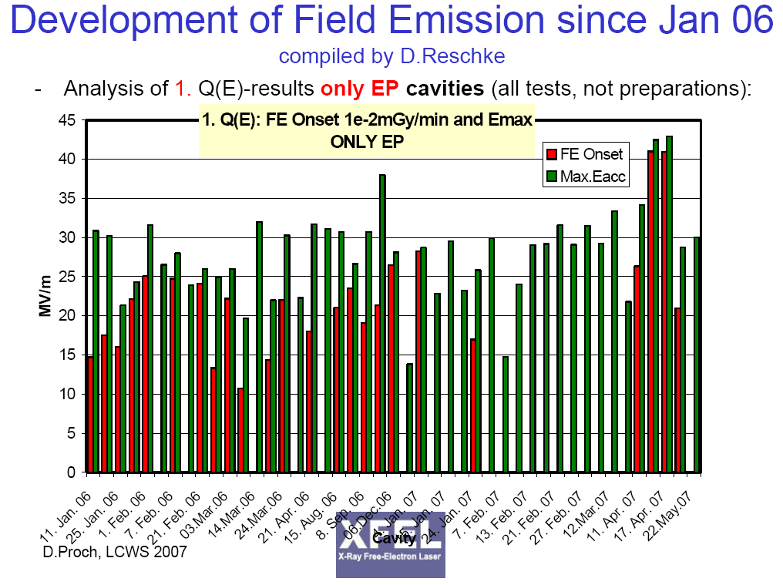
Choice of accelerating gradient
Stochastic parameters - DESY results
Series tests E_{a}
E_{a} = 28.1 ± 5.2 MV/m

Slide 19
Choice of accelerating gradient
Stochastic parameters - DESY results
Gradient spread Due to Quench
Probability of “Quench Only” DESY 9-cell Cavities (EP cavities only )
E_{a}= 29.8 ± 6.9 MV/m
Compiled by H.Padamsee from DESY Data Base, TTC Meeting at DESY, January 14 - 17, 2008 https://indico.desy.de/conferenceOtherViews.py?view=standard&confId=401

Slide 20
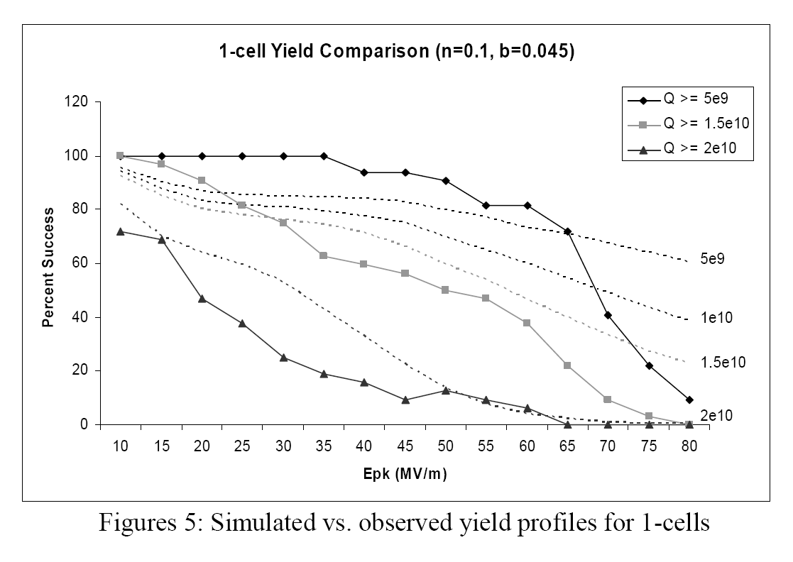
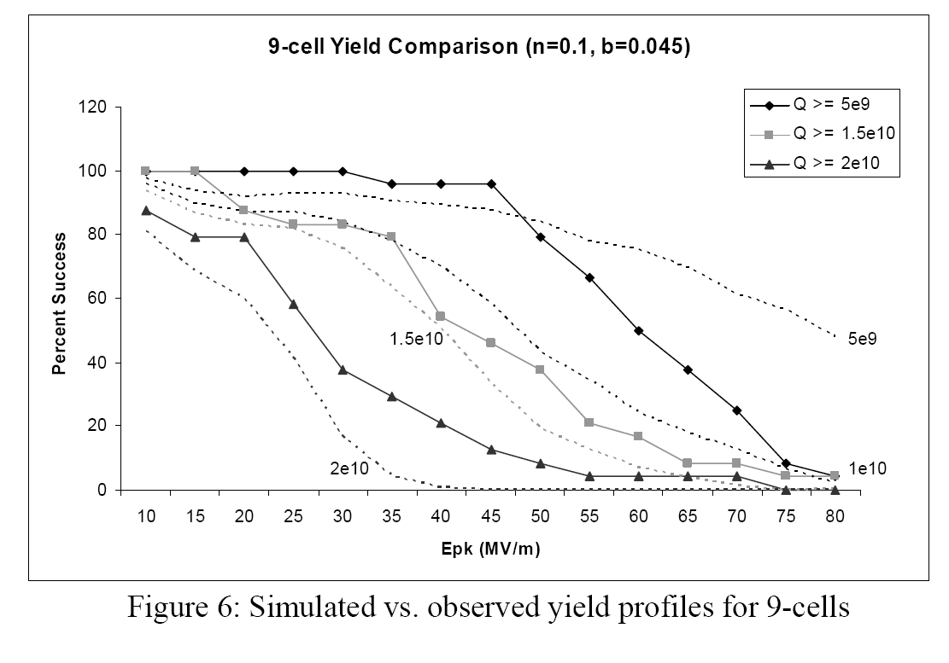
Choice of accelerating gradient
Stochastic parameters - DESY results
1 cell vs. 9 cells 1.3 GHz
From TESLA report 2008-02
J. Wiener, H. Padamsee
  On all cavities prepared by EP + low-temp baking:
  1-cell or 9-cells seem not to show different results

Slide 21
Choice of accelerating gradient
Stochastic parameters
ORNL/JLAB results
high β
E_{a}= 18.2 ± 2.6 MV/m
Source: I. E. Campisi and S.–H. Kim, SNS Superconducting Linac operating experience and issues,
Accelerator Physics and Technology Workshop for Project X, November 12-13, 2007
http://projectx.fnal.gov/Workshop/Breakouts/HighEnergyLinac/agenda.html
low β
E_{a}= 17.1 ± 1.9 MV/m

Slide 22
Choice of accelerating gradient
Stochastic parameters
Summary of results in other labs
Laboratory | <E_{a}> [MV/m] | ΔE_{a} [MV/m] | ΔE_{a}/<E_{a} > [%] | <E_{a}> [MV/m] @ 90 (50) [%] processing yield *)
CERN @ 1985 350 – 500 MHz 1-cell | 4.9 | 1.8 | 37 | 3 (4.9)
CERN/Wuppertal @ 1985 3 GHz 1-cell | 5.5 | 2.1 | 38 | 3 (5.5)
DESY 1.3 GHz (all) ditto (quench) 9-cell | 28 30 | 5.2 6.9 | 19 23 | 22 (28) 23 (30)
ORNL/JLAB SNS 805 MHz β = 0.61 6-cell β = 1 (extrapolated) | 17.1 23.0 | 1.9 2.6 | 11 11 | 15 (17) 20 (23)
β = 0.81 6-cell β = 1 (extrapolated) | 18.2 20 | 2.6 2.8 | 14 14 | 15 (18) 16 (20)
*) 11 (100) [%] re-processing needed ( = 1/yield)

Slide 23
Choice of accelerating gradient
Stochastic parameters
Influencing quantity | Impact quantity | Physical explanation | Cure
Field emission sites (foreign particles sticking to the surface, size, density) | Q – value / acc. gradient radiation HOM coupler quench | Modified Fowler-Nordheim-theory | Electro-polishing Assembling in dust-free air Rinsing with ultrapure water (control of resistivity and particulate content of outlet water) and alcohol High pressure ultrapure water rinsing (ditto) “He- processing” Heat treatment @ 800 – 1400 °C
Secondary emission coefficient δ | Electron-multipacting | Theory of secondary electron emission | Rounded shape of cavity Rinsing with ultrapure water Bake-out RF - Processing
Unknown | Q – slope / Q-drop (Q – value / acc. gradient) | Unknown | Annealing 150 °C Electro-polishing
Metallic normal-conducting inclusions in Nb | Acc. gradient | Local heating up till critical temperature of Nb | Inspection of Nb sheets (eddy current or SQUID scanning) Removal of defects ( ≈ 1 μm) Sufficiently large thermal conductivity (30 - 40 [W/(mK)])
Residual surface resistance | Q – value / acc. gradient | Unknown to large extent | Quality assurance control of a multitude of parameters

Slide 24
Choice of operating temperature and frequency
Power grid – beam transfer efficiency (T_{b}, ω)
Simulation parameters
High Power SPL
β = 1
E_{a} = 25 MV/m
R_{res} = 24 nΩ
n = 5
τ = 0.72 msec
I_{b} = 40 mA
T_{in} = 0.64 GeV
T_{out} = 5 GeV
φ = 20 degrees
r = 50 sec⁻¹
η _{real-estate}= 0.5
η _{Rf} = 0.4
η _{td} = 0.2
P_{cst} = 15 W/m
Low Power SPL
β = 1
E_{a} = 25 MV/m
R_{res} = 24 nΩ
n = 5
τ = 1.2 msec
I_{b} = 20 mA
T_{in} = 0.64 GeV
T_{out} = 4 GeV
φ = 20 degrees
r = 2 sec⁻¹
η _{real-estate}= 0.5
η _{Rf} = 0.4
η _{td} = 0.2
P_{cst} = 15 W/m

Slide 25
Choice of operating temperature and frequency
Power grid – beam transfer efficiency (T_{b}, ω)
Results high power SPL
2.5 K
0.7 GHz
4.5 K
1.4 GHz

Slide 26
Choice of operating temperature and frequency
Results high power SPL
Total power sharing [%]
cryo
RF (+beam)
2.5 K
0.7 GHz
beam
cryo
4.5 K
RF (+beam)
1.4 GHz
beam

Slide 27
Choice of operating temperature and frequency
Power grid – beam transfer efficiency (T_{b}, ω)
Results low power SPL
2.5 K
0.7 GHz
4.5 K
1.4 GHz

Slide 28
Choice of operating temperature and frequency
Results low power SPL
Total power sharing [%]
cryo
0.7 GHz
2.5 K
RF (+beam)
beam
4.5 K
cryo
1.4 GHz
RF (+beam)
beam

Slide 29
Choice of operating temperature and frequency
Remarks concerning cryostat
Comparison of planned and existing sc linacs
 | (LEP) | LP-SPL high β | HP-SPL high β | SNS high β | Project X | XFEL | ILC
f [MHz] | 352 | 704 | 704 | 805 | 1300 | 1300 | 1300
Beam energy on target [GeV] | 100 | 4 | 5 | 1 | 8 | 20 | 500
Beam current in bunch train [mA] | 3 | 20 | 40 | 26 | 9 | 5 | 9
Pulse duty factor [%] | 100 | 0.2 | 2.0 | 6.0 | 0.5 | 0.7 | 0.5
Acc. gradient E_{a} = voltage gain / active length [MV/m] | 6 | 25 | 25 | 18 | 32 | 24 | 31.5
E_{p}/E_{a} | 2.3 | 2.0 | 2.0 | 2.1 | 2.0 | 2.0 | 2
B_{p}/E_{a} [mT/MV/m] | 3.9 | 4.0 | 4.0 | 4.6 | 4.3 | 4.3 | 4.3
Operating temperature [K] | 4.5 | 2.0 | 2.0 | 2.1 | 2.0 | 2.0 | 2.0
Unloaded Q-factor [10¹⁰] @ nominal gradient | 0.32 | 1 | 1 | 0.5 | 1 | 1 | 1
Dissipated power per cavity at nominal gradient [W] | 70 | 0.3 | 2.5 | 6.1 | 0.5 | 0.4 | 0.5
Active length of cavity [m] | 1.7 | 1.07 | 1.07 | 0.91 | 1.04 | 1.04 | 1.04
Max. power per cavity [MW] | 0.06 | 0.5 | 1.1 | 0.4 | 0.3 | 0.1 | 0.3
Bunch repetition spectrum [MHz] | 0.044 | 352 | 352 | 403 | 323 | 5 | 3
Number of cells per cavity | 4 | 5 | 5 | 6 | 9 | 9 | 9

Slide 30
Choice of operating temperature and frequency
Remarks concerning cryostat
Comments:
The LEP cryostat could reliably be operated under CW conditions with beam and in pulsed conditions without beam in the present LHC tunnel environment (1.4 % slope).
It is worth noting that the lHe tank, the gas openings, and gHe collector were relatively small.
Pulsed operation: The thermal diffusivity κ=λ/(c∙ρ) is such that it takes ~1 ms before the temperature pulse arrives at the niobium helium interface => advantage compared to CW operation.
This cryostat was tested under pulsed conditions with beam in the CERN SPS.

Slide 31
Concluding remarks
β < 1 cavities are inherently lower in gradient, compared to β = 1 cavities, because of
    larger radial field increase
    lower acceleration efficiency (transit time factor).
If corrected for these two effects, performances are similar.
Simulation of Q(Ea) by taking into account the deterministic performance parameters -
  such as critical magnetic fields and heat transport through niobium wall and across Nb-He interface -
predicts possible operation at acc. gradients of 25 MV/m and more at all lHe temperatures, with a smaller margin at 1408 MHz and 4.5 K.
A residual surface resistance corresponding to a Q-value of 10¹⁰ at the operating gradient presents a challenge (because of lacking knowledge of the causes).
Test results from outside labs show that acc. gradients of 16 – 23 MV/m (β = 1 cavities) for a production yield of 90 % are possible.
Higher gradients (20 – 30 MV/m) are possible at the expense of a lower production yield (~ 50%).
Electro-polished and baked 1.3 GHz mono-cell and 9-cell cavities exhibit no significant difference in yield.
The power consumption for the high power SPL is dominated by RF. It has the largest grid to beam power transfer efficiency ( ~ 24 %) at 2.5 K and 1.4 GHz.
The power consumption for the low power SPL is dominated by cryogenics. The grid to beam power transfer efficiency depends only weakly on the frequency and increases with temperature (2 – 4 %).
Power dissipation per cavity in the SPL in pulsed operation is by 1 – 2 orders of magnitude smaller than for the LEP cavities in CW operation. Therefore, design considerations for the LEP cryostat could provide valuable guidelines in addition to other designs.
The temperature increase at the Nb-He interface is significantly reduced compared to CW for pulsed operation (< 1 msec pulse length).

