Slide 1
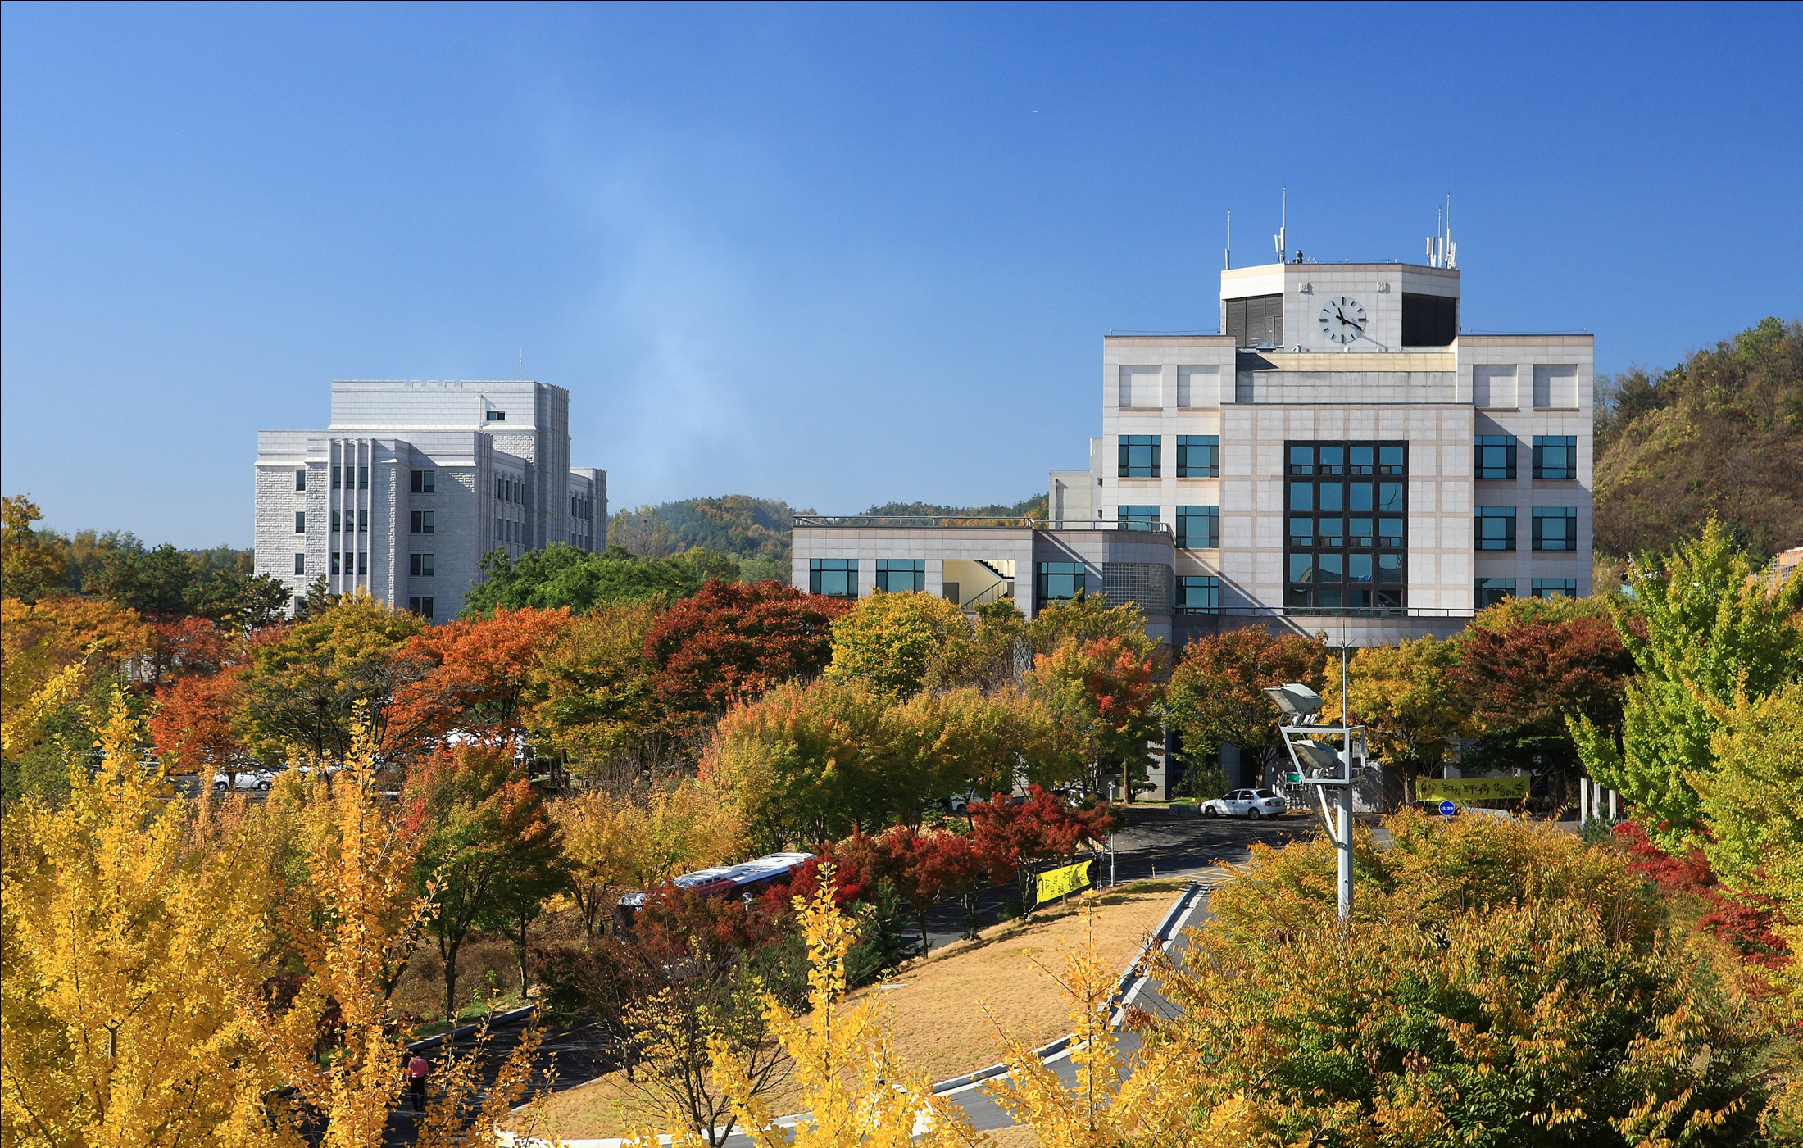
Introducing
Computer Information & Science Dept.(CIS) in Korea University

Slide 2

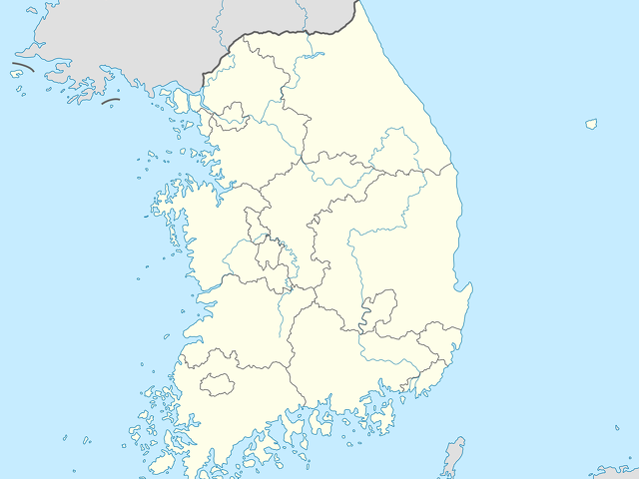
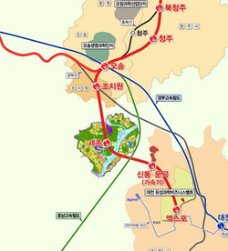


We are in Sejong City

Slide 3
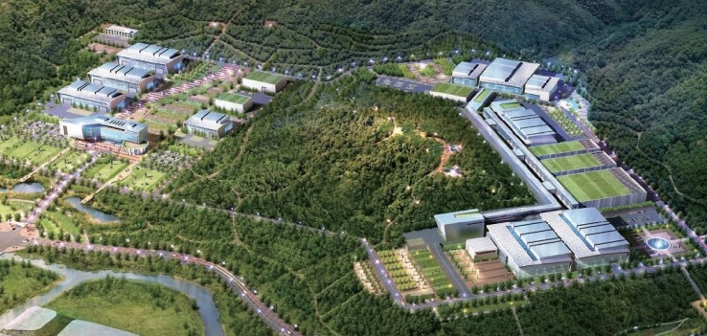
Constructing ISBB is ongoing nearby
ISBB (International Science and Business Belt)
  An area focusing on basic science research
  Mission includes:
    [International] to be globally open research hub
    [Science] to create world-class basic science research environment
      E.g., Establishing a Rare Isotope Accelerator
    [Business] to nurture science-based industries

Slide 4

We were awarded “BK21+” grant
BK21+ Grant Program
  7 year-long Graduate-level Education Support Program
We got awarded!!!
  Under the title of “An Educational Research Team Connected with ISBB”
  Objective : educate graduate students to have SW skills for supporting ISBB, e.g., big data analysis and management, etc.
  2013~2019
Mission
  Educating students with the state-of-art software knowledge
  Training graduate students to have problem solving skills
  Building a research-friendly environment for creative works
  Expanding connection to ISBB

Slide 5
Our graduate school
Provides two degree programs
  Master’s degree program
  PhD degree program
Currently, we have about 30 full-time graduate students
We have 8 research labs
    Intelligent Information System Lab.
    Data Communication and Network Lab.
    DB and Data Mining Lab.
    Software Engineering Lab.
    Security and Parallel Algorithm Lab.
    Network Management Lab.
    Embedded systems & Real-time Computing lab.
    Internet of Things lab.

Slide 6

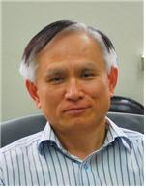
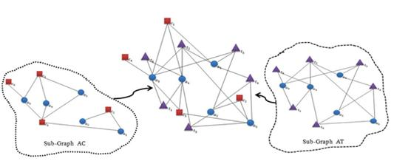
IIS Lab.
http://iis.korea.ac.kr
Faculty
  Dr. In-Jeong Chung, chung@korea.ac.kr
Area of interest
  Semantic Web and Ontology
  Social Web (Social Network Service and Analysis)
  Intelligent Information Systems
  Content Recommendation Systems
  Collective Intelligence
  Sentiment Analysis
Publication (selected)
  A Real Time Process Management System Using RFID Data Mining, Computers in Industry, Vol. 65, Issue 4, pp. 721-732, May 2014
  Contents Recommendation Method Using Social Network Analysis, Wireless Personal Communications, Vol. 73, Issue 4, pp. 1529-1546, Dec. 2013
  Dynamic FOAF management method for social networks in the social web environment, Journal of Supercomputing, Vol. 66, Issue 2, pp. 633-648, Nov. 2013

Slide 7

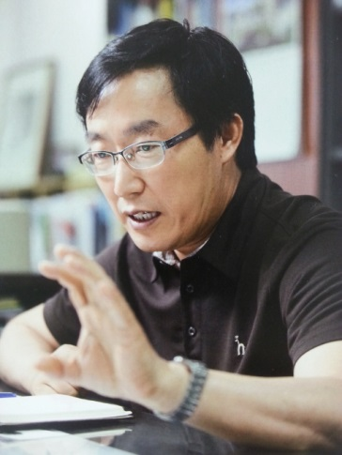
DCN Lab.
ICT Convergence
http://dcn.korea.ac.kr
Faculty
  Dr. Choongho Cho, chcho@korea.ac.kr
Area of interest
  Wireless/Mobile Networks
    Control & Optimization of 5G / LTE-Advanced Celluar network :
    Device-to-Device Communication, M2M
  Enterprise Femtocell based on SDN/Cloud Computing in Next Generation Internet (KOREN)
  ICT Convergence
    Smart Building/Home Energy Management system
    Electric Vehicle Charging System & Scheduling
Publication (selected)
  Information and Communications-based Intelligent Building Energy Monitoring and Efficient Systems, TIIS, 2013
  Performance analysis of a cellular network using frequency reuse partitioning, Performance Evaluation, 2013
  Femtocell Architecture based on SDN (Software Defined Network), KICS, 2013

Slide 8

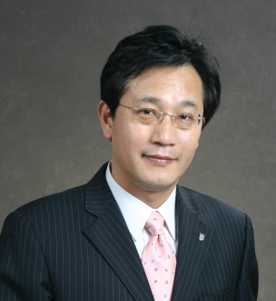
DB & Data Mining Lab.
http://idb.korea.ac.kr
Faculty
  Dr. Daihee Park, dhpark@korea.ac.kr
Area of interest
  Intelligent Database Management Systems & Applications
  Data & Multimedia Mining
  Pattern Analysis & Soft Computing
  CCTV Surveillance Systems
Publication (selected)
- NetCube: A Comprehensive Network Traffic Analysis Model based on Multidimensional OLAP Data Cube, IJNM, 2013.
- Automatic Detection of Cow’s Oestrus in Audio Surveillance System, AJAS, 2013.
- Automatic Detection and Recognition of Pig Wasting Diseases Using Sound Data in Audio Surveillance Systems, Sensors, 2013.
- A Data Clustering using the Modified Gaussian Kernel Metric and the Kernel PCA”, ETRI Journal, 2014.

Slide 9

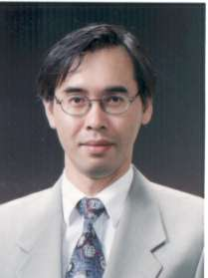
SE Lab.
http://selab.korea.ac.kr
Faculty
  Dr. Taewoong Jeon, jeon@korea.ac.kr
Area of interest
  Construction of Model-Driven CBD (Component-Based Development) Environment
  Methods of specifying essential aspects of software in a formal, abstract model. Methods of verifying and evaluating properties of software through model analysis.
  Model-driven testing methods and supporting testing frameworks
  Application frameworks for mobile applications and context-aware applications
Publication (selected)
  “A Cost-Effective Pigsty Monitoring System Based on a Video Sensor”, KSII Trans. Internet and Information Systems, Vol. 8, No. 4, April 2014
  “Parallel Processing of Multimedia Data in a Heterogeneous Computing Environment”, Multimedia and Ubiquitous Engineering, LNEE 308, 2014
  “Mobile-to-Grid Middleware: Bridging the Gap between Mobile and Grid Environment”, LNCS 3470, February 2005

Slide 10

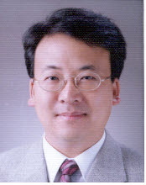
PA Lab.
http://algolab.korea.ac.kr
Faculty
  Dr. Yongwha Chung, ychungy@korea.ac.kr
Area of interest
  Computer Architecture : Multi-core processor, Symmetric/Asymmetric(Heterogeneous)
  Algorithms: Parallel programming, Load balancing
  Performance Indicator: Reducing execution time, Reducing energy consumption
  Applications Area:
    Crypto algorithms
    Compression algorithms
    Image processing algorithms
Publication (selected)
  “Parallelizing H.264 and AES Collectively”, TIIS, 2013
  “Energy-Efficient Image/Video Data Transmission on Commercial Multi-Core Processors", Sensors, 2012

Slide 11
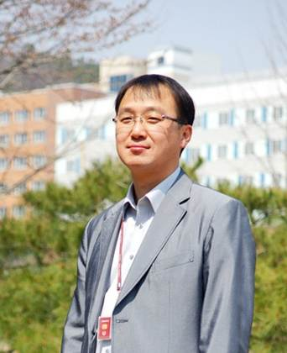

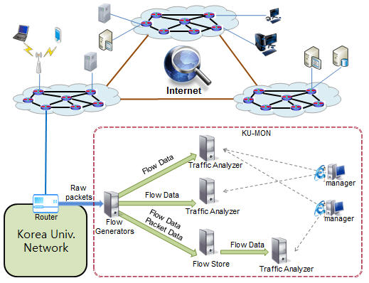
NM Lab.
http://nmlab.korea.ac.kr
Faculty
  Dr. Myung-sup Kim, tmskim@korea.ac.kr
Area of interest
  Internet Traffic Monitoring and Analysis
  Management of Future Internet
  Network and System Management
  Autonomic Network Resource Management
  Application level Networking
Publication (selected)
  M. Choi, J. Park, M. Kim, "An Integrated Method for Application-level Internet Traffic Classification," TIIS, Vol. 8, No. 3, Mar. 2014.
  B. Park, J. Chung, Y. Won, M. Kim, J. W. Hong, "Fine-grained Traffic Classification based on Functional Separation," IJNM, Vol. 23, No. 5, Sep., 2013.
  J. Park, S. Yoon, M. Kim, "Performance Improvement of the Payload Signature based Traffic Classification System using Application Traffic Temporal Locality," APNOMS 2013.

Slide 12

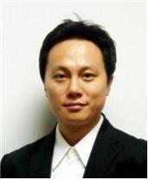
ESRC Lab.
http://esrc.korea.ac.kr
Faculty
  Dr. Hyeonjoong Cho, raycho@korea.ac.kr
Area of interest
  Real-time computing for embedded systems
    Real-time scheduling for multi-core architectures
    Real-time virtual machines for multiprocessors
    Energy-aware and temperature-aware management
  Human-computer interactions
    Gesture recognition-based natural interfaces
    Distance-independent eyes-free methods
Publication (selected)
  H. Cho, B. Ravindran, E. D. Jensen, "T-L Plane-Based Real-Time Scheduling for Homogeneous Multiprocessors�, J. of Parallel and Distributed Computing, 2010
  H. Cho, B. Ravindran, and E. D. Jensen, ��Lock-Free Synchronization for Dynamic Embedded Real-Time Systems", ACM Trans. on Embedded Computing Systems, 2010
  H. Cho, B. Ravindran, E. D. Jensen, "Utility accrual real-time scheduling for multiprocessor embedded systems", J. of Parallel and Distributed Computing, 2010

Slide 13
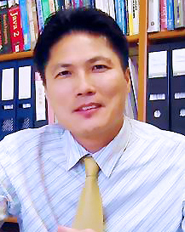
IoT Lab.
http://iis.korea.ac.kr
Faculty
  Dr. Minho Cho, minhojo@korea.ac.kr
Area of interest
  Networks & algorithms, cognitive radio, network security, mobile cloud computing, optimization & probability in networks, cellular networks in 4G & 5G, spectrum sharing, energy-efficient (green) mobile computing, vehicular ad-hoc networks, wireless body area networks, MIMO
Publication (selected)
  An Auto-Scaling Mechanism for Virtual Resources to Support Mobile, Pervasive, Real-Time Healthcare Applications in Cloud Computing, IEEE Network, October 31, 2013
  Selfish Attacks and Detection in Cognitive Radio Ad-hoc Networks, IEEE NetworkJune 15, 2013
  A Fair Transmission Opportunity by Detecting and Punishing the Malicious Wireless Stations in IEEE 802.11e EDCA Network, IEEE Systems Journal, December 31, 2011

Slide 14
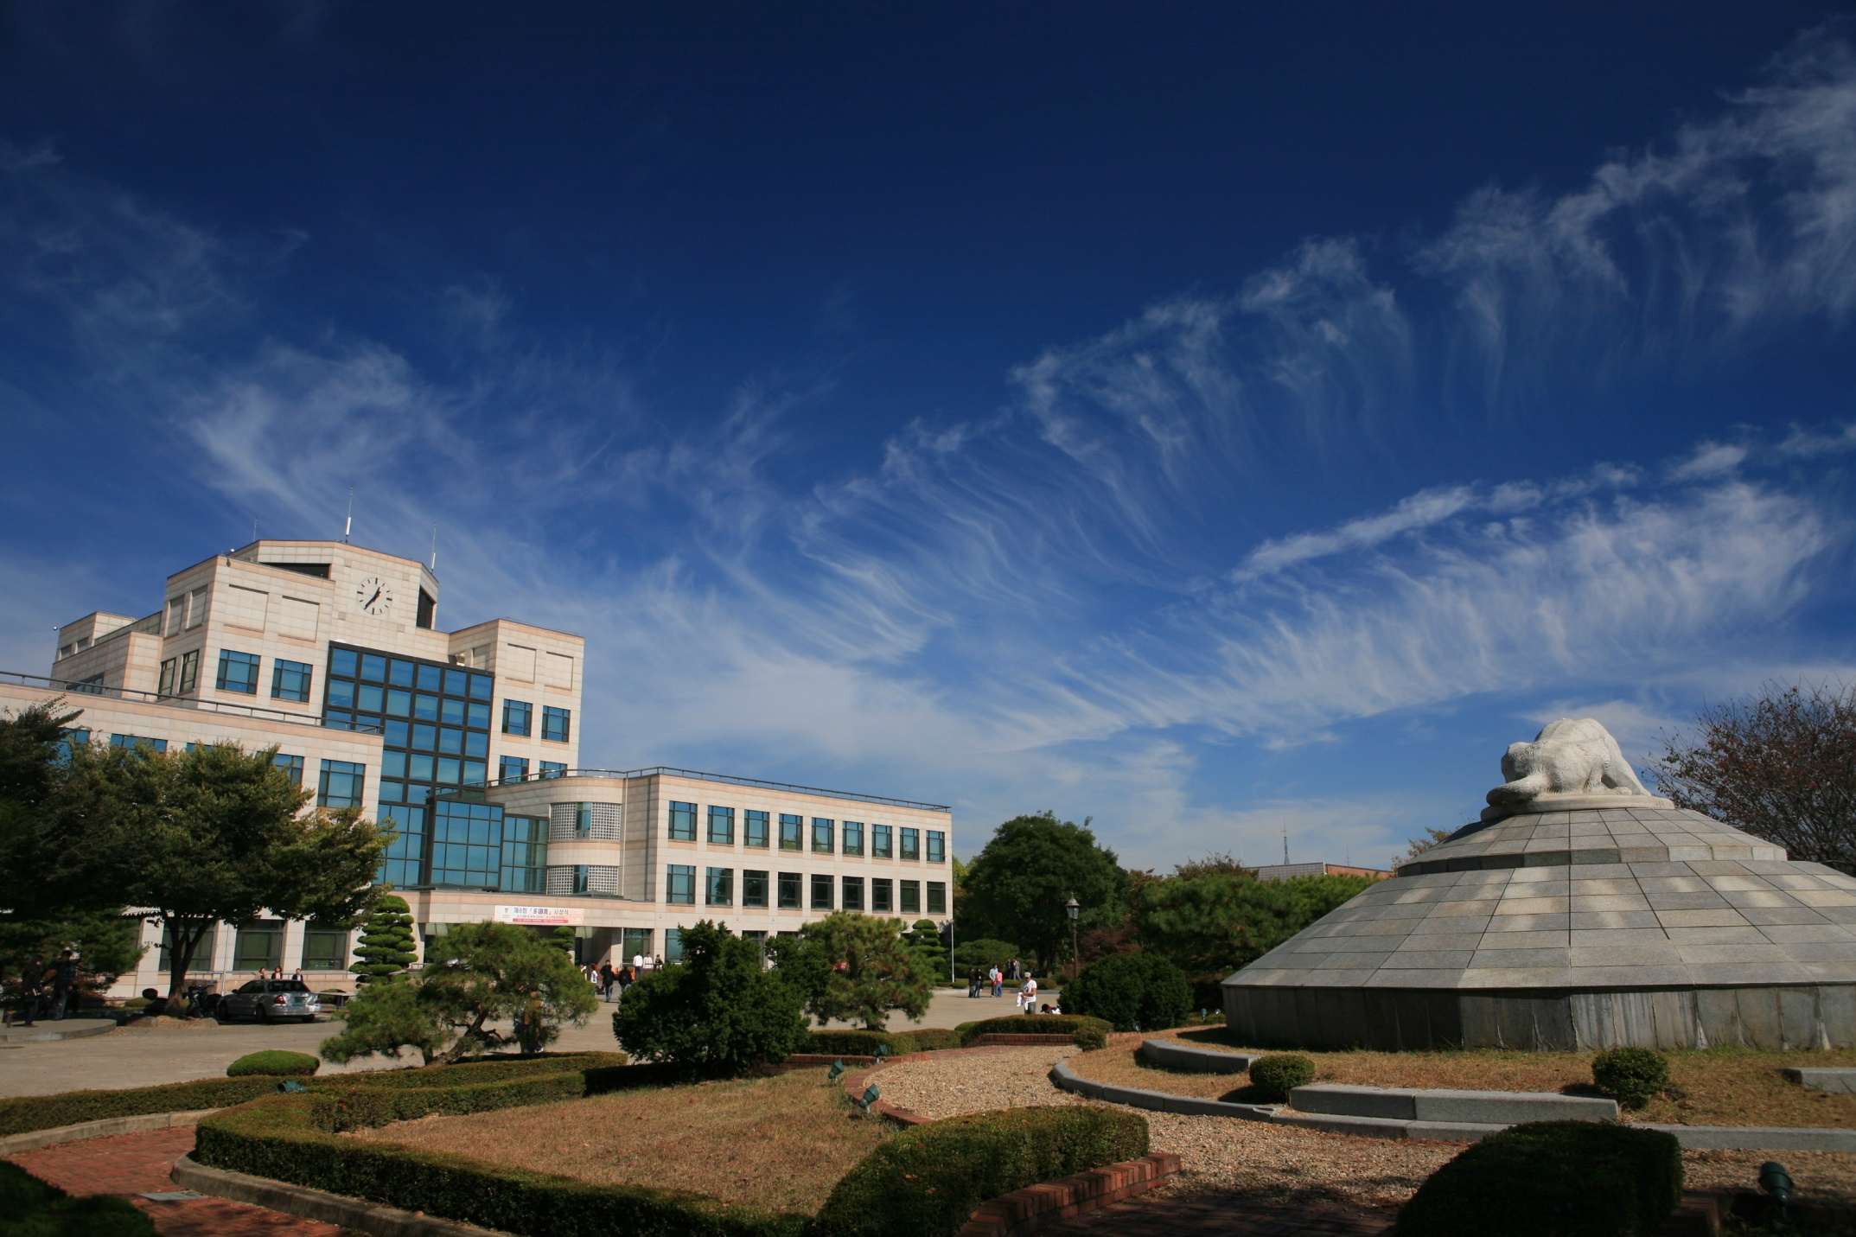
Thank you!

