Slide 1
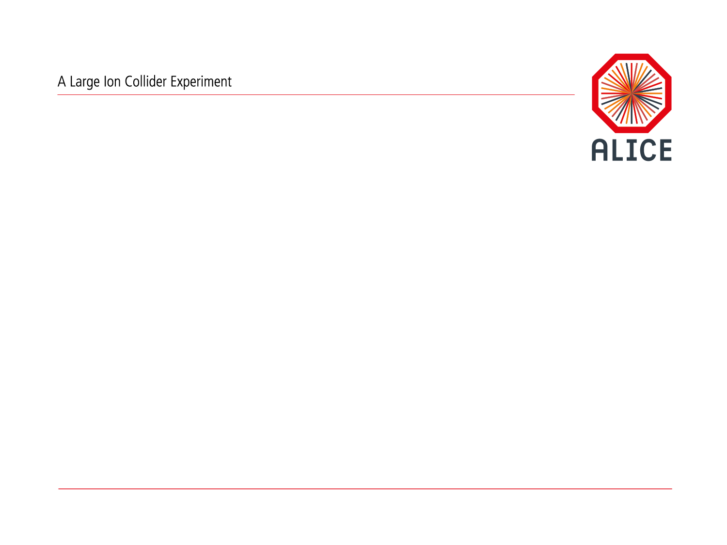
O² Project : Upgrade of the ALICE online and offline computing
Pierre VANDE VYVRE / CERN – PH

Slide 2
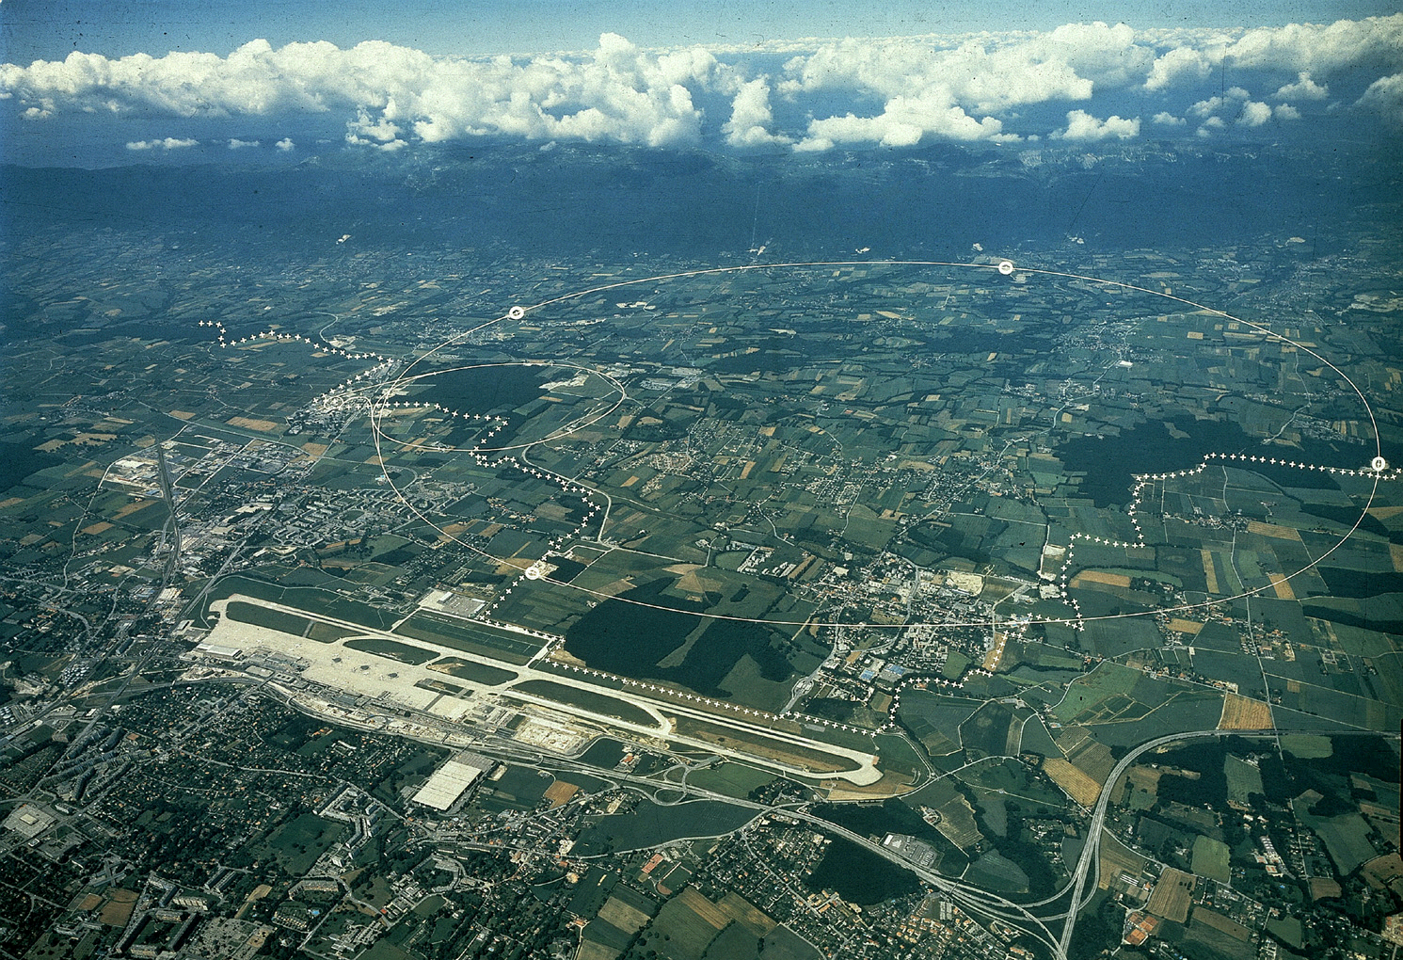
The Large Hadron Collider (LHC) at CERN
LHC
27 km circumference
100 meters underground
Geneva airport

Slide 3
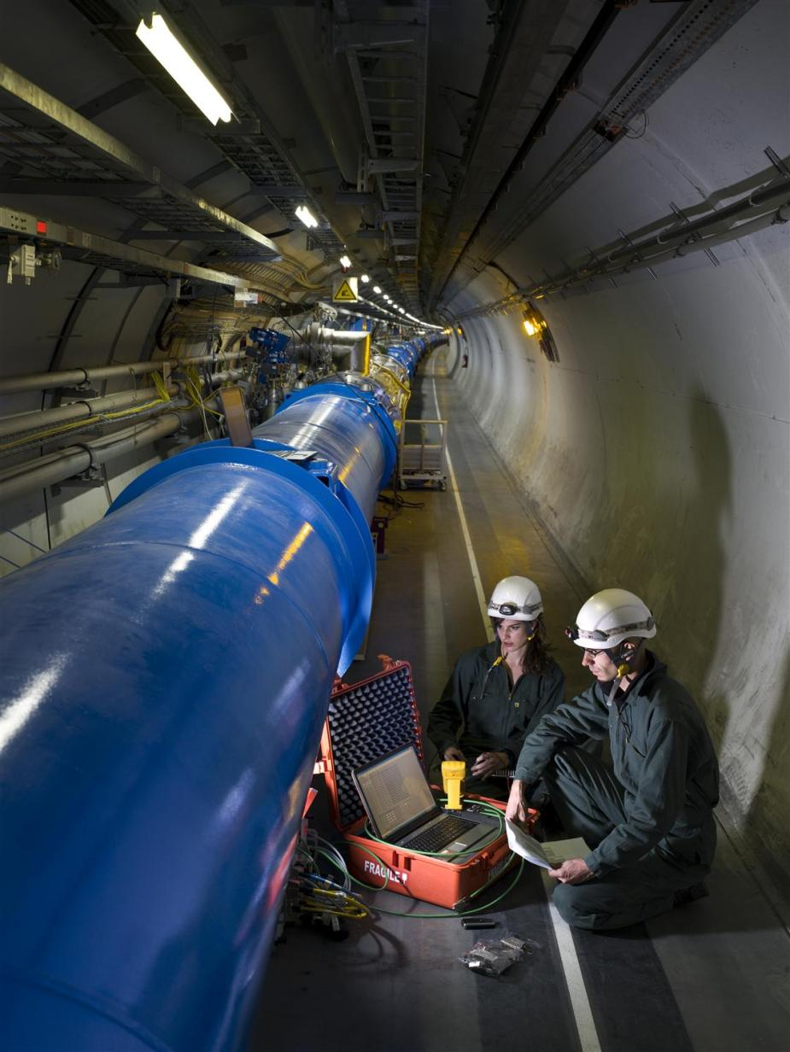
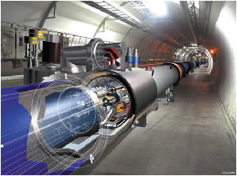
Inside the LHC machine

Slide 4
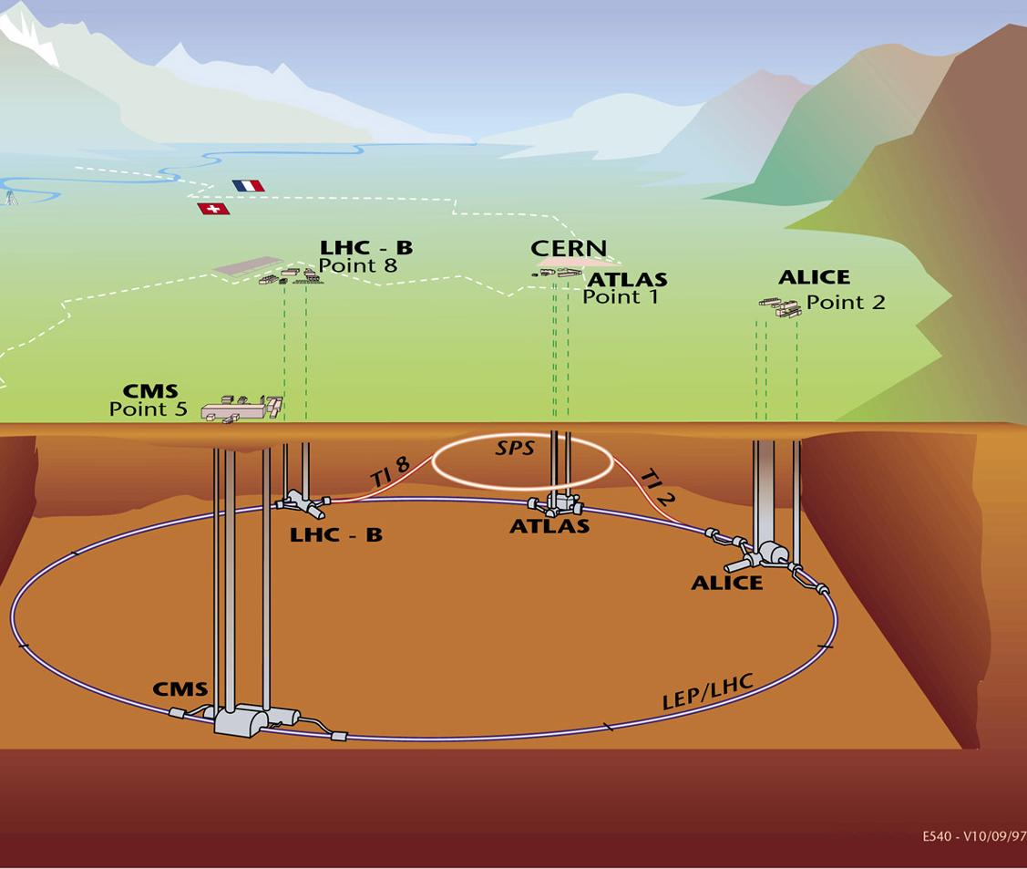
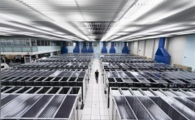


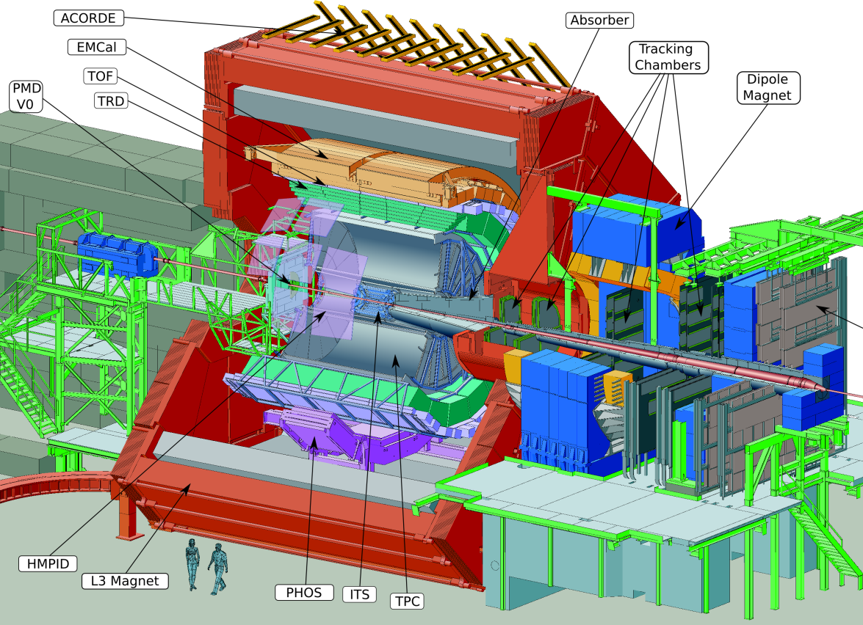


Experiments
4
Underground
“cathedrals”
CERN
Computing
Centre
P. Vande Vyvre-CERN

Slide 5
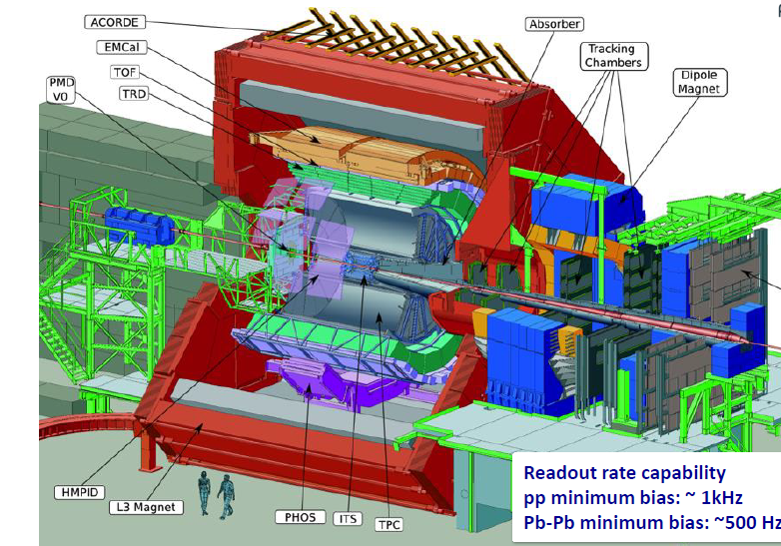
Current status of the ALICE experiment

Slide 6
ALICE Upgrade Strategy
High precision measurements of rare physics probes
  Cannot be selected with a trigger as it is presently the case
  Require a large sample of events recorded on tape
Target of the LS2 upgrade
  Pb-Pb recorded luminosity ≥ 10 nb⁻¹ 8.0 x 10¹⁰ events
  pp recorded luminosity ≥ 6 pb⁻¹ 1.4 x 10¹¹ events
Gain a factor 100 in statistics over the present performance
  Read-out all Pb-Pb interactions at a maximum rate of 50 kHz with a minimum bias trigger
  Perform online data reduction based on reconstruction of cluster and tracks
Significant improvement of vertexing and tracking capabilities
  Entirely new Inner Tracking System (ITS)
  Upgrade of the Time Projection Chamber (TPC) to allow a faster read-out

Slide 7
Requirements for the Computing System
Online System Requirements
Sample full 50kHz Pb-Pb interaction rate
current limit at ~500Hz, factor 100 increase
system to scale up to 100 kHz
⇨ ~1.1 TByte/s detector readout
However:
Storage bandwidth limited to a much lower value (design decision/cost)
Many physics probes have low S/B:
classical trigger/event filter approach not efficient

Slide 8
O² System from the Letter of Intent
Design Guidelines
Handle >1 TByte/s detector input
Produce (timely) physics result
Minimize “risk” for physics results
  Allow for reconstruction with improved calibration,
  e.g. store clusters associated to tracks instead of tracks
  Minimize dependence on initial calibration accuracy
  Implies “intermediate” storage format
Keep cost “reasonable”
  Limit storage system bandwidth
  to ~80 GB/s peak and 20 GByte/s average
  Optimal usage of compute nodes
Reduce latency requirements & increase fault-tolerance
Online Reconstruction to
reduce data volume
Output of System AODs

Slide 9
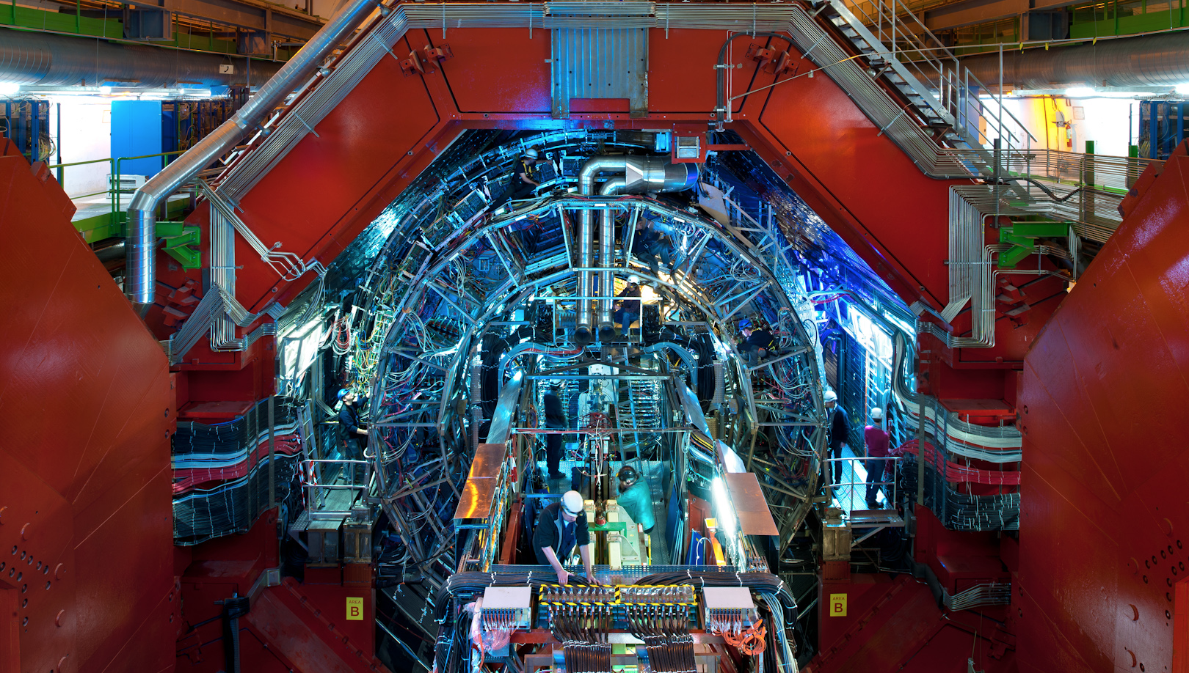


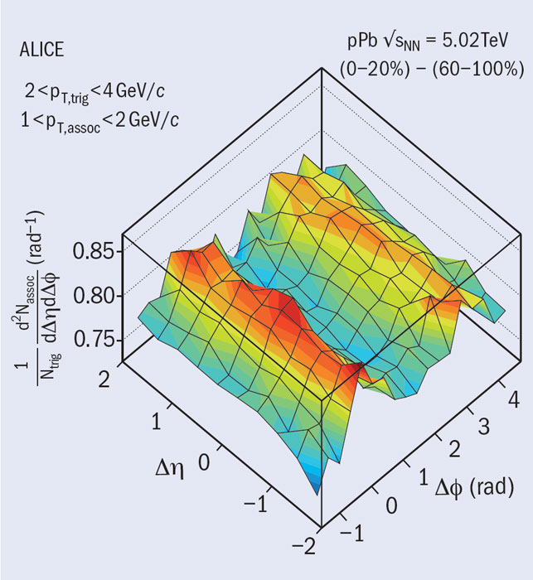
O² Project
Detector | Input to Online System (GByte/s) | Peak Output to Local Data Storage (GByte/s) | Avg. Output to Computing Center (GByte/s)
TPC | 1000 | 50.0 | 8.0
TRD | 81.5 | 10.0 | 1.6
ITS | 40 | 10.0 | 1.6
Others | 25 | 12.5 | 2.0
Total | 1146.5 | 82.5 | 13.2
Requirements
Handle >1 TByte/s detector input
Support for continuous read-out
Online reconstruction to reduce data volume
Common hw and sw system developed by the DAQ, HLT, Offline teams

Slide 10
O² Project
Project Organization
PLs: P. Buncic, T. Kollegger, P. Vande Vyvre
Computing Working Group (CWG) Chair
Architecture S. Chapeland
Tools & Procedures A. Telesca
Dataflow T. Breitner
Data Model A. Gheata
Computing Platforms M. Kretz
Calibration C. Zampolli
Reconstruction R. Shahoyan
Physics Simulation A. Morsch
QA, DQM, Visualization B. von Haller
Control, Configuration, Monitoring V. Chibante
Software Lifecycle A. Grigoras
Hardware H. Engel
Software framework P. Hristov
Editorial Committee
L. Betev, P. Buncic, S. Chapeland, F. Cliff, P. Hristov, T. Kollegger, M. Krzewicki, K. Read, J. Thaeder, B. von Haller, P. Vande Vyvre
Physics requirement chapter: Andrea Dainese
O² CWGs
O²
Technical
Design
Report

Slide 11
Hardware Architecture
ITS
FLP
Farm
Network
Storage
Network
~ 2500 DDL3s
in total
2 x 10 or
40 Gb/s
10 Gb/s
TPC
FLP
EPN
10 Gb/s
TRD
FLP
FLP
EPN
Data
Storage
EMC
PHO
FLP
Data
Storage
EPN
TOF
FLP
Muon
FLP
L0
L1
EPN
FTP
FLP
Trigger Detectors
~ 250 FLPs
First Level Processors
~ 1250 EPNs
Event Processing Nodes

Slide 12



Design strategy
Iterative process: design, benchmark, model, prototype
Design
Technology
benchmarks
Model
Prototype

Slide 13
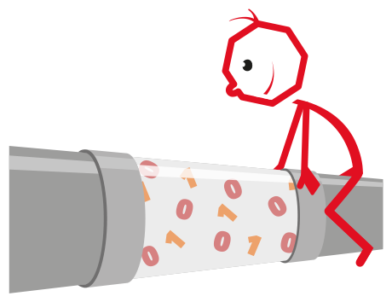

Dataflow
Dataflow modelling
Dataflow discrete event simulation implemented with OMNET++
  FLP-EPN data traffic and data buffering
    Network topologies (central switch; spine-leaf),
    Data distribution schemes (time frames, parallelism)
    Buffering needs
    System dimensions
  Heavy computing needs
  Downscaling applied for some simulations:
    Reduce network bandwidth and buffer sizes
    Simulate a slice of the system
System global simulation with ad-hoc program

Slide 14

Hardware Architecture: FLP-EPN data transport model
E_{i+3} E_{i+2} E_{i+1} E_{i}
FLP
Farm
Network
10 x 10 Gb/s
2 x 10 or
40 Gb/s
FLP
EPN
E_{i}
E_{i+1}
E_{i+2}
E_{i+3}
10 Gb/s
FLP
Simulations parameters
- 250 FLPs (200 for TPC), 1250 EPNs
- Data compression in FLP: now 4, LoI:~7, use 4 for system
design and simulation
Network bandwidth
  $\sum_{n=1}^{250}{FLP Bwin=\left(25 MB∗50 kHz\right)=1.25 TB/s }$
  $\sum_{n=1}^{250}{FLP Bwout=\frac{1.25\frac{TB}{s}}{4}=0.3 TB/s=2.5 Tb/s }$
  $FLP Min Bwout =\left(2.5\frac{Tb}{s}\right)/256=10 Gb/s$
  10 Gb/s does not leave any headroom.
  Use 40 Gb/s as baseline. Compatible with industry evolution
FLP
EPN
FLP
EPN
FLP
FLP
EPN
FLP
~ 2500 DDL3s
~ 250 FLPs
First Level Processors
~ 1250 EPNs
Event Processing Nodes

Slide 15

Hardware Architecture: FLP-EPN traffic shapping
E_{i+3} E_{i+2} E_{i+1} E_{i}
FLP
Farm
Network
10 x 10 Gb/s
40 Gb/s
FLP
EPN
E_{i}
E_{i+1}
E_{i+2}
E_{i+3}
40 Gb/s
FLP
FLP
EPN
Constraints
  Ensure the total data throughput
  Optimize the number of concurrent I/O
Data transfer
  $FLP Max Bwout to 1 EPN=\left( 40\frac{Gb}{s}\right)/250=160 Mb/s$
  $FLP Min Parallel transfer to EPNs=\frac{\left( 10\frac{Gb}{s}\right)}{160}\sim 64 transfers$
  A minimum of ~16’000 concurrent data transfers at any time
FLP
EPN
FLP
FLP
EPN
FLP
~ 2500 DDL3s
~ 250 FLPs
First Level Processors
~ 1250 EPNs
Event Processing Nodes

Slide 16
Hardware Architecture: FLP buffer size
E_{i+3} E_{i+2} E_{i+1} E_{i}
Bin
FLP
Farm
Network
10 x 10 Gb/s
40 Gb/s
Bout
FLP
EPN
E_{i}
E_{i+1}
E_{i+2}
E_{i+3}
40 Gb/s
FLP
FLP
EPN
FLP
Time frame for the continuous detector readout
TPC FLP subEventSize = 20 MB / 200 = 0.1 MB
TPC drift time 100 us, 5 overlapping events at 50 kHz
Nb event frame >> Nb event at the “borders”
Number events >> ~4 (@50 kHz)
1000 events → 100 MB timeframe / FLP
256 FLPs → ~25 GB timeframe / EPN
FLP Buffer usage
Input buffer for partial timeframes aggregation
Data waiting to be processed
Data processing buffers
Output buffer for timeframes being sent to EPNs
EPN
FLP
FLP
EPN
FLP
~ 2500 DDL3s
~ 250 FLPs
First Level Processors
~ 1250 EPNs
Event Processing Nodes

Slide 17
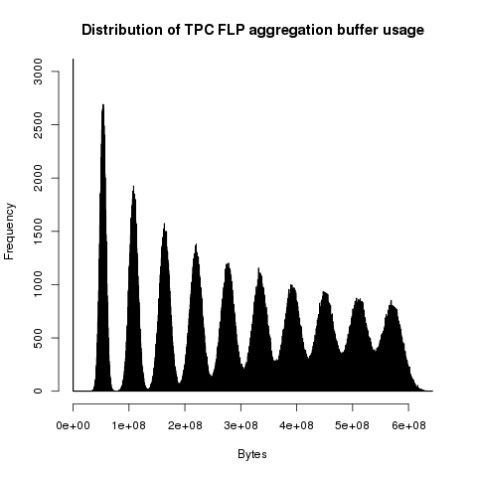
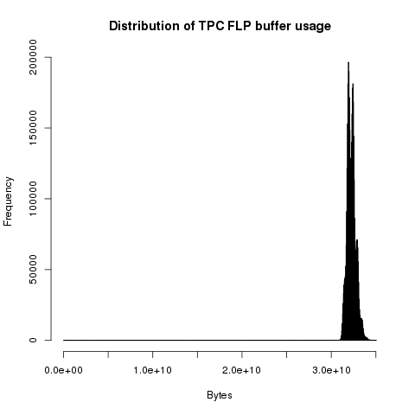
FLP-EPN Dataflow simulation
S. Chapeland, C. Delort
TPC FLP memory usage
Configuration: 40 Gbps 250x1250
Asynchronous arrival of data blocks with a normal
distribution from 10 DDLs in the FLP
Algorithms used for FLP buffer management and
data distribution to the EPN adequate.
Buffering needs of ~32 GB with no tail.

Slide 18
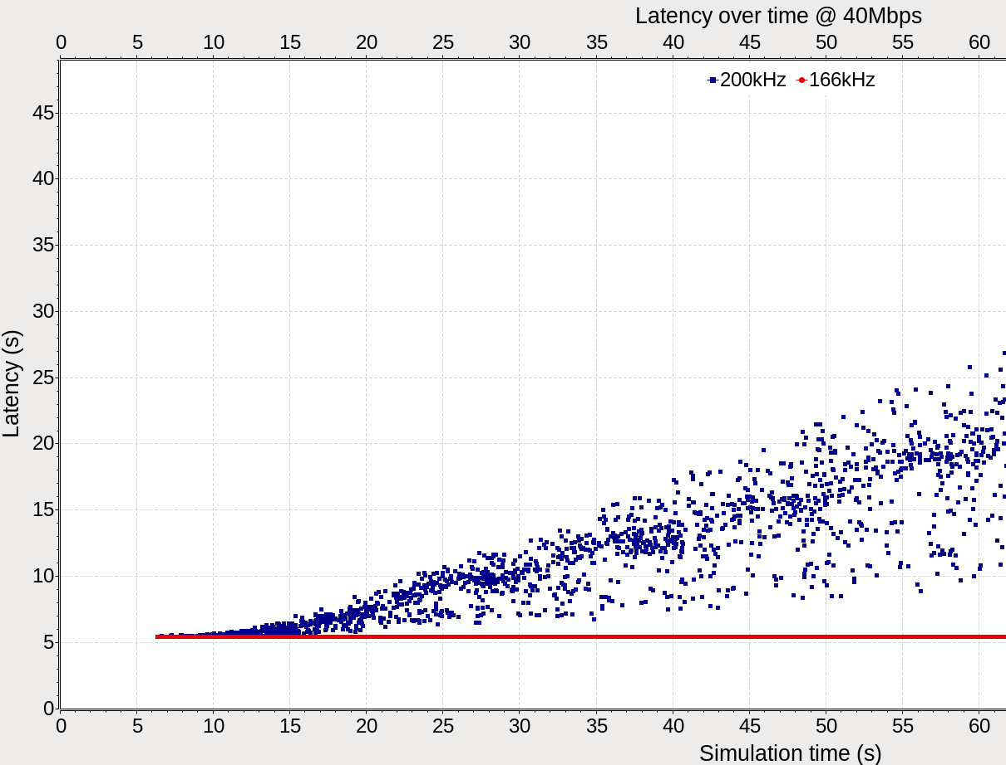
FLP-EPN Dataflow simulation
S. Chapeland, C. Delort
System scalability study
Configuration 40 Mbps 250x288
System scalability study
System studied on
a ¼ of the entire system
and lower bandwidth
to limit the simulation time
System scales at up to
166 kHz of MB interactions

Slide 19
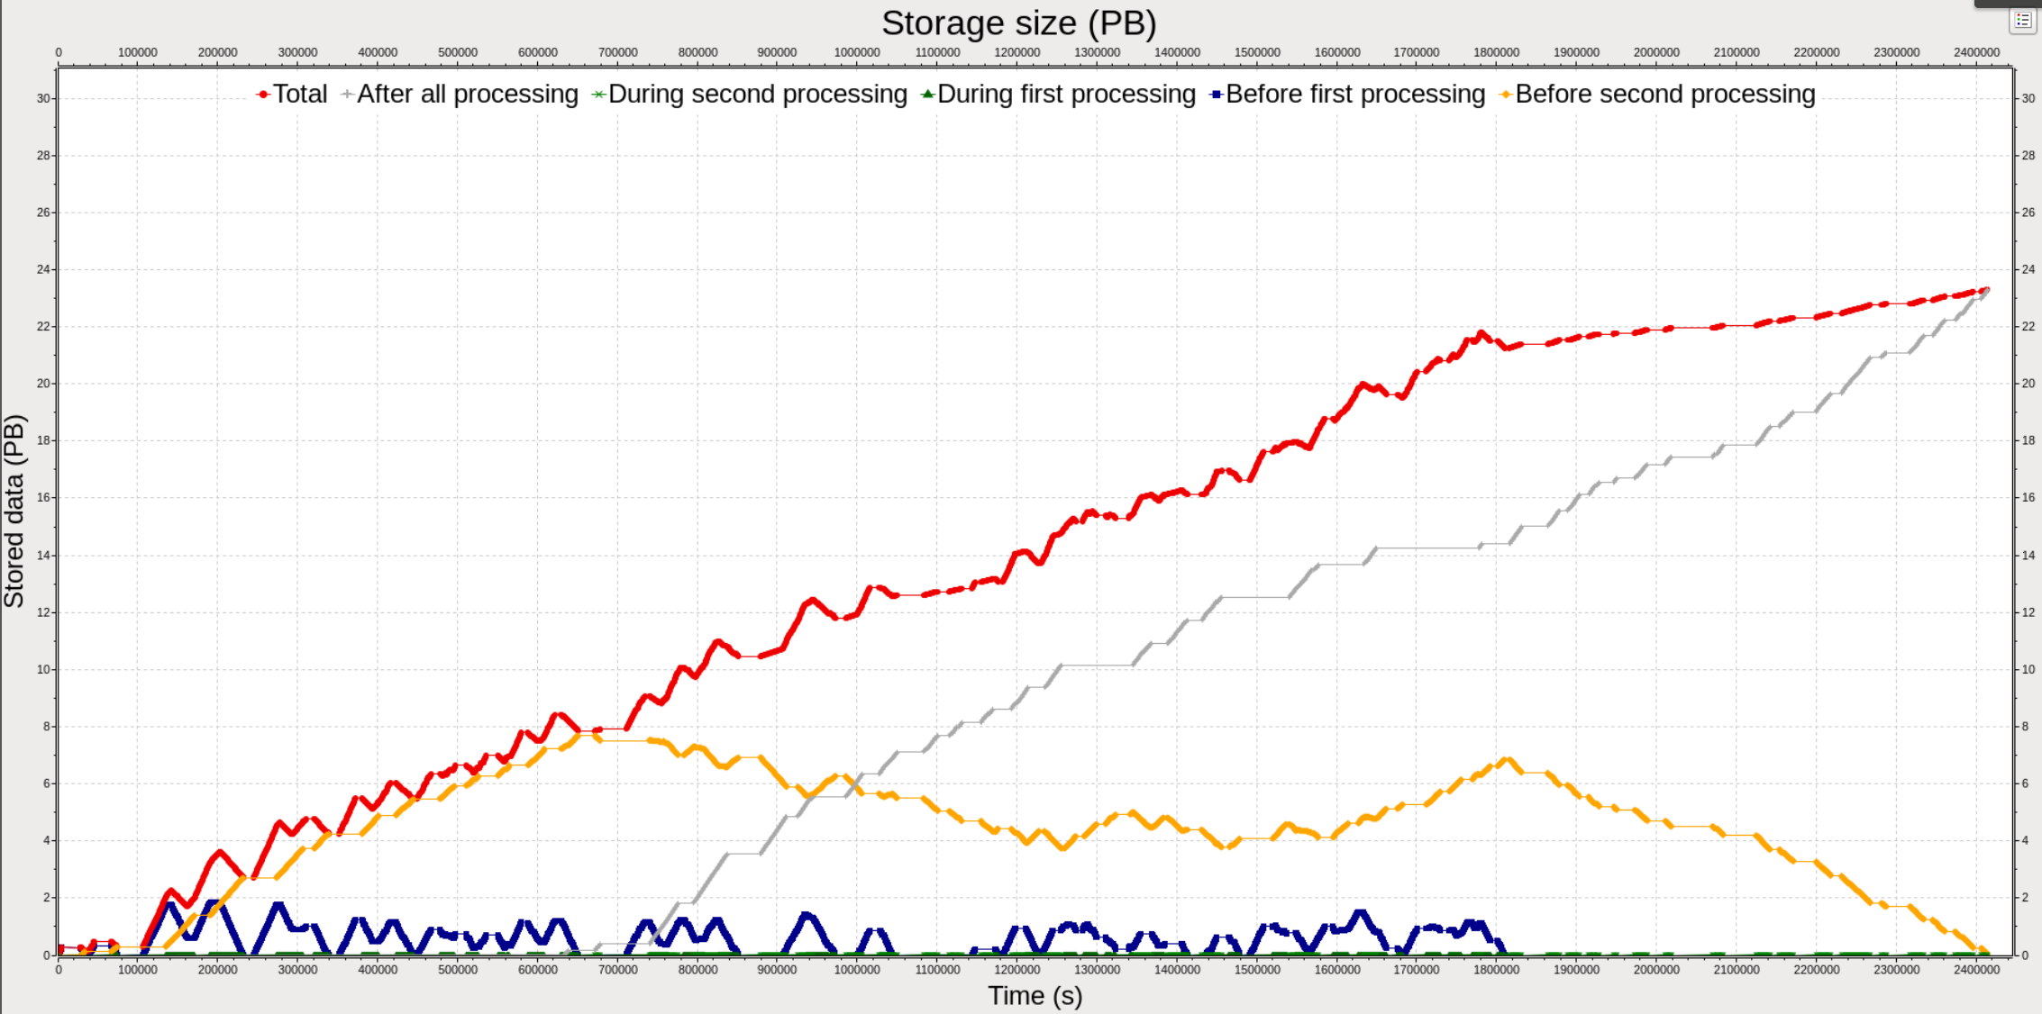
Data storage needs of the O² facility
dk
Need of ~25 PB of local data storage for 1 year of data taking

Slide 20

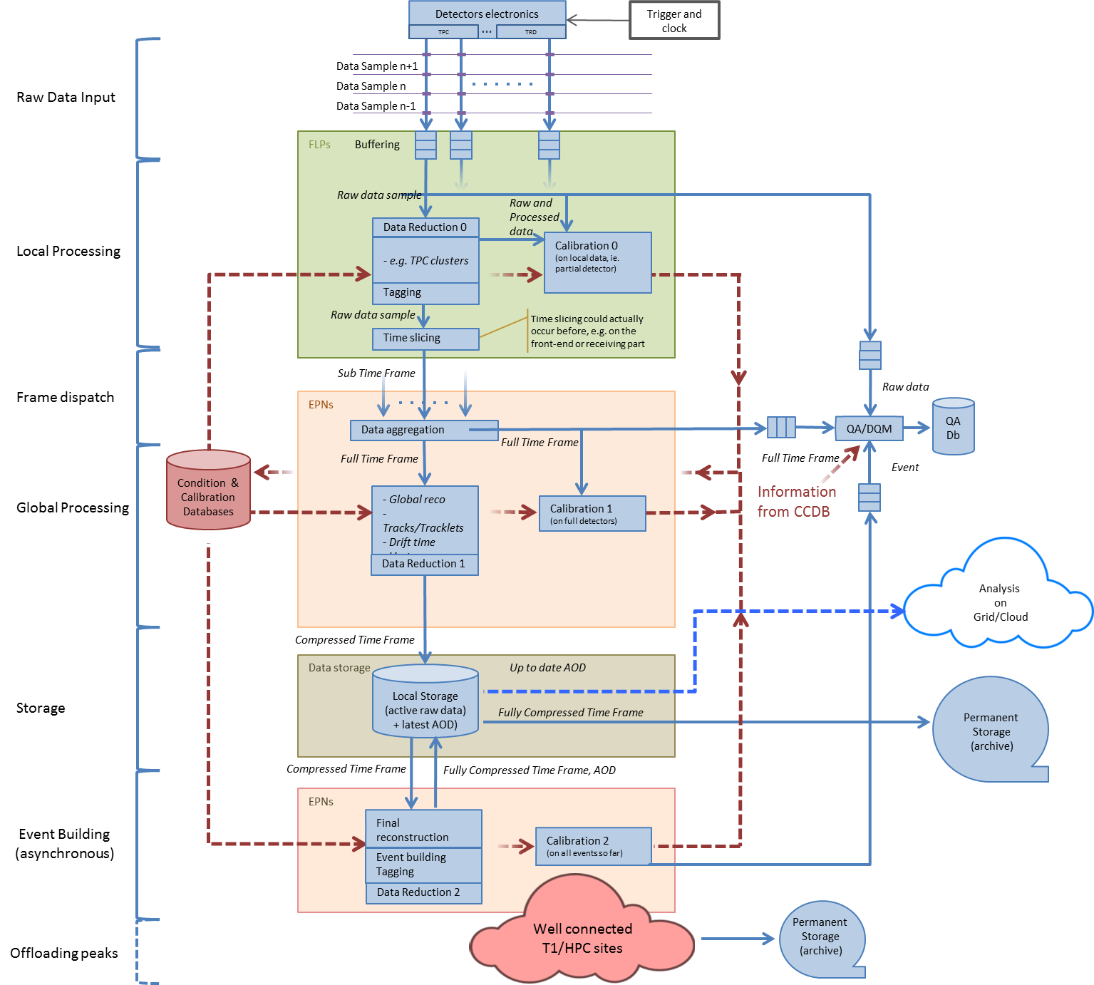
Architecture
O² Architecture and data flow
TPC Data
1 TB/s
250 GB/s
125 GB/s
80 GB/s
  Includes now asynchronous processing and offloading
  peaks to other sites.

Slide 21
Detector Readout via Detector Data Links (DDLs)
Common Interface to the Detectors:
DDL1 (2.125 Gbit/s)
DDL2 (5.3125 Gbit/s)
DDL3 (>=10 Gbit/s)
  10 Gbit Ethernet
  PCIe bus
More development of VHDL code still needed. Looking for more collaborators in this area.

Slide 22
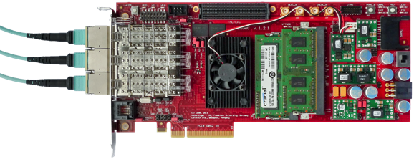
PC Input/Output Bandwidth
ALICE CRORC
F. Costa
PCIe Gen2 performance measured for the LoI
PCIe Gen3 measured with a FPGA development board
(Xilinx Virex-7 Connectivity Kit VC709)
  Large data blocks: wire speed 8 GB/s, theoretical max 7.2, measured 5.8
  Very low performance with small block sizes: more tests will be performed
  FLP I/O capacity needed will at least require: 3 slots PCIe Gen 3 x8 or 2 slot x16
Current generation of I/O bus could be used for the upgrade

Slide 23
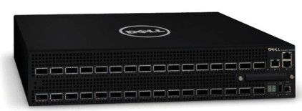
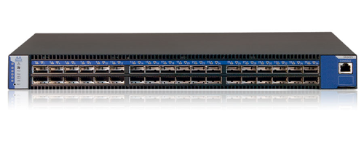
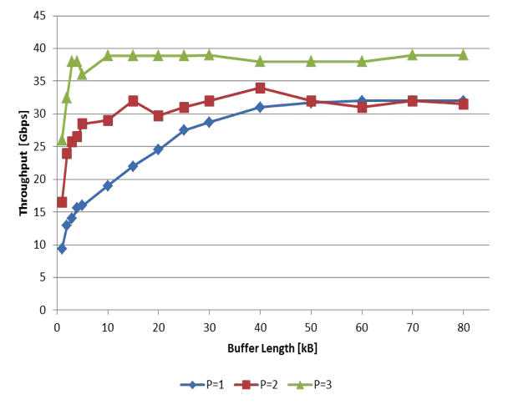
FLP and Network prototyping
FLP requirements
  Input 100 Gbit/s (10 x 10 Gbit/s)
  Local processing capability
  Output with ~20 Gbit/s
Two network technologies under evaluation
  10/40 Gbit/s Ethernet
  Infiniband FDR (56 Gbit/s)
  Both used already
  (DAQ/HLT)
Benchmark example
Chelsio T580-LP-CR with
TCP/UDP Offload engine
1, 2 and 3 TCP streams,
iperf measurements

Slide 24

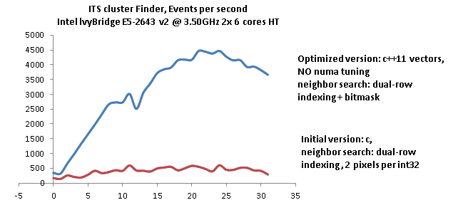
Computing Platforms
ITS Cluster Finder
Use the ITS cluster finder as optimization use case and as benchmark
Initial version memory-bound
Several data structure and algorithms optimizations applied
More benchmarking of detector-specific code still needed.
Looking for more collaborators in this area.
Events processed/s
Number of parallel processes
S. Chapeland

Slide 25
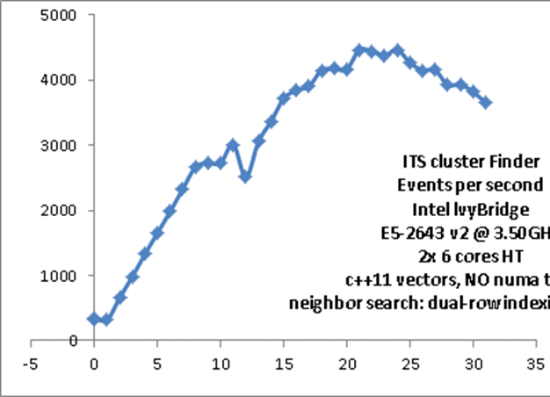
Computing Platforms
ITS Cluster Finder
S. Chapeland
Intel IvyBridge E5-2643 v2 3.5 GHz
2 x 6 cores with Hyper-Threading (HT)
C++11 vectors, no NUMA tuning, neighbor search: dual-row indexing + bitmask
Performance scalability of a dual-CPU server used for ITS cluster finder
  1-6 linear increase with # cores
  7-12 penalty when threads running on the second CPU
  13-18 HT fully effective
  19-24 limited gain
  >24 performance penalty
Future work
  Non-Uniform Memory Access (NUMA) tuning
Events processed/s
Number of parallel processes
Mem.
CPU
CPU
Mem.
Mem.
Mem.
NUMA

Slide 26
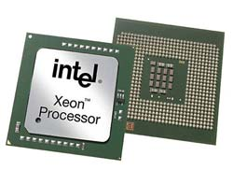
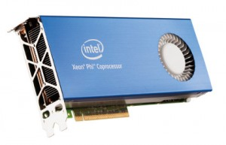
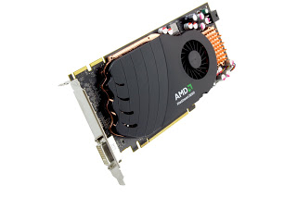
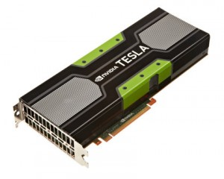
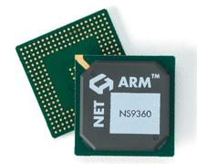
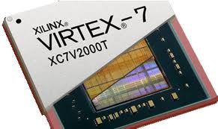
CWG5: Computing Platforms
  The Conversion factors
Shift from 1 to many platforms
Speedup of CPU Multithreading:
  Task takes n1 seconds on 1 core, n2 seconds on x cores
  Speedup is n1/n2 for x cores, Factors are n1/n2 and x/1
  With Hyperthreading: n2‘ seconds on x‘ threads on x cores. (x‘ >= 2x)
  Will not scale linearly, needed to compare to full CPU performance.
    Factors are n1 / n2‘ and x / 1 (Be carefull: Not x‘ / 1, we still use only x cores.)
Speedup of GPU v.s. CPU:
  Should take into account full CPU power (i.e. all cores, hyperthreading).
  Task on the GPU might also need CPU resources.
    Assume this occupies y CPU cores.
  Task takes n3 seconds on GPU.
  Speedup is n2‘/n3, Factors are n2‘/n3 and y/x. (Again x not x‘.)
How many CPU cores does the GPU save:
  Compare to y CPU cores, since the GPU needs that much resources.
  Speedup is n1 / n3, GPU Saves n1 / n3 – y CPU cores.
  → Factors are n1 / n3, y / 1, and n1 / n3 - y.
Benchmarks: Track Finder, Track Fit, DGEMM (Matrix Multiplication – Synthetic)

Slide 27
CWG5: Computing Platforms
  Track finder
Nehalem 4-Core 3,6 GHz (Smaller Event than others)
1 Thread | 3921 ms | Factors:
4 Threads | 1039 ms | 3,77 / 4
12 Threads (x = 4, x‘ = 12) | 816 ms | 4,80 / 4
Westmere 6-Core 3.6 GHz
1 Thread | 4735 ms | Factors:
6 Threads | 853 ms | 5.55 / 6
12 Threads (x = 4, x‘ = 12) | 506 ms | 9,36 / 6
Dual Sandy-Bridge 2 * 8-Core 2 GHz
1 Thread | 4526 ms | Factors:
16 Threads | 403 ms | 11,1 / 16
36 Threads (x = 16, x‘ = 36) | 320 ms | 14,1 / 16
Dual AMD Magny-Cours 2 * 12-Core 2,1 GHz
36 Threads (x = 24, x‘ = 36) | 495 ms
3 CPU Cores + GPU – All Compared to Sandy Bridge System
 |  | Factor vs x‘ (Full CPU) | Factor vs 1 (1 CPU Core)
GTX580 | 174 ms | 1,8 / 0,19 | 26 / 3 / 23
GTX780 | 151 ms | 2,11 / 0,19 | 30 / 3 / 27
Titan | 143 ms | 2,38 / 0,19 | 32 / 3 / 29
S9000 | 160 ms | 2 / 0,19 | 28 / 3 / 25
S10000 (Dual GPU with 6 CPU cores | 85 ms | 3,79 / 0,38 | 54 / 6 / 48

Slide 28
O² System
Storage
“Intermediate” format:
Local storage in O2 system
Permanent storage in
computing center
GRID storage
AODs
Simulations

Slide 29

Data Storage
80 GB/s over ~1250 nodes
Option 1: SAN
(currently used in the DAQ)
Centralized pool of storage arrays,
Dedicated network
5 racks (same as today)
would provide 40 PB
Option 2: DAS
Distributed data storage: 1 or
a few 10 TB disks in each node

Slide 30

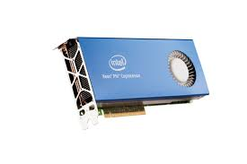





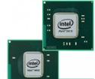
Software Framework
Multi-platforms
Multi-applications
Public-domain software
Analysis
Clusters
Simulation
Tracking
Analysis
PID
ESD
AOD

Slide 31

Software Framework Development
Design and development of a new modern framework targeting Run3
Should work in Offline and Online environment
  Has to comply with O² requirements and architecture
Based on new technologies
  Root 6.x, C++11
Optimized for I/O
  New data model
Capable of utilizing hardware accelerators
  FPGA, GPU, MIC…
Support for concurrency and distributed environment
Based on ALFA - common software foundation
developed jointly between ALICE & GSI/FAIR
ALFA
Common Software Foundations
O²
Software
Framework
FairRoot
Large development in progress.
Looking for more collaborators in this area.
See presentation of P. Hristov:
“Software framework development”
PandaRoot
CbmRoot

Slide 32
Software Framework Development
ALICE + FAIR = ALFA
Expected benefits
  Development cost optimization
  Better coverage and testing of the code
  Documentation, training and examples.
  ALICE : work already performed by the FairRoot team concerning features (e.g. the continuous read-out), which are part of the ongoing FairRoot development.
  FAIR experiments : ALFA could be tested with real data and existing detectors before the start of the FAIR facility.
The proposed architecture will rely:
  A dataflow based model
  A process-based paradigm for the parallelism
    Finer grain than a simple match 1 batch on 1 core
    Coarser grain than a massively thread-based solution

Slide 33
Prototyping
EPN
Software components
EPN
FLP
Merger
EPN
FLP
EPN
Merger
FLP
EPN
EPN
Test set-up
  8 machines
    Sandy Bridge-EP, dual E5-2690 @ 2.90GHz, 2x8 hw cores - 32 threads, 64GB RAM
  Network
    4 nodes with 40 G Ethernet, 4 nodes with 10 G Ethernet
Software framework prototype by members of DAQ, HLT, Offline, FairRoot teams
  Data exchange messaging system
  Interfaces to existing algorithmic code from offline and HLT

Slide 34


Calibration/reconstruction flow
MC Reference TPC map
Adjusted accounting for current luminosity
Average TPC map
One EPN
Exact partitioning of some components between
real-time, quasi-online and offline processing depends on (unknown) component CPU performance
Rescaled TPC map
Standalone
Adjusted with multiplicity
FIT → multiplicity
Matching to
TOF, HMPID,
calorimeters
TRD seeded
track finding and matching with TPC
TPC
track finding
All FLPs
DCS data
Global track
inward fitting
ITS track finding/fitting
Vertexing
Final TPC calibration
(constrained
by ITS, TRD)
Final
ITS-TPC matching,
outward refitting
Raw data
TPC-ITS
matching
PID calibrations
Clusterization
Calibration
MOUN track finding/fitting
MUON/MFT
matching
V0, Cascade
finding
MFT track finding/fitting
…
Event building:
(vertex, track, trigg association)
Compressed data storage
AOD storage
Step 1
Step 2
Step 3
Step 4

Slide 35

Control, Configuration and Monitoring
Large computing farm with many concurrent activies
Software Requirements Specifications
Tools survey document
Tools under test
Monitoring: Mona Lisa, Ganglia, Zabbix
Configuration: Puppet, Chef
Reconstruction /
AOD Production
Data Reduction
System design and evaluation
of several tools in progress.
Looking for more collaborators in this area.
Time
Start LHC Fill
Beam Dump

Slide 36

O² Project
Institutes (contact person, people involved)
  FIAS, Frankfurt, Germany (V. Lindenstruth, 8 people)
  GSI, Darmstadt, Germany (M. Al-Turany and FairRoot team)
  IIT, Mumbay, India (S. Dash, 6 people)
  IPNO, Orsay, France (I. Hrivnacova)
  IRI, Frankfurt, Germany (Udo Kebschull, 1 PhD student)
  Jammu University, Jammu, India (A. Bhasin, 5 people)
  Rudjer Bošković Institute, Zagreb, Croatia (M. Planicic, 1 postdoc)
  SUP, Sao Paulo, Brasil (M. Gameiro Munhoz, 1 PhD)
  University Of Technology, Warsaw, Poland (J. Pluta, 1 staff, 2 PhD, 3 students)
  Wiegner Institute, Budapest, Hungary (G. Barnafoldi, 2 staffs, 1 PhD)
  CERN, Geneva, Switzerland (P. Buncic, 7 staffs and 5 students or visitors)
  (P. Vande Vyvre, 7 staffs and 2 students)
Looking for more groups and people
  Need people with computing skills and from detector groups
Active interest from (contact person, people involved)
  Creighton University, Omaha, US (M. Cherney, 1 staff and 1 postdoc)
  KISTI, Daejeon, Korea
  KMUTT (King Mongkut's University of Technology Thonburi), Bangkok, Thailand
  (T. Achalakul, 1 staff and master students)
  KTO Karatay University, Turkey
  Lawrence Berkeley National Lab., US (R.J. Porter, 1 staff and 1 postdoc)
  LIPI, Bandung, Indonesia
  Oak Ridge National Laboratory, US (K. Read, 1 staff and 1 postdoc)
  Thammasat University, Bangkok, Thailand (K. Chanchio)
  University of Cape Town, South Africa (T. Dietel)
  University of Houston, US (A. Timmins, 1 staff and 1 postdoc)
  University of Talca, Chile (S. A. Guinez Molinos, 3 staffs)
  University of Tennessee, US (K. Read, 1 staff and 1 postdoc)
  University of Texas, US (C. Markert)
  Wayne State University, US (C. Pruneau)
Institutes

Slide 37
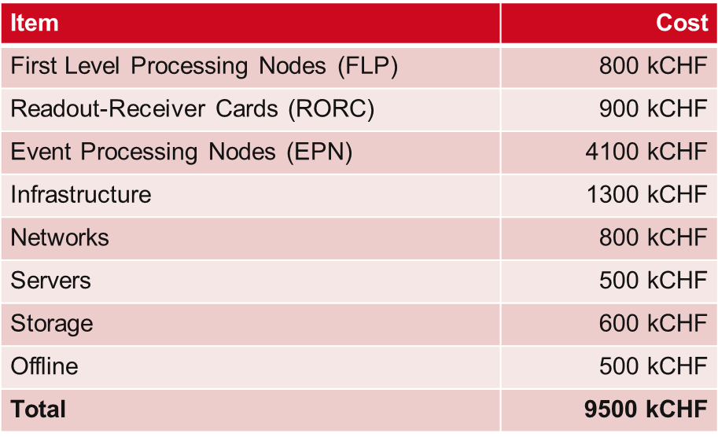
Budget
~80% of budget covered
Contributions possible by cash or in-kind
Continuous funding for GRID assumed

Slide 38
Future steps
A new computing system (O²) should be ready for the ALICE upgrade during the LHC LS2 (currently scheduled in 2018-19).
The ALICE O² R&D effort has started in 2013 and is progressing well but additional people and expertise are still required in several areas:
  VHDL code for links and computer I/O interfaces
  Detector code benchmarking
  Software framework development
  Control, configuration and monitoring of the computing farm
The project funding is not entirely covered.
Schedule
  June ‘15 : submission of TDR, finalize the project funding
  ‘16 – ’17: technology choices and software development
  June ’18 – June ’20: installation and commissioning

