Slide 1

FCC news

Slide 2
FCC-ee Collaborations:
-- Detectors: had contact with ILD and SiD spokespersons to follow up on suggestion by some
of their members to use these detectors as benchmark for FCC-ee
-- positive answer from Ties Benhke (ILD) ;
+ agreed to share talks at respective meetings
+ collaboration on software via AIDA2.
-- ‘no manpower available’ from SiD -- except from CERN-CLIC group.
Neither are binding collaborations, so collaborators are free to do as desire
-- many collaborators interested mostly on physics studies for the moment
(FCC-ee detector studies are not yet perceived as critical except for low angle region)
NB: MOU makes sense for several institutes which are not already part of LHC
or for particularly vital theorists
i.e. QED calculations related to luminosity measurement
Bhabha rad.scat (beam lifetime)
and other obstacles to precision measurements.

Slide 3
FCC news from ICHEP2014 Valencia
-- generally the meeting was very much geared up as ILC celebration.
-- excellent talks and posters from FCC at various sessions (accelerator and physics)
-- FCC definitely on the map of future projects (including electron collider) as described by
Swapan Chattopadhyay (session on future accelerators)
and Nick Walker (plenary session): although his time scales (ILC 2028, FCC 2038) are
somewhat «ILC-optimistic» he clearly acknowledged that ‘physics should decide’ and that
for lower energies such as 250 GeV, circular collider e+e- is clearly better.
-- ICFA meeting reiterated support for the ILC but also that
“ICFA continues to encourage international studies of circular colliders, with an ultimate goal
of proton-proton collisions at energies much higher than those of the LHC”.
(Which is meant as support both for IHEP’s CepC+CppC and CERN FCCs)
-- my (personal) reading of the situation (from discussions with Japanese colleagues)
-- Japan will keep ILC option open until results from LHC come out in 2-3 years from now.
--HyperK process likely to be on hold until then, although collaboration is preparing actively

Slide 4
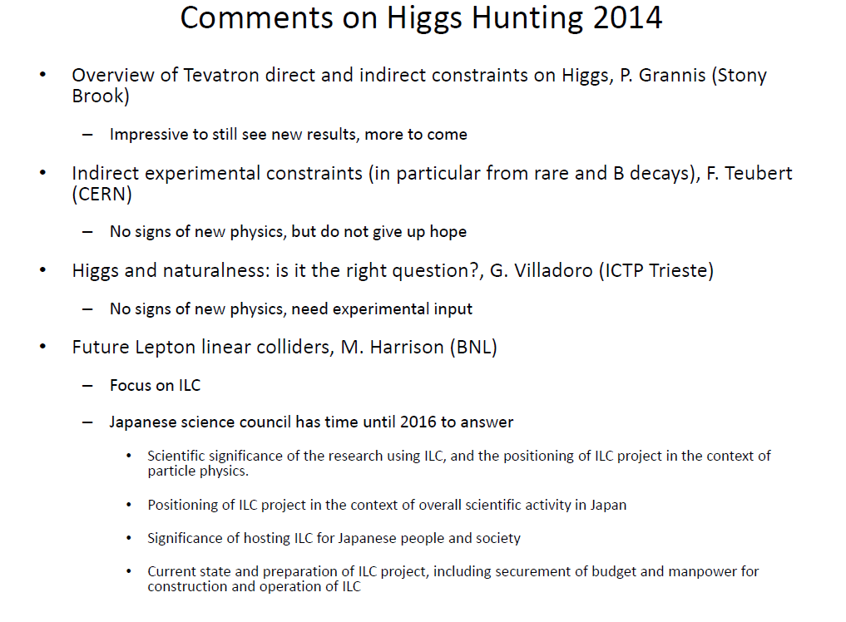
from Fabiola

Slide 5
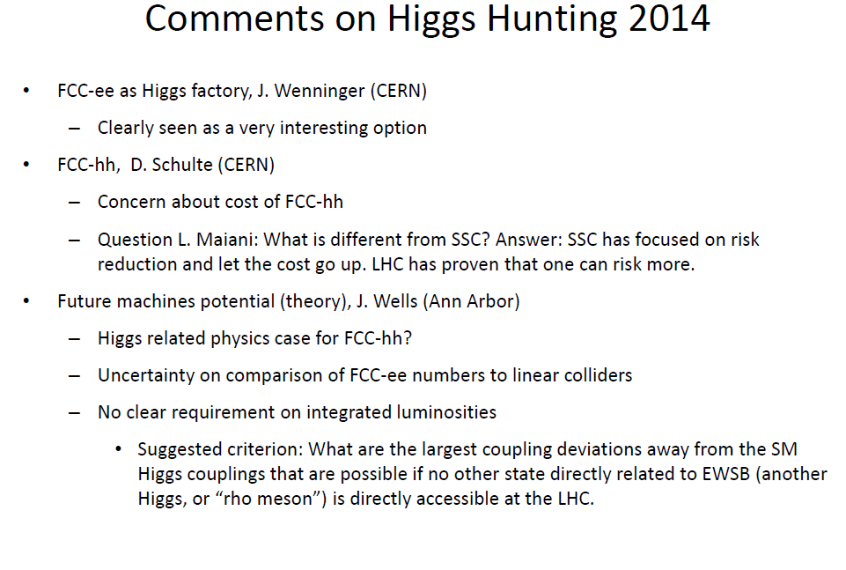

Slide 6
The first FCC international collaboration board meeting is taking place on the 9th and 10th September.
The 8th FCC-ee Physics Workshop will take place on the 27-29 October in Paris
the Pisa group has volunteered to organize the 9th one at the beginning of 2015.
A general FCC Workshop is being considered for April next year.
AND....
http://twitter.com/TLEP_FCCee

