Slide 1

FCC news
1st September 2014 back to school!

Slide 2
NEWS
1. Have a look at the FCC-ee news:
http://tlep.web.cern.ch/sites/tlep.web.cern.ch/files/FCC-ee-news-July2014.pdf
and follow
http://twitter.com/TLEP_FCCee
2. last time I gave reports on ICFA meeting, ICHEP Valencia, Higgs Hunting 2014
this time can report on Rencontres du Vietnam «Physics at LHC and beyond»
https://indico.cern.ch/event/300048/ where certainly FCC was very much on the map!
(see summary by J. Virdee)
3. Markus Klute is part of the organization committee for the LCWS14 as representation of
FCC-ee -- hopefully a good way to connect.
Also discussions on their way to be able to use ILD as one of the benchmark detectors
for FCC-ee
4. recall here the goals of the FCC physics coordination

Slide 3
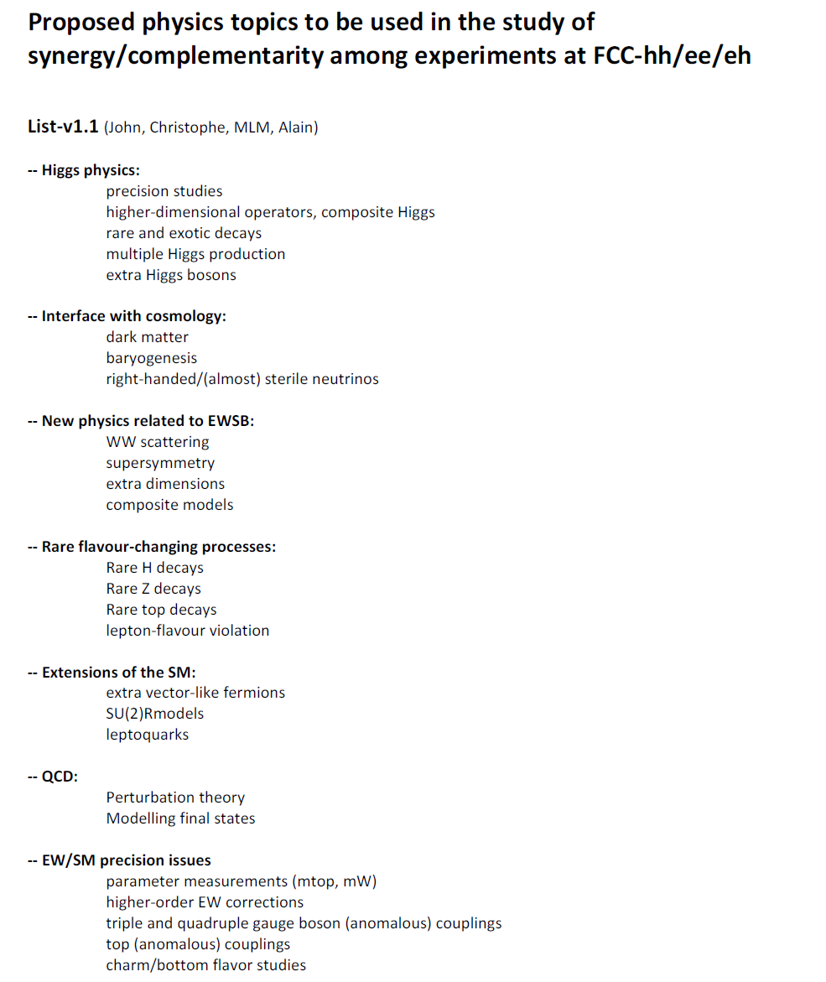

Slide 4
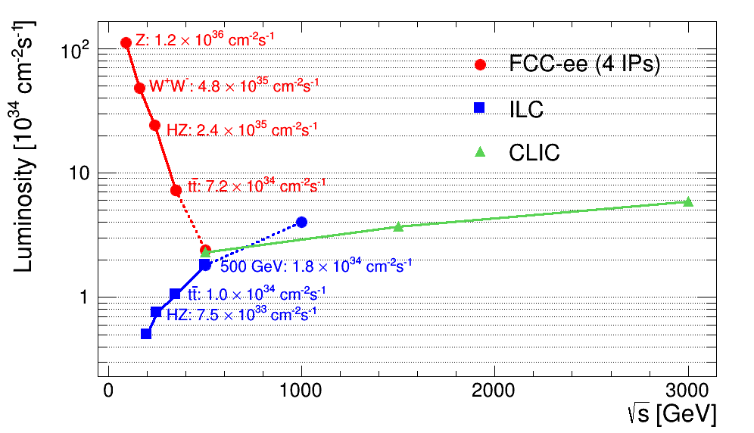
Goal performance of e+ e- colliders
FCC-ee as Z factory: 10¹² Z
(possibly even 10¹³ with crab-waist)
possible
upgrade
complementarity
ww
NB: ideas for lumi upgrades:
ILC arxiv:1308.3726 (not in TDR. Upgrade at 250GeV by reconfiguration after 500 GeV running; under discussion)
FCC-ee (crab waist)

Slide 5
The first FCC international collaboration board meeting is taking place on the 9th and 10th September.
I would like to re-issue the interest of MOUs for people working on FCC-ee design studies (all but esp detectors and software) in particular as a way to provide support for funding requests.
The FCC-ee conveners meeting will be 12 September in the morning
The 8th FCC-ee Physics Workshop will take place on the 27-29 October in Paris
the Pisa group has volunteered to organize the 9th one at the beginning of 2015.
The general FCC Workshop is planned March 23 to 27, 2015
by then
1. we should have a first paper outlining the entries in the physics goals map and further content
2. all working groups should be operational!
3. having software running is a high priority!

