Slide 1
Web application component mapping
Noé Fernández

Slide 2
The Problem
Dozens of emails/day
Lack of information
  Users don’t know what is involved
Complex environment
  Huge number of systems
  Each system has more subsystems
Notes:
The IMS Section receives dozens of emails/day of things that are not working properly
Sometimes this emails doesn´t have all the required information to indentify the problem, because

Slide 3

Current situation
No generic tools
Unintuitive small tools
  Without relationships
Text based

Slide 4
The Project challenge
Search engine
  Different ways to show the information
Information on demand
Notes:
My Project provides a search engine , which is responsible to search for the right systems and as a result to generate a readable format for users.

Slide 5
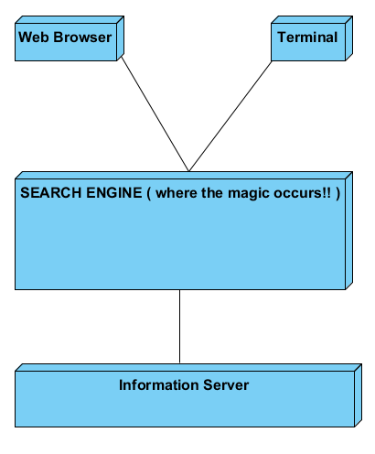
Personal Solution

Slide 6
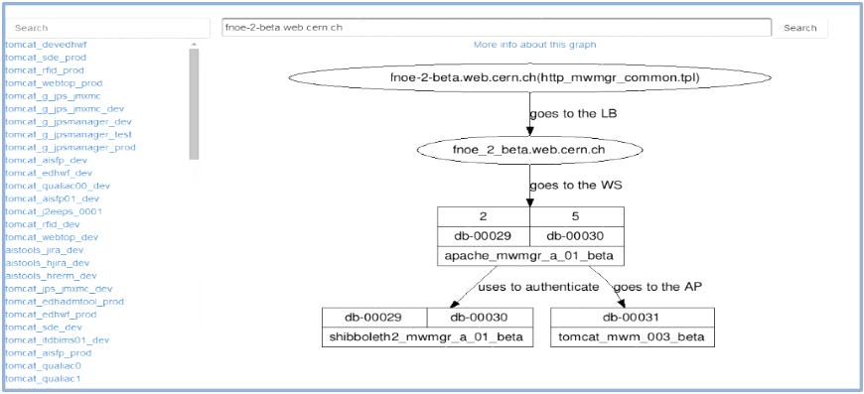
Personal Solution
Web Interface

Slide 7
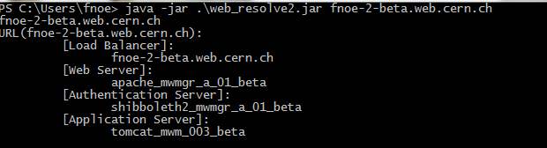
Personal Solution
Command line tool

Slide 8
The Project Impact
User friendly
Productivity
  Instant queries
Expandable
  Ability to show new types of information

Slide 9
Web application component mapping
Noé Fernández

