Slide 1
Knowledge Transfer at CERN
N.Ziogas
Knowledge Transfer Group

Slide 2
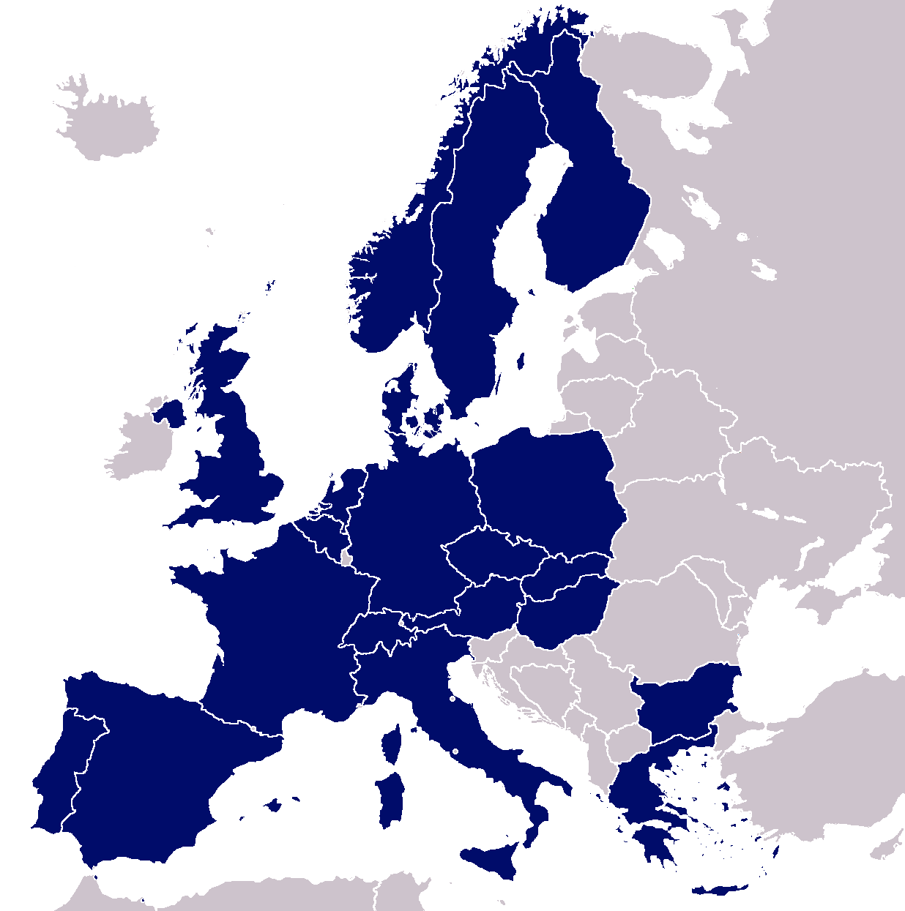
Knowledge Transfer Aims
Maximizing the technological and knowledge return to the Member States industry and society in general
Promoting CERN’s image as a center of excellence for technology

Slide 3
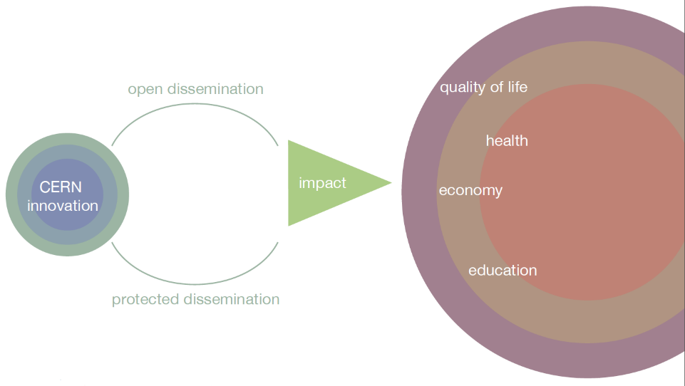
Impact-driven Innovation Approach
Key words: dissemination and impact
Notes:
Have to innovate e.g LHC is a 27 km cryogenic installation at 1.9 K. You can’t go out any buy that stuff.
Our mission is to transfer these innovations (through open or protected dissemination) in order to
Have impact in society (quality, health, economy, education)

Slide 4
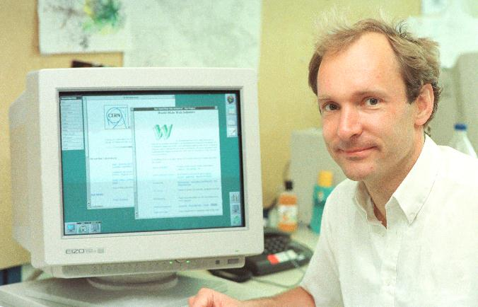
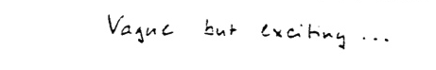

The World Wide Web
Invented at CERN in 1989 by British scientist Tim Berners-Lee and has grown to revolutionize communication worldwide

Slide 5
How? – The Knowledge Exchange
Service Agreements
Training (Research Programs, Events, Outreach)
Consortia & exploitation agreements
R&D Collaborations
Licensing (Open, Protected)
Know-How Exchange
Procurement
Consultancy agreements
Patents
Spin Out Companies and Incubators
Notes:
Collaboration agreements
Joint R&D
Others
Service agreements
Consultancy agreements
Consortia & exploitation agreements
Through Procurement
Licensing
Open
Protected
Patents
Know-how exchange
(Trade secrets)
Spin out companies & Incubators
Training
Research programs
Events & Conferences
Students & Outreach

Slide 6
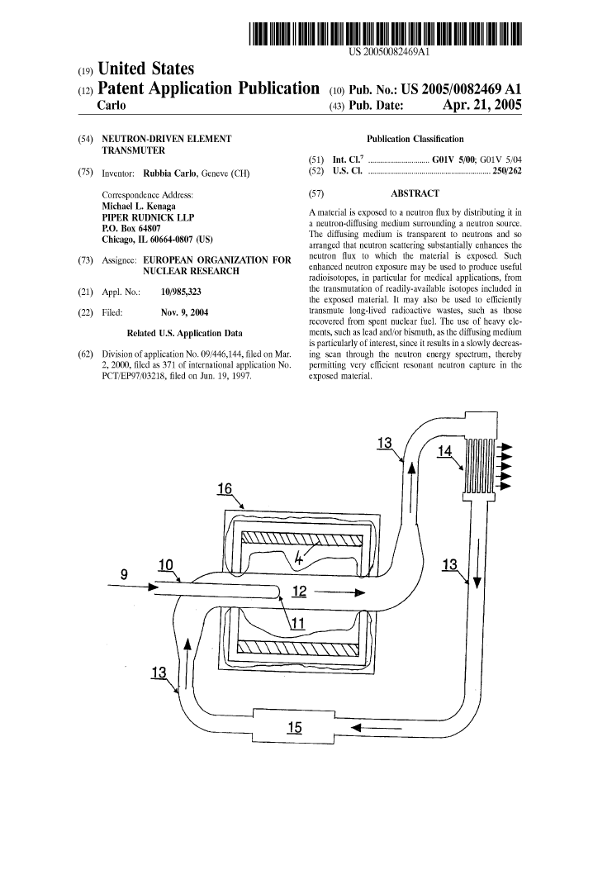
CERN and patents
Strategic motivation:
  “Promote and enhance the image of the organization as a source of innovation and economic activities”
Patents are taken when it:
Increases the probability of having the technology transferred (justify development investments from industry)
Significantly enhances the commercial value
Is needed to ensure CERNs recognition as inventor
Notes:
The patent in the picture is the Energy Amplifier by Nobel Laureate Carlo Rubia and one of the earlier patents taken by CERN!

Slide 7
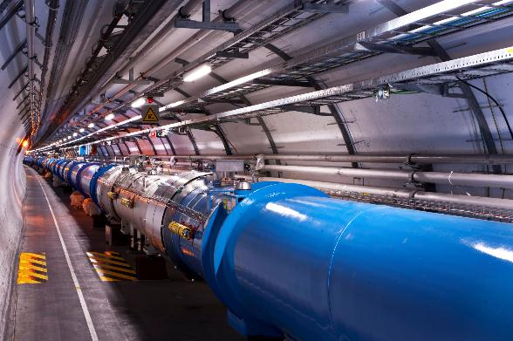
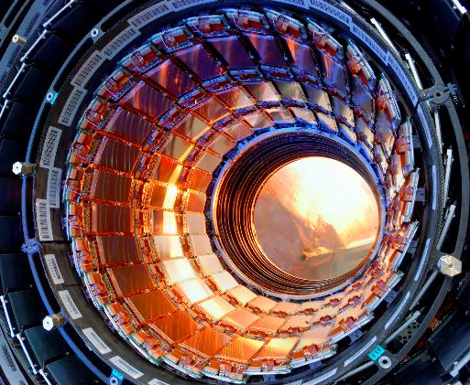
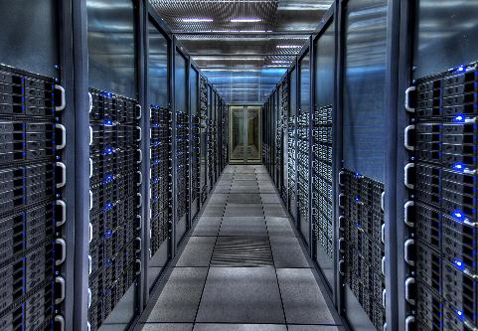
CERN’s areas of excellence
Notes:
Accelerator Technology
Detectors
Information Technology (Grid etc)

Slide 8
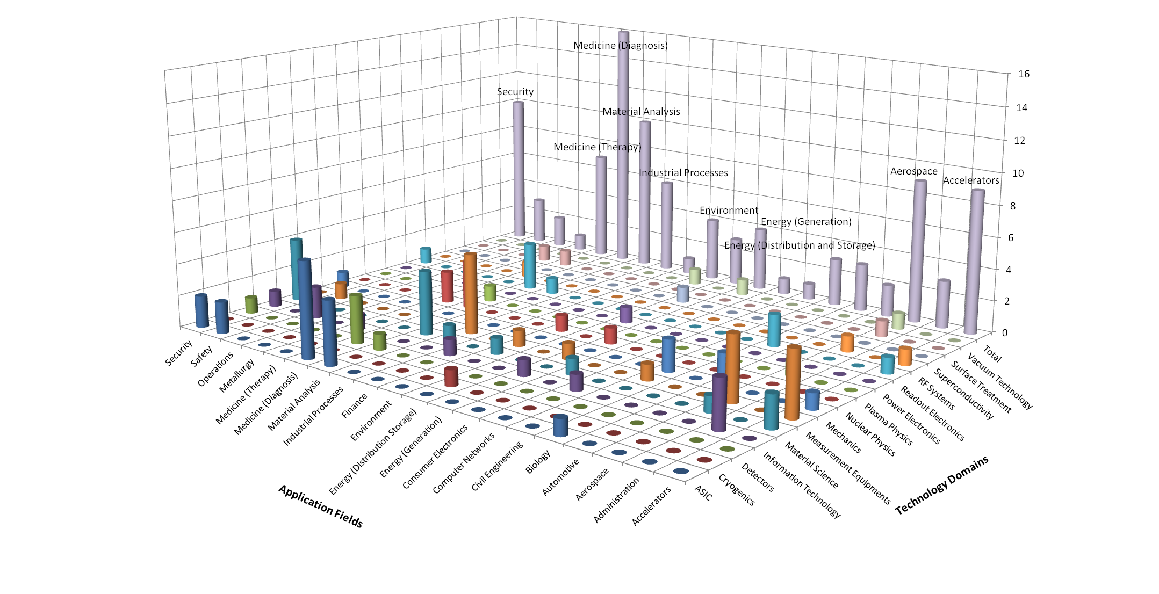
CERN’s Technology Portfolio
Knowledge Transfer | Accelerating Innovation

Slide 9
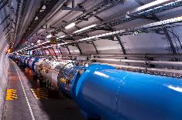
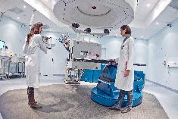

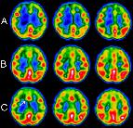
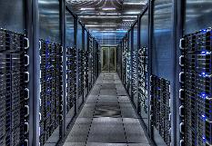
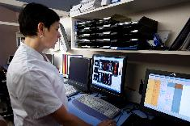
Medical application examples
From particle accelerators to cancer therapy
From particle detectors to medical imaging
From grid computing to medical data management and analysis

Slide 10

Hadron Therapy
New treatment opportunities for deep-seated tumours
Photons
Carbon
Protons
Notes:
Protons and other ions deposit most of their energy at the end of their path,

Slide 11
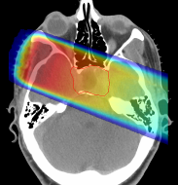
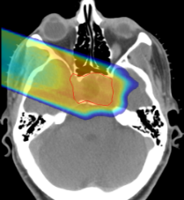
Hadron Therapy
New treatment opportunities for deep-seated tumours
Photons
Carbon
Protons
GSI

Slide 12
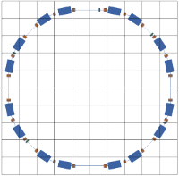



Hadron Therapy
Contributions from CERN
PIMMS Proton-Ion Medical Machine Study
Coordinated by CERN
PIMMS was then modified by the TERA foundation in Italy
CNAO in Italy and MedAustron in Austria are based on the modified PIMMS and also collaborated with CERN on the accelerator development
Notes:
Hadron therapy was originally developed at Berkeley in the US.
CERNs contribution to the European community came first trough the Proton Ion Medical Machine Study
This study was modified by the TERA foundation and later used as the basis for CNAO in Italy and MedAustron in Austria.
CERN has shared its expertise in accelerators with both these projects and hosted many researchers for periods at CERN during the development and construction of the accelerator components and for training of personnel,
CNAO started treating patients in 2012 and MedAustron will be ready in 2015!

Slide 13
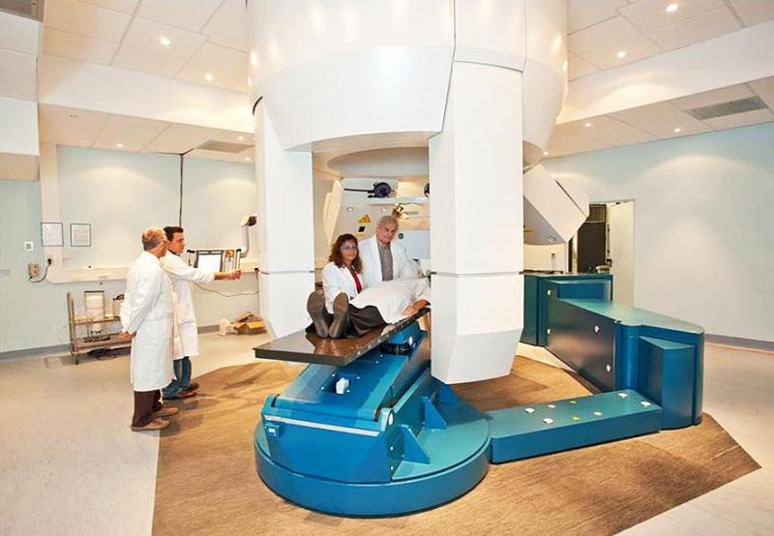
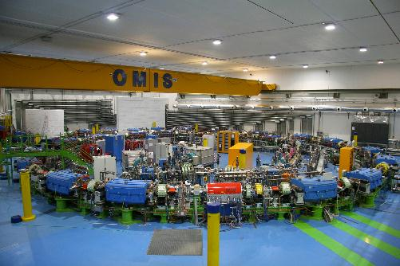
Hadron Therapy
CNAO
Notes:
Treatment room and accelerator at CNAO

Slide 14
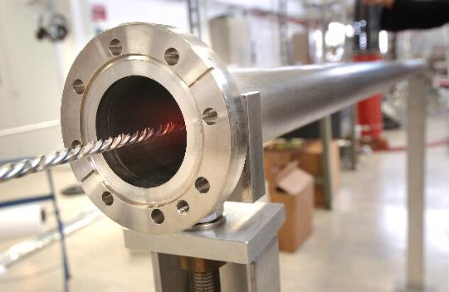
From high vacuum…
NEGs - Non-Evaporable Getter thin film coatings
Technology used to create and maintain ultra-high vacuum in the accelerator vacuum chambers.

Slide 15
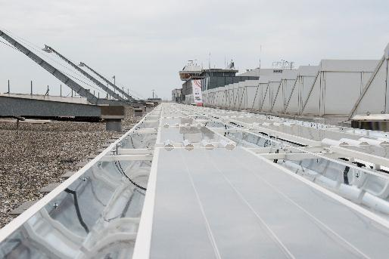
… to solar energy collectors
The innovative technology within the collectors was developed at CERN and commercialized by the CERN spin-off company, SRB Energy.
Here you can see thermal solar collector panels on the roof of Geneva airport

Slide 16
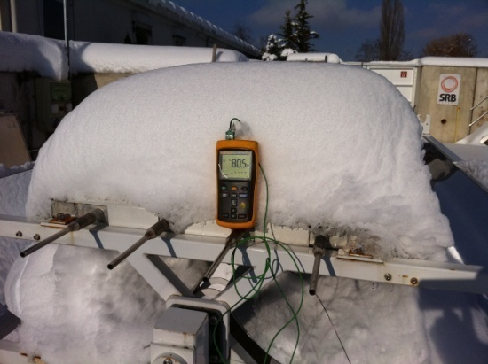
… to solar energy collectors
Vacuum acts as an Excellent insulator!

Slide 17
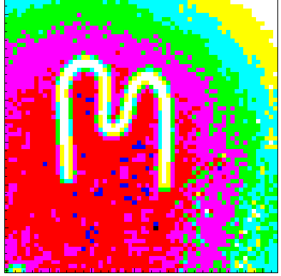
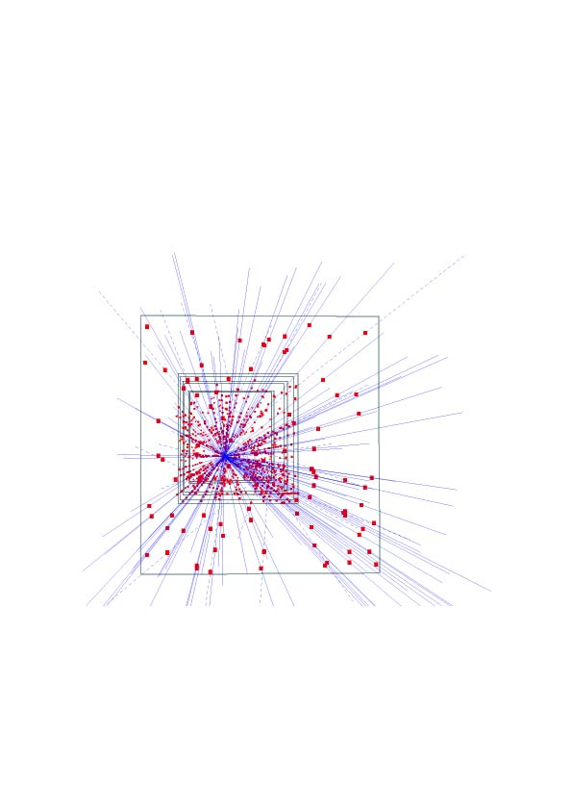
Silicon pixel detectors (SPDs)
Hybrid silicon pixel detectors for tracking applications in High Energy Physics
153 high energy particle tracks flying through a telescope of half a million pixels in the WA97 experiment back in 1995

Slide 18
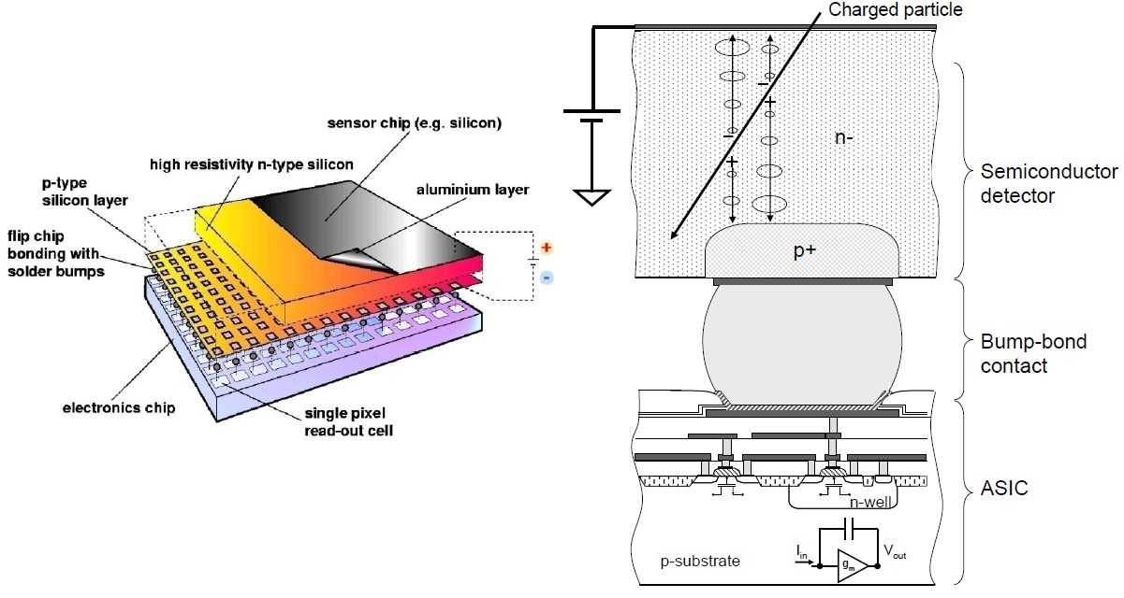
Medipix
Notes:
Medipix is a family of application specific integrated circuits or ASICs combined with a detection medium typically a semiconductor detector.
In Medipix the ASIC is connected to the detection medium by a bump-bond contact, as shown in the figure to the right. This separation allows better optimization of both detection medium and electronics.
The complex electronics, with different forms of embedded intelligence allows for high resolution and low noise in x-ray and gamma-ray detection, and the ability to detect single photons.

Slide 19
Medipix
A family of single photon counting integrated circuits used in Hybrid Silicon Pixel Detectors
The Medipix collaborations (close to 20 institutes) contributed to the development and dissemination of the technology
A good example of how (fundamental) science fosters innovation which can be transferred to society… and back!
Notes:
The Medipix chips was developed a part of the Medipix collaborations, which is hosted by CERN and contains close to 20 different institutes.
These institutes have contributed both to the development of the chip itself, but also the dissemination of the technology, to industry by collaborations and spinning off companies, and to academia
The Medipix case is special as the knowledge and technology transfer has gone full circle, so to speak.
Initially the Medipix project sprung out as researchers saw that the detector technology developed for the experiments for the LHC could be useful in medical applications and the Medipix project was established.
Later, however, developments done in the collaboration, the Timepix chip in particular, can be used in many high-energy physics applications.
Timepix is based on the Medipix 2 developments, and it not only counts the particle arriving in the pixel, but also measures the time of their arrival with very high precisions. This is very useful for high-energy physics applications and the Medipix design team is working on using the Timepix as a prototype for one of the upgrades of LHCb, which is one of the LHC experiments.

Slide 20
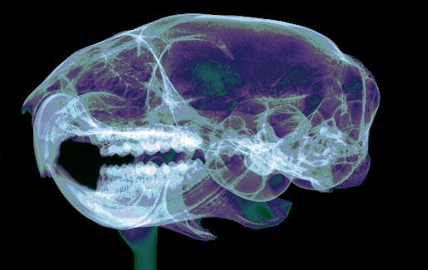
Application: X-Ray
Medical and industrial X Ray imaging
Picture is from X-Ray Imaging Europe GmbH a start-up company selling Medipix2 and Timepix detectors and detector systems
Credit X-Ray Imaging Europe

Slide 21
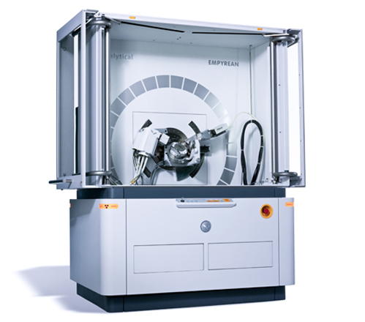
Application: Material analysis
PANalytical is a Dutch company that develops and produces scientific instruments
Medipix is used in their range of for x-ray diffractometers
Notes:
In this picture we can see a system for material analysis using medipix as detector, provided by a company from the Netherlands.

Slide 22

Application: Radiation monitoring
Medipix is used for radiation monitoring in space and other types background radiation monitoring and dosimetry
Notes:
We have also applications in the space, like … ESA and NASA are using the medipix family of chips to characterize the radiation in the space.

Slide 23
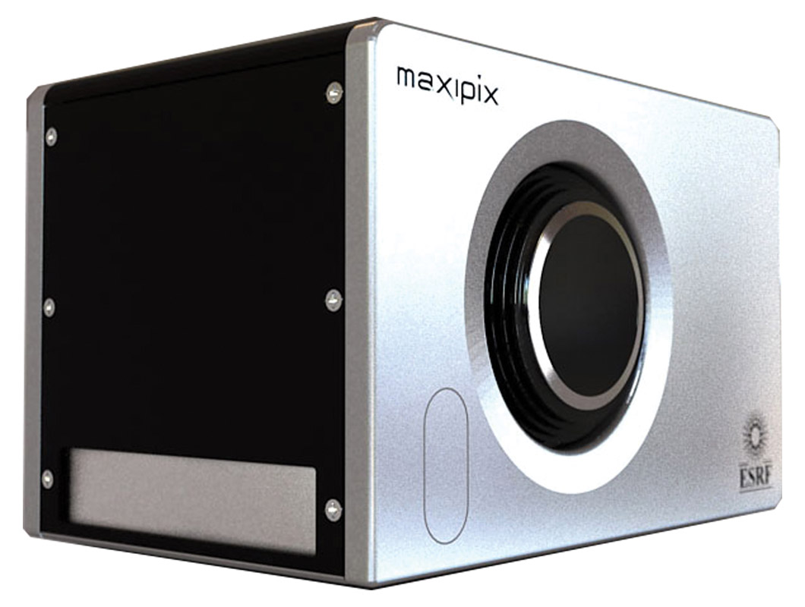
Application: Research
Research applications:
Synchrotron radiation
Electron microscopy
Detection of low energy particles
Adaptive optics
Neutron imaging
and more
Notes:
We have also research applications such as … In this picture we can see an example of system based on the medipix family of chips, developed for synchrotron radiation applications in the ESRF (European Synchrotron Radiation Facility) in Grenoble

Slide 24
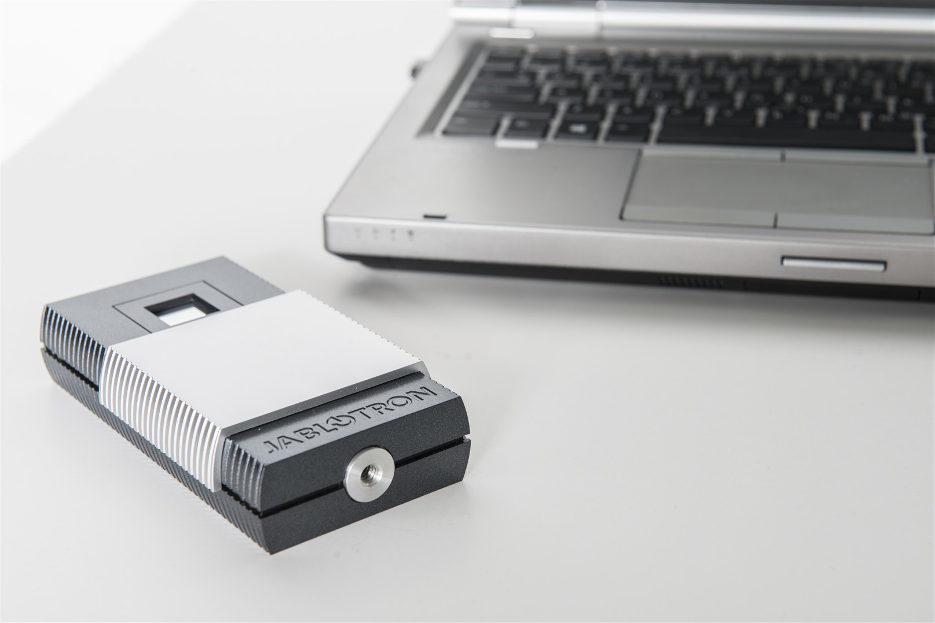
Application: Education
Medipix 2 technology used in an educational toolkit
Allows students to use a Timepix chip in the lab to visualise radiation
CERN has recently adopted this toolkit as part of its new SchoolLab
Notes:
The Czech company JABLOTRON is using medipix 2 technology to produce and sell an educational toolkit, that consists of an easy to use particle detector that can detect ionizing radiation in real time. The students can then observe the particles arriving to the detector on a PC screen. CERN has recently adopted this toolkit as part of its new SchoolLab

Slide 25
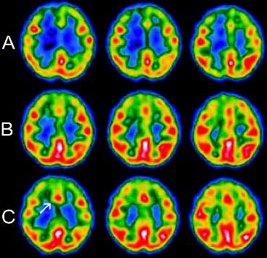
Application: Medical Imaging
Computed Tomography (CT)
Radiography,
Mammography,
SPECT,
Dental radiography,
Angiography,
PET
and more
Notes:
The collaboration was initially founded to design the hybrid pixel detector for medical use

Slide 26
Other ways of dissemination
The Technology Transfer process:
invention disclosure → IP protection → license to a company
Difficult, especially for the world of particle physics.
Collaborative R&D (with industry and other research institutes) is key for a successful transfer.
Other ways of dissemination are also very important for the Organization

Slide 27

CERN Open Hardware License
A legal framework to facilitate knowledge exchange across the electronic design community.
Notes:
In the spirit of knowledge and technology dissemination, the CERN OHL was created to govern the use, copying, modification and distribution of hardware design documentation, and the manufacture and distribution of products.

Slide 28
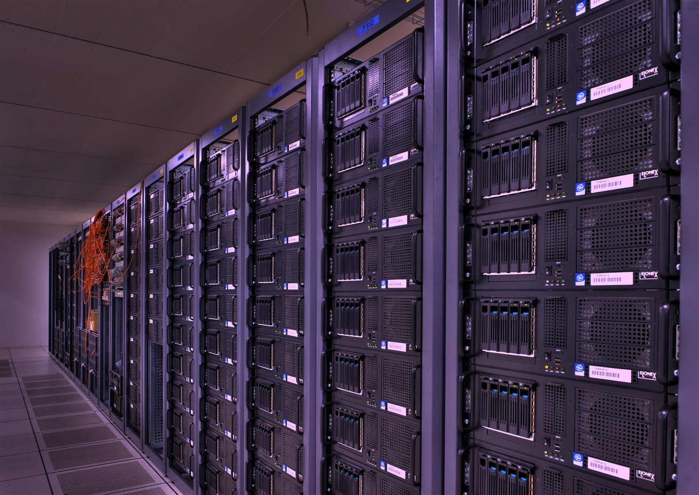
Open Source Software
Software developed at CERN is often released as open source
Some examples of the use of CERN’s open source software are:

Slide 29
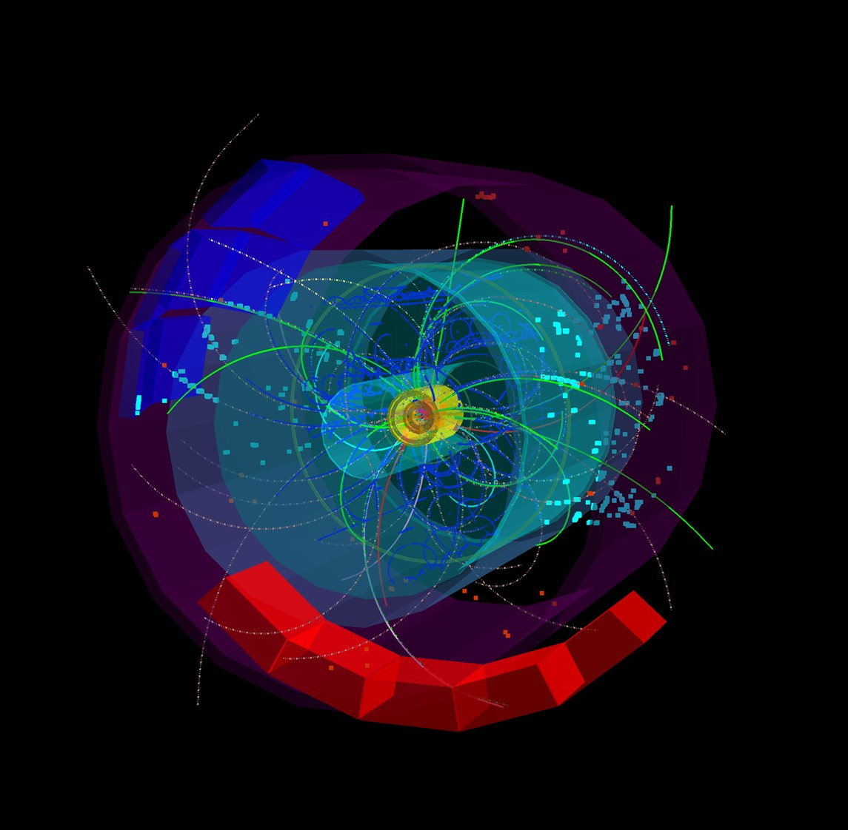
OSS example
ROOT
Powerful tool developed for handling big data in the CERN experiments
Widely adopted by the physics community and has found other applications such as:
Finance
Aerospace
Telecom
Automobile and more

Slide 30
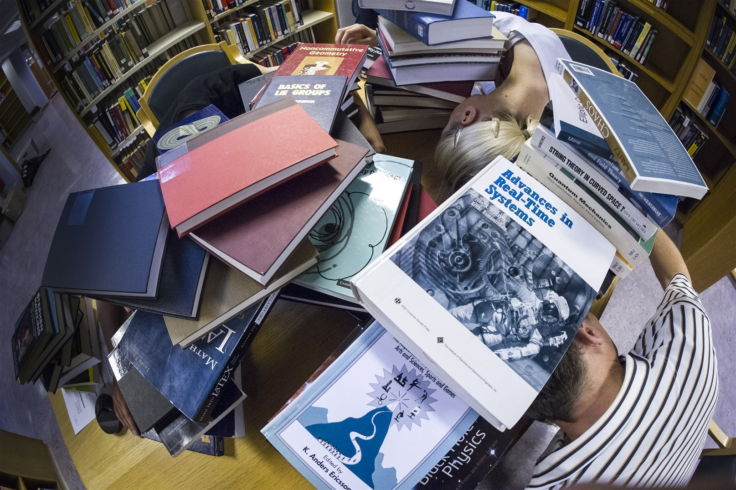
OSS example
Invenio
Software developed for running the digital library at CERN
Invenio is widely adopted outside CERN and a spin-off company has been created for delivering service, support and customisation

Slide 31
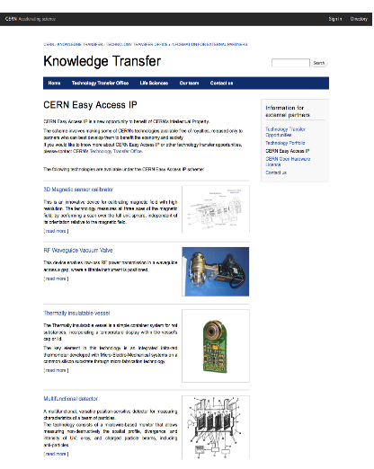
CERN Easy Access IP
Scheme pioneered by the University of Glasgow
For some of our technologies free licenses are given to companies who will demonstrate that they can turn it into a product
Notes:
Screenshot from our webpage, showing the different technologies that are released under easy access IP.

Slide 32

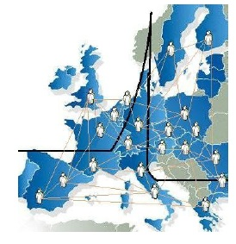
12 years of ENLIGHT Collaboration
CERN philosophy into health field
Common multidisciplinary platform
Identify challenges
Share knowledge
Share best practices
Harmonise data
Provide training, education
Innovate to improve
Lobbying for funding
Coordinated by CERN
> 150 institutes
> 400 people
> 25 countries
(with >80% of MS involved)
Notes:
32

Slide 33






ENLIGHT platform projects
Marie Curie Initial Training Network
12 institutions
29 trainees
Infrastructures for hadron therapy
20 institutions
2008-2012
2009-2014
R&D on medical imaging for hadron therapy
16 institutions
Marie Curie ITN
12 institutions
16 trainees
2010-2014
2011-2015
13/06/2013
Manjit Dosanjh – Zuppinger-Symposium 2013
33
Notes:
All FP7 projects
Partner – Multi disciplinary, & Entervision – Medical Imaging TRAINING
Med Physicist, Doctors, Engineers, IT specialists, Radiobiologists
ULICE – Infrastructure. Learn from HIT, CNAO, MedAustron
Clinical trials etc
Envision – Quality assurance for Hadron therapy in real time
& asses the effectiveness.

Slide 34
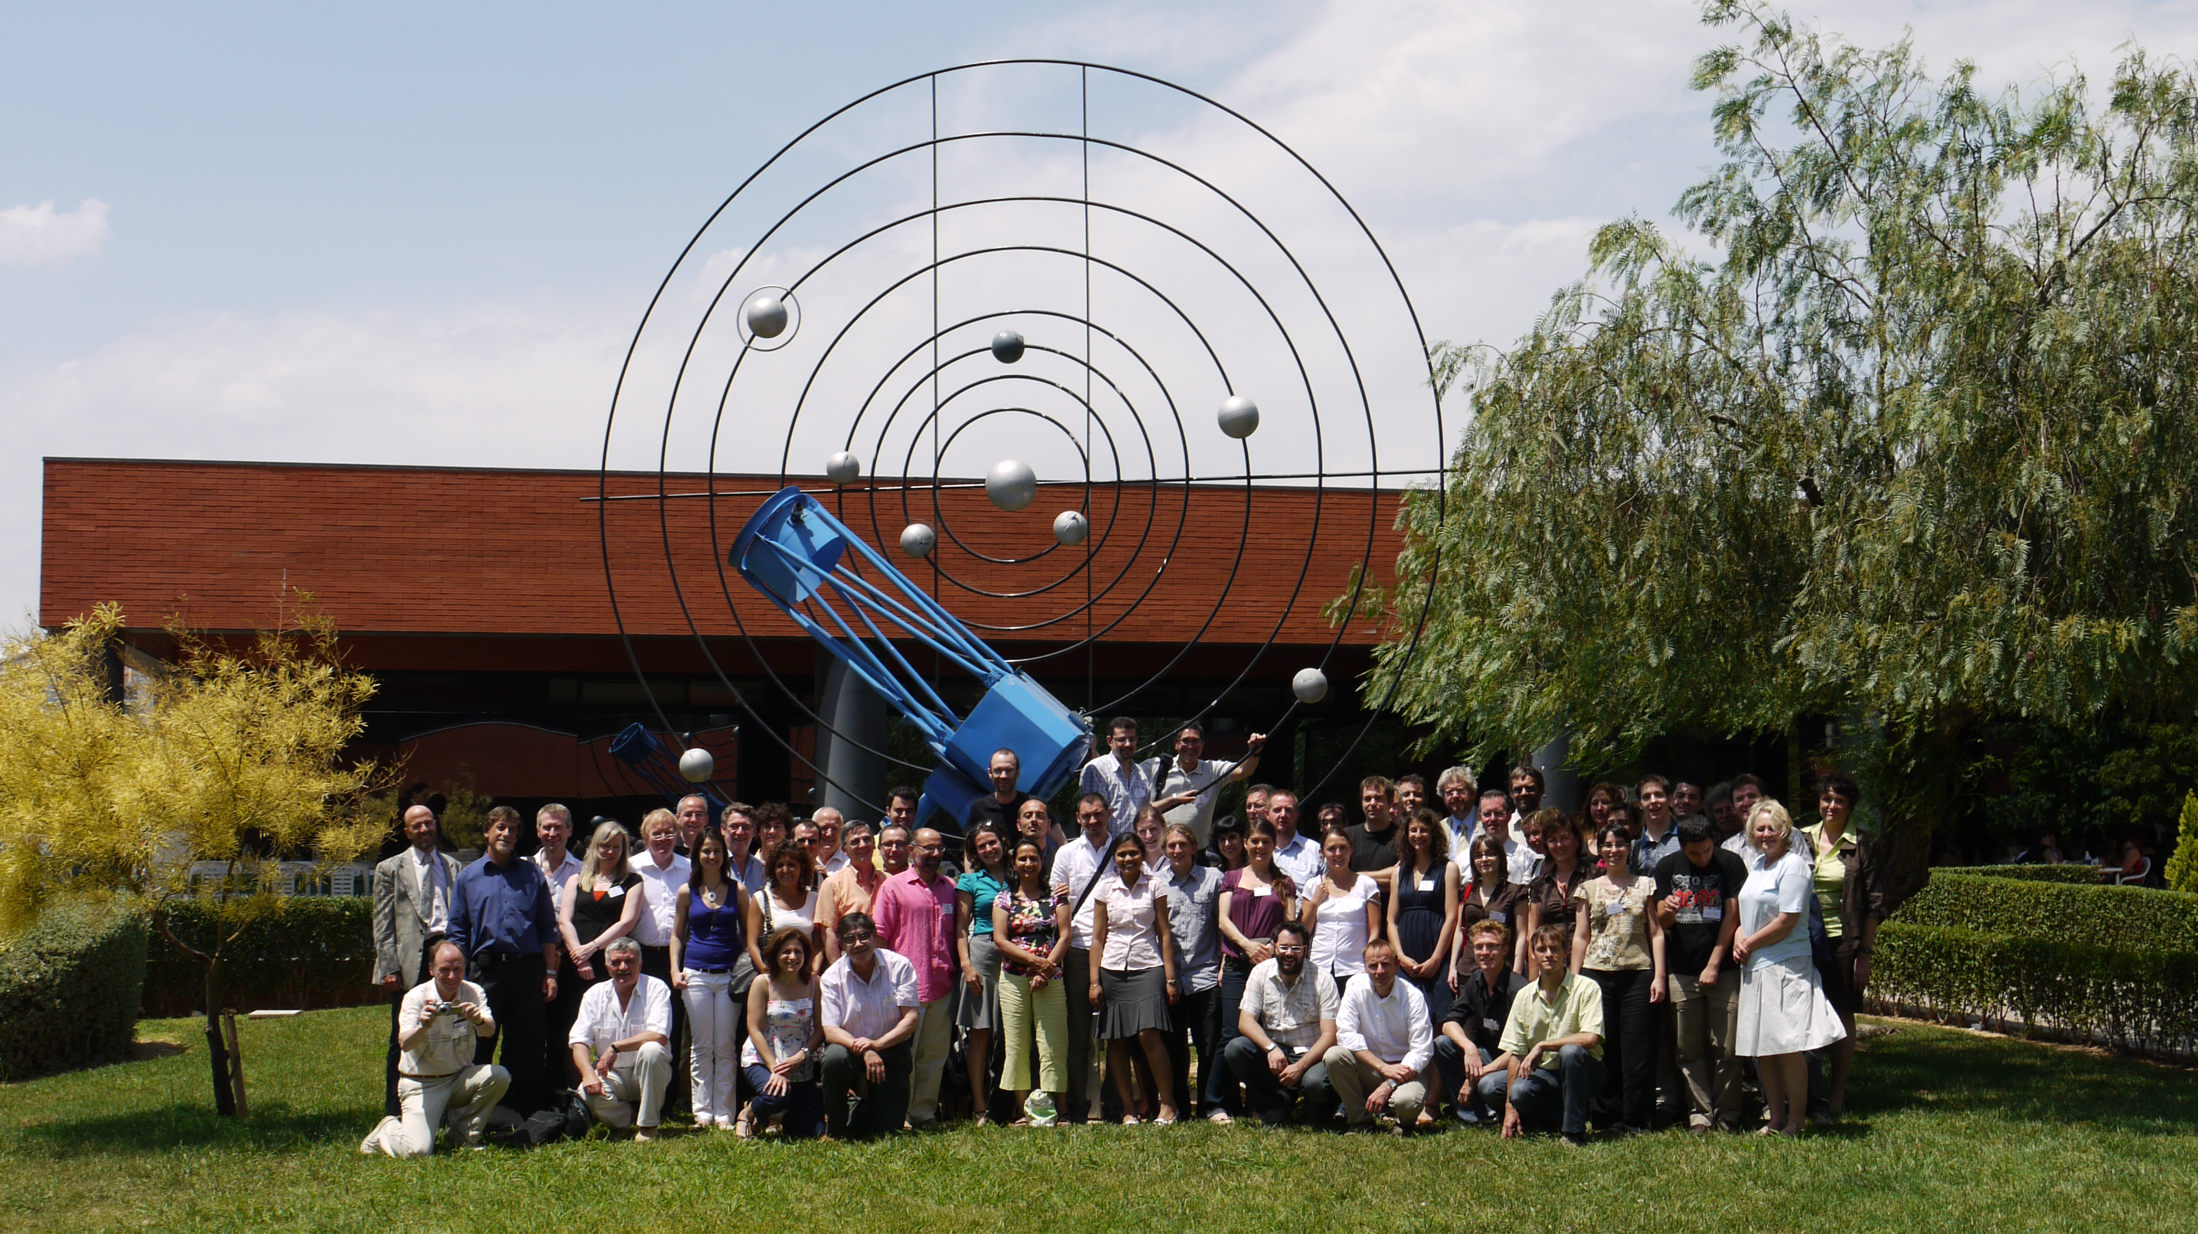
PARTNER – one of the ENLIGHT platform projects:
Particle Training Network for European Radiotherapy
4-year Marie Curie Training project
Research and training opportunities for 25 young biologists, engineers, physicians and physicists with aim of creating the new generation of experts
Brought together key academic institutes and research centres and IBA and Siemens
PARTNER research published in Open Access Journal of Radiation Research

Slide 35


Envision and Entervision
Accurate positioning is a crucial challenge for targeting moving organs during particle treatment
R&D in real-time medical imaging for more precise and effective hadron therapy
2 demonstrators for real time imaging have been constructed and are being tested
More than 40 scientific publications and 80 conference talks/posters
Marie Curie ITN for young scientists that uses ENVISION as training platform
15 researchers recruited from 9 nationalities and from disciplines such as medical physics, engineering, nuclear physics, high energy physics and biological physics

Slide 36

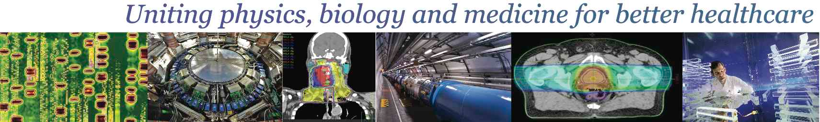
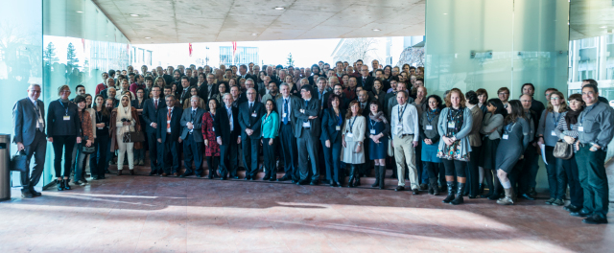
February 10 – 14, 2014 (CICG, Geneva)
2 days devoted to physics, 2 days to medicine, 1 day of overlapping topics
Chairs: Jacques Bernier (Genolier) and Manjit Dosanjh (CERN)
Key Subjects:
Biology
Pre-clinical & clinical strategies
Nuclear medicine
Detectors & Imaging
New Technologies
Radiotherapy
400 participants from 31 countries

Slide 37
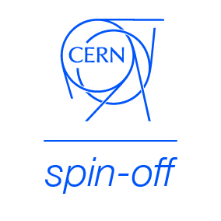
KT implementation ways
Market Pull
Transfer to Existing Companies
Technology Push
Creation of New Companies
Spin-Off Support

Slide 38

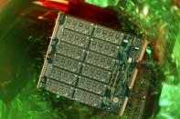

CERN Business Ideas Accelerator
CERN
Pre-Incubator
CERN STFC BIC
NATIONAL BIC
NATIONAL BIC
NATIONAL BIC
NATIONAL BIC

Slide 39
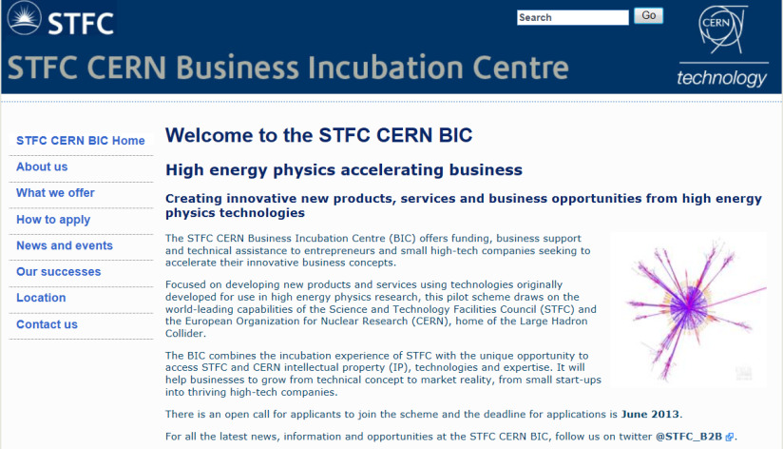
Turning CERN technologies into new business opportunities
Notes:
Sci – Tech STFC Innovation Campus in Daresbury in the UK

Slide 40
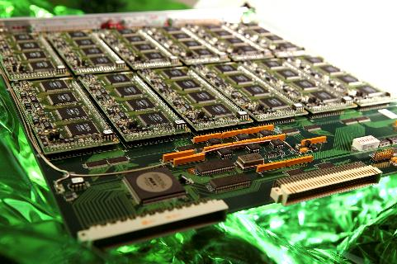
Knowledge Transfer through Procurement
Survey of companies involved in technology-intensive procurement contracts with CERN.
178 questionnaires analyzed
503 MCHF procurement budget
Results:
44% indicated technological learning
42% increased their international exposure
38% developed new products
36% indicated market learning
13% started new R&D teams
52% would have had poorer sales performance without CERN
41% would have had poorer technological performance

Slide 41
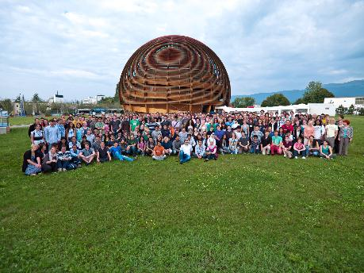
Knowledge Transfer through People
Every year hundreds of students come to CERN to ontribute to our research programs
An opportunity for young people to learn in a multicultural environment
Not only for physicists! Also engineers, computer scientists, administrative students…

Slide 42





European Knowledge Transfer Networks
Forum for European Intergovernmental Research Organisations
EEN, Enterprise Europe Network
TTN, Technology Transfer Network
TTO Circle - European Technology Transfer Offices Circle
The European Network for LIGht ion Hadron Therapy

Slide 43
Conclusions
KT is integral part of CERN’s mission
CERN technologies have applications in several domains with high relevance to society.
Significant contribution to innovation in medical sciences over the last 10-15 years
Impact which delivers tangible benefits to mankind

Slide 44

More info / Contacts
www.cern.ch/knowledgetransfer
mail-KT@cern.ch
Nick.Ziogas@cern.ch
Questions ?

