Slide 1
HPPS extraction, 24-June-14
 |  | 50 GeV |  | 75 GeV
 |  | foil | laser | foil | laser
Required kick | [mrad] | 3.1 | 3.3 | 2.4 | 2.7
Kicker/septum drift length | [m] | 15.065 | 15.065 | 15.065 | 15.065
MQFS1, required radius | [mm] | 90 | 99 | 70 | 80
MQDS1, required radius | [mm] | 110 | 124 | 84 | 100
MQFS2, required radius | [mm] | 97 | 99 | 75 | 80
Emittance x/y, rms, normalised | [um] | 10.5/13.5 | 10/13 | 5.5/8 | 6/7.5
Dp/p, full |  | 6.6e-3 | 7.3e-3 | 7.6e-3 | 7.6e-3
Phase advance (MKE→MSE) | [deg] | 107 | 90 | 107 | 90
Maximum kick strength in 18 m with conventional cables:
50 GeV: 3.1 mrad
75 GeV: 2.1 mrad

Slide 2
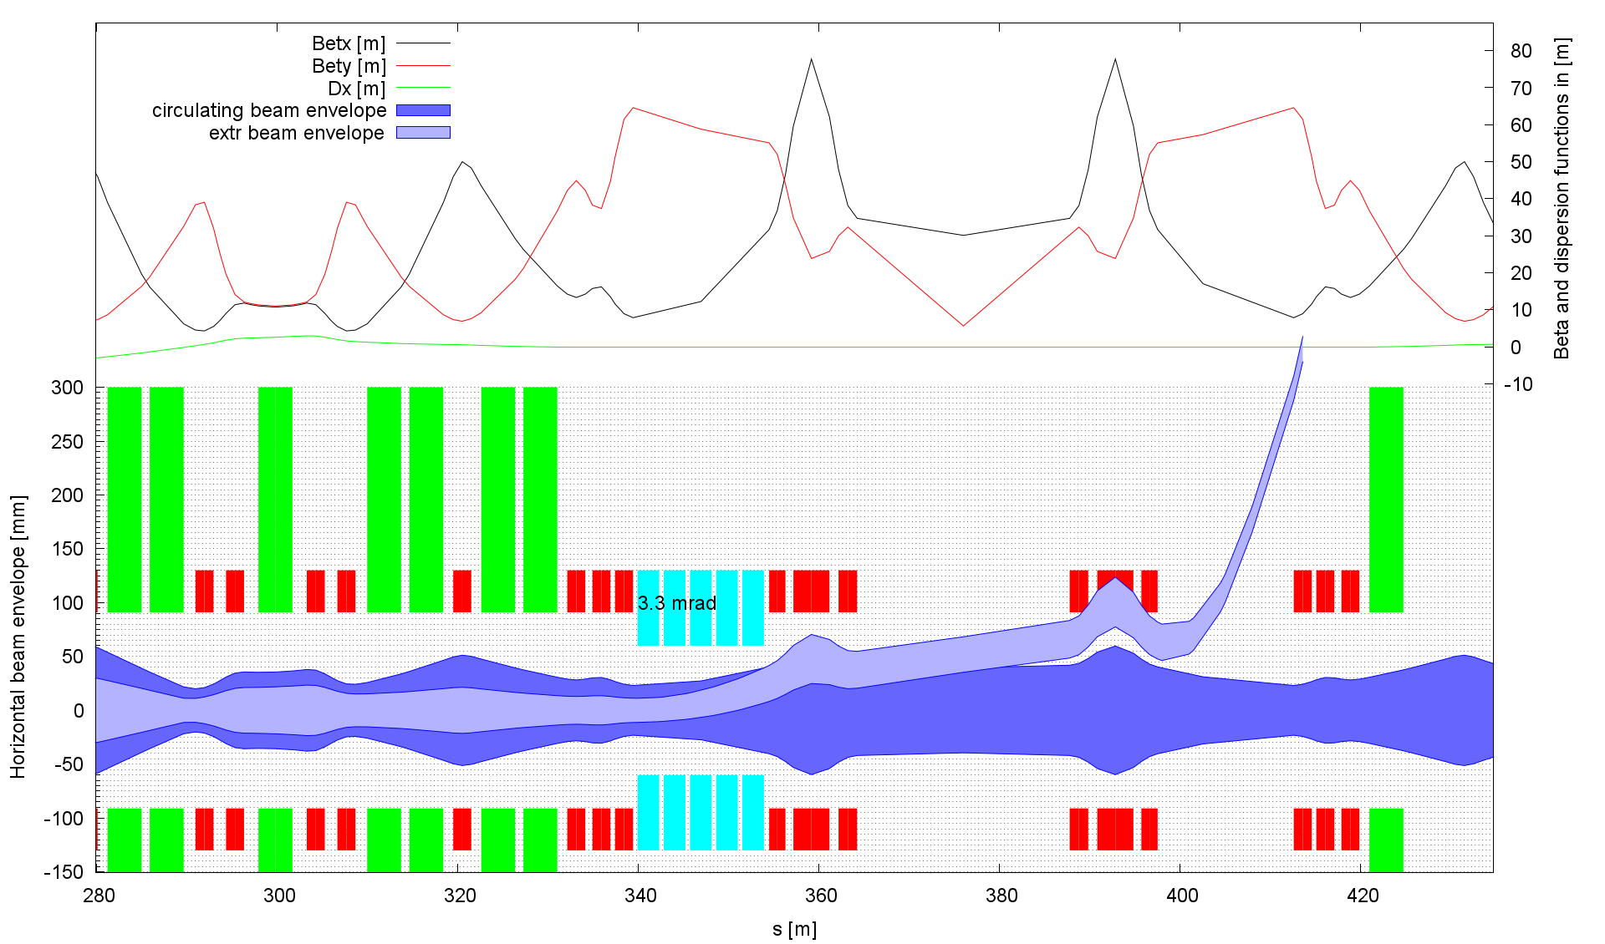
Extraction: Laser optics, 50 GeV

Slide 3
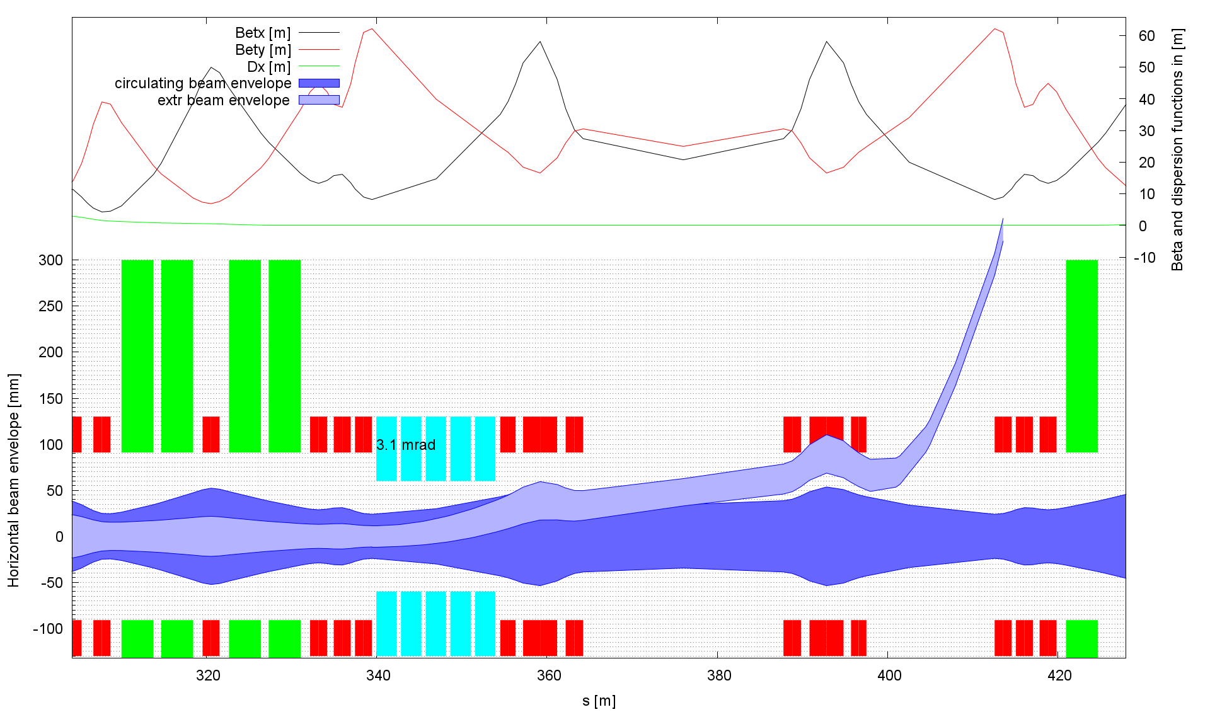
Extraction: Foil optics, 50 GeV

Slide 4
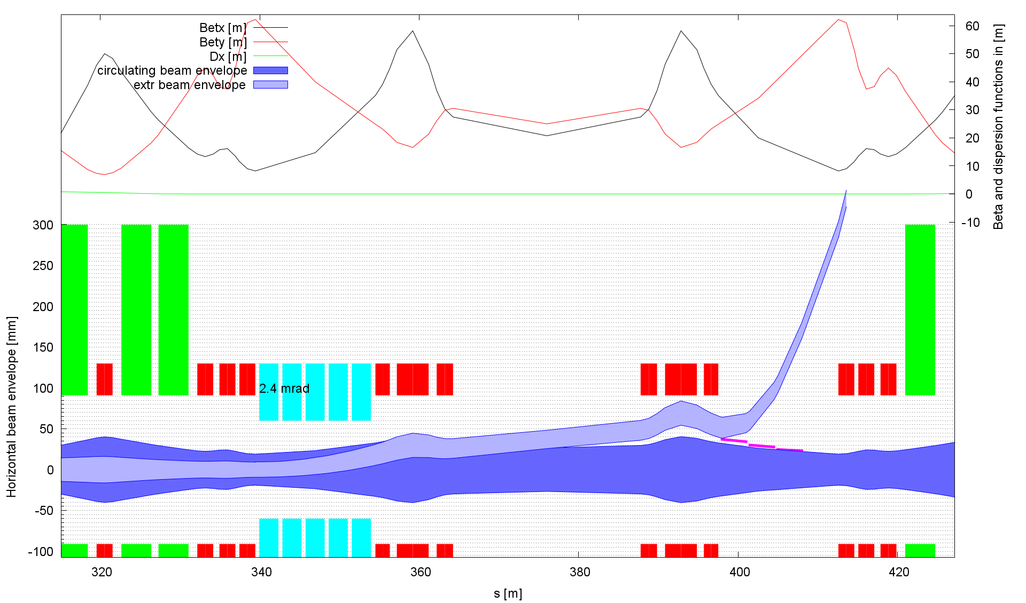
Extraction: Foil optics, 75 GeV

