Slide 1
ROOT, I/O and Concurrency
Philippe Canal
Fermilab

Slide 2
Overview
ROOT
I/O
Concurrency

Slide 3
ROOT Guiding Principles
User Oriented
  Support and Feedback is essential
  HEP is main but not sole user/target
C++: Interpreter and Reflection
High performance (many dimensions)
Release early and often
Open-ended
  Include interfaces to other languages
  Help promote associated project (RooFit, etc.)

Slide 4
I/O Long Term Goals
Performance
  Keep up / Pass competition
    With StreamerInfo layer and JIT, large opportunities for optimizations
Features
  Maintain and enhance schema evolution support
  Adapt to new hardware landscape
    Today: multitask, vectorization ; Tomorrow: transactional memory.
Interoperability
  Open their ecosystem to using ROOT [I/O]
  Open ROOT users to use the other ecosystem(s)

Slide 5
I/O Priorities
Multi-processing / Multi-threading
Performances improvements
  Amdahl, File Format, Streaming, Vectorization
Interface Simplification and Clarification
  Leverage C++11 for ease of use/documentation
Interoperability
  HDF5, R, Python, Blaze, numpy, etc.
Additional statistics and Feedback on I/O Perf.

Slide 6

Here comes cling
Cling introduces binary compatible
Just In Time compilation of script
and code snippets.
Will allow:
  I/O for ‘interpreted’ classes
  Runtime generation of
  CollectionProxy
    Dictionary no longer needed for collections! [Summer Student]
  Run-time compilation of I/O Customization rules
    including those carried in ROOT file.
  Derivation of ‘interpreted’ class from compiled class
    In particular TObject
  Faster, smarter TTreeFormula
  Potential performance enhancement of I/O
    Optimize hotspot by generating/compiling new code on demand
  Interface simplification thanks to full C++ support
    New, simpler TTree interface (TTreeReader) [Summer Contributor]

Slide 7
Challenges
Two distinct user bases
  Individual Users
    Want everything automatic / just works
  Framework Developers
    Want to control everything (want no surprise)
Two distinct mode of operations
  Thread based
  Task based
Must support all 4 combinations
Concurrent access must not cost (too much) for non-threaded use.

Slide 8
User / Thread Example
Simple merge histo interface.
  User add ‘only’ the lines (*)
// Main Thread
TDirectory *merger = new THistoMerger(nthreads); // (*)
// Each thread init
merger->cd(); // (*)
TH1F* h = new THF1(“h”,…);
// Each thread init
merger->cd(); // (*)
TH1F* h = new THF1(“h”,…);
// Each thread event loop
h->Fill(value);
// Each thread event loop
h->Fill(value);
// Tear down or end
merger->Merge(); // (*)
ouputdir->cd();
merger->Write();

Slide 9
User / Task Example
Simple merge histo interface.
  User add ‘only’ the lines (*)
// Main initialization
TDirectory *merger = new THistoMerger(nthreads); // (*)
// Each task init
TH1F* h = new THF1(“h”,…);
h->SetDirectrory(merger); // (*)
// Each task init
TH1F* h = new THF1(“h”,…);
merger->Append(h); // (*)
// Each task iteration
h->Fill(value);
// Each task iteration
h->Fill(value);
// Final task
merger->Merge(); // (*)
ouputdir->cd();
merger->Write();

Slide 10
Framework example
Framework want to owns histos.
But what about the case where there is 100,000 of histo?
  Especially if filled rapidly (so need lock less Fill)
// Each thread/task init
TH1F* h = new THF1(“h”,…);
fwk_ownlist->push_back(h);
// Each thread/task event loop
h->Fill(value);
// Tear down or end
foreach h in ownlist(s) (or equiv)
TList *lst = complex_code_to_gather_histo(fwk_threadlist);
merged = Merge(lst);
outputdir->WriteObject(merged);

Slide 11
100,000 of histos on several threads
Questions:
  What is the use case really like?
    What is the required performance (‘where’ can we put a lock)
  When is the data merge done?
    Every Fill
    Every so many calls fills
      One of the threads
      A merger thread?
      Why is it better that one histo per threads
  Are TH* really heavy weight?
    What is the real over-head?
    When/how is the allocate-the-bins-only-when needed used?
  Related concerns
    Should variable size and fixed size bins histo be more clearly separated?
      Improve performance, Reduce over head (of fixed size case)
      Is it making the interface harder to use/explain?

Slide 12
Another interface idea.
// Main initialization
TH1F *mainh = new TH1F(“h”,….)
// Each task init
HistoTaskHandle h(mainh);
h->SetBufferSize(…);
// Each task init
HistoTaskHandle h(mainh);
h->SetBufferSize(…);
// Each task iteration
h->Fill(value);
// Each task iteration
h->Fill(value);
// Final task
foreach handle h:
mainh->Add(h);
outputdir->Write(mainh);

Slide 13
Another interface idea.
Spot the difference ☺
// Main initialization
TH1F *mainh = new TH1F(“h”,….)
// Each task init
TH1*h = mainh->Clone();
h->SetBufferSize(…);
// Each task init
TH1*h = mainh->Clone();
h->SetBufferSize(…);
// Each task iteration
h->Fill(value);
// Each task iteration
h->Fill(value);
// Final task
foreach handle h:
lst->Add(h);
mainh->Merge(lst);
outputdir->Write(mainh);

Slide 14
Framework Requirements
If ROOT uses threads that should be not computationally intensive
  Example: prefetching thread
If ROOT wants to run cpu-intensive tasks they must (be able to be forced to) request CPU time from the framework
  For example a parallel unzipping would need to be a Task pushed on the TBB stack
  Implies that when adding improvement that uses parallel execution we ought to follow a task model

Slide 15
Task vs. Thread
Task model simpler to use
  Delegate load balancing to ‘framework’
  Similar to Proof
    However task more ‘flexible’ control flow
    Proof more extensive (over more hardware config)
  Should we promote the task mode (tutorials, etc.) ?
Requirements
  Need (virtual) Interface
    To allow replacing TBB with Apple GCD.
  Need always available default implementation
    Which is easily replaceable by the user controlled one.
  Need to be pluggable/controllable by the user
Other Utilities we could offer
  Similar to boost::thread_specific smart pointer.

Slide 16
PROOF vs. Task Models
What are the difference?
i.e. can PROOF(lite-with-thread) be (extended to be) our interface?
If not how do we provide a smooth experience
  From single stream of operation
  To many streams of operation
  To many machine with many streams of operations
  Without changing the code?

Slide 17
Vectorization
Many alternative vectorization techniques
  VC, VDT, Cuda, by hand, etc.
GeantV uses template techniques and traits to steer the choice.
Should we adopt the same techniques
  and share/distribute the common parts?

Slide 18
Backup slides

Slide 19
Priorities
Multi-processing / Multi-threading
Performances improvements
  Amdahl, File Format, Streaming, Vectorization
Interface Simplification and Clarification
  Leverage C++11 for ease of use/documentation
Interoperability
  HDF5, R, Python, Blaze, numpy, etc.
Additional statistics and Feedback on I/O Perf.

Slide 20

Multi-Processing
Import Chris’ changes to v5.34 and port to v6.02
Extend the ability to disable auto-add
  Limited to TH* so far
  Remove use of I/O in TH*::Clone
Resolve parallelism limitations
  As shown in the CMS condition database example

Slide 21
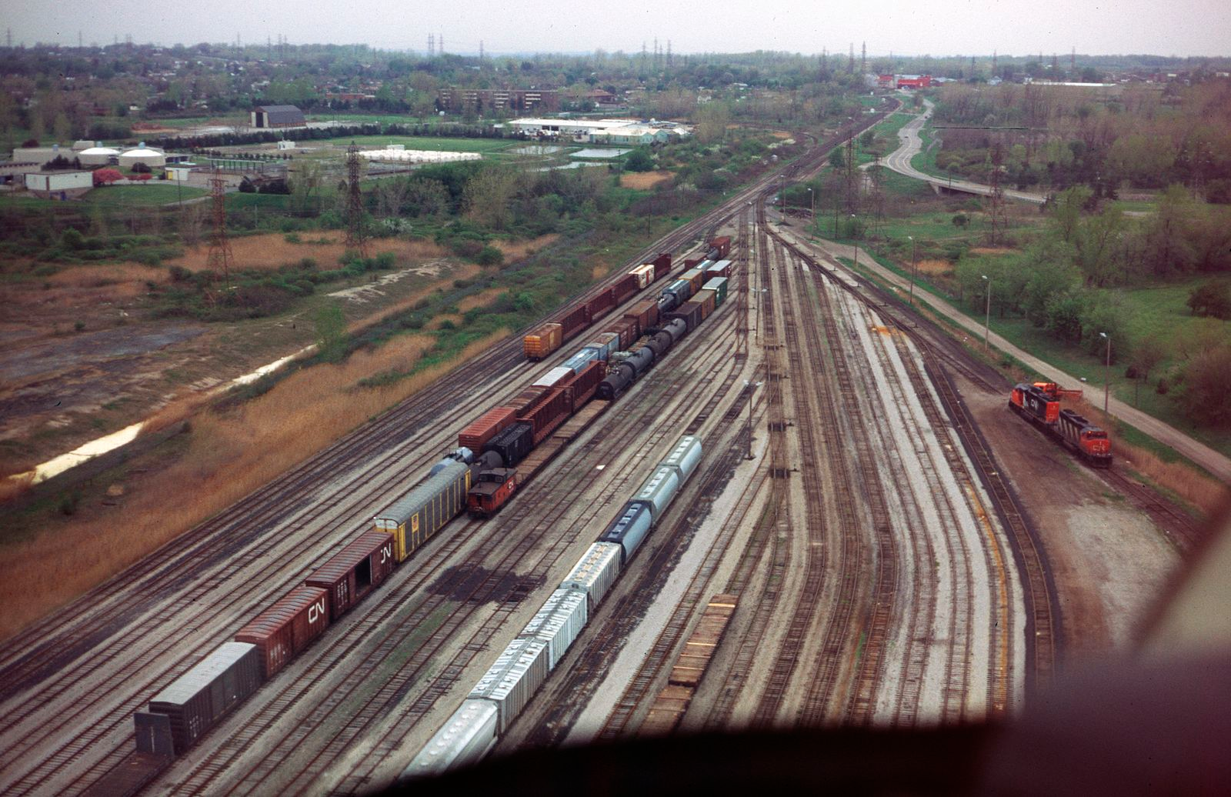
Multi-Processing
Histogram and
multi-threading
  Need to start prototyping &
  testing asap
  New interface to incrementally
  merge histograms from
  multiple threads
Read/Write TTree branches in multiple user thread
  Need to start prototyping/testing asap
  Do we need new/simpler interface?
  Need to design the limit and semantics
  Extra complexity/cost to conserve basket clustering
  Require TFile synchronization

Slide 22
Thread Safety
Cling enables support for robust multi-thread I/O
  Cling has clear separation of database engine and execution engine allowing to lock them independently
Chris’ changes allow multi-threaded I/O as long as
  Each TFile and TTree objects are accessed by only one thread (or the user code is explicitly locking the access to them)
  Interpreter is *not* the top level entry point.
  Cling will allow to remove the second limitation.
More has to be done to optimize
  Some object layout leads to poor performance and poor scalability
  Reduce number of ‘class/version/checksum’ searches
    To reduce the number of atomic and thread local uses

Slide 23
Parallel Merge Challenges
Need official daemon/thread parallelMergeServer
  Could use Zero MQ as underlying transport.
Need to efficiently deal with many histograms
  Each of them still need to be merged at the end
Lack of ordering of the output of the workers
  No enforcing of luminosity block boundaries for example
  Support for ordering increases worker/server coupling
  Space reservation is challenging (variable entry)
Need a new concept (an Entry Block)
  ‘Set of entries that are semantically related’
  To be used to gather those entries together ‘automatically’
  Need flexible/customizable marker
  Is it really worth the extra complexity?

Slide 24

Parallel merge
Fully tested and performing version requires
    Parallel Merge Thread
    Parallel Merge Daemon (authorization, auto-start, error handling)
    Parallel Merge for Histogram (proper set
    of benchmarks, performance improvement, etc.)
Benchmarks
  Still to be designed
  Based on existing example (some multithread) and new example based of the Event test.
  Based on experiment uses cases.

Slide 25

Other Possible Parallel Processing
Read/Write branches using internals thread/tasks
  Need to partially back out memory optimization
  Require TFile synchronization
Offload work (compression) to separate thread
  Need to work well with task based scheduler
Thread safe version of TFile
  Not quite sure of semantic
  Need to be cost-neutral for traditional uses
Support for ‘multiple’ interpreter state
  Decide on need / interface / use limitations
  shared libraries (their PCMs) shared between interpreters?

Slide 26
Vectorization
In TTree
  Eg. TTree::Draw execute formula on more than one element at a time
  New interface allowing retrieval of multiple entries at once.
In Streaming
  Changing endianess would also merging and vectorization of even more streaming actions.

Slide 27
Interoperability
HDF5, R, Python, Blaze, numpy, etc.
  These ecosystems has their strengths and weaknesses as well some similarities and significant differences with ROOT
  What can we learn from them?
  How can ROOT [I/O] can be leveraged to enhance them?
  How could our workflows benefit from using directly or indirectly any part of these ecosystems?
  Who can help?

Slide 28

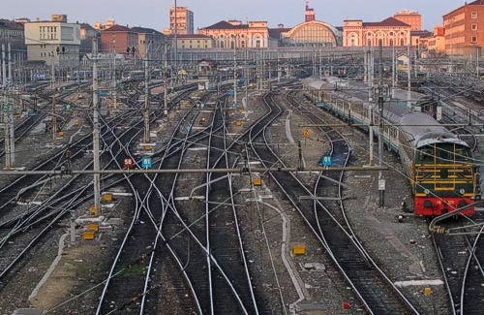
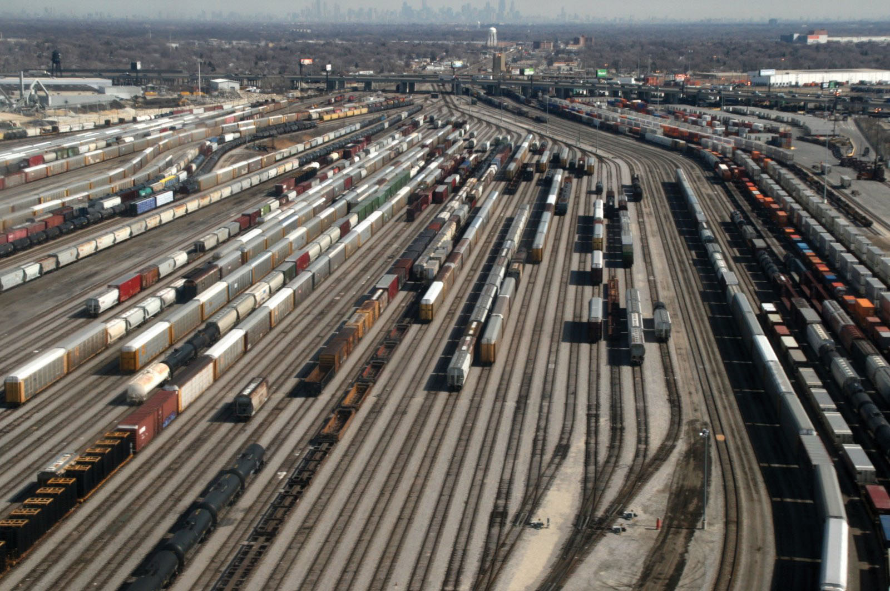
Why one thread/schedule per TTree
When reading TTree holds:
  Static State:
    List of branches, their types their data location on file.
  Dynamic State:
    Current entry number, TTreeCache buffer (per TTree),
    User object ptr (one per (top level) branch),
    Decompressed basket (one per branch)
  Separating both would decrease efficiency
Advantages
  Works now!
  No need for locks or synchronization
  Decoupling of the access patterns
Disadvantages
  Duplication of some data and some buffers.
    However this is usually small compare to the dynamic state.
  Duplication of work if access overlap

