Slide 1
Towards a coherent program to establish the systematic errors
in the long baseline experiments
The community should support a program for detector R&D and critical measurements like cross sections and hadron production. The CERN neutrino platform is an important basis to fulfil these goals.
The European members of the ICFA Neutrino panel
P5 report NuSTORM is a proposal for a small muon storage ring to produce ~GeV neutrinos and antineutrinos with the advantage of a precisely known flux. The facility would also serve as an intense source of low-energy muons and serve as a technology demonstrator for a future neutrino factory. The physics reach of this program includes sensitive sterile neutrino searches and precision neutrino cross-section measurements. Although the concept is attractive as a first step towards a neutrino factory and as a means to reduce the beam-related systematic errors for LBNF, the high cost makes it impossible to pursue at the same time as PIP-II and LBNF, which are the primary objectives.
While the agencies and the laboratory directors recognise that to realise the success of the above projects there will be a need for investment in theory and necessary support measurements, this document should not be interpreted as a funding endorsement.

Slide 2
consequences of large theta_13.
Superbeam (Water Cherenkov vs Liquid Argon) vs betabeam / neutrino factory
-1- golden channel signal ν_{μ}→ν_{e} is large ( 5%)
➔ backgrounds are not so important (water OK)
➔ signal can be seen and CP violation measured at conventional superbeam.
-2- CP asymmetry is small (~0.3 x sinδ ) for first maximum
➔ Systematics from detection (efficiency x cross-sections) become dominant
(to demonstrate «better than 5%» on ν_{e} / ν_{μ} is not trivial)
=> ICFA panel : need comprehensive program to tackle systematic errors.
Among best possibilities: muon storage ring nustorm for cross-section and calibration
with Liquid Argon or Water Cherenkov detector (as the case maybe).
Not in P5, US wont do it.
My personnal opinion: this could be a fantastic contribution from CERN.

Slide 3
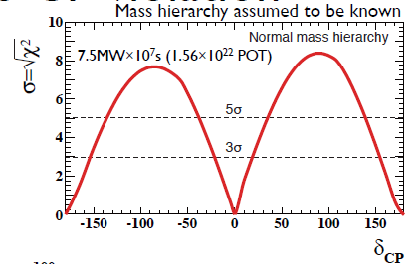
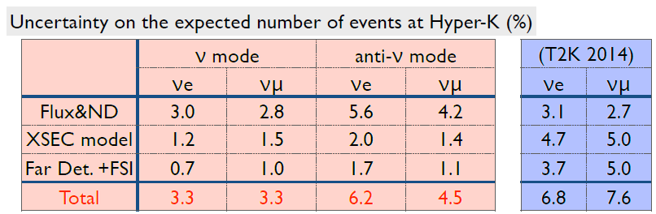
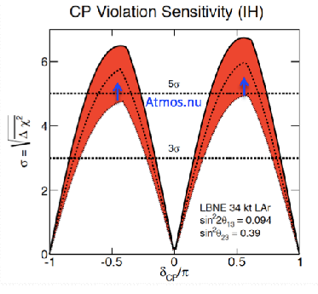

HYPERK (WC, 300km optimized off-axis narrow band)
New near detector to reduce systematics!
LBNE (Larg, 1300km Optimized Wide Band)
Also to consider:
timing, political situation,
astroparticle and proton decay capabilities.

Slide 4
Complementarity
-1- HyperK is the natural continuation to T2K
We have invested in NA61, and in the near detectors of T2K
It is the most sensitive proposal for the observation
of CP violation in neutrino oscillations
and for a large part of underground physics
(proton decay, atmospheric, solar and supernovae neutrinos)
.... and the most straight-forward technology
-2- it is not complete however and there is a physics case
for a complementary experiment that would determine
unambiguously the value of δ_{CP} and the mass hierarchy,
complete the observations of oscillations involving tau
leptons and matter effects ➔ {LBNO; LBNE} .
This requires a more sensitive technology (Liq. Argon) , in need
of R&D and experience (and probably a longer time scale)
The path is not unique and includes focused R&D (WA105)
and application + experience on running experiments (microboone)

Slide 5
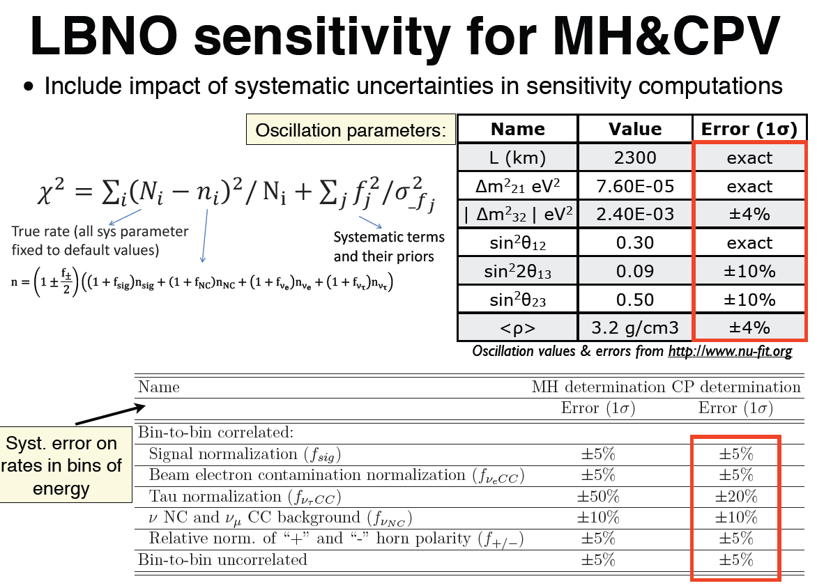

Slide 6
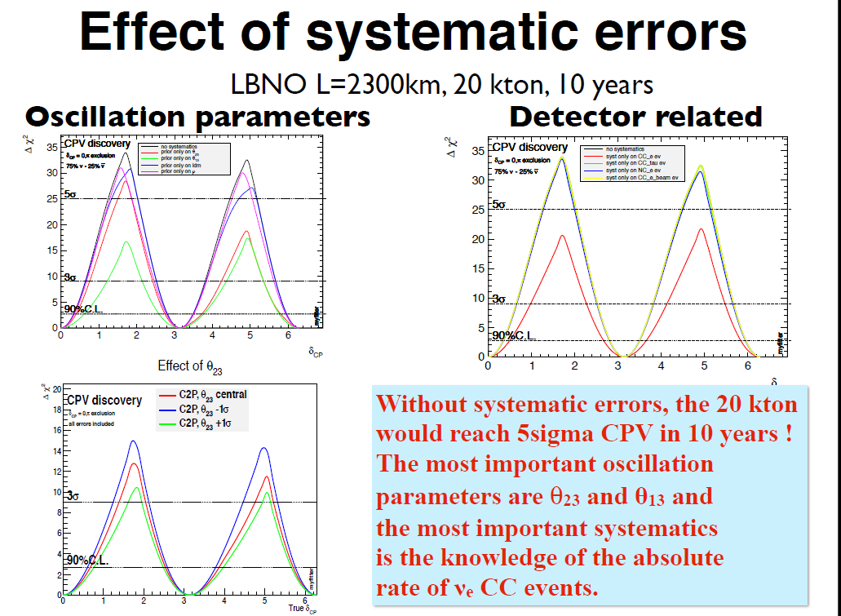

Slide 7
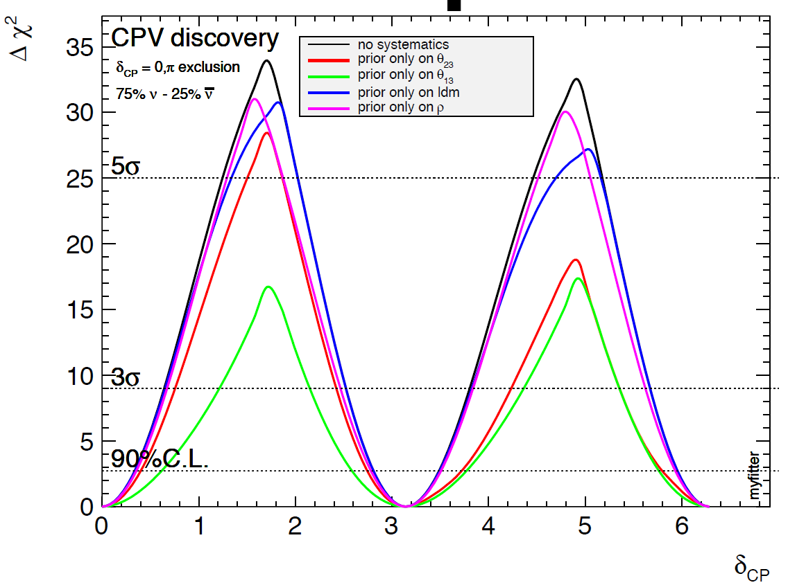
Zooming on «parametric» systematic errors
As expected θ₁₃ dominates

Slide 8
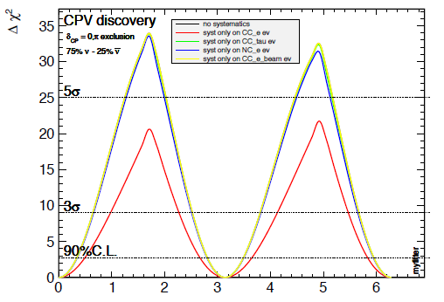
Zooming on detection-related systematics
As expected σ_{νe} dominates!
δ_{CP}
Emphasizes once more the importance to know
cross-section x efficiency for the ν_{e} (in far detector) / ν_{μ} (in near detector)

Slide 9
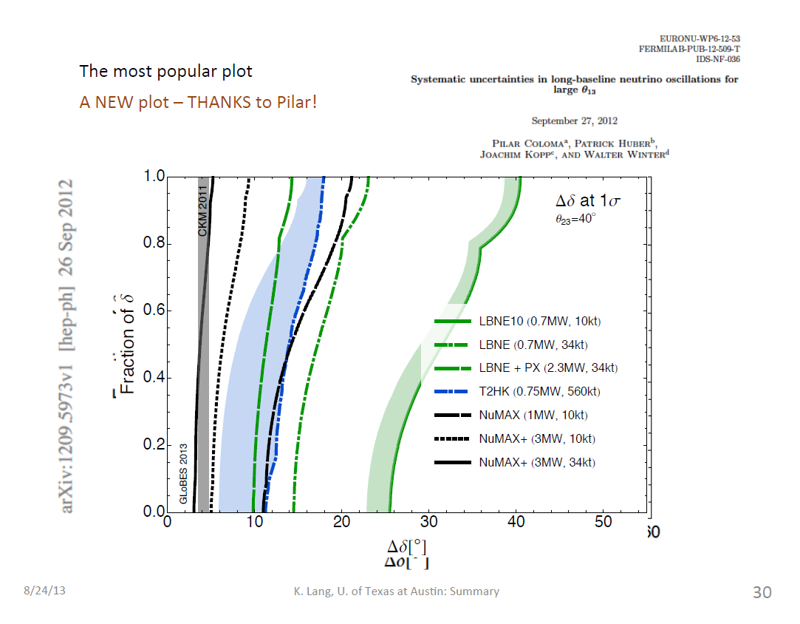

Slide 10
what is needed to keep systematics at low level in the measurements of
ν_{μ}→ν_{e} oscillation probability
-- need hadroproduction experiment for near/far flux ratio NA61/SHINE
-- need energy calibration of electrons vs muons
-- need cross-section measurements especially to establish ratio
σ(ν_{μ})xeff /σ(ν_{e})xeff for neutrino and antineutrino
(especially sensitive for CP violation)
-?- is theory/experiment otherwise able to provide cross-section ratio and precise
event generator
-- need to understand resolution on reconstruction of Eν
esp. sensitive for θ₂₃

Slide 11
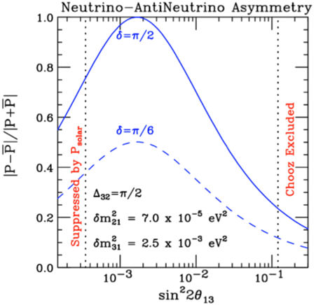
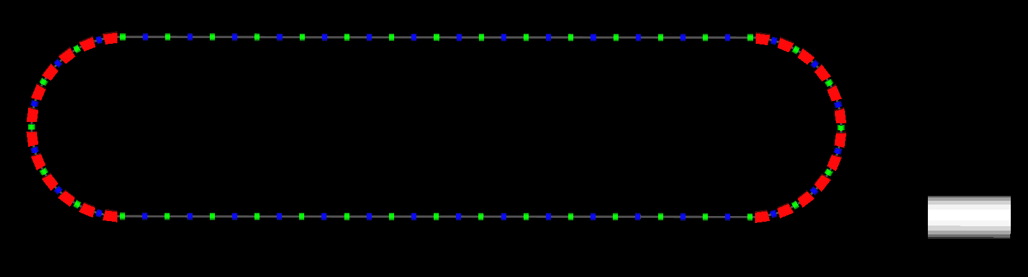
CP asymmetry decreases as
sin²2θ₁₃ increases… Systematics!
First maximum
Challenge of precision!
Flux and cross-sections must be known to <<5%
➔hadro production experiments (NA61@CERN)
+ near detectors → cross-sections to 5%
needed to measure cross-sections
to 1% precision ➔ mini neutrino factory (first step muon storage ring)
Old idea, re-publicized in 2009. Now proposed under name nuSTORM
Bross@NUFACT11
TASD, LArg…

Slide 12
PRACTICALITIES

Slide 13
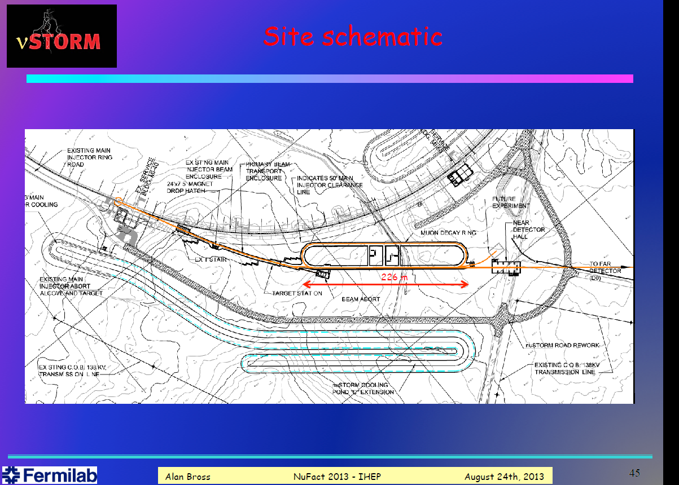

Slide 14
Implementation, at CERN:
Principal issue:
  SPS spill is 10 μs:
    Implies bend for proton or pion beam
      Or development of fast extraction
Two options:
  NA implementation:
    Possible exploitation of synergies with ICARUS/NESSiE
  NA-to-WA implementation:
    Advantage is proton/pion bend not required;
    Longer baseline must be tuned to larger muon energy (possibly an advantage too)

Slide 15
Implementation, at CERN:
North area
extension
Principal issue:
  SPS spill is 10 μs:
    Implies bend for proton or pion beam
      Or development of fast extraction
Two options:
  NA implementation:
    Possible exploitation of synergies with ICARUS/NESSiE
  NA-to-WA implementation:
    Advantage is proton/pion bend not required;
    Longer baseline must be tuned to larger muon energy (possibly an advantage too)

Slide 16

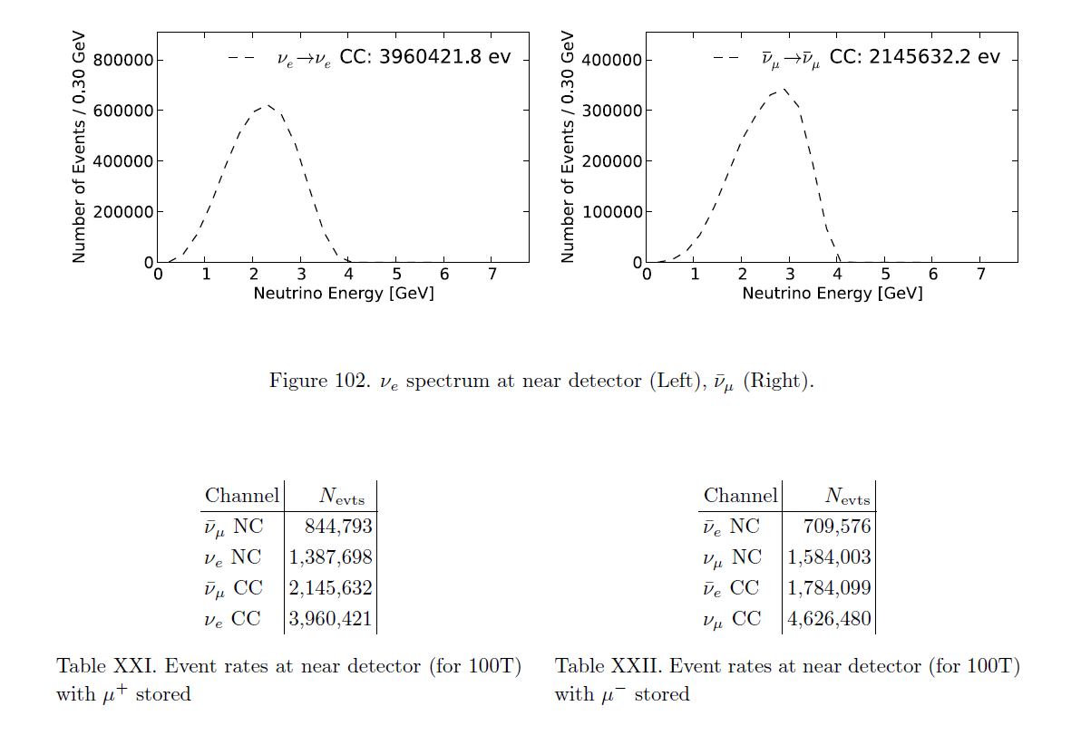
Event rates per 100ton
at the near detector station
arXiv:1308.6822v1

Slide 17
by varying the muon beam energy, can access a narrow band beam
➔ evaluate resolution and calibration of neutrino energy reconstruction

Slide 18
It seems that adding precise signal cross-section ( =σ.ε )
-- for near detector normalization channel (ν_{μ} or‾ν_{μ} )
-- and far detector signal channel (ν_{e} or‾ν_{e})
can improve the final reach of a long baseline experiment considerably.
nuSTORM exposure of near detector and far detector prototype
-- size 1-100 tons
should provide the proper data set for 1% meaasurement of cross-sections.
It fits well in a staged approach with excellent physics output at each stage
desired date = if possible a few years before the LBL experiment starts.

Slide 19
Personal comments on nuSTORM:
nuSTORM does four things:
1. a first experience with running a production muon storage ring!
2. provide beams of nu_e, antinu_e, nu_mu and antinu_mu with fluxes known to <1% precision and measurements of neutrino cross-sections with that kind of precision for these four species of neutrinos and for any detector that can distinguish e's from mu's,
Liquid Argon in particular.
3. possibly provide a very sensitive search for the particular light sterile neutrino that is claimed to have been observed by the LSND experiment at Los Alamos. My fear is that this observation is very weak and controversial, and furthermore maybe killed long before nustorm can be built, by e.g. the LAR1 program on the BooNE beam at Fermilab.
4. also provide a high flux of muons for the sake of doing muon cooling R&D
Because of property 2. I would argue that nuSTORM should be integral part of the long baseline neutrino program aiming at the discovery and study of CP violation with conventional neutrino beams (HyperK, LBNE or LBNO). The desirable commissioning timescale is "early 2020's". nuSTORM would be a fantastic contribution from CERN.

Slide 20
Conclusions
I believe we should look at nuSTROM with great interest
For instance implementation at CERN should point to Larg prototype!
This could be a very important (and interesting) contribution
to a long baseline program.

