Slide 1
LHCb DAQ for Run3 and beyond
Niko Neufeld
HL-LHC Trigger, Online and Offline Computing Working Group Topical Workshop
Sep 5th 2014

Slide 2
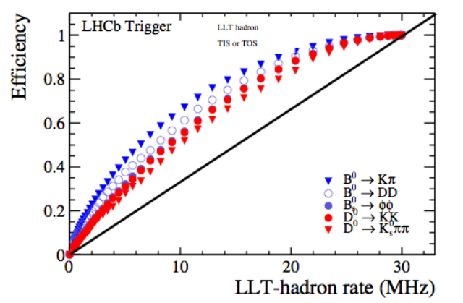
LHCb after LS2
Substantial increase in physics reach only possible with massive increase in read-out rate
Geometry (spectrometer) and comparatively small event-size make it possible – and the easiest solution – to run trigger-free, reading every bunch-crossing
Note:
  Any increase beyond
  1 MHz requires
  change of all
  front-end electronics
  To keep data-size
  reasonable,
  all detectors must
  zero-suppress at
  the front-end

Slide 3
Recap - requirements
Event rate 40 MHz
  of which ~ 30 MHz have protons
Mean nominal event size 100 kBytes
Readout board bandwidth up to 100 Gbits/s
  to match DAQ links of 2018
CPU nodes up to 4000
  actual requirements are probably less, but provide for sufficient power, cooling and connectivity to accommodate a wide range of implementations
Output rate to permanent storage 20 to 100 kHz

Slide 4
In one number…
8800 (# VL) * 4.48 Gbit/s (wide mode) ➔
40 Tbit/s

Slide 5
40 Tbit/s DAQ in practice
By 2018 100 Gbit/s technologies will be well established in the data-centre. Currently we see three candidates:
  100 G Ethernet (data-centre links probably 2015)
  InfiniBand EDR (available end of 2014)
  Intel OmniScale Fabric (available ~ 2015)
The event-builder will use 100 Gbit/s links.
Add 20% safety margin for protocol overheads etc… → need 500 100 Gbit/s links
Start study with InfiniBand (because it’s already available)

Slide 6
Architecture considerations
Want to be able to use data-centre switches → need lots of buffering in event-builder units
Want to decide on network technology and manufacturer as late as possible → use COTS network interfaces (i.e. PC)
Trigger processing in any imaginable “compute unit” will be CPU-bound not I/O-bound → optimal match by combination of “high-speed” network (event-building) and “low-speed” network (event-filtering)
Keep distances short → minimize cost of individual links

Slide 7
The evolution of Network Interconnects
PCIe Gen4
expected
PCIe Gen3
available
EDR (100 Gb/s) HCA
expected
100 GbE NIC
expected
Chelsio T5 (40 GbE)
Mellanox FDR
Mellanox 40 GbE NIC

Slide 8
Readout Architecture
Detector front-end electronics
UX85B
8800
Versatile Link
Clock & fast commands
Clock & fast commands
500
Eventbuilder PCs + software LLT
TFC
throttle from PCIe40
Eventbuilder network
6 x 100 Gbit/s
6 x 100 Gbit/s
Point 8 surface
subfarm switch
subfarm switch
Online storage
Eventfilter Farm
~ 80 subfarms

Slide 9
Challenges
200 Gbit/s full duplex in PC (including opportunistic use of idle CPU resources)
100 Gbit/s FPGA receiver card
300 m operation of Versatile Link
40 Tbit/s event-building network

Slide 10
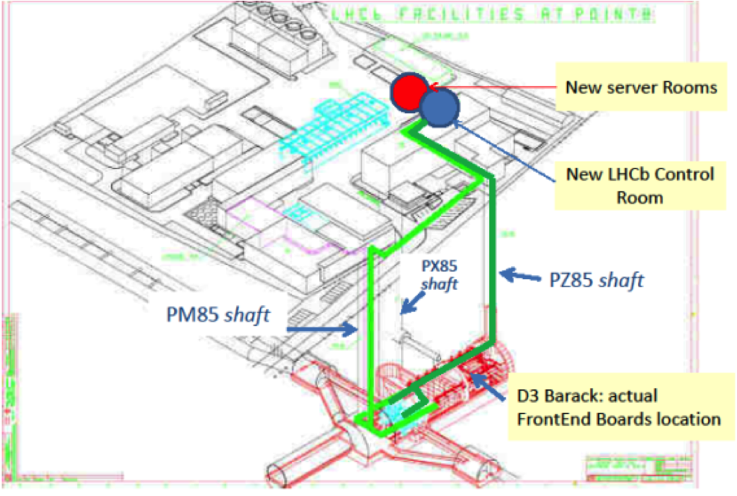
Long-distance optical fibres
Most compact system achieved by locating all Online components in a single location
Power, space and cooling constraints allow such an arrangement only on the surface: containerized data-centre
Versatile links connecting detector to readout-boards need to cover 300 m
Test installation will start tomorrow 5/9/14 in collaboration and with the help of EN/MEF and EN/EL

Slide 11
Long distance versatile link lab tests
Various optical fibres tested show good optical power margin and very low bit error rates
For critical ECS and TFC signals Forward Error Correction (standard option in GBT) gives additional margin
On DAQ links expect < 0.25 bit errors / day / link in 24/7 operation

Slide 12
PCIe40
Up to 48 bi-directional optical I/Os (VL)
Up to 100 Gbit/s I/O to the PC (PCIe Gen3 x 16 card)
Designed by CPP Marseille. Firmware and production support by INFN Bologna, LAPP and CERN
Universal building block for DAQ, ECS and TFC

Slide 13
Latency measurements
Message Size[byte] | lat[μs]
256 | 4.3
512 | 4.7
1024 | 5.2
2048 | 7.1
4096 | 9.1
8192 | 13.3
16384 | 17.2
32768 | 22.9
65536 | 33.7
Latency measurements for single threaded client/server
Average value over 100 repetitions
Low latencies are good for RDMA / pull protocols
measurements by A. Falabella et al. (UNIBO & INFN) on Qlogic IB

Slide 14
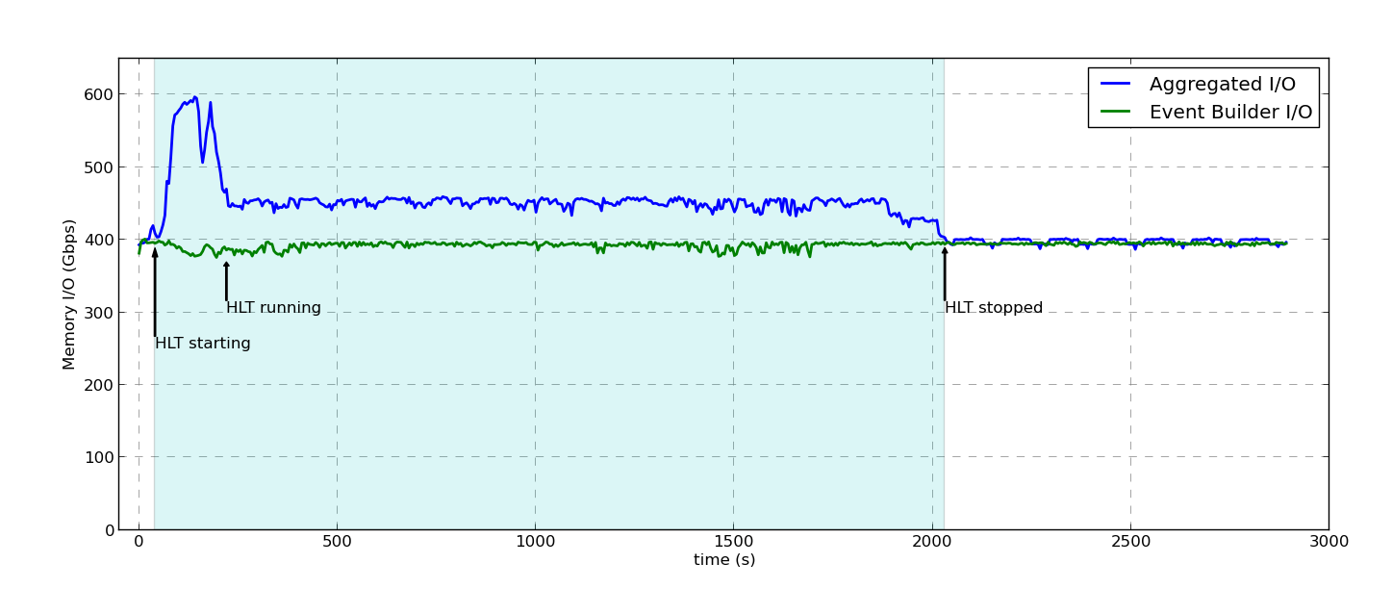
Performance results – eventbuilder PC
400 Gbps stable on I/O
Opportunistic CPU usage on event-builder nodes possible
Can be used for High Level Trigger and/or Low Level Trigger
measurements by D. Campora et al. (CERN) on Mellanox IB

Slide 15
Network building & testing
Core network will require a 500 port 100 Gbit/s device → this will be available
  Internally probably a Clos (like) topology → need to carefully verify blocking factors and protocol
Large scale tests require large system
  Can test opportunistically in HPC sites

Slide 16
Current and future DAQ
 | LHCb Run1 & 2 | LHCb Run 3
Max. inst. luminosity | 4 x 10^32 | 2 x 10^33
Event-size (mean – zero-suppressed) [kB] | ~ 60 (L0 accepted) | ~ 100
Event-building rate [MHz] | 1 | 40
# read-out boards | ~ 330 | 400 - 500
link speed from detector [Gbit/s] | 1.6 | 4.5
output data-rate / read-out board [Gbit/s] | 4 | 100
# detector-links / readout-board | up to 24 | up to 48
# farm-nodes | ~ 1000 (+ 500 in 2015) | 1000 - 4000
# links 100 Gbit/s (from event-builder PCs) | n/a | 400 - 500
final output rate to tape [kHz] | 5 | 20 - 100

Slide 17

Talking about BIG DATA
LHC / year
16 PB
Business email / year
2900 PB
Data processed by the
LHCb software
trigger per year from 2021
19000 PB
Google search index
97 PB
2900 PB
Youtube upload /
year 15 PB
Facebook upload / year
182 PB
© Wired http://www.wired.com/2013/04/bigdata/

Slide 18
Summary
The trigger-free readout of the LHCb detector requires
  new, zero-suppressing front-end electronics
  a 40 Tbit/s DAQ system
This will be realized by
  a single, high performance, custom-designed FPGA card (PCIe40)
  A PC based event-builder using 100 Gbit/s technology and data centre-switches
We are confident that all inherent challenges can be met at a reasonable cost

Slide 19
More material

Slide 20
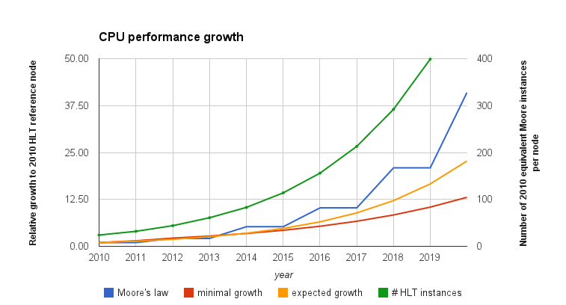
Event-filter farm
Only major discussion: performance evolution and/or number of instances per node

Slide 21
Cost
Cost of the Online System Cost [kCHF]
Event builder (network and PCs) 3600
Optical Fibres 1700
Controls network 905
Controls system (ECS) 930
Event-filter farm 2800
Infrastructure 775
Timing and Fast Control (TFC) 500

Slide 22
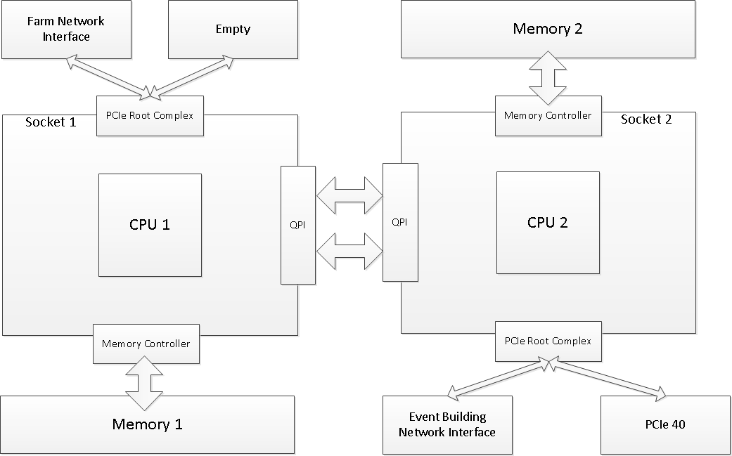
Performance tests
I/O Setup (2)
QPI link - 128 Gbps
Memory throughput – 200 Gbps
Dual-port IB FDR – 109 Gbps
GPUgen –
110 Gbps
Memory throughput – 200 Gbps
Dual-port IB FDR – 109 Gbps

