Slide 1



ECFA - TOOC
ECFA HL-LHC Workshop
PG7: Trigger, Online, Offline and Computing Preparatory Group Workshop: L1 Trigger:
Welcome and Introduction
Wesley H. Smith
  U. Wisconsin - Madison
Graeme Stewart
U. Glasgow
  September 5, 2014

Slide 2
ECFA TOOC Membership
ALICE: Latchezar Betev, Mikolaj Krzewicki, Pierre Vande Vyvre,
ATLAS: Graeme Stewart, Benedetto Gorini, Nikos Konstantinidis, Imma Riu, Stefano Veneziano
CMS: Wesley Smith, Maria Girone, David Lange, Frans Meijers
LHCb: Peter Clarke, Vava Gligorov, Niko Neufeld

Slide 3
Identified Topics: L1/L0 Trigger
Novel technologies such as associative memory devices and track triggers
Multi-variate trigger strategy
Real time alignment and calibration strategy
Architecture Comparisons: L0 (if applicable), L1, L2 (if applicable) rates and latencies. Justification of differences.
Performance Comparisons: Predicted trigger rates for various benchmark signals with and without a tracking trigger. Specific rate reductions from tracking trigger.
Triggering using Pixels.
Use of timing information.
Simulation of trigger (e.g. associative memories)
IBM's Power initiative and in general non-x86 FPGA/CPU hybrids including OpenCL for FPGAs

Slide 4
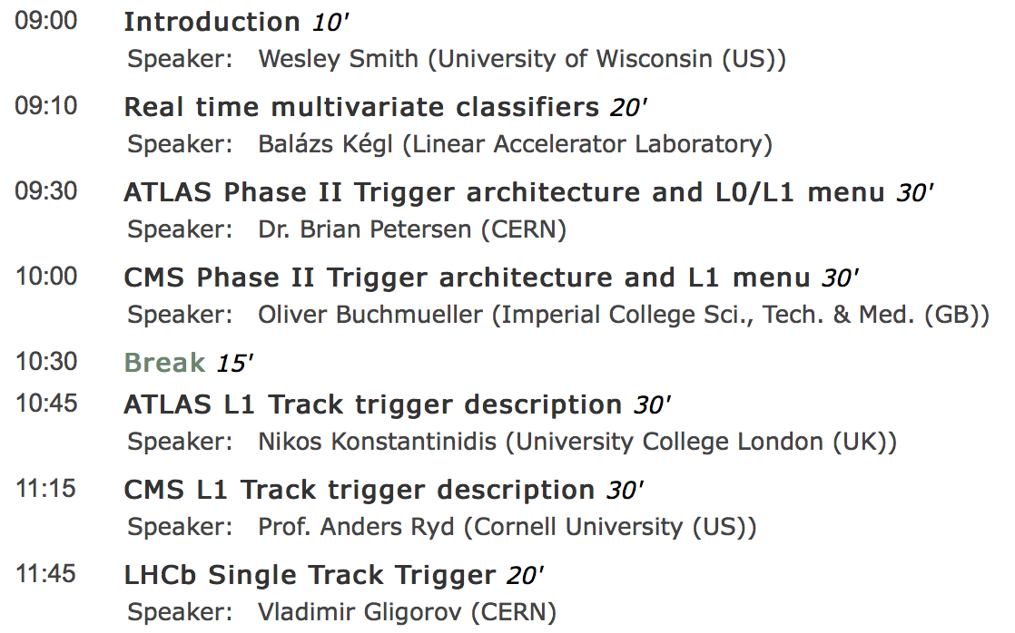
Agenda
Timing is tight.
Speakers are asked to keep to their times

