Slide 1
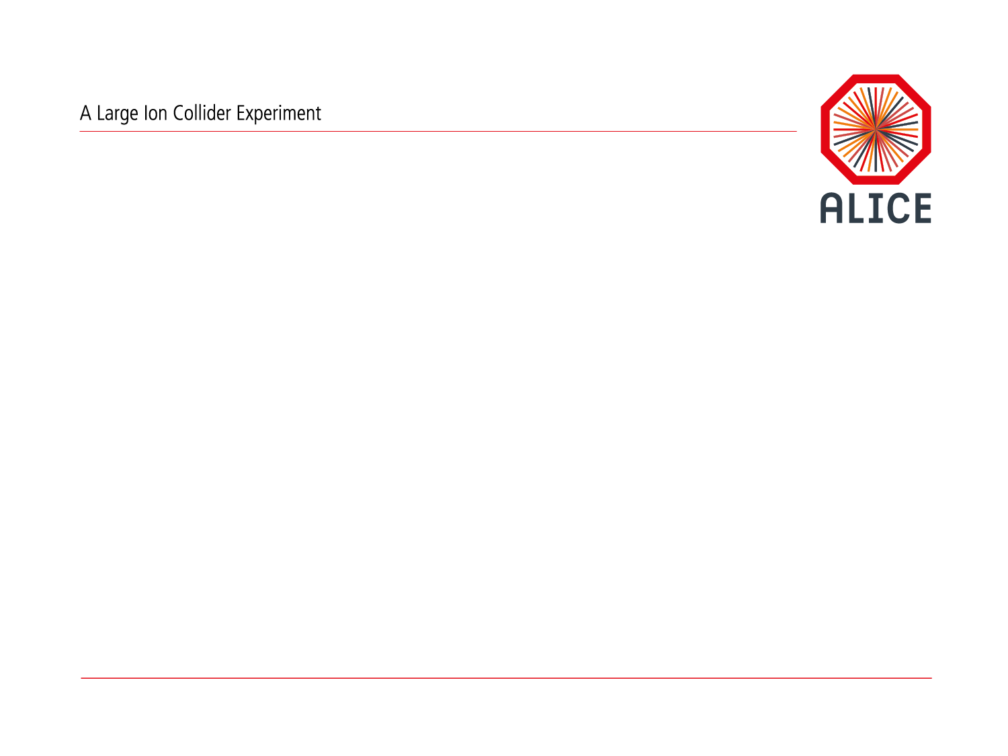
O² Project :Upgrade of the online and offline computing
ECFA HL-LHC Workshop
PG7: Trigger, Online, Offline and Computing
Pierre VANDE VYVRE for the O² project

Slide 2

O² Project
Institutes
  FIAS, Frankfurt, Germany
  GSI, Darmstadt, Germany
  IIT, Mumbay, India
  IPNO, Orsay, France
  IRI, Frankfurt, Germany
  Jammu University, Jammu, India
  Rudjer Bošković Institute, Zagreb, Croatia
  SUP, Sao Paulo, Brasil
  University Of Technology, Warsaw, Poland
  Wiegner Institute, Budapest, Hungary
  CERN, Geneva, Switzerland
Active interest from
  Creighton University, Omaha, US
  KISTI, Daejeon, Korea
  KMUTT (King Mongkut's University of Technology Thonburi), Bangkok, Thailand
  KTO Karatay University, Turkey
  Lawrence Berkeley National Lab., US
  LIPI, Bandung, Indonesia
  Oak Ridge National Laboratory, US
  Thammasat University, Bangkok, Thailand
  University of Cape Town, South Africa
  University of Houston, US
  University of Talca, Chile
  University of Tennessee, US
  University of Texas, US
  Wayne State University, US
Institutes

Slide 3

Requirements
Focus of ALICE upgrade on physics probes
requiring high statistics: sample 10 nb⁻¹
Online System Requirements
Sample full 50kHz Pb-Pb interaction rate
current limit at ~500Hz, factor 100 increase
system to scale up to 100 kHz
TPC drift time >> minimum bias rate
Continuous (trigger-less) read-out
⇨ ~1.1 TByte/s detector readout
However:
Storage bandwidth limited to a much lower value (design decision/cost)
Many physics probes have low S/B:
classical trigger/event filter approach not efficient

Slide 4
O² System from the Letter of Intent
Design Guidelines
Handle >1 TByte/s detector input
Produce (timely) physics result
Minimize “risk” for physics results
  Allow for reconstruction with improved calibration,
  e.g. store clusters associated to tracks instead of tracks
  Minimize dependence on initial calibration accuracy
Keep cost “reasonable”
  Limit storage system bandwidth
  to ~80 GB/s peak and 20 GByte/s average
  Optimal usage of compute nodes
Online Reconstruction to
reduce data volume
Output of System AODs

Slide 5

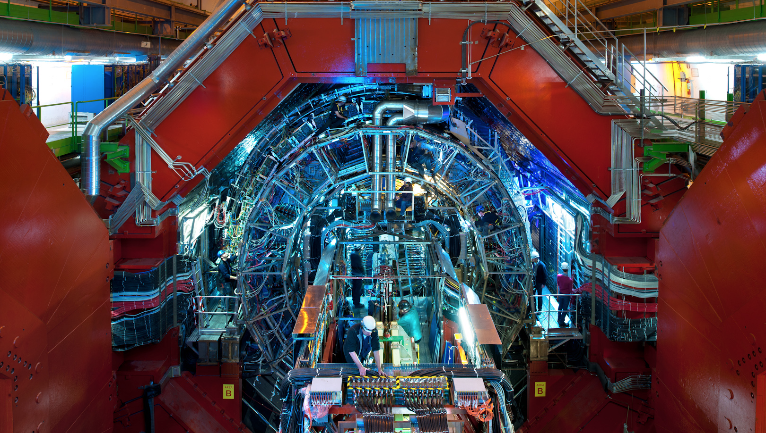


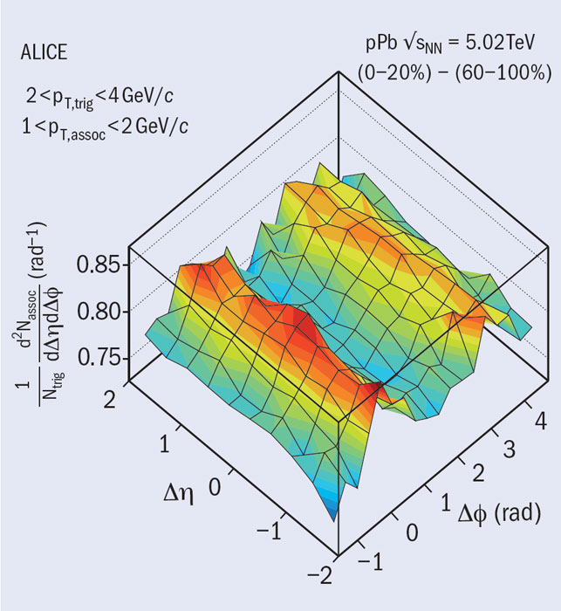
O² Project
Detector | Input to Online System (GByte/s) | Peak Output to Local Data Storage (GByte/s) | Avg. Output to Computing Center (GByte/s)
TPC | 1000 | 50.0 | 8.0
TRD | 81.5 | 10.0 | 1.6
ITS | 40 | 10.0 | 1.6
Others | 25 | 12.5 | 2.0
Total | 1146.5 | 82.5 | 13.2
Requirements
Handle >1 TByte/s detector input
Support for continuous read-out
Online reconstruction to reduce data volume
Common hw and sw system developed by the DAQ, HLT, Offline teams

Slide 6
O² Project
Project Organization
PLs: P. Buncic, T. Kollegger, P. Vande Vyvre
Computing Working Group (CWG) Chair
Architecture S. Chapeland
Tools & Procedures A. Telesca
Dataflow T. Breitner
Data Model A. Gheata
Computing Platforms M. Kretz
Calibration C. Zampolli
Reconstruction R. Shahoyan
Physics Simulation A. Morsch
QA, DQM, Visualization B. von Haller
Control, Configuration, Monitoring V. Chibante
Software Lifecycle A. Grigoras
Hardware H. Engel
Software framework P. Hristov
Editorial Committee
L. Betev, P. Buncic, S. Chapeland, F. Cliff, P. Hristov, T. Kollegger, M. Krzewicki, K. Read, J. Thaeder, B. von Haller, P. Vande Vyvre
Physics requirement chapter: Andrea Dainese
O² CWGs
O²
Technical
Design
Report

Slide 7
Hardware Architecture
ITS
FLP
Farm
Network
Storage
Network
~ 2500 DDL3s
in total
2 x 10 or
40 Gb/s
10 Gb/s
TPC
FLP
EPN
10 Gb/s
TRD
FLP
FLP
EPN
Data
Storage
EMC
PHO
FLP
Data
Storage
EPN
TOF
FLP
Muon
FLP
L0
L1
EPN
FTP
FLP
Trigger Detectors
~ 250 FLPs
First Level Processors
~ 1250 EPNs
Event Processing Nodes

Slide 8


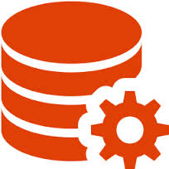
Design strategy
Iterative process: design, benchmark, model, prototype
Design
Technology
benchmarks
Model
Prototype

Slide 9


Dataflow
Dataflow modelling
Dataflow discrete event simulation implemented with OMNET++
  FLP-EPN data traffic and data buffering
    Network topologies (central switch; spine-leaf),
    Data distribution schemes (time frames, parallelism)
    Buffering needs
    System dimensions
  Heavy computing needs
  Downscaling applied for some simulations:
    Reduce network bandwidth and buffer sizes
    Simulate a slice of the system
System global simulation with ad-hoc program

Slide 10
Hardware Architecture: FLP buffer size
E_{i+3} E_{i+2} E_{i+1} E_{i}
Bin
FLP
Farm
Network
10 x 10 Gb/s
40 Gb/s
Bout
FLP
EPN
E_{i}
E_{i+1}
E_{i+2}
E_{i+3}
40 Gb/s
FLP
FLP
EPN
FLP
Time frame for the continuous detector readout
TPC FLP subEventSize = 20 MB / 200 = 0.1 MB
TPC drift time 100 us, 5 overlapping events at 50 kHz
Nb event frame >> Nb event at the “borders”
Number events >> ~4 (@50 kHz)
1000 events → 100 MB timeframe / FLP
256 FLPs → ~25 GB timeframe / EPN
FLP Buffer usage
Input buffer for partial timeframes aggregation
Data waiting to be processed
Data processing buffers
Output buffer for timeframes being sent to EPNs
EPN
FLP
FLP
EPN
FLP
~ 2500 DDL3s
~ 250 FLPs
First Level Processors
~ 1250 EPNs
Event Processing Nodes

Slide 11
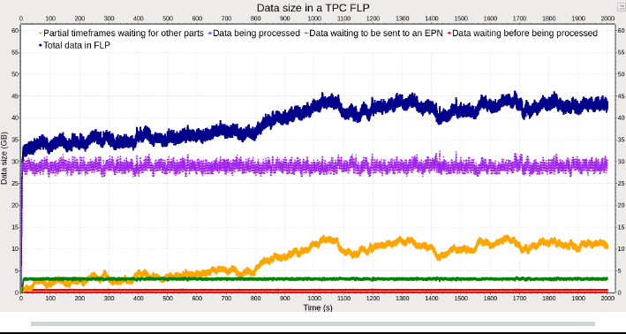
FLP-EPN Dataflow simulation
FLP buffer size

Slide 12
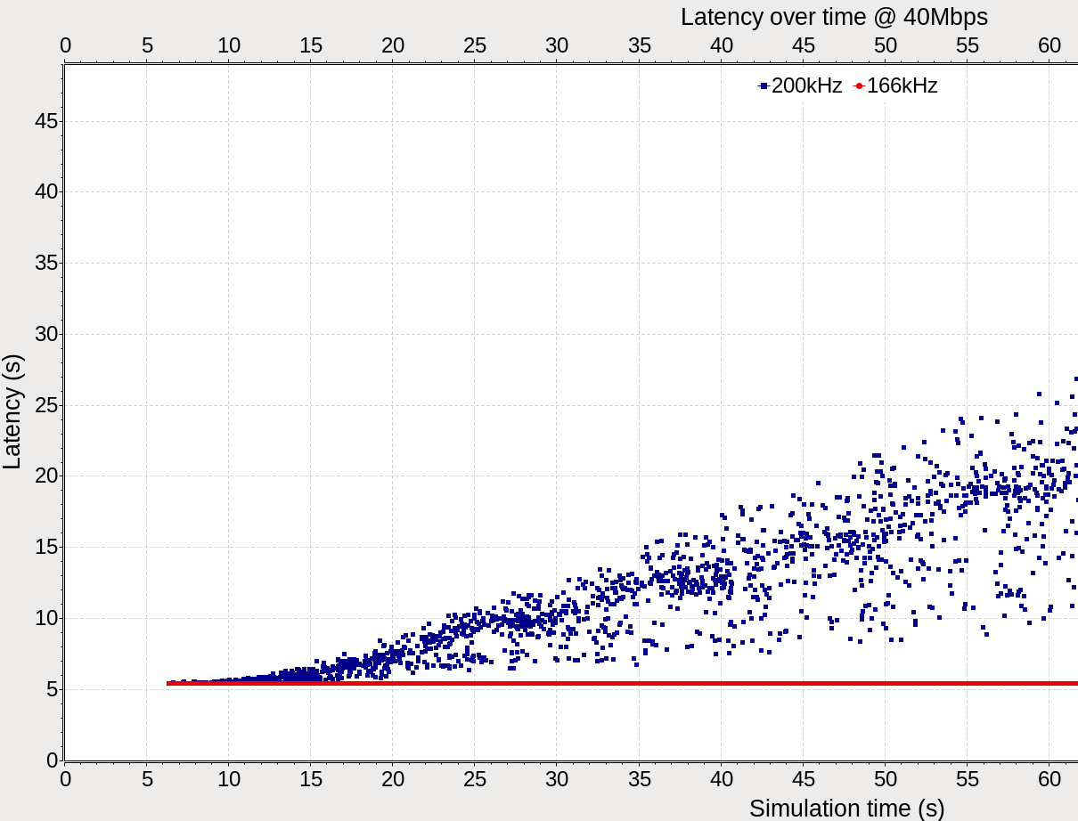
FLP-EPN Dataflow simulation
S. Chapeland, C. Delort
System scalability study
Configuration 40 Mbps 250x288
System scalability study
System studied on
a ¼ of the entire system
and lower bandwidth
to limit the simulation time
System scales at up to
166 kHz of MB interactions

Slide 13
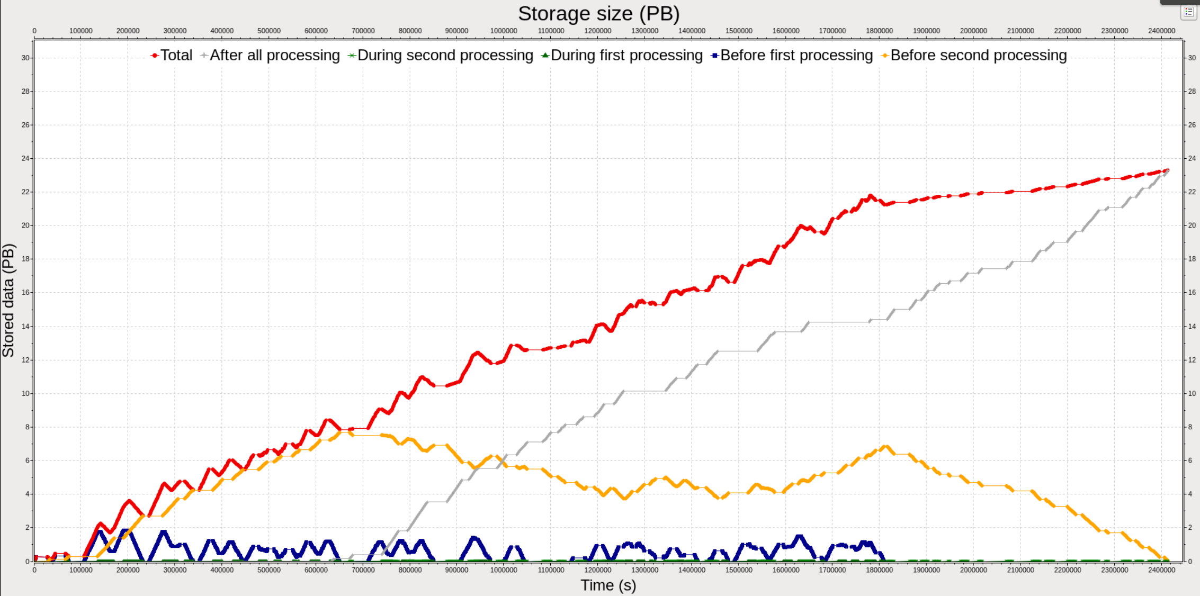
Data storage needs of the O² facility
dk
Need of ~25 PB of local data storage for 1 year of data taking

Slide 14
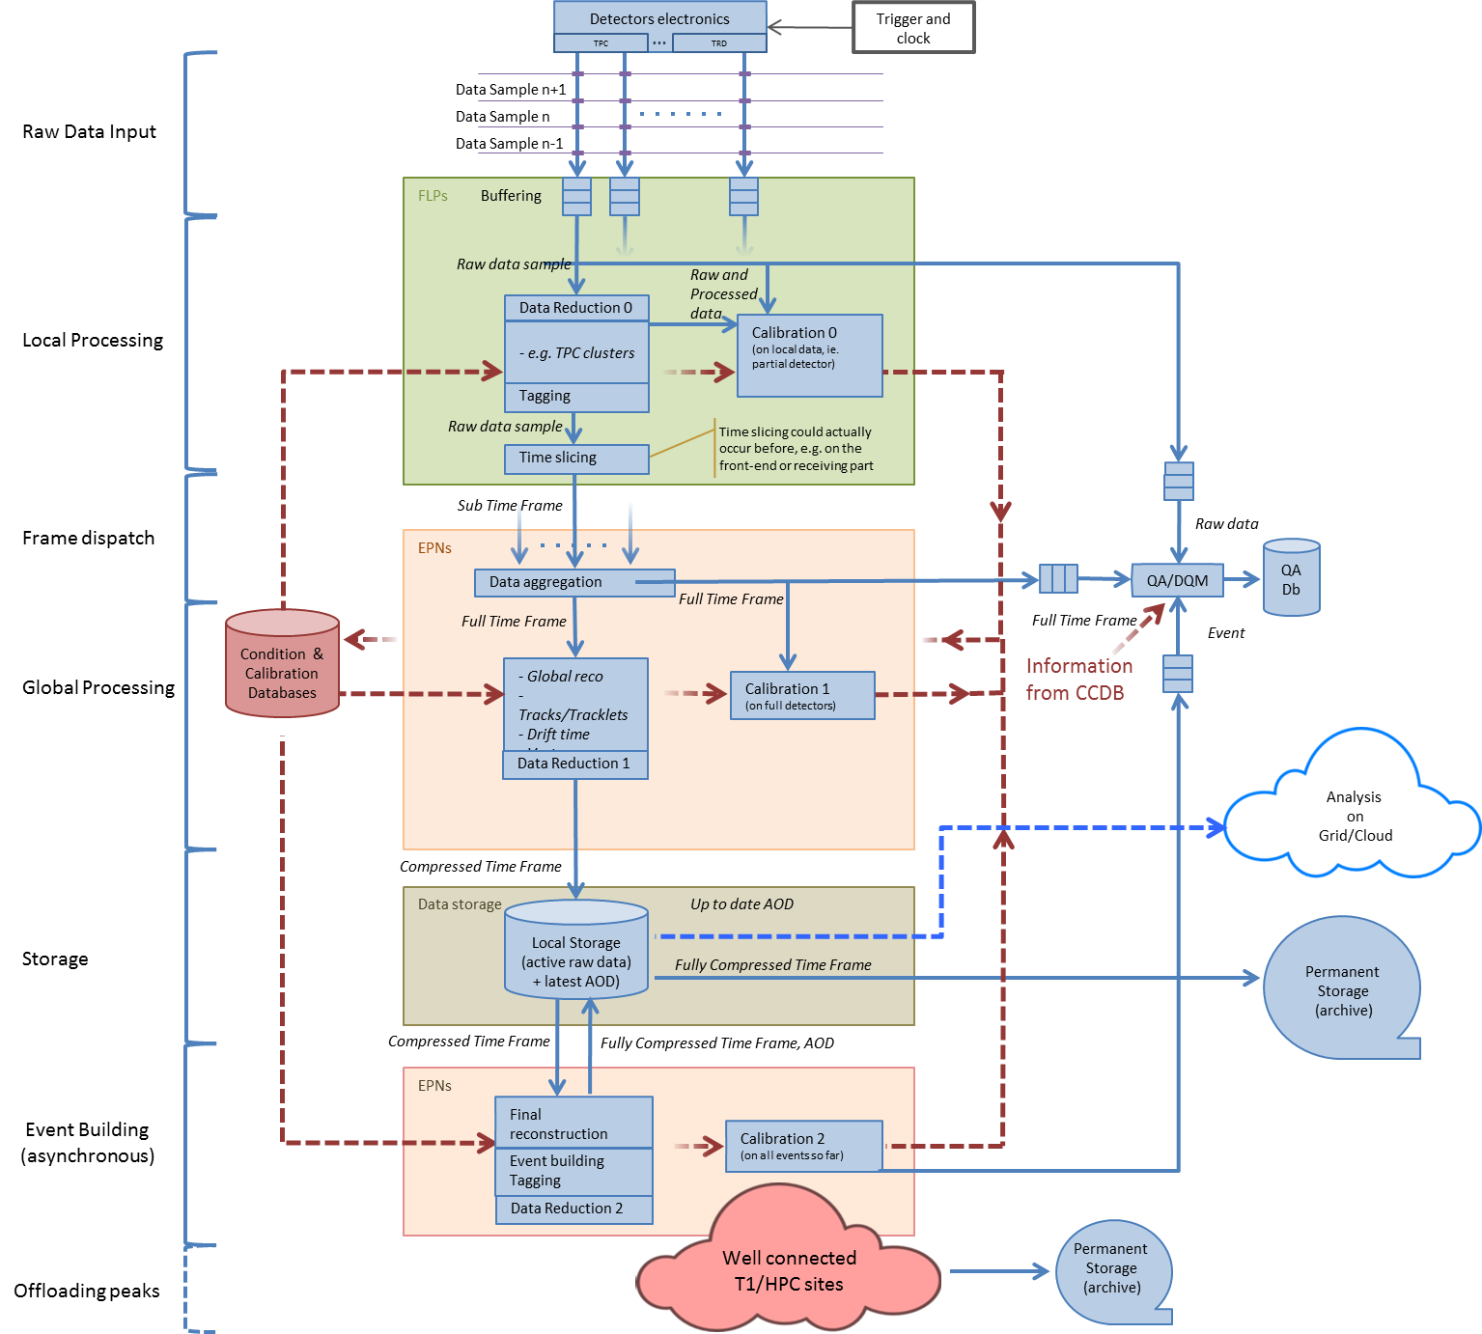
Architecture
O² Architecture and data flow
TPC Data
1 TB/s
250 GB/s
125 GB/s
80 GB/s
  Includes asynchronous processing and offloading
  peaks to other sites.
Storage
“Intermediate” format:
Local storage in O2 system
Permanent storage in
computing center
GRID storage
AODs
Simulations

Slide 15

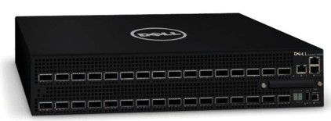
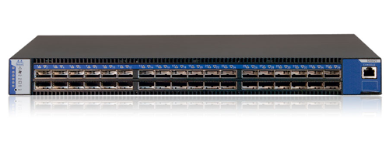
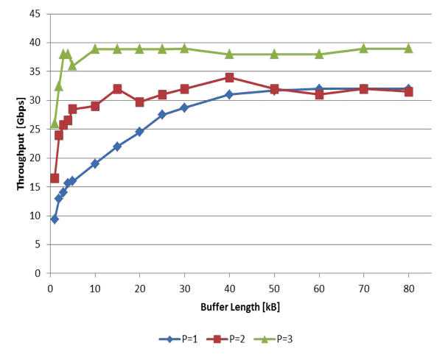
FLP and Network prototyping
FLP requirements
  Input 100 Gbit/s (10 x 10 Gbit/s)
  Local processing capability
  Output with ~20 Gbit/s
Two network technologies under evaluation
  10/40 Gbit/s Ethernet
  Infiniband FDR (56 Gbit/s)
  Both used already
  (DAQ/HLT)
Benchmark example
Chelsio T580-LP-CR with
TCP/UDP Offload engine
1, 2 and 3 TCP streams,
iperf measurements

Slide 16

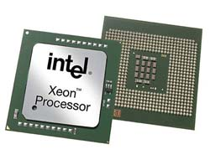
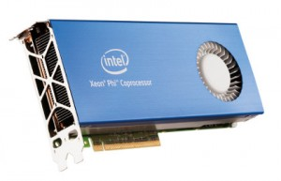
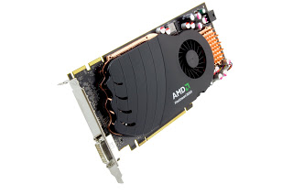
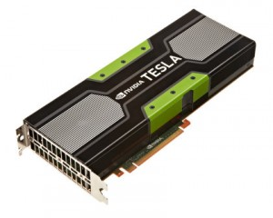
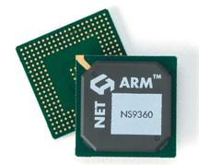
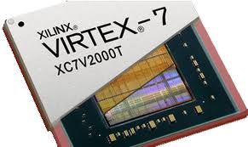
CWG5: Computing Platforms
  The Conversion factors
Shift from 1 to many platforms
Speedup of CPU Multithreading:
  Task takes n1 seconds on 1 core, n2 seconds on x cores
  Speedup is n1/n2 for x cores, Factors are n1/n2 and x/1
  With Hyperthreading: n2‘ seconds on x‘ threads on x cores. (x‘ >= 2x)
  Will not scale linearly, needed to compare to full CPU performance.
    Factors are n1 / n2‘ and x / 1 (Be carefull: Not x‘ / 1, we still use only x cores.)
Speedup of GPU v.s. CPU:
  Should take into account full CPU power (i.e. all cores, hyperthreading).
  Task on the GPU might also need CPU resources.
    Assume this occupies y CPU cores.
  Task takes n3 seconds on GPU.
  Speedup is n2‘/n3, Factors are n2‘/n3 and y/x. (Again x not x‘.)
How many CPU cores does the GPU save:
  Compare to y CPU cores, since the GPU needs that much resources.
  Speedup is n1 / n3, GPU Saves n1 / n3 – y CPU cores.
  → Factors are n1 / n3, y / 1, and n1 / n3 - y.
Benchmarks: Track Finder, Track Fit, DGEMM (Matrix Multiplication – Synthetic)

Slide 17
CWG5: Computing Platforms
  Track finder
Nehalem 4-Core 3,6 GHz (Smaller Event than others)
1 Thread | 3921 ms | Factors:
4 Threads | 1039 ms | 3,77 / 4
12 Threads (x = 4, x‘ = 12) | 816 ms | 4,80 / 4
Westmere 6-Core 3.6 GHz
1 Thread | 4735 ms | Factors:
6 Threads | 853 ms | 5.55 / 6
12 Threads (x = 4, x‘ = 12) | 506 ms | 9,36 / 6
Dual Sandy-Bridge 2 * 8-Core 2 GHz
1 Thread | 4526 ms | Factors:
16 Threads | 403 ms | 11,1 / 16
36 Threads (x = 16, x‘ = 36) | 320 ms | 14,1 / 16
Dual AMD Magny-Cours 2 * 12-Core 2,1 GHz
36 Threads (x = 24, x‘ = 36) | 495 ms
3 CPU Cores + GPU – All Compared to Sandy Bridge System
 |  | Factor vs x‘ (Full CPU) | Factor vs 1 (1 CPU Core)
GTX580 | 174 ms | 1,8 / 0,19 | 26 / 3 / 23
GTX780 | 151 ms | 2,11 / 0,19 | 30 / 3 / 27
Titan | 143 ms | 2,38 / 0,19 | 32 / 3 / 29
S9000 | 160 ms | 2 / 0,19 | 28 / 3 / 25
S10000 (Dual GPU with 6 CPU cores | 85 ms | 3,79 / 0,38 | 54 / 6 / 48

Slide 18
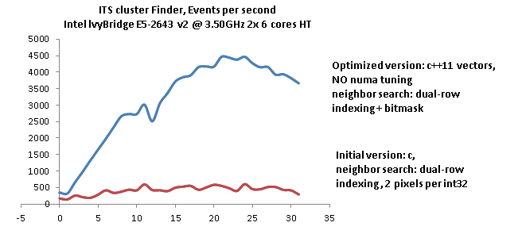
Computing Platforms
ITS Cluster Finder
Use the ITS cluster finder as optimization use case and as benchmark
Initial version memory-bound
Several data structure and algorithms optimizations applied
Events processed/s
Number of parallel processes
S. Chapeland

Slide 19

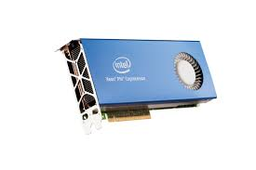





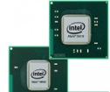
Software Framework
Multi-platforms
Multi-applications
Public-domain software
Analysis
Clusters
Simulation
Tracking
Analysis
PID
ESD
AOD

Slide 20

Software Framework Development
Design and development of a new modern framework targeting Run3
Should work in Offline and Online environment
  Has to comply with O² requirements and architecture
Based on new technologies
  Root 6.x, C++11
Optimized for I/O
  New data model
Capable of utilizing hardware accelerators
  FPGA, GPU, MIC…
Support for concurrency and distributed environment
Based on ALFA - common software foundation
developed jointly between ALICE & GSI/FAIR
ALFA
Common Software Foundations
O²
Software
Framework
FairRoot
PandaRoot
CbmRoot

Slide 21
Software Framework Development
ALICE + FAIR = ALFA
Expected benefits
  Development cost optimization
  Better coverage and testing of the code
  Documentation, training and examples.
  ALICE : work already performed by the FairRoot team concerning features (e.g. the continuous read-out), which are part of the ongoing FairRoot development.
  FAIR experiments : ALFA could be tested with real data and existing detectors before the start of the FAIR facility.
The proposed architecture will rely:
  A dataflow based model
  A process-based paradigm for the parallelism
    Finer grain than a simple match 1 batch on 1 core
    Coarser grain than a massively thread-based solution

Slide 22
Prototyping
EPN
Software components
EPN
FLP
Merger
EPN
FLP
EPN
Merger
FLP
EPN
EPN
CERN test set-up
  8 machines : Sandy Bridge-EP, dual E5-2690 @ 2.90GHz, 2x8 hw cores - 32 threads, 64GB RAM
  Network : 4 nodes with 40 G Ethernet, 4 nodes with 10 G Ethernet
GSI test set-up
Software framework prototype by members of DAQ, HLT, Offline, FairRoot teams
  Data exchange messaging system
  Interfaces to existing algorithmic code from offline and HLT

Slide 23


Calibration/reconstruction flow
MC Reference TPC map
Adjusted accounting for current luminosity
Average TPC map
One EPN
Exact partitioning of some components between
real-time, quasi-online and offline processing depends on (unknown) component CPU performance
Rescaled TPC map
Standalone
Adjusted with multiplicity
FIT → multiplicity
Matching to
TOF, HMPID,
calorimeters
TRD seeded
track finding and matching with TPC
TPC
track finding
All FLPs
DCS data
Global track
inward fitting
ITS track finding/fitting
Vertexing
Final TPC calibration
(constrained
by ITS, TRD)
Final
ITS-TPC matching,
outward refitting
Raw data
TPC-ITS
matching
PID calibrations
Clusterization
Calibration
MOUN track finding/fitting
MUON/MFT
matching
V0, Cascade
finding
MFT track finding/fitting
…
Event building:
(vertex, track, trigg association)
Compressed data storage
AOD storage
Step 1
Step 2
Step 3
Step 4

Slide 24

Future steps
A new computing system (O²) should be ready for the ALICE upgrade during the LHC LS2 (currently scheduled in 2018-19).
The ALICE O² R&D effort has started in 2013 and is progressing well
  Design, modelling, benchmarks, prototype
  Development of the Alfa framework in collaboration with the sottware team of GSI
Schedule
  June ‘15 : submission of TDR, finalize the project funding
  ‘16 – ’17: technology choices and software development
  June ’18 – June ’20: installation and commissioning

