Slide 1

ALICE Upgrade for Run3:
Computing
HL-LHC Trigger, Online and Offline Computing Working Group Topical Workshop
Sep 5th 2014

Slide 2
Timeline and resources consideration
ALICE upgrade in Run3
  CPU needs proportional to track multiplicity + pileup
  Storage needs proportional to accumulated luminosity
ALICE upgrade basic estimates
  Event rate 50KHz (Pb-Pb), 200KHz (p-p, p-Pb)
  Event size 1.1TB/sec from detector; 13GB/sec average processed and compressed to storage

Slide 3
Data processing and systems consolidation
RAW data rates and volume necessitate the creation of an online-offline facility (02) for data compression, incorporating
  DAQ functionality – detector readout, data transport and event building
  HLT functionality – data compression, clustering algorithms, tracking algorithms
  Offline functionality – calibration, full event processing and reconstruction, up to analysis objects data

Slide 4
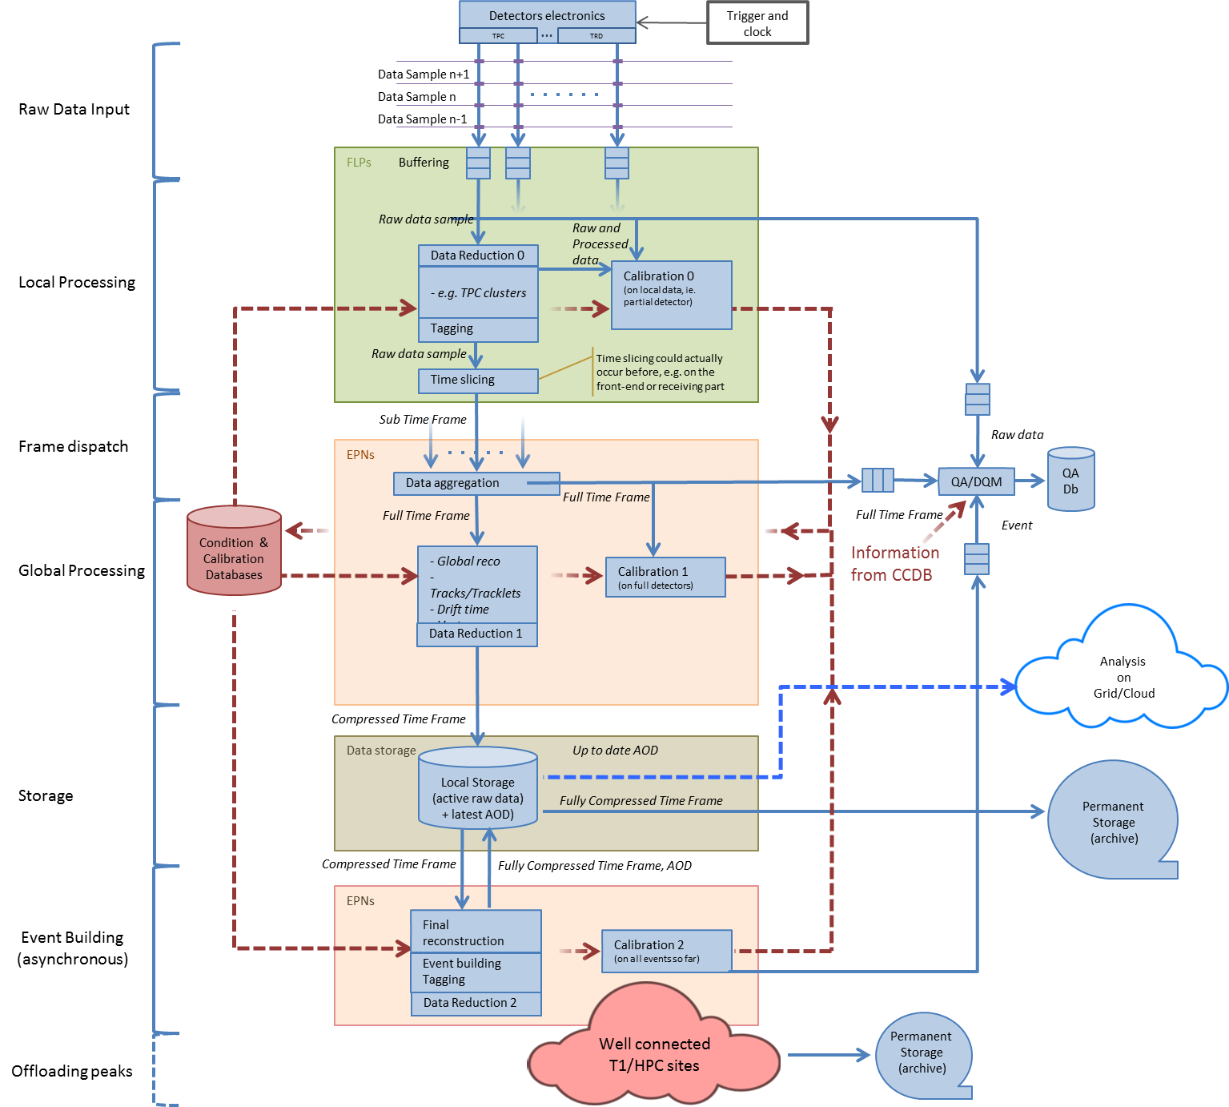
Data flow and compression in O2
Internal O2 Storage
“Intermediate” format:
Synchronous and asynchronous RAW data processing with increased precision – up to max compression
GRID storage
AODs
Simulations
Compressed RAW (custodial)

Slide 5
Hardware architecture of O2
ITS
FLP
Farm
Network
Storage
Network
~ 2500 DDL3s
in total
2 x 10 or
40 Gb/s
10 Gb/s
TPC
FLP
EPN
10 Gb/s
TRD
FLP
FLP
EPN
Data
Storage
EMC
PHO
FLP
Data
Storage
EPN
TOF
FLP
Muon
FLP
EPN
FTP
FLP
Trigger Detectors
~ 250 FLPs
First Level Processors
~ 1250 EPNs
Event Processing Nodes

Slide 6
Software and process improvements for O2
‘Offline quality’ calibration
  Critical for the data compression
  Compressed data in format allowing reprocessing, i.e. finer-grain calibration is still possible
Use of FPGAs, GPUs and CPUs in combination
  Software uses specific advantages of each
  A well-tested approach in production (current HLT)
New framework to incorporate all tasks
  ALFA (ALICE-FAIR) developed in collaboration with the FAIR collaboration at GSI Darmstadt

Slide 7
ALFA – online system for data processing
Technical challenges
Data transport Cluster infrastructure File systems and package distribution Access of large data sets Process orchestration
Algorithmic challenges
Fast algorithms Scalable processing instances Data model
Collaborative challenges
Combination of computer scientists (online) and physicists (offine)
Technical/Algorithmic challenges are addressed in
already formed Computing Working Groups

Slide 8
Simplified data processing scheme
Detector
Cluster
finder
Data
Compression
O2 storage
Calibration
Final Reconstruction
Data Compression
Fast Reconstruction
Data compression
First Level
Processor
Focus on online processing
Develop and/or reuse code for data generation
Data transport mechanism
Processing algorithms
Store the results
Permanent storage
Event Processing
Node

Slide 9
Data transport prototype
aidrefma04
EPN
EPN
EPN
EPN
EPN
FLP
EPN
EPN
EPN
EPN
EPN
EPN
EPN
aidrefma06
aidrefma08
aidrefma02
EPN
EPN
aidrefma05
aidrefma07
FLP
EPN
EPN
EPN
EPN
EPN
EPN
aidrefma01
EPN
EPN
aidrefma03
Existing and tested to expected throughput
EPN
EPN

Slide 10
Preparations for Run3 – tests of processing chain
Cluster finding in HLT for all detectors
  New, more powerful, HLT cluster
  System validated for TPC over 2 years of data taking in Run1
  Largest data compression factor (x4)
Detector calibration online
  Many detectors (currently offline) calibration algorithms in HLT
  Critical step for good quality tracking and data compression
Preparation of O2 test cluster @10% of expected size
  Testbed for ALFA development

Slide 11
The Grid
General assumption and roles
  Will continue to do what it does now
  MC simulation, end-user and organized data analysis, raw data reconstruction (reduced)
  Custodial storage for RAW data – output of O2 compressed data stream
Expected that the Grid will grow with the same rate
Search for additional resources
  New sites
  Contributed resources from existing sites

Slide 12
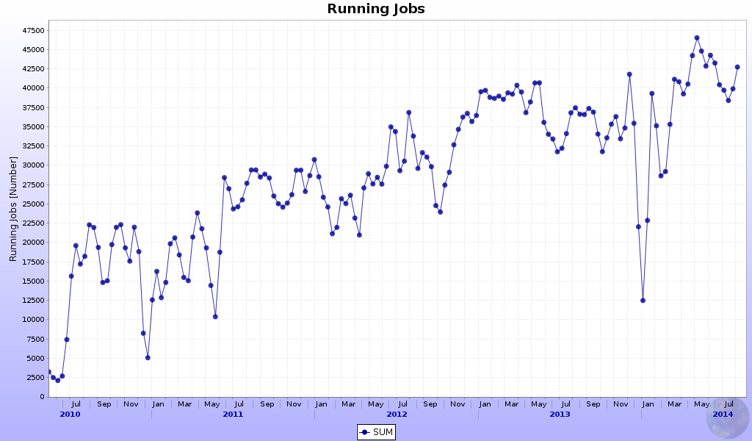
Growth expectations
Based on ‘flat budget’ and modified Moore’s law
Number of cores growth by 25% year on year – power/core ~constant
Storage growth at 20% per year
Projected at 2020 => ~3-4x the current power

Slide 13
Grid upgrades – data processing
Assume sites will continue offering standard CPUs
  ‘GPU ready’ algorithms have to cope
Growth beyond ‘flat budget’ scenario necessitates finding new resources
  This is an ongoing process
Contributed cycles from existing, non-standard sources
  Supercomputer back-fill – this can potentially bring equivalent of tens of thousand CPU cores for MC
  Ongoing collaborative work with ATLAS (PanDa)
Support for various cluster configurations will continue and expand, as needed
  Standard batch/whole node/AI-cloud-on demand
  Increases flexibility, efficiency

Slide 14
Grid upgrades – data storage
Grid storage is expected to hold the analysis object data and compressed RAW (custodial)
The data volume to the Grid will be reduced to reasonable size by the O2 facility
General expectation for cheaper storage driven by the needs of the ‘big players’ (insert Facebook here)
  May modify upward the current 20% yearly growth
  Perhaps slower media – need for more sophisticated data access models
  Biggest impact is on the cost of storage for the O2 facility

Slide 15
Summary
ALICE upgrade for LHC Run3 (2020 and beyond)
  Event rate x 100, data volume x 10 (of current rates)
Data reduction to manageable levels - dedicated O2 computing facility, incorporating DAQ/HLT and Offline functions
  Heterogeneous hardware (CPU/GPU/FPGA)
  Data volume reduction by x10 to 13GB/sec, up to analysis-ready data containers
  Framework development, software demonstrators, test cluster in preparation
Grid resources are expected to grow with the usual rate
  Intensive programme to incorporate new sites and contributed computing power on existing facilities

