Slide 1
LHCb computing plans for Run 3

Slide 2
Towards the LHCb Upgrade (Run 3, 2020)
We do not plan a revolution for LHCb Upgrade computing
Rather an evolution to fit in the following boundary conditions:
  Luminosity levelling at 2x10³³
    Factor 5 c.f. Run 2
  100kHz HLT output rate for full physics programme
    Factor 8-10 more than in Run 2
  Flat funding for offline computing resources
Computing milestones for the LHCb upgrade:
  TDR: 2017Q1
  Computing model: 2018Q3
Therefore only brainstorming at this stage, to devise model that keeps within boundary conditions

Slide 3
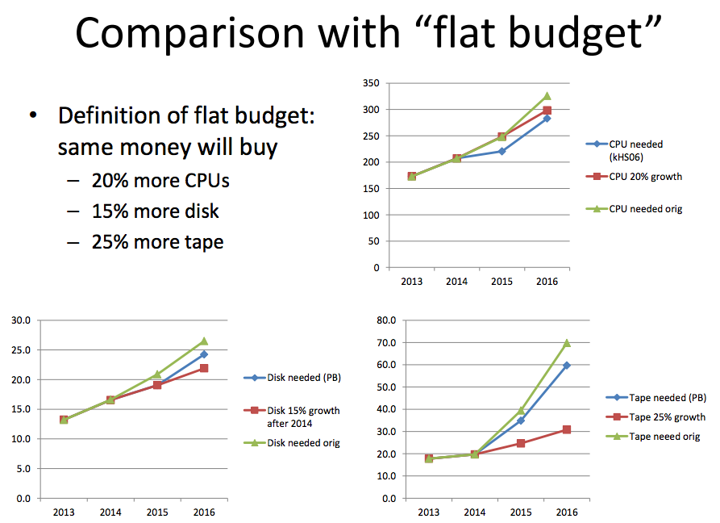
Run 2: computing resources
CPU projections ~OK to >2016
Disk ~OK Tape explodes
  Tape requirement driven by:
    Two copies of RAW
      Incompressible, but ~never accessed
    One copy Reconstruction output (FULL.DST)
  Flat funding cannot accommodate order of magnitude more data expected in Run 3 - need new ideas

Slide 4
Evolution of LHCb data processing model
Run 1:
  Loose selection in HLT (no PID)
  First pass offline reconstruction
  Stripping
    selects ~50% of HLT output rate for physics analysis
  Offline calibration
  Reprocessing and Restripping
Run 2:
  Online calibration
  Deferred HLT2 (with PID)
  Single pass offline reconstruction
    Same calibration as HLT
    No reprocessing before LS2
  Stripping and Restripping
    Selects ~90% of HLT output rate for Physics analysis
Given sufficient resources in HLT farm, online reconstruction could be made ~identical to offline

Slide 5
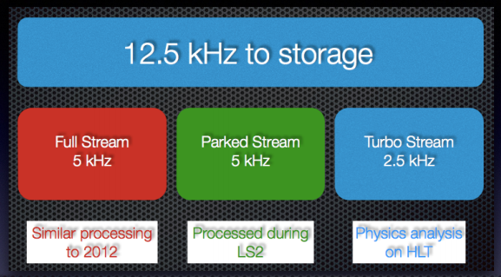
Run 2: Reconstruction streams
Full stream: prompt reconstruction as soon as RAW data appears offline
Parked stream: safety valve, probably not needed until 2017
Turbo stream: no offline reconstruction, analysis objects produced in HLT
  Important test for Run3

Slide 6
TurboDST: brainstorming for Run 3
In Run 2, Online (HLT) reconstruction will be very similar to offline (same code, same calibration, fewer tracks)
    If it can be made identical, why then write RAW data out of HLT, rather than Reconstruction output?
In Run 2 LHCb will record 2.5 kHz of “TurboDST”
    RAW data plus result of HLT reconstruction and HLT selection
    Equivalent to a microDST (MDST) from the offline stripping
  Proof of concept: can a complete physics analysis be done based on a MDST produced in the HLT?
    i.e. no offline reconstruction
      no offline realignment, reduced opportunity for PID recalibration
    RAW data remains available as a safety net
  If successful, can we drop the RAW data?
    HLT writes out ONLY the MDST ???
Currently just ideas, but would allow a 100kHz HLT output rate without an order of magnitude more computing resources.

Slide 7
Simulation
  LHCb offline CPU usage is dominated by simulation
    Already true in Run 2: simulation >60% of CPU needs in 2016
      Many measurements start to be limited by simulation statistics
  Simulation suited for execution on heterogeneous resources
    Pursue efforts to interface Dirac framework to multiple computing platforms
      Allow opportunistic and scheduled use of new facilities
    Extend use of HLT farm during LHC stops
  Several approaches to reduce CPU time per event
    Code optimisation, vectorisation etc.
      Contribute to and benefit from community wide activities, e.g. for faster transport
    Fast simulations
      Not appropriate for many detailed studies for LHCb precision measurements
      Nevertheless many generator level studies are possible
    Hybrid approach
      Full simulation for signal candidates only
      Fast techniques for the rest
        e.g. skip calorimeter simulation for out of time pileup
  To avoid being limited by disk space
    Deploy MDST format also for simulated data

Slide 8
Conclusions
LHCb event output rate will be an order of magnitude larger in Run 3 (2020)
Currently brainstorming on ideas for reducing data rate without reducing physics reach
  Run 2 as a test bed
Computing efforts concentrated on
  Code optimisation
  Opportunistic use of diverse resources

