Slide 1



Future Circular Collider (FCC)
Study Status
http://cern.ch/fcc
Michael Benedikt

Slide 2

Outline
Motivation & scope
Parameters & design challenges
Study organization, study time line
Summary

Slide 3
Summary: European Strategy Update 2013
Design studies and R&D at the energy frontier
….“to propose an ambitious post-LHC accelerator project at CERN by the time of the next Strategy update”:
d) CERN should undertake design studies for accelerator projects in a global context,
with emphasis on proton-proton and electron-positron high-energy frontier machines.
These design studies should be coupled to a vigorous accelerator R&D programme, including high-field magnets and high-gradient accelerating structures,
in collaboration with national institutes, laboratories and universities worldwide.
http://cds.cern.ch/record/1567258/files/esc-e-106.pdf

Slide 4
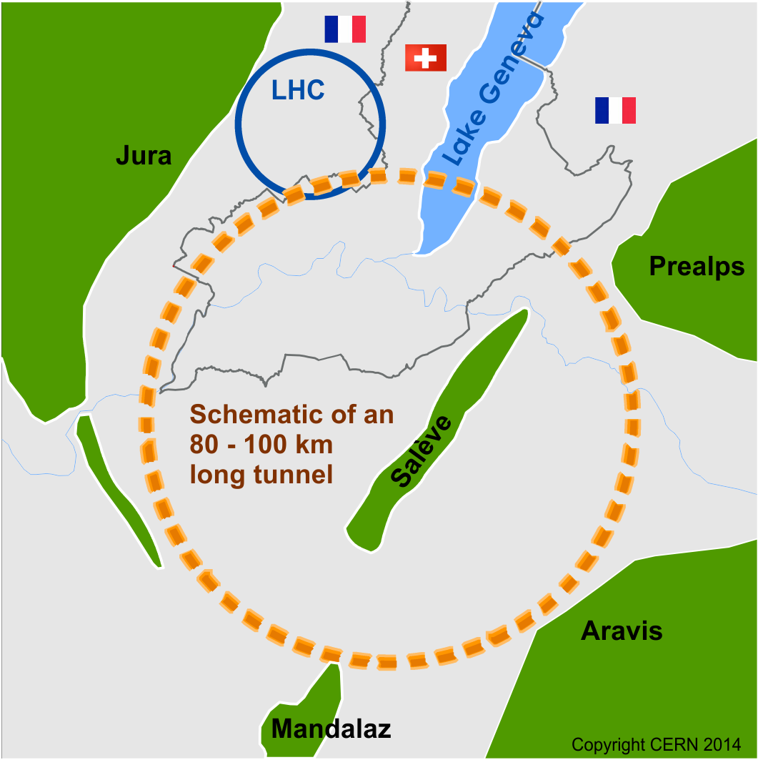
Future Circular Collider Study - SCOPE
CDR and cost review for the next ESU (2018)
Forming an international collaboration to study:
pp-collider (FCC-hh) → defining infrastructure requirements
e⁺e⁻ collider (FCC-ee) as potential intermediate step
p-e (FCC-he) option
80-100 km infrastructure in Geneva area
~16 T ⇒ 100 TeV pp in 100 km
~20 T ⇒ 100 TeV pp in 80 km

Slide 5
Goals CDR phase 2014-2018
Conceptual design report by end 2018
  Parameter optimisation and baseline development
  Conceptual design of machines, experiments and infrastructure
  Launch R&D in SC magnet and SRF areas
  Identification of technical challenges and R&D needs and R&D planning
  Cost model and estimation, project schedule estimation
  Preparation and planning for a technical design phase (TDR phase)
  Preparation of global FCC collaboration

Slide 6
Hadron collider FCC-hh parameters
Energy 100 TeV c.m.
Circumference ~ 100 km (base line) [80 km option]
Dipole field (top energy) ~ 16 T (base line) [20 T option]
Dipole field (injection) ~ 1 T (base line) [1.2 T option]
Bunch spacing 25 ns [5 ns option]
Bunch population (25 ns) 1x10¹¹ p
#bunches 10500
Stored beam energy 8.2 GJ/beam
Luminosity 5x10³⁴ cm⁻²s⁻¹
β* 1.1 m [2 m conservative option]
#IPs 2 main (tune shift) + 2
Synchroton radiation arc 26 W/m/aperture (filling fact. 78% in arc)
Longit. emit damping time 0.5 h

Slide 7
FCC-hh: high-field magnet targets
FHC baseline is 16T Nb₃Sn technology for ~100 TeV c.m. in ~100 km
Develop Nb₃Sn-based 16 T dipole technology (at 4.2 K?),
with sufficient aperture (40 – 50 mm) and
accelerator features (margin, field quality, protect-ability, cycled operation).
conductor developments
Goal: 16T short dipole models by 2018/19 (America, Asia, Europe)
In parallel HTS development targeting 20 T.
HTS insert, generating o(5 T) additional field (EuCARD2), in an outsert of large aperture o(100 mm) (FRESCA2 or other)
Goal: Demonstrate HTS/LTS 20 T dipole technology in two steps:
a field record attempt to break the 20 T barrier (no aperture), and
a 5 T insert, with sufficient aperture (40 mm) and accelerator features

Slide 8
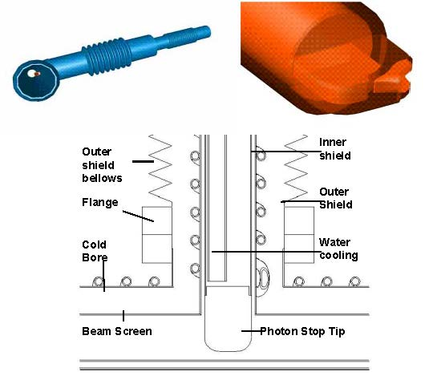
FCC-hh: some other design challenges
Energy in beam & magnets, dump, collimation, quench protection
  Stored beam energy and losses critical: 8 GJ/beam (0.4 GJ LHC)
  Collimation, losses, radiation effects are very important
  Magnet and machine protection to be considered from early phase
High synchrotron radiation load on beam pipe (inside cold-mass)
  Up to 26 W/m/aperture in arcs, total of ~5 MW for the collider
  (LHC has a total of 1W/m/aperture from different sources)
  LHC-type beam screen
    Cooling efficiency depends on screen temperature, higher temperature → larger impedance → 40-60 K?
  Open midplane magnets
    Synergies with muon collider developments
  Photon stops
    dedicated warm photon stops for efficient cooling between dipoles, as developed by FNAL for VLHC
http://inspirehep.net/record/628096/files/fermilab-conf-03-244.pdf
Also P. Bauer et al., "Report on the First Cryogenic Photon Stop Experiment," FNAL TD-03-021, May 2003

Slide 9
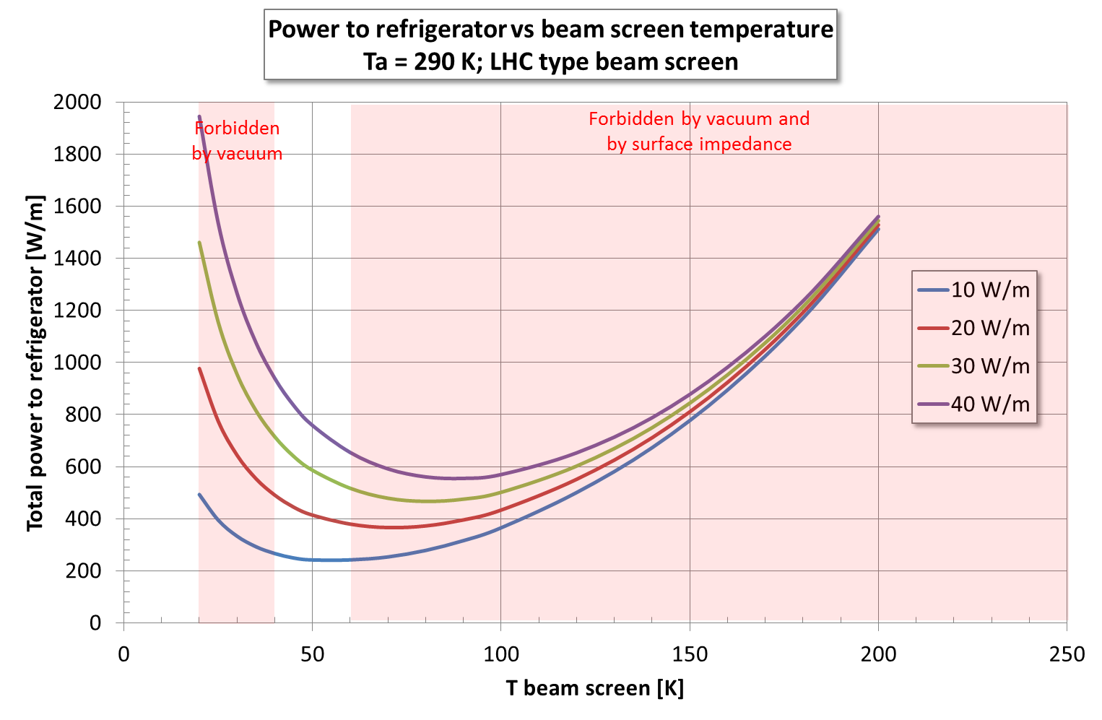
total cryo power for cooling of SR heat
Ph. Lebrun
D Schulte
contributions: beam screen (BS) &
cold bore (BS heat radiation)
Optimum BS temperature range: 50-100 K ;
40-60 K favoured by impedance & vacuum considerations

Slide 10
Lepton collider FCC-ee parameters
Design choice: max. synchrotron radiation power set to 50 MW/beam
  Defines the max. beam current at each energy.
  4 Physics working points
  Optimization at each energy (bunch number & current, emittance, etc).
Parameter | TLEP-Z | TLEP-WW | TLEP-H | TLEP-tt_{bar} | LEP2
E/beam (GeV) | 45 | 80 | 120 | 175 | 104
I (mA) | 1450 | 152 | 30 | 6.6 | 3
Bunches/beam | 16700 | 4490 | 170 | 160 | 4
Bunch popul. [10¹¹] | 1.8 | 0.7 | 3.7 | 0.86 | 4.2
L (10³⁴ cm⁻²s⁻¹) | 28.0 | 12.0 | 4.5 | 1.2 | 0.012
For TLEP-H and TLEP-t the beam lifetime of ~few minutes is dominated by Beamstrahlung (momentum acceptance of 2%).

Slide 11
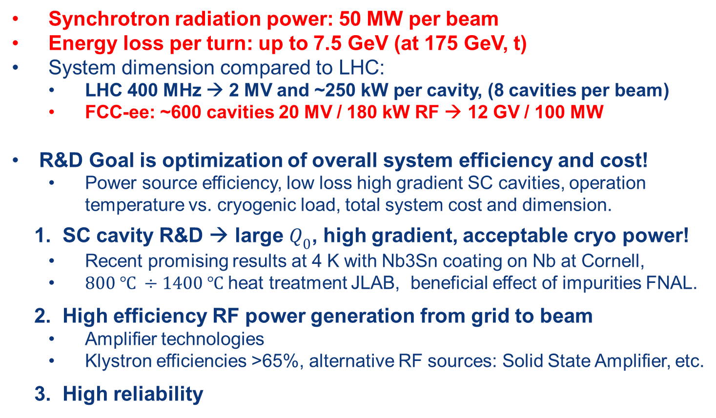
FCC-ee: RF parameters and R&D
Synchrotron radiation power: 50 MW per beam
Energy loss per turn: up to 7.5 GeV (at 175 GeV, t)
System dimension compared to LHC:
  LHC 400 MHz → 2 MV and ~250 kW per cavity, (8 cavities per beam)
  FCC-ee: ~600 cavities 20 MV / 180 kW RF → 12 GV / 100 MW
R&D Goal is optimization of overall system efficiency and cost!
  Power source efficiency, low loss high gradient SC cavities, operation temperature vs. cryogenic load, total system cost and dimension.
  1. SC cavity R&D → large $Q_{0}$, high gradient, acceptable cryo power!
  Recent promising results at 4 K with Nb3Sn coating on Nb at Cornell,
  $800 ℃ ÷1400 ℃$ heat treatment JLAB, beneficial effect of impurities FNAL.
2. High efficiency RF power generation from grid to beam
  Amplifier technologies
  Klystron efficiencies >65%, alternative RF sources: Solid State Amplifier, etc.
3. High reliability

Slide 12
Other SC magnet R&D for FCC
Nb₃Sn quadrupoles for regular arc hadron collider
IR magnets and special magnets in collimation regions
  in high radiation zones, larger aperture
  HTS
Transmission line magnet (injectors, TLs)
  SC cable in warm iron yoke (SF magnet), double aperture magnets
Pulsed SC magnets (injectors, TLs)
  SC cable in warm iron
SC septum magnets for beam dumping (injection?)
  Beam losses, quench per design?
Current leads
  Overall optimization of powering and energy distribution system

Slide 13
FCC study status
Global collaboration based on general MoU between CERN and individual partners.
Addenda for each participant describing specific contributions and conditions.
Presently discussions with potential collaborators to conclude MoUs and establish collaboration.
First international collaboration board meeting on 9. and 10. September 2014 at CERN.

Slide 14
EU H2020 FCC Design Study proposal
Focused on hadron collider design (main emphasis of study)
HH Interaction region design
Collider functional
machine design
HH Arc design
HH Cryo-magnet-vacuum-beam pipe
Key technological
aspects
HH high-field magnet design
Coordination, CDR,
Strategy, Cost
Management, Coordination and Implementation

Slide 15

FCC work plan study phase
2014 |  |  |  | 2015 |  |  |  | 2016 |  |  |  | 2017 |  |  |  | 2018
Q1 | Q2 | Q3 | Q4 | Q1 | Q2 | Q3 | Q4 | Q1 | Q2 | Q3 | Q4 | Q1 | Q2 | Q3 | Q4 | Q1 | Q2 | Q3 | Q4
Prepare
Kick-off, collaboration forming,
→study plan and organisation
Ph 1: Explore options
“weak interaction”
Workshop & Review →identification of baseline
Explore options, now – spring 2015:
Investigate different options in all technical areas, taking a broad view
Deliverables: description and comparison of options with relative merits/cost, Develop schedules, understand relative impact of options on overall schedule (physics operation time, machine installation time, etc.)
FCC workshop to converge to common baseline with small number of options
Proposed WS date 23 – 27 March 2015 (presently no known collisions…)
Followed by review ~2 months later, begin June 2015
Ph 2: Conceptual study of baseline “strong interact.”
Workshop & Review, cost model, LHC results → study re-scoping?
Ph 3: Study
consolidation
4 large FCC Workshops distributed over participating regions
Workshop & Review
→ contents of CDR
Report
Release CDR & Workshop on next steps

Slide 16
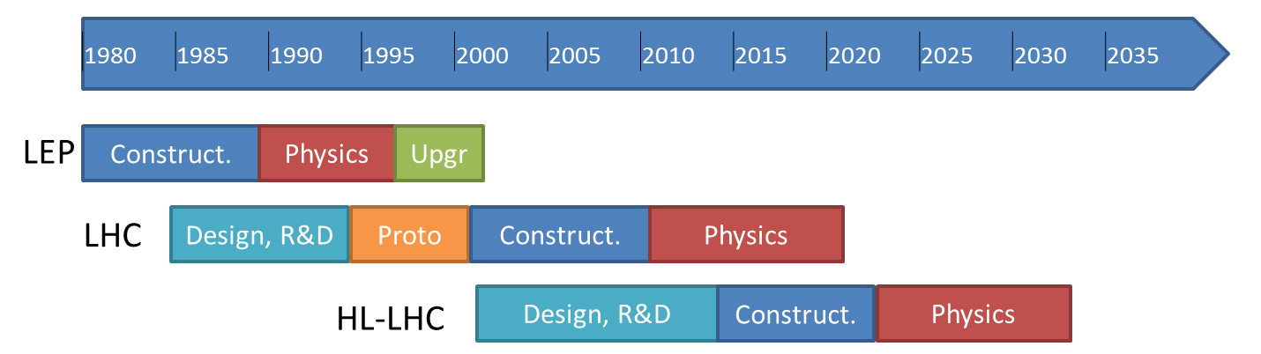

FCC study milestones
CDR and Cost Review 2018
today
ESU
Project
Kick-off meeting: 11th Nov. 2013 (Daresbury)
FCC
Kick-off meeting
12th-14th February 2014
Study
CDR and Cost Review for 2018

Slide 17
Conclusions
There are strongly rising activities in energy-frontier circular colliders worldwide. CERN is setting-up an international study for the design of Future Circular Colliders (FCC).
Worldwide collaboration in physics, experiments and accelerators will be essential to advance and reach the goal of a CDR by 2018.
FCC presents challenging R&D requirements for SC magnets in many different areas:
  Main focus is the 16 T Nb₃Sn program as hadron collider baseline, representing a natural continuation of HL-LHC developments
  HTS for special magnets and as option to the 16T program
  SF and pulsed SC magnets as potential options for injectors, TLs.
  SC septum magnets
  HTS current leads for power distribution systems.
Need your collaboration and use all synergies to move forward!

Slide 18
Work and organisation status (i)
Work/meeting structures established based on INDICO, see:
FCC Study: https://indico.cern.ch/category/5153/
FCC-hh Hadron Collider VIDYO meetings
  https://indico.cern.ch/category/5263/
  Contacts: daniel.schulte@cern.ch
FCC-hadron injector meetings
  https://indico.cern.ch/category/5262/
  Contacts: brennan.goddard@cern.ch
FCC-ee (TLEP) Lepton Collider VIDYO meetings
  https://indico.cern.ch/category/5264/
  Contacts: jorg.wenninger@cern.ch,

Slide 19
Work and organisation status (ii)
FCC infrastructure meetings
  https://indico.cern.ch/category/5253/
  Contacts: philippe.lebrun@cern.ch, peter.sollander@cern.ch
FCC-hh Hadron Collider Physics and Experiments VIDYO meetings
  https://indico.cern.ch/category/5258/
  Contacts: michelangelo.mangano@cern.ch, fabiola.gianotti@cern.ch, austin.ball@cern.ch
FCC-ee Lepton Collider (TLEP) Physics and Experiments VIDYO meetings
  https://indico.cern.ch/category/5259/
  Contacts: alain.blondel@cern.ch, patrick.janot@cern.ch

