Slide 1
Conductor for LHC Upgrades
ASC 2014
13 August 2014
A. Ballarino
Ballarino, B. Bordini, L. Bottura, L. Rossi
CERN, Geneva

Slide 2
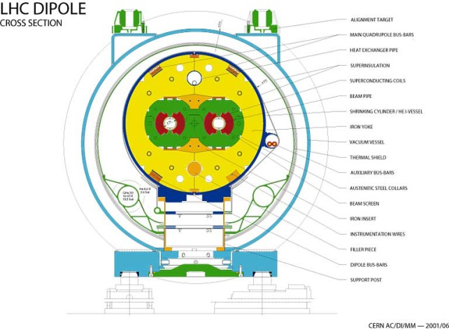
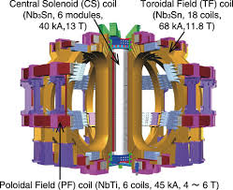

Large Scale Productions
LHC ∼ 1200 tons of Nb-Ti
∼ 200 kg of HTS (Bi-2223)
ITER PF and CC coils
∼ 200 tons of Nb-Ti
TF and CS coils
∼ 500 tons Nb₃Sn
Hi-Lumi LHC 11 T Dipoles, IR Quadrupoles
∼ 25 T tons Nb₃Sn
+ ∼ 5 tons for CERN development program
+ ∼ 5 tons for LARP development program*
* Arup Ghosh, BNL
6000 tons of Nb₃Sn for 16 T FCC
2000 tons of HTS for 20 T FCC
Notes:
1200 ton = 7600 km
ITER: larger production of Nb3Sn strand ever

Slide 3
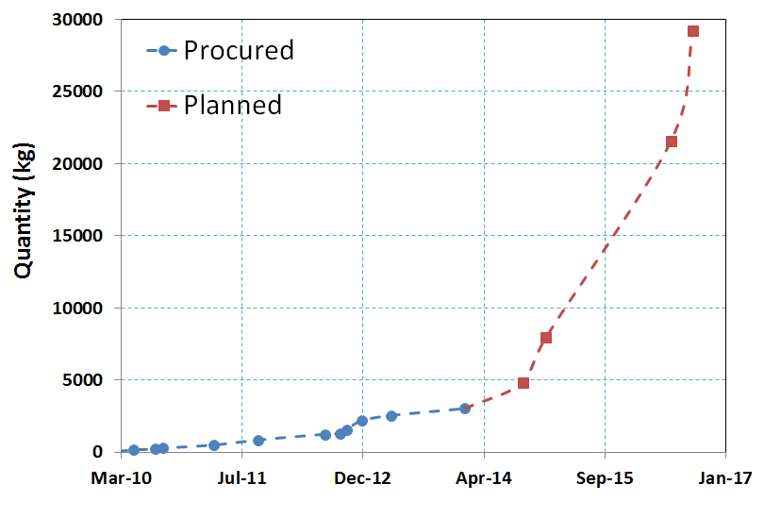
Nb₃Sn Procurement for Hi-Luminosity LHC
Dual sourcing
Series 11 T Dipoles
LS3 (2023)
Series Quadrupoles
LS3 (2023)
Series 11 T Dipoles
LS2 (2018)
Total procurement = 30 t
∼ 5 t for magnet short models and prototypes

Slide 4
Nb₃Sn Conductor Procurement at CERN
FRESCA 2 dipole – Magnet for upgrade of cable test facility – FRESCA . Block dipole, 13 T, 100 mm bore
Diameter of strand =1 mm. Procurement (CERN and CEA, Eucard 1) started in March 2010 and it was completed in Dec 2013 (∼ 170 km tot)
11 T Dipoles for LHC
Diameter of strand =0.7 mm. Procurement started in May 2010
Hi-Lumi Quadrupoles for LHC
Diameter of strand =0.85 mm. Procurement started in August 2012

Slide 5
Nb₃Sn Conductor Specification
Performance
Peak field
Cost
J_{C} (kA/mm²)
Hi-Luminosity wire
specification:
Jc > 2.45 kA/mm²
D_{fil} < 50 μm
RRR > 150
1
Dream wire
target performance:
Jc > 3 kA/mm²
D_{fil} < 20 μm
RRR > 150
1.5
2
2.5
3
3.5
target
Magnetization Field Quality
Stability
4
10
200
20
150
50
100
100
50
D_{fil} (m)
RRR (-)
Stability Protection
+ Mechanical properties for cabling

Slide 6
Hi-Luminosity LHC Nb₃Sn Wire - Specification

Slide 7
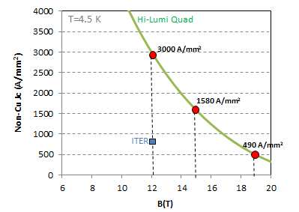
Hi-Luminosity LHC Nb₃Sn Wire – Measured Performance

Slide 8
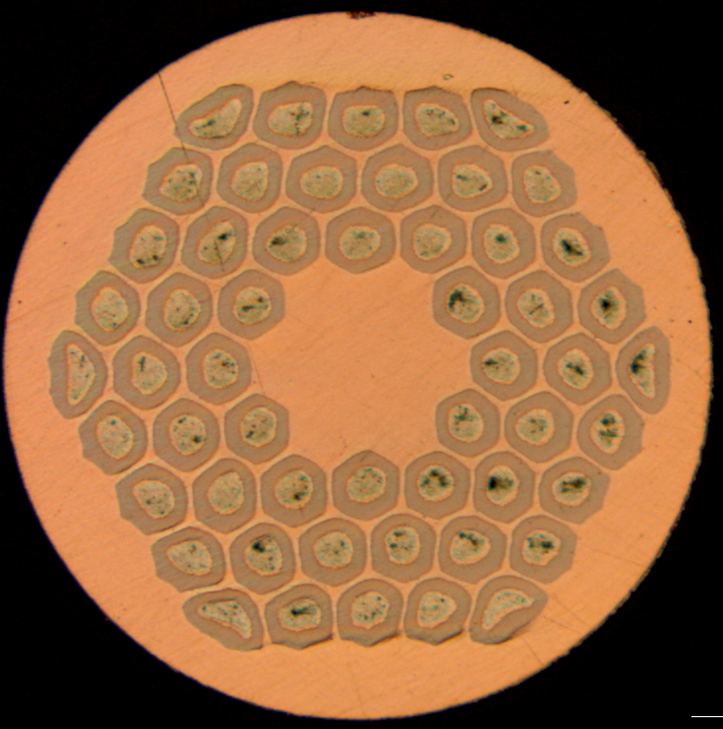
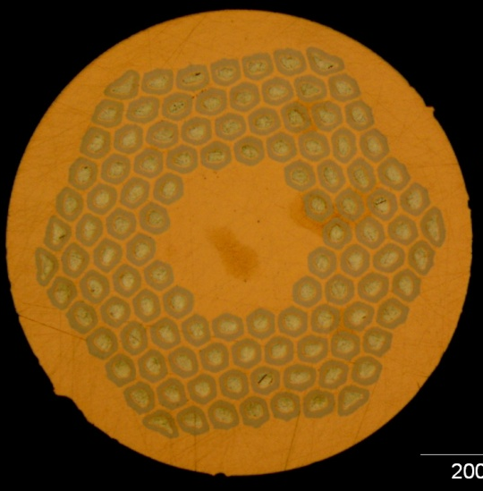
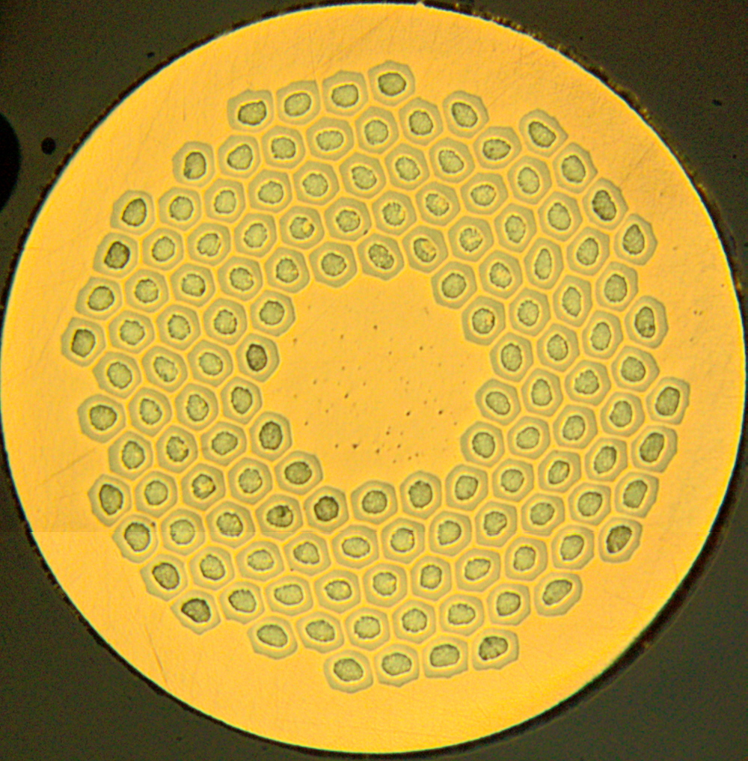
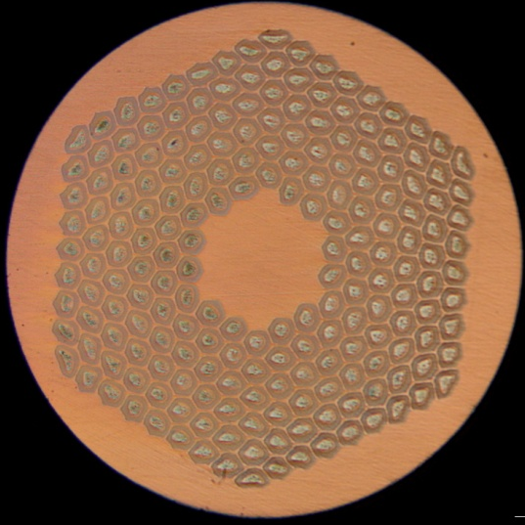
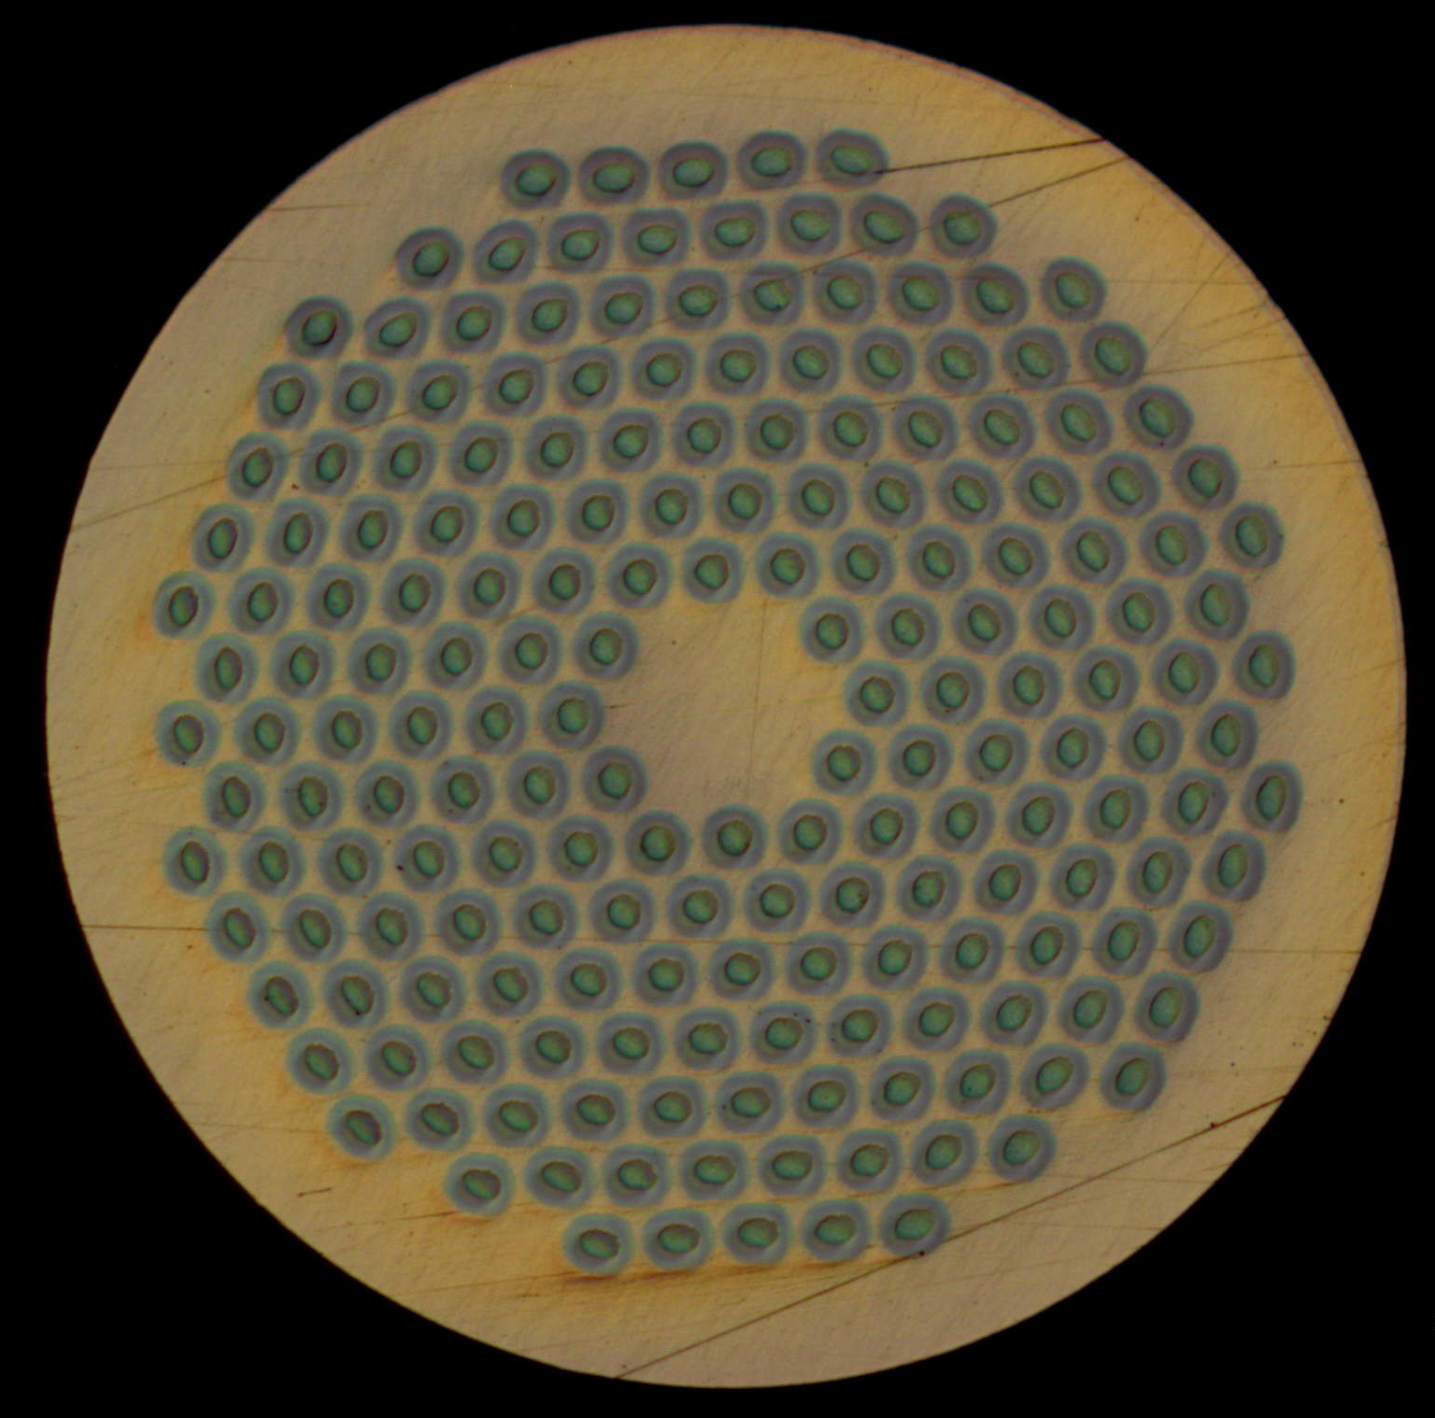
Hi-Luminosity LHC Nb₃Sn wire
 | Sub-element size (μm)
 | Wire Φ (mm) | RRP® 108/127 | RRP® 132/169 | RRP® 192/217 | PIT 114 | PIT 192
FRESCA 2* | 1 | - | 58 | - | - | 48
Hi-Lumi Quad | 0.85 | - | 48 | - | - | 41
11 T | 0.7 | 46 | 41 | 32 | 44 | -
Smaller sub-element size
RRP®
PIT
54/61
108/127
132/169
198/217
114
192
*Fresca 2 conductor: procurement by CERN and CEA – FP7 European Project

Slide 9
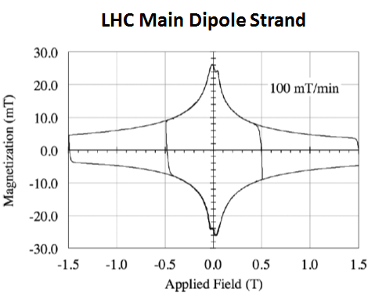
11 T Nb₃Sn Dipole Strand (Φ = 0.7 mm)
T = 1.9 K
Φfil_RRP=41 μm
Φfil_PIT=44 μm
300 mT
M-loop width (0.5 T, 1.9 K) < 30 mT
Max spread around average ± 4.5 %
Flux Jump Amplitude ≤ 12 mT
Measurements by D. Richter

Slide 10
Jc vs Φ of filaments
RRR > 100
Mesurements performed at CERN

Slide 11
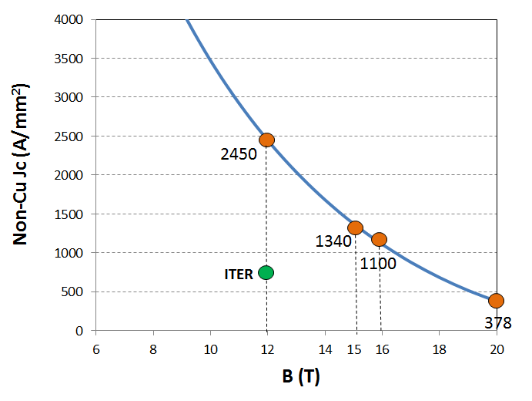
Nb₃Sn for LHC High Energy Upgrade
+ Smaller filament size
(Φ_filaments ∼ 20 μm)
+ RRR > 150

Slide 12

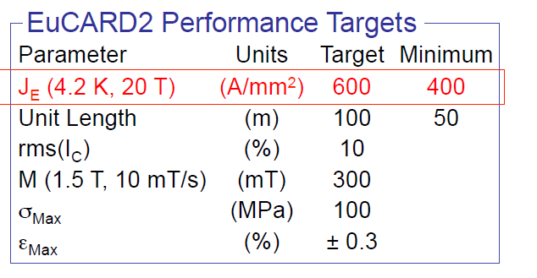
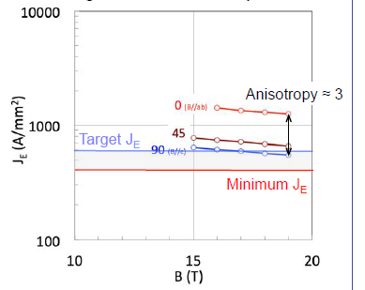
YBCO Conductor
Bruker Tape, Eucard 2,

Slide 13
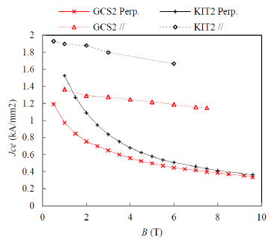
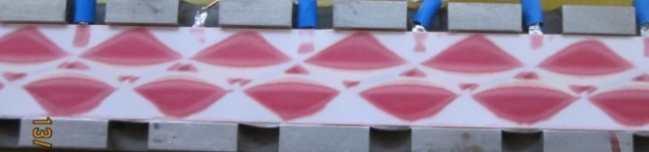
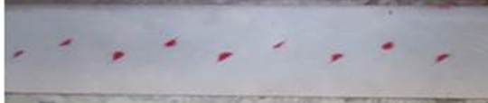

YBCO Cables
Eucard 2 activity
Measurements at CERN
Roebel cable by KIT

Slide 14
To get there….
  Nb₃Sn (16 T magnets )
  Increase Jc in high fields
  Develop wire architectures that meet the characteristics required for accelerator quality magnets (reduce filaments size for field quality, assure stability requirements (RRR), guarantee mechanical properties as needed for cabling, winding and operation in a magnet assembly)
  HTS (20 T magnets)
  Assure Je at 4.5 K and in high (20 T) fields
  Reduce (or cope with…) conductor anisotropy (REBCO tape)
  Develop and demonstrate high current HTS cables
  Understand and handle quench performance and quench protection (first on strands and cables and after on magnets)
  Study and demonstrate field quality - for tape and wire geometry. Improve conductor geometry as needed – striation for tape, smaller filament size for wire ….
Eucard 2 Program

Slide 15
Conclusions
In order to make a high-energy superconducting machine possible, conductors need to undergo a sustained and intensive program of R&D including:
development of materials that meet the desired characteristics for accelerator quality magnets;
work with conductor manufacturers to ensure that the developed strands are also of a sufficiently robust quality for large scale production (i.e. good yield)
.

Slide 16
Thanks for your attention !

