Slide 1
FUTURE CIRCULAR COLLIDER
MAGNETS OVERVIEW
CERN, 12th August 2014
Future Circular Collider at Applied Superconductivity Conference
E. Todesco
CERN, Geneva Switzerland
Acknowledgements: L. Bottura, B. Holzer, R. Garcia Tomas

Slide 2
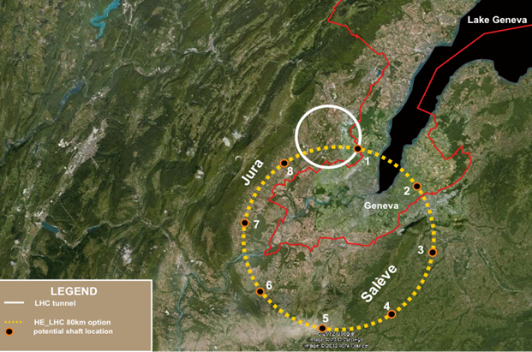
RECALL OF MAIN PARAMETERS
Energy target: 50 TeV
  7 times larger LHC
Length 100 km
  This makes 16 T dipole field
Two parts
  The cell
  The insertion regions

Slide 3
THE CELL
Main parameters
  Injection energy γ_{i} (450 GeV in the LHC)
  Cell length L (100 m in the LHC)
Cell length (twice the spacing of the quadrupoles)
  Beta function ∝ cell length β ∝ L
  Larger cell length means larger aperture but less quadrupoles and larger filling factor
  Assuming same dynamic range of LHC (15.5 energy increase), injection energy is 7 times larger the LHC (~3 TeV)
Aperture LHC: 56 mm
  Scaling √(2/7) ~0.5 so 30 mm a minimal starting value
  Large shielding needed, so we propose to explore the range 40 to 50 mm (and maybe larger)

Slide 4
THE CELL
Cell magnets aperture: 40-50 mm
Dipoles: 16 T target
  Since coil width is of the order of 60 mm > 20-25 mm of aperture radius, dependence of cost on aperture is not dramatic
Quadrupoles:
  LHC integrated field is 700 T
  For FCC, scales with energy and inverse of cell length, so 2500 T
  We need strong gradient to avoid having too long quadrupoles
    Nb-Ti would probably go to ~ 300 T/m, so 8-10 m long quad
    With Nb₃Sn we could go to ~450 T/m, so 5.5 m
      5% filling factor saved, i.e. dipole can have 5% less field
    Further gain by using HTS looks marginal

Slide 5
THE INTERACTION REGION:
SEPARATION DIPOLES
Separation/recombination dipoles D1/D2
  26 T· m kick in the LHC, 35 T· m in HL-LHC
  7 to 50 TeV: 7 times more from energy increase
  200 to 300 mm separation: 1.5 more from aperture separation
  Doubling the distance from D1 to D2: factor 2 less
    Needed kick is 26*7.14*1.56/2=145 T· m [R. Tomas proposal]
    I would also consider 290 T· m, giving a D1-D2 space of 87 m
  12 T field, Nb₃Sn dipoles, 12-m-long (one or two modules)
HL LHC IR layout

Slide 6
THE INTERACTION REGION
THE TRIPLET
Triplet aperture is related to β* size of the beam in the IP
  Larger triplet aperture, smaller size in the IP, larger luminosity
  Today 70 mm, 200 T/m 25 m long triplet (G· l_{t}=5000 T)
7 times larger energy means G· l_{t} ~ 35 000 T
  Other relevant parameter l* (today 23 m, double in FCC?)
You gain in aperture only with √energy
  So same β* as in LHC target means much longer triplet
Reasonable starting value is ~70 mm aperture
HL LHC IR layout

Slide 7
SUMMARY

