Slide 1
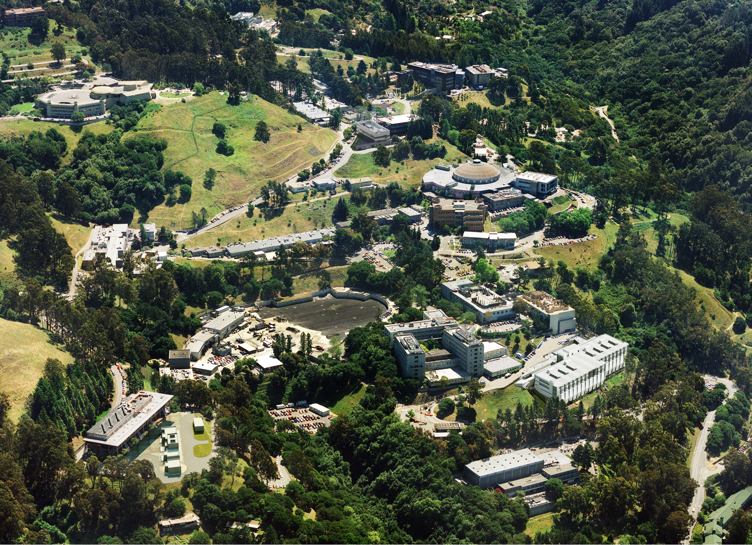
LBNL Superconducting Magnet Program
Steve Gourlay
August 13, 2014
High Energy Physics

Slide 2
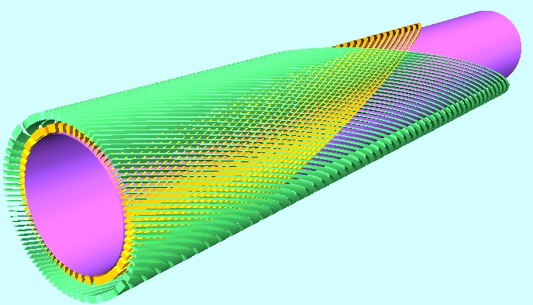
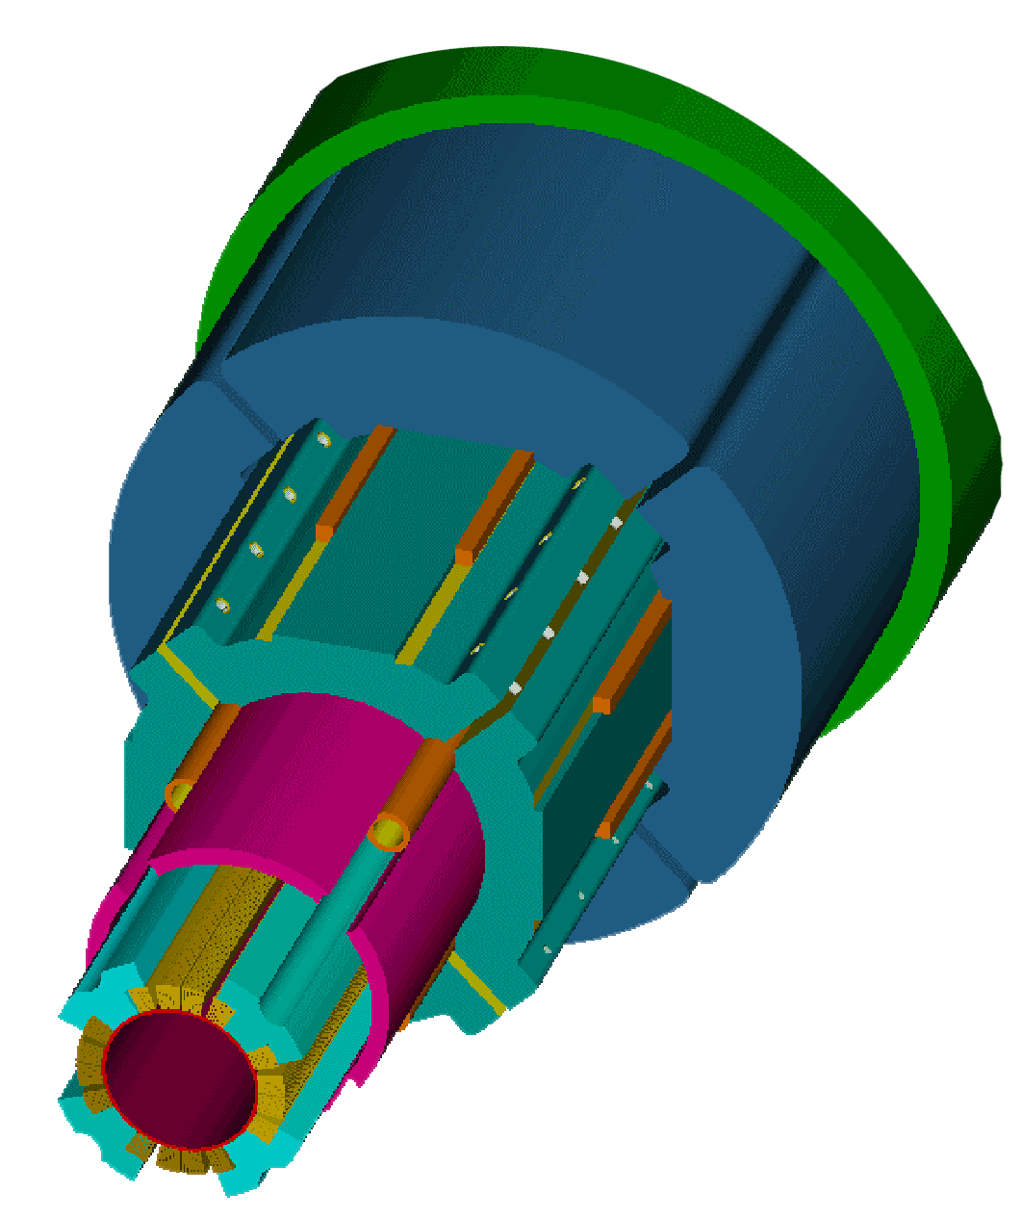
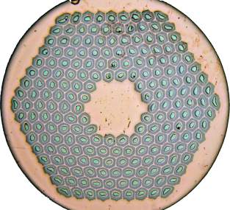
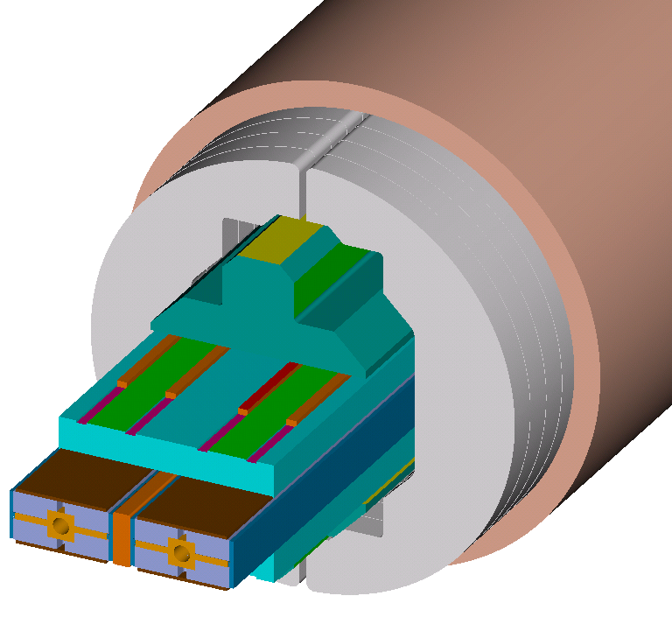
The Superconducting Magnet Program aims at innovative, cost effective magnets for present and future colliders
Program elements
    LARP activities
    Long-term R&D program:
        Canted cosine theta magnets
        HD block magnets
  Program resources
    Top notch staff
    Test facility
Superconducting Magnets

Slide 3
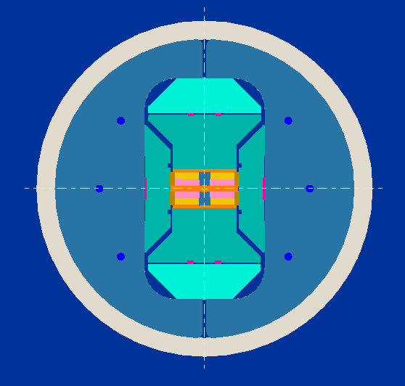
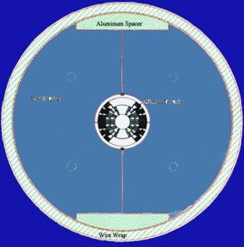
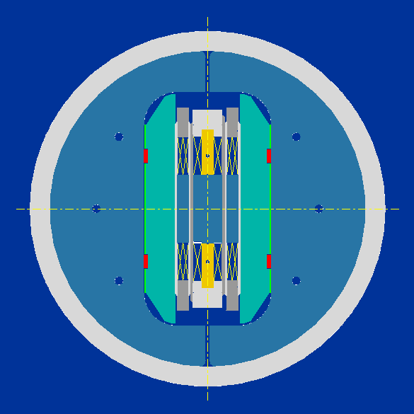
High Field (>13 T) Dipoles
Three coil configurations explored, each has potential advantages
Realistic evaluation requires model fabrication and test at high field
Cos θ
Common Coil
Block
D20
RD3
HD1, HD2, HD3

Slide 4
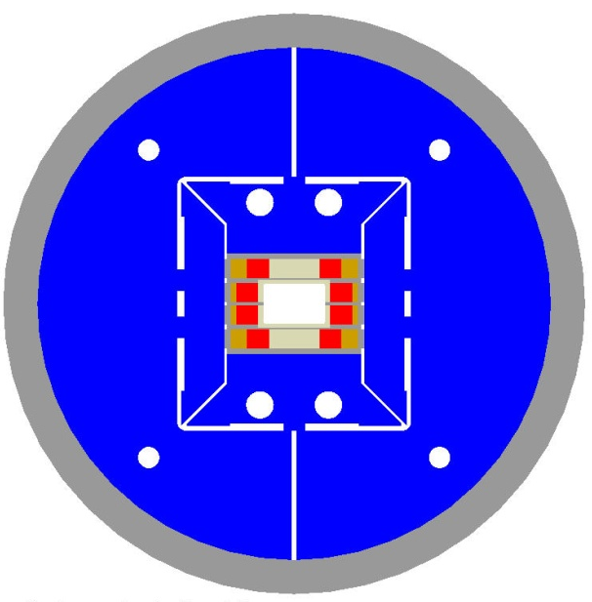
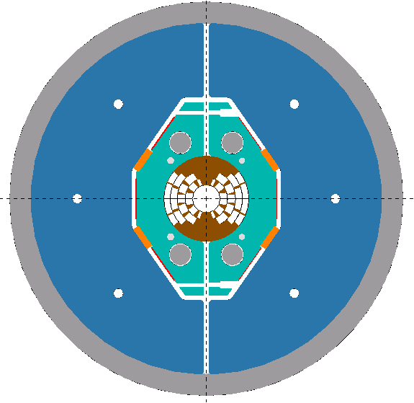
Large Dipole Facility (LDF)
No facility is available to support testing of cables and inserts in high transverse field and under load
The background field dipole is the critical component of such a facility. LBNL expertise can be applied to design and fabricate this magnet
Two alternative options were considered, using either block-coils (large-aperture version of HD2) or a cosθ design
A bore size of 150x100 mm is suitable for testing of ITER cables
Requires fabrication and test facility upgrades
Current status: Shell, iron and cable have been fabricated.
On indefinite hold due to budgetary/resource issues.

Slide 5
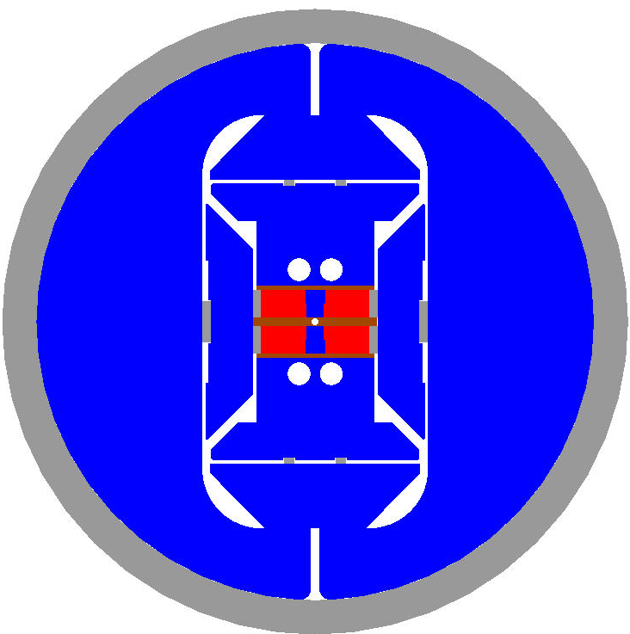
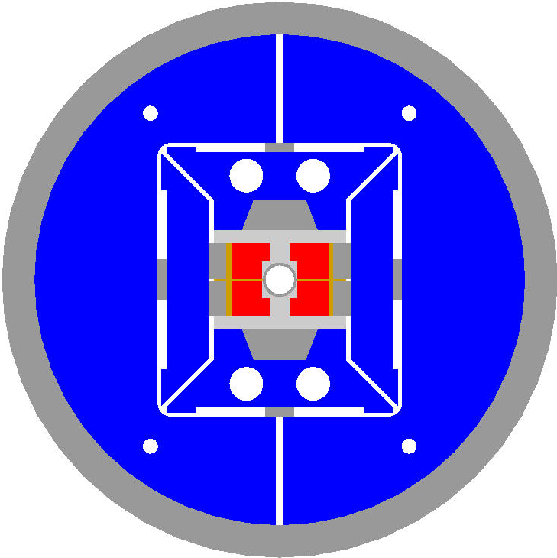
HD Model Objectives
The block-coil R&D plan was formulated in two basic steps:
HD1: Force and Stress
HD2: Aperture and Field Quality
Mechanical
structure
Conductor
Limits
Bore
support
Coil End
layout

Slide 6
HD2 Test Program Overview
Coils assembled around a central tube for bore support (36 mm clear bore)
  Three coils fabricated: 1&2 tested in HD2a/b, 2&3 tested in HD2c
  Highest field on record for an accelerator dipole: 13.8 T (87% SSL)
  Limiting quenches at the end of the straight section (before HW bend)
Same coils (2&3) assembled without the central tube (43.5 mm clear bore)
  Winding pole provides sufficient support according to mechanical FEM
  Minimizing bore structural support is a key R&D issue for block design
  Also a simpler configuration for mechanical analysis & optimization
  Outcome: 13.4 T maximum field (-3%) but slower training (HD2d/e)
Coil design iteration aimed at more accurate conductor placement
  Avoid cable contact with corner of pole-island at quench locations
  Addressed by thicker separation between layers, larger radius of hard-way bend and curing step (curing was only implemented in one coil)
  Two coils fabricated and tested in HD3a/b
  Limited by similar quench patterns to slightly lower field than HD2

Slide 7
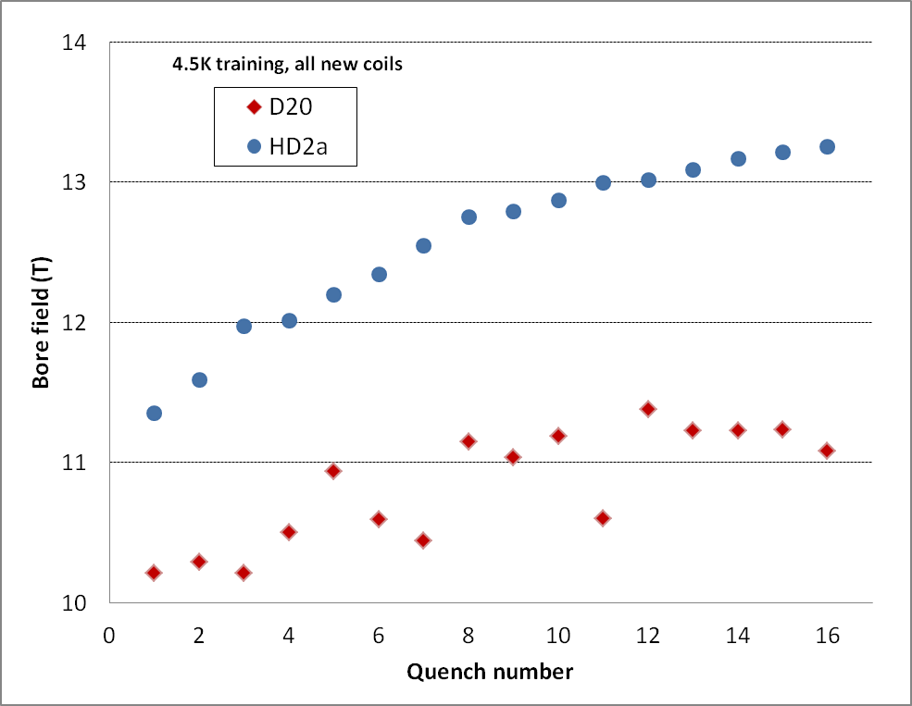
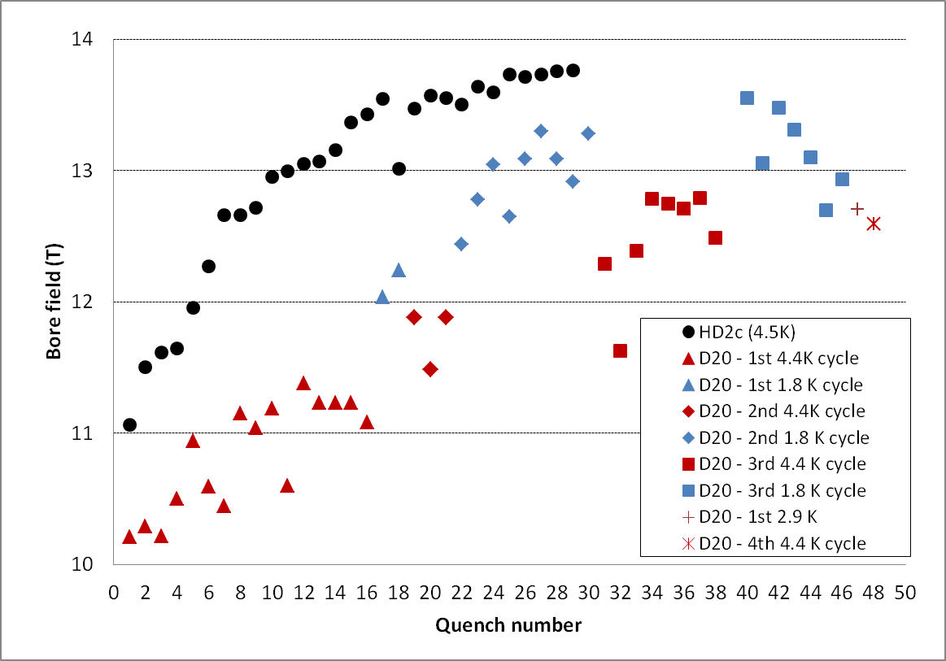
HD2-D20 Performance Comparison
Many differences: state of the art, conductor, design goals, test temperature/strategy
  General considerations are possible but no direct, fully consistent comparison
D20 was an extraordinary achievement: record field and pioneered Nb₃Sn technology
HD shows significant performance improvements (maximum field, training, reliability)
  Higher field in HD2c at 4.5K (13.8T) than D20 at 1.9K (13.5T)
  Faster training in a single cycle & stable plateaus at the highest fields in HD2a/b/c

Slide 8
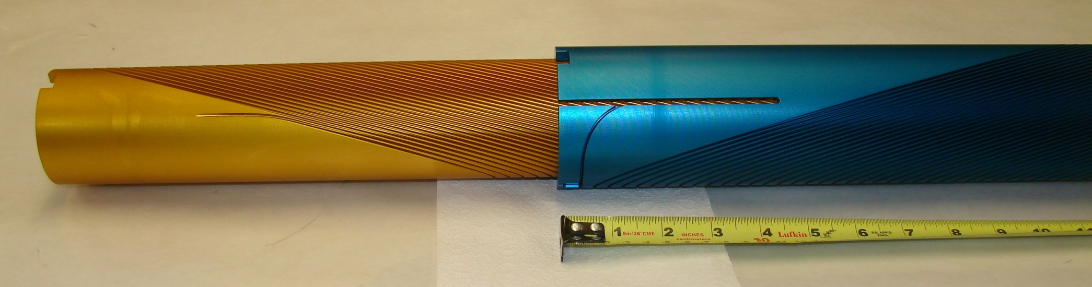
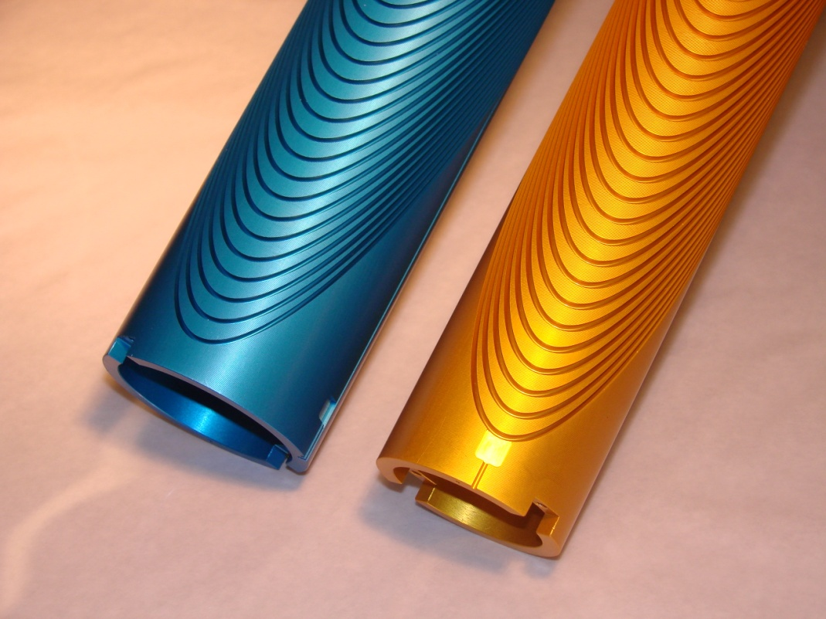
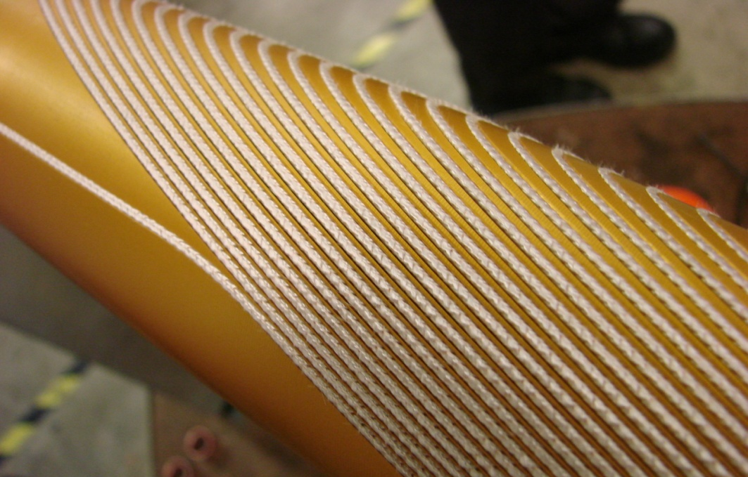
CCT1 Layers 1 and 2
2.5 T NbTi

Slide 9
P5 is very supportive of superconducting magnet R&D
“The U.S. is the world leader in R&D on high-field superconducting magnet technology, . . . .”
“The HL-LHC is strongly supported and is the first high-priority large-category project in our recommended program.”
“The U.S. also contributed critical components . . . . . the construction of the LHC accelerators. Similarly, the experiments and accelerator upgrades cannot occur without the unique U.S. technical capabilities (e.g., the high-field magnets necessary for the success of the project) and resources.”
“The future of particle physics depends critically on transformational accelerator R&D to enable new
capabilities and to advance existing technologies at lower cost. “
“The program is driven by the physics goals, but future physics opportunities will be determined by what is made possible.”
“Going much further, however, requires changing the capability-cost curve of accelerators , which can only happen with an aggressive, sustained, and imaginative R&D program.”
“Primary goal, . . . . build the future-generation accelerators at dramatically lower cost. For, example, the primary enabling technology for pp colliders is high-field accelerator magnets, . . .”
“Strengthen national laboratory-university R&D partnerships, leveraging their diverse expertise and facilities.”
Now
The
Future
High Energy Physics

Slide 10
These comments are easily summarized
The US, as leaders in high field magnet R&D, should pursue an aggressive program to develop cost-effective, transformational technology that will generate new opportunities & enable the future success of HEP
The success of LARP and Hi-Lumi is really, really important
The FCC is an example of one of the P5 goals
The Goal: 100 TeV – 100 km/16T or 80 km 20T
An optimal solution will require a highly manufacturable design with flexibility in choice of field and bore
Timeframe -
“. . . . deliver a conceptual design report (CDR) together with a cost review by 2018, in time for the next update of the European Strategy for Particle Physics.”
A relevant historical note:
The LBNL program that developed the technology for a critical upgrade of the LHC was started more than 20 years before the LHC turned on and while the SSC was still the flagship project of US HEP!
High Energy Physics
Notes:
The goose laid a golden egg. Do you want to take it and invest in something else?

Slide 11
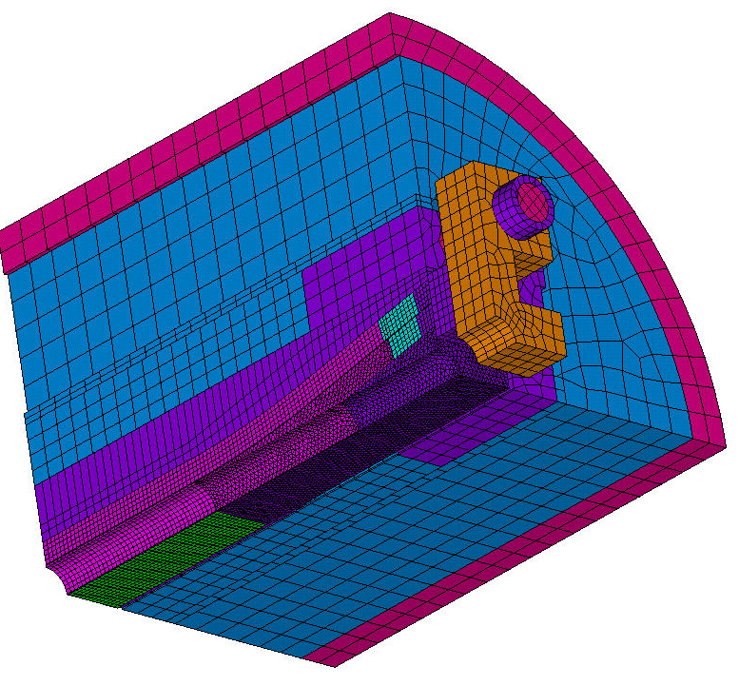
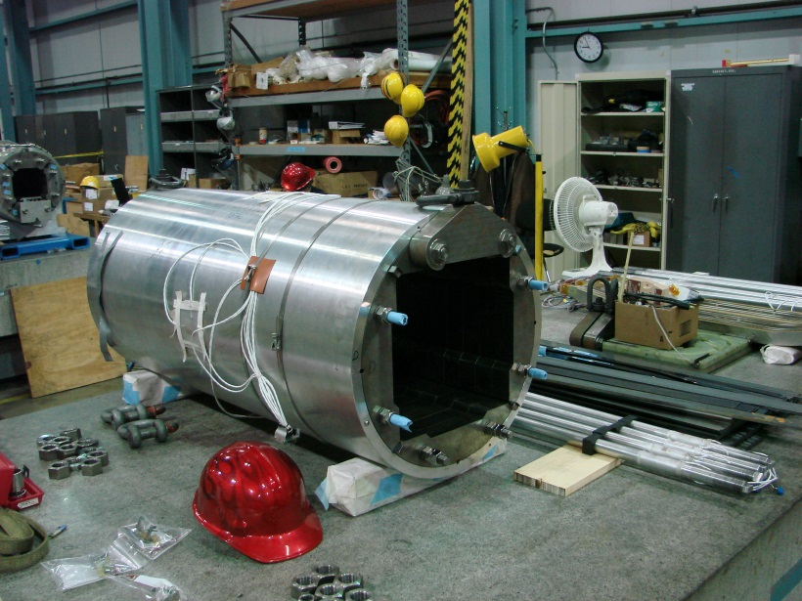
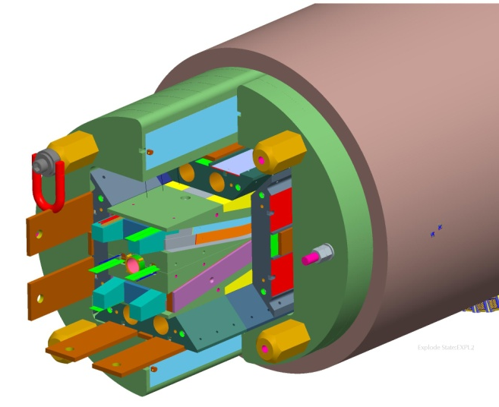
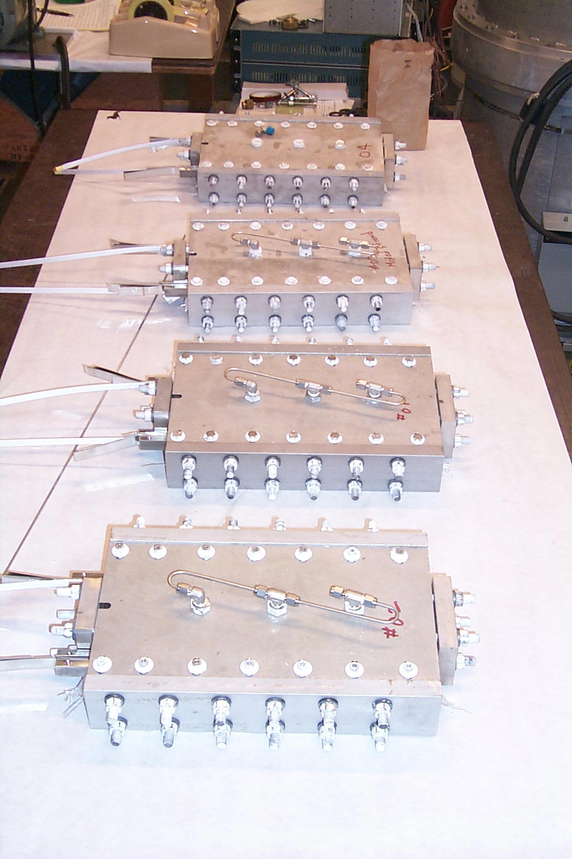
We have built a strong R&D platform and are ready to launch an aggressive new program that will meet the P5 challenge
Experience with a variety of geometries
Cos-Theta – D20 and more recently, LARP
Common Coil
Block
Sub-scale racetracks
Some Canted-Cos-Theta
Analysis tools
Unique Instrumentation and Diagnostics
  Infrastructure
Fabrication
Testing (still need for facility improvements)
We have the tools and
experience required for success
We have time but not that much time. And we need to substantially raise the level of expectation for magnet performance.
High Energy Physics

Slide 12
Still Room for Improvement: The State of State-of-the-Art
About 27 km of NbTi magnets running at 1.9K and (hopefully) 7 - 8T
More than half a century after discovery, Nb₃Sn is ready for major implementation in an operating accelerator. (US LHC Accelerator Research Program)
Some significant improvements in HTS conductors, but much left to do.
High field accelerator magnet development has reached 14 – 15T. Getting close to the Nb₃Sn limit.
Training is still a problem
So how do we move from 20th century technology to 21st century technology?
High Energy Physics
Notes:
Nb₃Sn and HTS – some progress has been made beyond NbTi

Slide 13
A new paradigm with aggressive goals and high expectations is needed
Decrease operating margin
Minimize or eliminate training
Fully utilize grading
Flexible choice of bore diameter
Manufacturability (reliability and reproducibility)
Goals of a program to realize this paradigm are
  Simplicity
  Reduce Stress
Reduce effective $/T by a factor of 3
To achieve these goals we need a portfolio that combines baseline technology development with a strong component of higher risk, potentially high payoff disruptive technology development that can leapfrog the status quo
High Energy Physics

Slide 14

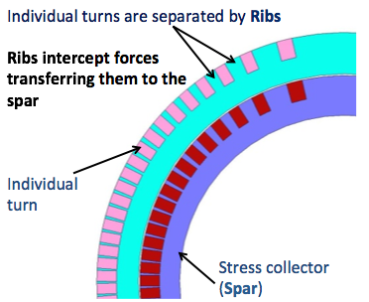
The CCT has the potential to meet the goals of the new paradigm but needs to be demonstrated
Simplicity – better performance?
Robust, reproducible, manufacturable
Minimal external structure (little or no prestress?)
Mandrel (ribs + spar) replaces pole, collars, end parts, spacers
No body-end transition
Modest tooling requirements
Intrinsic Stress Reduction
No accumulation of stress on the midplane
Allows grading (near optimal conductor efficiency)
Allows larger bores (conductor scales with bore radius only)
Excellent geometric field quality
Combines the best of our former program
Subscale characteristics – simple and relatively inexpensive
High field – scalable to highest fields and use of inserts
A natural platform to apply the tools we have developed over the last 2 decades
CCT is our
highest priority
High Energy Physics

Slide 15
A phased, aggressive R&D Program
Based on Four Pillars
  1. CCT – high potential payoff
  2. Block Dipoles
  Demonstrated to achieve fields close to limit of Nb₃Sn. Modify design for 16T operating with bore. Platform for training and reproducibility studies (this will eventually require more than just a few magnets). Use sub-scale where we can to reduce cost but still need to test at highest fields)
  Baseline for comparison to CCT
  3. Advanced Materials R&D
  Nb₃Sn high field performance and cost reduction
  HTS (REBCO, Bi-2212) via CCT, sub-scale racetracks
  4. Support through ancillary studies using subscale models
Phase I
    Technically-limited program to quickly demonstrate the feasibility of the CCT concept
  Nb₃Sn and HTS inserts (Bi-2212 and REBCO)
  Target: Large bore dipole with HTS insert that will reach close to 20T
  (staged approach to high field)
  Modified HD block dipole utilizing LARP experience
Phase II
Technology down-select
        Focus on further development of chosen approach
        Dual-bore prototype
Notes:
Phase II is necessarily less-well defined as it depends on early outcomes and funding profiles

Slide 16
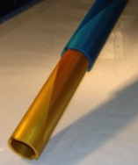

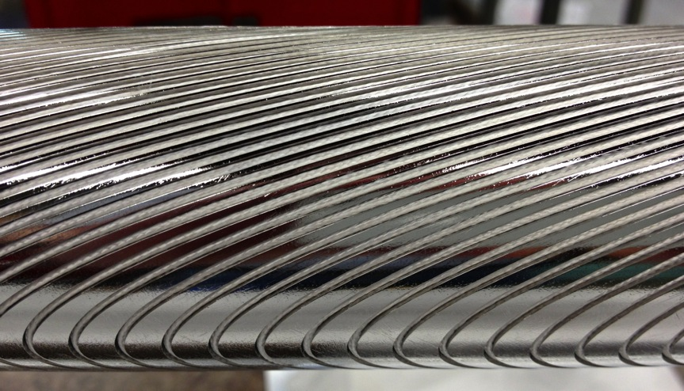
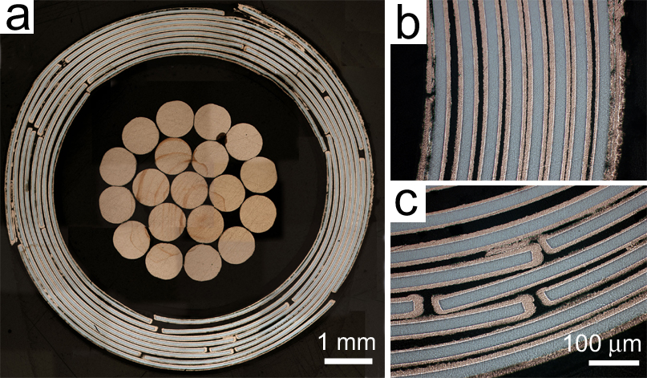
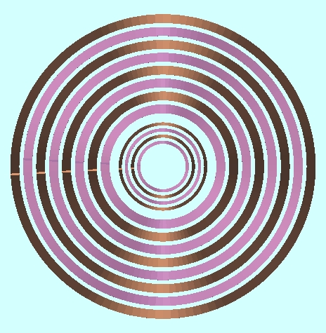
Phase I R&D Program Tree – Creating the New Paradigm
NbTi CCT
5 T NbTi
10 T NbTi
$5.5M
13 FTE
2.5T NbTi
Insert Test
2212 and YBCO
inserts
6X1
CORC
Self Field Test
Self Field Test
Rutherford
HTS Racetrack
5-Turn
Nb₃Sn CCT
Insert Test
CCT Insert
Nb₃Sn CCT
10 T Nb₃Sn
13 T Nb₃Sn
14.6 T Nb₃Sn
16 T Nb₃Sn
+ HTS 19 T
HD4
FY14
FY15
FY16
High Energy Physics

Slide 17
Why do we need a high field magnet program?
Scaling models point to lower fields as being more cost-effective
There is a practical answer . . .
There are specialty magnets that require the highest possible fields
(IRs, separation dipoles, etc)
There is a philosophical answer . . .
Pushing the limits stresses the technology, leading to new developments
and a knowledge base that will allow optimal parameter choices that will
result in lower overall cost of the machine
And, perhaps change the model by creating a new paradigm

Slide 18
Exploring Extremes Generates New Technology
Undirected
20 - 25 T
New tools
New Applications
Broad understanding of limits
Goal-Driven Materials R&D
16 T
Performance Improvement
- Operating Margin
- Training
14 T
Directed
12 T
10 T
8 T
Application-specific
optimization
6 T
4 T

Slide 19
R&D Plan Summary
An aggressive 2-year plan to demonstrate the CCT concept
    16 T Nb₃Sn, 90 mm clear bore
    HTS insert to take it to 18 – 19 T
  Next iteration of HD
    Utilize LARP experience
    We have a clear idea of what we want to do
    A significant step to understanding and conquering training in a design that
    could be used for FCC
  A modest sub-scale program to support technology development
  Highly leveraged materials R&D to support the program
  Strong collaborative partnerships
High Energy Physics

Slide 20
Outcomes are . . .
New record dipole fields
A discontinuity in superconducting magnet technology
A platform that can be used to design and build magnets for a variety of
applications with optimal field, coil configuration and bore size
Significant increase in performance/cost ratio

