Slide 1
The FCC Magnet Program seen from CERN
Luca.Bottura@cern.ch
Meeting at ASC-2014, Charlotte, August 13t, 2014

Slide 2
Quick summary
The FCC-hh magnet program builds upon the HL-LHC magnet R&D and construction
We see three legs to the magnet R&D in support to the FCC-hh design study
We have to achieve a good cog-wheeling of many running, planned and collaborating programs into a coherent R&D

Slide 3
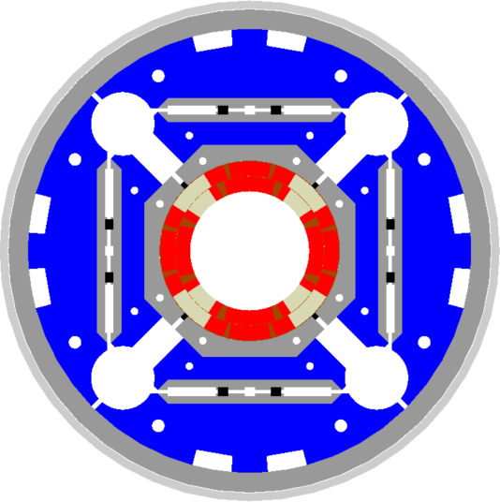
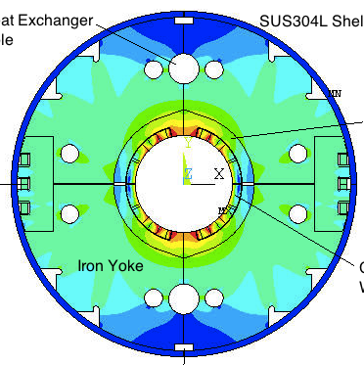
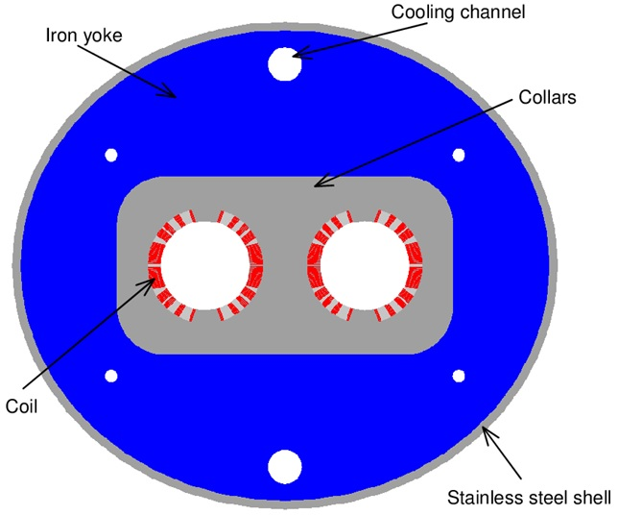
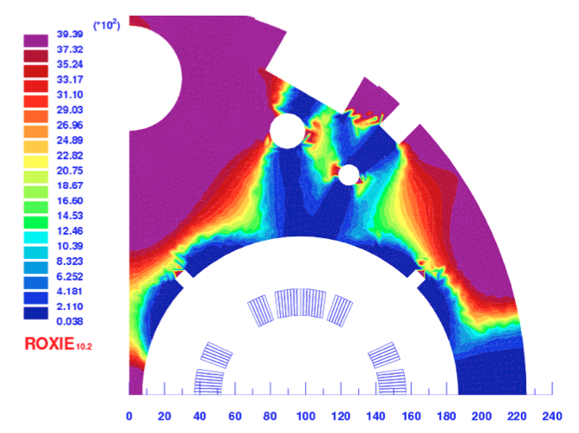
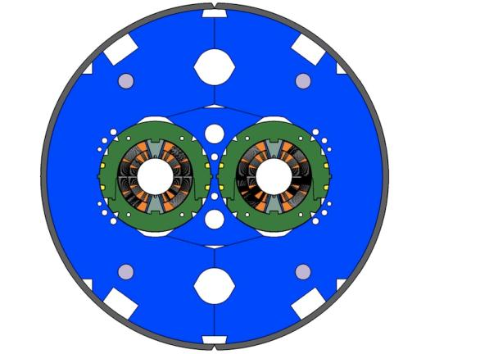
HL-LHC (main) magnets
 | Type | Material | Field/Gradient (T)/(T/m) | Aperture (mm) | Length (m) | Units (-)
Q1,Q3 Q2 | Single aperture | Nb₃Sn | (12.1) 140 | 150 | 8 6.7 | 40
D1 | Single aperture | Nb-Ti | 5.2 | 150 | 6.7 | 6
D2 | Twin aperture | Nb-Ti | 3.5…5.0 | 95…105 | 7…10 | 6
Q4 | Twin aperture | Nb-Ti | (5.9) 120 | 90 | 4.2 | 6
DS 11T | Twin aperture | Nb₃Sn | 10.8 | 60 | 11 | 40
NOTE: Correctors not included

Slide 4
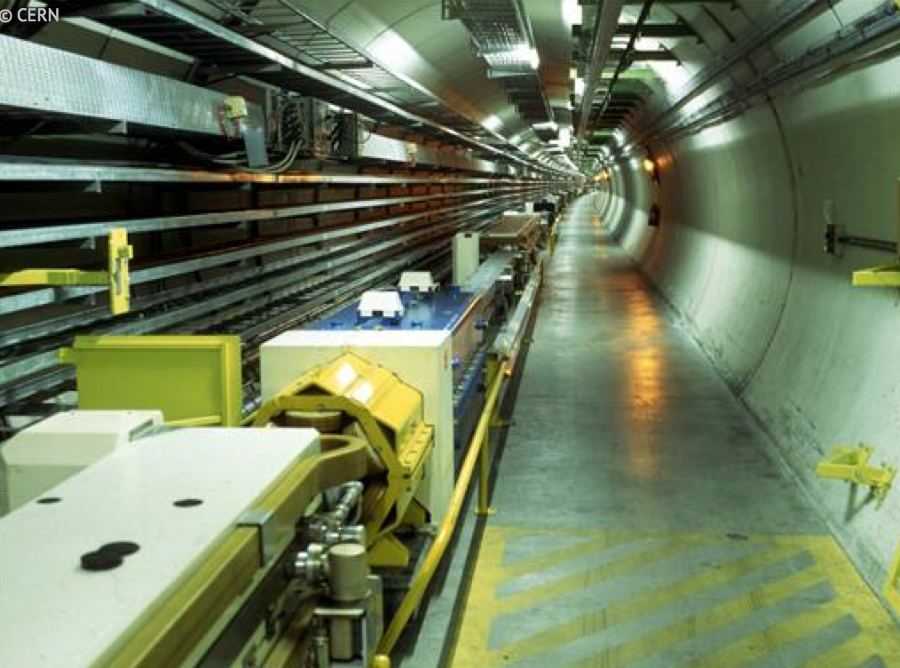
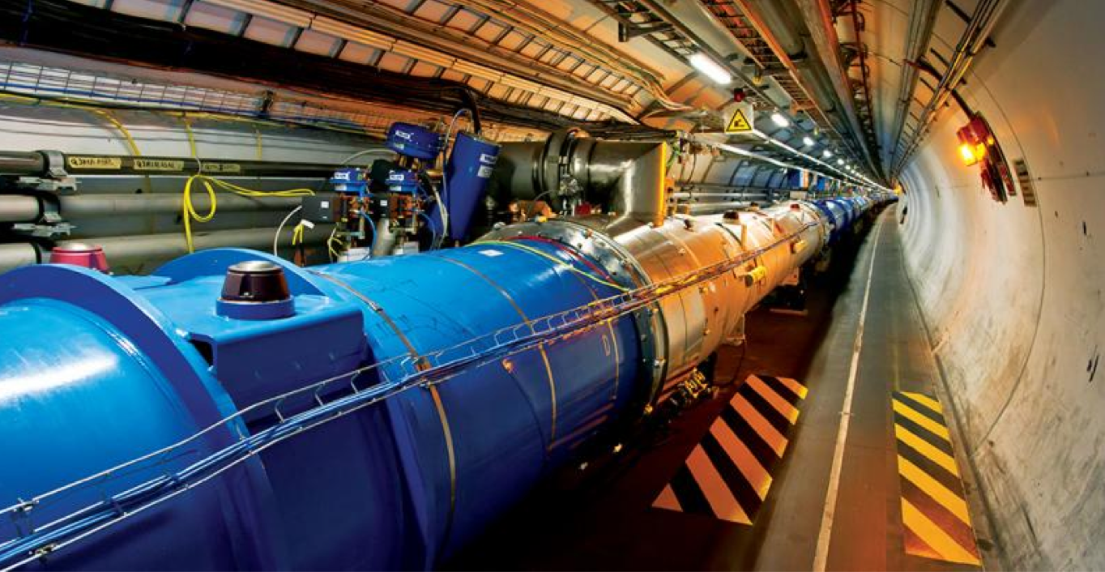


A possible timeline (for an FCC @ CERN)
construction
LEP
physics
upgrade
Design R &D
prototyping
LHC
construction
physics
Design R&D
prototyping
HL-LHC
construction
physics
Design R&D
CDR
prototyping
FCC
construction
physics
1980
1990
2000
2010
2020
2030
2040

Slide 5
FCC magnets – LTS option
 |  | B / G (T) / (T/m) | B_{peak} (T) | dB/dt (mT/s) | Bore (mm) | Length (units x m)
FCC | MB | 16 | 16.8 | 16 | 40 | 4578 x 14.3
 | MQ | 375 | 10 | 10 | 40 | 762 x 6.6
 | QX | 200 | 12.5 | 12.5 | 90 | Optics ?
 | D1 | 12 | 13 | 13 | 60 | 4x2 x 12
 | D2 | 10 | 10.5 | 10.5 | 60 | 4x3 x 10
Booster in the FCC | MB | 1.1 | 2 | 2 | 50 | 4578 x 14.3
injector in the LHC | MB | 5 | 5.25 | 20 | 50 | 1232 x 14.3
injector in the SPS | MB | 12 | 12.5 | 100 | 50 | 892 x 4.7

Slide 6
FCC magnets – HTS option
 |  | B / G (T) / (T/m) | B_{peak} (T) | dB/dt (mT/s) | Bore (mm) | Length (units x m)
FCC | MB | 20 | 21 | 16 | 40 | 3662 x 14.3
 | MQ | 375 | 10 | 10 | 40 | 610 x 6.6
 | QX | 200 | 12.5 | 12.5 | 90 | Optics ?
 | D1 | 12 | 13 | 13 | 60 | 4x2 x 12
 | D2 | 10 | 10.5 | 10.5 | 60 | 4x3 x 10
Booster in the FCC | MB | 1.5 | 2.2 | 2.2 | 50 | 3662 x 14.3
injector in the LHC | MB | 5 | 5.25 | 20 | 50 | 1232 x 14.3
injector in the SPS | MB | 12 | 12.5 | 100 | 50 | 892 x 4.7

Slide 7
Three directions for R&D
16 T dipole for the FCC-hh main arc
  Challenges: field level with a 40…50 mm bore, field quality, protection, cost
  Proposal: develop A15-based 16 T dipole technology, with sufficient aperture and accelerator features. Build short model(s) as a worldwide effort
20 T dipole for the FCC-hh main arc and special regions
  Challenges: feasibility, field level, protection, field quality
  Proposal: demonstrate HTS/LTS 20 T dipole technology in two steps:
    a field record attempt at breaking the 20 T barrier (no aperture)
    a 5 T insert, with sufficient aperture (40 mm) and accelerator features
1 T … 2 T injectors and booster magnets
  Challenges: power consumption, compatibility with other collider options (e.g. FCC-ee)
  Proposal: demonstrate low consumption, compact (HTS based ?) dipole technology
High awareness of potential and impact in other domains of magnet technology and applied superconductivity

Slide 8
FCC Magnet Design and R&D
HH SC magnets
Injectors and booster
Compact, low consumption resistive magnets
Redundancy/fast connectivity, radiation hardness
Fast cycled 5 T magnets (LHC tunnel)
Fast cycled 12 T magnets (SPS tunnel)
Fast cycled 1.5 T magnets for an FCC-hh booster
LTS magnets
Arc dipole designs
Arc quadrupole designs
IR magnets design
A15 material R&D (Nb₃Sn, Nb₃Al)
16 T dipole model(s) construction and test
HTS magnets
Arc dipole designs as hybrid LTS/HTS
IR and collimation region magnet designs
HTS material R&D
20 T (no bore) insert R&D and test
5 T (40 mm) standalone and insert R&D and test
H2020
Conceptual and engineering design of 16 T dipole
EuCARD
6 T insert
H2020-FET ?
2 T HTS FCM with high energy efficiency
EuCARD2
5 T dipole

Slide 9
H2020 proposal
Not to be confused with the Euro-Circus
EuroCirCol proposal (September 2014): “The objective of [the] proposal is to develop the conceptual design of a future high-energy frontier hadron collider infrastructure as an international, collaborative effort, to assess the feasibility of the accelerator key elements and to draft an implementation scenario”
≈15 beneficiaries, 5 work-packages
  WP1 management and coordination
  WP2 Interaction region design
  WP3 Arc lattice design
  WP4 cryogenic beam vacuum system concept
  WP5 High-field accelerator magnet design
“Horizon 2020 is the biggest EU Research and Innovation programme ever with nearly €80 billion of funding available over 7 years (2014 to 2020)”

Slide 10
H2020 EuroCirCol WP5
Explore design options for an accelerator dipole magnet in the range of 16 Tesla, and produce the engineering design of the selected baseline configuration
7 partners (CERN,CEA, CIEMAT, INFN, TUT, UG, UT) and discussions with associated partners (US, J)
7 tasks:
  5.7: Management of Work Package
  5.1: Study accelerator dipole magnet design options
  5.2: Develop a cost model based on dipole magnets
  5.3: Develop electromagnetic design
  5.4: Develop mechanical engineering design
  5.5: Devise quench protection concept
  5.6: Produce manufacturing folder for a 16 T dipole short model

