Slide 1

BNL High Field and
HTS Magnet Program
Ramesh Gupta
BNL, NY USA
H T

Slide 2
HTS Magnet Program at BNL
HTS magnet R&D over a wide range:
  High field, Medium field and low field (high temperature)
  Many geometries – racetrack, cosine theta, solenoid
Number of HTS coils/magnets designed built & tested:
  Well over 100 HTS coils and well over 10 HTS magnets
Type of HTS used:
  Bi2223, Bi2212, ReBCO, MgB₂ – wire, cable, tape
Amount of HTS acquired:
  ~50 km (4 mm tape equivalent)
Or recent activities have been largely on magnets with ReBCO
  (yet one Bi2223 and one MgB₂ magnet is ready for testing)

Slide 3
Superconducting Magnetic Energy Storage (SMES)
Key Target Parameters: 25T, 100mm, 1.7MJ, 12mm ReBCO
High field large aperture HTS solenoid with huge stresses
Ramesh Gupta, BNL, Aug 2014
Funded by arpa-e as a “high risk, high reward” project
Notes:
3

Slide 4
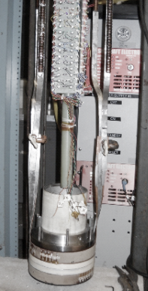
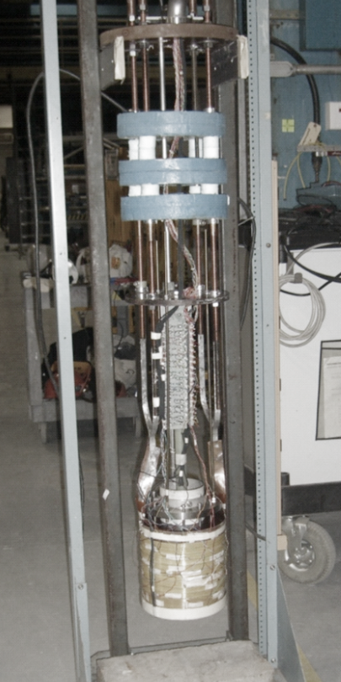
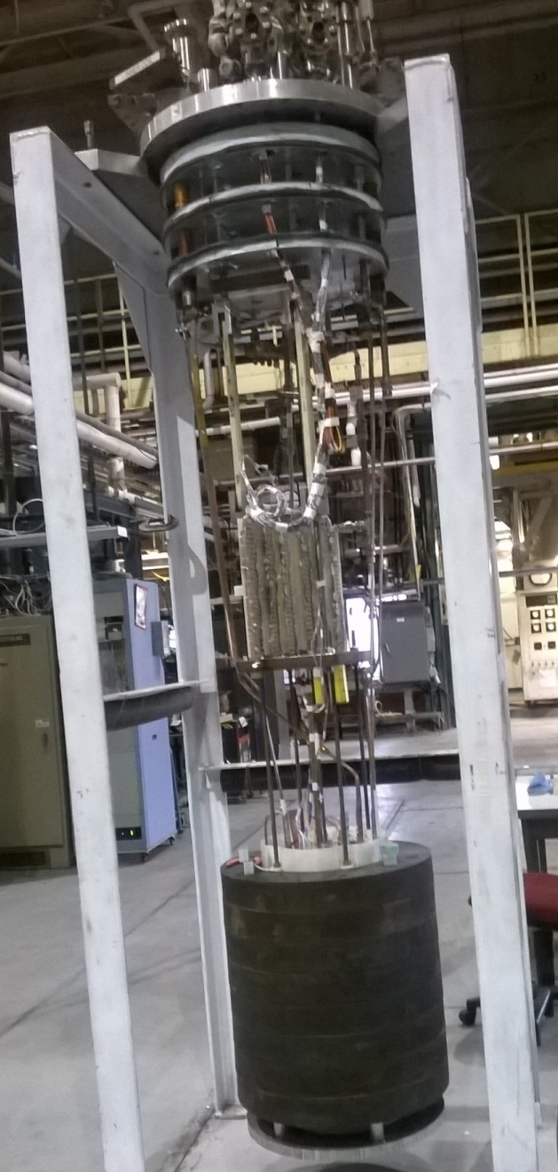
HTS Magnet Test Results (BNL/ABB/SuperPower/Houston)
100 mm bore ReBCO ARPA- E SMES Coil
2 pancakes
1140 A, 4K
46 pancakes
350 A, 27K, 12.5 T
12 pancakes
760 A, 4K, 11.4 T
Peak fields higher
R. Gupta, BNL, Aug 2014

Slide 5
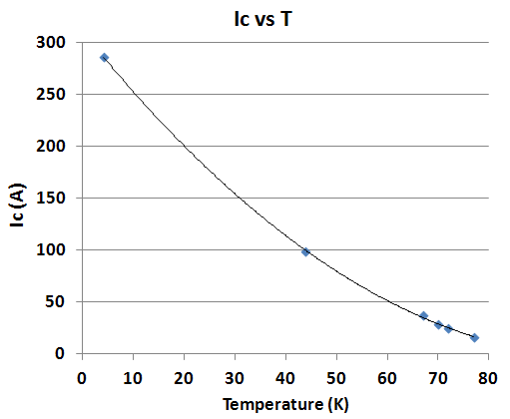
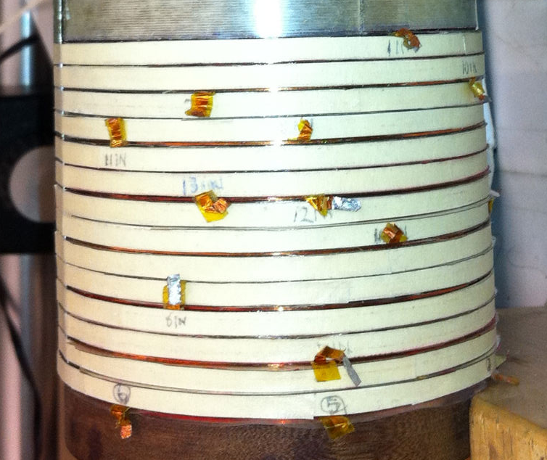
High Field HTS Magnet- PBL/BNL SBIR
Field on axis: 15.7 T
Field on coil : 16.2 T
(original target: 10-12T)
Highest field all HTS solenoid
Overall J_{o} in coil:
>500 A/mm² @16 T
Aperture = 25 mm
*Credit to SBIR/STTR office for this and SMES work which was the result of this

Slide 6
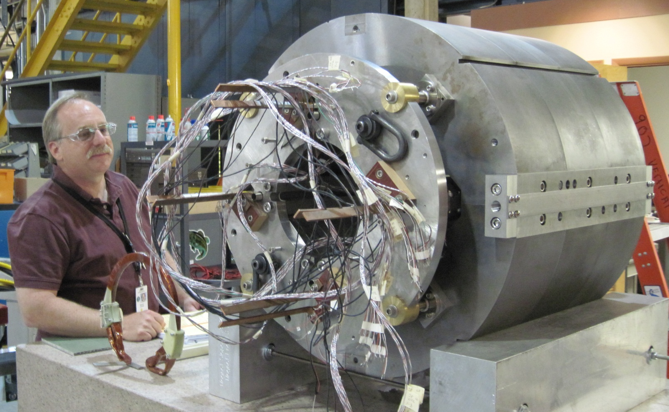
2G HTS Quad for FRIB Fragment Separator Region
Important: Magnet for a real machine- baseline design of FRIB

Slide 7
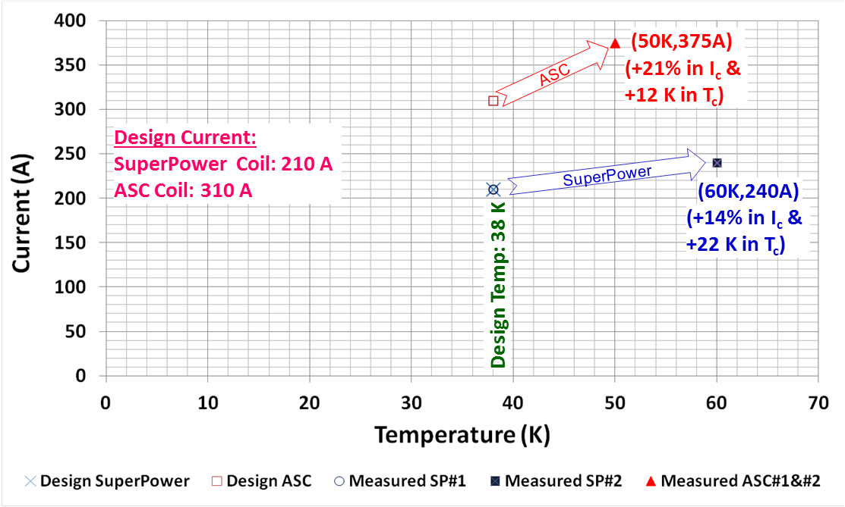
Large Temperature Margins
(only possible with HTS)
Provides robust operation against local and global heat loads

Slide 8
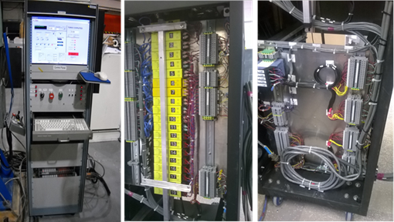
Advanced Quench Protection Electronics
Detects onset of pre-quench voltage at < 1mV and with isolation voltage > 1kV allows fast energy extraction

Slide 9
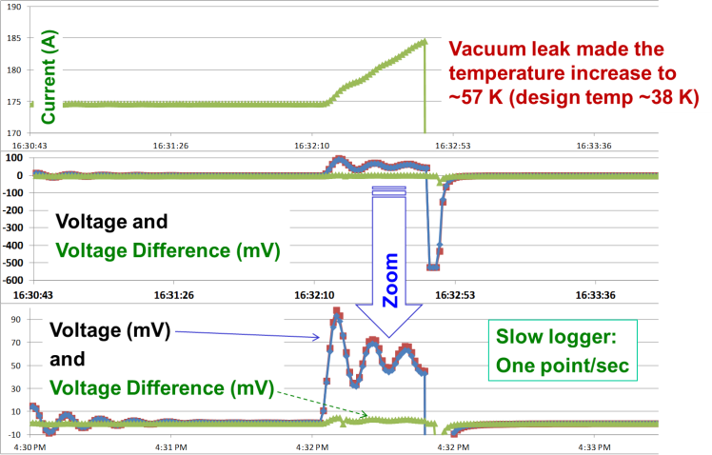
Protection of HTS Magnet During an Operational Accident Near Design Current
Design: 210 A in SP Coils
185A
175A
Ringing in power supply made situation worse
90mV

Slide 10
Magnet Designs for FCC

Slide 11
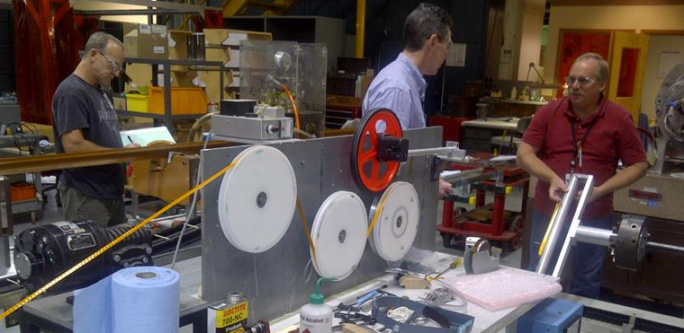
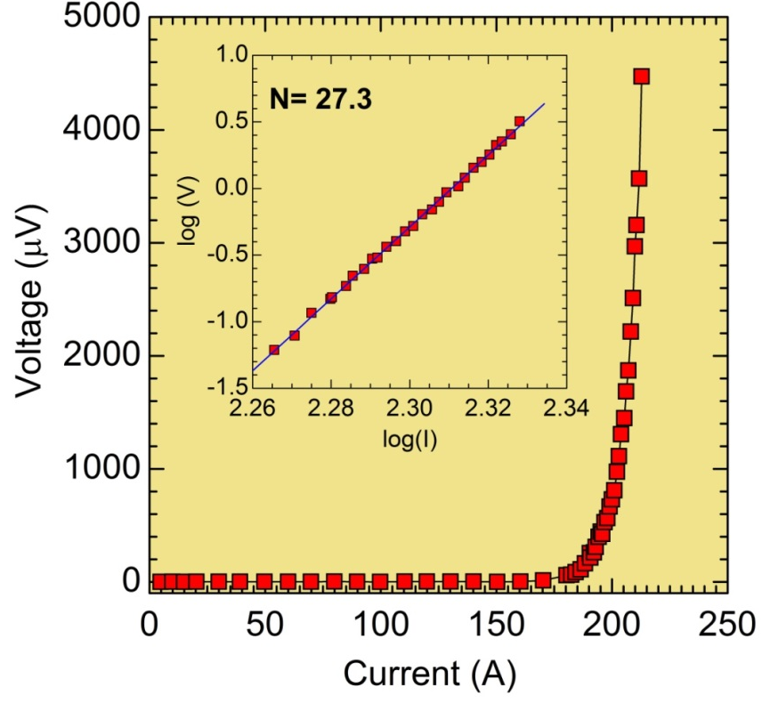
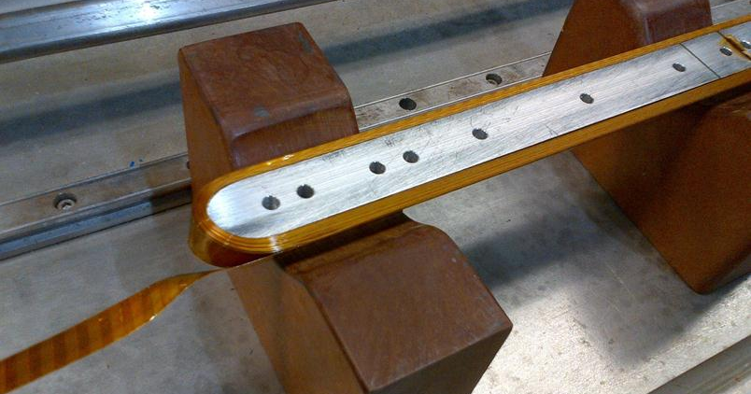
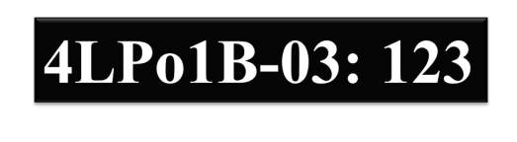
Cos (θ) Coil - PBL/BNL STTR#1
(12 mm, one block, 77 K)
BENEFITS of Kapton-CI:
No epoxy/adhesive to HTS tape (prone to degradation by epoxy)
Standard insulation in magnets
Cured coil can be handled easily
Makes good coil (including ends)
No measurable degradation@77 K

Slide 12
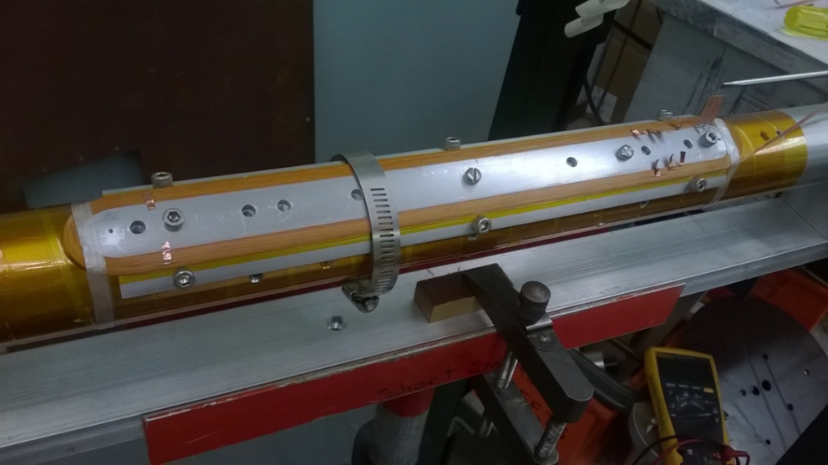
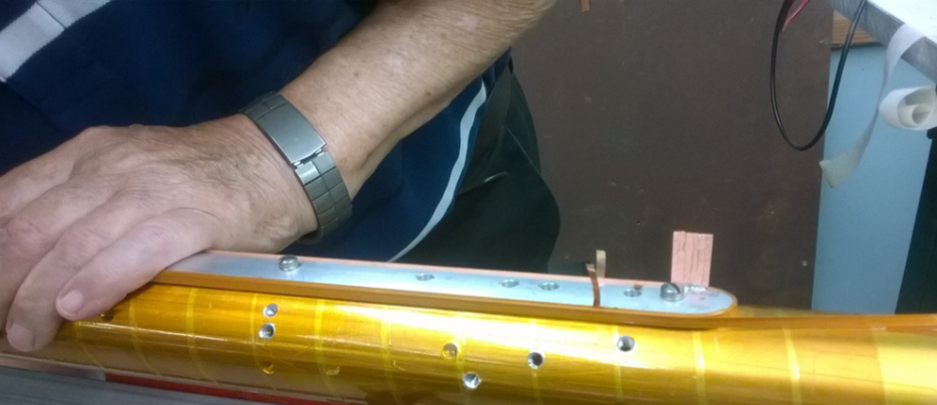
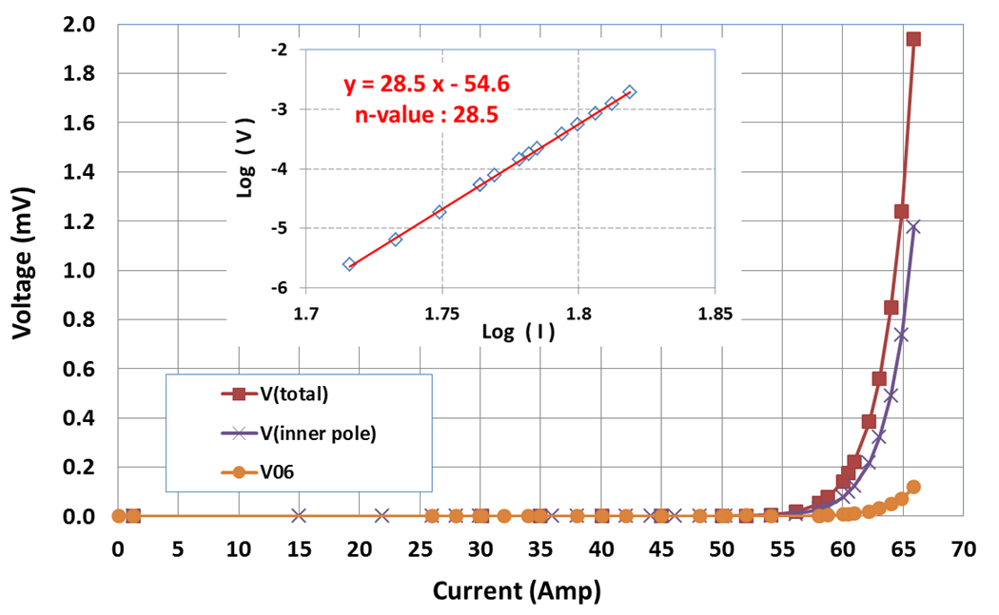
Cos (θ) Coil - PBL/BNL STTR#2
(4 mm, goal: full coil, 4 K test)
Future Plan (Phase I & Phase II)
Construction and 4 K test of full cos (θ) coil in next few months
R&D to develop base technology for accelerator magnets in next few years (includes measuring and finding ways to deal with magnetization)
Use these magnets in an accelerator in next few decades
No measurable degradation@77 K

Slide 13
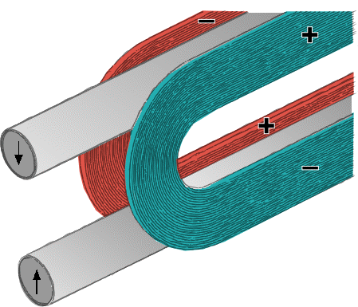
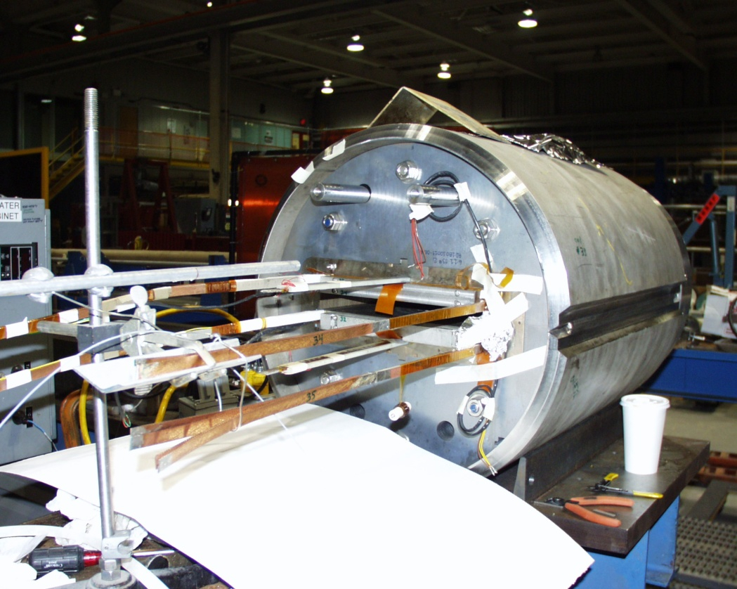
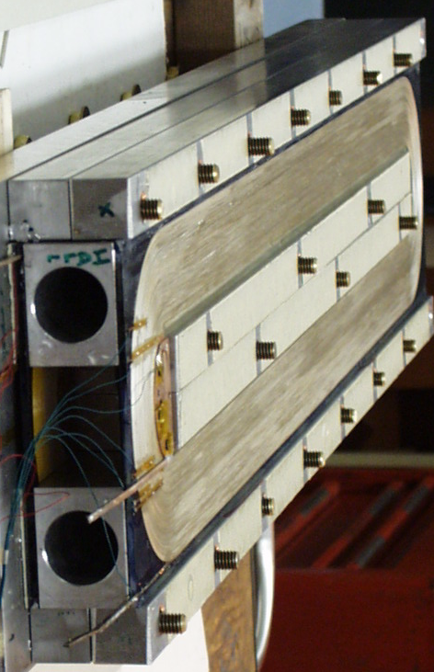
High Field 2-in-1 Common Coil Dipole Design for Colliders
Coil #1
Beam #1
Coil #2
Beam #2
Highest field R&W
Nb3Sn dipole
HTS tape common coil dipole
A conductor friendly design
  Suitable for HTS coils – Roebel cable?
  Unfavorable orientation wrt field
      However, think long term. Will Ic remain so anisotropic forever?

Slide 14
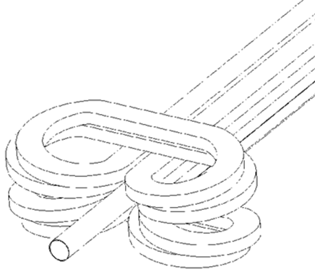
A Coil Design with Overpass/Underpass Ends Optimized for ReBCO Tape
R. Gupta, et al., “Next Generation IR Magnets for Hadron Colliders,” ASC2002
No need for lifting the ends and no reverse curvature
  Less strain on the conductor but winding more complicated
Align ReBCO tape parallel to the field for
  Higher Jc
  Lower magnetization (will depend on the thickness and not on the width)
Solenoid
Type Ends

Slide 15
Magnet R&D for FCC

Slide 16
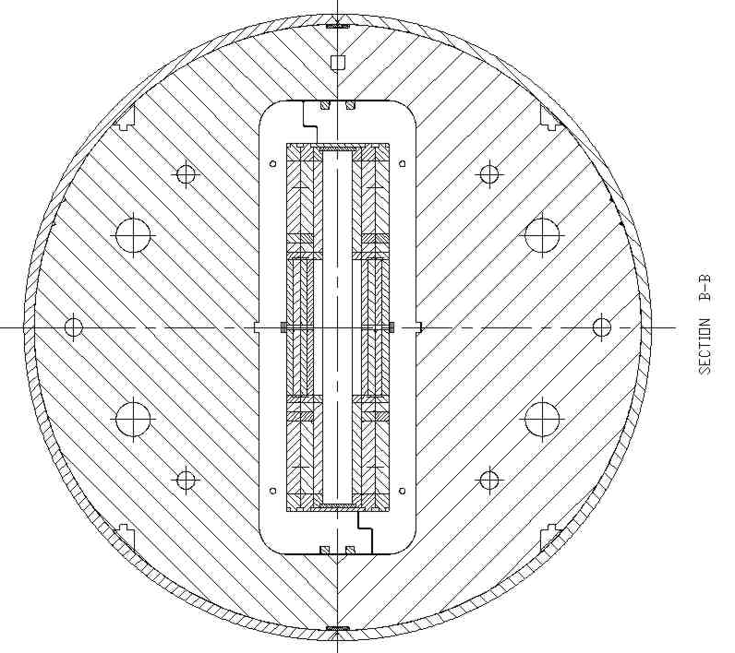
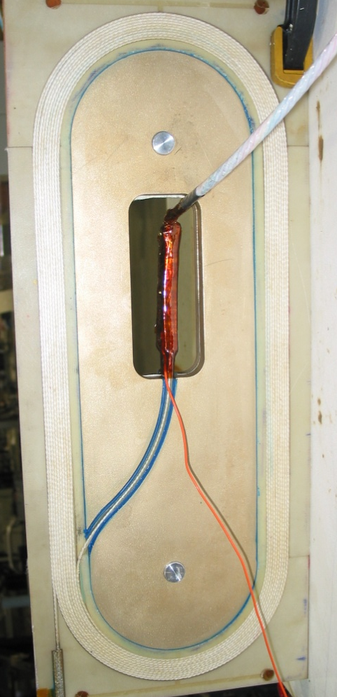
Common Coil Dipole at BNL for Testing HTS Insert Coils as in a Hybrid Magnet
BNL has a unique 10⁺ T Nb₃Sn common coil dipole with large open space to test HTS coils in background field.
Provides fast turn around and economic R&D as no disassembly/assembly of the magnet is required
HTS coil become a part of the hybrid magnet test (~15 T)
High current 2212 coil

Slide 17
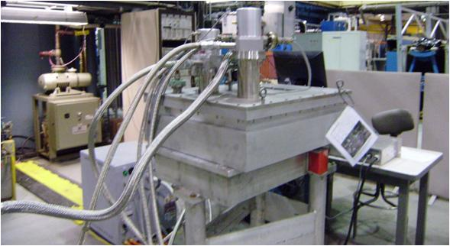
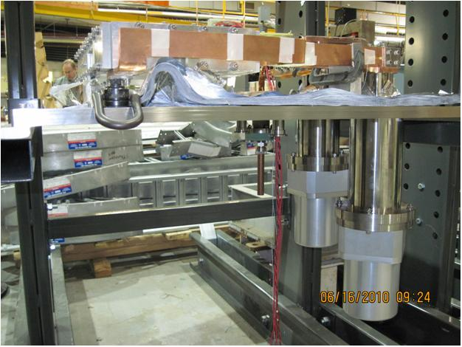
A Warm bore Cryo-cooled Magnet with 6 HTS coils
Suitable for various studies
Quench studies
Measure magnetization induced harmonics
  as a function of time
  as a function of temperature
  as a function of field
Evening: Switch ON; Morning: COLD
BNL has about 50 HTS coils available for various studies; about 30 with ~100 meters of HTS
Consider utilizing this asset

Slide 18
Summary
Yet a long way to go before HTS magnets can be used in HEP accelerators, HTS magnet technology has made a major progress over last decade. (I’m personally optimistic).
BNL has been active on developing HTS magnet technology and has made many significant demonstrations. BNL is looking forward to offer its unique and substantial experience to future HTS magnet R&D for FCC.
However, we are more than HTS‘R’US (of which I’m proud of). We also have active programs on LTS magnets (our bread-and-better), and are the one US facility with working superconducting accelerator magnets.

