Slide 1

NHMFL goals for very high DC fields in FCC design study time-frame
David Larbalestier
  High field NMR - Ulf Trociewitz, David Hilton and team,
  32 T User magnet – Huub Weijers, Denis Markiewicz and team
  20 T MRI planning – Mark Bird and team
  REBCO conductor team – Dima Abraimov, Jan Jaroszynski and team
  Bi-2212 conductor team – Jianyi Jiang, Tak Kametani and team
  A15 development team – Peter Lee and Chiara Tarantini
Future Circular Collider Workshop at ASC 2014
Charlotte NC,
August 13 2014
Support by NHMFL core grants, DOE-OHEP, NIH and CERN

Slide 2
Outline
The conductors (no magnets without conductors!)
  Bi2212 (requires OP – but now in >500 m, twisted, high Je)
  REBCO (lengths up to 200 m, good but variable Ic(x))
  HTS cables (vital for REBCO larger magnets)
  Advanced Nb₃Sn (under DOE support – not discussed here)
The projects
  Construct a 32 T user magnet using REBCO (Weijers 4LOr3D-05 Thursday 6.15)
  Construct prototype Bi-2212 NMR coils (Trociewitz 4LOr2A-07 Thursday 4 PM)
Near term strategic drivers
  >30 T superconducting magnets (NHMFL) (RIKEN agreement)
  Conductor development (DOE-OHEP)
  Preparation for 20 T MRI, 60 T hybrids and other MagSci goals

Slide 3
Ic of recent deliveries : SP125 – SP172 (~3720m)
Data arranged by delivery time
Abraimov 1MOr3D-01
Only SP144,149,150,152,154 did not passed I_{c}(4K, 17T) test
SP144, SP 152 did not passed I_{c} test at any ab-plane orientations
Very good correspondence between I_{c}(77K; SF) measured in ASC and min I_{c}(77K;SF) measured by SP
Stars mark I_{c} data measured at different ab-plane orientation

Slide 4
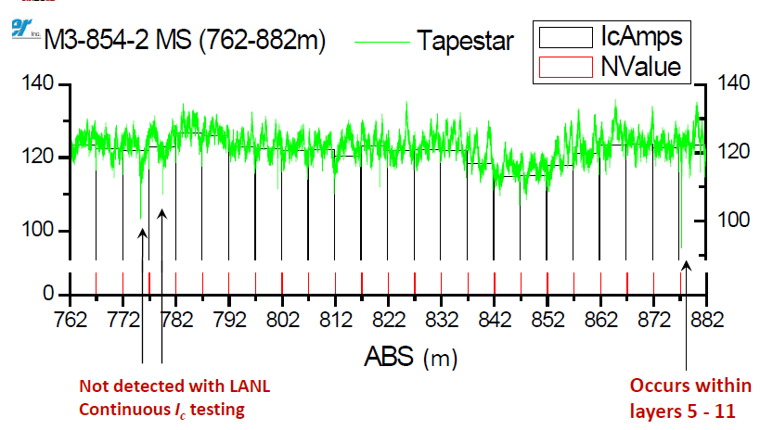
Superconducting length (non) uniformity
Hu 2LPo1B-05
Data courtesy of SuperPower
“Yatestar” NHMFL
Transport I_{c} per 2 cm
T = 75 K (LN₂) B = 0.5 T, …..variable angle
Low throughput
Position counted from start of Ic(x) as in measurements
B||c
Not detected with LANL device (“Yatestar”)
Used in section of coil where quenches originate
Tapestar:
Magnetization-I_{c} corresponds well to transport I_{c} over 5 meters at 77 K
High through-put
Spikes may or may not correlate to physical realities
B||ab
θ = 72 deg
We have many elements of what is needed to accurately measure long lengths in transport at 77K and to correlate magnetization at 77 and 4 K
Prototype built at LANL by Yates Coulter and engineered for 200m lengths at NHMFL by Jan Jaroszynski and John Sinclair, now with Hall probes operating at both 77 and 4 K (Alex Stangl)
Notes:
2 devices considered

Slide 5
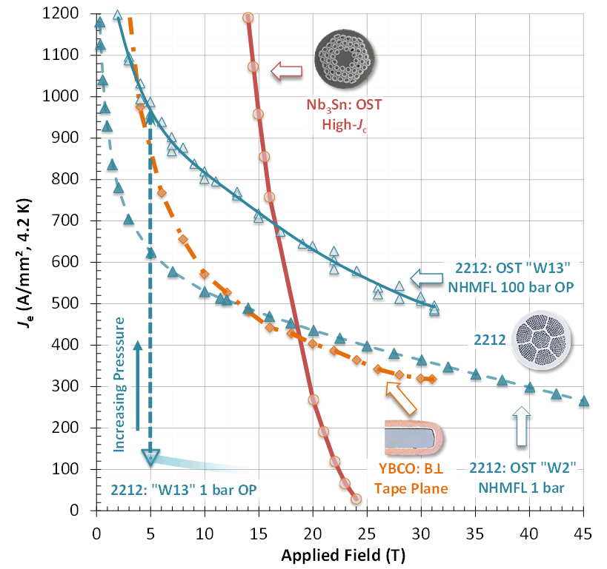
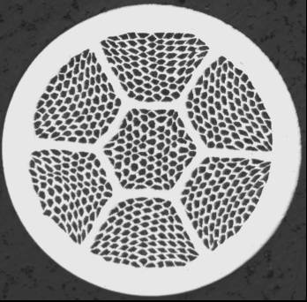

Prior to 2012, all HTS conductors (Bi-2223, REBCO) were tapes delivered in reacted form
Bi-2212 upended this paradigm, delivering a high current density (the highest of all actually) in round-wire, multifilament, twisted form
The first HTS conductor to look like an LTS conductor
Conductor must be wound, then reacted
  Big advantage – very flexible architecture
Jiang 1Mor2A-05
2012 with Overpressure
1990-2012
2212 (25% sc)
REBCO coated conductor (1% sc)

Slide 6
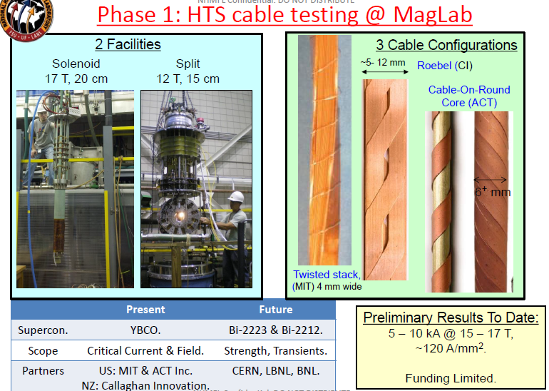
Cable test program is ramping up
Arno Godeke joins NHMFL next month
REBCO and BSCCO focus
Slide from Mark Bird

Slide 7
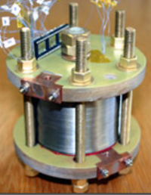
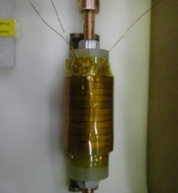
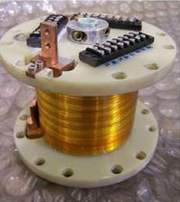
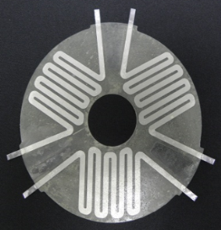
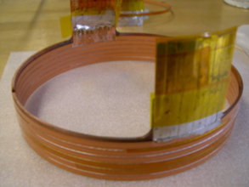
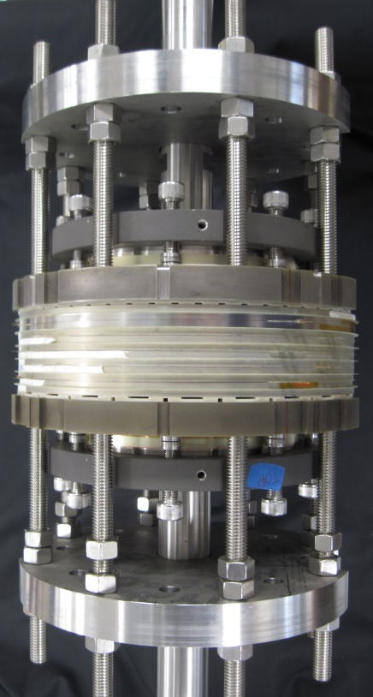
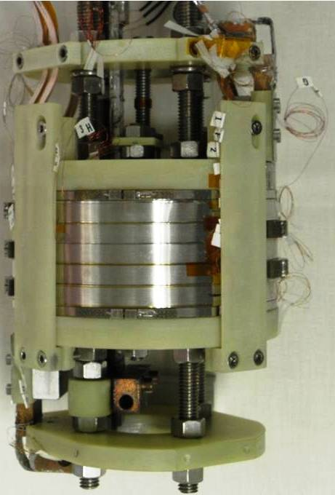
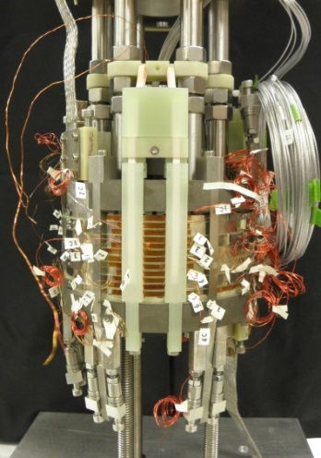
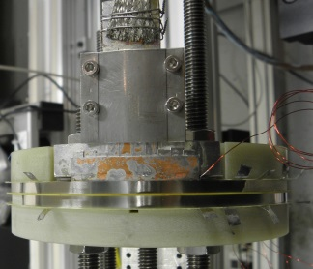
32 T Technology (REBCO) Development
Weijers, 4LOr3D Thursday 6 PM
Proposed Coils ≥ 20x mass increase
Prototype coils represent 20% of 32 T REBCO coils
After prototype phase: TRL = 7, start of construction phase
2009: Technology Readiness Level TRL=3/9
Development:
YBCO tape characterization & QA
Insulation technology
  Ceramic on co-wound SS tape
Coil winding technology
Joint technology
Quench analysis & protection
Extensive testing of components
2007
2008
High-B coils
31 T + ΔB
320 mm
2008
2009
∅140
Quench heater
∅232
Demonstration inserts
20 T+ ΔB
High Hoop-stress coils
>760 MPa
Heater-only quench protection
2011
2012
2013
2014
∅124
First Quench Heaters
42-62 Mark 1:
1st test coil
∅124
∅140
∅232
42-62 Mark 2:
2nd test coil
20 - 70:
1st Full-featured Prototype
82 - 116:
2nd Full-featured Prototype

Slide 8
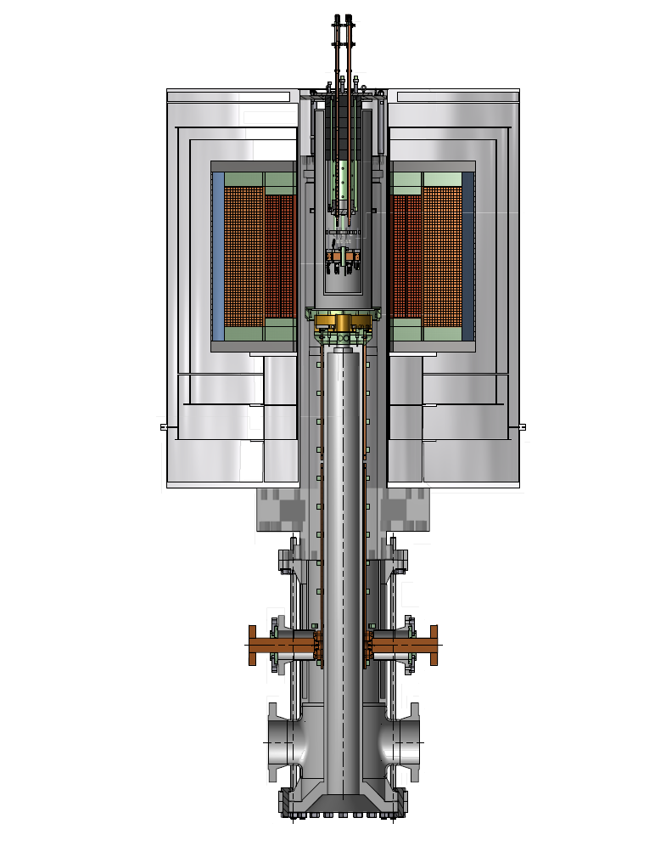
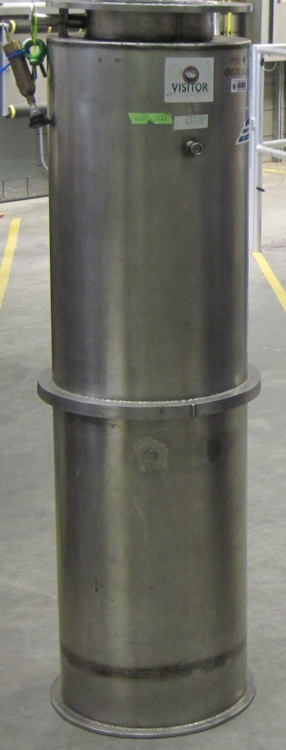
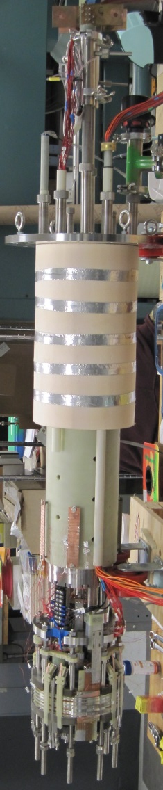
2014: Coil 1 and Coil 2 Prototype tests in 45 T Hybrid Outsert (11.5 T) went well
Weijers, 4LOr3D Thursday 6 PM
Coil support
Cryostat support
posts
zoom
45 T Hybrid
Resistive coils removed to provide space for test cryostat
Resistive magnet housing
Proto-coils (6 modules each, 1.6 H)
Test cryostat

Slide 9
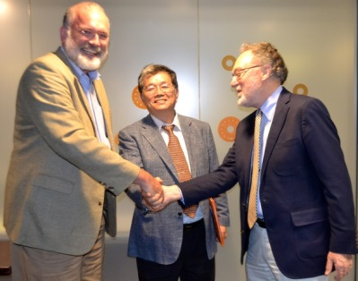
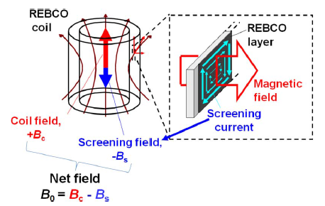
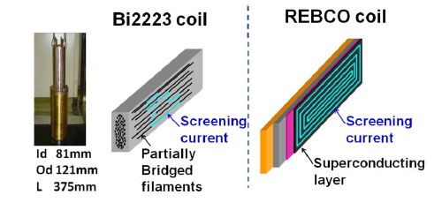
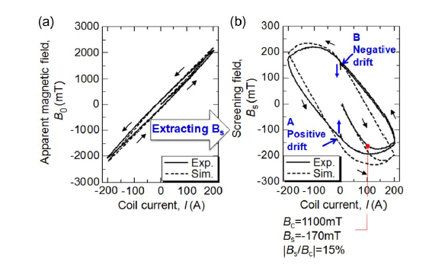
RIKEN experience with 2223 and REBCO in their 500 MHz solution NMR system (100 MHz HTS + 400 MHz LTS)
Screening Currents in HTS Tapes
August 8 MOU with RIKEN to deliver prototype 2212 for NMR tests at RIKEN
Quite different shielding current patterns in multi- and single filament conductors
Outcome:
Bi-2223 insert gave signals equivalent to LTS magnet
By contrast, great difficulty stabilizing and shimming the REBCO magnet
Non-linear, hysteretic effects in REBCO coil
Maeda and Yanagisawa IEEE TAS 24, 4602412 (2014)

Slide 10
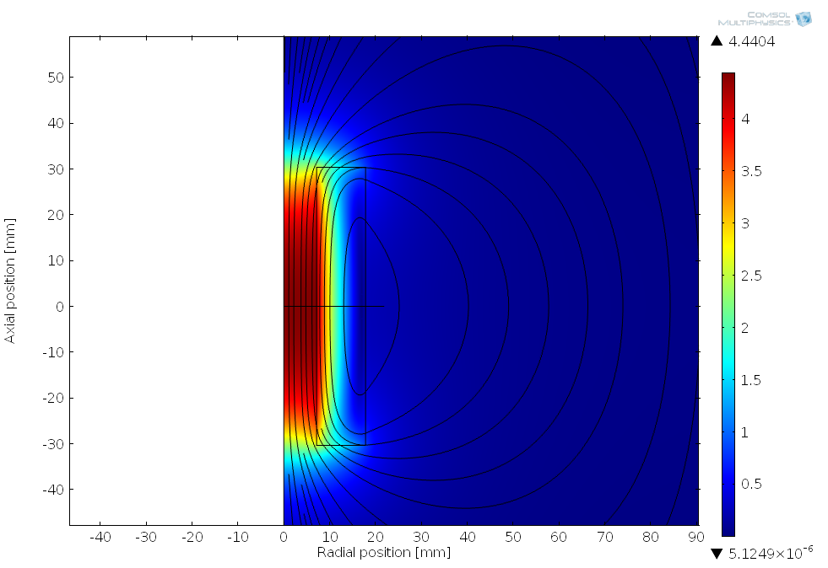
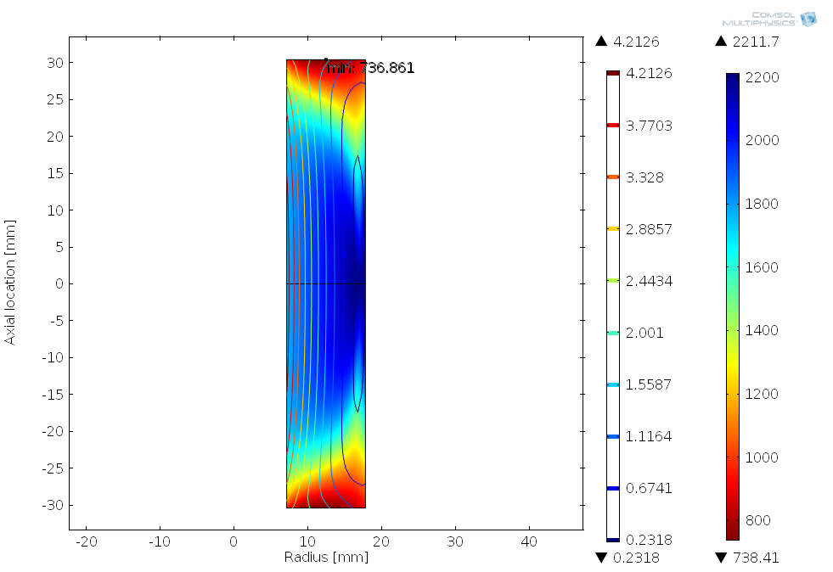

There is a Substantial Difference Between Tape and Round Wire
Bi-2212 isotropic: I_{c} scales with the field: high |B| => low I_{c}, with no field orientation dependence
REBCO anisotropic: both |B| and its orientation matter
In absence of other defects (hot spots etc.) a Bi-2212 RW coil will likely have tendency to quench from inside out while REBCO coil will quench from its ends
  Cooling may become an issue (He-bubble trapping in high B $·$ grad B region)
B_{tot} [T]
Zone of lowest I_{c} (737 A)
B_{tot} [T]
I_{c} [A]
4.4404
4.21
2212
50
Bi-2212
Zone of lowest I_{c}
30
REBCO
z [mm]
z [mm]
-30
-40
-20
r [mm]
40
0.23
738
-40
r [mm]
90
5E-6
-40

Slide 11
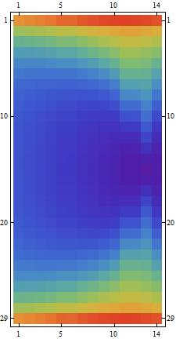
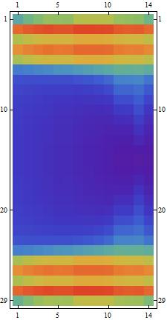
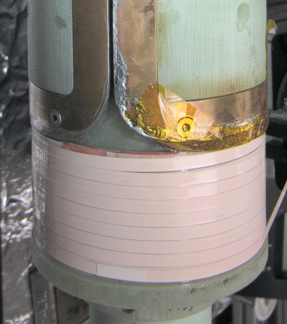
How Do Screening Currents Affect REBCO Coil Performance?
Radial field component at coil ends induces strong screening currents
Screening currents absent :
Screening currents present:
Platypus-I
1520 A
770 A
2740 A
2740 A
95 mm
D.K. Hilton
Large reduction in I_{c} at coil ends
Change in current distribution causes change of field profile
Magnetic decay causes significant field drift, problem for high field homogeneity magnets
2LPo2G-06: D.K. Hilton; D.S. Davis

Slide 12
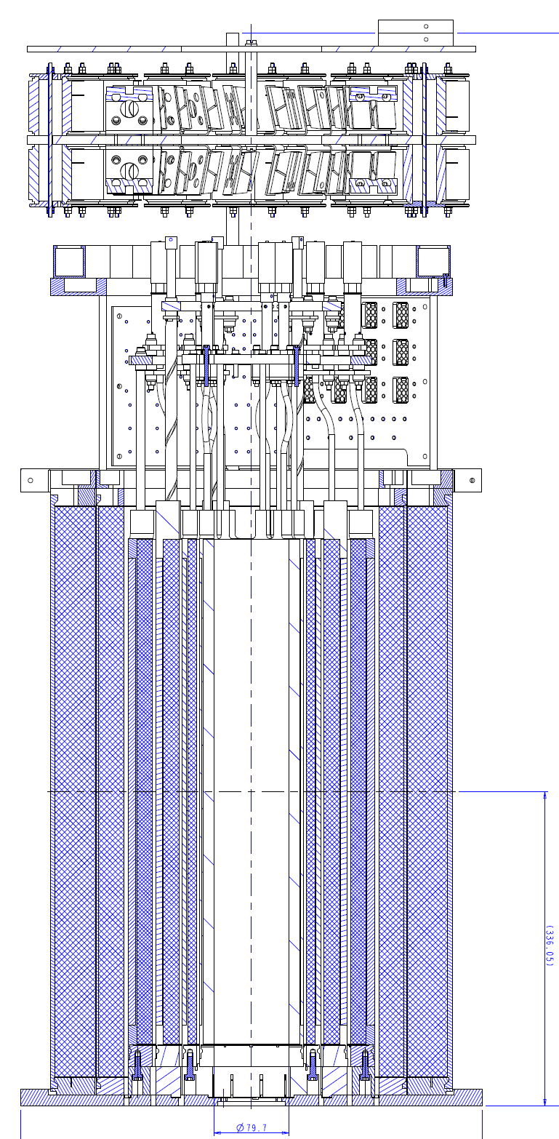
A Bi-2212 High Field Homogeneity R&D Magnet
Our concept evolved from REBCO to 2212:
We acquired an Oxford LTS magnet as test bed (16 T in 110 mm bore)
We initially aimed to generate about 24 T with REBCO conductor (Platypus 1)
RIKEN evaluation of 100 MHz REBCO insert made our concerns about REBCO concrete and we moved to Platypus 2 with Bi-2212
  Bi-2212 layer-wound (TiO₂ insulated, epoxy impregnated) with Bi-2212 layer-wound compensation coils
HTS insert powered separately from the LTS using low noise power supply (Danfysik)
LTS outsert
240 mm
Bi-2212 insert
Trociewitz- 4LOr2A-07

Slide 13
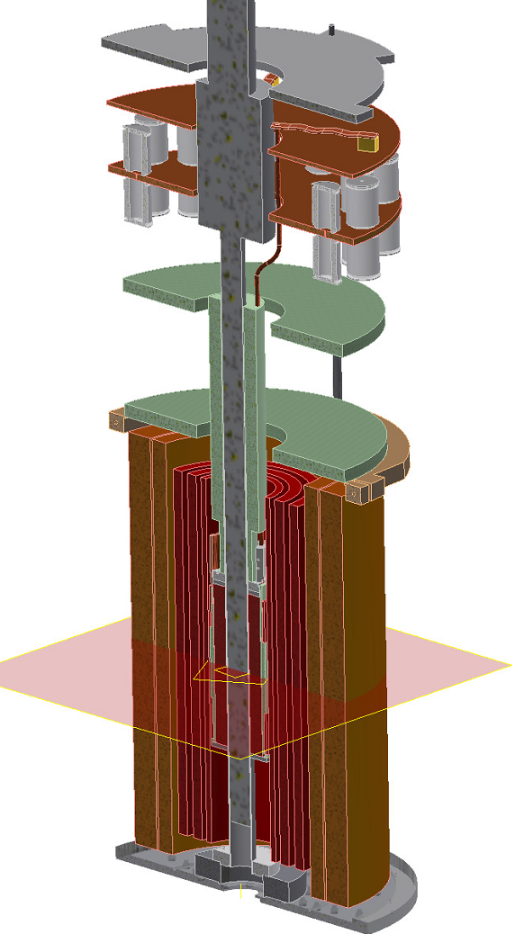
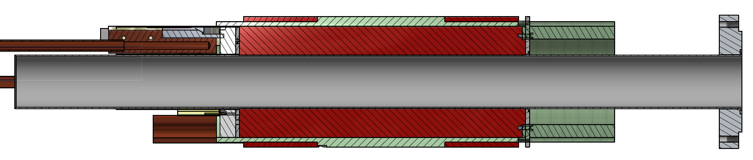
How Do We Imagine Platypus II?
Bi-2212 conductor has been delivered (all twisted in single lengths up to 520 m)
Wire will be insulated with TiO₂-loaded polymer coating
Mandrel and flanges are from Inconel 600
Ceramic plate provides electric standoff between terminals and coil
Ag-pads provide electrical and mechanical link to current lead extensions made with CORC (REBCO current lead made by ACT, Inc., CO)
Termination
point
VTI
CORC lead extensions
Bi-2212 compensation coil pair
Support lead extensions
Bi-2212 solenoid
LTS-magnet
Insert magnet
G. Miller

Slide 14
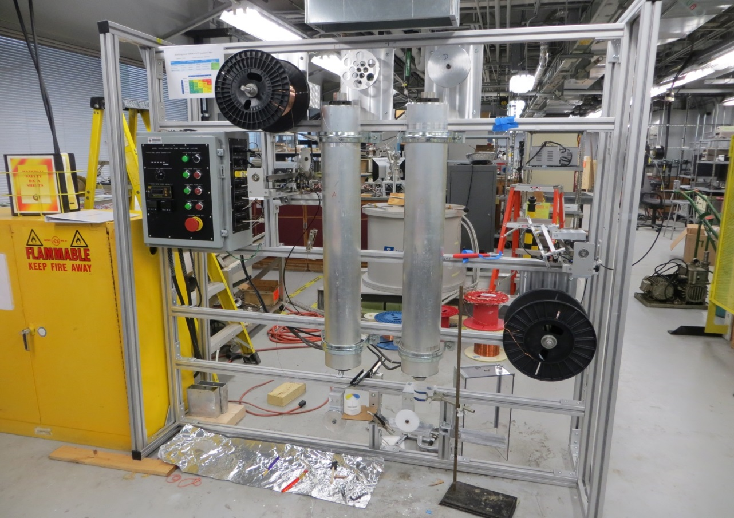
Conductor Insulation is Vital
Payoff
Ventilation
Bi-2212 conductor requires electrical insulation compatible with heat treatment at ~890ºC
Uses TiO2 in polymer matrix that is burned off prior to full heat treatment
Homogeneous, porous coating remains
Both commercial (nGimat) and in-house routes are currently being pursued
Traverse guide
Furnaces 150 C
Coating
Tanks
Take up
Great recent progress with in-house insulation now scaled up to 200 m, uniform thickness coatings - Hom Kandel and Jun Lu (2MPo1B-05)

Slide 15
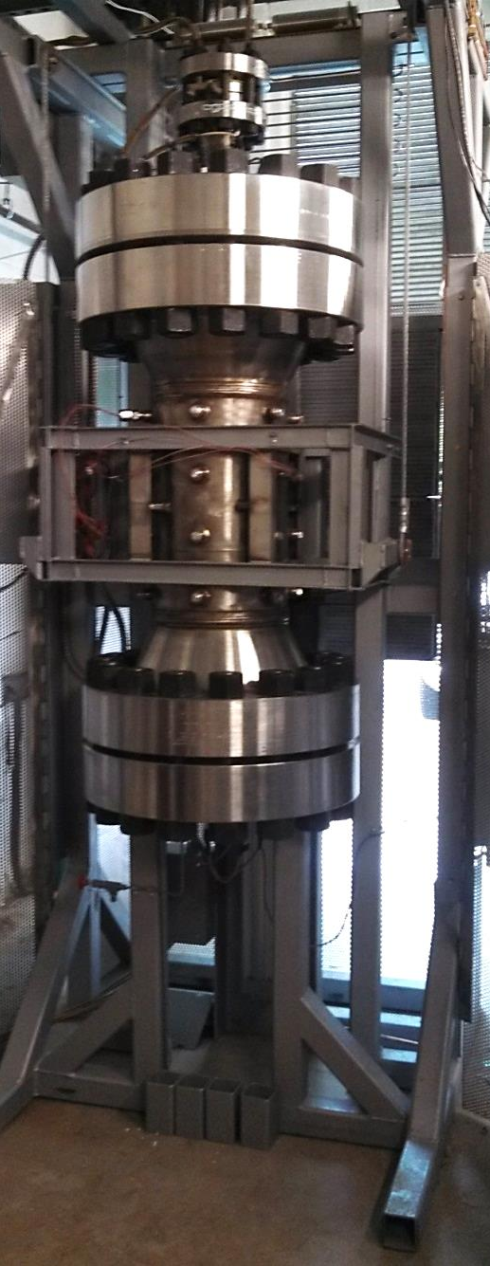
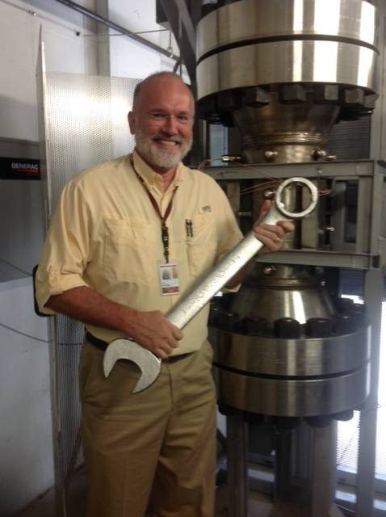
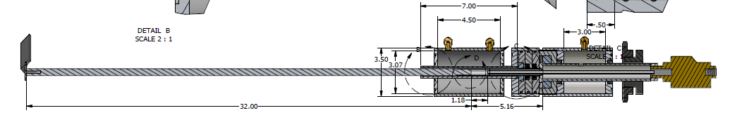
How to Process Large Coils?
Sample
space
Stirrer to force convection and homogeneous O₂ mix
2000 ft-lbs torque on each bolt
3.5 m
2.65 m
Large furnace made by Deltech, Inc.
Hot Zone: 17 cm dia, 50 cm at up to 100 bar (1 bar pO₂)
Will be key equipment for Bi-2212 coil manufacturing
Final setup in progress
L. English, J. Jiang, E. Hellstrom

Slide 16
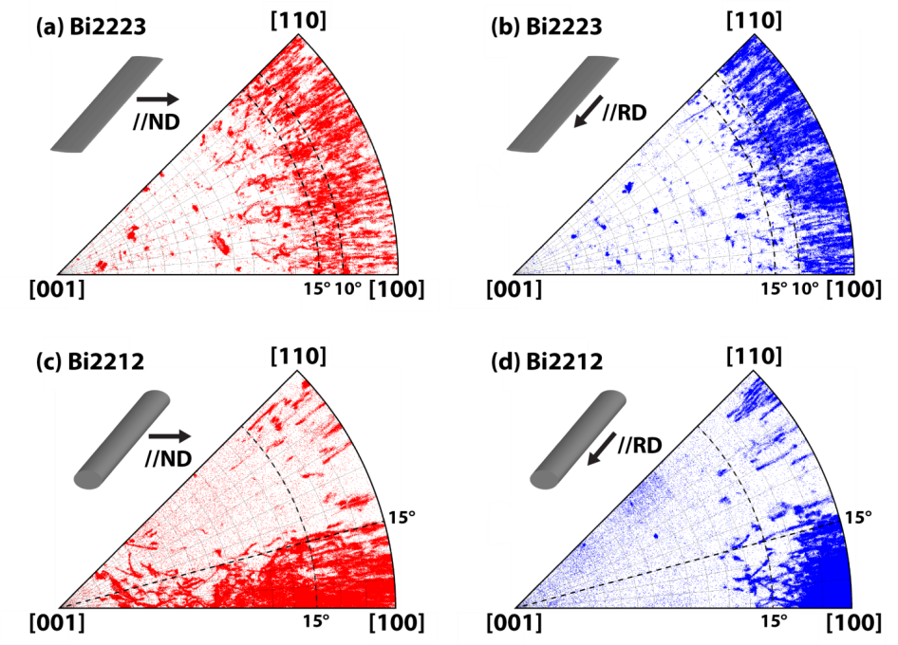
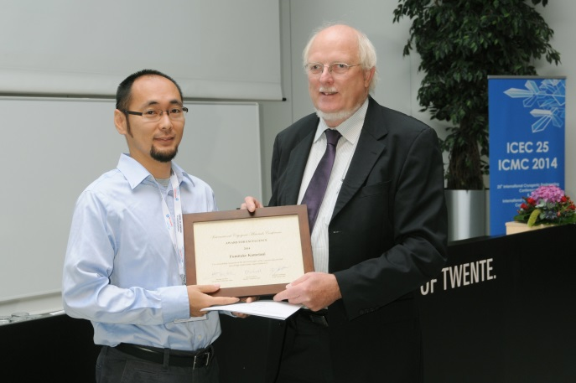
Round Wire HTS could be the future by 2018!
HTS magnet conductors are not just restricted to Bi-2212, Bi-2223 and REBCO
  Round wire MgB₂ is being aggressively industrialized by CERN for the power supply-magnet links
    High field use not possible at present but H_{c2} engineering could allow this)
  Round wire versions of (K,Ba)Fe₂As₂ - requires improved intergranular properties but not far off practicality
  Thick film 65-77 K REBCO conductors for 10-20 T coils are in prospect
    If 5 x thicker REBCO layers can be grown
Holy grail would be round wire REBCO or other higher T_{c} cuprate
  Very interesting insights from recent Kametani analysis of the key difference in grain-to-grain misorientations in Bi-2212 and Bi-2223
Bi-2223: self-organized in-plane texture much less effective than Bi-2212
only uniaxial texture
Bi-2212: self-organized in-plane texture due to melt texturing
Quasi-biaxial texture
Fumitake Kametani, ICMC Award of Excellence, July 2014 (Enschede NL)

Slide 17
Broad Partnerships and Collaborations are In Place!
Bismuth Superconducting Strand and Cable Collaboration (BSCCo) – (leaders Larbalestier, Hellstrom, Cooley (FNAL), Godeke (LBNL), Ghosh (BNL) – direct DOE support to NHMFL (2013-2015, with FNAL and LBNL lab support through GARD funds)
  Industrial collaborations with Oxford Superconducting Technology (OST), Nexans and CERN
  Conductor Development Program (Dan Dietderich and Ken Marken leads)
BSCCo MOU with CERN for contributions to EUCARD2, (WP10) to develop 5-10 kA HTS cable for 5 T HTS insert dipole magnet –US side coordinator is David Larbalestier, leveraging BSCCO effort with support from the Conductor Development Program of DOE-HEP for industrial production, leader Dan Dietderich (LBNL).
NMR collaboration with RIKEN – Bi-2212 coil to be built for Professor Hideaki Maeda’s 500 MHz system
Coated Conductor Round Table – meeting of REBCO coated conductor project labs (NHMFL, MIT-NMR, MIT-PFC, BNL, CAPS-FSU, SuperPower, Advanced Conductor Technologies) coordinated by Trudy Lehner (SP), David Larbalestier (NHMFL) and Yuki Iwasa (MIT)
  The partnership with SuperPower on REBCO coated conductor starting in 2007 is what enabled us to propose 32 T so early
  R&D partnership with group of Selvamanickam at TcSUH through former PhD Aixia Xu
CORC with Danko van der Laan – several year collaboration, now with funds in from SBIR phase 2 on REBCO cables
32 T outsert coil design and manufacture – Oxford Instruments team led by Ziad Melhem
Broad outreach to the other applications described in MagSci – photons, MRI, regional centers

Slide 18
    High Magnetic Field Science and Its
    Application in the United States: Current
    Status and Future Directions
    The recommendations (Halperin (Harvard) Chair)
Consider regional 32 T superconducting magnets at 3-4 locations optimized for easy user access.
Establish at least 3 US 1.2 GHz NMR instruments (planned commercial) for broad access and plan for ~1.5 GHz class system development
Establish high field (~30 T) facilities at neutron and photon scattering facilities
Construct a 20 T MRI instrument (for R&D)
A 40 T all‐superconducting magnet should be designed and constructed,
A 60 T DC hybrid magnet that will capitalize on the success of the current 45 T hybrid magnet at the NHMFL‐Tallahassee should be designed and built.
Strong synergy with goals of FCC, DOE-OHEP and (we hope) NIH goals for NMR and MRI

