Slide 1
sTGC for ATLAS Small Wheel upgrade
Short introduction to sTGC
Layout of the system
Achieving the necessary precision and construction of Module-1.
Preliminary results with Module-1.
Conclusions

Slide 2
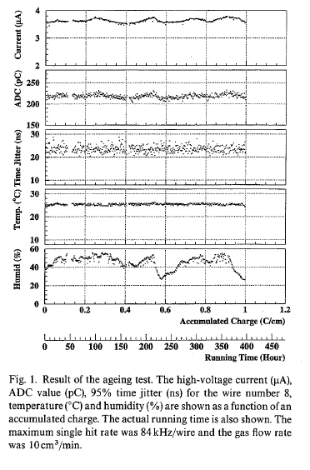
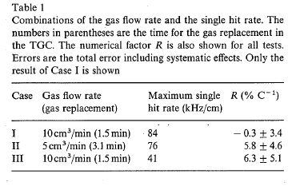
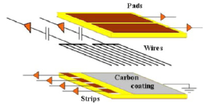
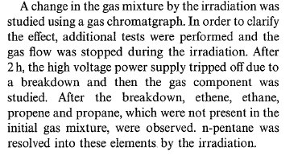
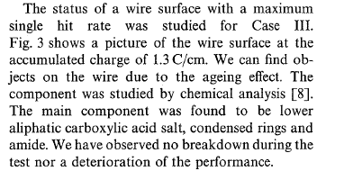
Aging tests (I)
Many aging tests have been performed since 1997 at different flow rates, showing no deterioration of performance with rates (up to 1.3C/cm (Fukui et al, NIM A419 (1998), 497-502.
This was followed in 2007 by a long irradiation up to 6C/cm showing the same lack of effect. The n-pentane, being a good cleaning agent helps in keeping clean wires, while the quasi saturation of the operation, makes it insensitive to small wire deposits.

Slide 3
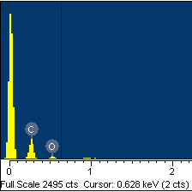
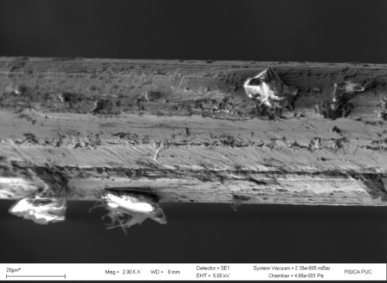
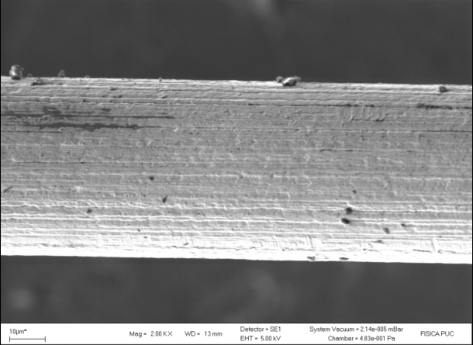
Aging tests (II)
By going to a low resistivity cathode (100KOhm/square), one can increase the rate capabilities to <30 KHz/cm^{2.}
Both elements have been implemented in 10 small prototypes that have been tested during the last year.
Most important, they need to be able to take the high radiation levels of SLHC.
A small chamber has accumulated 6 Coulomb/cm, without any deterioration= 20 years at SLHC with safety factor 5.
Anode and cathodes were analyzed for deposits in Chile, where a new Lab was established to continue radiation tests.
Deposits due mainly to
Carbon and Oxygen

Slide 4
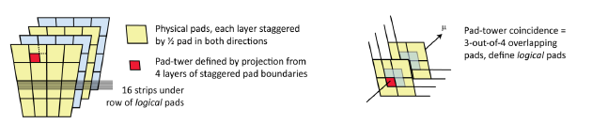
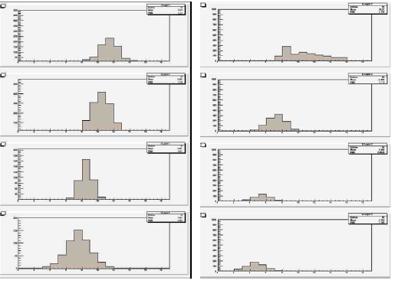
Principle of the system: reduced number of channels to use for trigger by making coincidence with pads.
Make a 3-out-4 coincidence to select what strips to be readout for trigger
Fast detectors consistent with 40MHz bunch crossing.
Get PH information from the relevant strips using flash-ADC.
Reject info from any layer containing too many strips (δ-ray) or too high PH (neutron).
Angular resolution of single quadruplet (for trigger 2.9mrad), while between the 2 quadruplets in the New Small wheel, 35cm apart, this gives <0.5mrad.

Slide 5
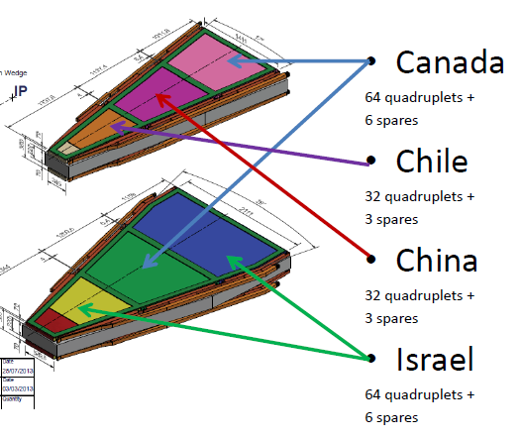
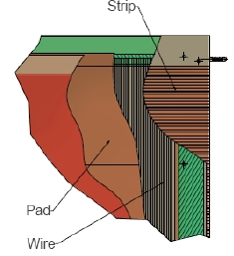
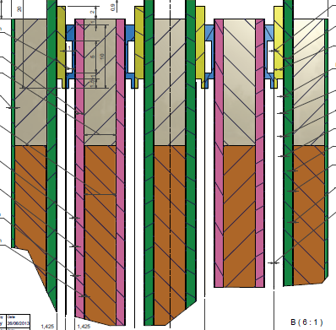
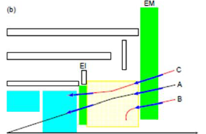
Layout of the system
To reduce μ trigger rate in forward direction, need accurate vector (>1mrad) in front of magnet.
Groups from Canada, Chile, China and Israel developed the sTGC that have achieved good position (~70μm) resolution and high efficiency in high background environment
Two type of detectors to be used in ATLAS Phase I New Small Wheel (NSW) upgrade (sTGC & MicroMegas).
New method to produce large (2X1.2m²) multi-layer PCB’s had to be developed that can be placed with respect t each other with a precision of 40μm.
First final size quadruplet of such a detector has been tested at FERMILAB (T1049 in M6-FTBF between 9/5 to 20/5).

Slide 6
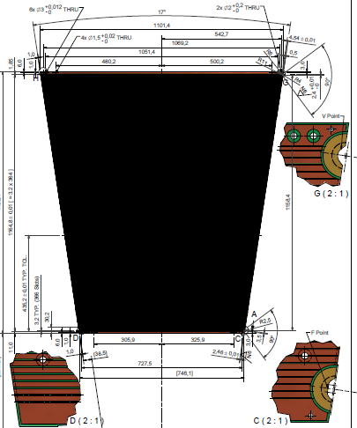
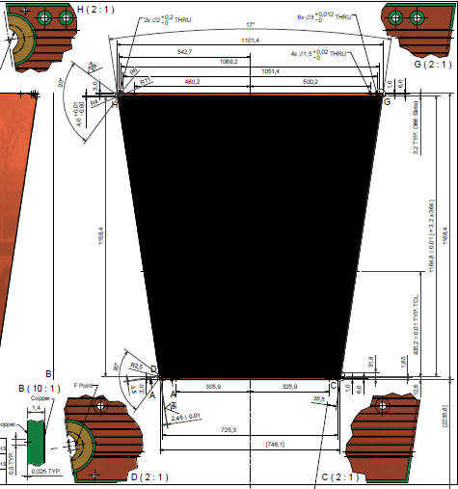
The necessary mechanical precision and alignment between strips in the 4 layers is achieved by machining the cathode boards with CNC, together with the alignment incerts
2 different type of strips shifted by ½ strip to avoid systematics.
The 100μm pre-preg is then glued using standard PCB multi-layer technology.
This allows the construction of precise, large cathode boards.
The boards are precise in the thickness to within 30μm.

Slide 7
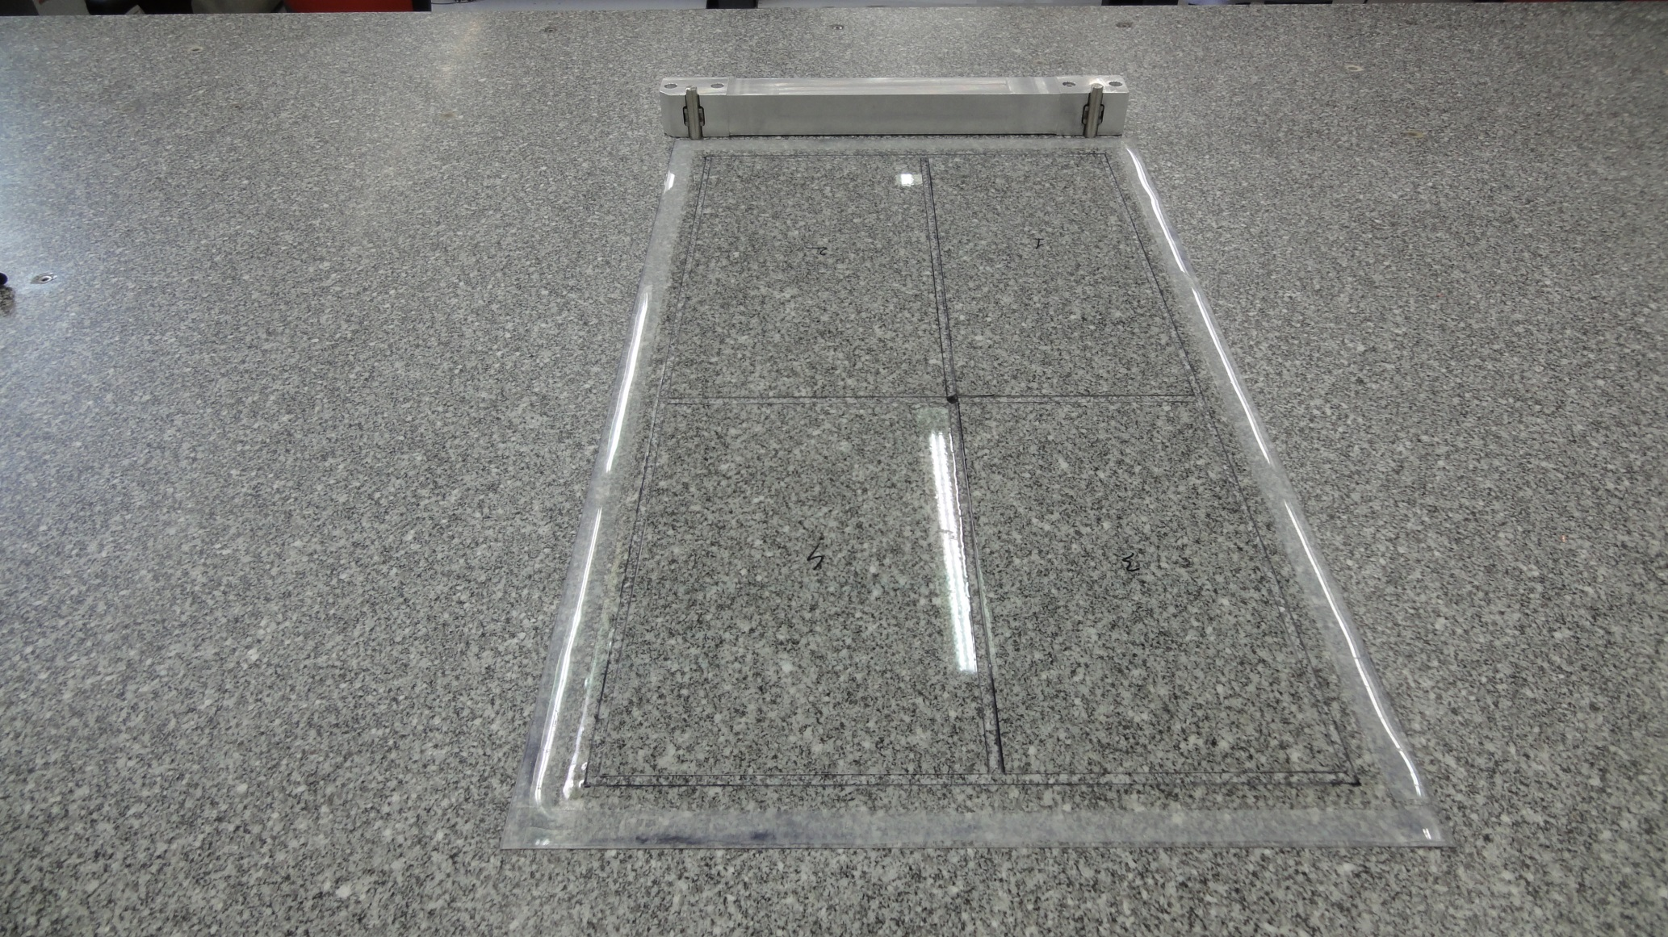
Vacuum system in granite table with jig holding precision pins

Slide 8
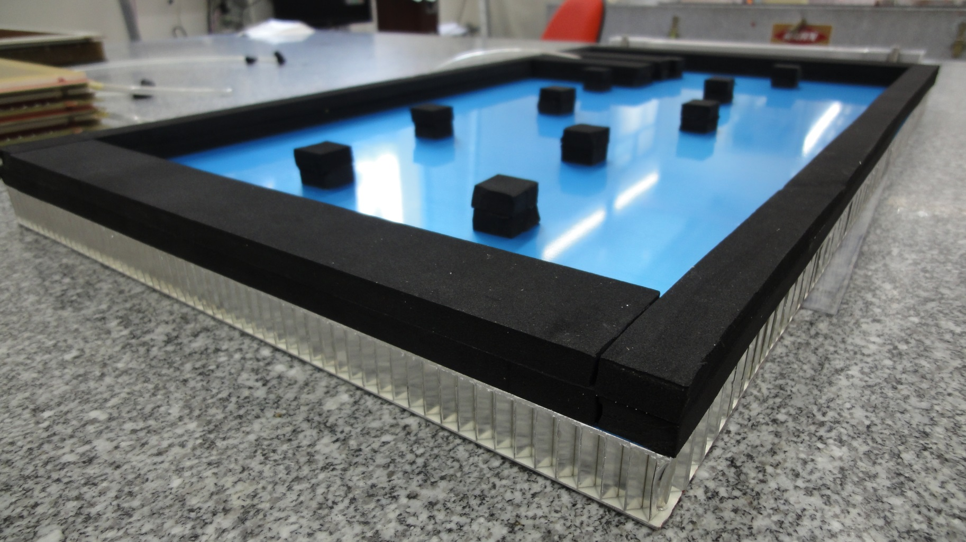
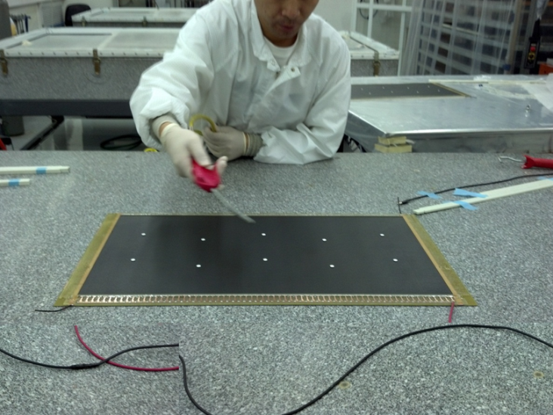
Back of the Al Honeycomb plate
Internal rubber supports only used to close individual planes, so inner chamber supports under pressure.
For gluing layers with 4.9mm honeycomb, 5.1mm glass-fiber frame, only outer frame rubber support is kept.

Slide 9

Leave space for glue, when gluing honeycomb, using soft plastic 100μm sheet

Slide 10
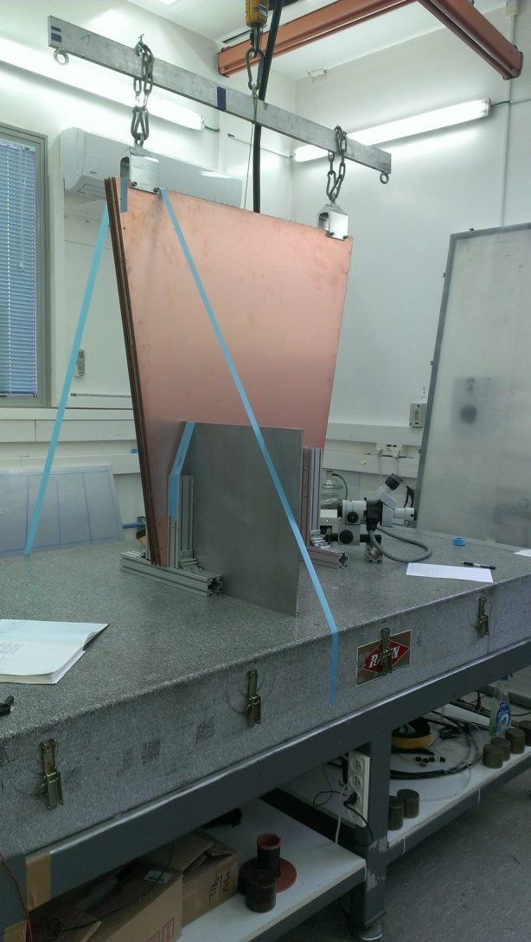
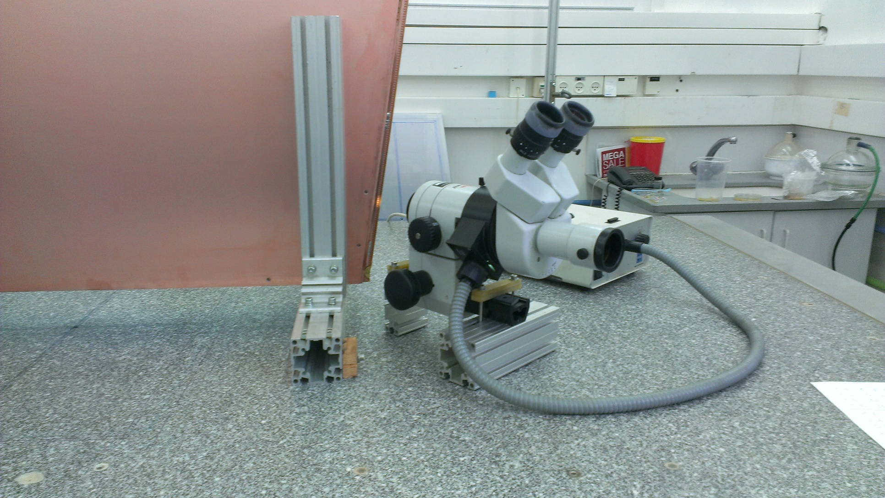
Flatness achieved for quadruplet, better than 50μm RMS, maximal deviation 250μm
Relative alignment between strip boards consistent within 10μm across detector with the wrongly produced boards (inserts and strips not machined in one go).

Slide 11
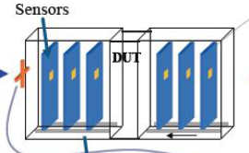
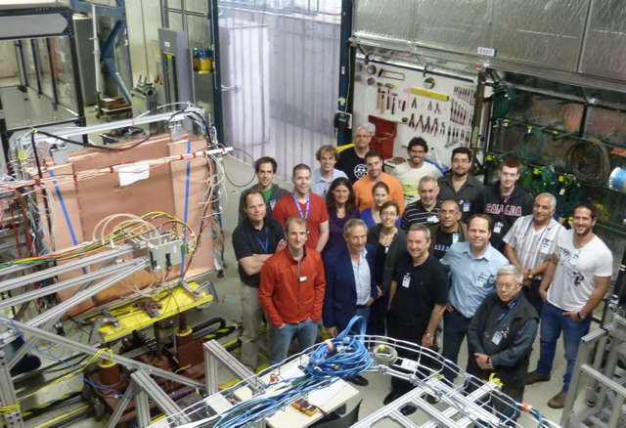
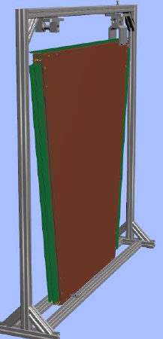
Test beam set-up
Sandwich the sTGC quadruplet prototype between 2 pixel telescopes (EUDET)

Slide 12
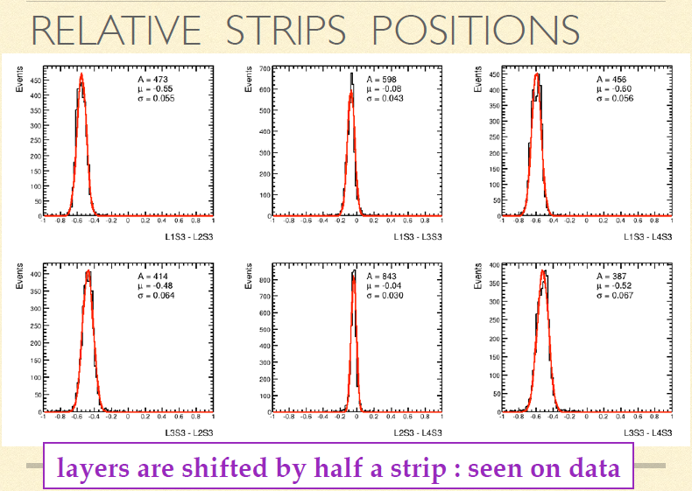
Relative shift between pairs of layers consistent with ½ strip

Slide 13
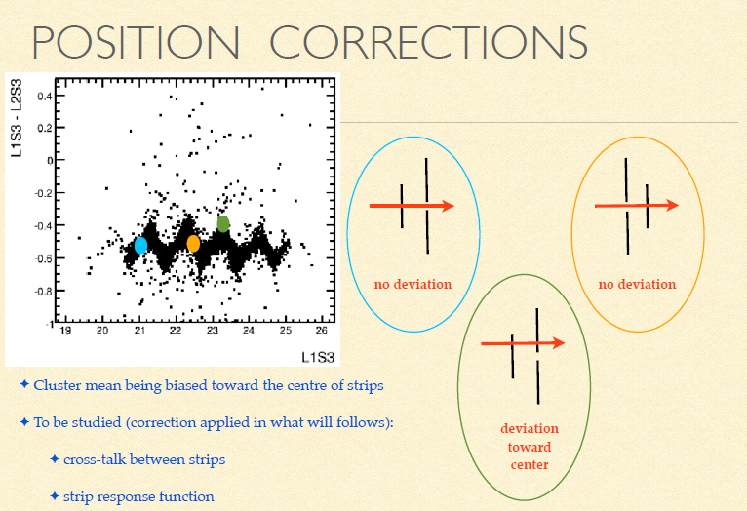
Relative bias of position due to final size strips, observed and corrected.

Slide 14
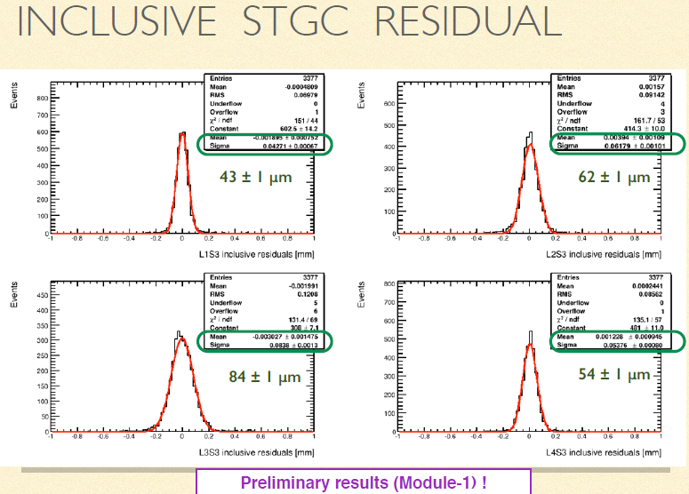
First preliminary results look good

Slide 15
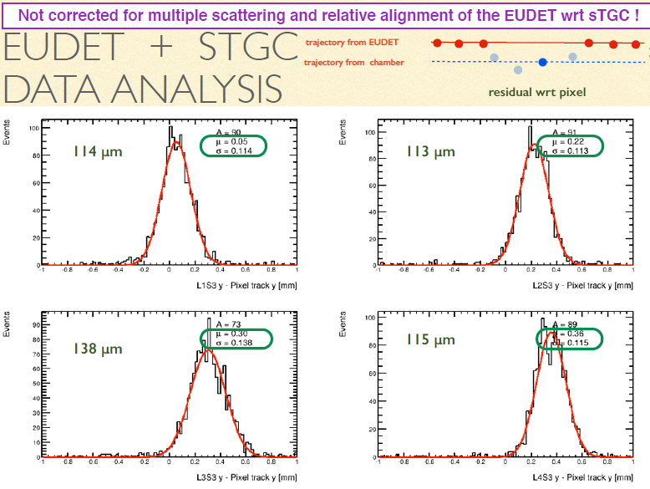
While using outside telescope not correcting for MS, gives worst resolutions, but consistent with needs

Slide 16
Conclusions
sTGC technology seems to be ripe for the production of the ATLAS New Small Wheel, and provides the needed performance.
Most of the manufacturing problems have been understood and corrected.
One should be able to move to the first mass production module, to be produced before the end of the year.

