Slide 1
Micromegas for the ATLAS muon system upgrade

Slide 2
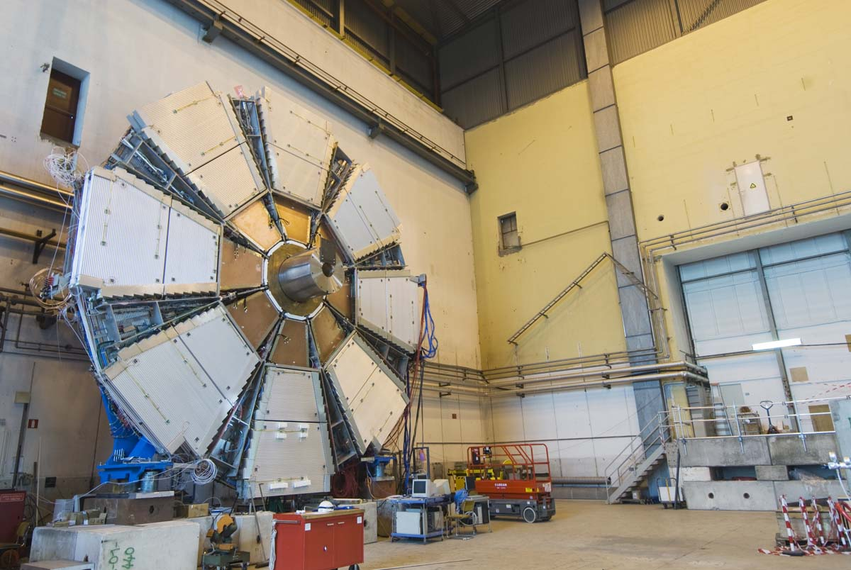
ATLAS Small Wheel upgrade project
Today:
MDT chambers (drift tubes) +
TGCs for 2nd coordinate (not visible)
Two New Small Wheels equipped with sTGCs and micromegas (MM) detectors, to be installed in LS2 (2018/19)
Redundant system where each technology combines precision and 2nd coord. measurement as well as trigger functionality
Eight active layers per detector technology, i.e., a total of 16 measurement points along tracks
Micromegas: 1300 m² detector area with readout strips with a pitch of 0.45 mm
  2M readout channels
2.4 m
CSC chambers

Slide 3
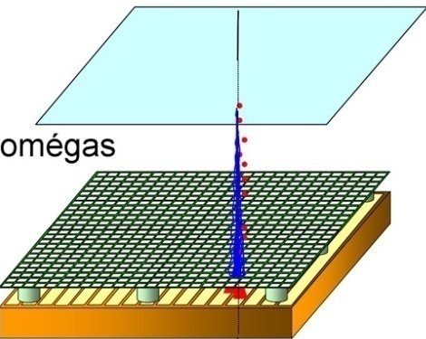
Micromegas operating principle
Micromegas (I. Giomataris et al., NIM A 376 (1996) 29) are parallel-plate chambers where the amplification takes place in a thin gap, separated from the conversion region by a fine metallic mesh
The thin amplification gap (short drift times and fast absorption of the positive ions) makes it particularly suited for high-rate applications
Weak point is the relative large spark rate
-800 V
Conversion & drift space
-550 V
(few mm)
Mesh
Amplification
Gap 128 µm
The principle of operation
of a micromegas chamber

Slide 4
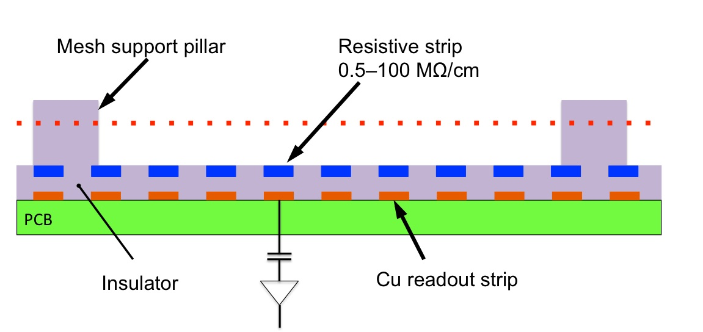
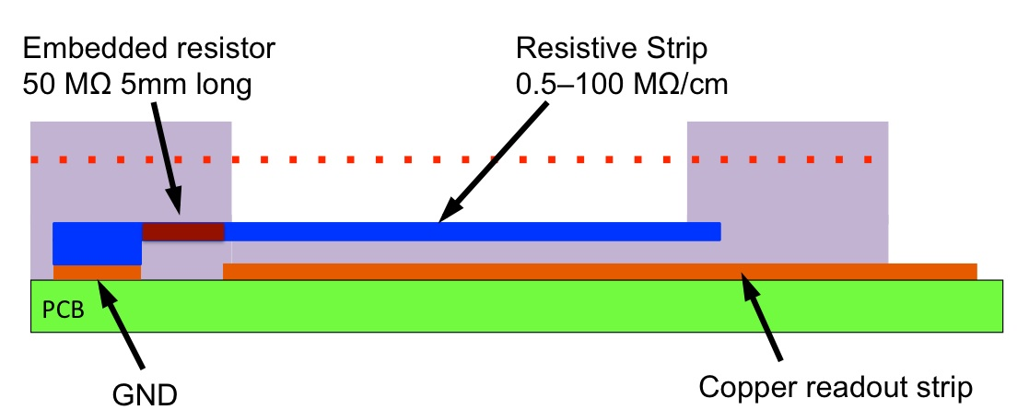
Micromegas for the ATLAS upgrade
Development to make MM spark-insensitive by adding a layer of resistive strips, separated by an insulating layer, above the readout strips (NIM A 640 (2011) 110–118)
Need of detectors of 2–3 m² area with excellent mechanical precision asked for an approach different from the ‘standard’ bulk micromegas concept
A spatial resolution ≤ 100 µm/layer independent of track impact angle has been achieved by exploiting the µTPC mode
The resistive-strip protection concept

Slide 5
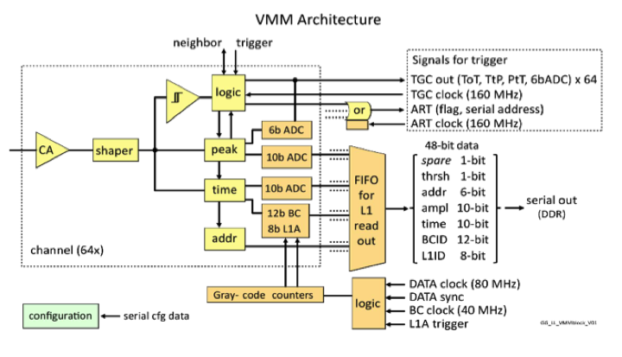
Custom readout chip for Micromegas (and sTGC)
To read out the 2M readout strips a new 64-channel digital chip (VMM) has been developed at BNL incorporating zero suppression and trigger functionality
VMM Design Parameters/Features
Dual Polarity
Adjustable Gain (0.5 – 9.0 mV/fC)
Adjustable peaking Time (25-200 ns)
Address in Real Time (Fast OR for Trigger)
Prompt digitized (6-bit) Amplitude, ToT, time-to-peak (TGC Trigger)
Peak Detector, Time Detector (<1 ns)
Discriminators with sub-hysteresis
Neighbour-enable logic (channel to channel and across Ics)
Sparse readout w/smart token passing,
Threshold trim, built-in calibration, channel mask, analog monitor, temp. sensor, 600 BGR, 600 mV LVDS

Slide 6
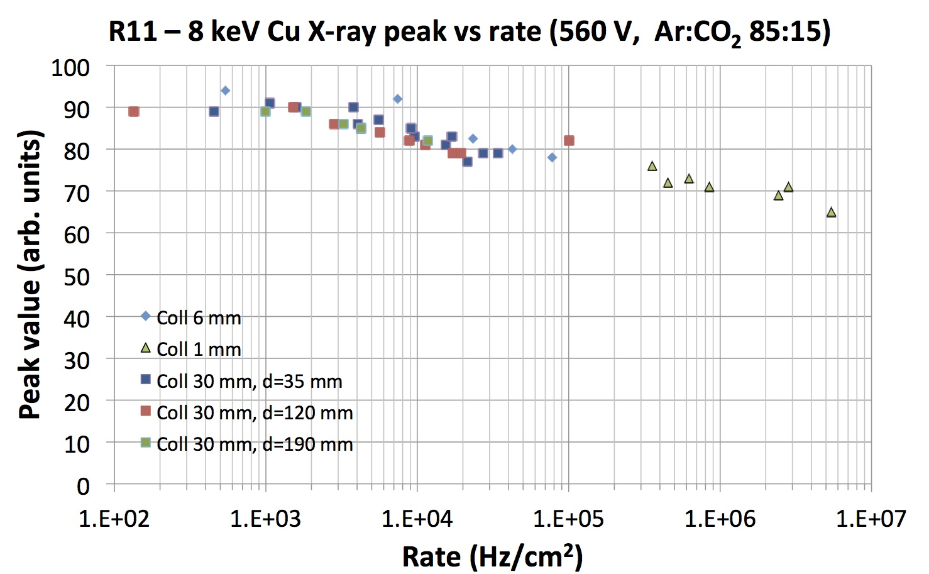
Rate capability of resistive-strip MMs
Rate capability has been extensively studied using Cu X-ray beams up to MHz/cm²
Small double-gap MM with resistive strips has been successfully operated during one year in front of the e/m calorimeter of ATLAS with rates up to 150 kHz/cm²
Rate in NSW at HL-LHC
Note: 8 keV ≈ 6–7 x MIP

Slide 7
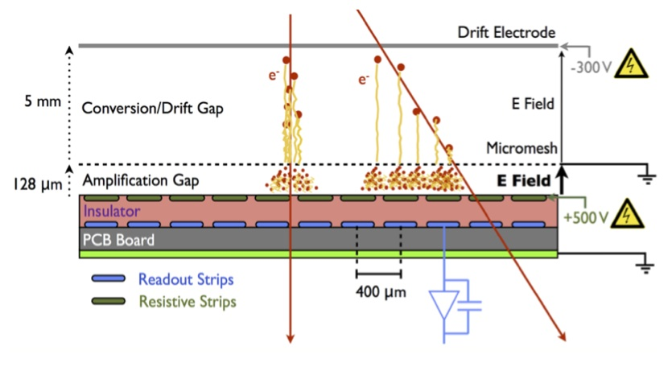
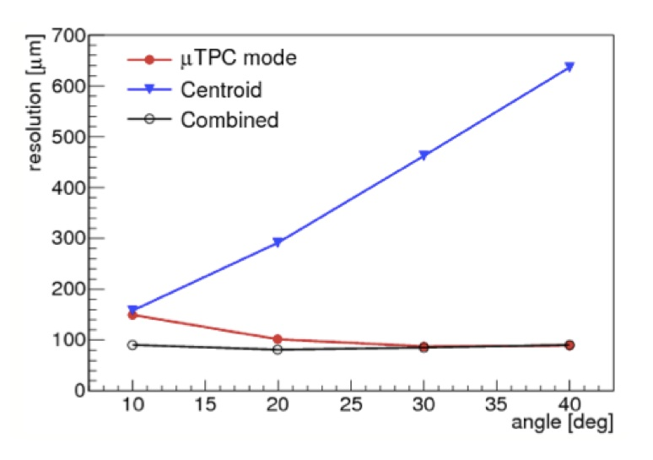
Micromegas as µTPC
Detector parameters
  Gas: Ar:CO₂ (93:7)
  Drift region: 5 mm; E=600 V/cm
  Amplification gap: 128 µm; E=40–50 kV/cm
  Drift velocity: ≈5 cm/µs (or 20 ns/mm); maximum drift time for the ionization electrons is 100 ns
By measuring the arrival time of the signals a MM functions like a TPC
  => Track vectors for inclined tracks
Combining cluster centroid and µTPC information yields a spatial resolution of ≈100 µm over a wide range of track impact angles
Range of track angles in NSW

Slide 8
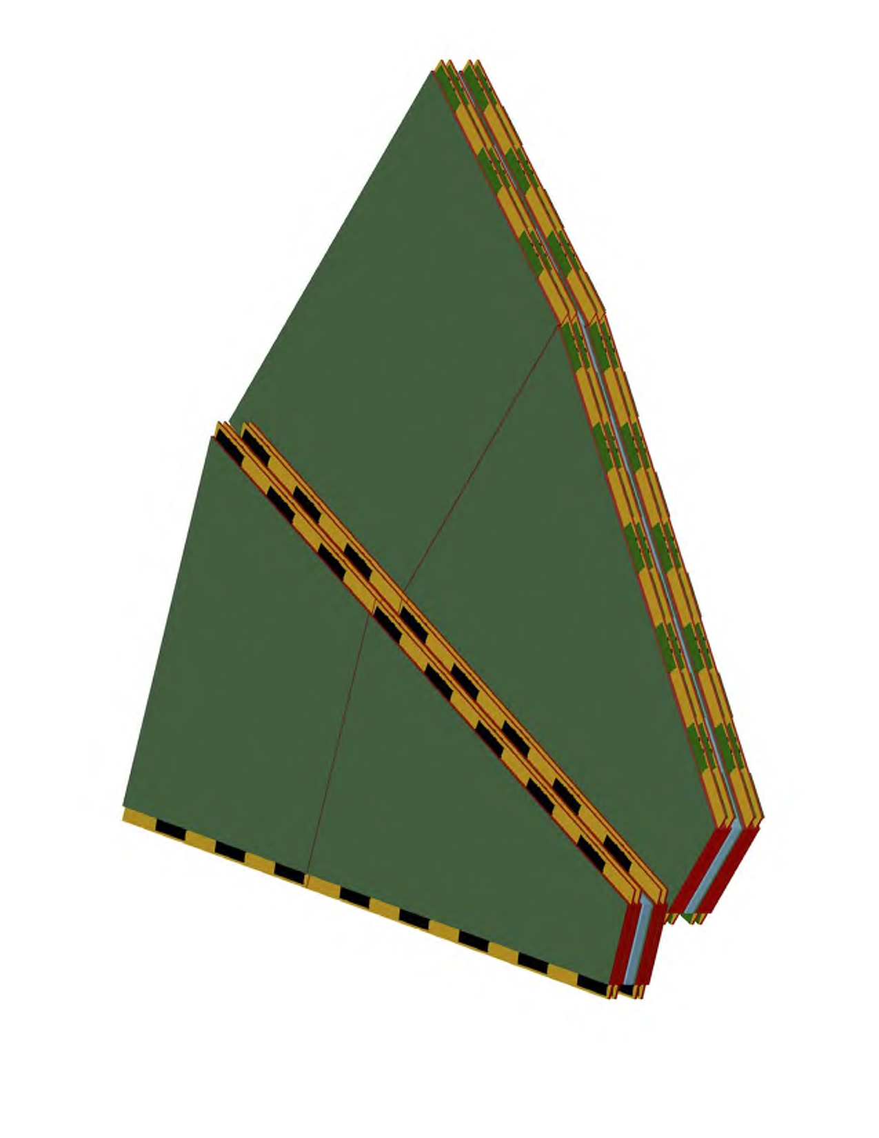
MM layout & dimensions
1.8 m
2.2 m
3.7 m

Slide 9
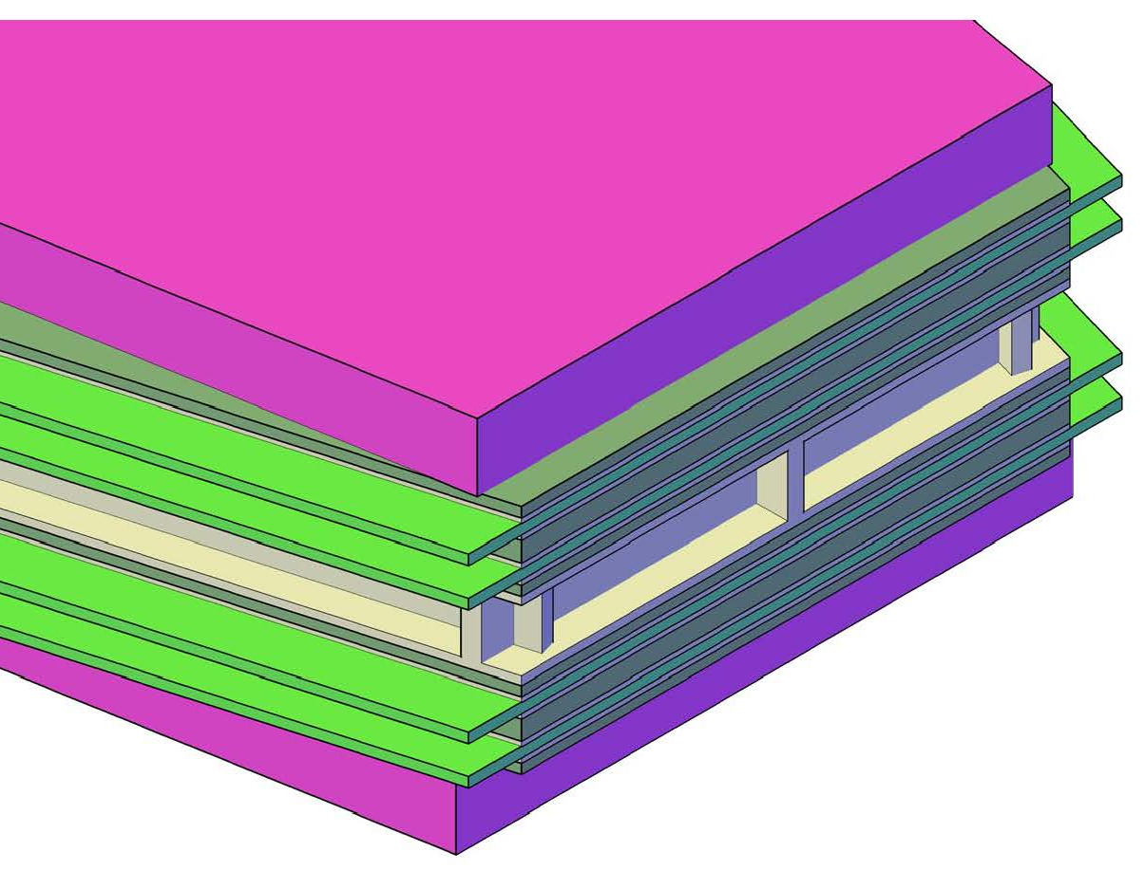
Arrangement of MMs (& sTGCs)
sTGC
MM quadruplets
Drift panel (10 mm)
Spacer (50 mm)
Double faced drift panel (10 mm)
Read-out panel (10 mm)

Slide 10
Arrangement of PCBs & electronics on MM readout panels
≈450 mm
60 x 215 mm²
≈450 mm
60 x 215 mm²
Stereo planes require slightly different routing of readout strips; same readout boards
and
Electronics boards
Size: 60 x 215 mm
8 VMM chips à 64 ch
Total: 512 ch/board
Straight (η) strips
Stereo strips
Zebra contact

Slide 11
Detector construction
Main features
Mesh is separate from readout board; glued to drift panel
Mesh is touching readout board pillars when the detector is closed
Detector panels are kept together by bolts around the circumference and a few interconnects across the detector area
Gas tightness is achieved by an O-ring
Detector is demountable
Stiffening panel
Stiffening panel
Stiffening panel
Stiffening panel

Slide 12
Status & timeline of project
Project approved by ATLAS & LHCC in fall 2013
30–40 institutes involved; MoU is being signed
Total financial volume ≈6 MCHF
  Detectors: ≈2.8 MCHF or ≈2000 CHF/m²
  Readout electronics: ≈2 MCHF (1 CHF/channel)
  HV/LV/gas/alignment (services): ≈1 MCHF
Detector construction in DE/FR/IT/GR+RU (+CERN/JP)
Electronics: US/GR/RO ++
Module-0s of all four module types expected by end 2014/beg 2015
Detector construction: mid 2015 – mid 2017
Assembly and installation: 2017 – 2018/19

Slide 13
Backup

Slide 14
Ageing
Radiation | Energy | Integrated charge | Result
Cu X-rays | 8 keV | 5 years HL-LHC equivalent | No evidence for ageing
Reactor neutrons | 5–10 meV | 10 years HL-LHC equivalent | No evidence for ageing
Gamma (⁶⁰Co) | 1.17 & 1.33 MeV | 10 years HL-LHC equivalent | No evidence for ageing
Alpha particles in gas | 5.64 MeV | 5 x 10⁸ sparks equivalent | No evidence for ageing
Extensive tests at CEA Saclay with two 10 x 10 cm² resistive MMs (one used as reference)
No significant difference between irradiated and non-irradiated detector observed
Plans: large-area exposure in GIF++

