Slide 1
RPC technology for HL-LHC
G. AIelli
Mini-workshop of PG4
CERN, 11/07/2014

Slide 2
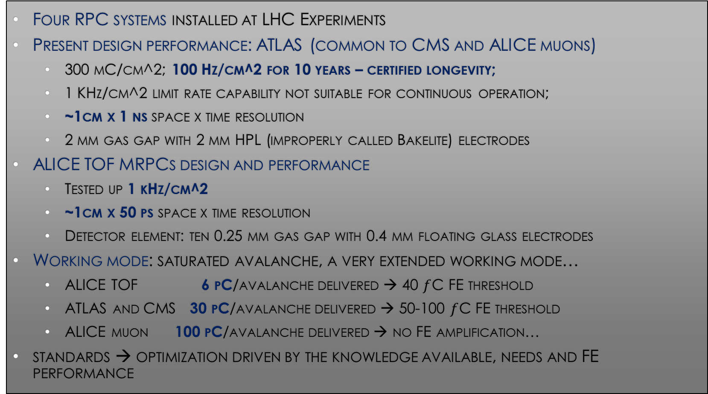
Classic RPC performance summary
LHC projects and tech frozen 15 years ago → huge improvements are now possible
Four RPC systems installed at LHC Experiments
Present design performance: ATLAS (common to CMS and ALICE muons)
  300 mC/cm^2; 100 Hz/cm^2 for 10 years – certified longevity;
  1 KHz/cm^2 limit rate capability not suitable for continuous operation;
  ~1cm x 1 ns space x time resolution
  2 mm gas gap with 2 mm HPL (improperly called Bakelite) electrodes
ALICE TOF MRPCs design and performance
  Tested up 1 kHz/cm^2
  ~1cm x 50 ps space x time resolution
  Detector element: ten 0.25 mm gas gap with 0.4 mm floating glass electrodes
Working mode: saturated avalanche, a very extended working mode…
  ALICE TOF 6 pC/avalanche delivered → 40 $f$C FE threshold
  ATLAS and CMS 30 pC/avalanche delivered → 50-100 $f$C FE threshold
  ALICE muon 100 pC/avalanche delivered → no FE amplification…
standards → optimization driven by the knowledge available, needs and FE performance

Slide 3
NEW generation RPC R&D framework
In the late ‘90 the LCH needs pushed toward RPC standardization which became a world reference
  “classic” (ALICE, Argo, ATLAS, BaBar, CMS, Opera, INO)
  “timing” (ALICE TOF)
The standard was founded on :
  common construction
  common qualification (GIF)
Success → RPC working well in many experiments
After about 15 years we started again a common effort to face the challenge of HL-LHC and other next coming experiments.
EOI in the AIDA 2020 program from ALICE+ATLAS+CMS
Industrial template for next generation RPCs
  scale up the “classic” RPC performance
  Define the new standard
Plan to revise all key features:
  The FE design
  Gap form factor,
  materials and construction
  The gas mixture
  Mechanical structure
CERN based collaboration proposal, RDxy
The RPC was born in Italy and now has passports in all the continents…
In order to strengthen the international collaboration among RPC groups an adequate instruments is an R&D collaboration (RDxy) at CERN following the model of those already made for LHC (RD5, RD51…)
This was endorsed in the recent RPC2014 conference at Tsinghua University (Beijing)

Slide 4
RPC R&D focus
Prompt multiplication in uniform field: gas target and amplification coincide
Resistive electrodes: spark free
  Advantages:
    space time localization of events
    wide range for Saturated avalanche 1pC → 100pC
    Easy to build in Large dimension and different shapes
  Limiting features:
    The fast signal is << then the total charge
    Statistical fluctuations →Wide charge spectrum
    Need of quenching and electronegative gases
    Need of highly resistive and smooth electrodes
R&D themes and initiatives
Form Factor: gap and electrode thickness and segmentation
  Thinner gas gap → better timing, position and lower charge
  Thinner electrodes → better S/N on the pickup and position
  Multi-gap → better efficiency timing and charge spectrum
High spatial resolution readout:
  Optimization of the form factor → higher fraction transferred
  New Gas studies:
  Replace Freon → environmental friendly
  Better mixtures → faster, lower working point
New FE concept:
  New design: Fast signals, sensitive and low capacitance noise
  Si-Ge technology: extremely low noise and high speed
E₀
d₁
E₀
g
E
d₂

Slide 5
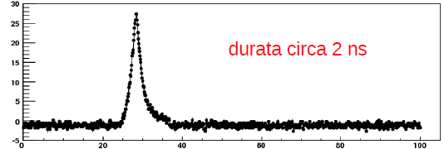
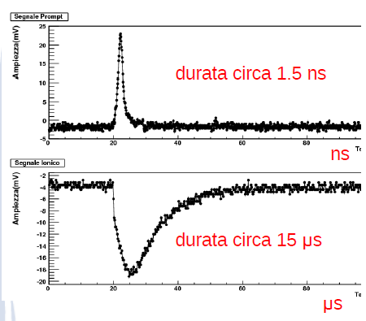
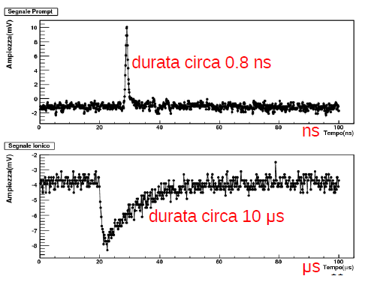
Toward thinner gas gaps
New design + new Si-Ge
(0,1 pC)
Amplitude (mV)
2mm
Duration about 3 nsec
Time (nsec)
Amplitude (mV)
1mm
Duration about 1.7 nsec
ATLAS FE
New design FE
Time (nsec)
Amplitude (mV)
0,5mm
Duration about 1.0 nsec
Thinner gas gap
  → higher E field → higher charge density
  → same saturation with less charge
  → less total charge, faster avalanche
Time (nsec)

Slide 6
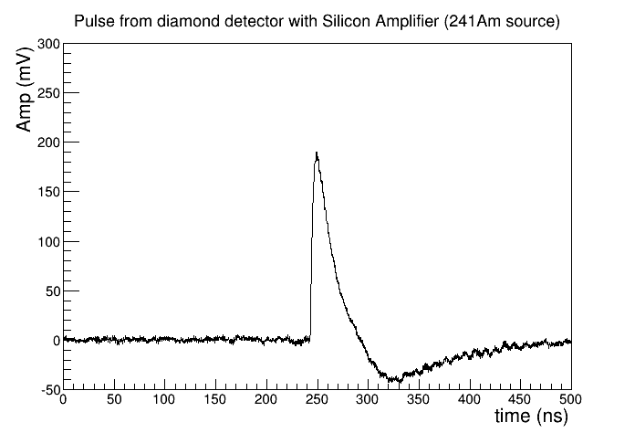
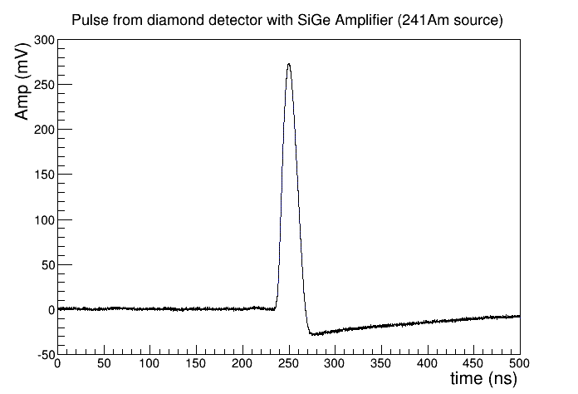
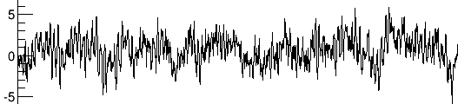
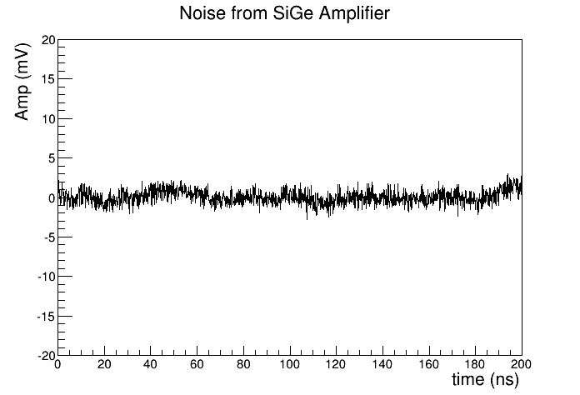
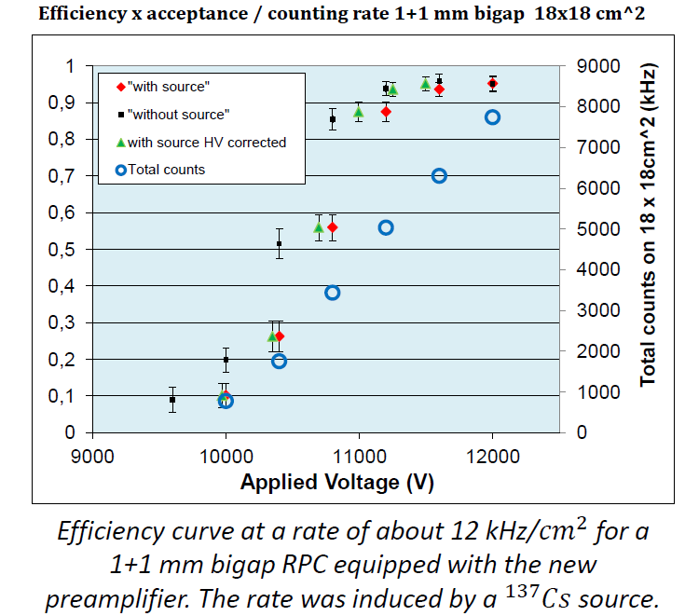

NEW RPC developments → high performance FE
Silicon amplifier
SiGe amplifier
Total charge vs HVeff with working point highlighted. In red: ATLAS FE. In blue: new BJT Si FE
FEATURE | Si transistor | SiGe transistor
Voltage supply | 3-5 V | 2-3
Sensitivity | 2-4 mV/fC | 2-6 mv/fc
Noise (up to 20 pF input capacitance) | 1500 e⁻ RMS | 200 e⁻ RMS (matched transmission line)
Input impedance | 100-50 Ohm | 50-200 Ohm
B.W. | 10-100 MHz | 30-300 MHz
Power consumption | 10 mW/ch | 2 mW/ch
Rise time input | 300 – 600 ps | 100-300 ps
Radiation hardness | 1 Mrad, 10¹³ n cm⁻² | 50 Mrad, 1015 n/cm2 (1)
(1) M. Ullan et al. Radiation hardness evaluation of GiGe Technologies for the front end electronics of the ATLAS upgrade; NIM-A 579 (828) 2007
New design prototype by R. Cardarelli →4000 rms $e$⁻ noise →
New Technology → SiGe ultra low noise 200 RMS Electorns

Slide 7
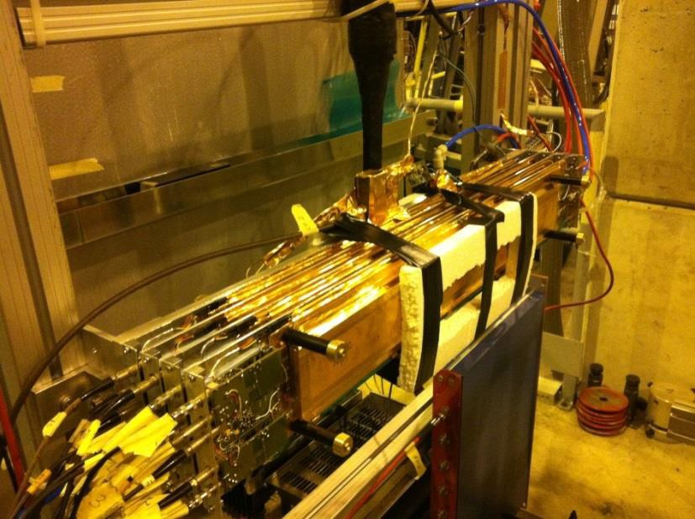
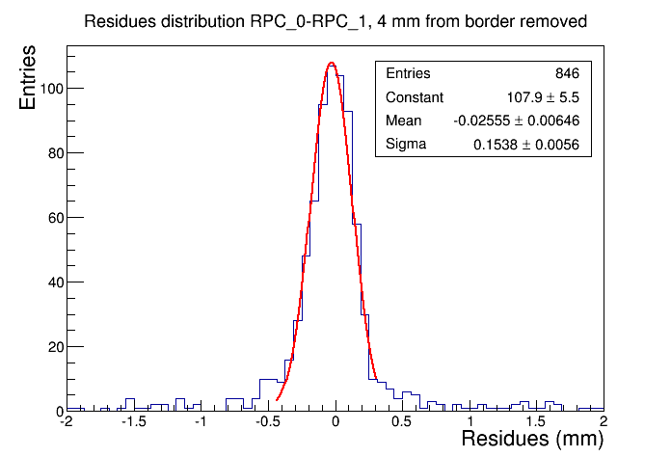
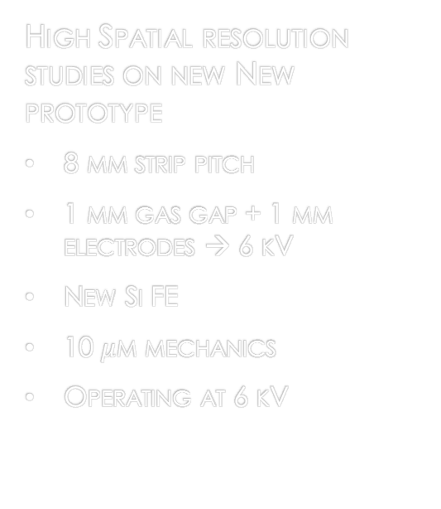

ATLAS specific R&D for PHASE2
Old chambers enhancement → See WG1 slides
improve the space resolution at ~ mm through TOT with the new readout (R&D ongoing)→ WG3 slides
New chamber performance → a new rpc standard is needed
1 KHz/cm^2 expected Rate → certification for 2 KHz/cm^2 | < 0.1 mm space resolution
Space very limited for self supporting chambers (structural) | < 0.4 ns time resolution
High Spatial resolution studies on new New prototype
8 mm strip pitch
1 mm gas gap + 1 mm electrodes → 6 kV
New Si FE
10 $μ$m mechanics
Operating at 6 kV
Working principle:
The physic signal is very localized
Centroid method using large strips
  Works if the FE S/N is sufficient
  Strip pitch to be optimized
Very good sensitivity and S/N is necessary
Time of flight between two identical RPCs resolution = 0.15/$\sqrt{2}$ ~0.1 mm

Slide 8
The Physical model

Slide 9
new gas mix studies
The European Community has prohibited the production and use of gas mixtures with Global Warming Power > 150 (GWP(CO₂) = 1)
  This is valid mainly for industrial (refrigerator plants) applications
  Scientific laboratories would be excluded
  CERN could require to stick to these rules anyhow
C₂H₂F₄ and SF₆ Crucial to ensure a stable working point in avalanche
  GWP(C₂H₂F₄) = 1430, GWP(SF₆) = 23900, GWP(iC₄H₁₀) = 3.3
  We based on the physical and chemical properties of this components to:
  Design FE electronics and chambers
  Study performance, ageing and calibration tests
  C3H2F4 – tetrafluoropropene (GWP=4)
Early tests have showh excellent properties for this gas
We can exploit this opportunity for a major progress in the gas mix performance, being helped by the new FE electronics
a promising candidate
being investigated
(the most similar to C2H2F4)

Slide 10
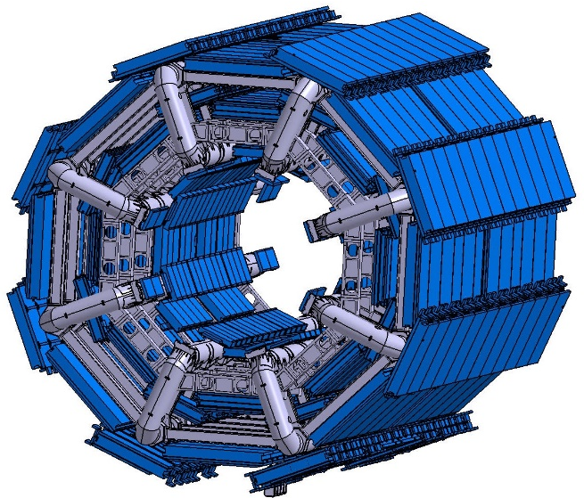
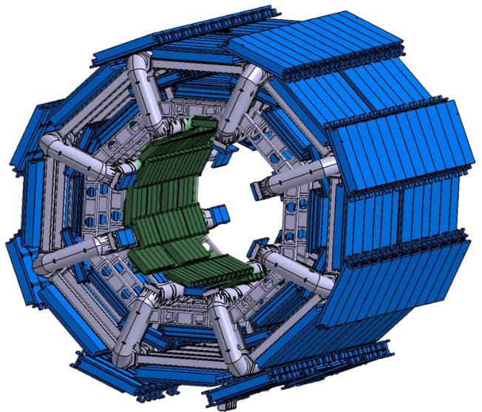
ATLAS RPCs for HL-LHC runs
Present System and needed enhancements
System conceived in the early nineties as a fast, robust and simple device
  Only 2 stations → Limited redundancy: 3/4 majority on low pT
  Certified at 100 Hz/cm^2 for 10 years (including safety factor)
Increase redundancy with high performance RPCs in the inner region
Would solve all the issues
Foreseen in the original ATLAS proposal but down-scoped in 1997 TDR
Performance requirements in the LOI for Phase 2:
  A new trigger scheme → higher selectivity for LVL1
    An pT higher selectivity not achievable with the present trigger design
  preserve longevity of the old detectors → robust LVL0
    Expected 300 Hz/cm^2 → 3 times more than the design safety factor:
    Switch to 2/4 majority →a much easier working point → a factor of 3 lower current
    Improve the poor acceptance in the barrel is (73%) due to the barrel toroid ì
Minimal Good track Today
Good track
in new scheme
2 stations
6 layers
3 stations
9 layers

Slide 11
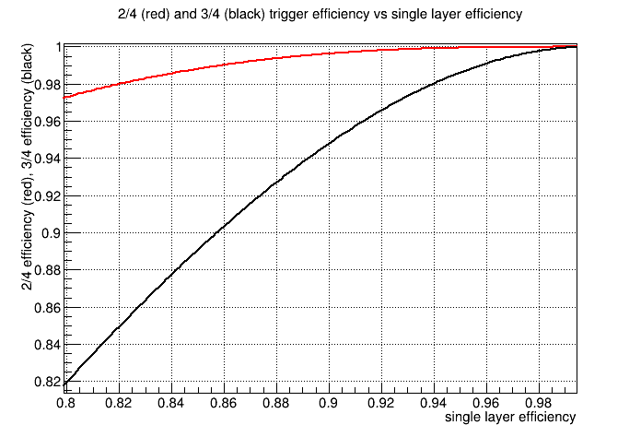
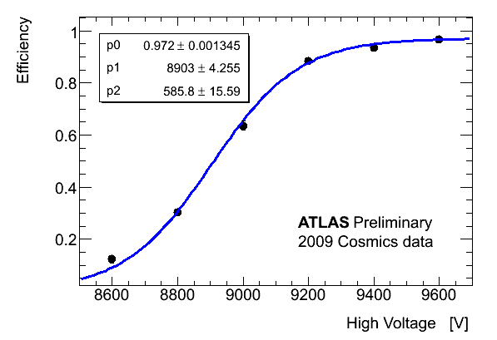
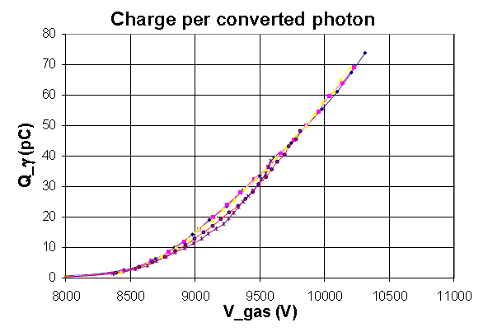
If we increase the detector redundancy
The BM station can be used with a 2/4 majority instead of the 3/4 allowing a consistent reduction of gap efficiency without affecting the trigger efficiency
This results in a fundamental detector protection, which is equivalent to work at a corresponding lower rate by a factor proportional to the current drop. Apparently it is possible to achieve easily a factor of 3
By lowering the voltage we compensate the excess of rate → constant current
2/4 vs. 3/4 majority

Slide 12
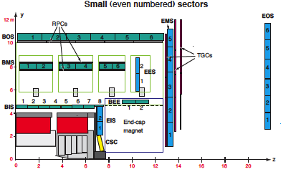
The barrel acceptance
Acceptance holes of L1 barrel trigger
- feet + elevators (partially cured…)
toroid (and ribs) holes in small sectors
BM chambers
2012 data
eta=0.0
0.4
0.75
1.0
2012 data

Slide 13
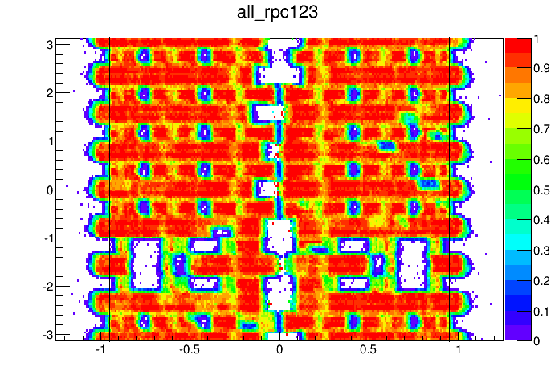
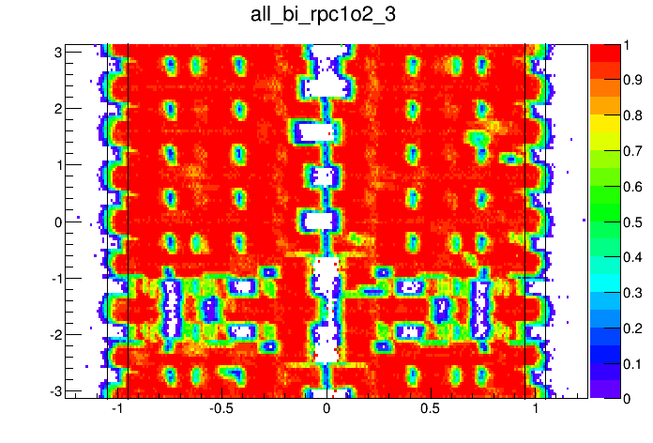
Increasing the trigger acceptance
The additional redundancy can also be used to increase the acceptance since the Inner layer is upstream of the barrel toroid structures
Single muon simulation
- looking at hits in reconstructed muons
One of the Possible phase-II triggers:
BI && (rpc1||rpc2) && rpc3
Present high-pt trigger simulation, hits on
rpc1 && rpc2 && rpc3
acceptance increase x1.12
72% -> 81%
RPC1
BI

Slide 14
Further trigger scheme flexibility
Requirement | rpc1 && rpc2 && rpc3 | BI && (rpc1||rpc2) && rpc3 | any 3 out of 4 layers | (any 3 out of 4) || (inner&&outer)
Acceptance wrt muid | 73% | 82% | 88% | 96%
Flexibility of the trigger scheme

Slide 15
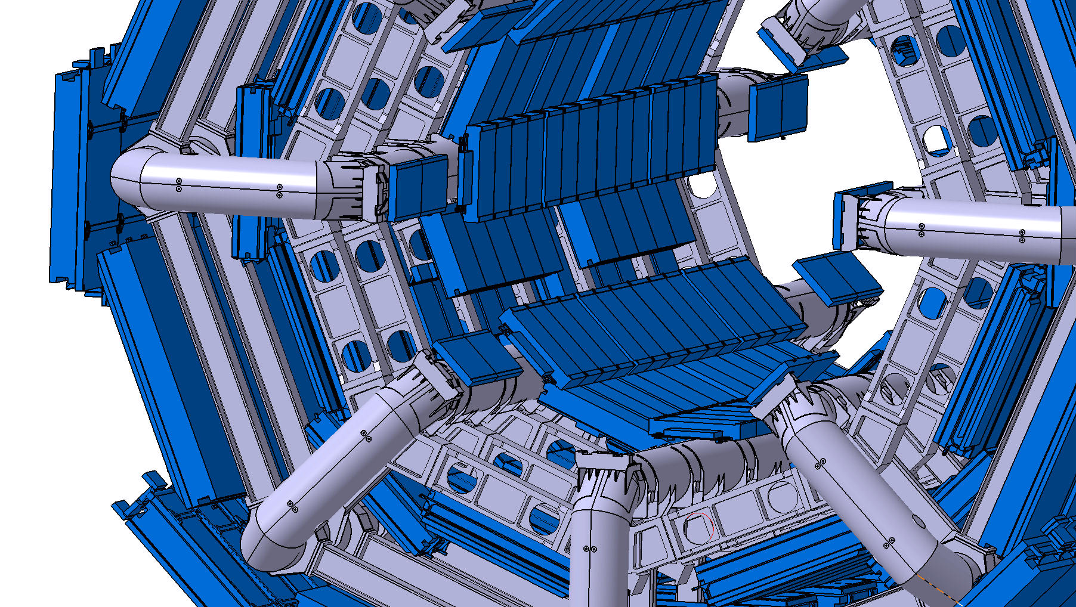

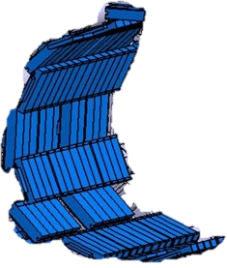
The BIS 78 project
The BIS extreme chambers (BIS7-8) represent less than 10% of the total BI coverage

Slide 16
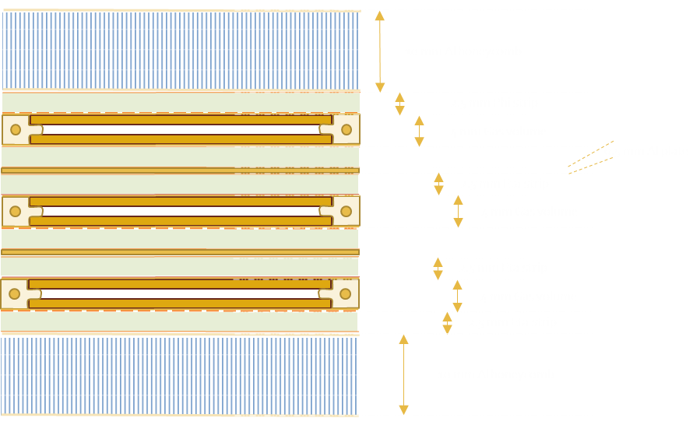
Layout
Compact Layout 48 mm
1 mm gas gap
1,2 mm electrodes
32 Triplets
Total area 150 m^2
Total channels 7000

Slide 17
Conclusions
A major breakthrough in the FE electronics is opening big possibilities for a new life for the rpcs
The new degrees of freedom ensured by the S/N and sensitivity are being used to design new rpc detectors with much higher capacities
keeping the usual advantages of low cost, large area and high time resolution
Adding high rate capability and high spatial resolution
HL-LHC is demanding more performance in a high rate – high pileup environment
Several application as fast muon chamber, large area TOF and tracking calorimetry

