Slide 1


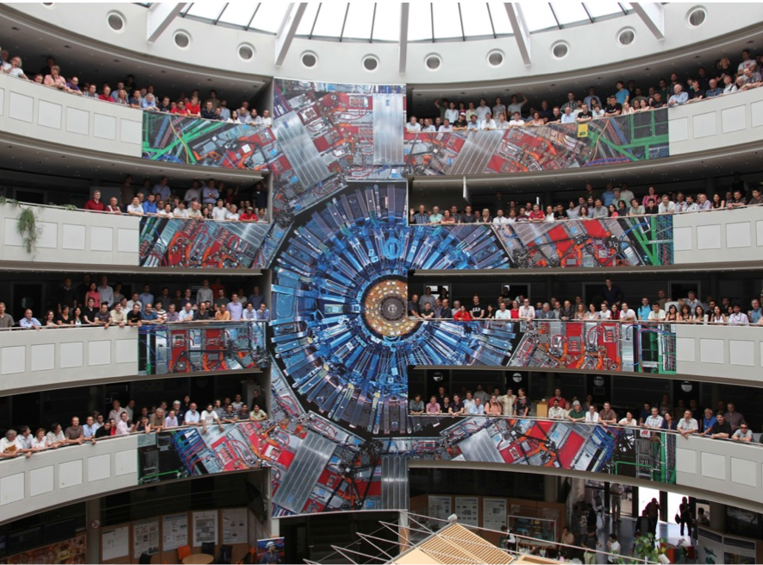


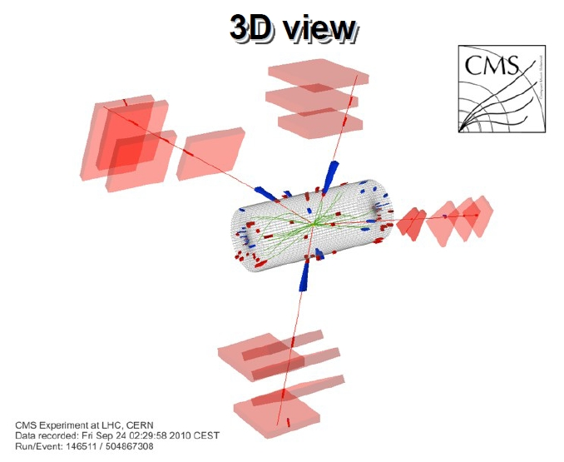
Brief info about the HL-LHC
ECFA workshop
M. Abbrescia
PG4 mini-workshop - July 11th, 2014

Slide 2

ECFA HL-LHC Workshop for 21st to 23rd October
October 2013 ECFA HL-LHC Experiments Workshop at Aix-les-Bains link at http://indico.cern.ch/conferenceDisplay.py?confId=252045
The report from this to ECFA can be found at https://cds.cern.ch/record/1631032
In 2014 will return to Aix (but now 20 Mb optical fibre installed for WiFi)
First 2014 SG meeting 27/3/14 at https://indico.cern.ch/event/309620/
Steering Group confirmed PG names last week and poster agreed with link to be at http://indico.cern.ch/event/315626/
All relevant material from last year can be found at http://indico.cern.ch/category/4840/

Slide 3
ECFA HL-LHC 2014: Possible Schedule
Opening |  | 30’
Accelerator Update | Current status and plans; injectors and LHC upgrades | 60’
Experiment Requirements | Motivation for R&D topics | 80’
PG1: Physics theory, Physics experiment, performance | Old PG1 (Physics goals and performance reach), plus theory talks | 180’
R&D sessions
PG2: Solid state tracking detectors | Old PG2 (tracker)+HGCAL | 120’
PG3: Scintillating devices | Old PG3 (calorimeter)+Tracking (LHCb) | 60’
Liquid noble gas | Invited talk | 30’
Large area fast timing detectors | Invited talk | 30’
PG4: Gaseous detector systems ( incl micro-pattern) | Old PG4 (muons)+TPC+CAL | 90’
PG5: Electronics systems ASIC - HDI - HBW links - Powering Scheme - Power Supply - Modular electronics & xTCA | Old PG6 (electronics) | 150’
PG6: Mechanics and Cooling | New session area | 60’
PG7: Trigger, Online and Offline Computing | Old PG5 (trigger/DAQ/Offline/Computing) | 120’
PG8: Accelerator and experiment interface, activation and mitigation | Old PG7 (LS and activation) and PG8 (accelerator experiment interface) | 90’
Conclusion (1 talk) |  | 30’

Slide 4
Preparatory Groups: Charge
The workshop is organized with only plenary sessions dedicated to each of the areas outlined above
The preparatory groups are charged to identify the key topics to be discussed and to organize their corresponding session at the workshop. In conjunction with program of other groups (avoid overlaps)
They will propose the detailed agenda within that session and propose speakers to the workshop Steering Committee
Chairs of the PGs will write a document of few pages summarizing the main outcomes of the workshop and proposing further steps on each topic
See 2013 charge at: http://indico.cern.ch/event/250557/material/0/1.pdf

Slide 5
Preparatory Groups: Modus Operandi
The chairs of PGs compile mailing lists of all those willing to contribute and organise dedicated meetings and/or mini-workshops advertised within the HL-LHC community to fulfil the objectives outlined above.
A common TWIKI page should be used to collect and circulate information and progress of each group as last time
(see https://twiki.cern.ch/twiki/bin/view/ECFA/ECFAHiLumiLHC)
The meetings of the groups should normally be fully open, although a mechanism to review talks and discuss material still being approved for release should be organised by the relevant PG chairs
Preparatory Group #4:
Gaseous detector systems (incl. micro pattern detectors)
  ALICE: Christian Lippman, Pascal Dupieux
  ATLAS: Oliver Kortner, Paolo Iengo
  CMS: Marcello Abbrescia, Archana Sharma
  LHCb: Alessandro Cardini

Slide 6
Summarizing:
The second edition of the HL-LHC workshop is more focussed on progresses on R&D on specific detector areas
Enphasys is put on getting contributions and feedback from the widest audience possible
We have set-up this preparatory mini-workshop:
  Contributions from the four LHC experiments
  First ideas on the material available
  First ideas on people willing to contribute
Note: contributions to this mini-workshop are ordered by experiments, talks at ECFA HL-LHC workshop will be across the four experiments (and most probably by detector technology)
RPC Upgrade, 17 June. 2014, pg. 2

Slide 7
