Slide 1
The LHCb GEM Upgrade
Gianni Bencivenni, Alessandro Cardini, Violetta Cogoni, Danilo Domenici, Davide Pinci, Marco Poli-Lener
INFN Cagliari and INFN Frascati

Slide 2
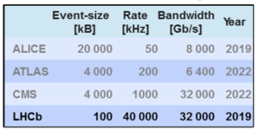
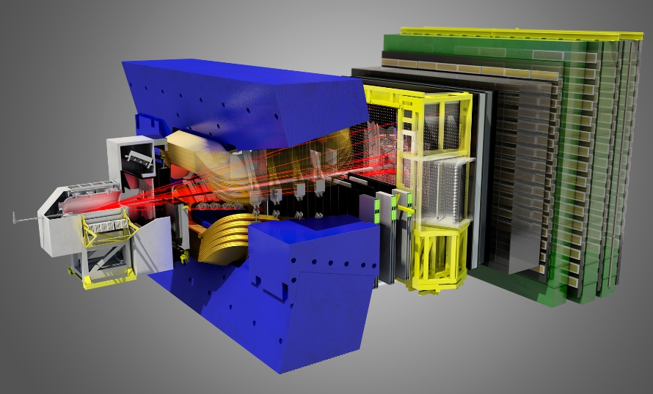
Why the upgrade
LHCb will be operating at an instantaneous luminosity of 2.10³³/cm²/s after LS2
To increase the physics potential (i.e. acquire more useful data) LHCb is going to a fully software trigger solution
  Take data at 40 MHz: new FEE, new DAQ
  Process all data through the High Level Trigger (HLT) (100 kB events at 40 MHz ➔ 32 TB/s)
  Record 20-100 kHz to disk
Challenges
  High pile-up
  High occupancies
    event reconstruction is more difficult
    more difficult PID
  Increased radiation damage
Tracker
VELO
Muon
RICHs
Calorimeter

Slide 3
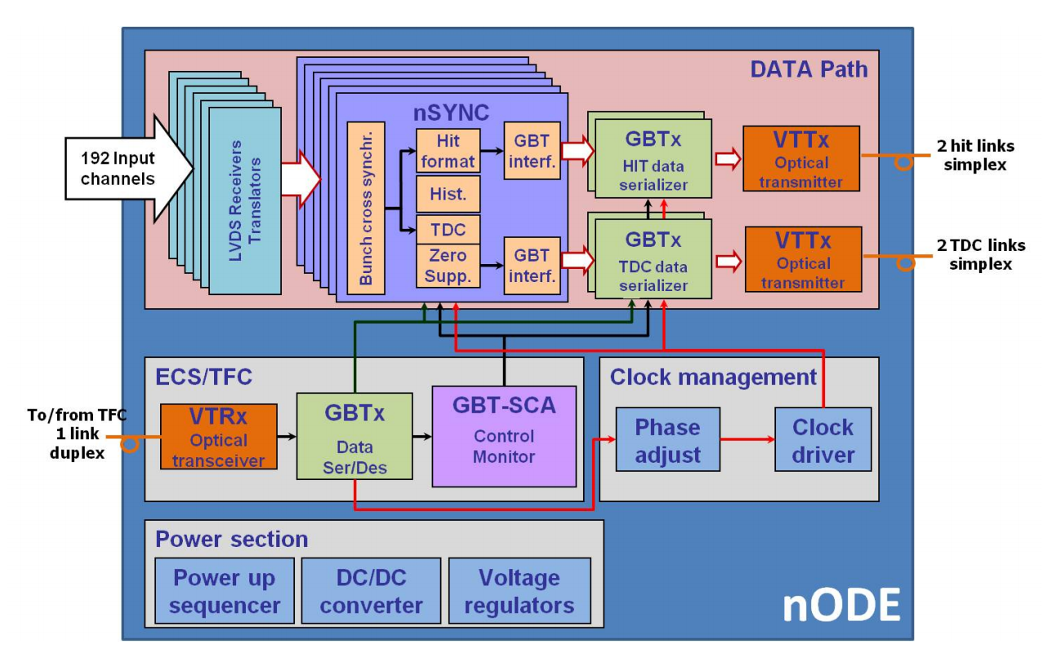
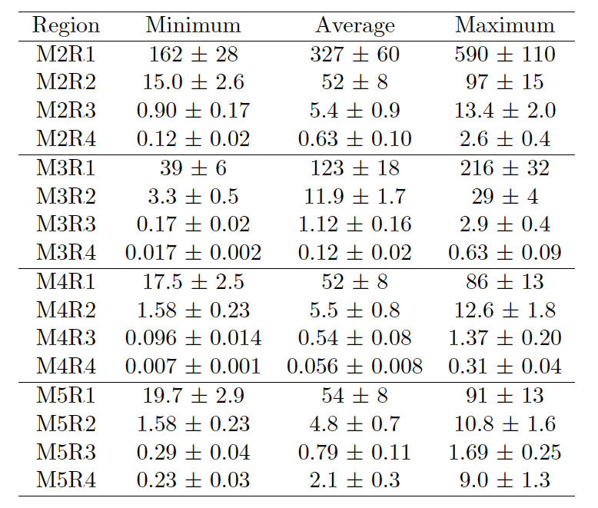
The Muon System Upgrade
Make the muon system compatible with the 40 MHz readout
  Replace the off-detector electronics with new 40 MHz-capable boards
  Redesign the electronics control to use GBT
Performance losses @ HL due to increase rate on detectors
  System designed for efficiency (4 gaps in OR)
    ➔ too large analog dead time (uncorrelated hits) in FE @ HL
  R/O savings
    too large occupancies in R/O @ HL ➔ large digital dead-time
    not all detector has a pad-based design, R/O X and Y strips and cross them ➔ many ghosts @HL
Upgrade of M2R1 and M3R1 MWPCs with double-gap Triple-GEM detectors with pad readout
Rates at 2.10³³/cm²/s (from PID Upgrade TDR)

Slide 4
M23R1 Upgrade
Rates as high as 600 MHz/cm² in M2R1 and 200 kHz/cm² in M3R1
Triple-GEM detectors already successfully in use in LHCb to equip region M1R1 (similar rates as above)
  Developed fast gas mixture Ar:CO₂:CF₄ 45:15:40
  Tested radiation capabilities (up to 2.2 C/cm², M. Alfonsi et al., IEEE TRANS. NUCL. SCIENCE, vol. 52 (2005)
  Designed dedicated FEE
What did we learn in RUN1
  Triple-GEM can operate in hadron-collider environment
  Neutron background can be an issue ➔ increased sparking rate ➔ carefully tune working point (possible with our HV PS system)
We believe that this technology is the one to be used for M23R1 upgrade

Slide 5
New Assembly Scheme
We plan to follow a detector design similar to what Rui developed for CMS ➔ embedded GEM foil stretcher
Many advantages!
  No gluing, no soldering during the assembly procedure
  No special tooling required
  The detector does not need spacers in the active area
  Assembly is very fast and easy (~ 1/day with 2 people crew)
  If needed, the detector can be re-opened for modifications or repairs,(or to replace a GEM foil)

Slide 6
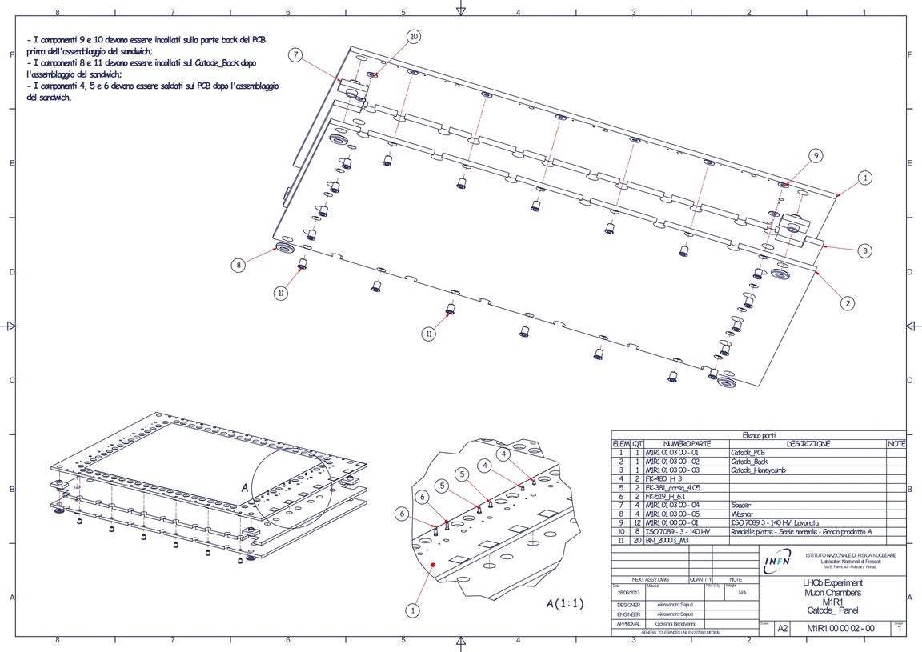
Cathode panel

Slide 7
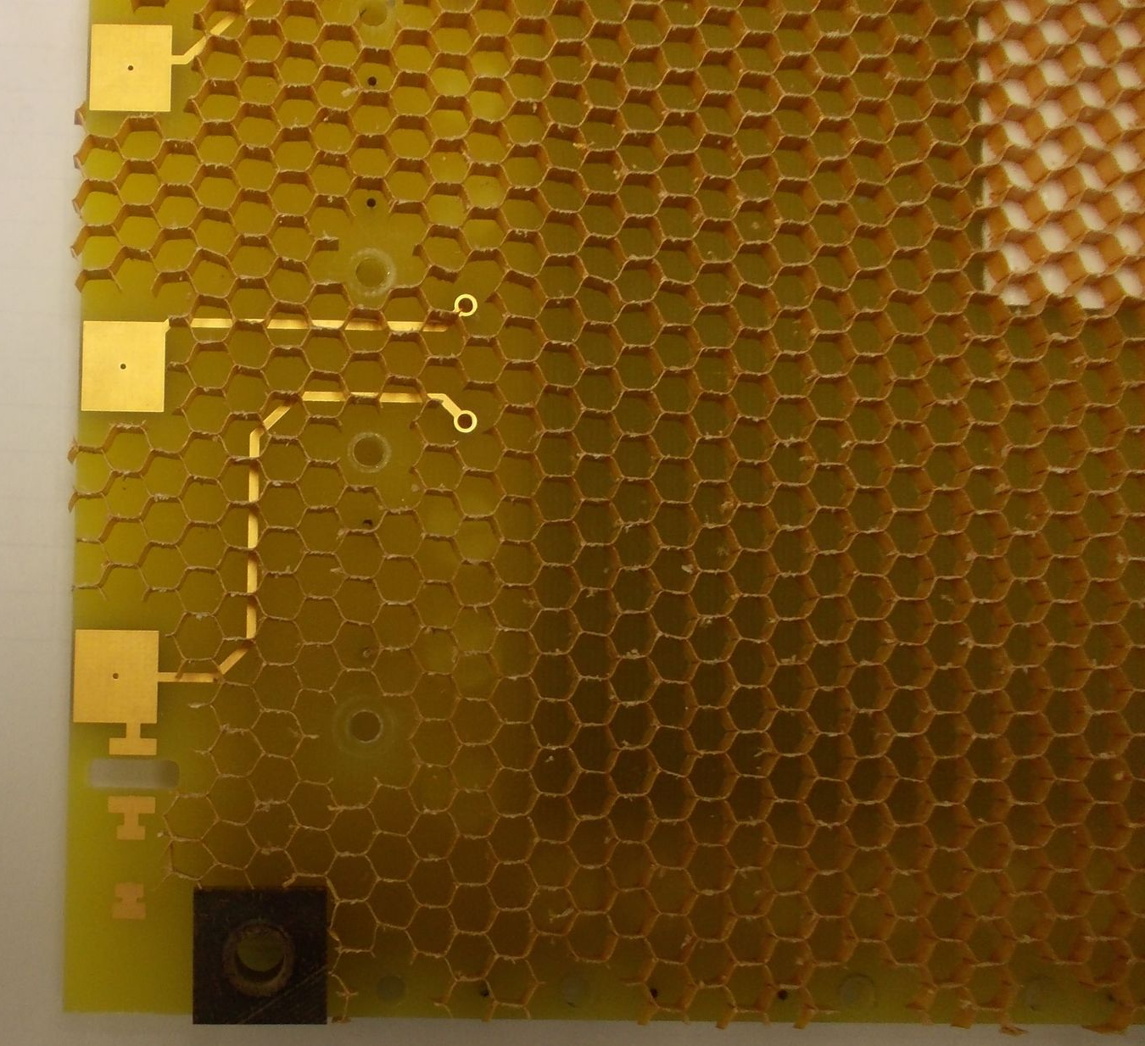
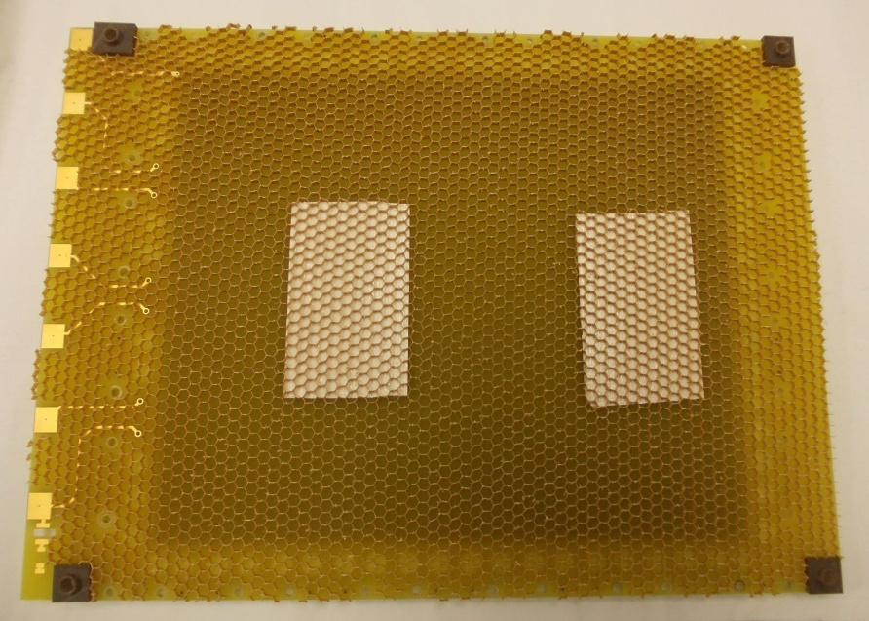
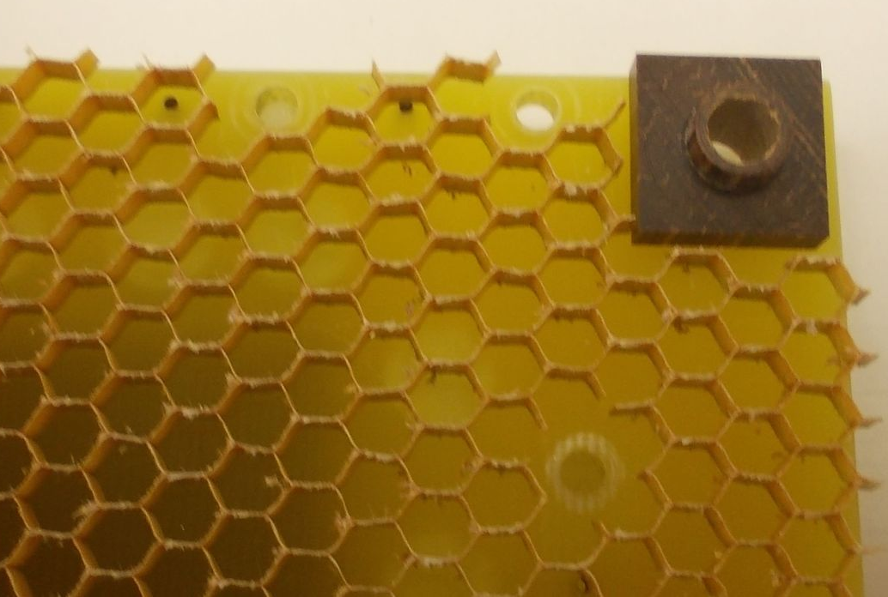
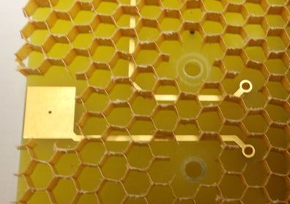
Places for washer
Angle spacer
Places for washer
Places for-pins
HV

Slide 8
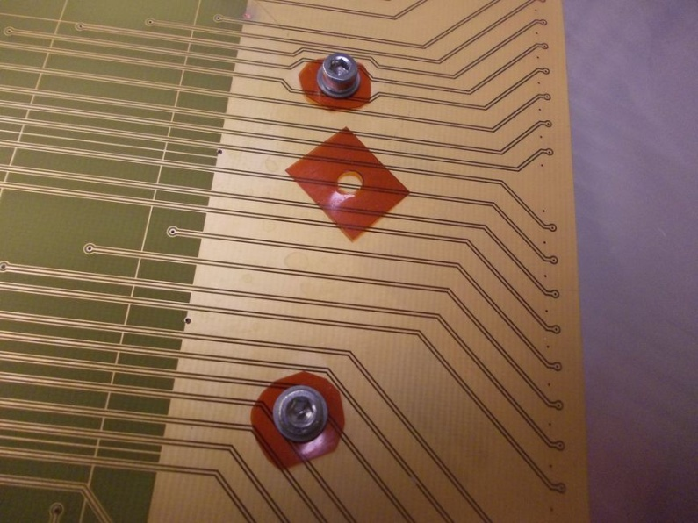
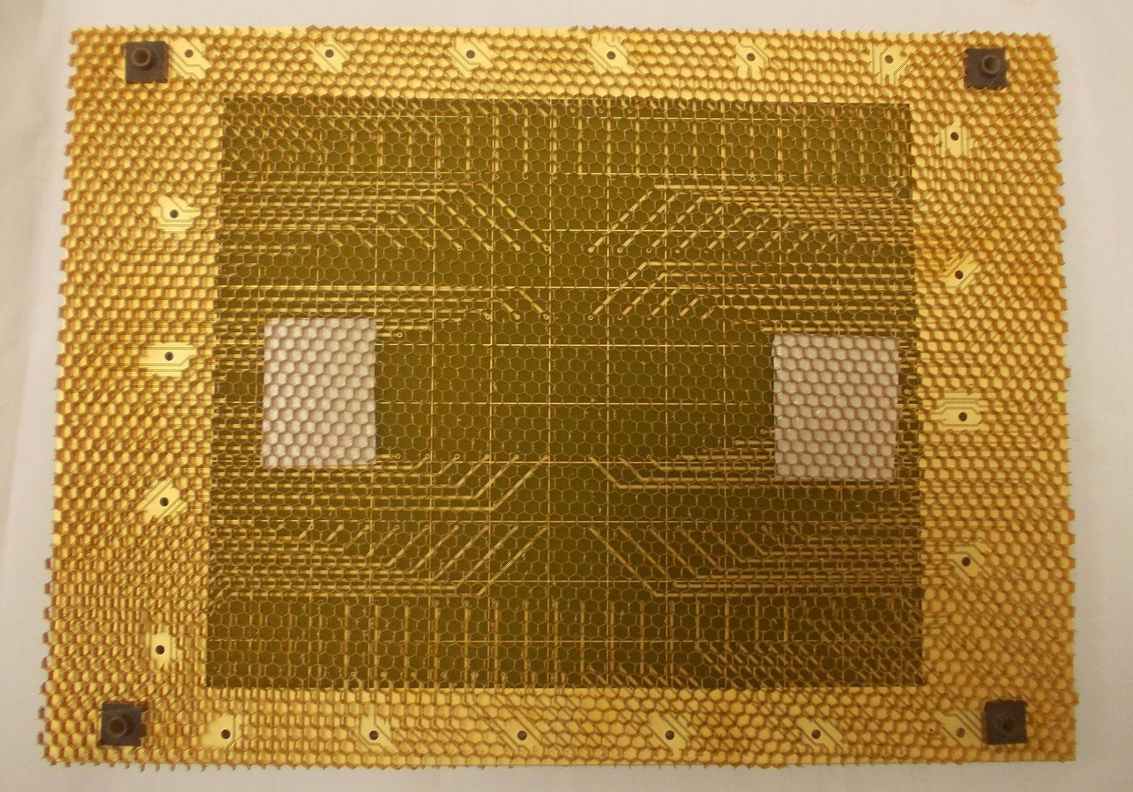
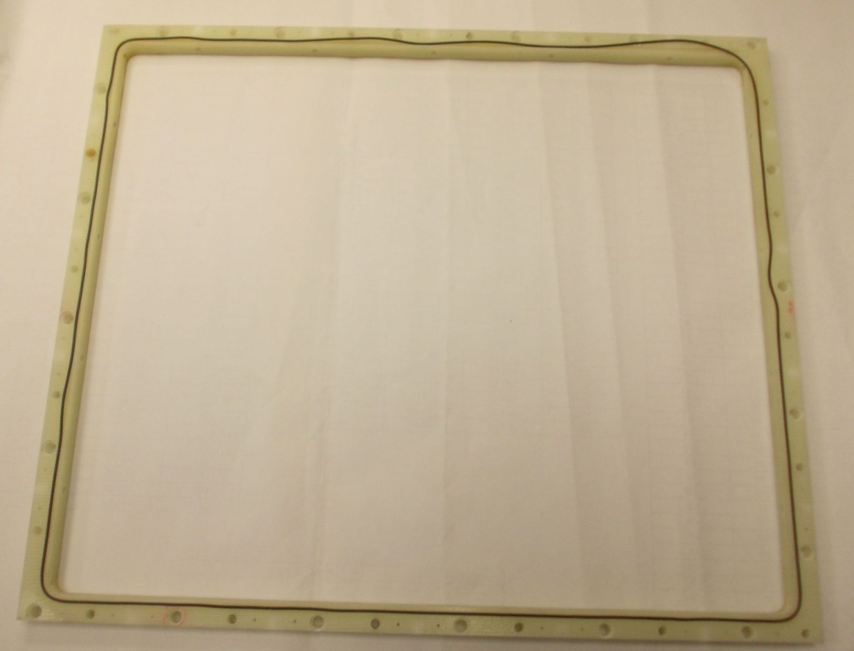
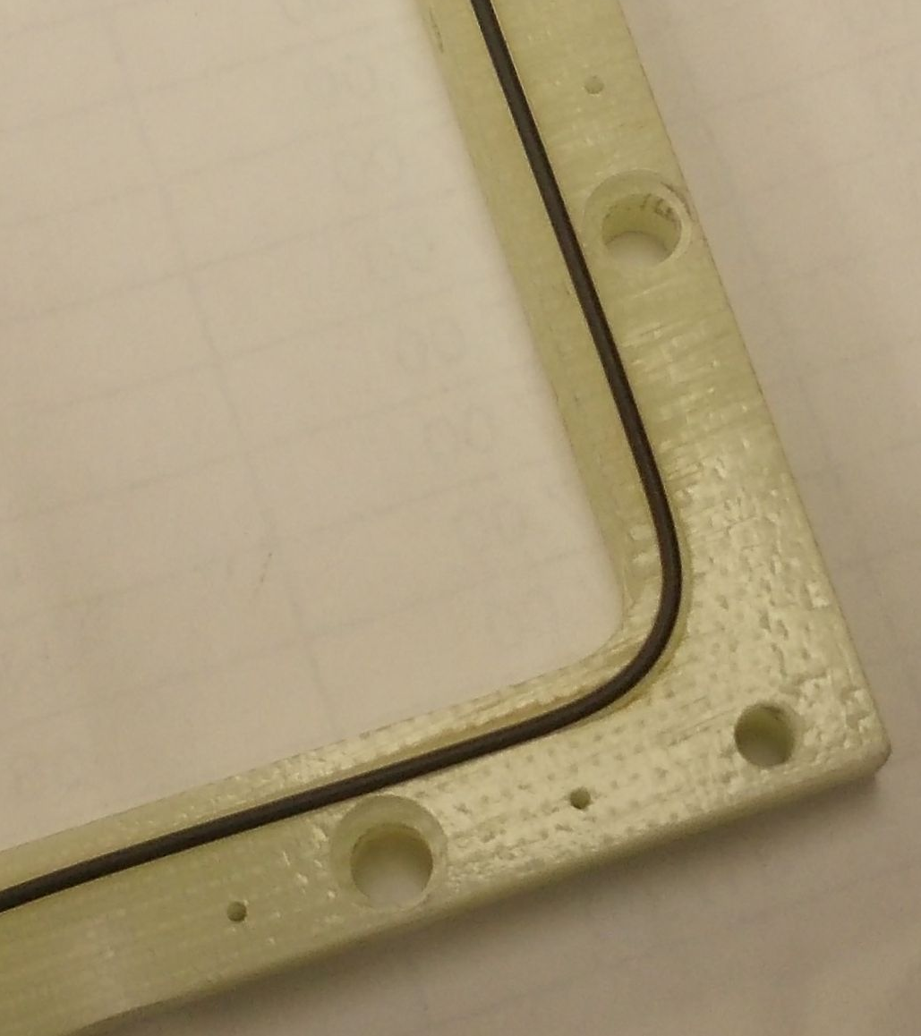

Slide 9
Production Cost Estimate (2012)
M2R1 or M3R1 (48 detectors per station, no FEE)
GEM foil → 10.8 m² x 2000 CHF/1.2 18.000 €/48 det.s = 375 € /det.
PCBs (cath.+anode) → 200 +576+350+1104 = 2230 €/48 det.s = 50 € /det.
Honeycomb+ backplane → 80x96 = 7680 €/48 det.s = 160 € /det.
Detector mechanics → 300 € /det.
___________
total 885 € /det.
TOTAL COST ESTIMATE FOR M2R1 or M3R1 → 885 x 48 = 42.480 €
In green : budgetary offer
In yellow : estimate (in excess) from our personal experiences

Slide 10
Summary
New detectors in preparation ➔ will be mounted in M1R1 for testing next year
Tests with O(10 MeV) neutrons planned at the end of 2014
Gas mixture issues
  The CF₄ nightmare
  Difficult to change gas mixture (5% CF₄-based gas mixture tested but not fast enough, other mixtures tested during R&D but limited performances)
  Will have to find a solution for all of us

