Slide 1
It is the spirit that counts
- people at and around CERN -
Herwig Schopper
at the occasion of the 60th anniversary of CERN

Slide 2
Thanks to John Ellis and Horst Wenninger for presenting excellently the scientific and technological achievements in the LEP I area
and thanks to Rolf Heuer for agreeing to this meeting
I want to talk mainly about aspects usually neglected and not recorded in any minutes:
human behaviour and relations,
which are equally important for success
was asked to talk in particular about LEP approval
experience maybe useful for future projects
Notes:
Anecdotes, between us

Slide 3
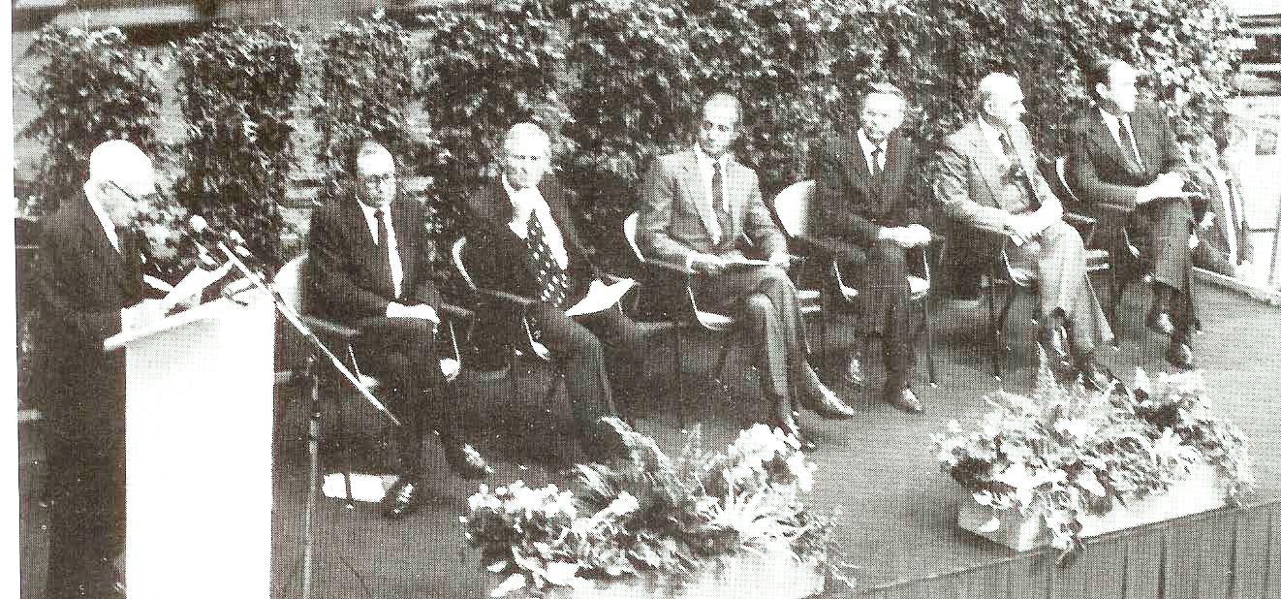
Anniversaries at CERN
CERN seems to count in 30 system
30th anniversary of CERN in 1984 with Isidor Rabi
This year
60th anniversary of CERN
90th anniversary Schopper
30th anniversary of CERN
Rabi, Aubert(CH) ,Merrison, Juan Carlos I, Schopper, Curien(F), Brooks (UK)

Slide 4
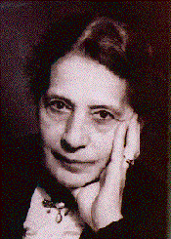
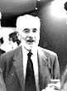
How I got into High Energy Physics via Nuclear Physics
give me a few minutes to explain
1950 Fellowship by Swedish Foreign Ministry:
(one of the first German scientists allowed to leave Germany)
1 year with Lise Meitner
at Techniska Högskola Stockholm
introduced me to beta decay
Many discussions about women in science and
being Jewish
when working with O.Hahn in Berlin in the 1930ies
In 1956 fellowship for 1 year at Cavendish Lab at Cambridge,UK with O.R.Frisch
(with L.Meitner explanation of nuclear fission)

Slide 5
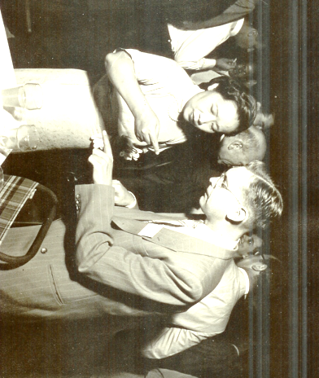
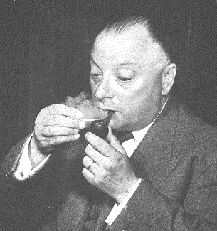
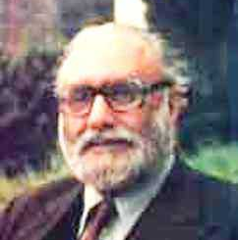
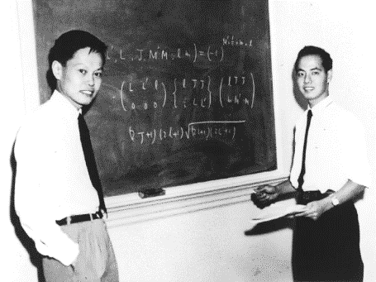
Frisch sent me to Colloquium at Harwell in December 1956
Chairman W.Pauli, speaker A.Salam
‘Two- component neutrino theory’
After rumours of Wu-experiment Pauli’s apologies to Salam for discouraging him to publish
With C.S.Wu
Do not trust authorities,
even by the name of W.Pauli
I learned about P-violation
Did rapidly β-γ circular polarisation correlation
Considered unfeasible by Lee and Yang
T.D.Lee and C.N.Yang

Slide 6
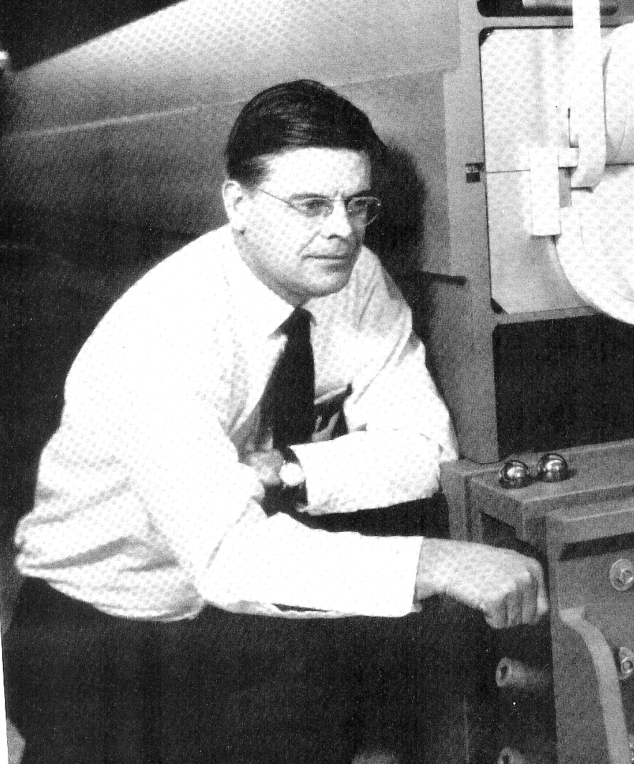
One more fellowship
After 1957 decision to build DESY at Hamburg
W.Jentschke suggested to me to spend one year 1960/61 at Cornell University with R.R.Wilson
to learn electron scattering at round machine
First meeting with Bob
Lab - Directors are not semi-gods
but easily accessible colleagues
Physicists had to operate synchrotron and experiment
Bob cutting the edge of synchrotron magnet
Bob was artist, high rise building, founder of Fermilab

Slide 7
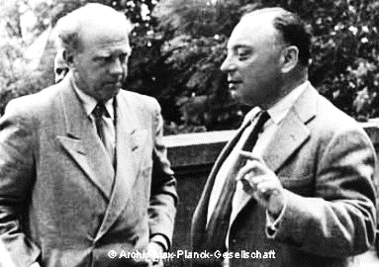
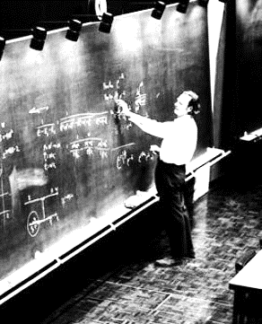
My first visit at CERN
Rochester Conference at CERN July 1958.
Session Fundamental theoretical ideas
Heisenberg’s talk on ‘great unification’
‘World Formula’
Chair. W.Pauli (died December 1958)
“There are no new fundamental ideas,
M. Heisenberg please take the floor”
First meeting with R. Feynman
His suggestion: lets go to Bata Clan
Study psychology of partners

Slide 8
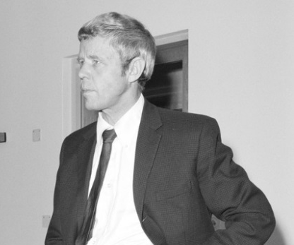
Getting to know CERN as a physicist
Invited to spend one year at CERN 1964/65
Pion production with Arne Lundby ,
Norwegian accepts German!
(P.Carlsson, D.Hartill, Yu.Galaktionov, et al)
got to know spirit of international collaboration in a CERN group (family)

Slide 9
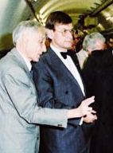
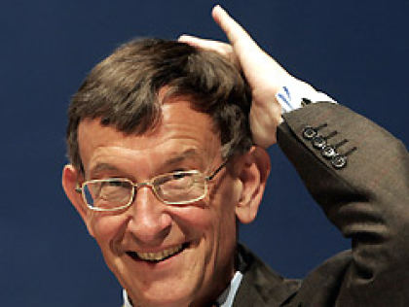
Later CERN experiments
with Karlsruhe group
1966 Neutron scattering on p and nuclei
Development of STAC (MC optimized)
(SamplingTotalAbsorptionCounter <-> hadron calorimeter,
Laughed at since not competitive with magnetic spectrometers, became important for colliders to cover large solid angle
Minister Riesenhuber, chemist
visits UA1
experiments 1966/67 at PS, ISR,
and Serpuchov
(First sit-in strike of students on Soviet soil)
Where are thermometers?

Slide 10
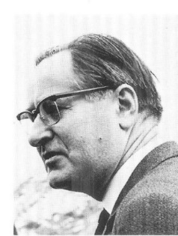
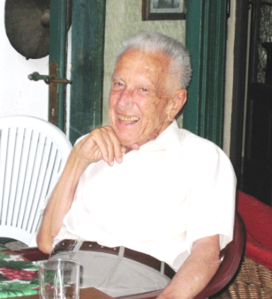

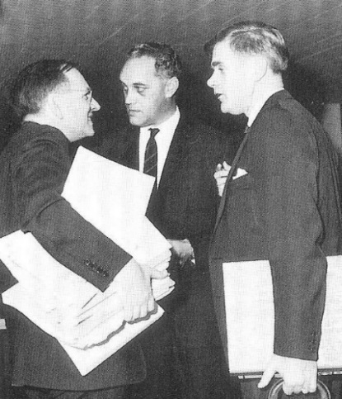
Getting to know the administration of CERN
Followed Peter Preiswerk (member of first Council)
as NP Division leader 1970/73
My Bosses as Scientific Directors
G.Cocconi followed by J.Steinberger
did not like their administrative jobs, preferred to work with their groups
For scientist the scientific reputation
more important than hierarchical positions
Mervin Hine
(Gray emminence)
Hine, Zilverschoon, Johnson

Slide 11
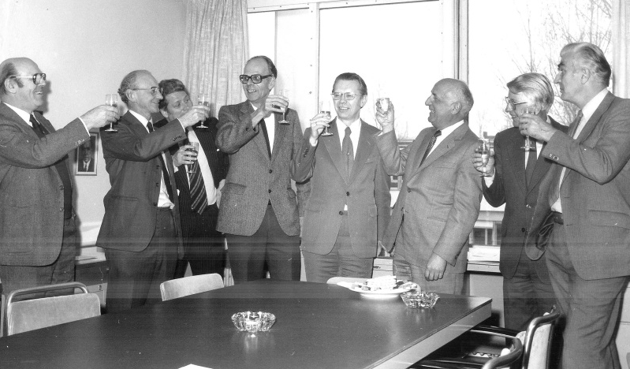
DG 1981-88
Appointment procedure in 1980
Difficult, 11 country yes, one against
No overruling!
Procedure to get unanimity and Keep face!
Interview in CC on February 1980
Main tasks:
- get LEP approved and built
- Unification of CERN I and CERN II
Unanimous Decision
C. President Jean Teillac
Paul, Stafford, ?, van Hove, HS, Teillac, Anderson, Adams
Hope that solidarity among Member States will continue in spite of their increasing number

Slide 12
The LEP proposals
LEP Study | Beam energy GeV | Circumferenc km | Cost MCHF | Year | Comment
LEP 100 | 100 | 50 | Too high | 1976
Blue Book | 70 | 22 | ? | 1978 | Refused by SPC
Pink Book | 86 (130) | 30.6 | 1300 | 1979 | (sc Rf cavities)
Pink BookRev | same | same | 950 | June 1980 | No new injectors
Green Book | 50 (100) | 26.7 | 910 | 1981 | My proposal
Pink book proposed by J.Adams and L.van Hove
After my appointment: Very good Cooperation with outgoing DGs
Common proposal to Council in June 1980
Pink Book revised, using existing machines as injectors
-> cost reduced,
-> participation of all Member States in LEP (Basic programme)
‘no MS voting against’
Cost still too high to get agreement of all MS Green Book 1981, but before…..

Slide 13
Main problem:
Circumference of tunnel ??
Geological problems under Jura:
G.Lombardi: ‘Reduce size and move out of Jura, or let others build the tunnel’
Advise from two respected colleagues:
Avoid mountains -> 23 km
J.Adams:“it seems to me that your choice now is either to battle on with the 27 km circumference LEP …….a serious risk of delays and overspending on the project, or to go flat out for a smaller LEP which would avoid all these problems.”
C.Rubbia: “---I believe however that one should go further and avoid the mountain completely. This corresponds approximately to a new circumference of 23 km…..
I would strongly advocate that one takes the fastest and safest solution of remaining under flat land..”.

Slide 14
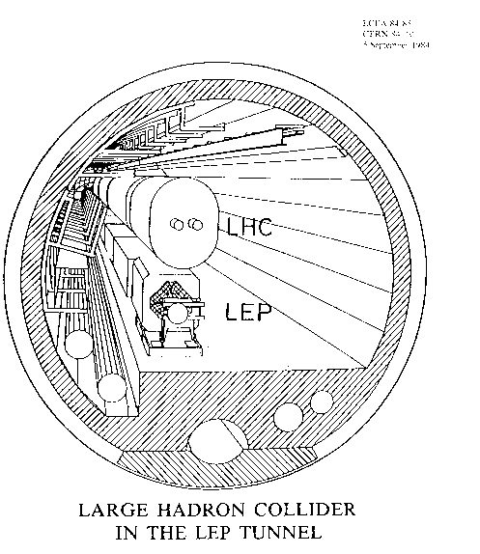
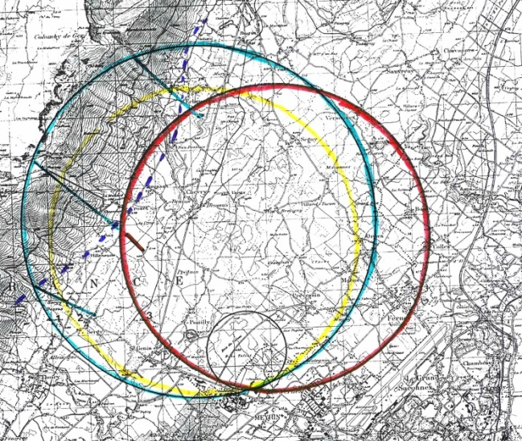
Price to pay:
Water in tunnel,
LEP one year delayed
Difficult decision :
23 km sufficient for e+e-
Choice of 27 km
only in view of LHC
(SSC was progressing in USA)
8 km still under Jura
on inclined plain
LHC discussions had started
Position of LEP:
Lonely secrete decision,
no committee recomendations

Slide 15
Final proposal
Green Book, Submitted to Council June 1981
Conditions:
stripped-down LEP 1 (minimum for Z production)
LEP evolving machine (LEP I, LEP II, LHC)
Only 4 interaction regions (instead of 8)
and first time at CERN:
Constant budget Investment for machine CHF 910 million
with no contingency – time is contingency
no funds for experiments! (revolution at CERN)
Users would have to find funds
only CHF 20 million for experiments infrastructure

Slide 16
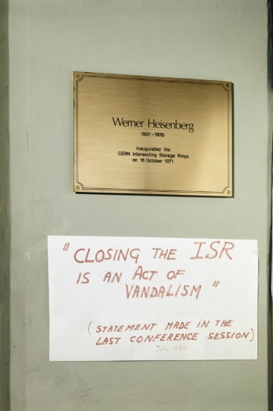
Consequences of budget limitations
ISR stopped in 1983 (only p-p collider in the world)
BEBC (Big European Bubble Chamber) closed down
Most of PS and SPS fixed target programme (West Hall) stopped or reduced
SC-ISOLDE operation hours cut by 30%
Accelerator research concentrated
on sc rf cavities and sc magnets
Lost many friends,
most came back
But
Heavy ion physics at SPS started
(financed from outside)
Notes:
(see talk by Horst Wenninger)

Slide 17
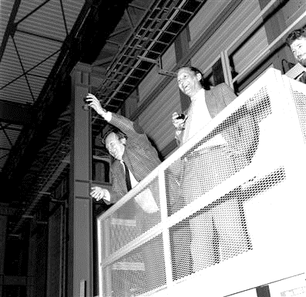
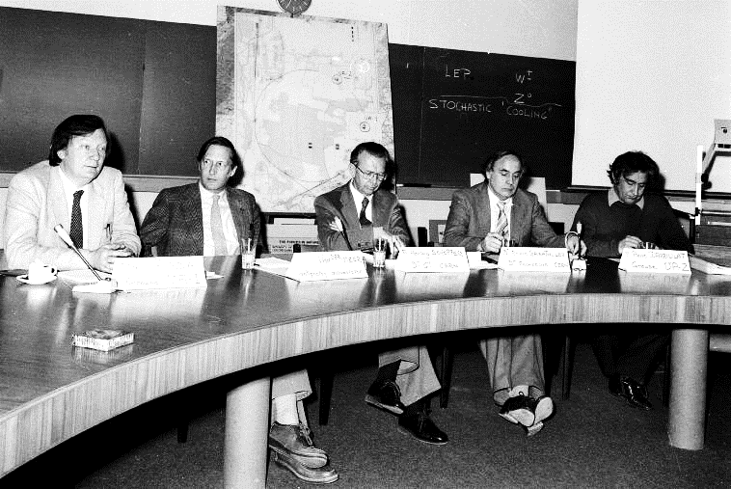
But : continue p – pbar at SPS
UA1 and UA2 even providing additional funds
1983 Discovery of Z and W
C.Rubbia and S. van der Meer Receiving Nobel Prise
Press conference discovery
Rubbia, van der Meer, Schopper, Gabathuler, Darriulat,

Slide 18
LEP Approval still very painful
MS affraid that LEP needs would eat into national programmes
Long fight about constant budget level:
final compromise CHF 617m, lower than proposed
Constant budget with Indexation? ‘No gentleman agreement’
(part indexation for material, not for staff), yearly fight
Budget was considered unacceptable by SPC
and Staff Association
“LEP is built at the cost of staff; Resign!”
Council June 1981: 8 MS in favour, 1 ad referendum, 3 internal discussions
Special Council : October 1981 unanimous approval
Promise of constant budget was decisive for approval
Notes:
FC dinner

Slide 19
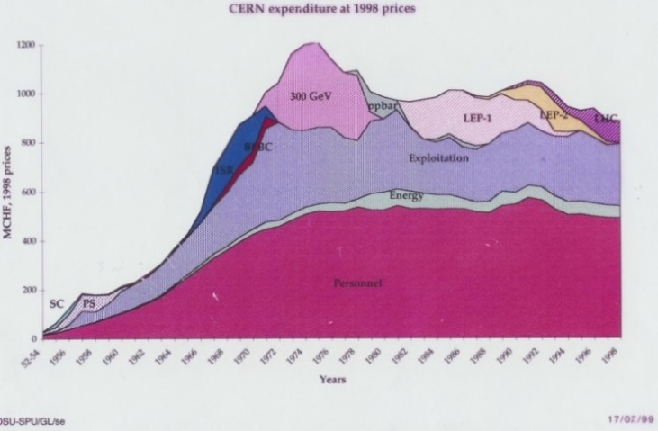
Constant budget since 1981 (for ever?)
glorious time up to SPS
Little bumps due to new Member States (Spain, Portugal)

Slide 20
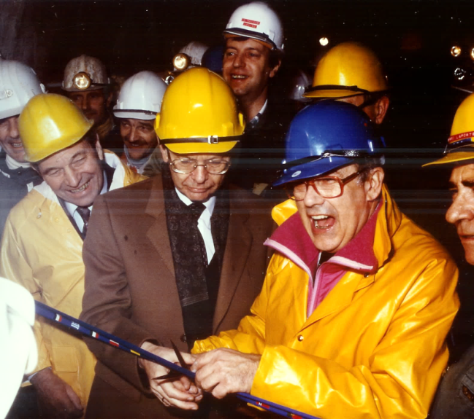
Appointment of Project Leader:
Emilio Picasso
not an accelerator expert ?!?!
why: human aspects -> find people in all divisions
30 % of staff had to be redeployed !!
Regret that he and many others cannot be with us today

Slide 21
LEP budget management
Overall Budget control and distribution
overview by only 3 people (E.P., H.S., Bühler-Broglin)
No budged allocation for various components,
ask department leaders: ‘build as cheap as possible’
Results:
components with new technics (magnets, rf, vacuum): cheaper
conventional material (power, cables, tunnelling):more expensive
LEP I was built within (few %) of the approved budget
Was possible only thanks to remarkable efficiency, dedication and imagination of staff

Slide 22
LEP project management board
Key players
E.Picasso (Project leader)
G.Plass (Deputy)
R.Billinge (PS)
F.Bonaudi (Infrastructure)
C.Bovet
H.Laporte (Buildings,tunnel)
B.de Raad (SPS)
H.P.Reinhard (vacuum)
L.Resegotti (magnets)
W.Schnell (RF system)
G.Brianti (Techn.Dir)
DG
And many more
Do not forget all the other staff,
services, administration,…….
All were essential!

Slide 23
Very efficient form of management,
With its essential basis:
- have confidence in the competence of staff,
- give them responsibilities
Much better than formalised (‘modern’) management (computer) control systems
Beware CERN
from bureaucratic management fashions
becoming obsolete after a few years !

Slide 24
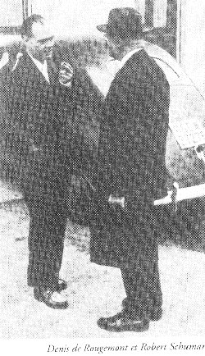
Dialogue with the population
Important Problem: change perception of CERN !
CERN not known to environment,
wanted by previous policy (misunderstanding of “N”)
about 200 information meetings in French villages
public discussions at university GE
story Denis de Rougemont, Swiss poet,
Great European
Founder of Institute of Europan Culture 1946
Founding father of CERN
Understand real motives of opponent
D. De Rougemont, R.Schuman

Slide 25

Legal problems for LEP approval:
CH: public referendum necessary? No!
Decision by Jaques Vernet (Cons.d’Etat)
courageous decision on his last day in office
F: property owned down to centre of earth
(≈2000 owners)
Get “declaration d’utilité publique” requires étude d’impact
Enemies’ slogan : “CERN was in the Pay de Gex,
now Pay de Gex inside CERN”
Other problems: traffic (100.000 truck loads of rocks),
Cooling towers spoil views, damage to water supply
Most problems today forgotten!

Slide 26
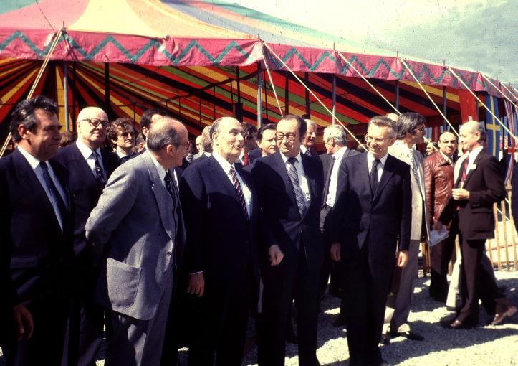
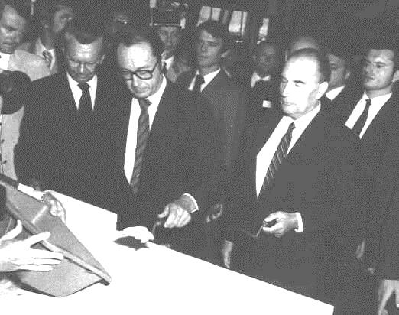
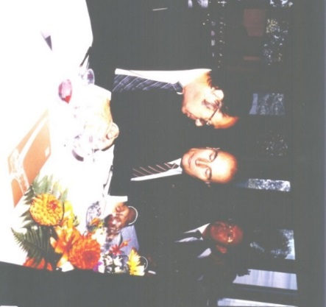
Finally LEP construction could start
Ground-breaking 13 September 1983
getting outside labour!
P.Aubert and F.Mitterrand
Lab visit?
Lunch discussions

Slide 27
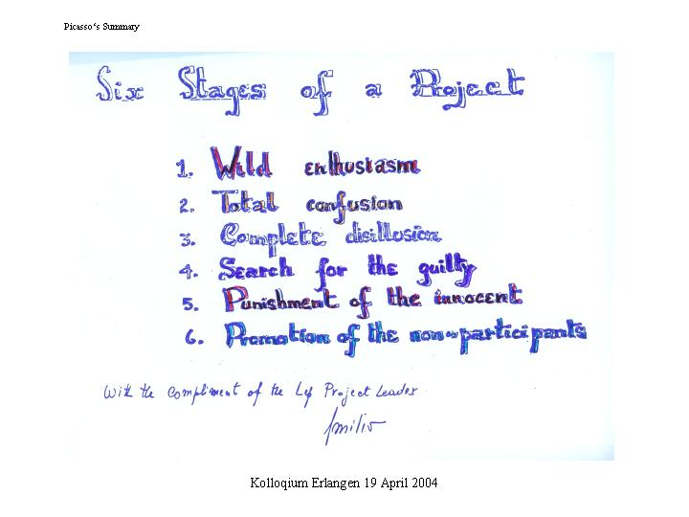

Slide 28
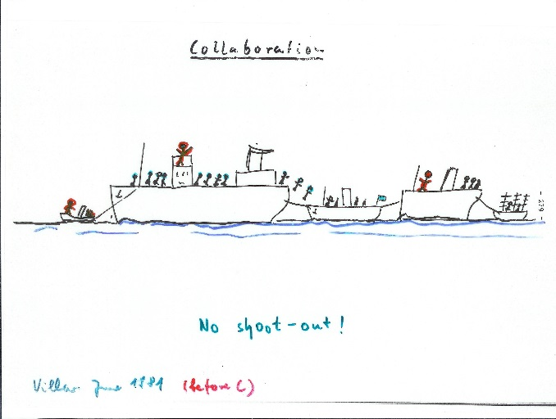
LEP experiments
With LEP experiments new epoch started at CERN:
- Financing from outside, also Non-Member States
- All scientists interested should be able to participate,
Selection procedure: 6 proposals, 4 interaction regions
Marriage market at Villars-sur-Ollon,
June 1981,
Club Mediterrané (gentil animateurs)
no shoot out
My imagination of future collaborations
No dominating partners

Slide 29
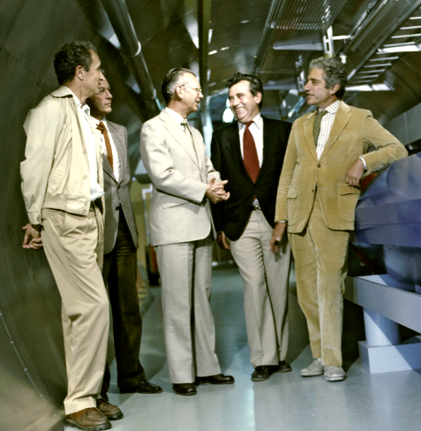
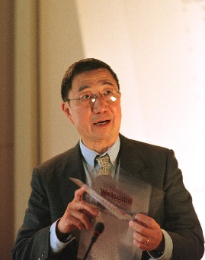
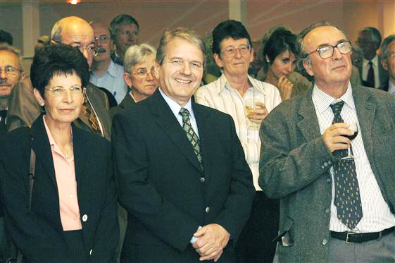
4 LEP experiments approved
ALEPH, DELPHI, OPAL, L3 (nice names, except L3)
2 strong leaders, 2 democratic leaders, would both work? YES !! Democratic style became models for LHC
Difficulties:
Contributions in kind, Components from various countries must fit together
and delivered in time
Sam Ting
Horst Wenninger, Technical Coordinator for Experiments
Michelini, Amaldi, HS, Laporte, Steinberger
Later R. Heuer

Slide 30
‘Experiments’ at LEP and LHC
– a new of way international collaboration
‘Experiments’ International organisations of their own
with several 1000 scientists from many countries
Own Budgets several 100 million $ each
No legal hierarchical structure (no legal boss!)
Spokesperson, coordination committee, resources committee,
Objectives defined bottom-up, consensus seeking
‘equal’ partners (no dominating country or group)
CERN provides frame for overall coordination
A ‘Style’ Cultivated at CERN over 30 years period
Should be followed by other projects
New way of global cooperation?

Slide 31
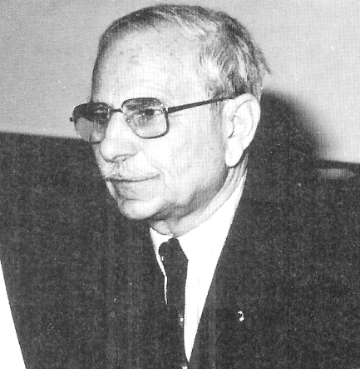
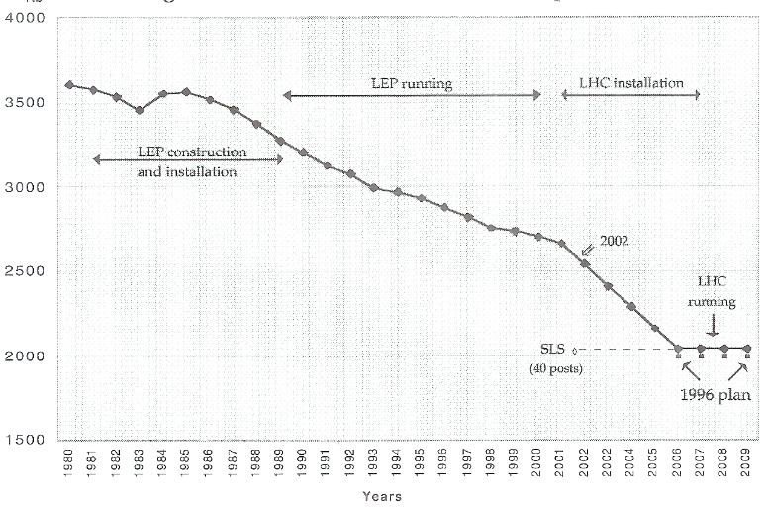
Abragam Committee
Review of management of CERN
Chair Anatol Abragam,
members high level industrialists,
secretary Chris Llewellyn Smith
Did not know each other
Benedetti (OlivettI): CERN is sclerotic (staff turn over few %)
Main advice: reduce staff by early retirement plan
Council decision:
Do it but no money for
Pension Scheme
Decision with longlasting consequences, still today
Notes:
Story Spanish Finance Minister

Slide 32
Long Range Planning Committee
CERN always plans far ahead !
Established by Council in 1985
To study the future of CERN after LEP
Chair: Carlo Rubbia
Subpanel for p-p collider in LEP tunnel
Chair: Giorgio Brianti
Proposal for LHC in 1987
«if decision in 1989…first collisions at LHC by 1995»

Slide 33
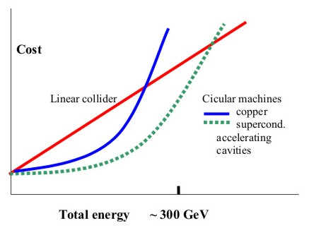
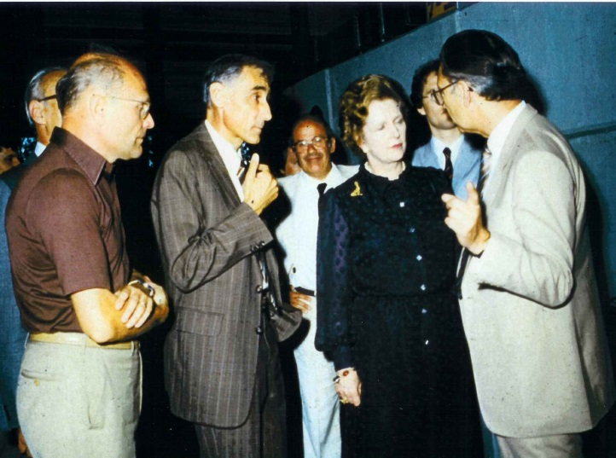
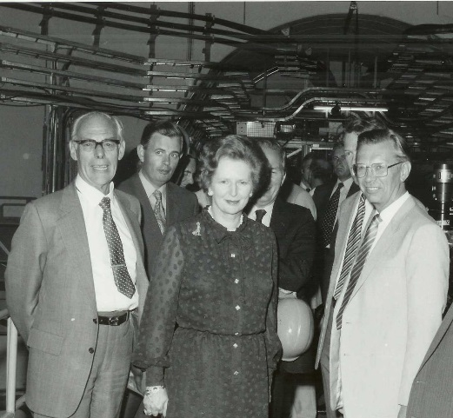
VIP visits just 3 examples
Margaret Thatcher (very charming, well prepared)
“I am here as fellow scientist, not as Prime Minister”
Questions:
Why ring and not linear colliders?
How big will be the next ring?

Slide 34
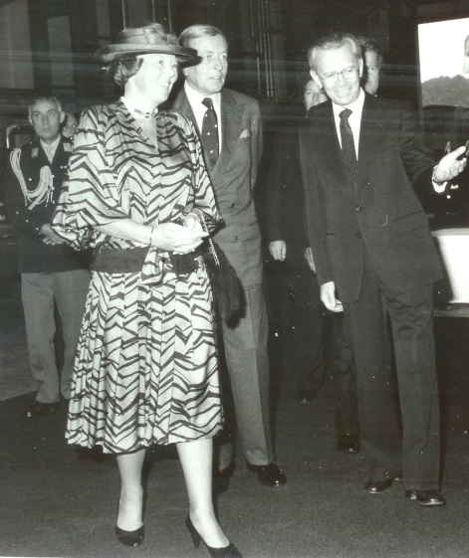
Queen Beatrix of Netherlands
Two experiences at CERN: a bad and a good one
Good one:
car accident was settled
within minutes
Bad one:
Question: Is there a limit to the speed of particles?
Answer: Stupid question!

Slide 35
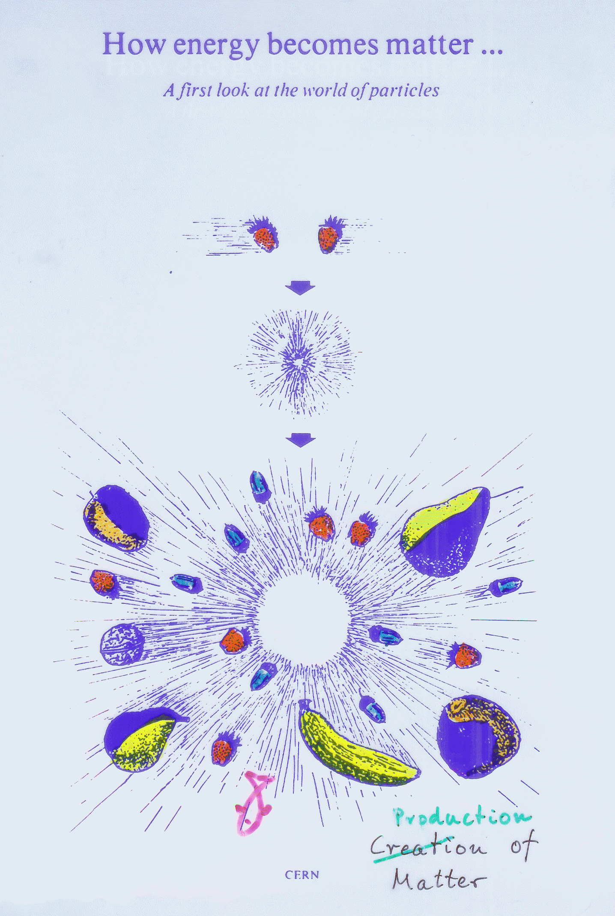
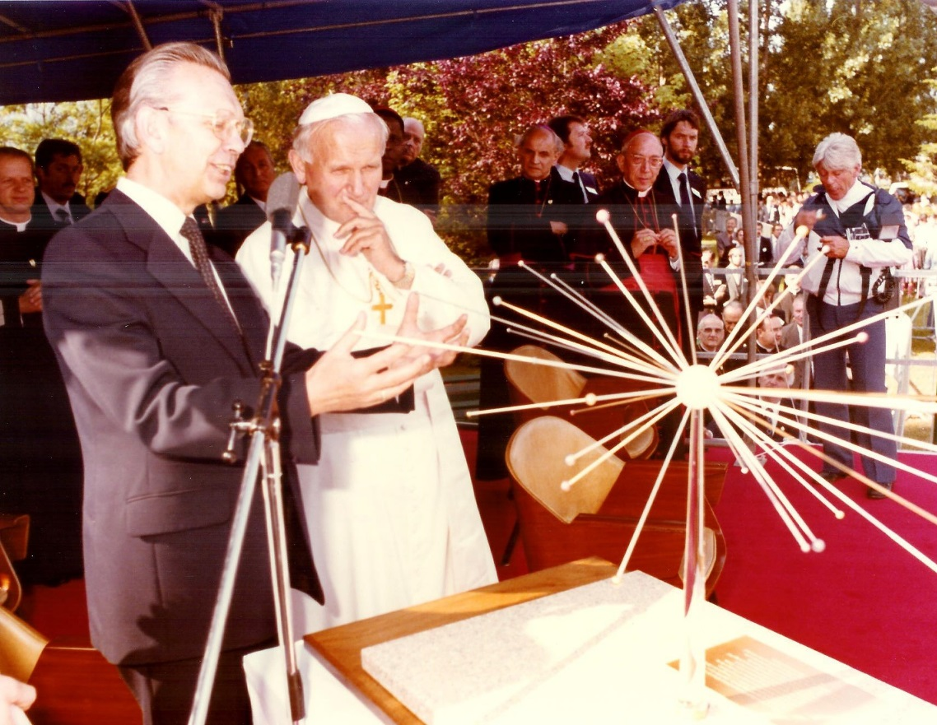
Science and religion
Visit of Pope Johannes Paulus II at CERN 1983
Conflict science – religion ? No!
Original graph shown to Pope

Slide 36
Bringing nations together
Do relations between physicists radiate into politics?
CERN – IHEP (Soviet Union) contract 1968
Became Model contract USA- Soviet Union (Breshnev-Ford)
Disarmament summit USA - Soviet Union 1985
(Reagan –Gorbachov) deadlocked released by dinner at CERN
Help for scientists in trouble
(e.g. Orlov, Okun)
Foundation of SESAME in Middle East (child of CERN)
MS: Bahrain, Cyprus, Egypt, Iran, Israel, Jordan, Palestine, Turkey
Now CERN recognised by UN,
represented in Scintific Advisary Cammittee
Investments at CERN justified by ‘Science for peace’
Notes:
Fabiola

Slide 37
Conclusions
The decade of the 80ies had deep and long-lasting consequences for future of CERN:
Scientific reputation strengthened Nobel Prize for Z and W
Construction of LEP and tunnel (for LHC)
provided basis for long-term future
New culture of international collaboration was born
Equal partners, no hierarchical structure, continued at LHC
Strong participation by Non-Member States,
first elements for World Laboratory
Constant budget New policy to finance projects
Opening to environment, changing perception of CERN

Slide 38
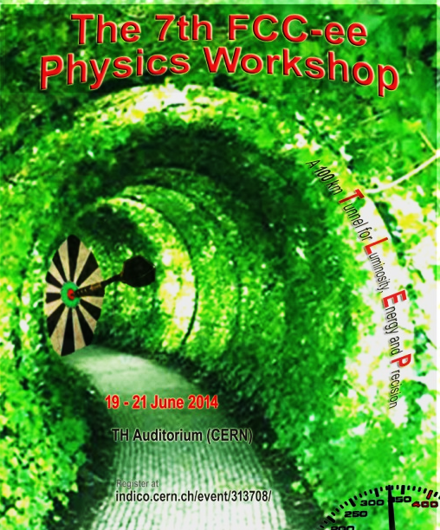
Far Future of CERN
Next event: 90. anniversary,
with various upgrades of LHC
CERN will still bloom!
Physicists think in orders
of magnitude:
What in 900 years?
Archaeologists will excavate tunnel!
What was it used for?
Street tunnel? No, not straight
Ring geometry extremely accurate

Slide 39
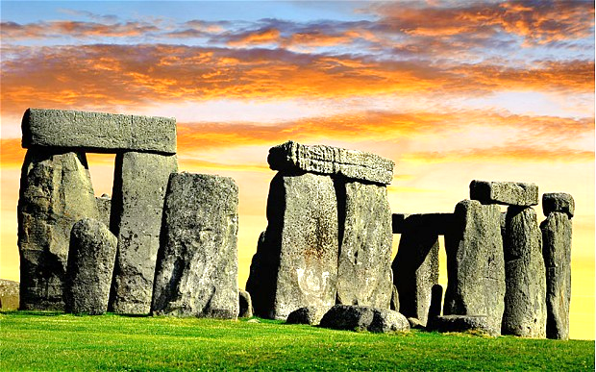
Compare with Stonehenge: astronomical observatory? or a place of worship!
CERN is and will remain a milestone of one of the noblest human cultural activities
– exploring the mysteries of nature
by peaceful worldwide cooperation
We all can be happy and proud
to have participated and contributed to this endeavour

