Slide 1

LEP1: the Ascent of the Standard Model
Contribution to the celebration of Herwig Schopper’s 90th birthday
John Ellis
(King’s College London & CERN)

Slide 2
The Historical Context - I
1964 – The Englert-Brout-Higgs mechanism
1967/8 – Weinberg-Salam model
1971/2 – Gauge theories renormalizable
1973 - Neutral currents
1974 – The November revolution
1975 – The τ lepton
e⁺e⁻ colliders pre-eminent: SPEAR, DORIS, …
Higher-energy machines under construction: PETRA, PEP

Slide 3
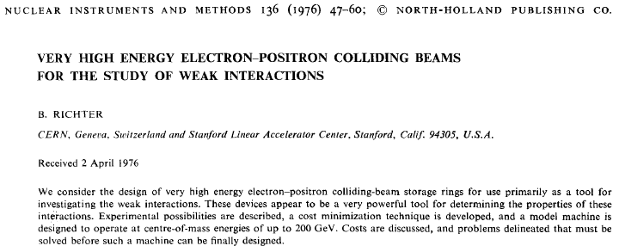
Think big!
1975/6 - Burt Richter on sabbatical at CERN

Slide 4
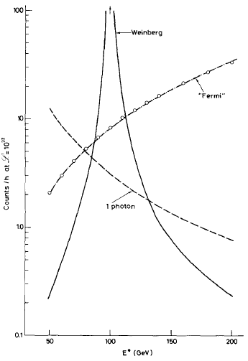
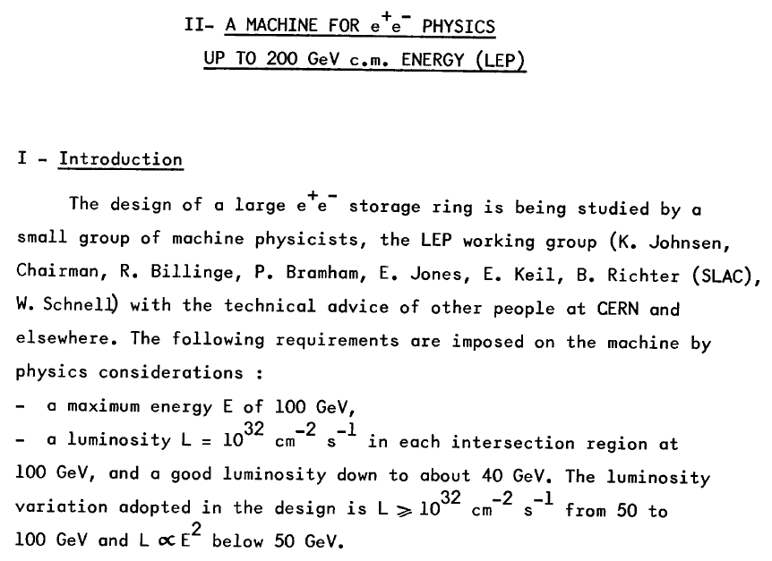
The Historical Context - II
Before the discovery of the W and Z (1983)
Should in any case be large cross-sections
First LEP
machine
study 1976
Richter

Slide 5
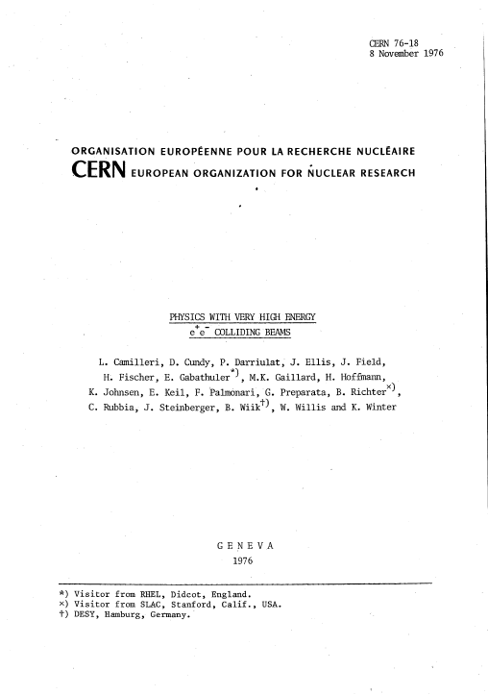
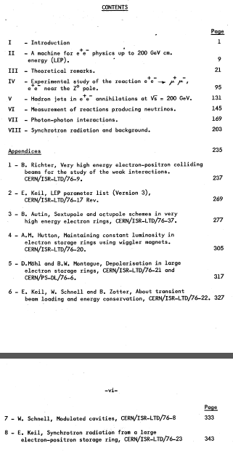
First LEP Study Group

Slide 6
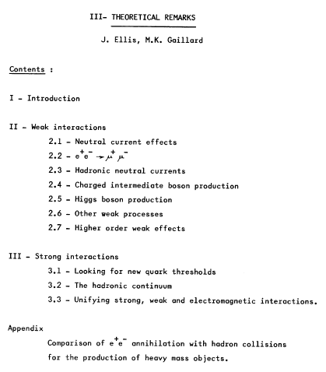
First LEP Theory Studies
Highlights:
Precision Z studies
W⁺W⁻ production
Higgs search
Heavy quarkonia
Jet studies

Slide 7
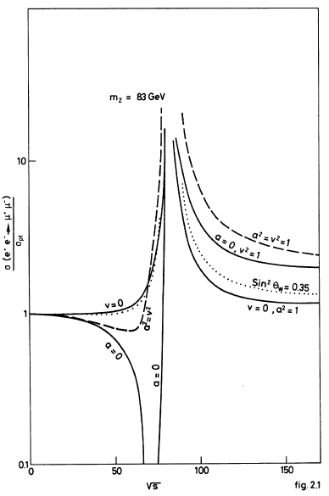
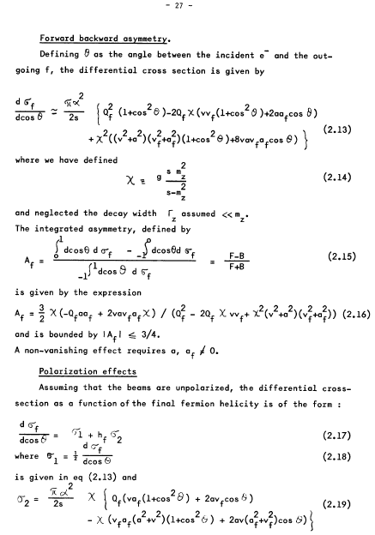
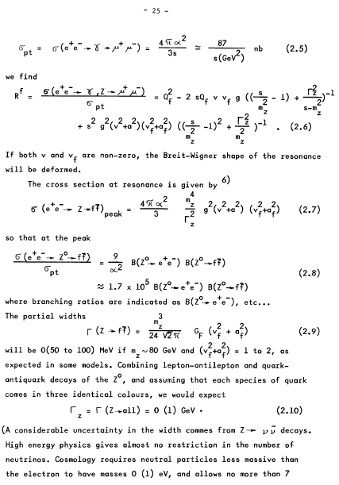
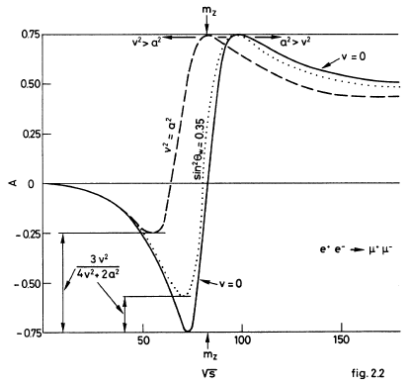
Z Cross-section & Asymmetries

Slide 8
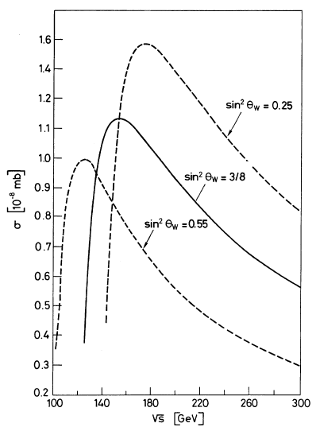
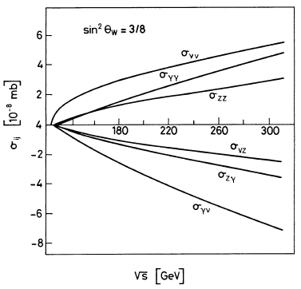
W⁺W⁻ Production
Alles, Boyer, Buras

Slide 9
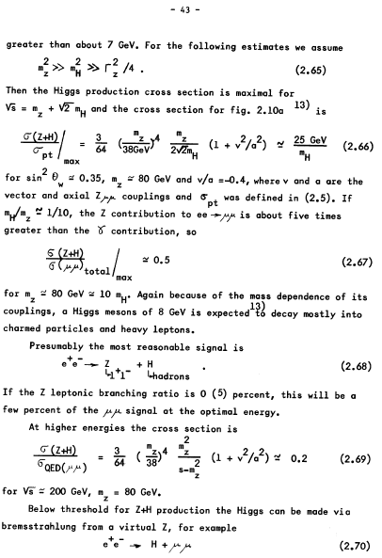
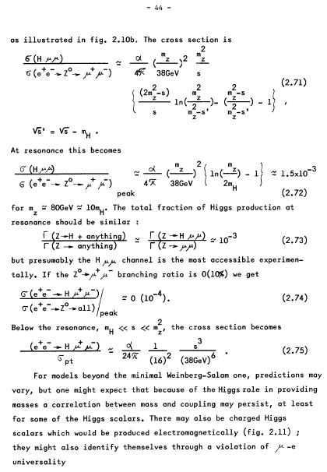
Higgs Production
Z decay @ LEP 1
Z+H: ‘Higgsstrahlung’ @ LEP 2
‘Bjorken’ process

Slide 10
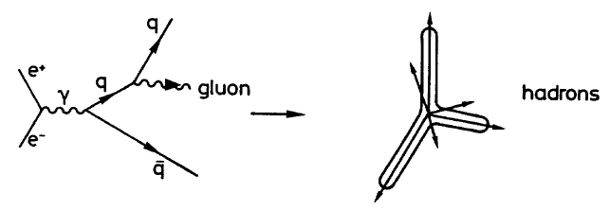
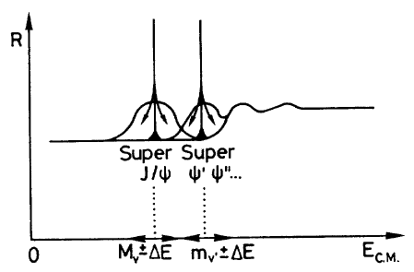
Strong Interactions: Jets & Onia
Gluon not yet discovered (1979)
Search for gluon bremsstrahlung
Toponia in LEP energy range?
JE, Gaillard, Ross

Slide 11
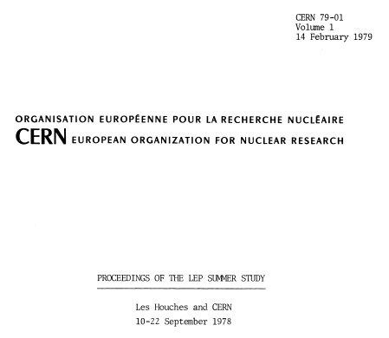
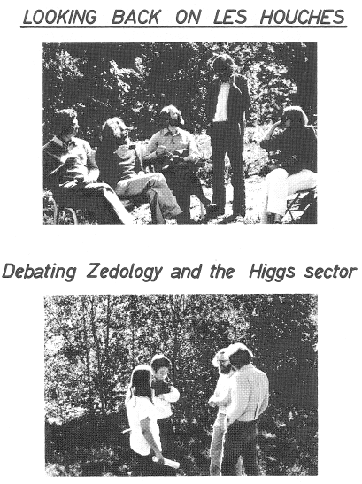
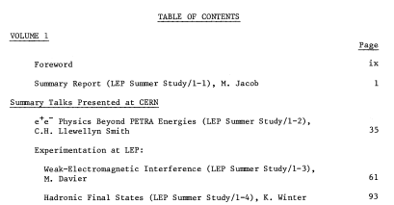
Les Houches Summer Study 1978

Slide 12
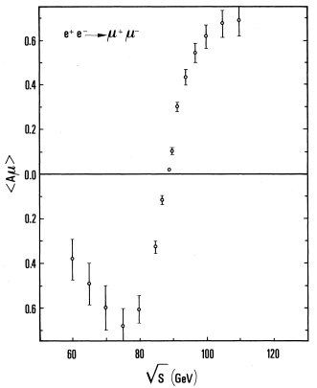
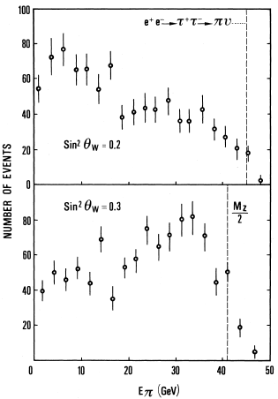
Anticipating LEP 1 Measurements
A_{FB} for e⁺e⁻ to μ⁺μ⁻
τ polarization
Davier

Slide 13
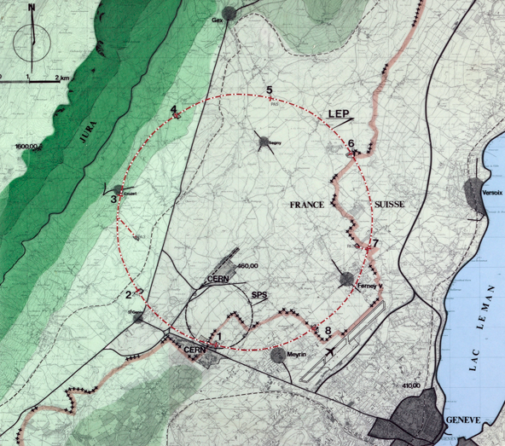
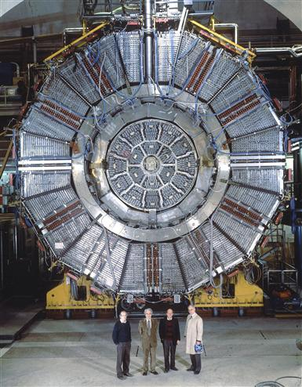
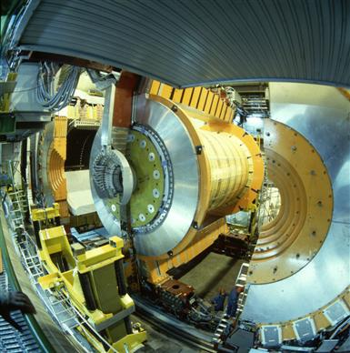
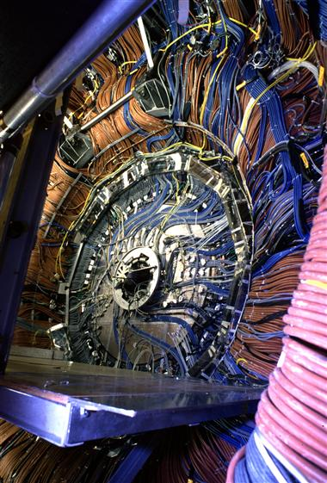
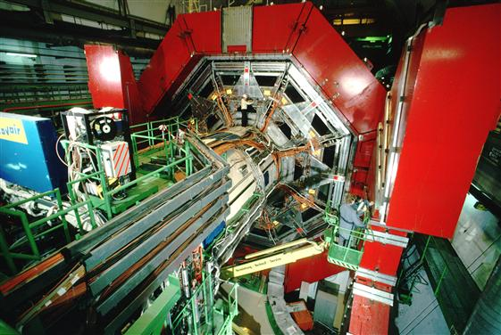
Towards the LEP Experiments
LEP experiments committee established 1982
“Exam questions”
  N_{ν} ≠ 4 @ 6 σ
  m_{H} ≤ 50 GeV
  Toponium

Slide 14
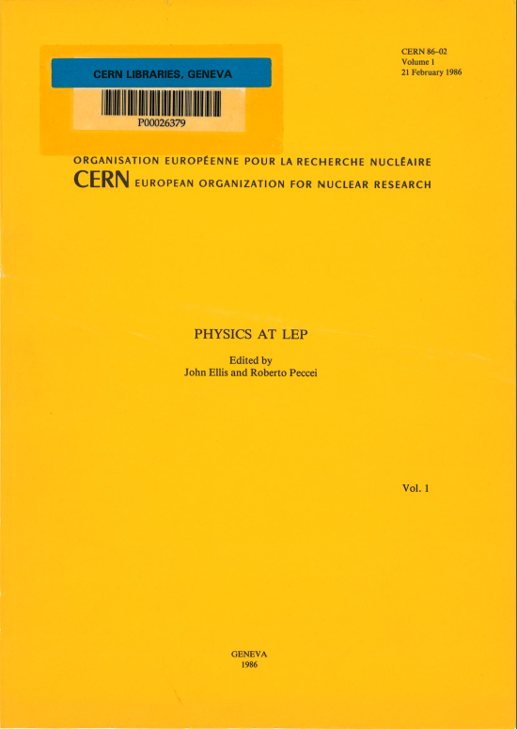
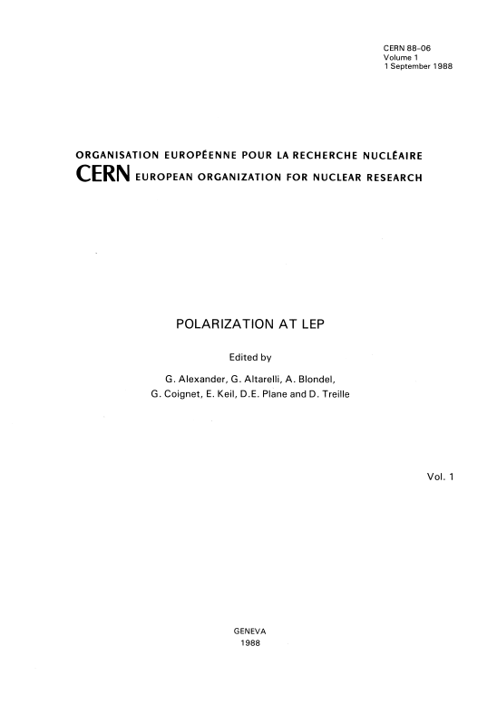
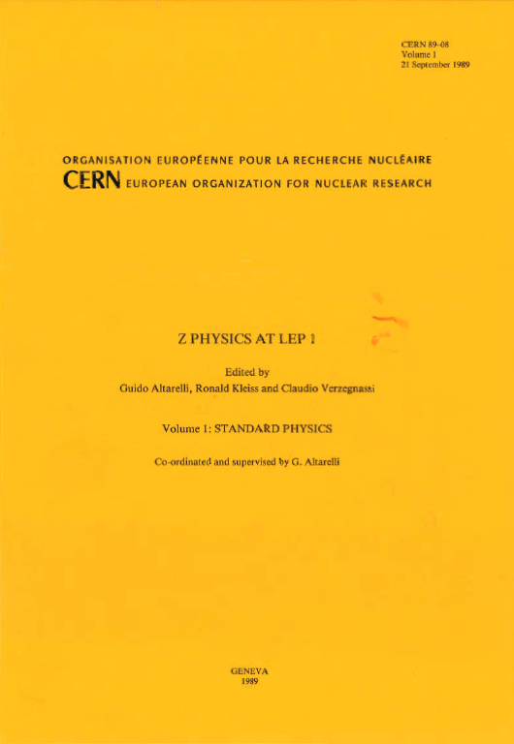
The Yellow Report Road
Theorists + experimentalists + accelerator physicists
working together to study physics opportunities

Slide 15
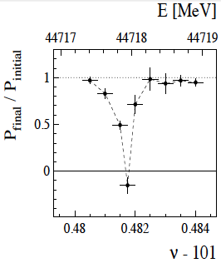
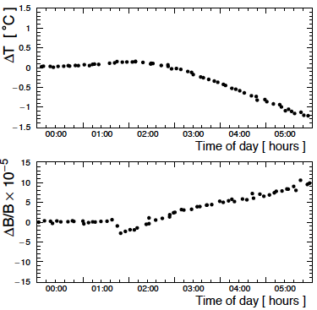
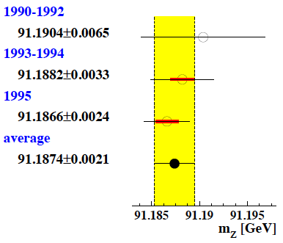
Measuring the Z Mass
Needed to measure beam energy at LEP using resonant depolarization
Affected by
  Magnet temperature
  Terrestrial tides
  Water (rain, Lake Geneva)
  Trains
Final error ± 2 MeV

Slide 16
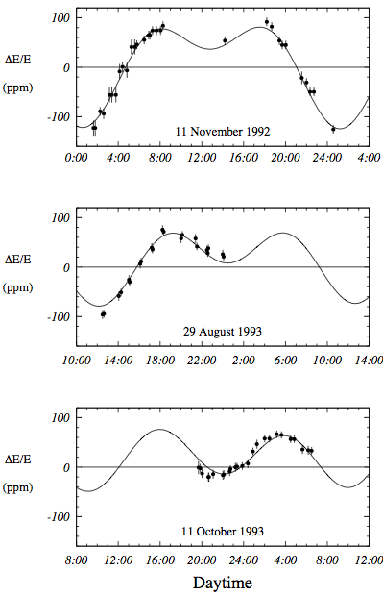
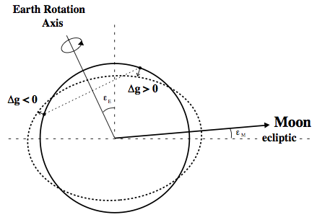
Terrestrial Tides
Affect circumference of ring
change beam energy

Slide 17
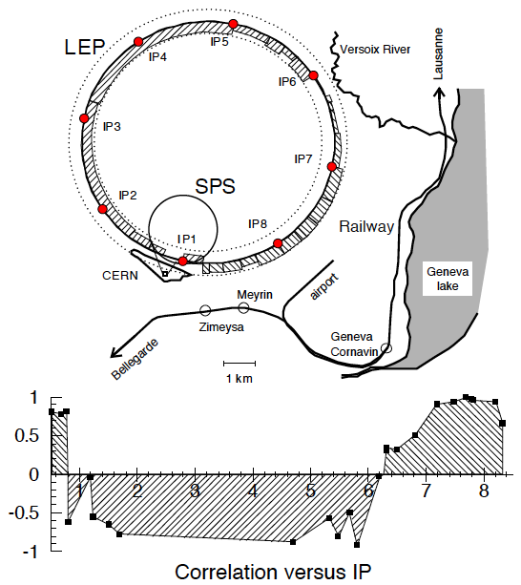
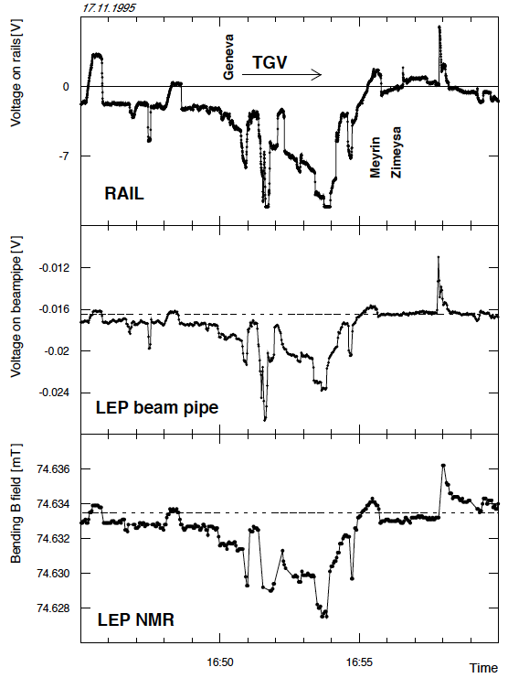
Trains: Currents through Magnets
Effect on magnetic field: ΔE several MeV

Slide 18
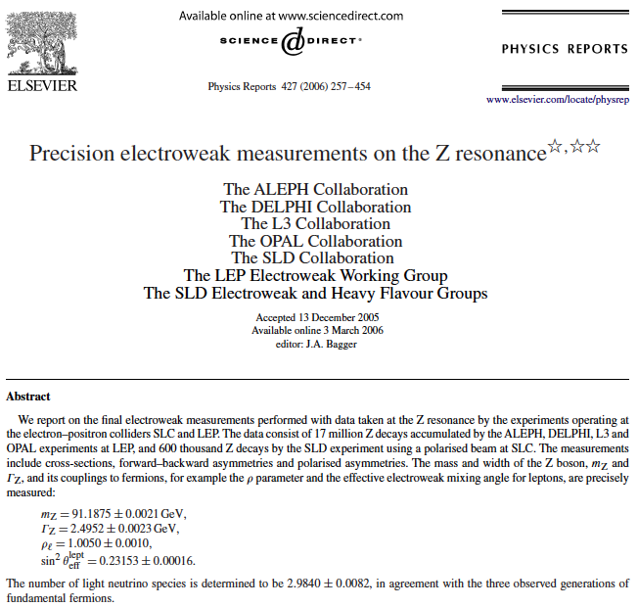
Combination of EW Measurements
Unprecedented
combined effort,
together with SLD

Slide 19
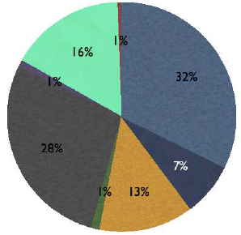
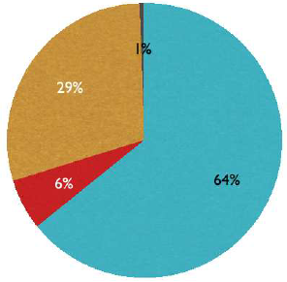
Contributions of EW Measurements
Different observables
Different laboratories
Erler

Slide 20
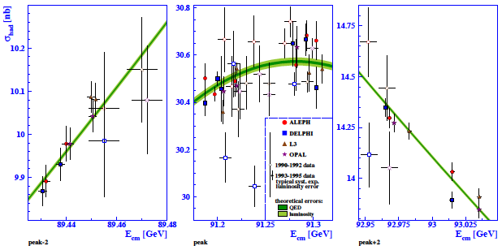
Cross-Sections on/off Z Peak

Slide 21
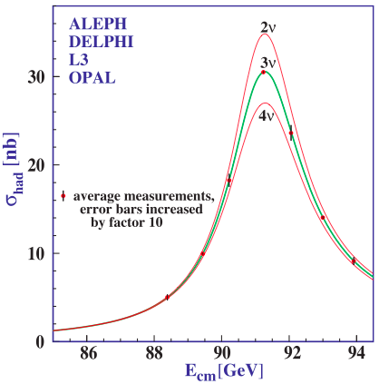
‘Neutrino’ Counting
One of the first LEP results: Oct. 1989
Two techniques: Z peak measurements:
  N_{ν} = 2.9840 ± 0.0082
Radiative return
  N_{ν} = 2.92 ± 0.05
Within SM:
  determines # generations
Beyond SM:
  constrains SUSY, …

Slide 22
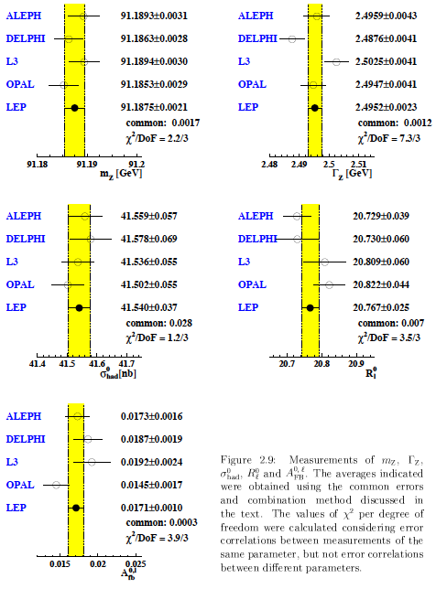
Electroweak
Measurements
Unanticipated precision
Unprecedented precision
Establish validity of SM @ per-mille level
Insights into BSM

Slide 23
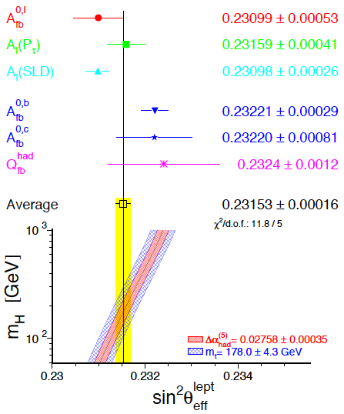
Electroweak Mixing Angle
Many contributing electroweak measurements
Tension between two highest-precision measurements
  A_{FB}^{b}, A_{l}(SLD)
Important clue for grand unification?

Slide 24
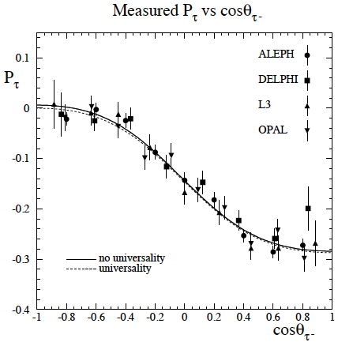
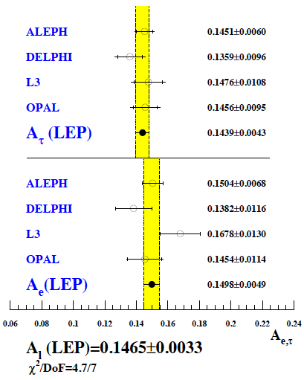
Tau Polarization Measurements
Lepton couplings
Pulls in global fit

Slide 25
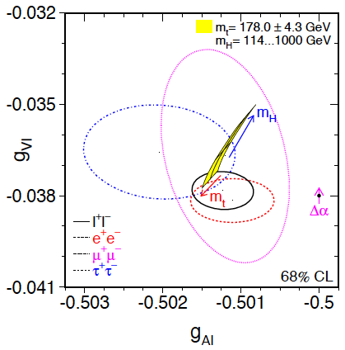
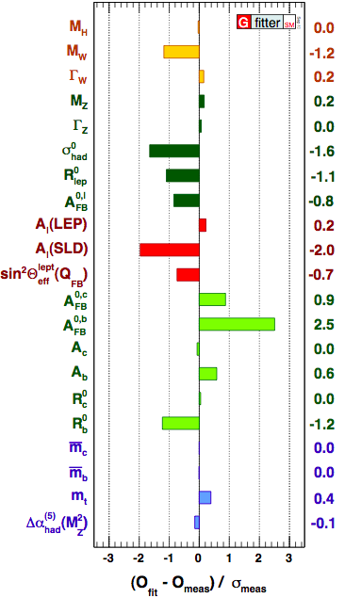
Precision Tests of the Standard Model
Lepton couplings
Pulls in global fit
The SM works!

Slide 26
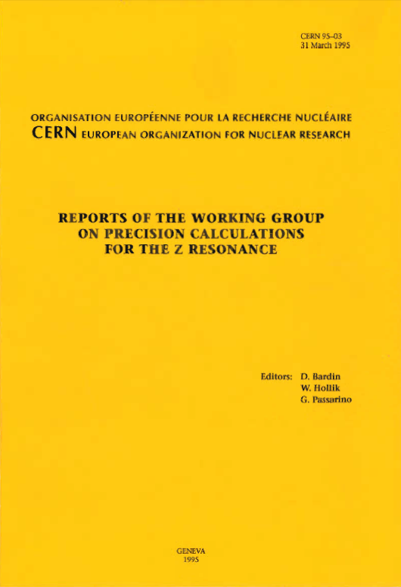
Electroweak Radiative Corrections
Attainable experimental precision greatly exceeded initial expectations
Heroic effort by several groups to calculate leading (and most important non-leading radiative corrections
Combination carried interpretation to unexpected level

Slide 27

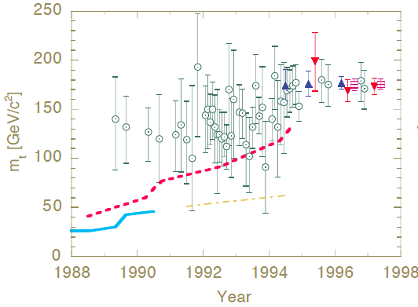


Constraints on Top, Higgs Masses
Electroweak observables sensitive via quantum loop corrections:
Quadratic sensitivity to top:
Successful prediction!
Logarithmic sensitivity to m_{H}
(Successful prediction!)
Veltman

Slide 28
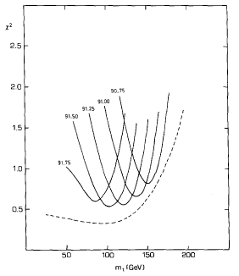


Predicting m_{t} before LEP
An accurate measurement of m_{Z} would make possible the prediction of m_{t}

Slide 29



Predicting m_{t} after the first high-precision measurement of m_{Z}
Combination with low-energy data
First discussion of m_{H}
JE, Fogli; Langacker; …

Slide 30


Estimating the Higgs Mass
First attempts in 1990, 1991:
Uncertainty before the discovery of the top
JE, Fogli, Lisi

Slide 31


Estimating the Higgs Mass
After the top discovery:
Solid indication that the Higgs is ‘light’
JE, Fogli, Lisi

Slide 32

Model-Independent Analysis
Important constraints
on BSM physics
Altarelli, Barbieri;
Peskin, Takeuchi

Slide 33


LEP Physics Working Groups
Uniting collaborations and interested theorists in combining data analyses:
  Electroweak, Higgs, Supersymmetry, Exotica, QCD/γγ, Heavy flavour, Energy calibration
Set standards for interpretation of LEP data

Slide 34



The LEP 1 legacy: Precision EW
Pulls in SM fit
Fit vs measurements
H mass sensitivity

Slide 35

The LEP 1 Legacy:
1999 Nobel Prize
The contributions of 't Hooft and Veltman … made it possible to compute quantum corrections to many processes and compare the results with experimental observations or to make predictions. For example, the mass of the top quark could be predicted, using high precision data from the accelerator LEP (Large Electron Positron) at the Laboratory CERN, Switzerland, several years before it was discovered, in 1995 at the Fermi National Laboratory in USA. …Similarly, comparison of theoretical values of quantum corrections involving the Higgs Boson with precision measurements at LEP gives information on the mass of this as yet undiscovered particle. By Professor Cecilia Jarlskog Member of the Nobel Committee for Physics

Slide 36

The LEP 1 Legacy: QCD
Determination of α_{s}
Important contributions to global average from LEP 1 measurements: σ_{peak}, jets, τ decay
α_{s}(m_{Z}) = 0.1185 ± 0.0006
Also 3-g coupling: C_{A} = 2.89 ± 0.21

Slide 37


The LEP 1 Legacy: SUSY GUTs?
Precision EW and QCD measurements test GUTs
Ordinary GUTs fail
Data consistent with SUSY GUTs
But no SUSY!
Amaldi, De Boer, Fürstenau

Slide 38

The LEP (& Tevatron) Legacy: m_{H}
m_{H} = 125 ± 10 GeV
Gfitter collaboration

Slide 39

The LEP 1 Legacy:
1944 papers, 57855 Citations
From Inspire records

Slide 40
The LEP Legacy
Establishment of the Standard Model
Hints/constraints on BSM physics
Collaborations of hundreds of physicists can work
Collaborations can work with each other
Theorists, experimenters and accelerator physicists can work together
Groundwork laid for the LHC

Slide 41

Happy Birthday!

