Slide 1


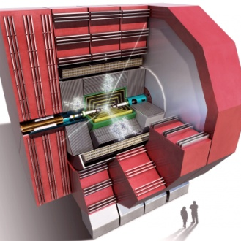
Discussion:
CLIC Detector HCal Design and Parameter Optimization
K. Elsener, W. Klempt,
L. Linssen, N. Nikiforou
CLIC Detector Optimization Meeting
CERN, July 15th, 2014

Slide 2
Introduction
Very soon we will have to have a realistic estimation of the HCal Barrel outer radius
  Input for Engineering and feasibility studies
  Used to limit degrees of freedom in optimization studies (#layers, absorber thickness, active layer thickness, total depth, radius)
This is a recap of ongoing discussions with several people
Implementation of HCal layers in current models
  CLIC_SID_CDR in GeomConverter/DD4hep
    10 mm TungstenDens24, 5 mm Scintillator, 1.5 mm Air
  CLIC_ILD_CDR in Mokka
    10 mm TungstenDens24, 5 mm Scintillator, 1.5 mm Air
Alloy TungstenDens24: 0.93 W, 0.061 Ni, 0.009 Fe

Slide 3
Current Assembly (16.5 mm per layer)
RADIATOR (W alloy or Fe)
SCINTILLATOR (polysterene)
16.5 mm
RADIATOR (W alloy or Fe)
10 mm
0.75 mm
5 mm
0.75 mm
10 mm
(Air presumably to allow for readout etc)
Recently verified that indeed the CLIC_ILD_CDR (Mokka) and CLIC_SID_CDR (GeomConverter) HCal models correctly simulate ~7.5 λΙ at θ=90^{ο} (see backup)
Both models do not include support for the radiator or any sort of cassette for the active elements/electronics
  Start looking into more realistic scenarios
On the other hand, we gain 15 cm reduction by going to 3 mm scintillator (@ 75 layers)
Material | Z | Density | λΙ | λΙ
 |  | g/cm3 | g/cm2 | cm
Fe | 26 | 7.874 | 132.1 | 16.77
Ni | 28 | 8.902 | 134.1 | 15.06
Cu | 29 | 8.96 | 137.3 | 15.32
W | 74 | 19.3 | 191.9 | 9.946
Si | 14 | 2.33 | 108.4 | 46.52
Polysterene |  | 1.06 | 81.7 | 77.07
N2 | 7 | 1.17e-3 | 89.7 | 76960
PCB | From Mokka driver of TB cal |  |  | 48.42
Electronics |  |  |  | 50
TungstenDens24 |  | 17.8 | 187.8 | 10.32
W Alloy in TB |  | 17.84 | 187.9 | 10.31

Slide 4
More Realistic Assembly (22 mm per layer)
2 mm AIR AIR AIR AIR
RADIATOR (W alloy or Fe)
STEEL
PCB~1.5 mm
SCINTILLATOR (polysterene)
STEEL
2 mm AIR AIR AIR AIR
22 mm
10 mm
RADIATOR (W alloy or Fe)
1 mm
12 mm
ELECTRONICS (30%) ~1.5 mm
3 mm
(Steel cassette)
3 mm
1 mm
10 mm
Material | Z | Density | λΙ | λΙ
 |  | g/cm3 | g/cm2 | cm
Fe | 26 | 7.874 | 132.1 | 16.77
Ni | 28 | 8.902 | 134.1 | 15.06
Cu | 29 | 8.96 | 137.3 | 15.32
W | 74 | 19.3 | 191.9 | 9.946
Si | 14 | 2.33 | 108.4 | 46.52
Polysterene |  | 1.06 | 81.7 | 77.07
N2 | 7 | 1.17e-3 | 89.7 | 76960
PCB | From Mokka driver of TB cal |  |  | 48.42
Electronics |  |  |  | 50
TungstenDens24 |  | 17.8 | 187.8 | 10.32
W Alloy in TB |  | 17.84 | 187.9 | 10.31
Active Element Cassette |  | ILD
Material | Thickness | Thickness
 | mm | mm
Steel | 2 | 0.5
PCB | 1.4 | 1
Cu (etching) | 0.1 | 0
Electronics (30%) | 1.5 | 1
Scintillator | 3 | 3
Sum (per layer) | 8 | 5.5
#λΙ (per layer) | 0.02 | 0.01
Notice ILD uses a 0.5 mm steel cassette (one plate)
Included (?) in Mokka driver
See next slide

Slide 5
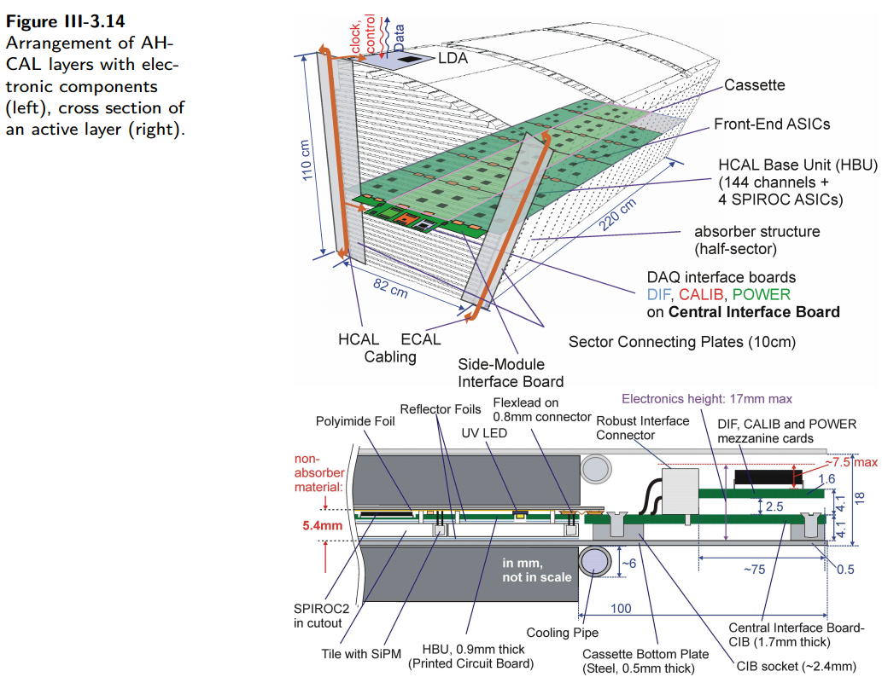
ILD AHCAL Assembly (from ILD TDR)
Active Element Cassette |  | ILD
Material | Thickness | Thickness
 | mm | mm
Steel | 2 | 0.5
PCB | 1.4 | 1
Cu (etching) | 0.1 | 0
Electronics (30%) | 1.5 | 1
Scintillator | 3 | 3
Sum (per layer) | 8 | 5.5
#λΙ (per layer) | 0.02 | 0.01
NB: ILD TDR also mentions “The active layers will contribute 4 mm of steel to each absorption layer” - Not shown in diagram?
16 mm (absorber layer) + 4 mm = 20 mm steel ?
+0.5 mm bottom plate?
Not clear what is done in code (comment says ignored)
  From what I can tell (SHcalSc04 driver) the steel is assumed part of the absorber
Update (from private communication): the drawing is not accurate
  ILD Cassette is 6.5 mm thick + 1 mm air total = 7.5 mm between absorber plates

Slide 6
Various Combinations for HCal Barrel
Detector | # Layers | Abs Thick | Active Thick | Air | Total Depth | Total Thickness | Inner R | Outer R
 |  | mm | mm | mm | #λΙ | mm | mm | mm
CLIC_ILD_CDR | 75 | 10 | 5 | 1.5 | 7.75 | 1237.5 | 2058 | 3295.5
CLIC_SID_CDR | 75 | 10 | 5 | 1.5 | 7.75 | 1237.5 | 1447 | 2684.5
Steel | 75 | 10 | 5 | 1.5 | 4.96 | 1237.5 | 1447 | 2684.5
Steel | 60 | 20 | 5 | 1.5 | 7.55 | 1590 | 1447 | 3037
Tungsten with realistic cassette | 75 | 10 | 8 | 4 | 8.79 | 1650 | 1447 | 3097
Tungsten with realistic cassette | 60 | 10 | 8 | 4 | 7.03 | 1320 | 1447 | 2767
Steel with realistic cassette | 75 | 10 | 8 | 4 | 5.99 | 1650 | 1447 | 3097
Steel with realistic cassette | 60 | 17 | 8 | 4 | 7.30 | 1740 | 1447 | 3187
NB: These (and next slide) are “by hand” calculations, i.e. not from simulation. C.f. with results from G4 material scans yielding ~7.5 λΙ for CDR models in backup. Nevertheless use 7.5-7.75 λI as baseline.

Slide 7
HCal Barrel in the new CLIC Detector
Assumptions: $R_{out}^{tracker}=1500 mm$ , use other sizes from CLIC_ILD_CDR:
$R_{out}^{tracker}−R_{in}^{ECal}=39 mm$, $R_{out}^{ECal}−R_{in}^{ECal}=173 mm, R_{in}^{Hcal}−R_{out}^{ECal}=38 mm$
=> $R_{in}^{HCal}=1500 mm+250 mm=1750 mm$
Detector | # Layers | Abs Thick | Active Thick | Air | Total Depth | Total Thickness | Inner R | Outer R
 |  | mm | mm | mm | #λΙ | mm | mm | mm
Tungsten with realistic cassette | 75 | 10 | 8 | 4 | 8.79 | 1650 | 1750 | 3400
Tungsten with realistic cassette | 60 | 10 | 8 | 4 | 7.03 | 1320 | 1750 | 3070
Steel with realistic cassette | 60 | 17 | 8 | 4 | 7.30 | 1740 | 1750 | 3490
Tungsten with ILD cassette | 75 | 10 | 5.5 | 0 | 7.98 | 1162.5 | 1750 | 2912.5
Again, notice that the calculations might be overestimating #λΙ
In fact, a material scan of the modified ILD model shows ~7.5 λΙ
  Perhaps indeed the 0.5 mm plate is not included in the model

Slide 8
Next Steps
Need to study HCal PandoraPFA Jet Energy Resolution as a function of absorber material, depth and granularity, but some constraints need to be imposed
Simulation studies are ongoing using a modified version of the ILD_o1_v06 Mokka Driver (includes 48x20 mm steel absorber)
  Calibration procedure adapted from Cambridge
  Using a $R_{out}^{tracker}=1500 mm$ , 75x10 mm Tungsten in barrel, 60x20 mm steel in Endcap
  Model has 3 mm scintillator thickness
Calibration needed for every variation of geometry
  Quasi-automatic calibration procedure in place, however the HCal performance obtained is far from optimal
    Working to debug the procedure
    Perhaps, however, for these studies, extensive tweaking is not worth the effort

Slide 9
Bonus material

Slide 10
Calibration - Linearity Check
“Baseline” Model modified from ILD_o1_v06
10 mm W (Barrel)
20 mm Fe (Endcap)
3 mm Scintillator
Will proceed with variations of material and thickness
Study JER for each model

Slide 11
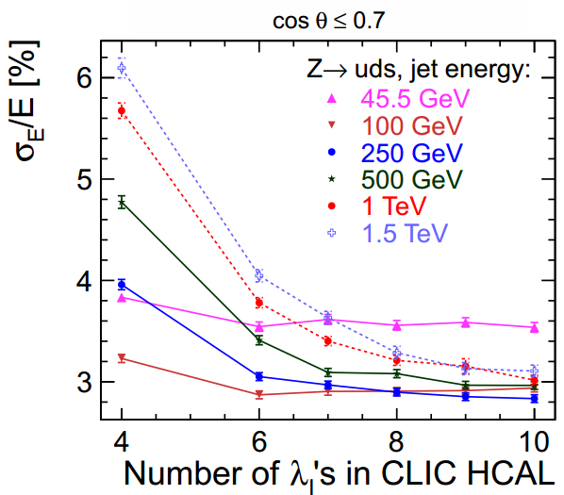
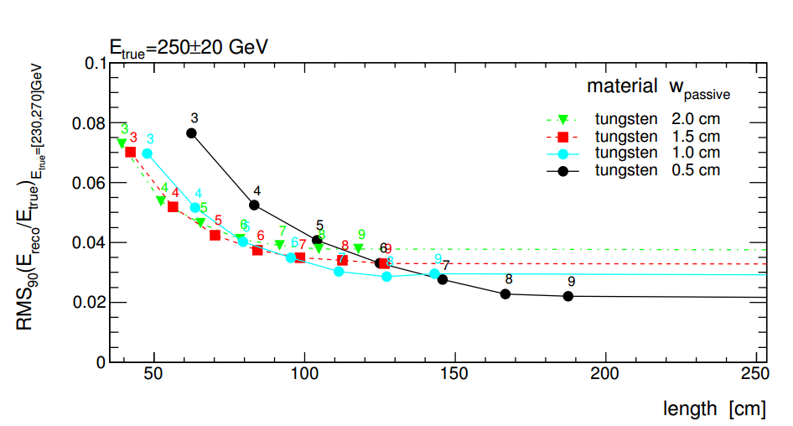
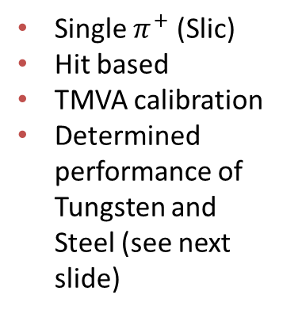
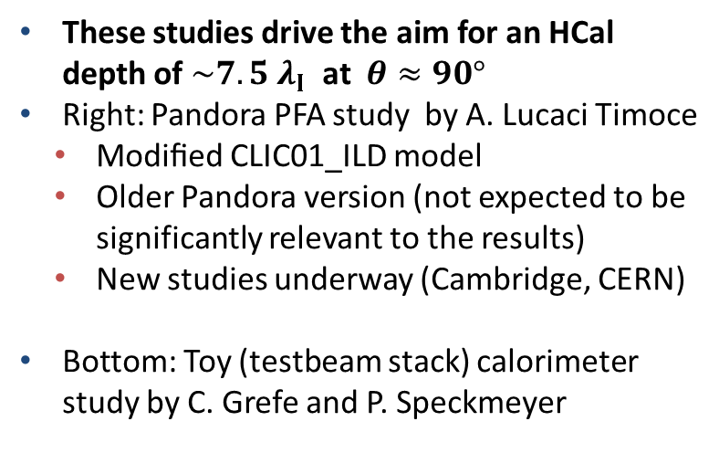

Plots from CDR
These studies drive the aim for an HCal depth of $\sim 7.5 λ_{Ι}$ at $θ≈90°$
Right: Pandora PFA study by A. Lucaci Timoce
  Modiﬁed CLIC01_ILD model
  Older Pandora version (not expected to be significantly relevant to the results)
  New studies underway (Cambridge, CERN)
Bottom: Toy (testbeam stack) calorimeter study by C. Grefe and P. Speckmeyer
CDR Fig. 6.2 and Refs. [3,4]
Single $π^{+}$ (Slic)
Hit based
TMVA calibration
Determined performance of Tungsten and Steel (see next slide)
Numbers indicate $\#λ_{Ι}$
CDR Fig. 6.1, see also Ref. [1]

Slide 12

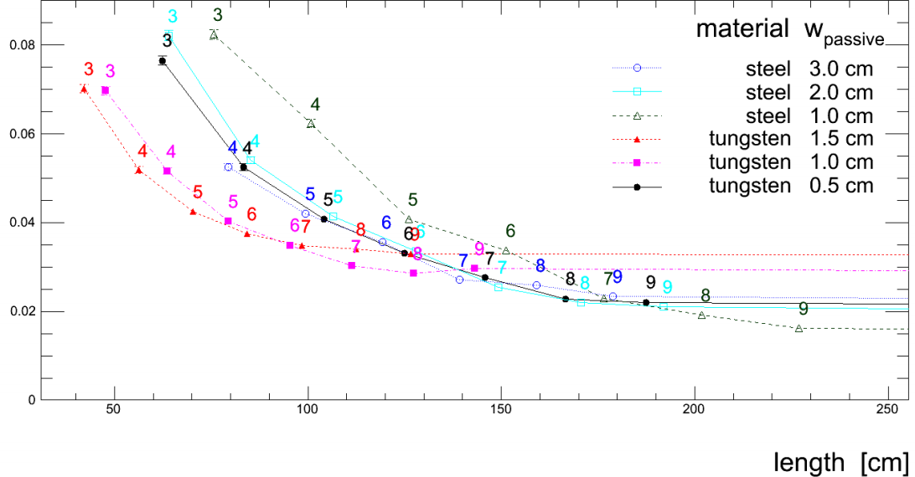
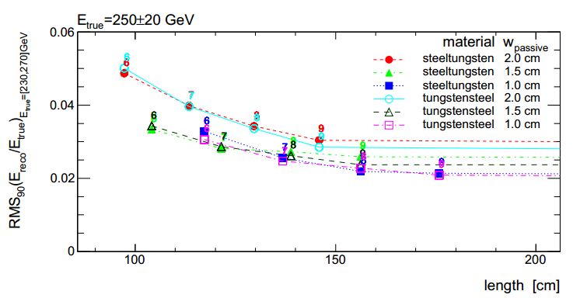

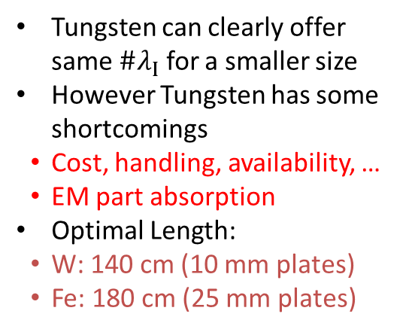
Steel/Tungsten Absorber Comparison (From [1])
Tungsten can clearly offer same $\#λ_{Ι}$ for a smaller size
However Tungsten has some shortcomings
  Cost, handling, availability, …
  EM part absorption
Optimal Length:
  W: 140 cm (10 mm plates)
  Fe: 180 cm (25 mm plates)
Numbers indicate $\#λ_{Ι}$
Taken from a talk by P. Speckmeyer [2], but studies fully documented in Note [1]
Note also discusses tungsten and steel combinations (W-Fe Vs Fe-W)
W-Fe (Steel downstream) appears to be preferable

Slide 13
Material Scan of W-HCAL (CLIC_SID_CDR)
Try to verify material budget in current detector geometry implementations
See whether we can squeeze some more the HCal outer radius
Scan using Slic/Geant4 (see backup)
Geometry Parameters:
(www.lcsim.org/detectors/clic_sid_cdr.html)
HCAL BARREL
Number Of Layers | 75
Number Of Sides | 12
Inner Radius | 1419 mm
Outer Radius | 2656.5 mm
Z Length | 3530 mm
Section Phi | 0.52 radians
Cell Size U | 30.0 mm
Cell Size V | 30.0 mm
Layers 0 - 74
10 mm | Tungsten
5 mm (sensor) | Polystyrene
1.5 mm | Air

Slide 14

CLIC_SID_CDR Material Scan in θ

Slide 15
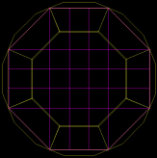
CLIC_ILD_CDR Material Scan in φ
Scan using Mokka/Geant4 (see backup)
Geometry Parameters:
(from CDR and http://www-flc.desy.de/ldcoptimization/tools/mokkamodels.php?model=CLIC_ILD_CDR)
HCAL BARREL | SHcalSc02
Number Of Layers | 75
Number Of Sides | (8) 16
Inner Radius | 2058 mm
Outer Radius | 3296 mm
Z Length | 4700 mm
Section Phi | 0.52 radians
Cell Size U | 30.0 mm
Cell Size V | 30.0 mm
Layers 0 - 74
10 mm | Tungsten
5 mm (sensor) | Polystyrene
1.5 mm | Air

Slide 16

CLIC_ILD_CDR Material Scan in θ
Note: this scan plot was not restricted to the barrel (includes the endcap)

Slide 17
References
HCal depth optimization Studies by C. Grefe, P. Speckmeyer
  LCD-Note-2010-01 on CDS: https://cds.cern.ch/record/1443830/files/LCD-2010-001.pdf
  http://indico.cern.ch/event/104099/contribution/3/3/material/slides/1.pdf (LCD weekly 17/8/10) - Just for illustration; better consult final results in note above
A.Lucaci PandoraPFA simulation study for #λΙ
  http://indico.cern.ch/event/106373/contribution/0/material/slides/0.pdf (WG2 meeting, 2/10/10)
  http://indico.cern.ch/event/107327/session/0/contribution/7/material/slides/0.pdf (LCD Software readiness meeting 27/9/10)
Tangential Sector/Drawer HCal layout and assembly (F. Duarte Ramos, H. Gerwig)
  https://indico.cern.ch/event/204269/session/19/contribution/182/material/slides/0.pdf
  http://agenda.linearcollider.org/getFile.py/access?contribId=126&sessionId=15&resId=0&materialId=slides&confId=5468
Alternate SiD assembly with Interlaced tungsten plate supports (M. Breidenbach)
  http://agenda.linearcollider.org/getFile.py/access?contribId=248&sessionId=32&resId=0&materialId=slides&confId=6301

Slide 18
Alternative HCal Assemblies/Layouts
HCal overall design, layout and assembly can play a significant factor in its optimization
  An optimal layout could perhaps reduce HCal outer radius (for a given material budget and/or sampling requirements
  Should also take into account and facilitate cable/readout routing
Mentioned in this talk are two alternative layouts:
  The Tangential Sector/Drawer assembly scenario (F. Duarte Ramos and H. Gerwig)
  Joint ECal/HCal support with a Wedge layout as proposed for SiD (M. Breidenbach et al)

Slide 19
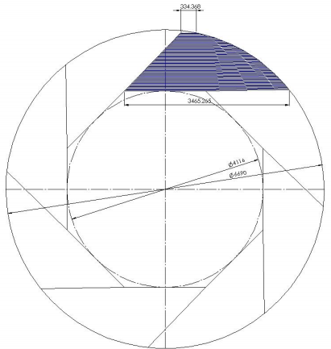
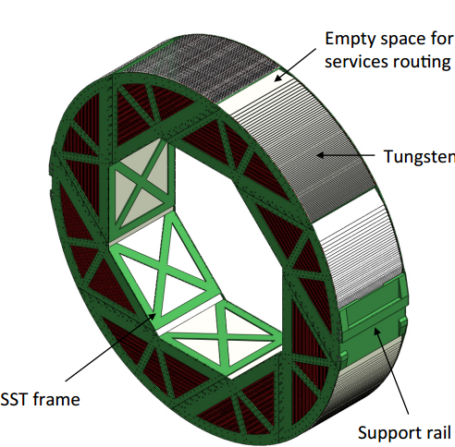
Tangential Sector HCal for CLIC_ILD_CDR [5,6]
Tungsten Plates
Designed to accommodate 75 layers per drawer
  Together with available tungsten plate sizes, drives octagon shape)
Three rings for a total length of 4.7 m
$R_{in}= 2058 mm$ (1st tungsten layer), $R_{out}=3345 mm$.
Total thickness: 1345 mm (incl 20 mm steel support and 3.5 gap before 1st layer)
Provides ease of assembly, structurally sound, takes into account material availability and limitations
Provides support with minimal additional material

Slide 20
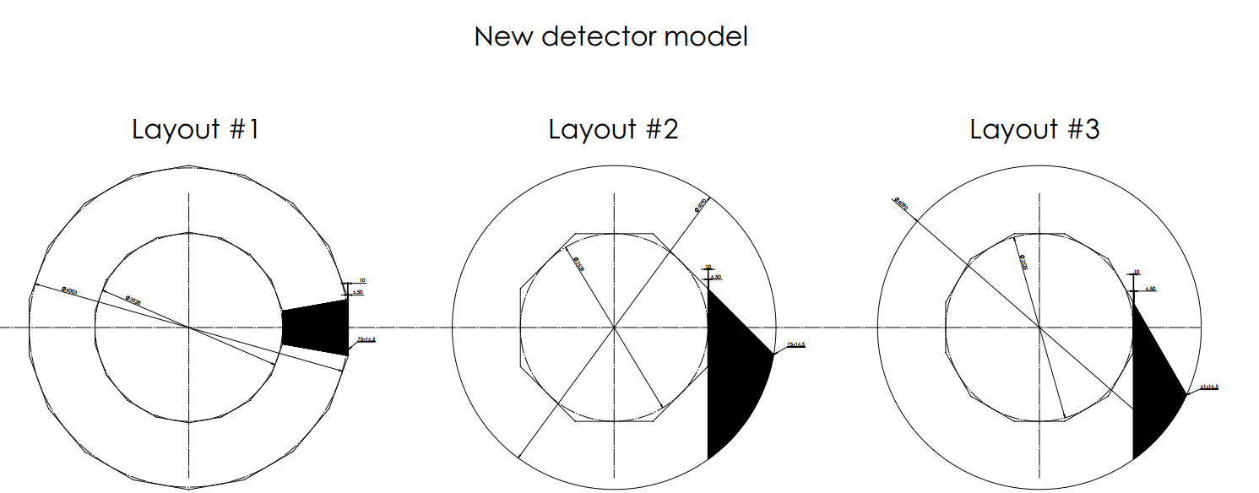
A Few More Layouts (from F. Duarte Ramos)
$$R_{in}=1764 mm$$
$$R_{face}^{out}=3001.5mm$$
$$R_{in}=1764 mm, R_{out}=3045 mm$$
Only the “Axial Wedge” model would satisfy a requirement of 75 discreet sampling layers

Slide 21
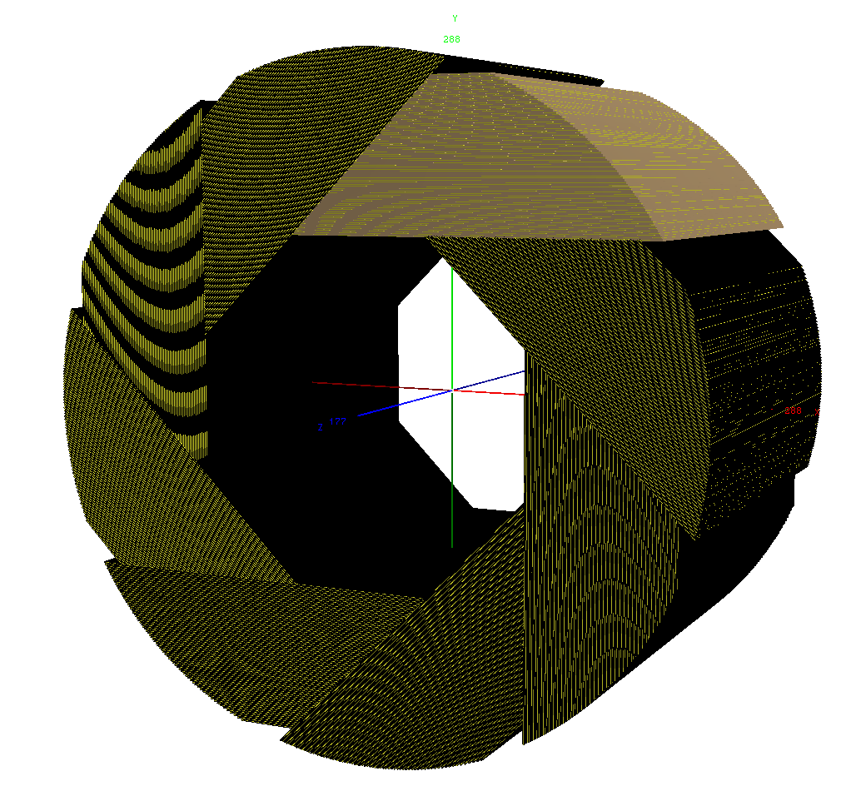
Model with DD4hep (based on CLIC_SID_CDR)
Primarily an exercise οn DD4hep and a way to study the material vs φ
  Probably no single φ-position “sees” 75 layers
  Effective “visible” material should still be close to nominal
  However, sampling fraction changes with φ (calibration?)
Started with CLIC_SID_CDR model dimensions
  $R_{min}=R_{in}=1419 mm$
  Actually had to increase $R_{max}=R_{out}$ from the Wedge model ($R_{out}^{wedge}=2656.5$) in order to accommodate 75 layers
  Used $R_{out}=2875 mm$ (HCalEndcap_rmax)
  Did not include support frame
  Only one cylinder (not three rings)

Slide 22
Material Scan in φ of “Tangential Sector” HCal
No cracks
φ-average of #λΙ: 7.9
  Cf. CLIC_SID_CDR: 7.4
  Cf. CLIC_ILD_CDR: 7.3
  (all according to my scans)
Probably can have same depth with fewer layers
  But would mean fewer samplings of course

Slide 23
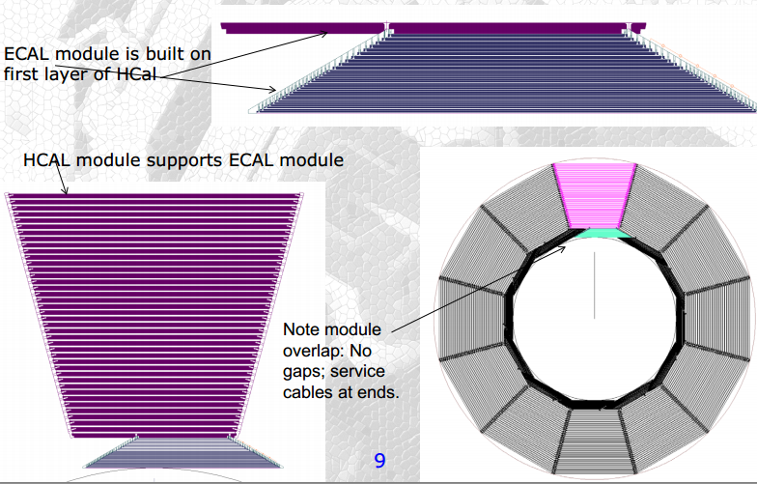
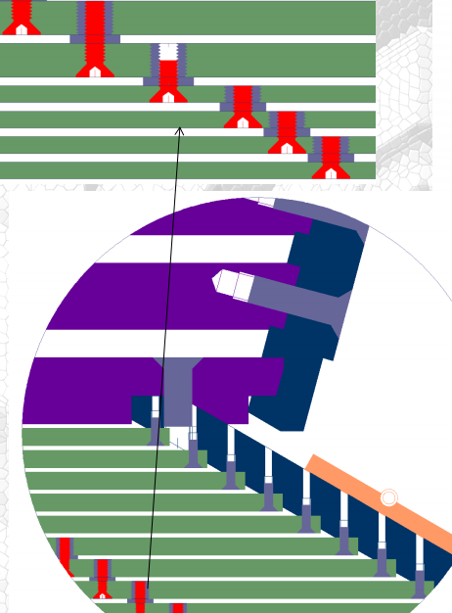
SiD ECal/HCal Assembly
Taken from [3] (Slides from M. Breidenbach)
Interesting layout, however it may prove hard to implement given the difficulties in Tungsten (brittleness, available sizes, etc)

Slide 24
Conclusions (?)
It will be an additional challenge to achieve the HCal goals as currently outlined (especially number of layers) AND minimize the solenoid inner radius
Further complicated by assembly, access and support requirements
Furthermore, one needs to take into account cabling (available material missing from today’s presentation)

Slide 25
Material Scan with Slic/Geant4
Used clic_sid_cdr.lcdd geometry description from lcsim.org
Added regions in lcdd file (to restrict scan to HCal/ECal)
<regions>
<region name="TrackingRegion" store_secondaries="true" cut="10.0" lunit="mm" threshold="1.0" eunit="MeV" />
<region name="HCalBarrelRegion" store_secondaries="true" cut="0.0" lunit="mm" threshold="1.0" eunit="MeV" />
<region name="ECalBarrelRegion" store_secondaries="true" cut="0.0" lunit="mm" threshold="1.0" eunit="MeV" />
</regions>
Used Geant4 “matScan” capability, e.g:
  /control/matScan/region HCalBarrelRegion
  /control/matScan/theta 1 0 0
  /control/matScan/phi 360 0 359
  /control/matScan/scan
Similarly for Mokka
  Use “–S” to select particular subdetector

Slide 26
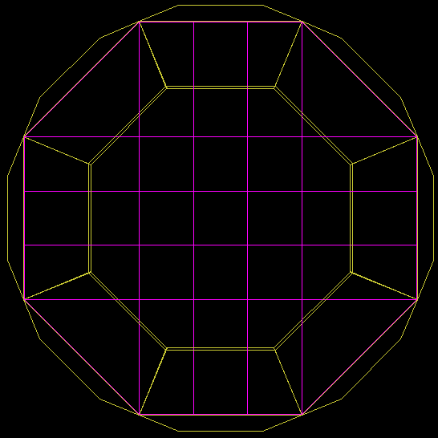
CLIC_ILD_CDR SHcalSc02

Slide 27
ILD AHCAL Assembly (from ILD TDR)
Active Element Cassette |  | ILD
Material | Thickness | Thickness
 | mm | mm
Steel | 2 | 0.5
PCB | 1.4 | 1
Cu (etching) | 0.1 | 0
Electronics (30%) | 1.5 | 1
Scintillator | 5 | 3
Sum (per layer) | 10 | 5.5
#λΙ (per layer) | 0.02 | 0.01
NB: ILD TDR also mentions “The active layers will contribute 4 mm of steel to each absorption layer”
Not shown in diagram?
16 mm (absorber layer) +
4 mm = 20 mm steel
+0.5 mm bottom plate?
Not clear what is done in code (comment says ignored)

