Slide 1
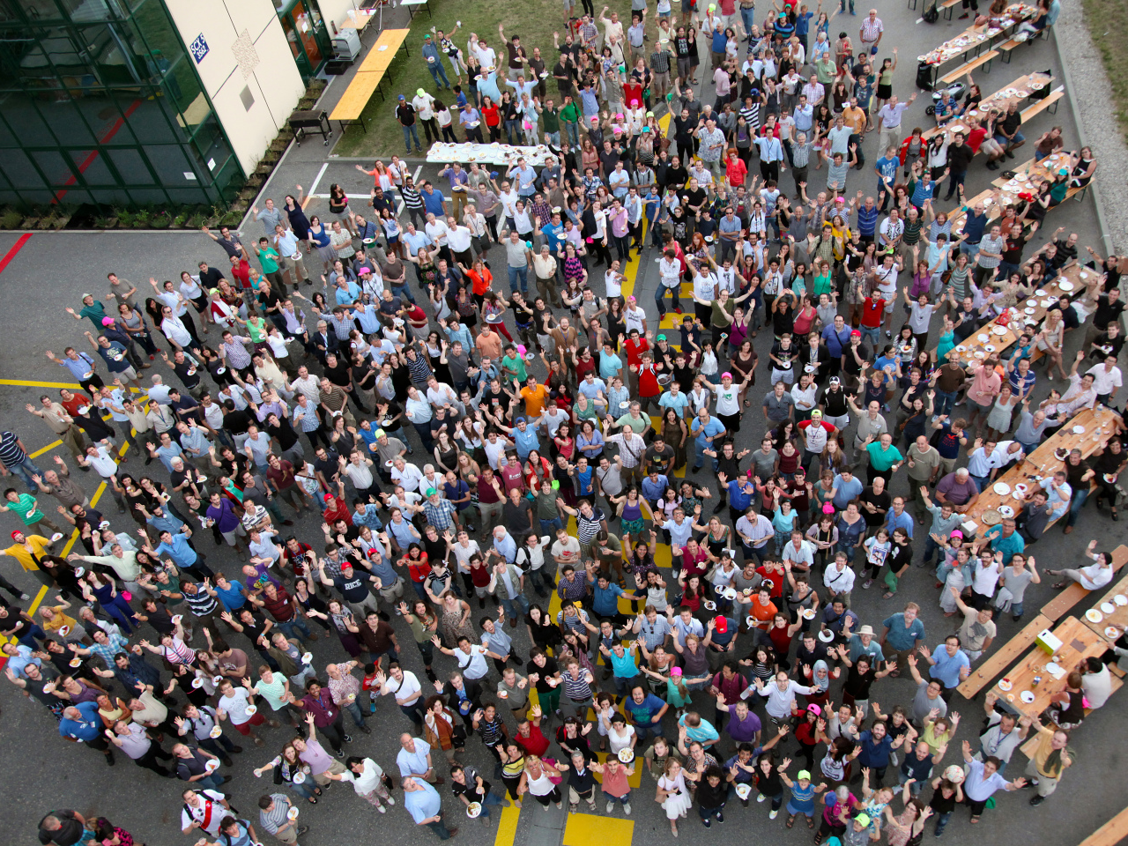
CMS
Collaboration
Industry Award ceremony
October 13th, 2014

Slide 2

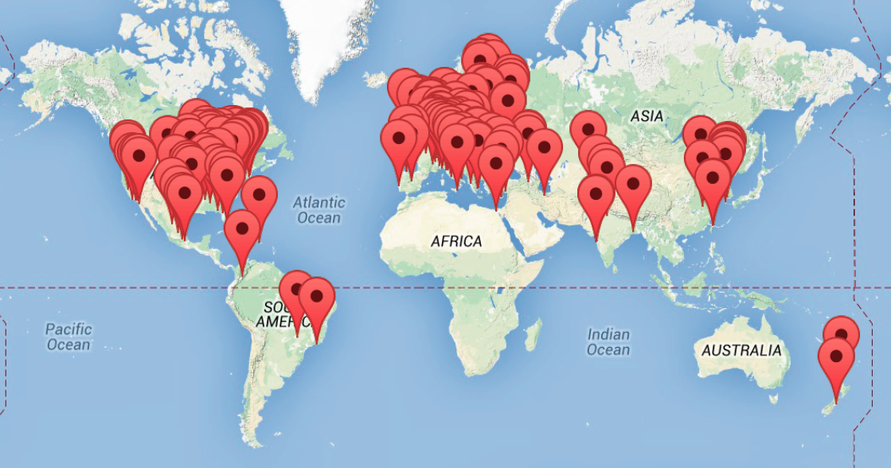
The CMS Collaboration
42 countries
183 institutes
1900 PhD physicists
Collaboration of institutes
850 engineers
690 undergrads
950 PhD students
caveat: map is not up to date
(~ 83% men, ~ 17% women)
https://cms-users.web.cern.ch/cms-users/cms/Management/Stats/stats.html

Slide 3
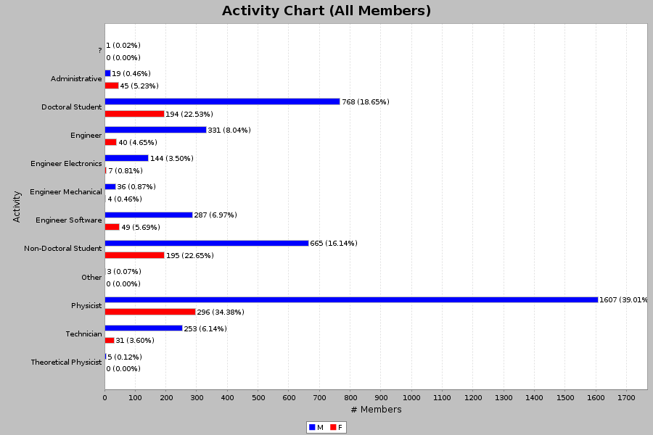
The CMS Collaboration – profile
Women
Men

Slide 4
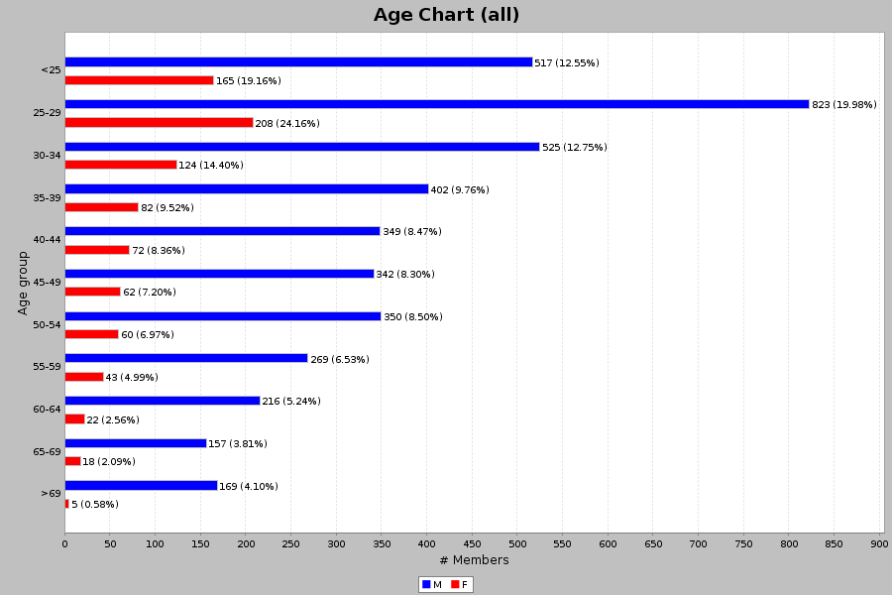
The CMS Collaboration – age
~50% of collaboration:
age < 35

Slide 5
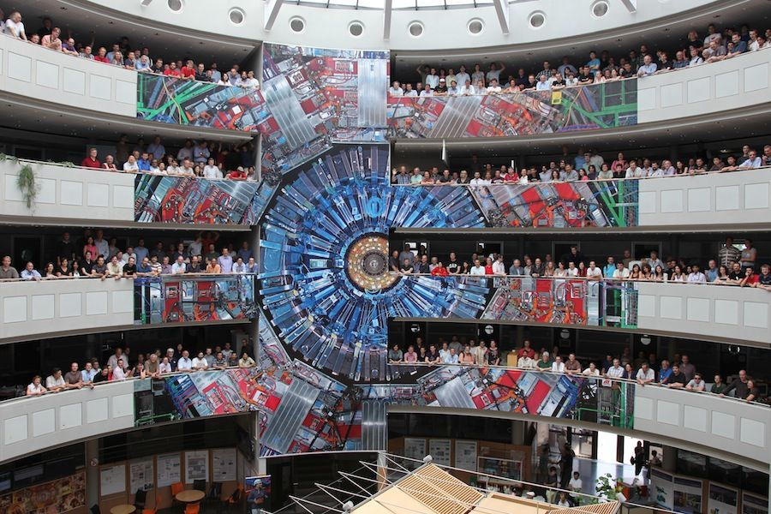
The CMS Collaboration

