Slide 1
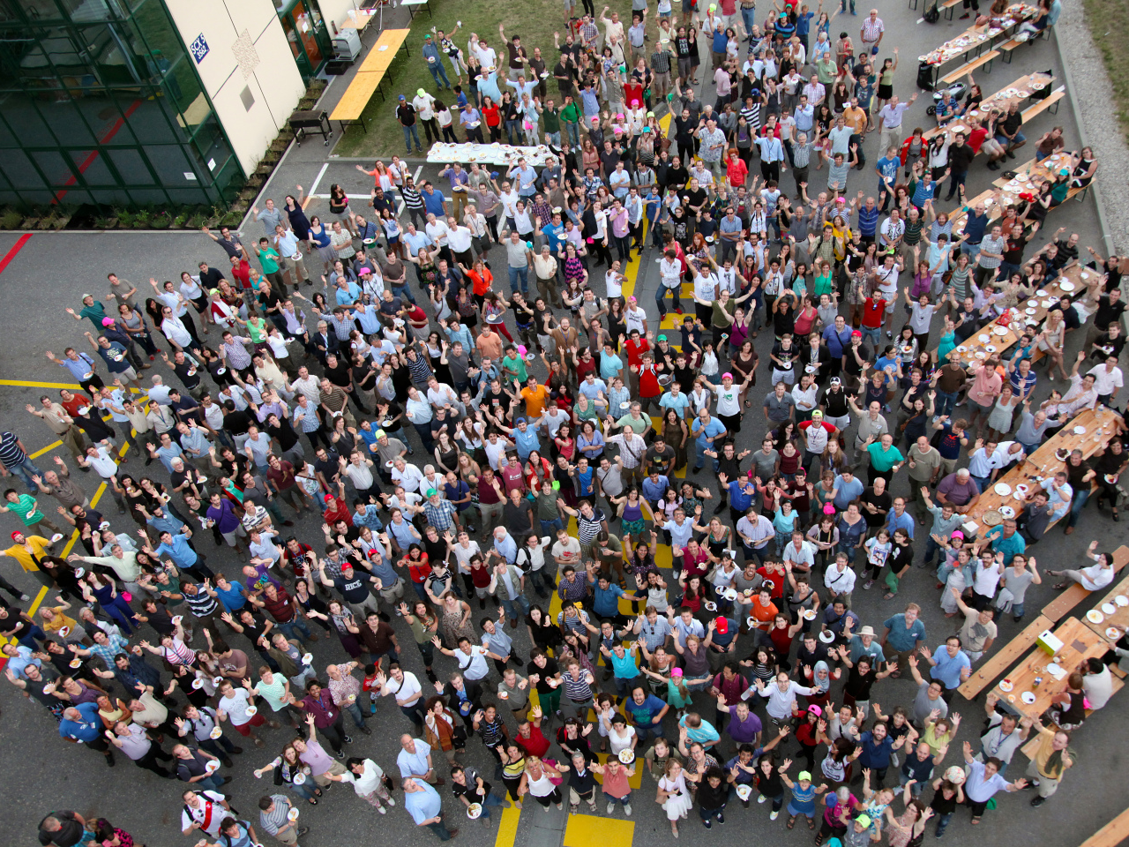
CMS
Collaboration
Career Event
October 13th, 2014

Slide 2
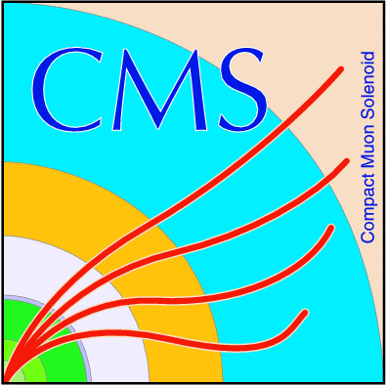
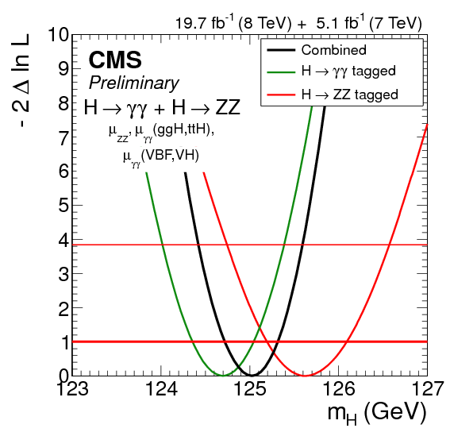
One of the many physics results

Slide 3
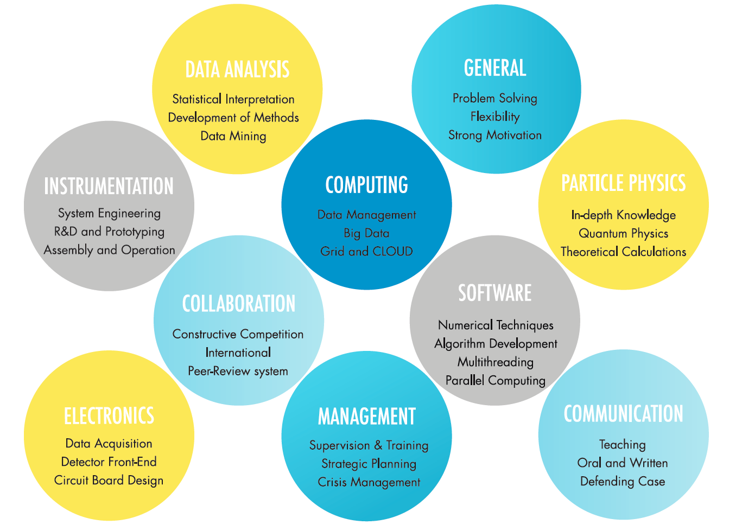
Skills of an experimental particle physicist
a snap-shot of the diversity

