Slide 1
Basic longitudinal structure of PyHEADTAIL
Helga Timko,
Alexandre Lasheen, Danilo Quartullo

Slide 2
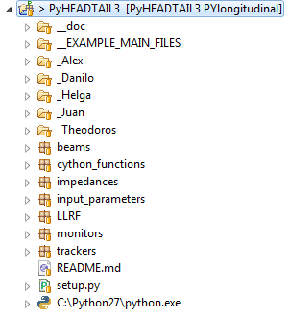
PYlongitudinal v 1.1 Basic Functionalities
Longitudinal tracker
E.O.M. as presented previously
Acceleration, multiple RF stations,
low-beta solution
Impedance (see Alex’ talk)
Input-output in 3 different units
Longitudinal statistics and plots
LLRF RF phase noise
To be extended with feedbacks
Documentation (‘gh-pages’ branch)

Slide 3
Versions and naming convention
PYlongitudinal Longitudinal “master” branch
Commits Have to be tested and transparent
Are given version numbers, v1.1.1
First digit Major change (e.g. single to multi-bunch)
Second digit Minor improvement; recommended to be
downloaded
Third digit Smaller bug fixes; you can continue with your
previous version if it doesn’t affect your work

Slide 4
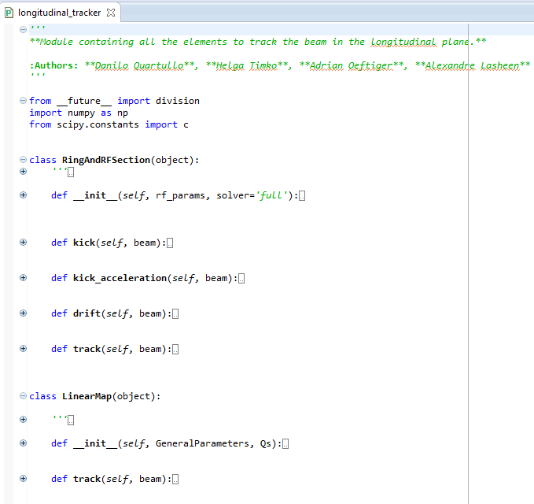
Longitudinal tracker
We ended up with the kicks and drift being part of the RingAndRFSection, as the class is already defined in a way that gives the most general combination of the kicks and the drift that is implemented

Slide 5
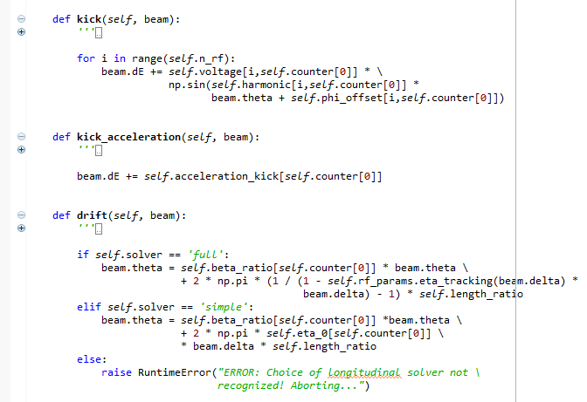
Longitudinal tracker equations
According to the E.O.M. presented in the previous meeting…
Full eta calculation
Zeroth order eta

Slide 6
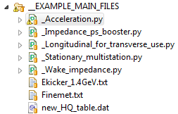
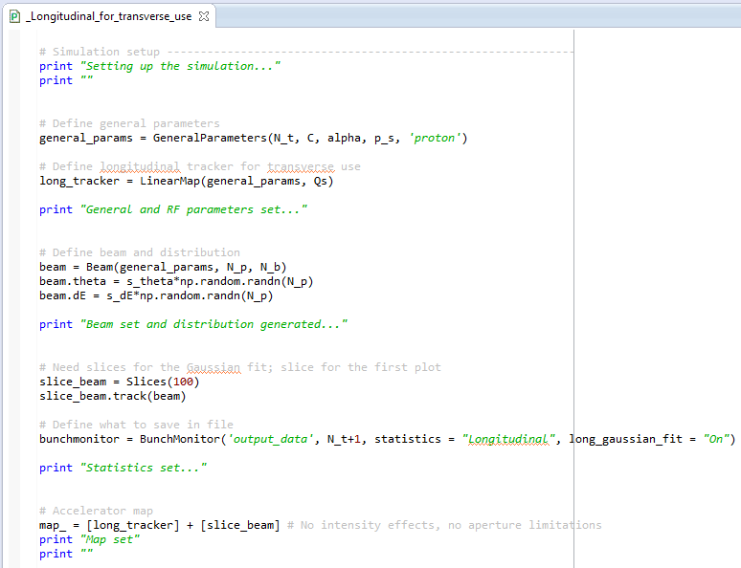
__EXAMPLE_MAIN_FILES Minimal longitudinal part

Slide 7
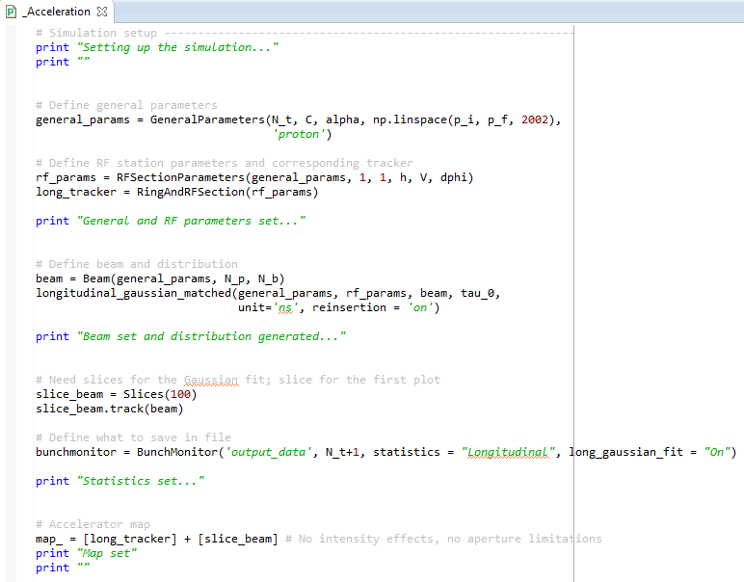
__EXAMPLE_MAIN_FILES Acceleration

Slide 8
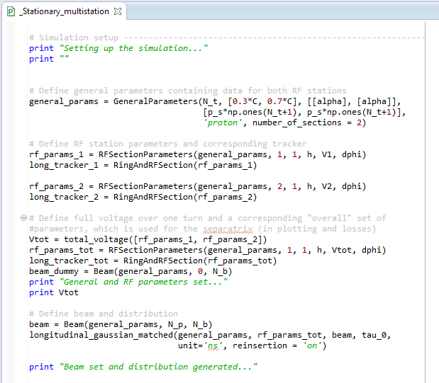
__EXAMPLE_MAIN_FILES Multiple RF stations
Temporary solution

Slide 9
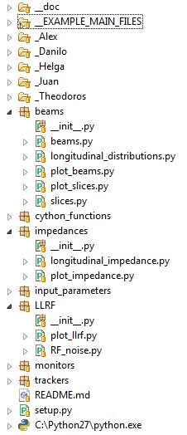
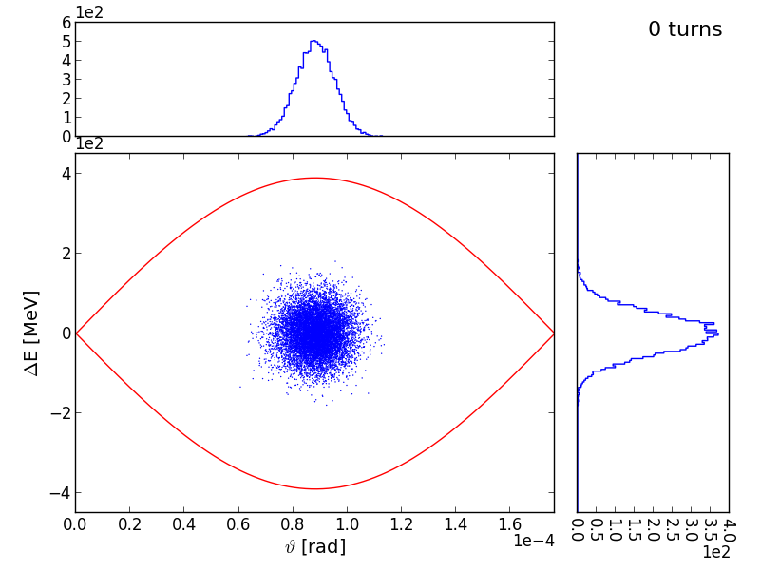
Some basic output
Longitudinal phase space, bunch length… etc.

Slide 10
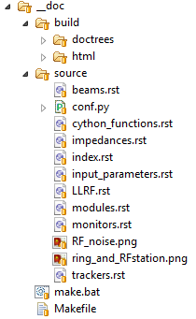
Sphinx documentation
Edit .rst files
Modules to be documented
Comment python files
See next slide
Compile and create ‘build’ folder
Run ‘make html’ in ‘__doc’ folder
Update the gh-pages branch
Copy the content of ‘html’ folder
For more info, ask Alex
Check out the cheat sheet

Slide 11
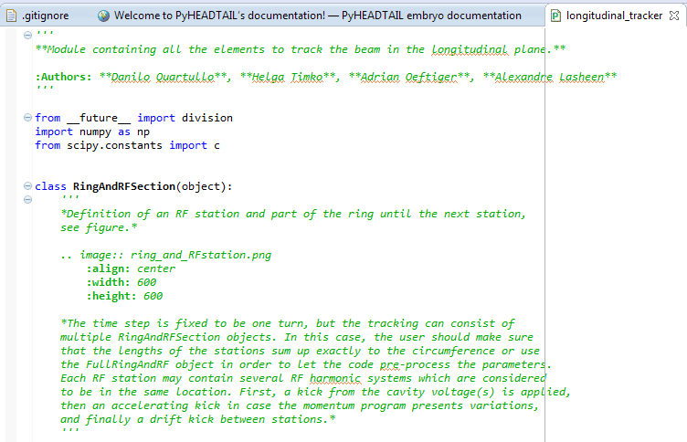
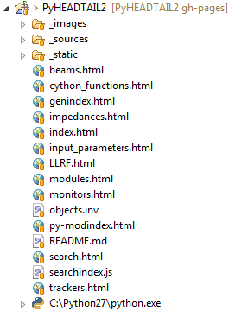
Sphinx documentation – Commenting python files
HEADER, AUTHORS
CLASSES and FUNCTIONS
INSERT IMAGE

Slide 12
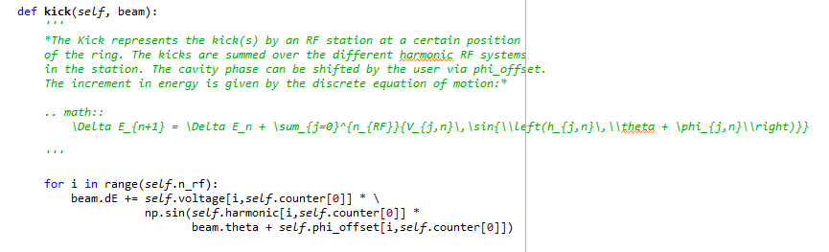
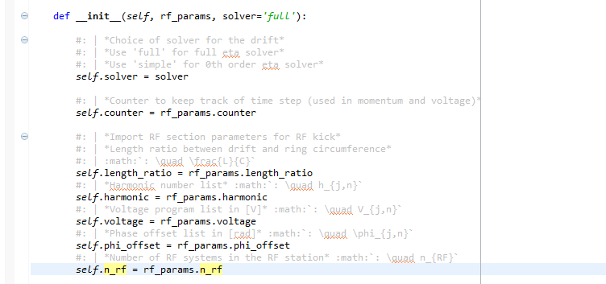
Sphinx documentation – Commenting python files
MATH
in function or class
PROPERTIES
USE | for new line
USE * for italics
MATH
in property

Slide 13
Conclusions
PYlongitudinal is ready to use
The tracker Has been benchmarked
Version numbers Only tested features can be added to the
code to make all modifications as transparent as possible to the user
Contact Danilo for any modifications

Slide 14
What’s left to do
Longitudinal_utilities.py
Methods for separatrix, hamiltonian, total voltage, etc. are presently defined for single RF only
Needs to be extended for multi-RF, multi-station cases
Generating matched bunch distributions
Only single RF, Gaussian distribution, w/o intensity effects
Matching w/ adiabatic increase of impedance already possible
Matching w/ Hamiltonian needs to be implemented (Theodoros)
Implementing other distributions (parabolic, etc.)
LLRF Planned extension w/ feedbacks
Slices Need to agree on this together (see Alex’ talk)

Slide 15
Outlook
Multi-bunch case Danilo, from September (?)
Merge transverse and longitudinal codes
Agree on the common transverse version
Meanwhile develop transverse and longitudinal parts such that they stay compatible
Not wait too long to update the master branch with a merge of the two
⇒ We’ll have to sit down and do the final merge together!

