Slide 1
PG2 Solid State Tracking Detectors
PG2: Solid state tracking detectors | Old PG2 (tracker)+HGCAL | 120’
Seems like we are all newcomers here
Topics are arranged according to R&D topic not sub-system as it was in 2013
  Meaning mechanics and standard electronics are in other groups
  Not much introduction necessary
  No generic R&D
  Can be more flexible and include a few invited talks on topics not included in session

Slide 2
How to Organise This Time:
Stay with all plenary format to keep the communication flow
Should not need as much introduction
Should involve theory and accelerator communities much more closely with more talks in these areas
Try to build on synergies identified/developed since last time and emphasise common approach
Therefore have proposed to organise sessions now more by R&D area than sub-detector/system
Need to keep clear relationship with HL-LHC detector needs (not a generic R&D discussion)
Need a way of preparing material that is as inclusive as possible ie:
  open groups to contributions from all interested collaborators
  through dedicated meeting or mini-workshops
Can be more flexible and include a few invited talks on topics not included in sessions
From first global prep meeting (Frank was not present)

Slide 3
Daniel’s and Frank’s first thoughts
Needs and interests of all four experiments must be covered
  But we might need to make some choices to fit in 2 hours
IMHO, we should focus on synergies and on challenges and wherever possible how we intend to tackle these!
Our interpretation of “Solid State Tracking Detectors” is the Trackers, the High Granularity Calorimeter (since it was requested in column 2 but no beam radiation detectors or luminometers etc.
IMHO, we are quiet advanced in the outer tracker and I see the main challenges in the pixel systems ergo propose to concentrate there
  It’ll be less glory but probably more challenging

Slide 4
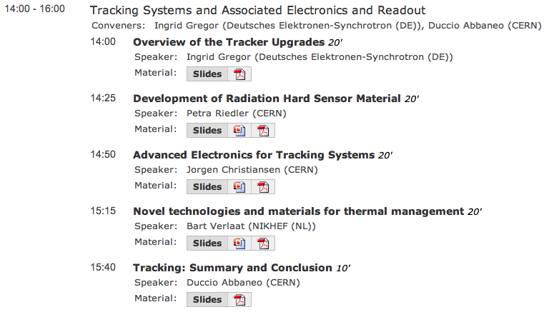
Session 2013

Slide 5
Daniel’s and Frank’s first thoughts on topics
Need to have 5 min in between each talk!
Can accommodate 5-6 talks max
What about
  Intro – 10 min (+5)
    layouts; concepts; physics motivation; challenges
  Sensors – 20 min (+5)
    Short status on OT since the R&D is mainly done
    Status and next steps on commercial aspects
      Will ATLAS and CMS go for a common MS?
    Pixel challenges (technicalities in small pitches / thickness)
    Etc.
  Pixel electronics – specific challenges – 20 min (+5)
    RD53 – radiation hardness of 65nm – granularity/connectivity
  HGCal – 15 min (CMS specific but novel) (+5)
    Technicalities – challenges – synergies/specifics
  Summary Talk – 10 min
    Concise executive summary of the challenges ahead!
Will need to clarify overlap with PG5 but IMHO the specifics belong here
20 min gives room for 1 (2?) more talk
CMOS – 10 min ?
Rates (trigger & readout)?
  Could be part of the pixel electronics)
  Do we want it for OT
Should we discuss BB?
Should we discuss modules?
We could discuss problems with services and power??
95 min
Am I to focused on ATLAS and CMS?

