Slide 1




Highlights from Run-I
from the CMS Experiment
Albert De Roeck
CERN, Geneva, Switzerland
Antwerp University Belgium
UC-Davis California USA
IPPP, Durham UK
BU, Cairo, Egypt

Slide 2
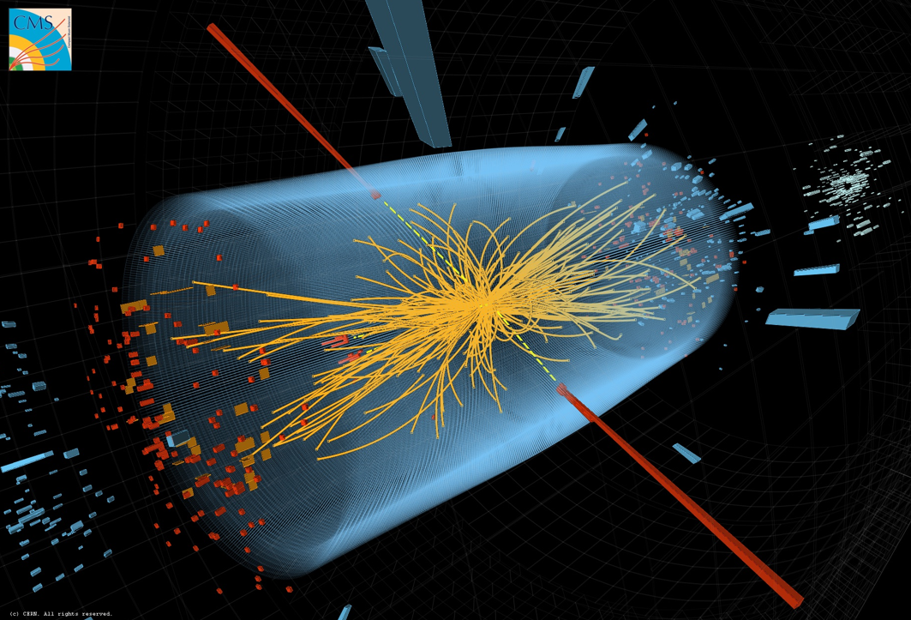




Outline
Standard Model Physics Results
Beyond the Standard Model!
“In Search of new Physics”
The Higgs Particle!!
Summary
Disclaimer: selected highlights
No discussion on details
Melbourne 4th July 2012,
late afternoon

Slide 3
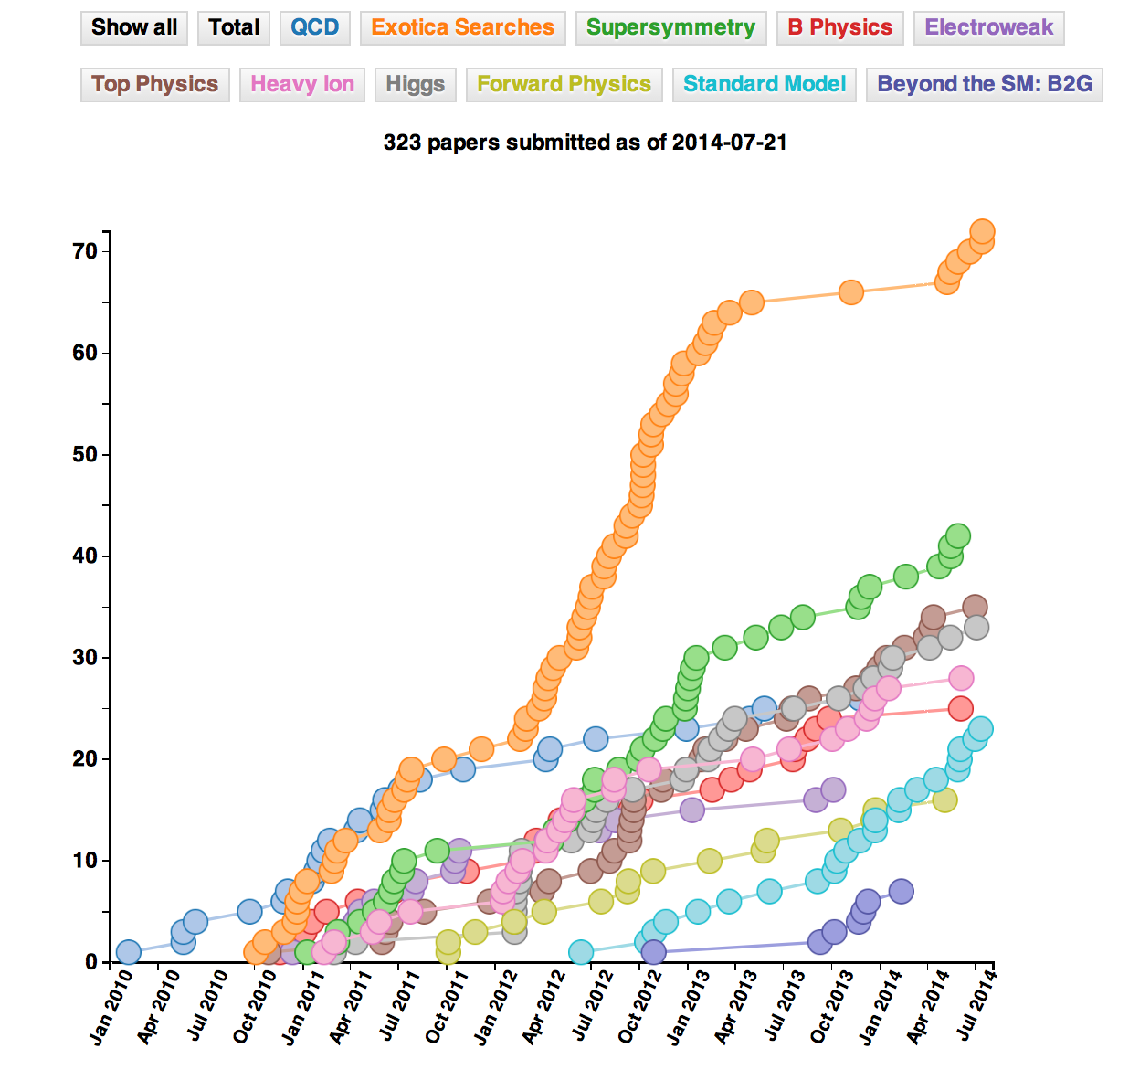
CMS Publications
323 publications on
pp (and pPb/PbPb)
physics since
January 2010
(03/8/2014)
Mostly on exotica
searches and
supersymmetry
(>100 papers
together)
Slightly too much
for 30 minutes ☹

Slide 4

Most cited paper so far...
Special Physics Letters B edition with the ATLAS and CMS CMS papers on the Higgs Discovery
Also…
More than 3000 times
cited so far…

Slide 5
Standard Model Studies
The study of the Standard Model at 13/14 TeV will be one of the
first points to tackle at the new energy.
The first QCD and Electroweak Studies can be done with << fb⁻¹
Luminosity profile in 2015 not fixed yet but the LHC is likely to make a careful start with low luminosity for some time, maybe a stop after the first 1 fb⁻¹

Slide 6
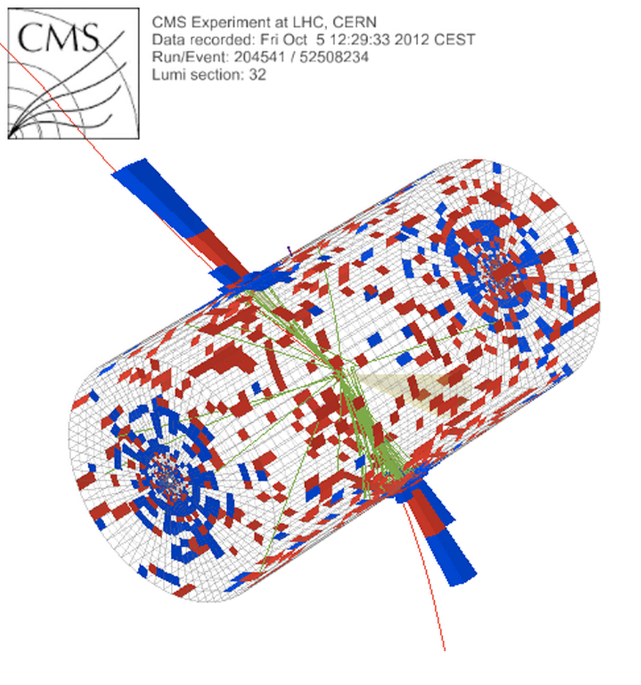
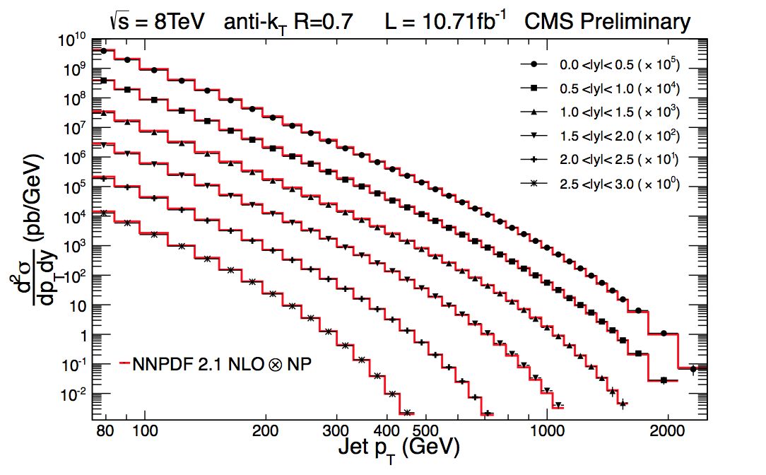
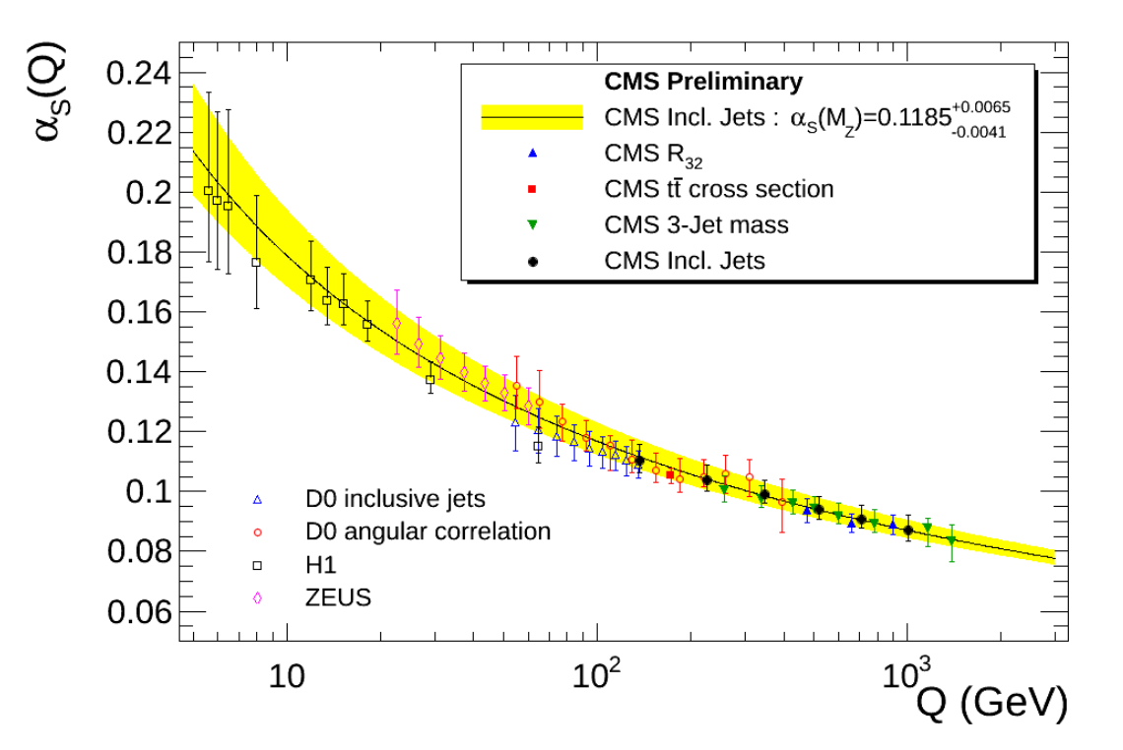
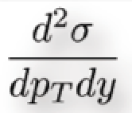


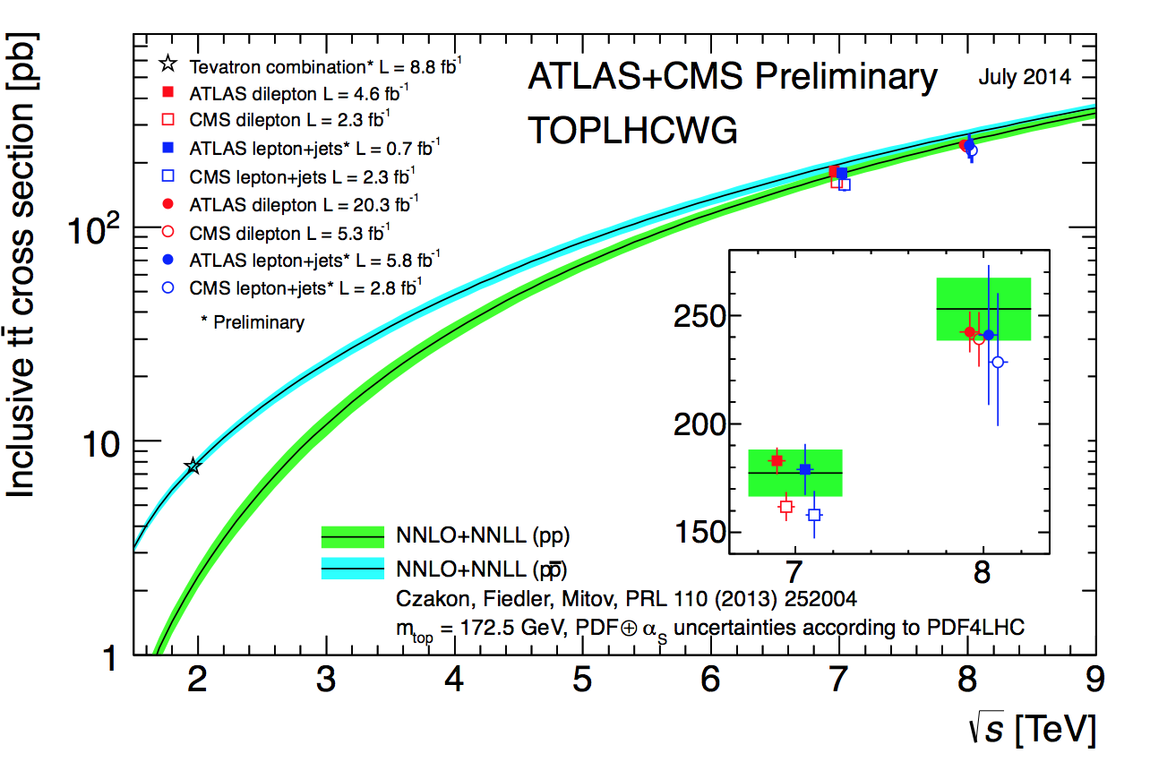
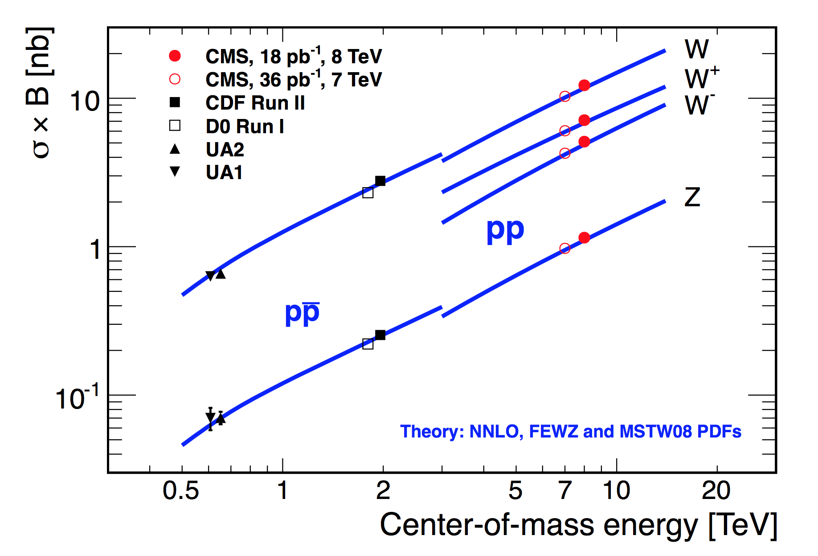
Jets, EWK Bosons, Top…
CMS-PAS-SMP-12-012
Precise measurements can
already be made with ~ 10 pb⁻¹
Di-jet invariant
mass = 5.15 TeV
(R=1.1 jets)
Measurements at 7/8 TeV in agreement with (N)NLO QCD

Slide 7
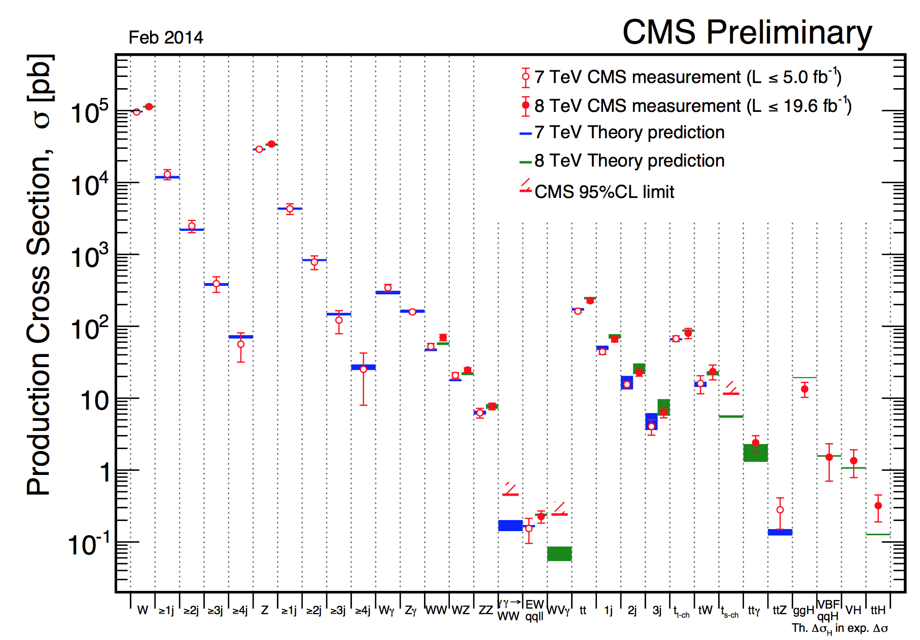
Summary: Cross Sections at 7/8 TeV
Measurements in good agreement with the Standard Model predictions

Slide 8
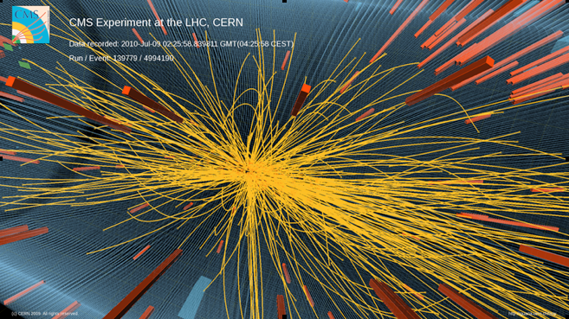
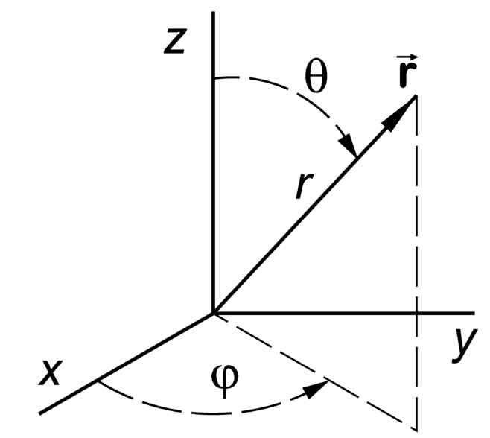
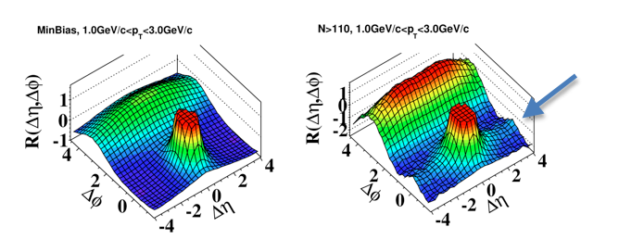
Correlations Between Produced Particles
•Select high multiplicity events
•Study the correlation between
two charged particles in the
angles φ (transverse):
Δφ and θ (longitudinal): Δθ
η= -ln tanθ/2
All events
High multiplicity events
A new phenomenon
in the ‘stronge force’?
•Multiple interactions?
•Glass condensates?
•Hydrodynamic models?Still not quant. explained
JHEP 1009 (2010) 091
This was the first (subtle) new effect, in 2010, studying the strong force…
Was first seen in AA, then pp (unexpected) and now also pA (~unexpected)

Slide 9
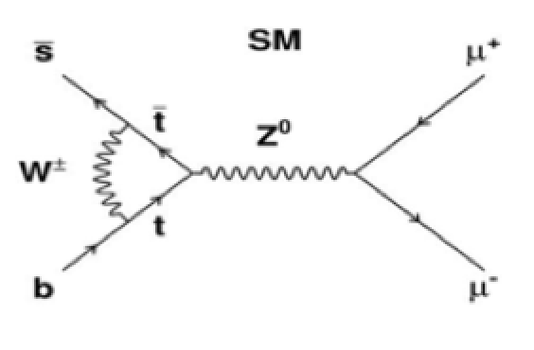
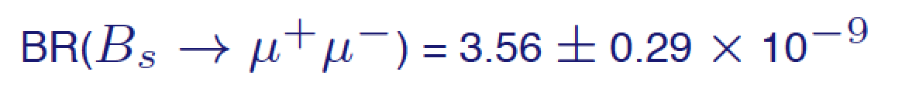
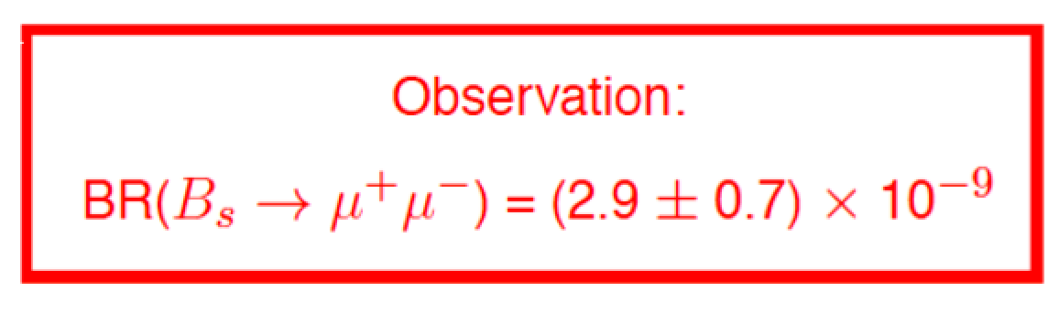

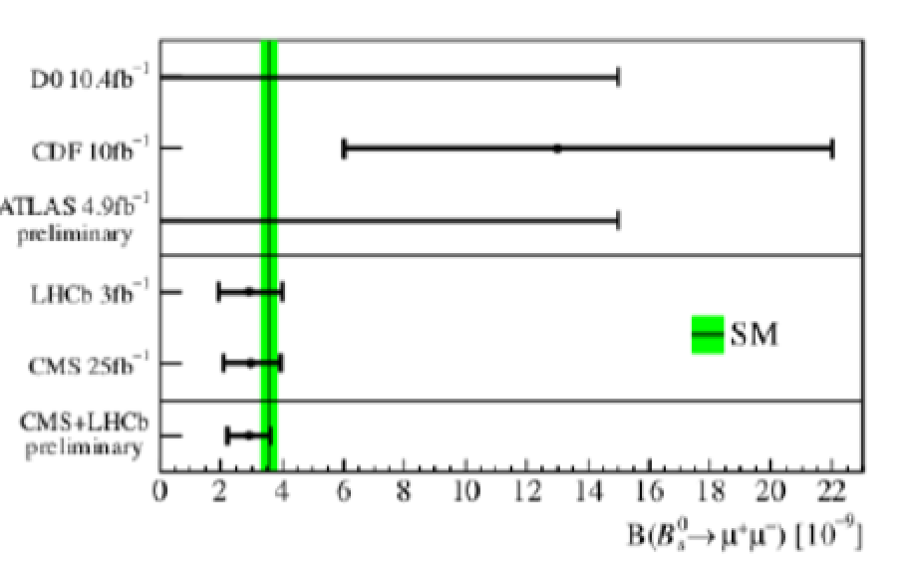
Precision Measurements: B_{s(d)} →μμ
2013
•A B_{s} particle is a particle consisting of a beauty-quark
and strangeness-quark, with a mass of ~ 10 GeV
•Three B_{s} particles in a million will decay into two
muons. This decay has been chased since 30 years.
•New physics modifies these Standard Models predictions
CMS-BPH-13-007
Results from
LHCb +CMS
experiments
combined
But no sign of New Physics here…☹

Slide 10
Searches for Supersymmetry
or other Exotic New Physics
We understand the Standard Model at 7 & 8 TeV from the
Standard Model measurements made, as reported before
Ready to search for physics BEYOND THE STANDARD MODEL

Slide 11
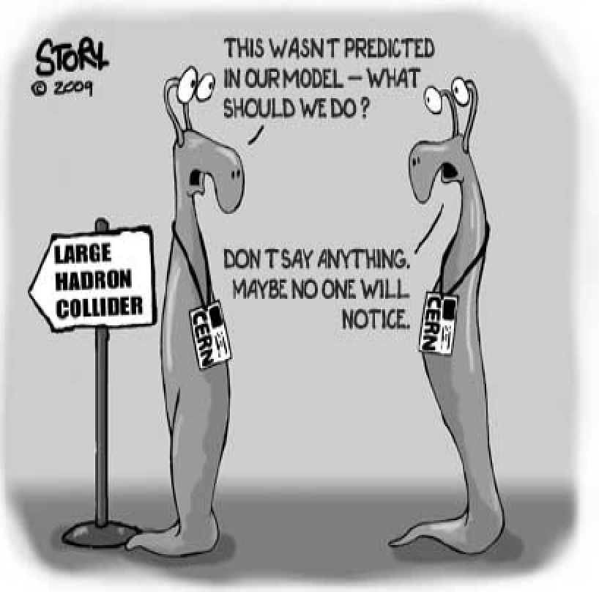
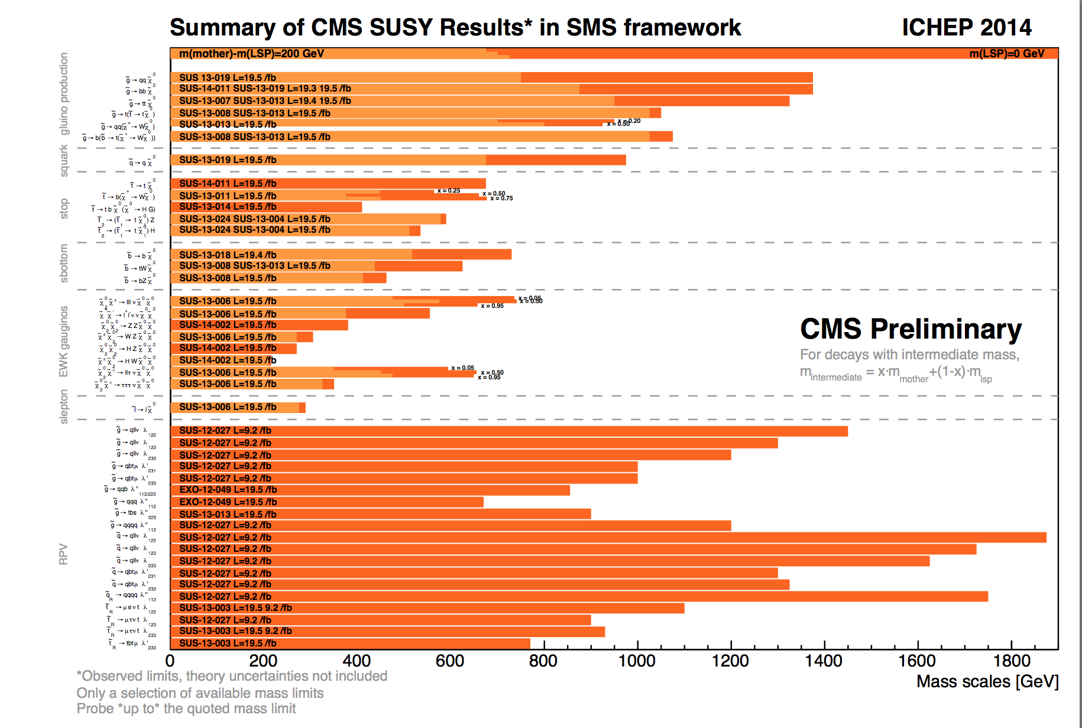
Summary of SUSY Searches
In short: no sign of SUSY with the data collected so far
https://twiki.cern.ch/twiki/bin/view/CMSPublic/PhysicsResultsSUS
New: compressed spectra, heavy stop (t₂) search, extended incl. searches…

Slide 12
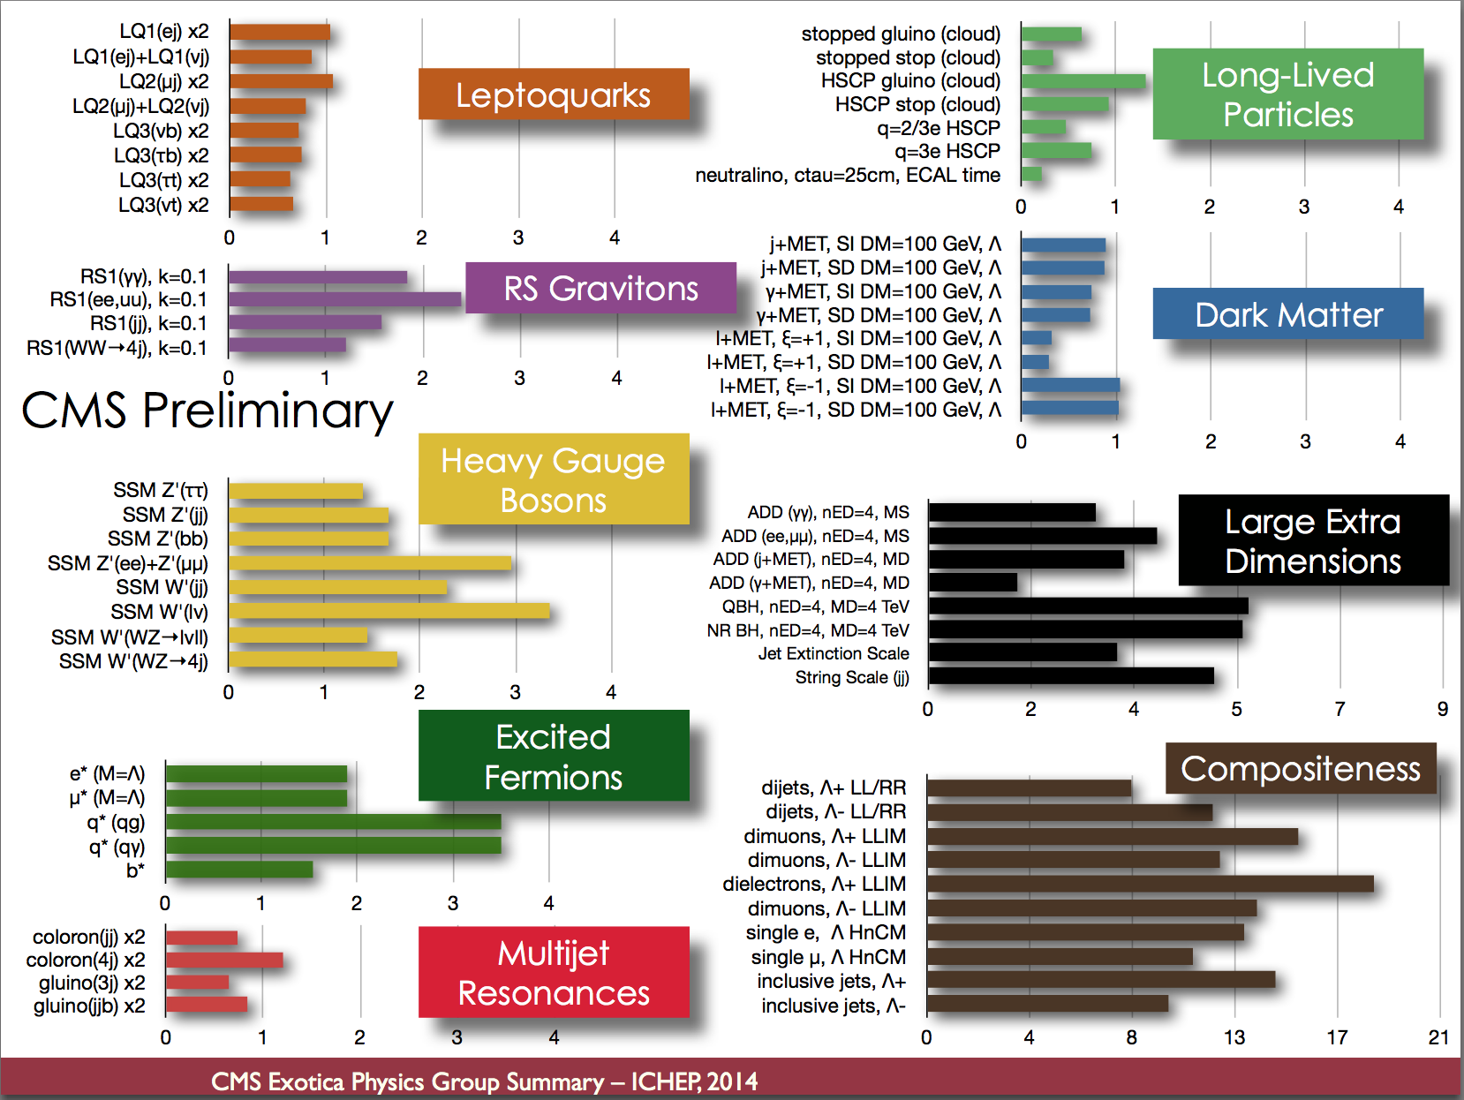
Summary of Exotica Searches

Slide 13



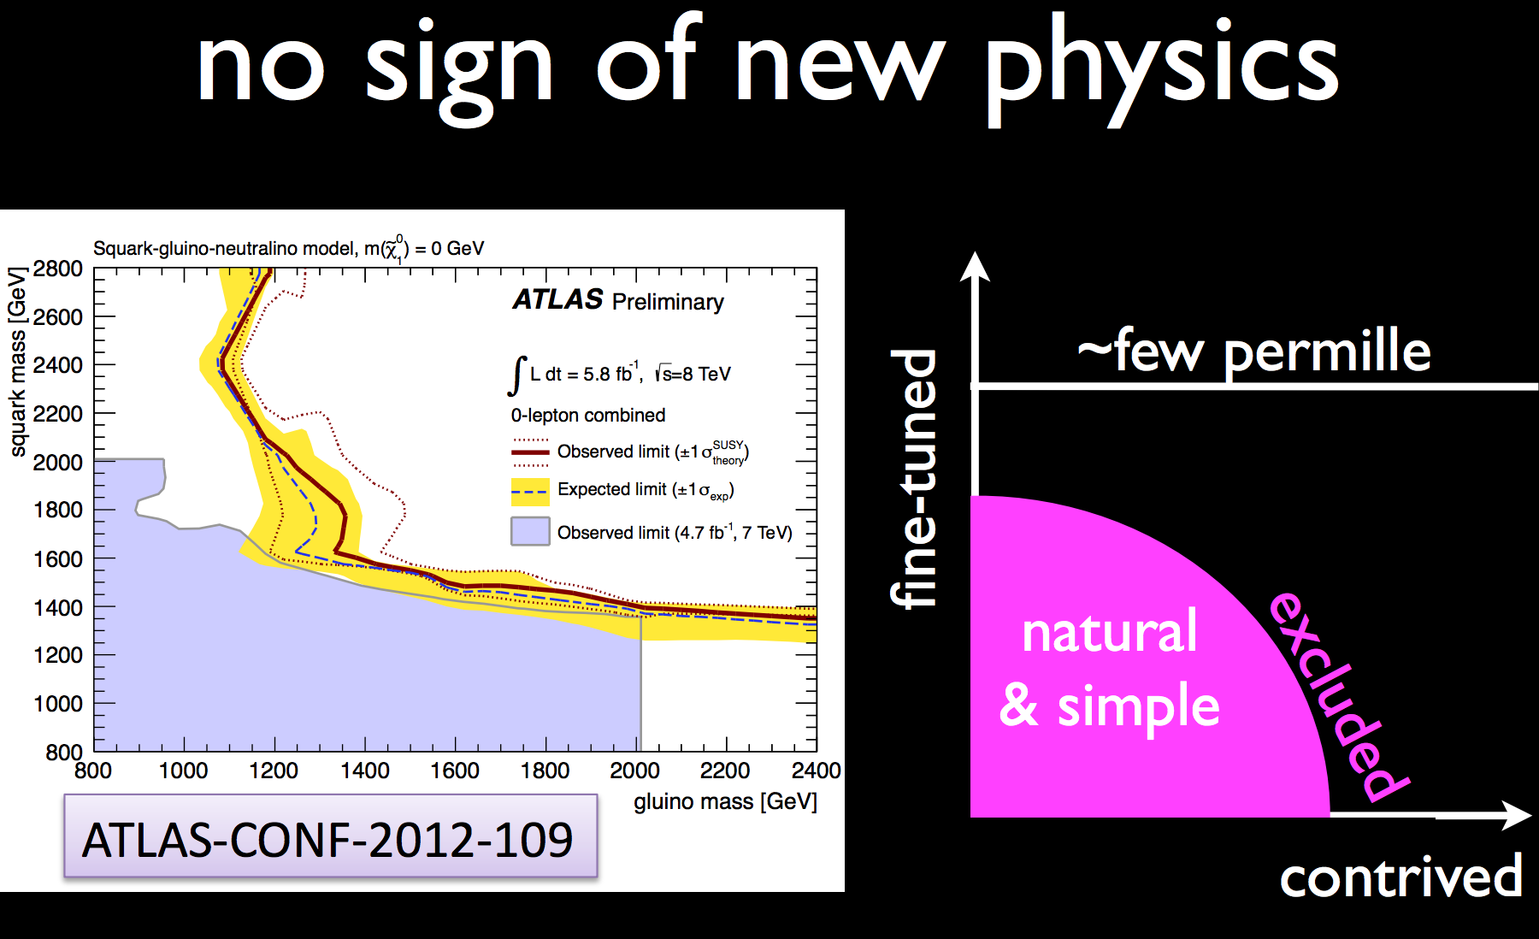
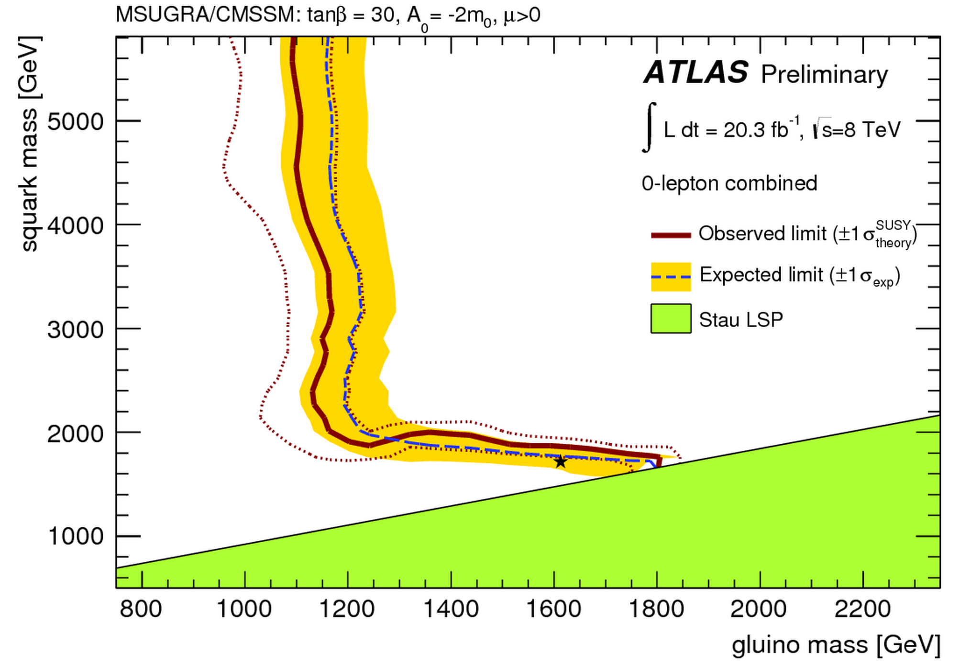
Supersymmetry? New Physics?
N. Arkani-Hamed
…The May Issue...
H. Murayama
allowed
excluded

Slide 14
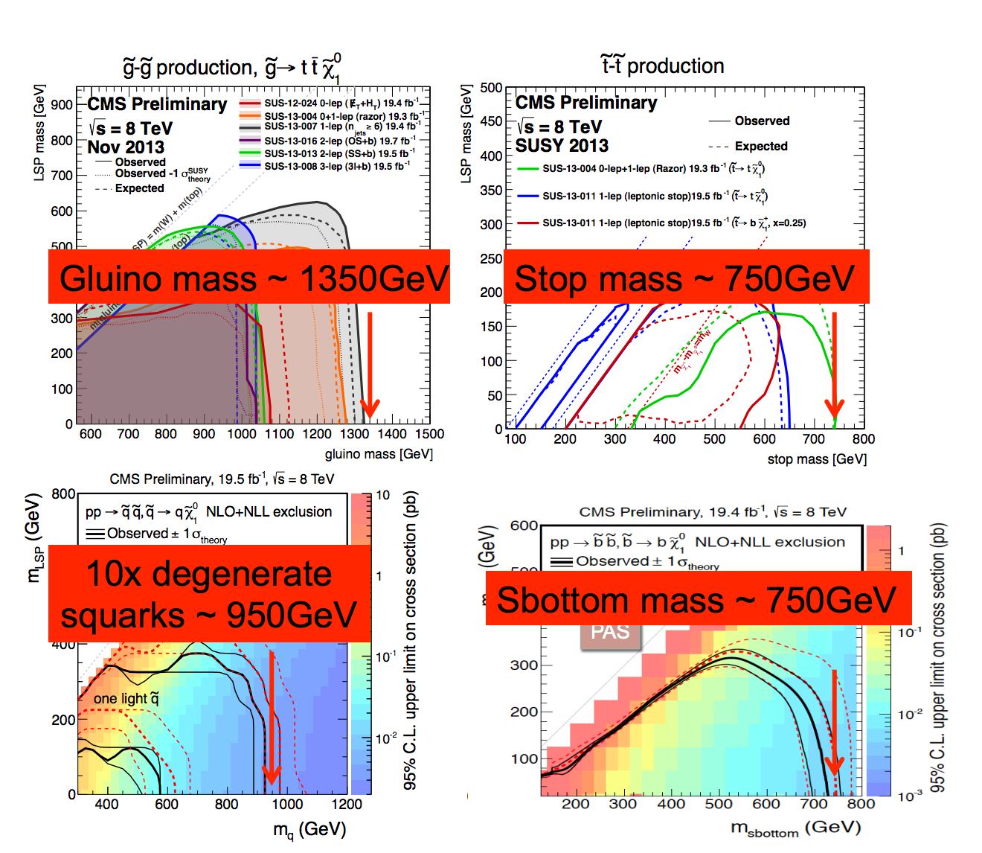
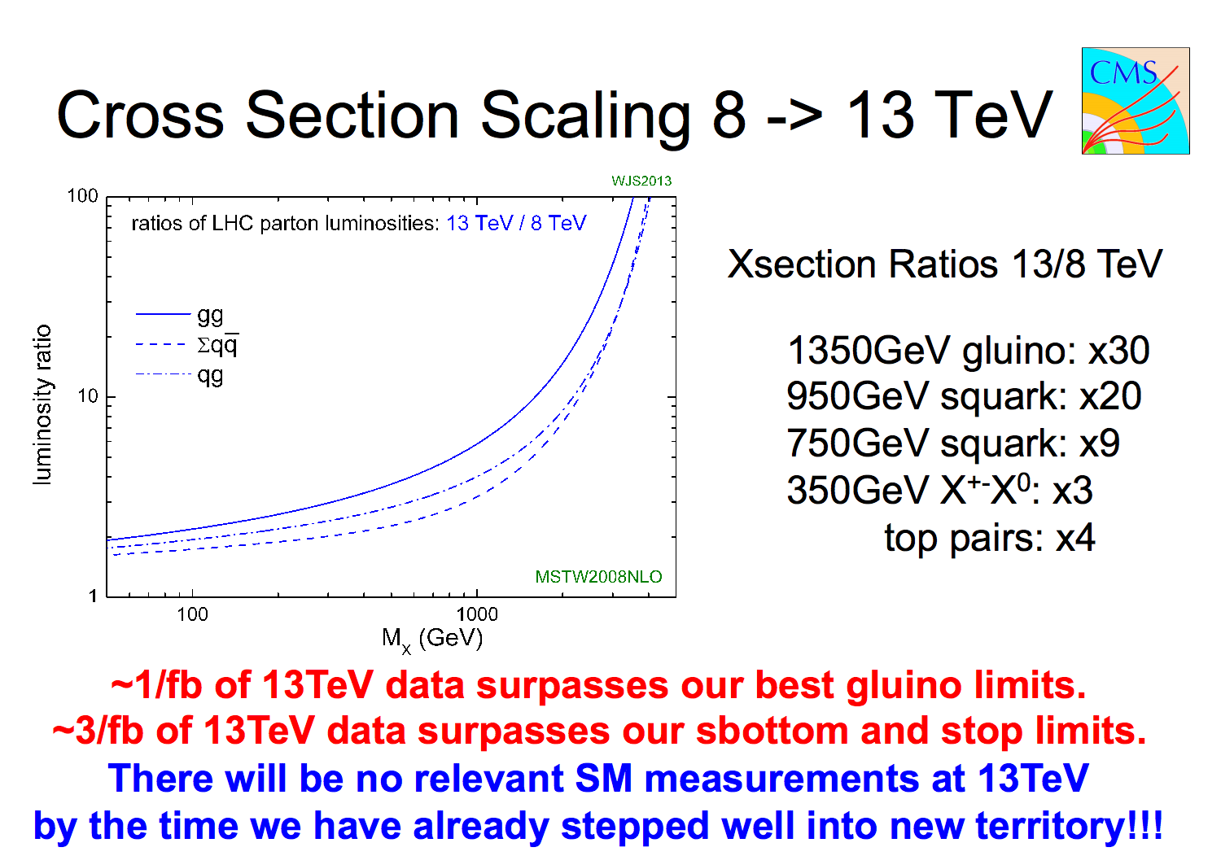
SUSY Prospects @ 2015/2016
Expect ~ 10-20 fb⁻¹ in 2015 & 40 fb⁻¹ in 2016 (present guestimates)
Now 2014
2015-2016
March CMS-SUSY workshop (Lisbon)
0.5-1 fb⁻¹ would be enough for first analyses entering new teritory
We expect that have such a sample by Summer 2015!!

Slide 15

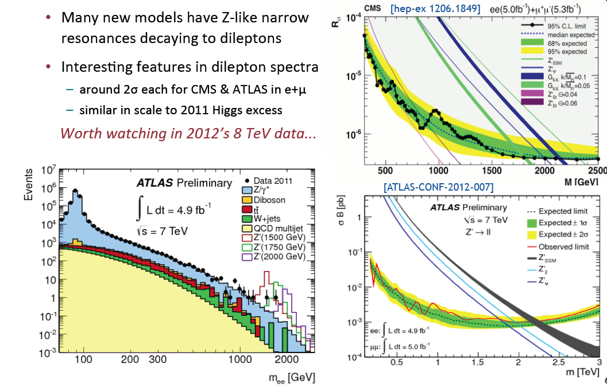
2011: Z’ Boson to ee or μμ?
Extension of the symmetry?
New Gauge bosons?
Mid 2012
Did additional
data confirm
the excess??

Slide 16
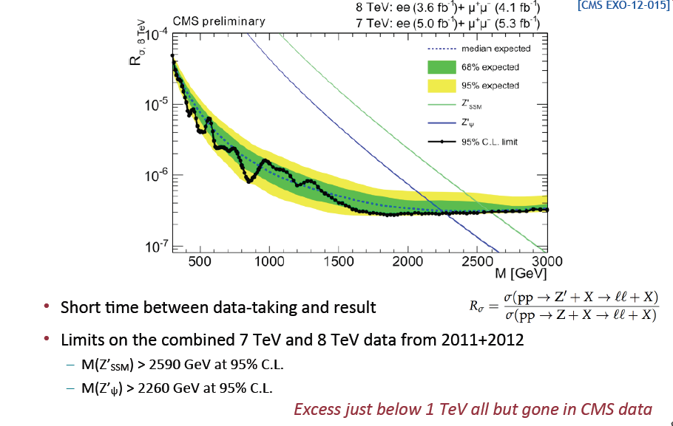
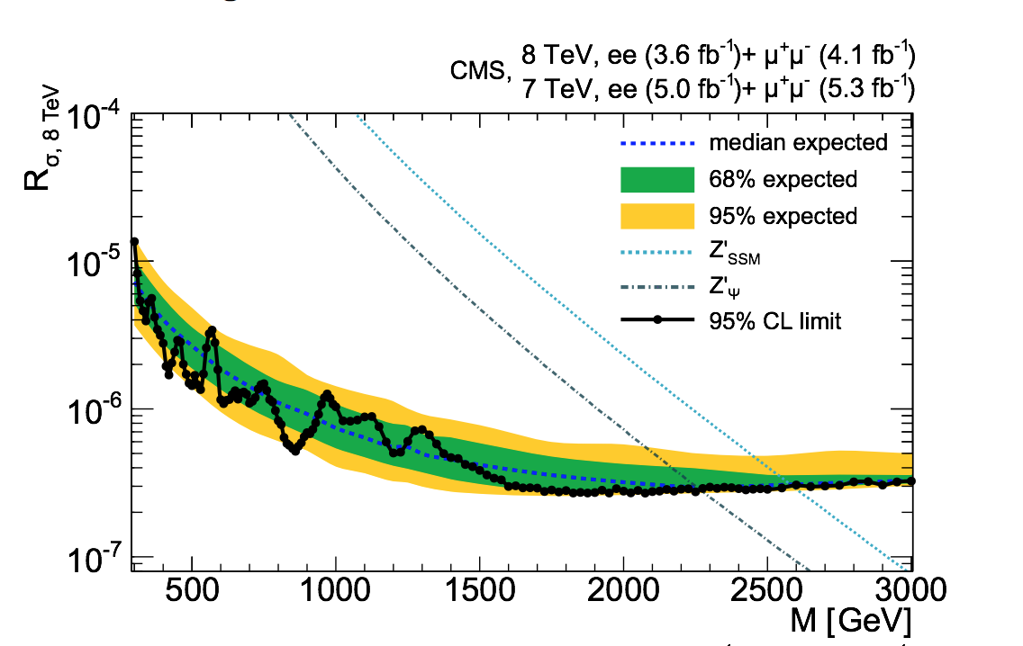
Z’ Combination of 7 & 8 TeV Data
2950 GeV
2600 GeV

Slide 17
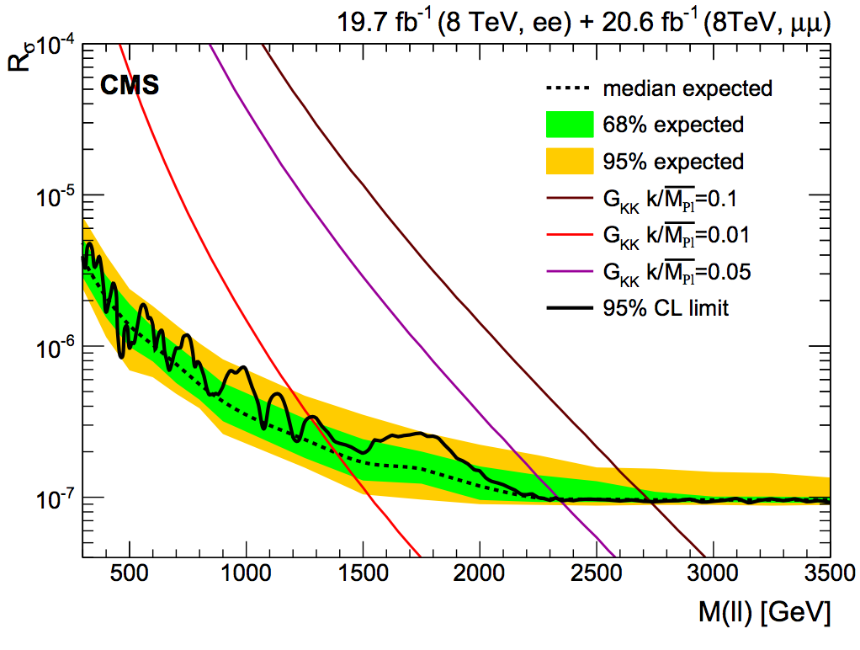
But Wait…: Z’ 8 TeV Data??
In CWR: final word on the Zprimes of CMS in run-I
Revenge of the Guido-prime? ☺

Slide 18
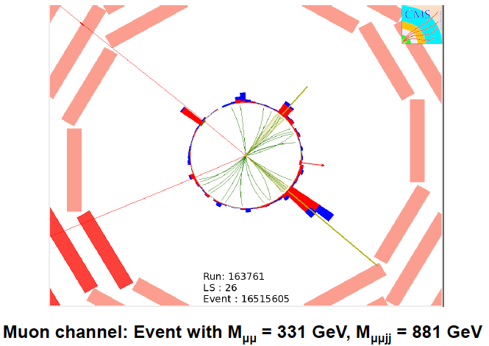
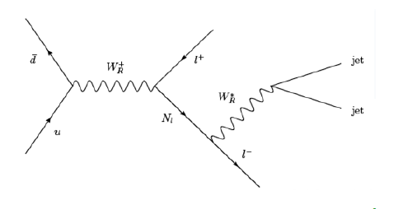
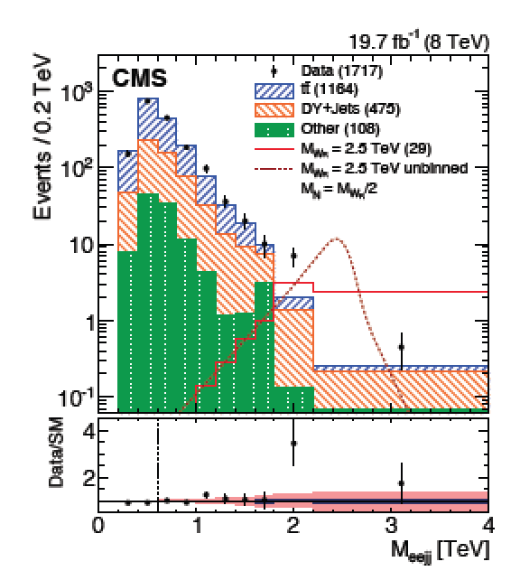
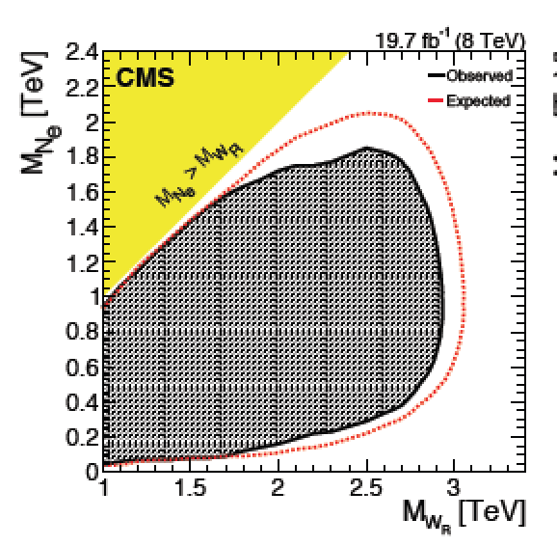
Search for Heavy Neutrinos and W_{R}
Left-right symmetric extension of the Standard Model
arXiv:1407.3683
Select events with
2 leptons and 2 jets
Large exclusion range
in mass of the W_{R} and
heavy neutrino
Observe a 2.8 sigma
excess in the electron
channel around 2 TeV
W_{R} mass

Slide 19
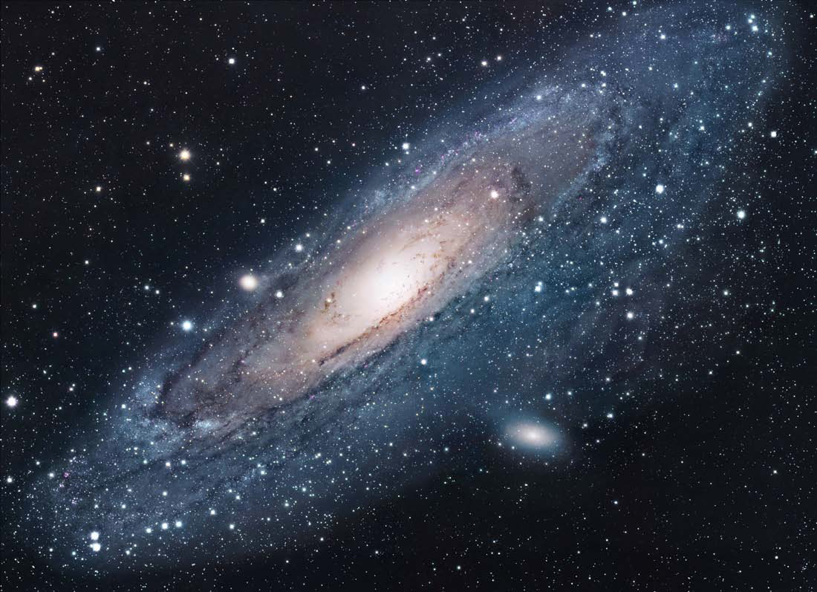
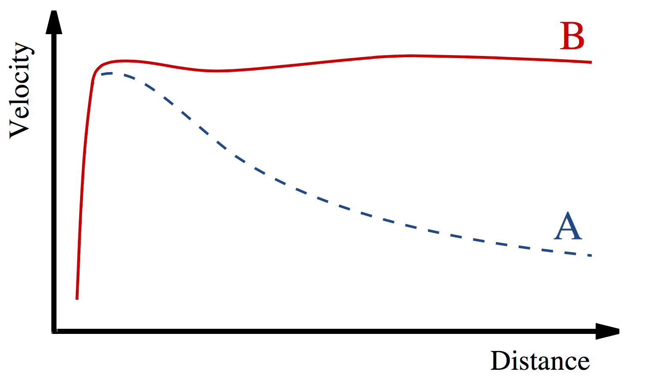
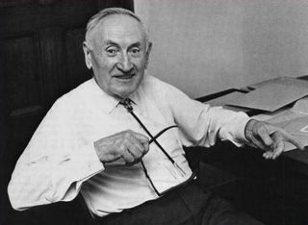
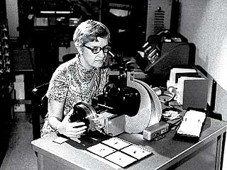
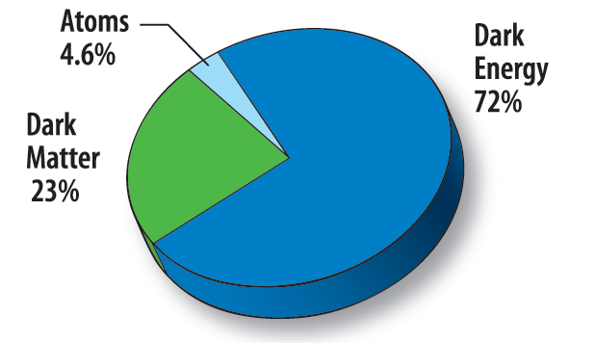
Dark Matter: The Next Challenge !?!
Astronomers found that most of the matter in the Universe must be invisible Dark Matter
‘Supersymmetric’ particles ?
Vera Rubin ~ 1970
F. Zwicky 1898-1974

Slide 20
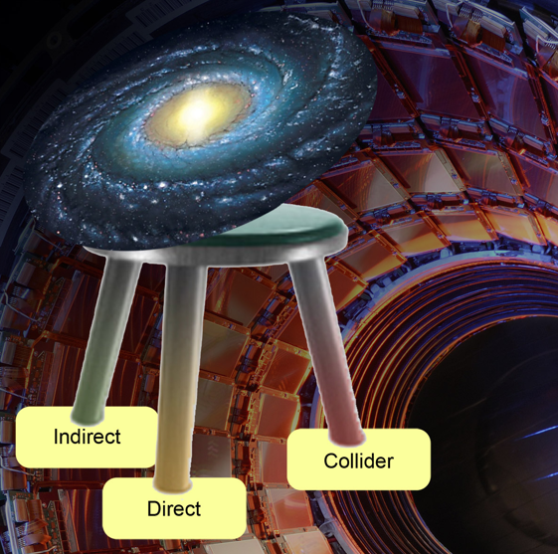
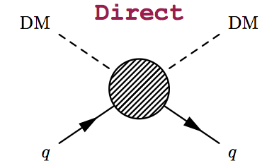
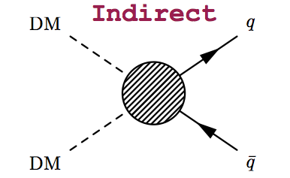
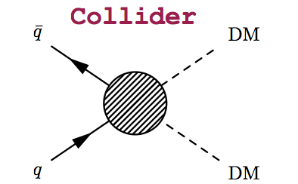
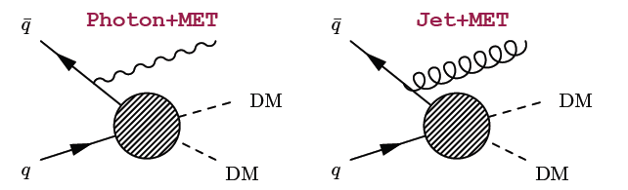
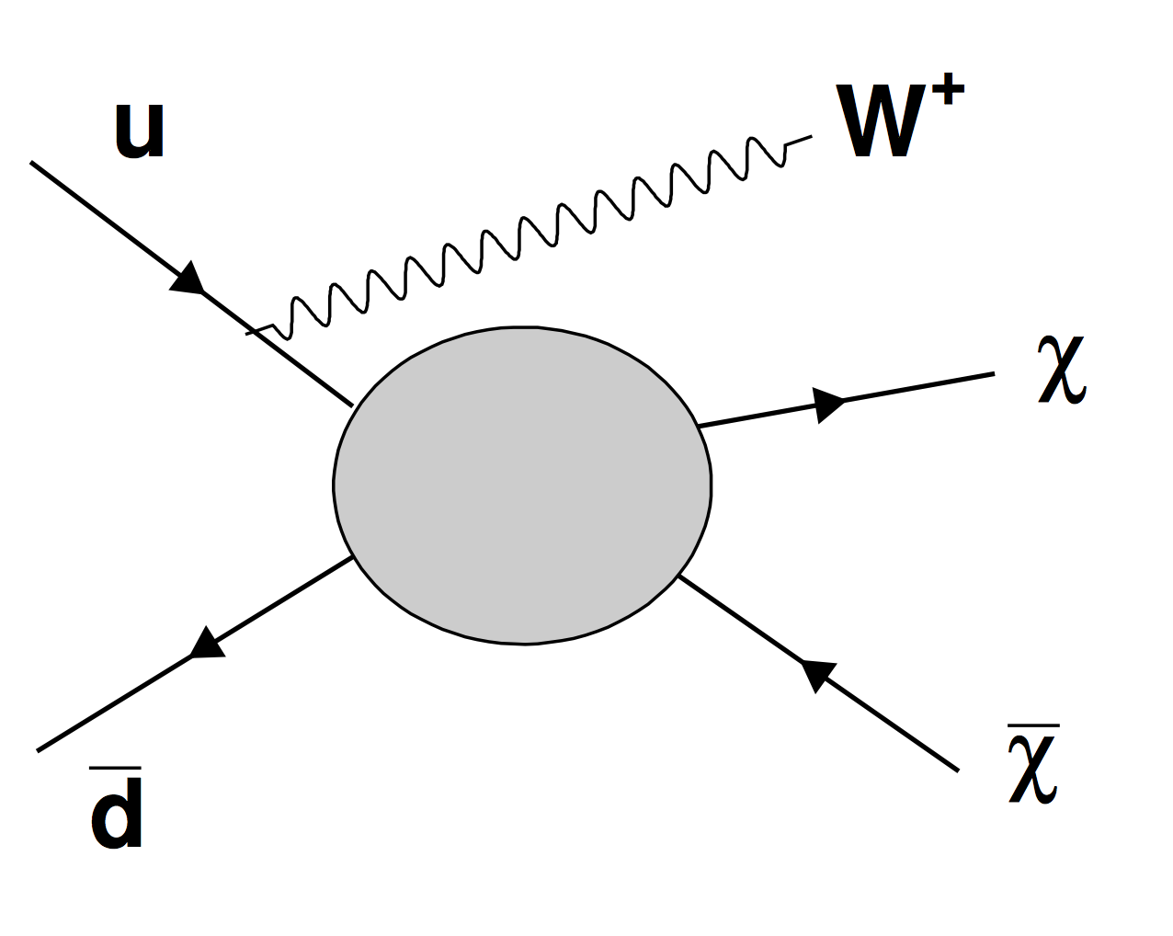
The Generic Dark Matter Connection
Searches for mono-jets and mono-photons can be used to search for
Dark Matter (DM)
Use effective theory or better simplified models to relate measurements to Dark Matter studies

Slide 21
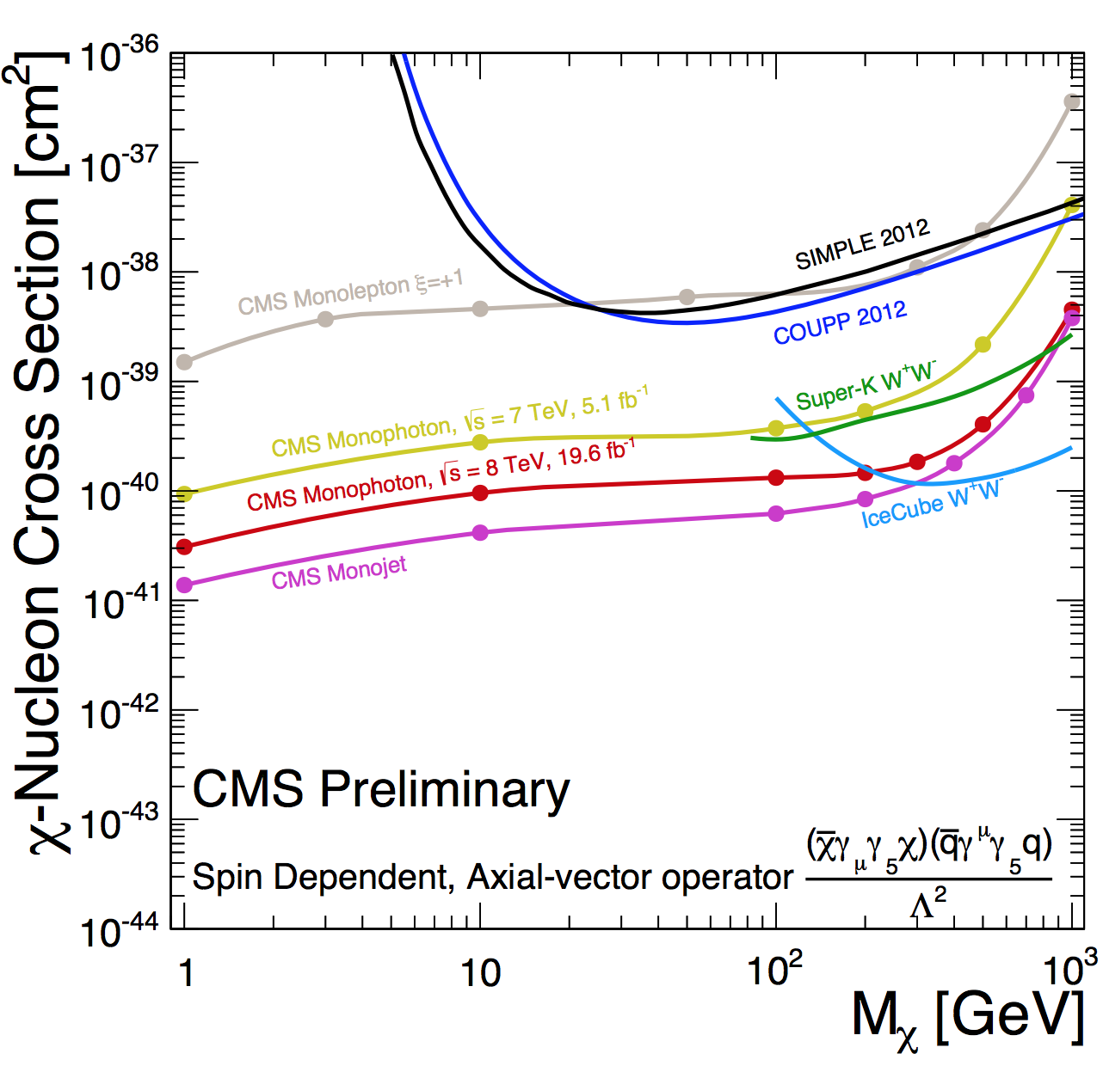
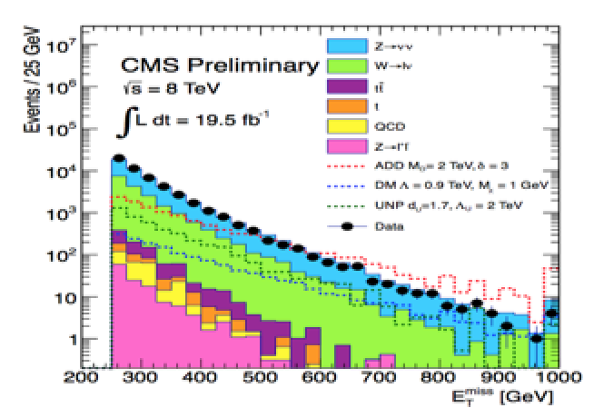
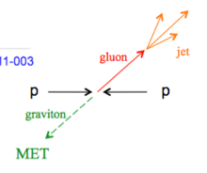
Mono-object Searches in CMS
Mono-jets: Generally the most powerful
Mono-photons: First used for dark matter Searches
Mono-Ws: Distinguish dark matter couplings to u- and d-type of quarks
Mono-Zs: Clean signature
Mono-Tops: Couplings to tops
Mono-Higgs: Higgs-portals
Higgs Decays?
Effective Field Theories for DM
interpretation are under attack!
Alternatives like SMS proposed…
Example Monojets
CMS-PAS-EXO-12-047
Dark Matter?

Slide 22
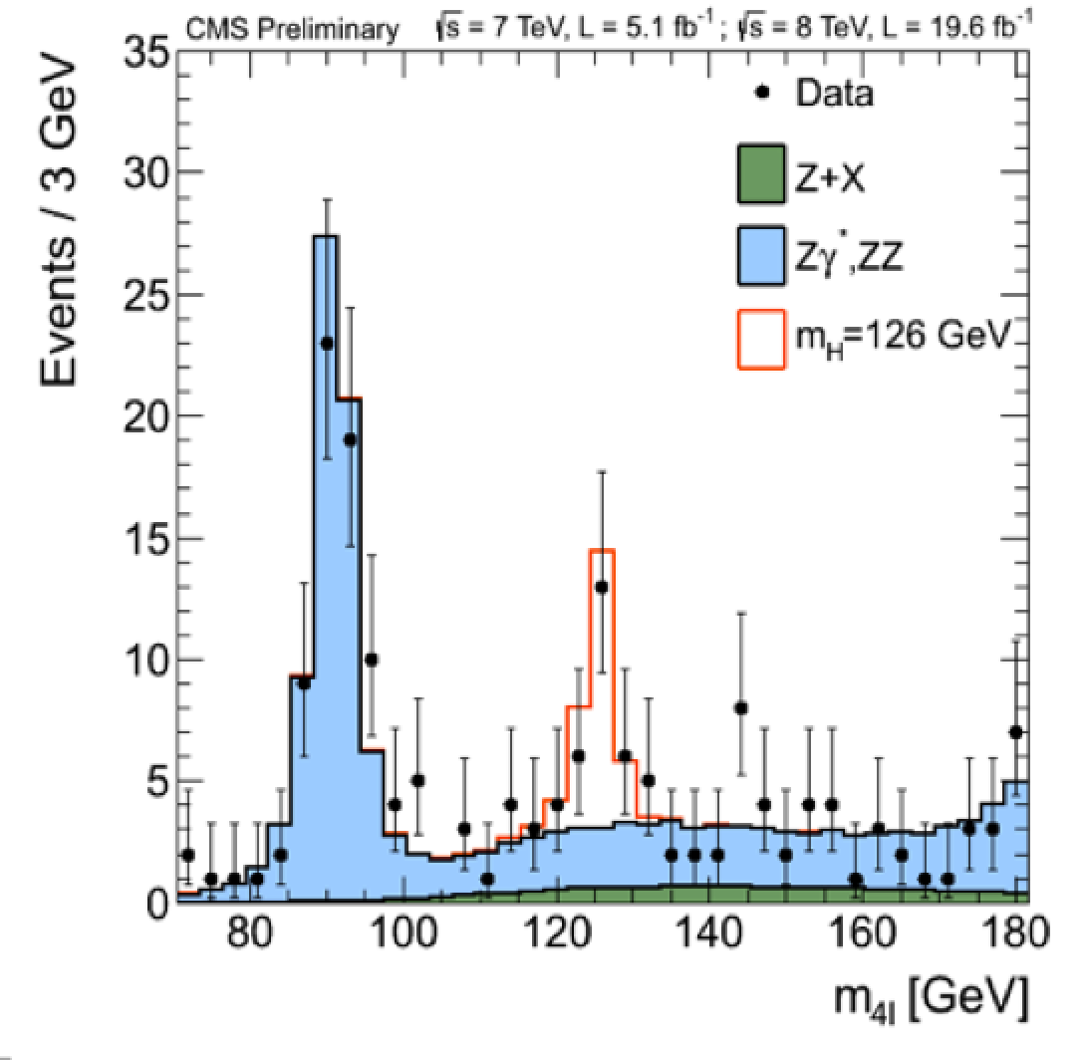
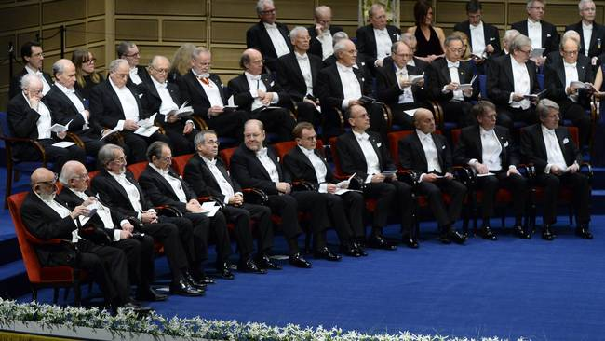

Higgs!
We discovered a Higgs particle!
December 2013

Slide 23
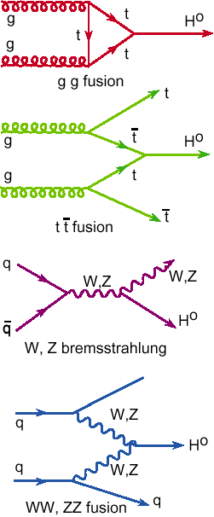
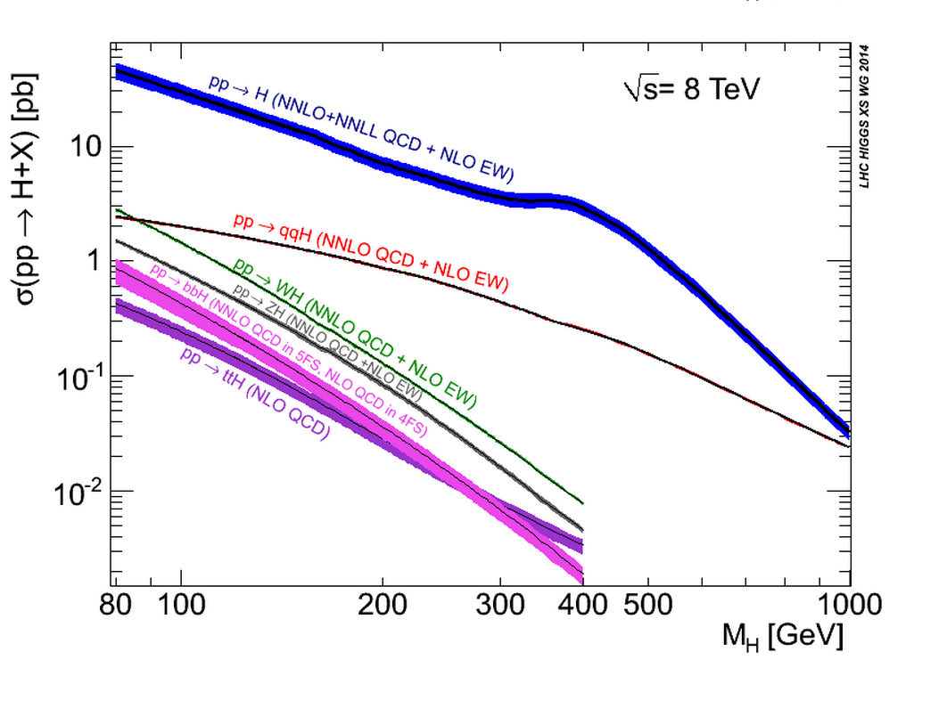
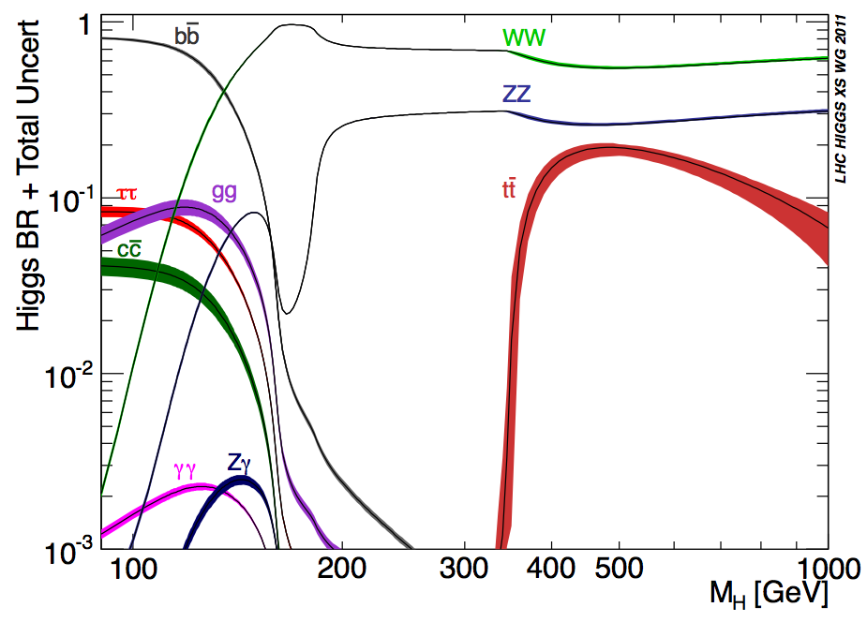
Higgs Production & Decay
Processes
•Gluon fusion
•Vector Boson Fusion
•W/Z associated prod.
•Top associated prod
•B-quark associated prod?
Numbers taken from the
LHC Higgs Cross Section WG
See yellow reports:
YR1: Inclusive cross sections
YR2: Differential cross sections
YR3: Properties (to appear)

Slide 24





Higgs Hunting: Channel Overview
Processes/decays studied:
Results released In progress
bbH?
Main decay channel characteristics:
+ more exotic channels

Slide 25
CMS Higgs Analyses
•In summer 2012 we called it a “Higgs-like” particle
•In spring 2013 (with 3x more data) we called it a Higgs particle
Spin/parity 0⁺ favored, couplings roughly as in SM for Bosons
What happened Next?
More detailed analyses of the 125 GeV particle, in particular the search for direct decays into fermions, ttH channel,...
Searches at higher masses
Searches for exotic, non-SM decays (none found so far)
Searches for di-Higgs events (in BSM scenarios, none found so far)
More detailed analyses of the properties (mass, spin, couplings…)
(Differential distributions + fiducial volume cross sections: ATLAS)
•Defined 6 legacy papers, for decays into γγ, ZZ, WW, bb, ττ
and the combination of channel & properties.
•So far CMS published 5 of these: decays into ZZ, WW, bb, ττ, γγ

Slide 26

Latest Results: Higgs → γγ
arXiv:1407.0558

Slide 27

High Mass: Higgs → γγ
CMS-PAS-HIG-14-006
No excess found (for small/big width)

Slide 28



The Mass of the New Particle
Determine the mass from ZZ and 2-photon channels which show a peak!
New calibration & strong effort on systematics
Two-photon and
two Z channel mass
estimates agree
(within 1.6σ)
Mass value is
about 125.0 GeV
with 0.3 GeV
uncertainty
Old value: 125.5 GeV

Slide 29



The Total Width of the Higgs
Direct width limits so far 3.4 GeV in ZZ and 6.9 GeV in two-photon decays (95% CL) from the resonance peak measurement
→Dominated by experimental resolution
Recent History
arXiv:1405.3455
•Until recently it seemed unlikely the LHC could
measure the total Higgs width (~4.2 MeV in SM)
•In 2012 it was noted that 7.6% of the Higgs to
ZZ cross section is above 180 GeV arXiv:1206.4803
•The off-shell contribution is independent of the
total width!
•The ratio of on-shell to off-shell can thus provide
information on the width
•Interference of the signal with ZZ continuum is
important and must be taken into account
2012/13: Kauer, Passarino; Caola, Melnikov; Campbell, Ellis, Williams …

Slide 30



The Total Width of the Higgs
•Study Higgs → ZZ in the 4 charged lepton and 2 charged lepton + 2ν decay
•Determine the total Higgs width in the two channels separately
•Use a kinematic discriminant and m_{T} distributions to reduce ZZ continuum
ICHEP: ATLAS!
Issue with the Theory??

Slide 31


Spin/Parity Studies
Combined study of H→ZZ and H→WW
•Tested using all diboson channels
•Hypotheses comparison O⁺/other states
CMS-PAS-HIG-14-014
All “exotic” scenarios excluded scenarios excluded with 99.9% CL
Also CP studies of J=0 state → Results consistent with SM

Slide 32

Spin/Parity Studies: Higgs → γγ
arXiv:1407.0558

Slide 33



Higgs → Fermions Combination
•The combined H(ττ) and H(bb) result establishes a strong evidence for
coupling of the Higgs boson to down-type third generation fermions
•Indirect and direct results on ttH coupling also evident for a coupling to
up-type fermions
arXiv:1401.6527 and
Nature Physics 10 (2014)

Slide 34


Higgs → μμ (ee)
•Observing H(μμ) decay may be the only way to show the flavor
non-universal couplings The coupling to charm will be hard to probe
•Requires very large statistics for an observation: a strong case for the
High Luminosity-LHC: HL-LHC
•First searches have been already done (@125 GeV)
-H→μμ μ < 7.4 (6.5 expected) @ 95% CL
-σ.BR(H→ee) < 0.041pb @ 95% CL
CMS-PAS-HIG-13-007
Paper in CWR
H→μμ
H→ee

Slide 35


Higgs-Top Associated Production
Various decay modes of the Higgs are considered
H→bb,ττ
(old value)
CMS: μ < 4.3 (1.7 expected) @ 95% CL μ= 2.5 ^{+1.1}_{-1.0} (New: μ= 2.79±0.99)

Slide 36



Single Top + Higgs Production
•Direct coupling to the top quark -> C_{t}=-1 or large cancelations in the SM?
•Cross sections could be surprisingly large if there are deviations from SM
Negative C_{t} gives 15x increased cross section plus 2x Higgs to 2 photons.
•Composite Higgs models heavy t’ -> top + Higgs..
•Study the Higgs decay to two photon decay channel
No events found top + two photon selection
95% upper limit is 4.1 times the expected cross section for C_{t}=-1
CMS-PAS-HIG-14-001

Slide 37




Invisible Higgs Decay Channel
Search for invisible Higgs decays using
Z+H → 2 leptons + missing E_{T}
VBF H → 2 jets + missing E_{T}
Possible decay in Dark Matter particles
(if M<M_{H}/2): Higgs Portal Models
Combined result from the three channels
BR(H→invisible)<58%(44% exp) at 95% CL.
for a Higgs with a mass of 125 GeV
arXiv1404.1344

Slide 38




Coupling Measurements
CMS-PAS-HIG-14-009
•New update of overall
combination since
spring 2013

Slide 39

All Channels in Overview
Overall strength was 0.82 ± 0.15 before ICHEP14 (spring 2013)

Slide 40

Signal Strength per Decay Channel

Slide 41





Brief Higgs Summary
We know already a lot on this brand new Higgs Particle!!
Mass =
125.0 ±0.3 GeV
Width =
< 22 MeV
(95%CL)
Couplings are
within 15-20% of
the SM values
Spin =
0⁺ preferred
over 0⁻,1,2
The Higgs is the new playground: Room for new experimental/theoretical ideas!!
Remember: we have already ~1 Million Higgses produced at the LHC

Slide 42


Search for LFV Decays: H →μτ
CMS-PAS-HIG-14-005
On public demand
from our theory
friends ☺

Slide 43

Search for LFV Decays: H →μτ
Mild excess giving a 2.5σ effect… To be watched!!!

Slide 44


The Future: Studying the Higgs…
Higher Energy in 2015!
LHC lumi upgrade !
Experiment upgrades!!
(Other/new machines?)
Many questions are still unanswered:
•What explain a Higgs mass ~ 126 GeV?
•What explains the particle mass pattern?
•Connection with Dark Matter?
•Where is the antimatter in the Universe?
•…

Slide 45


To End: WW Production
Di-boson production: This should not be a problem for theory, no?
Bizar: all measurements so far gave a systematically higher value!
Less the case for ZZ and WZ as far as we can see…

Slide 46

WW Production
What was missing until now was the ATLAS 8 TeV result
Important: how well do we control the theory? Now NLO, Higgs included

Slide 47





New Physics in WW Cross Sections?
Both these phenomenology papers appeared on June 3rd … → Next Talk!
Da
arXiv:1406.0858
arXiv:1406.0848
Interpretation in the two papers
(Overall analyses of WW, and
available SUSY searches):
→ Stop pair production -- with m_{stop}
~ 200 GeV– plus decay to chargino
leading to the WW excess
Da Costa
ICHEP14
My take:
•Need to have a careful look at QCD
corrections, effects of the jet veto…
•Need other measurements eg
WW→lνjj, WW+0/1/2 jets…
•Tests in other channels?
ATLAS already excluded this point?
•WW excess at 13 TeV?

Slide 48




Finally: a Global View!
Model independent search
•Divide events into exclusive classes
•Study deviations from SM predictions
in a statistical way
CMS-EXO-10-021
ATLAS-CONF-14-006
ATLAS for 20fb⁻¹
Probability distribution as expected
for 35 pb⁻¹ for CMS
→muons, electrons, photons, (b)jets, MET

Slide 49

Summary
Run-I delivered many measurements of Standard Model processes, eg on the top quark, EWK and in QCD. Some features of multi-particle production are not understood
A prime goal for the LHC is to look for New Physics. The Run-I data have cut strongly in the phase space of NP eg: Supersymmetry, putting Constrained and Natural models in trouble. 14 TeV data can be conclusive…
Understanding Dark Matter is the next big challenge! Generic studies with MET are a high priority. Maybe dark matter couples to the Higgs directly?
With one to a few fb⁻¹ of 2015 data, the LHC will overtake the run-I searches. 2015-2016 could well be very crucial – and very exciting years!!!
And maybe soon…

Slide 50

The LHC schedule
Next stop: 2015-2017
•Running at higher energy namely 13 TeV to 14 TeV
Depending on how the magnet training goes
•Higher luminosity ~ 100 fb⁻¹ per experiment
•Details of 2015 running year still under discussion

Slide 51


Reach at the Start of Run-II
What can we expect in reach at 13 TeV with 5 or 20 fb⁻¹?
•Look at the parton luminosities to predict sensitivity
•Compare reach @8 TeV/20 fb⁻¹ with future energy/luminosity
Salam & Weiler
http://cern.ch/collider-reach/
13 TeV/5 fb⁻¹
13 TeV/20 fb⁻¹
Expect about 20 fb⁻¹ in 2015: Expect gain in reach of ~50% at high mass!!

Slide 52


Reach with Run-II
What can we expect in reach at 14 TeV with 100-300 fb⁻¹?
•Look at the parton luminosities to predict sensitivity
•Compare reach @8 TeV/20 fb⁻¹ with future energy/luminosity
14 TeV/100 fb⁻¹
14 TeV/300 fb⁻¹
Phase-I LHC Expect gain in reach of a factor of two at high mass!!

