Slide 1

Diffractive processes at the LHC
Vladimir A. Petrov
Institute for High Energy Physics
Protvino
17th Annual RDMS CMS Collaboration Conference, Dubna, 7-8 August 2014
1

Slide 2

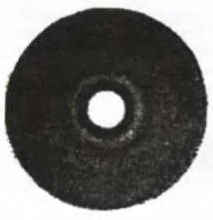
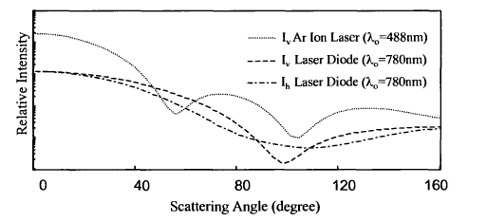
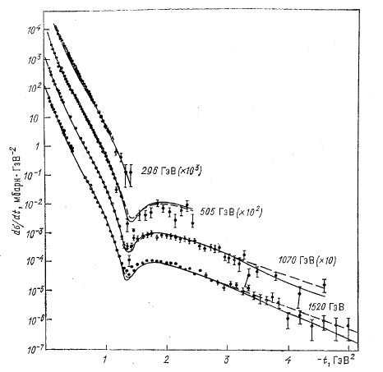
Diffraction Patterns
Light scattering off a polystirene latex particle
Proton-proton scattering
t = -4k²sin²(θ/2)
λ=2π/k ω = ck
ħ ω = E
E = 1.6 ÷ 2.5 eV
E = 2.96 • 10 ¹¹ eV ÷ 1.52 • 10 ¹² eV
R = 0.5 μm = 5 •10 ⁻⁷m = 5·10⁸ fm
R = 1.6 •10 ⁻¹⁵ m = 1.6·fm

Slide 3

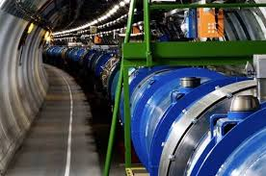
Why Should We Study Diffractive Processes?
What Are Diffractive Processes?
“Simplest” : Elastic Scattering

Slide 4
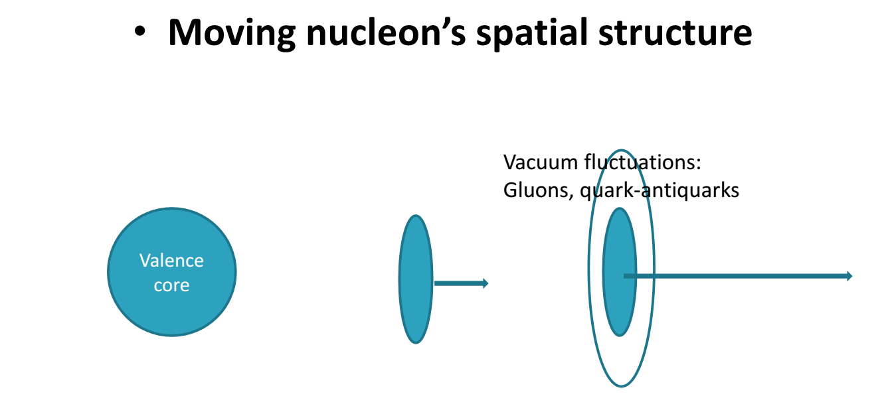
Nucleons aren’t balls
4

Slide 5

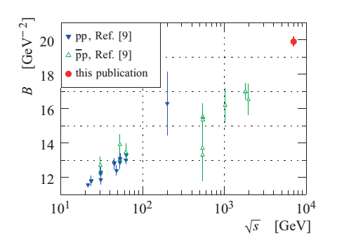


Interaction Region
The slope parameter: B(s) = d{d σ/dt}/dt|_{t=0}
→ d σ /dt = [d σ /dt]_{t=0} e ^{Bt}
Physical meaning :
2B(s) ≈ < b²> = Δx_{T}²
b
LHC ( TOTEM (2012)- ATLAS(ALFA, 2014)
7 TeV:
U-70 (IHEP (1971)) 0.01 TeV:

Slide 6
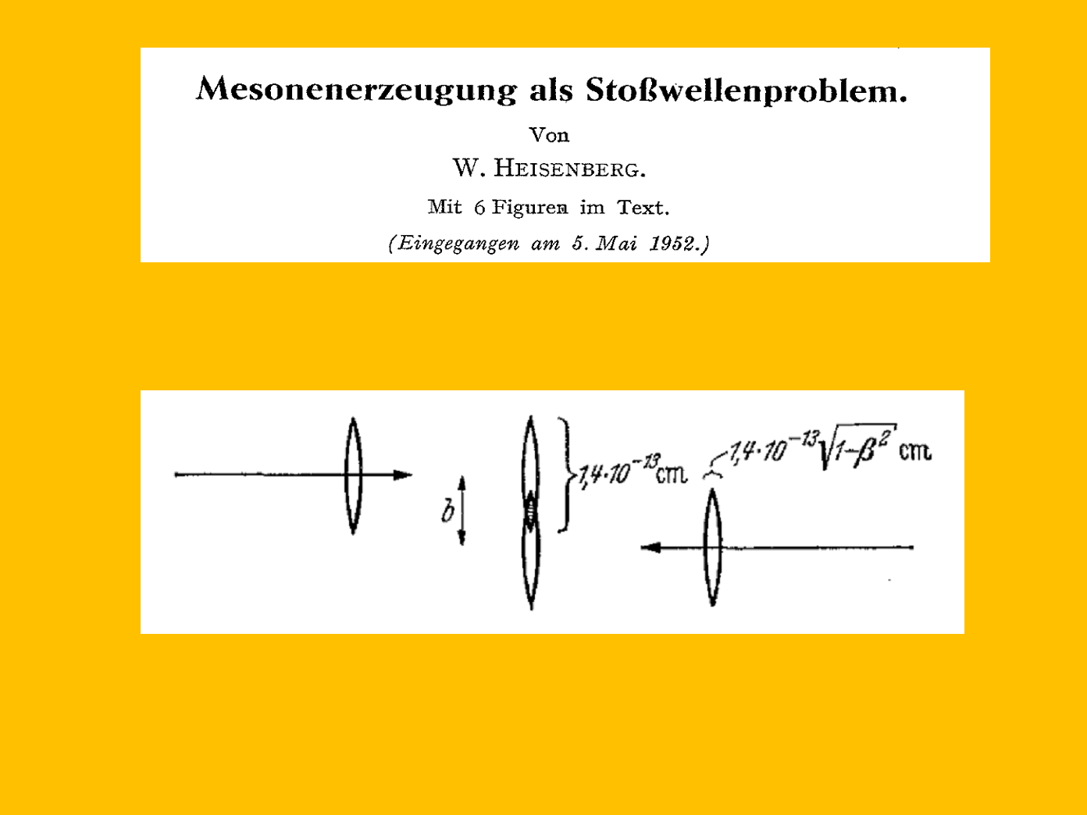

Longitudinal Direction ?
0.0004 fm
6

Slide 7
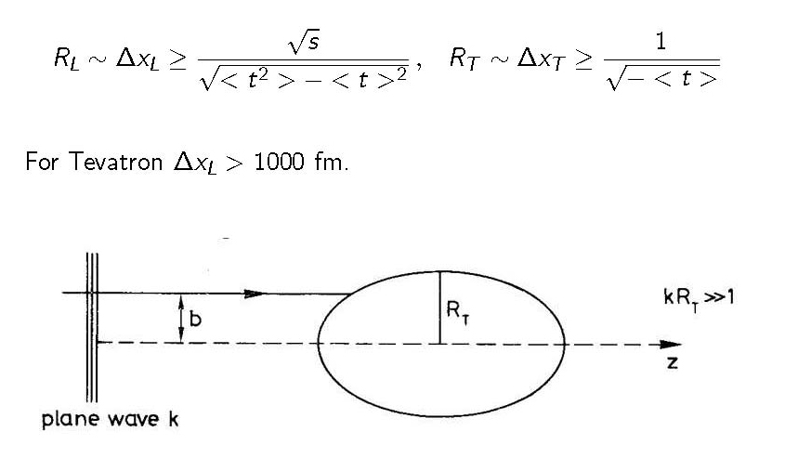




Heisenberg’s Uncertainties
7

Slide 8
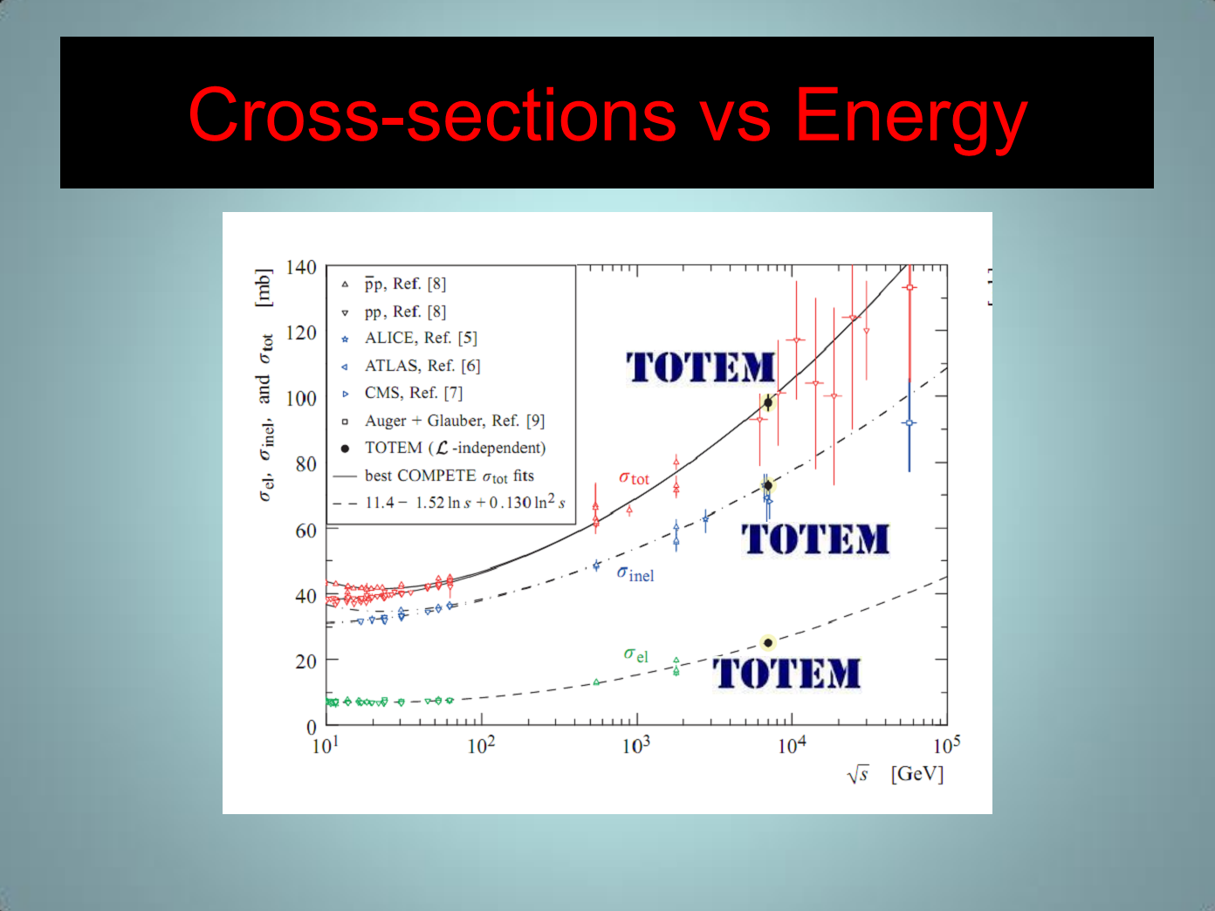

TOTEM
(2011-2013)
ATLAS (2014)
8

Slide 9
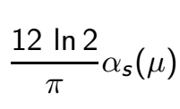
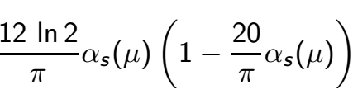

WHY DO CROSS-SECTIONS GROW?!
Theory: because Δ = α_{P}(0) -1 > 0
Why Δ > 0?
Because (1975-1998) Δ =
1998-2014: Δ =
Secret information: Δ doesn’t depend on
at all
WHY DO CROSS-SECTIONS GROW?!
9

Slide 10
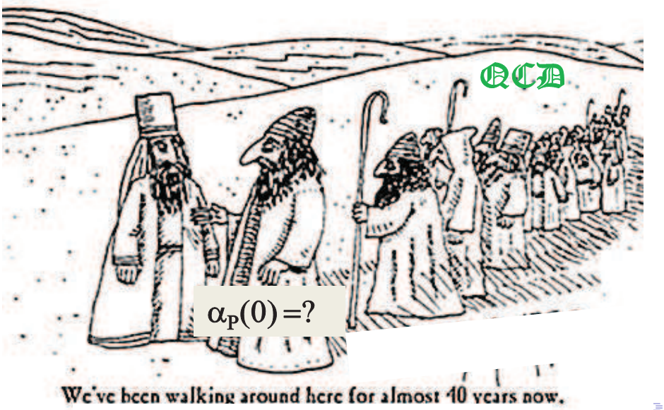
LE nouveau Moïse ou À la recherche du Pomeron perdu
10

Slide 11

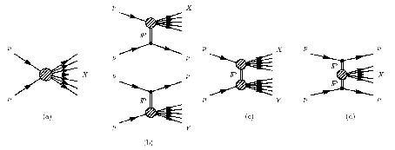
Elastic Scattering is Not Enough. Kindreds:
Single and Double Diffractive Excitation
Processes at √s = 7 TeV
Vertex Multiplicity Correction
Non-diffractive
events
ND
Single
Diffraction
Excitation
SDE
Double
Diffraction
Excitation
DDE
Central
Diffraction
Excitation
CDE
~35% of σ _{total}
~25% of σ _{total}
exponential suppression
of rapidity gaps
Exchange of color singlets:
Reggeons, Pomeron
Large Rapidity Gaps
11
Notes:
11
11
11
11
11
11
11

Slide 12


What’s Diffractive Dissociation?
B + A ―› B + A
y_{A}
y_{B}
B + A ―› B + X
All composants of the system X fly in the same direction as A.
X
“Materialization of proper proton fluctuations”
12

Slide 13

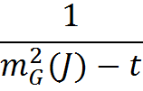


What can we learn from Diffractive Dissociation?
→
= Pomeronъ
X
=
So far extracted values of the Pomeron-proton cross-sections are uncomfortably small : O(1mb)
13

Slide 14
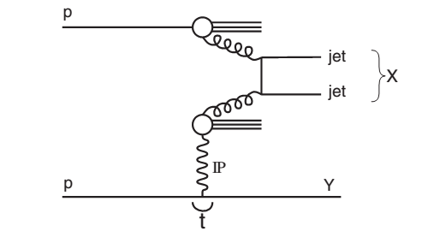
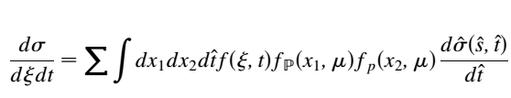

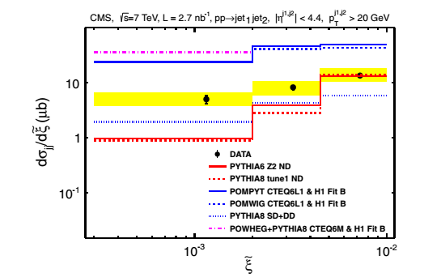

Hard Probes of the Soft Stuff
14

Slide 15

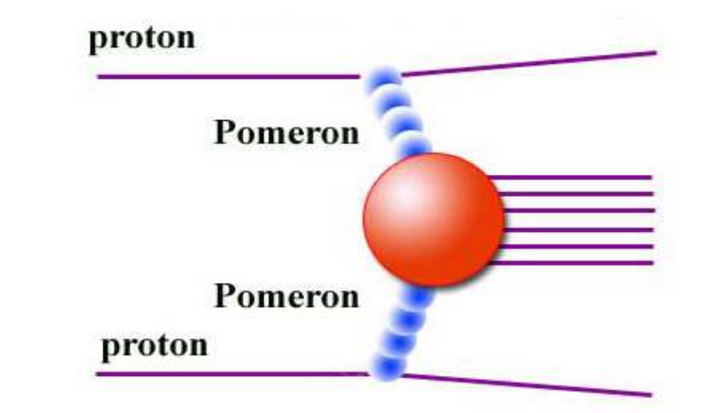

Central Diffraction: Short -Wave Diagnostics of the Pomeron
Prospects: a lot.
The task for the
CMS-TOTEM Collaboration
15

Slide 16
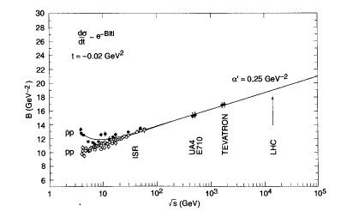




Whether We Achieve “Asymtopia”?
0.66 fm
R_{T}=1.26 fm
Asymptopia: Interaction Region >> Proper Hadron Sizes
Proton-Proton:
1000 TeV
16

Slide 17

Conclusions:
Let’s work! Thank you.
17

Slide 18







Static Stringy Confinement vs
High Energy Scattering ?
w
R
Longitudinal interaction range at high energies:
Transverse interaction range at high energies:
<b²> = 4w²
R L

