Slide 1

CMS Upgrade and Future Plans:
17th Annual RDMS CMS Collaboration Conference
Dubna, August 7th , 2014
L. Silvestris (INFN-Bari/CERN)

Slide 2
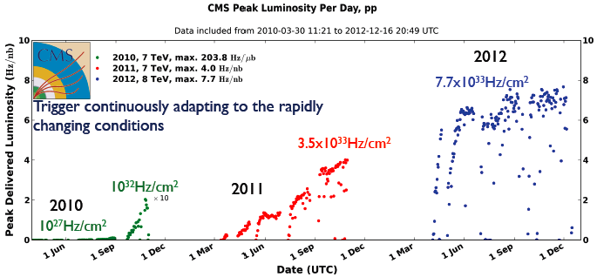
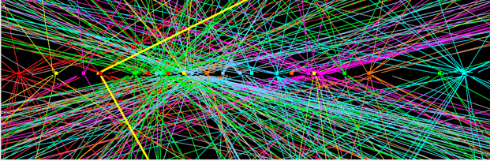
Run 1: LHC Performance
RUN 1: 7-8 TeV
50 ns bunch crossing
<PU> ~ 21 @ 2012
50 ns bunch crossing
<PU> ~ 21 @ 2012
Total L_{int}(pp) ~ 30 fb⁻¹
Design value: 25 pile-up events
at luminosity 10³⁴cm⁻² s^{‐1}
and 25 ns bunch spacing
Z → μμ event with 25 reconstructed vertices

Slide 3
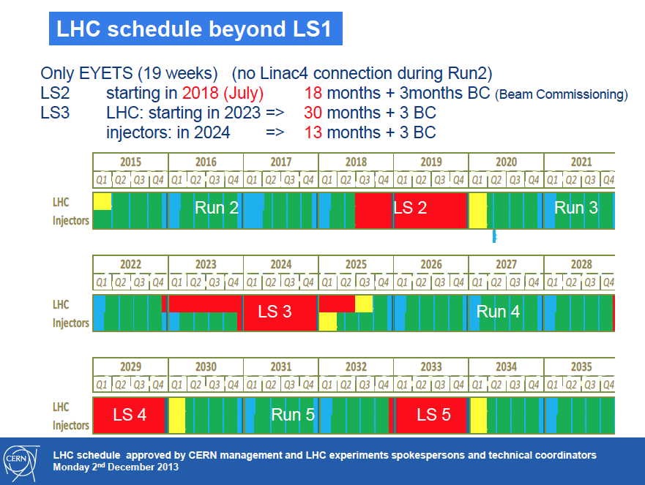
LHC projected performance
13-14 TeV
Phase-1
before LS3:
Total L_{int}(pp) 300 – 500 fb⁻¹
L_{max}(pp) ~ 2.5 10³⁴ Hz/cm²
Phase-2: HL-LHC
GOAL after LS3:
Total L_{int}(pp) 3000 fb⁻¹
L_{level}(pp) ~ 5 10³⁴ Hz/cm²
L (therefore <PU>) increase affects L1 trigger efficiency
TRIGGER UPGRADE
Needed: HIGH GRANULARITY DETECTORS
with rad-hard components

Slide 4
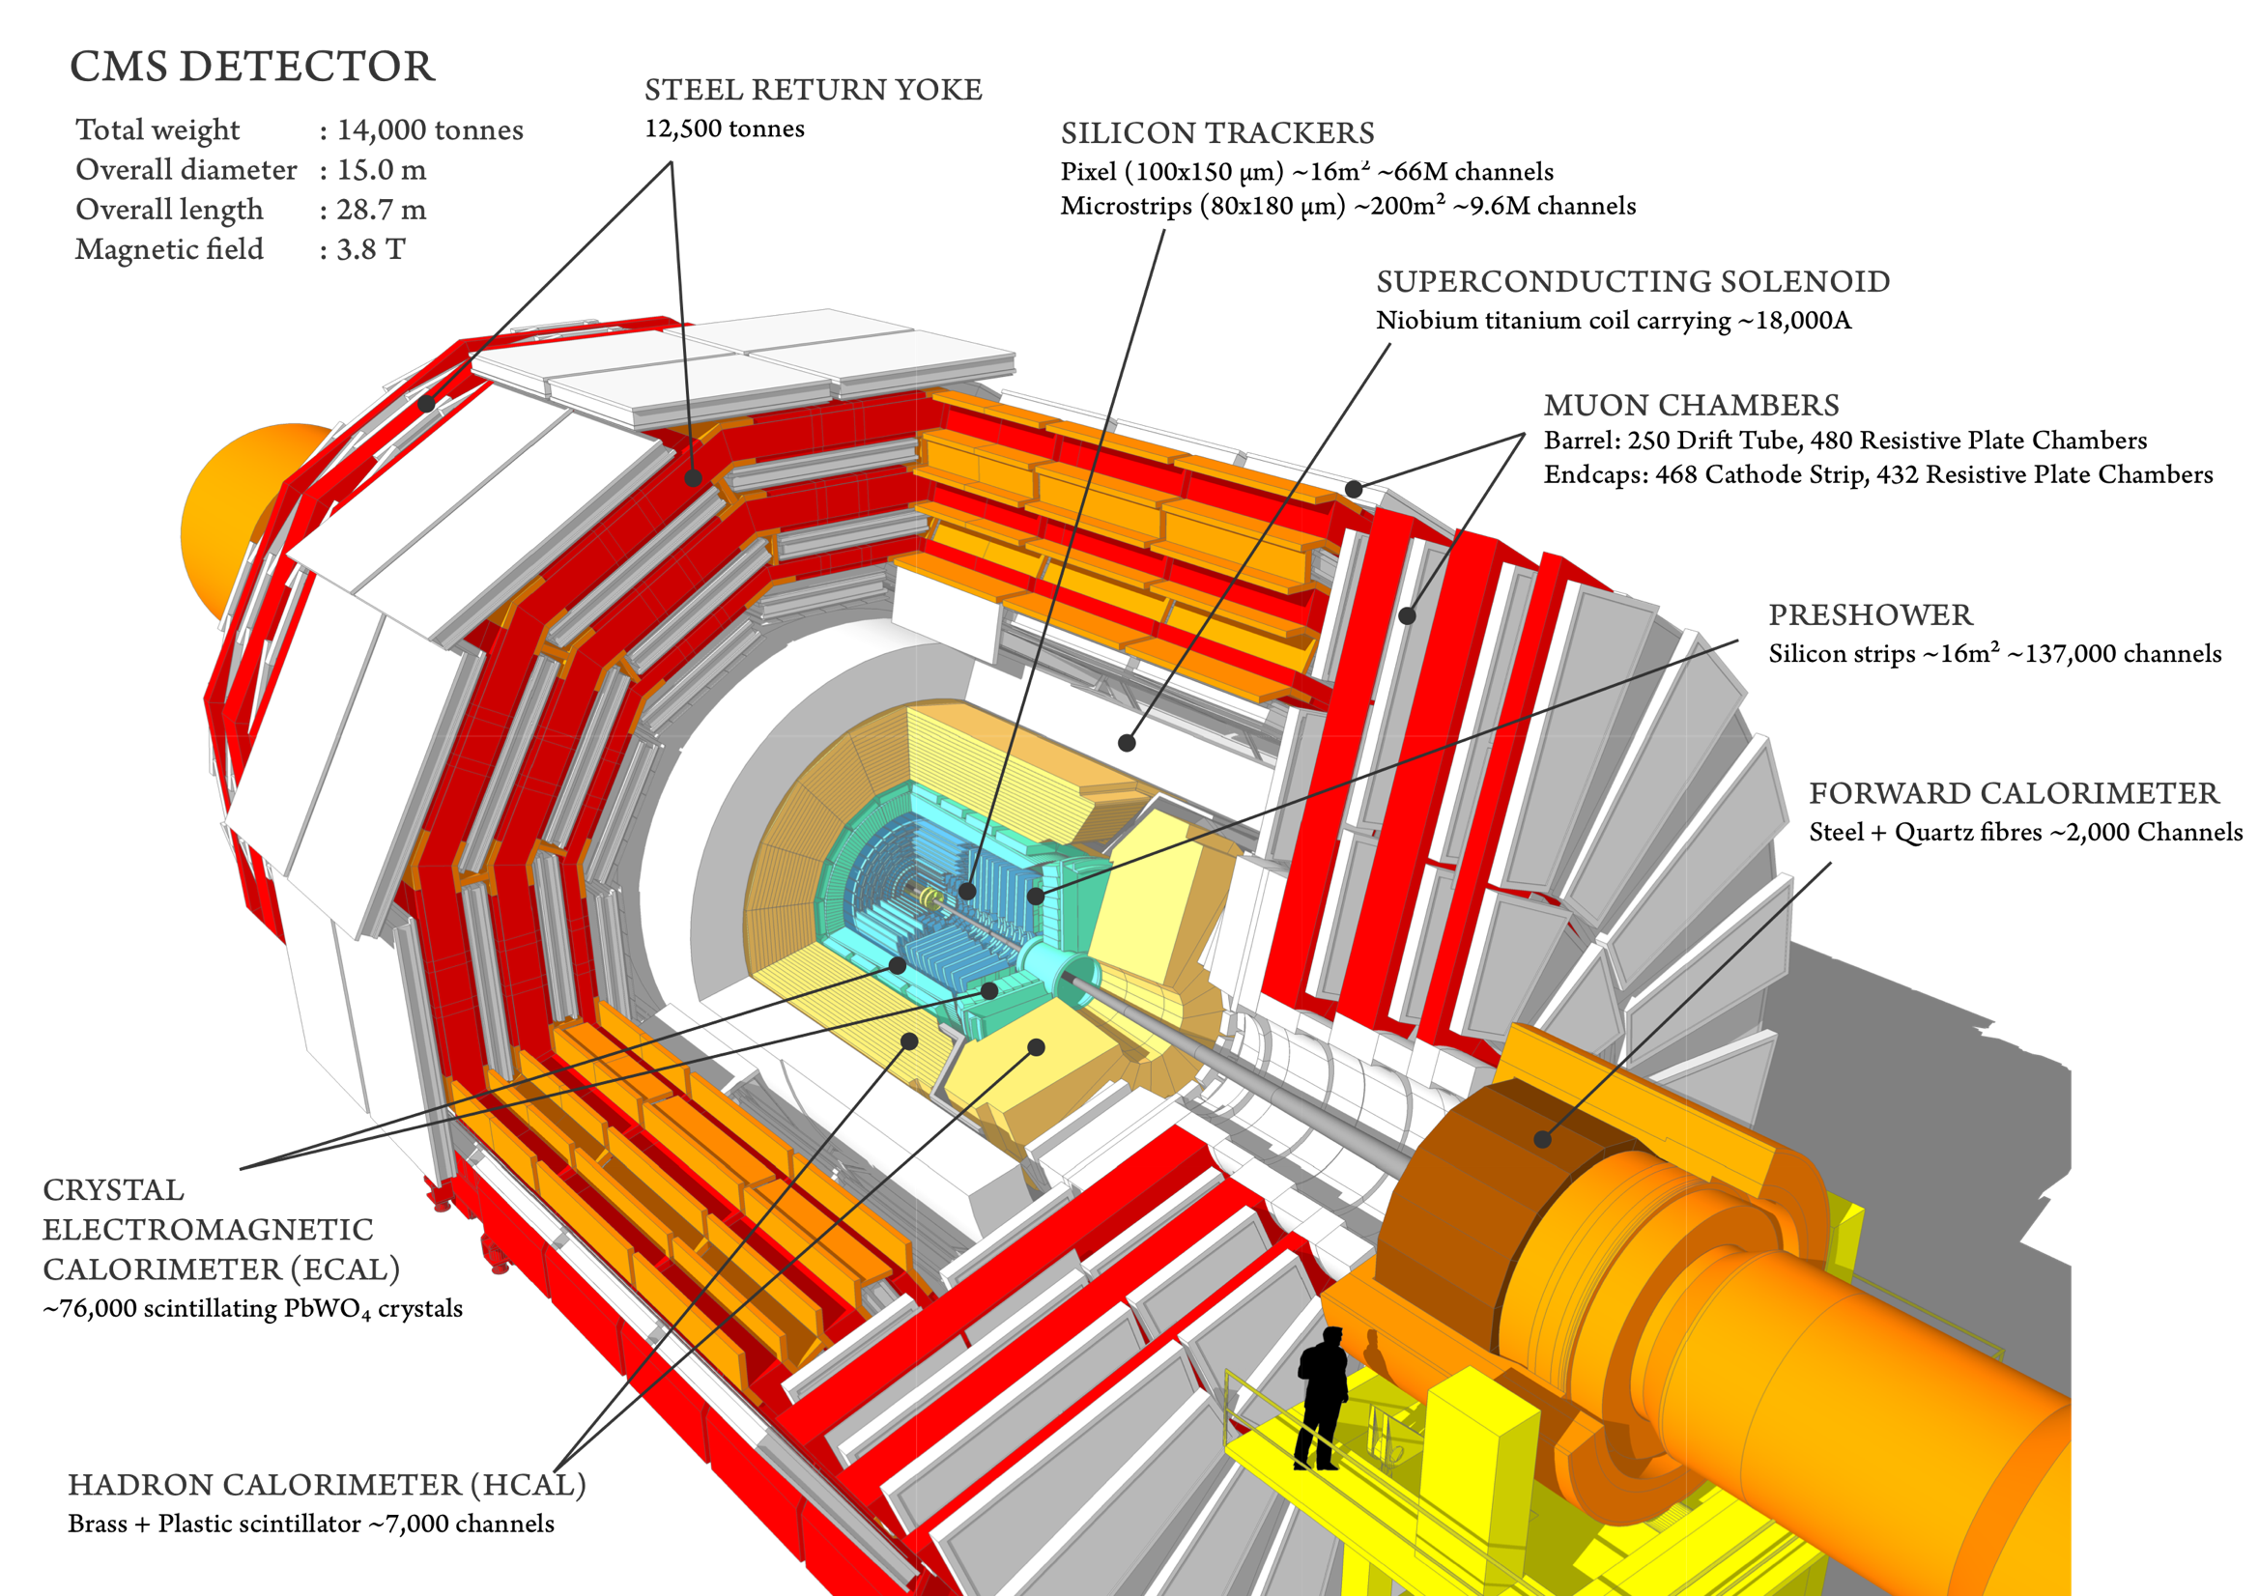

CMS Today
Emphasis on electron and photon energy measurement,
full silicon tracker providing high momentum resolution
Tracking:
σ_{pT}/p^{T} ≈ 1.5* 10-⁴ p^{T} (GeV) ± 0.5%
ECAL energy deposit:
σ_{E}/E ≈ 2.9% /√E (GeV) ± 0.5%
Muons (tracker + muon system):
σ_{pT}/p^{T} ≈ 5% for 1 TeV muons
Goal is to keep same performances at future high-luminosity LHC
despite the much harsher conditions.
HCAL energy deposit:
σ_{E}/E ≈ 120% /√E (GeV) ± 6.9%

Slide 5
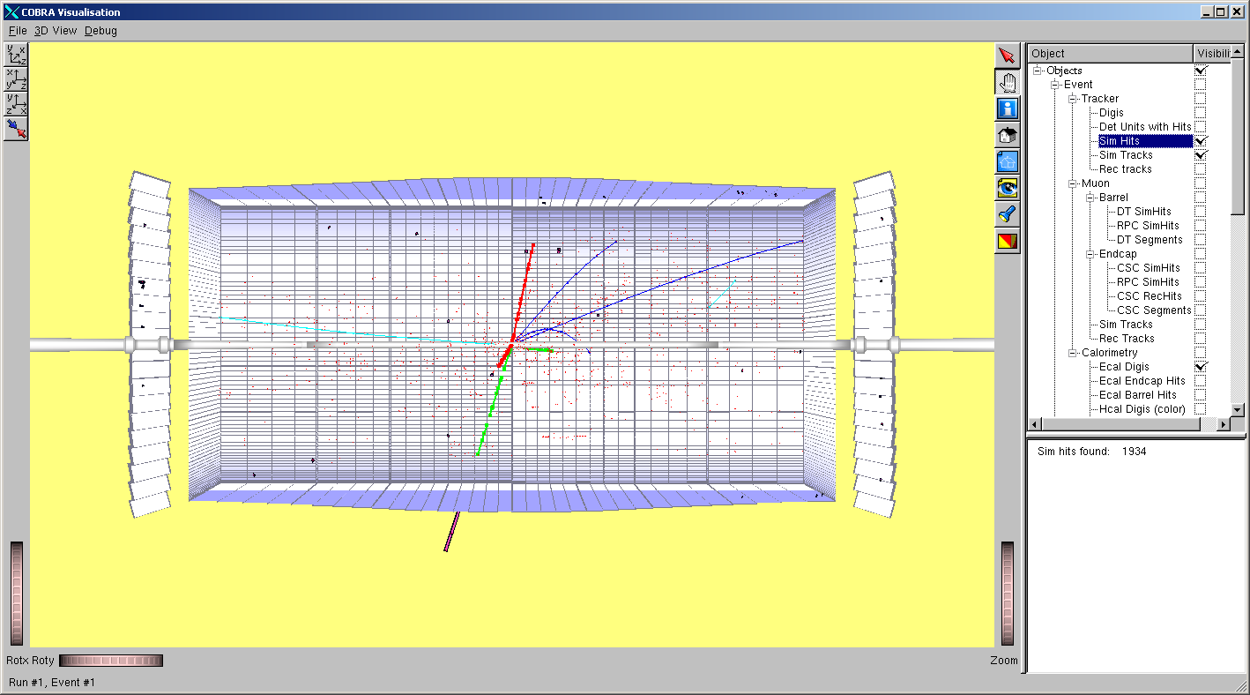
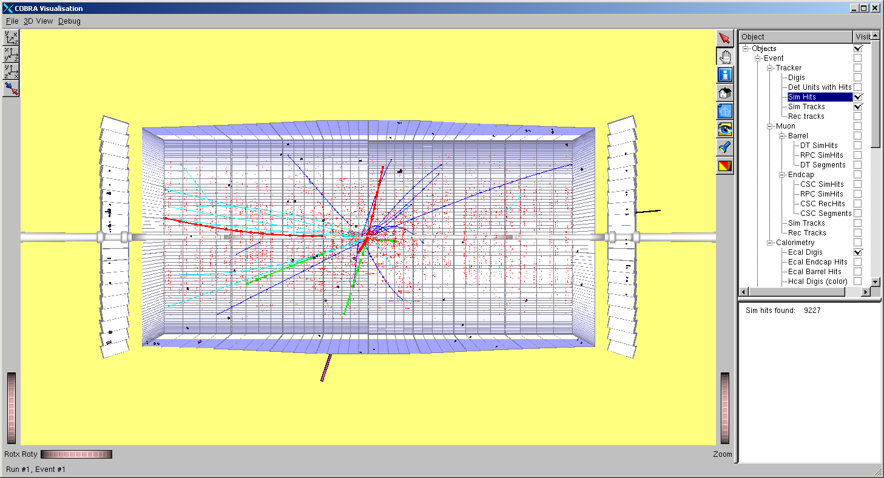
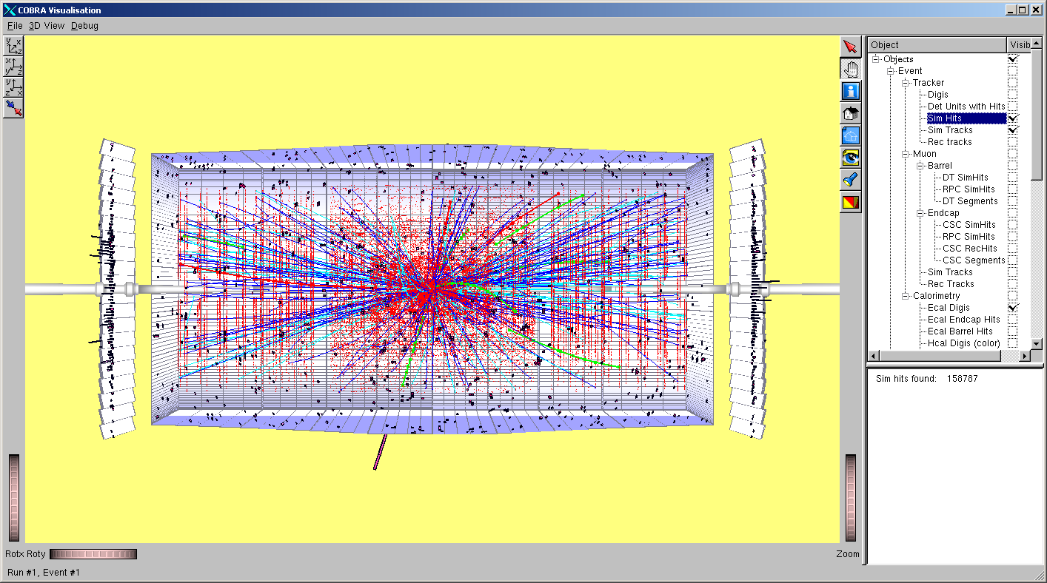
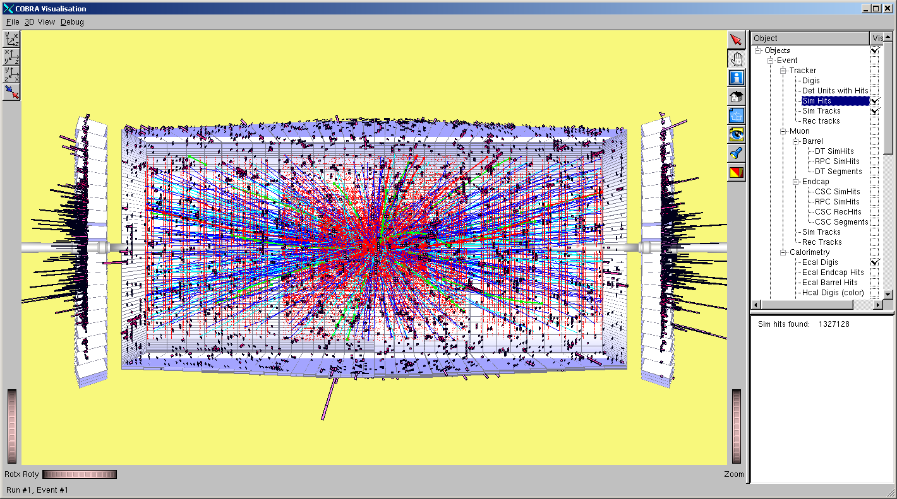
HL-LHC Challenges
10³² cm⁻² s⁻¹
10³³
10³⁴
10³⁵
HL-LHC presents increased challenges for Triggering, Tracking and Calorimetry, in particular for low to medium P_{T} objects

Slide 6
CMS Upgrade Strategy - Overview
Upgrades 2013/14 ongoing:
Completes muon coverage (ME4)
Improve muon trigger (ME1), DT electronics
Replace HCAL photo-detectors in forward (new PMTs)
and outer (HPD → SiPM)
A lot of consolidation work
Complete original detector
Address operational issues
Start upgrade for high PU
LS1 LS2 LS3
Phase 2 Upgrades: 2023-2025 (Technical Proposal in preparation)
Further Trigger/DAQ upgrade
Barrel ECAL Electronics upgrade
Tracker replacement/ Track Trigger
End-Cap Calorimeter replacement
Tracker & possible End-Cap Calo, Muon extension from |η| = 3 to |h| ~ 4
Phase 1 Upgrades 2018/19 (TDRs):
New Pixels, HCAL SiPMs and electronics, and L1-Trigger
Preparatory work during LS1:
  new beam pipe
  test slices of new systems (Pixel cooling, HCAL, L1-trigger)
Maintain/Improve
performance at high PU
Maintain/Improve performance at extreme PU
Sustain rates and radiation doses

Slide 7

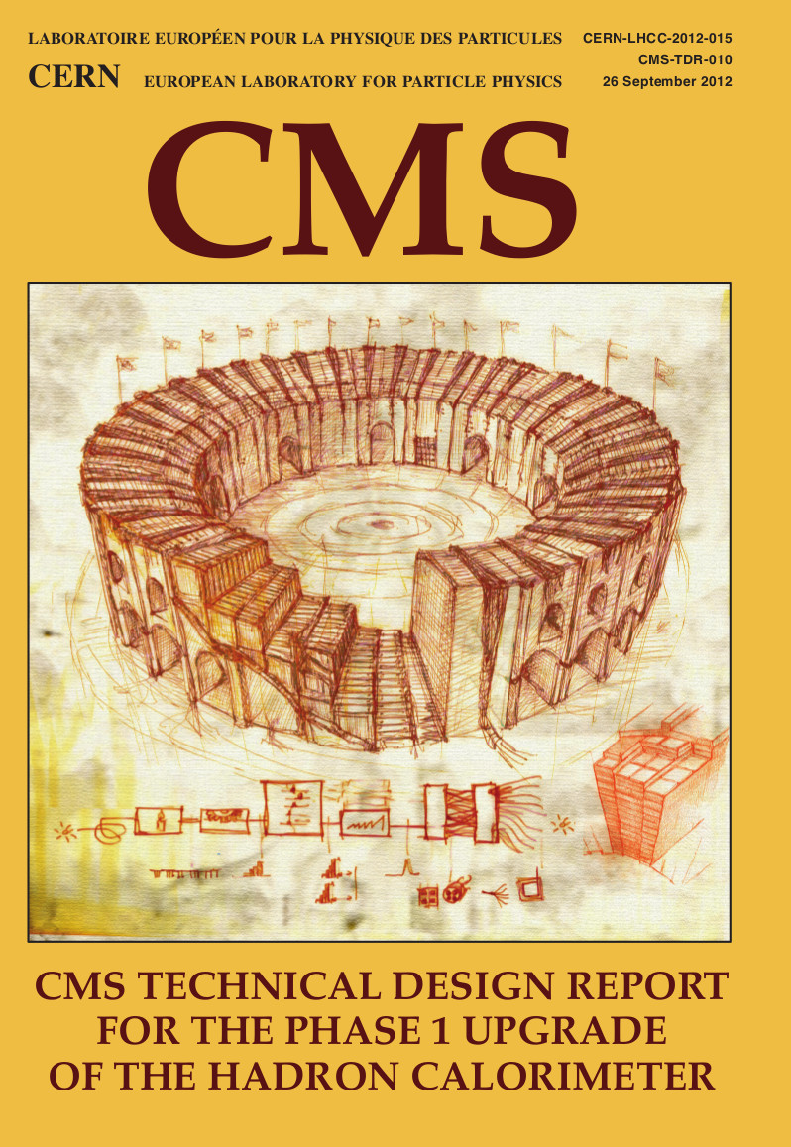
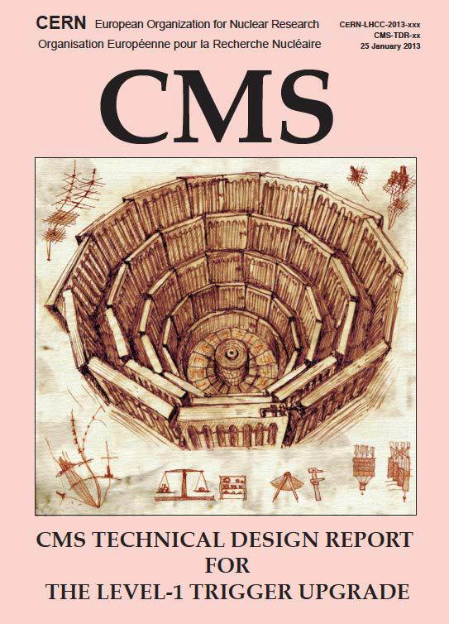
CMS Phase 1 Upgrade Strategy
Upgrade goals are to provide strong physics performance for luminosities up to twice the original design (2 x 1034) and manage radiation-damage effects up to 500 fb⁻¹
Upgrades planned to three subsystems of CMS
  Pixel tracker : four-layer barrel and 3 forward-disk pixel tracker with new readout chip (ROC) capable of higher hit rate
  Hadron calorimeter : Installation of SiPM devices into barrel/endcap calorimeters and new electronics in the forward calorimeter allowing timing-based background rejection
  Trigger : upgrade to the muon and calorimeter Level-1 trigger systems and global trigger processor to handle higher luminosities without loss of efficiency for key physics channels

Slide 8
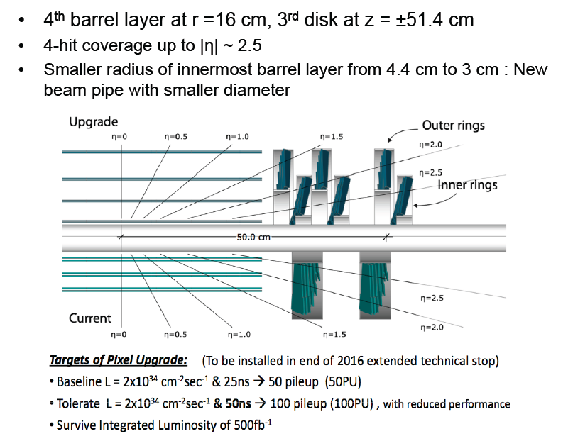
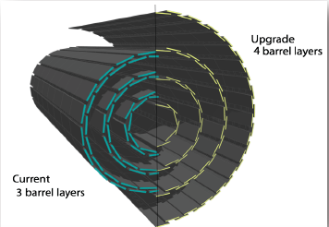
Phase I CMS 4 layer Inner Pixel

Slide 9
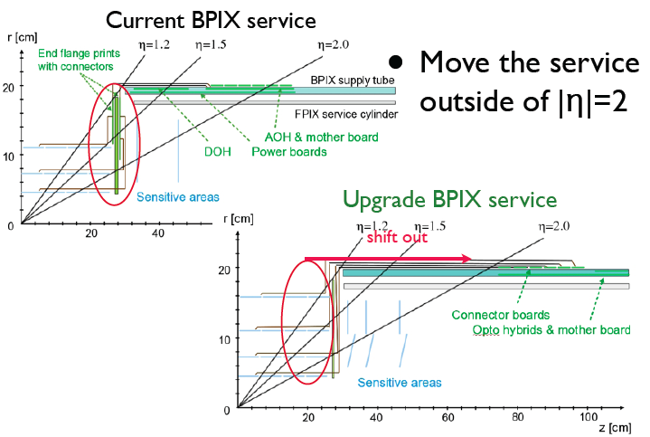
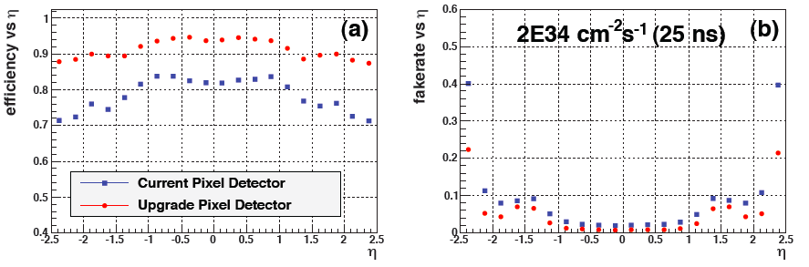
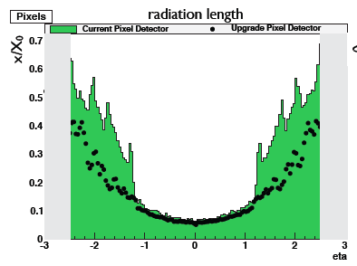
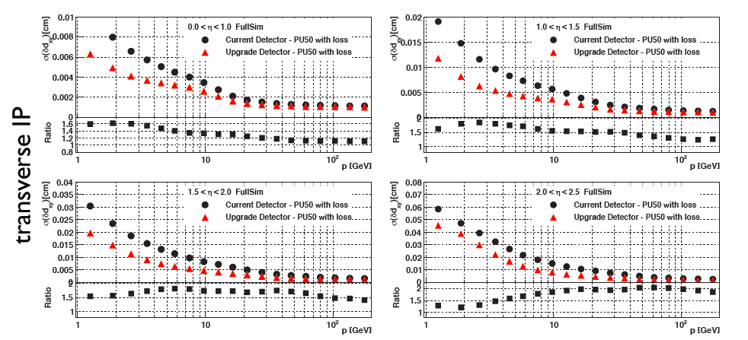
Phase I CMS 4 layer Inner Pixel
Minimize Material within Tracking Volume:
Optimize Performance of 4 Pixel Layer System
Tt samples
μ samples

Slide 10
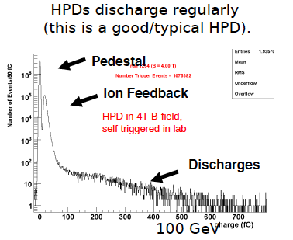
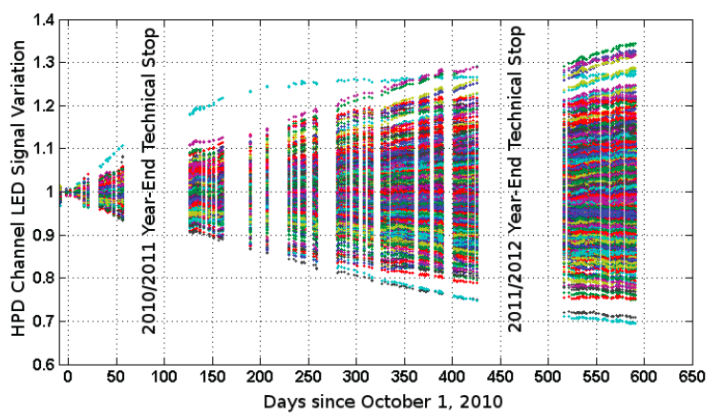
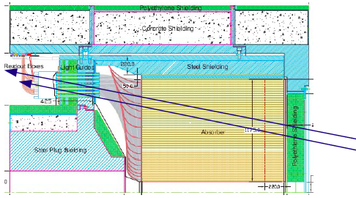
Phase I CMS HCAL Read-Out Upgrades
HB/HE Performance Concerns:
HPD discharges, and gain drift !
HF Performance Concerns:
Large signals from particles going directly through PMT window: cannot be usefully filtered with 25ns bunch-spacing

Slide 11
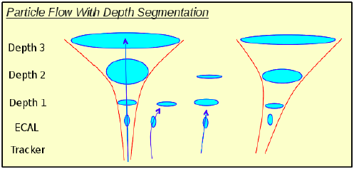
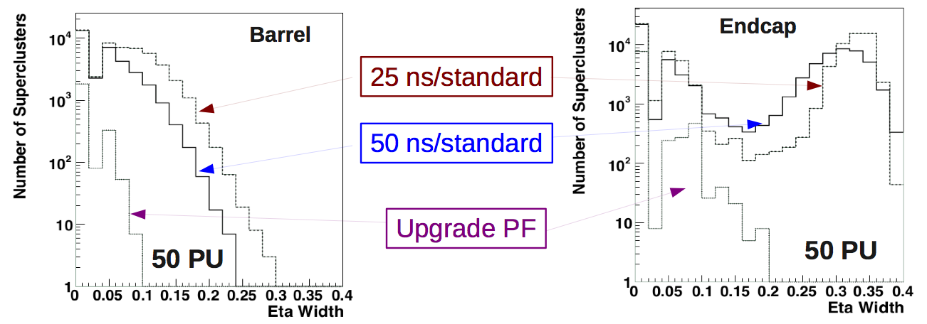
Phase I CMS HCAL Read-Out Upgrades
Hadronic showers spread out with increasing depth
  With a single –depth readout, pile-up energy will be pulled into a charged hadron cluster or true energy will be left out and labeled as a neutral hadron
  With multi-depth readout, clusters can remain bounded
A
B

Slide 12
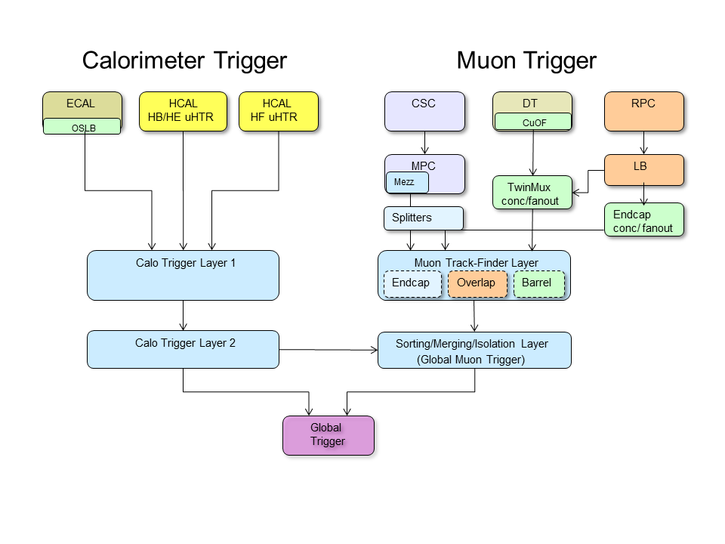
Trigger Upgrade Strategy and Architecture
Trigger rates are driven by the
increase in luminosity, PU, and √s
  Modern FPGAs and µTCA backplane technology for high bandwidth and processing power
    Allows higher calorimeter granularity and earlier combination of muon systems to provide better precision on trigger objects and more sophisticated selection algorithms
e, γ and μ isolation and jet finding with PU subtraction
τ id with narrower code
L1 menu sophistication
Build and commission upgrade in parallel with current trigger system in 2015 to safeguard physics, decouple from LHC schedule
Target deployment: 2016
Notes:
– new architecture for calorimeter with a full event in one processor

Slide 13
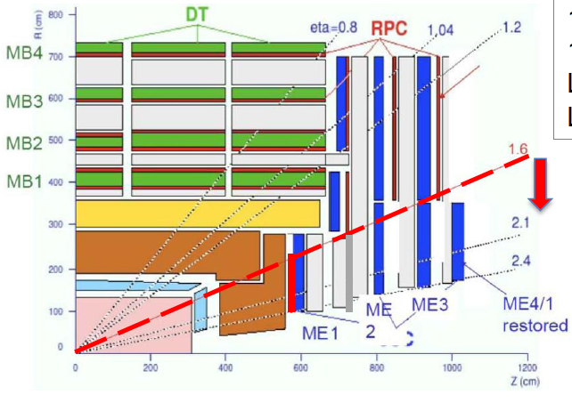
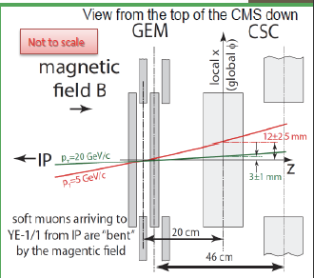
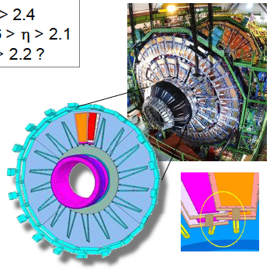
CMS GE1-1 Muon Trigger Upgrade
New GE1-1 GEM Muon Station combined with ME1
can substantially improve p_{T} determination
(measurement of bending angle) to reduce
trigger rate

Slide 14
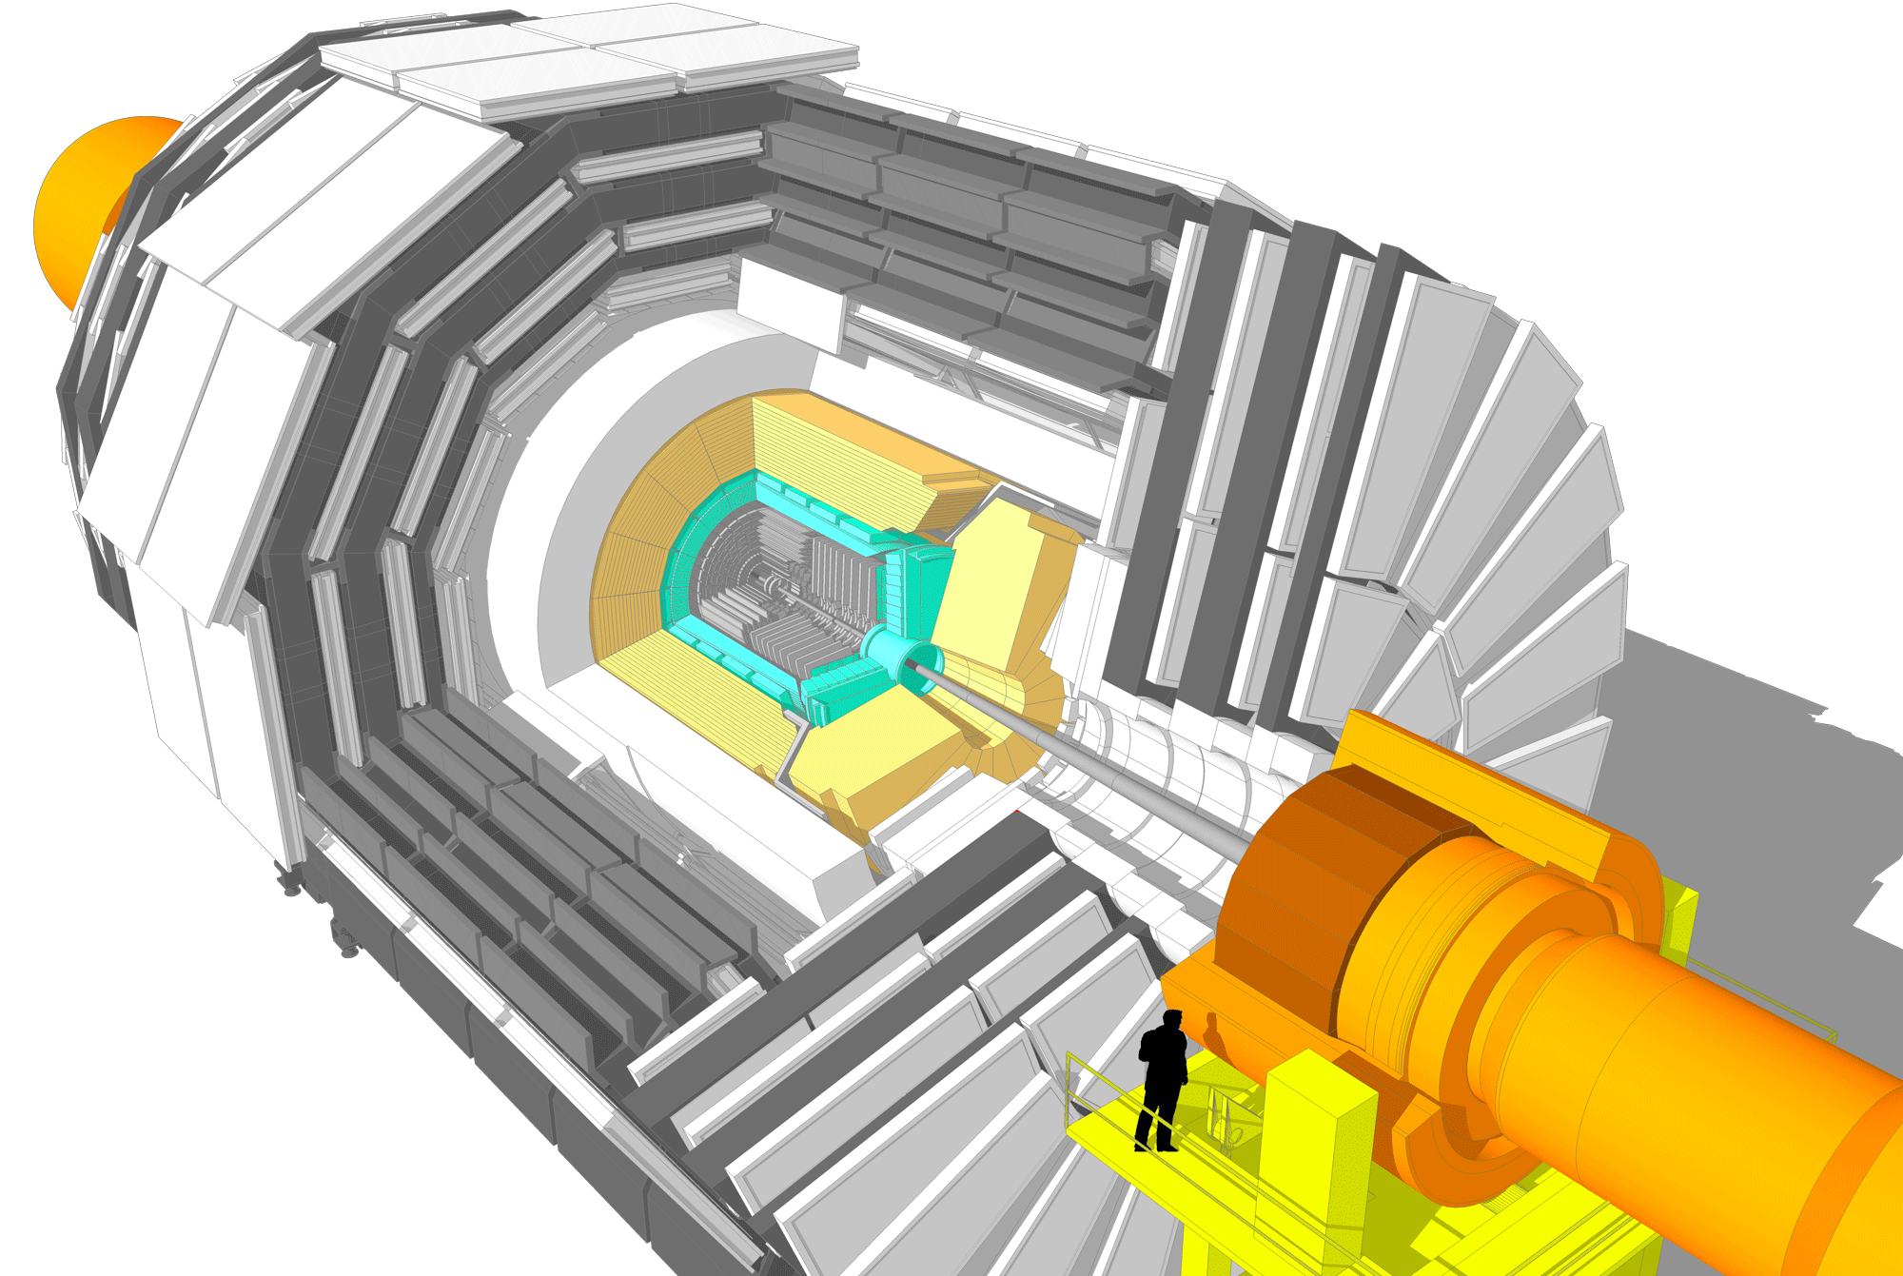
CMS Phase 2 Upgrades
Muons
Replace DT FE electronics
Complete RPC coverage in forward region (new GEM/RPC technology)
Investigate Muon-tagging up to η ∼ 4
CSC FEBs in inner rings
New Tracker
Radiation tolerant - high granularity - less material
Tracks in hardware trigger (L1)
Coverage up to η ∼ 4
New Endcap Calorimeters
Radiation tolerant - high granularity
Investigate coverage up to η ∼ 4
Barrel ECAL
Replace FE electronics
ECAL VFE electronics
Trigger/DAQ
L1 (hardware) with tracks and
rate up ∼ 500 kHz to 1 MHz
Latency ≥ 10µs
HLT output up to 10 kHz
https://cds.cern.ch/record/1605208/files/CERN-RRB-2013-124.pdf

Slide 15
Upgrades deadlines and milestones in 2014
LHCC Mar 4th : Report on R&D Program
2 0 1 4 | Mar
 | Apr
 | May
 | Jun
 | Jul
 | Aug
 | Sep
 | Oct
 | Nov
Jan - Mar : Review of Endcap Calorimetry
CMS Upgrade Week in Karlsruhe end of Mar ‘14 : First draft of TP
Mar - Aug : Review of TP cost estimates
May 8th - 9th : TP Studies Group workshop LPC @ FNAL
LHCC Jun 3^{rd:} Report on EC options and TP preparation
June CMS Week: Second TP version with full content for CMS reader
July: Readers for subsystem chapters
Aug: CWR for sub-system chapters
Sep CMS Upgrade Week: Final TP version for sub-system chapters
LHCC Sep 23rd : TP presentation to LHCC Closed session
RRB - October 13th -15th
2nd ECFA Workshop on 21st -23rd October
LHCC Nov 25th : TP presentation to LHCC Open session

Slide 16

CMS Phase 2 Upgrade Strategy : Technical proposal
Demonstrate the motivation of the Phase 2 upgrades: detector longevity and performance issues at high luminosity
Describe the detector conceptual designs and present supporting performance studies on physics objects, trigger and key physics signals
  Baseline for studies is 5x10³⁴ cm⁻² s⁻¹ and <PU> =140 - but we must prepare to evaluate potential to perform at higher PU (<PU> =200 with few selected studies)
Demonstrate that feasible solutions have been identified, and present plans for completion of necessary R&D
Present a preliminary production cost and organization plan
DRAFT
We are aiming at a ~250 pages document
Draft is available at:
https://cms-docdb.cern.ch/cgi-bin/DocDB/ShowDocument?docid=12143

Slide 17
Status of the Technical Proposal Approval Process
Chapter | Pre-approval | Comments from readers | Green-light | Approval | CWR begin
1.1 Intro: HL-LHC Operations | - |  | - | - | August 11
1.2 Intro: HL-LHC Physics | June 30 |  | July 17 | July 24 | August 11
1.3 Intro: BRIL | June 27 | July 6 | July 13 | July 16 | August 11
1.4 Upgrade Summary | - | - | - | - | August 11
2. Tracker | June 19 | June 29 | July 6 | July 9 | August 11
3. Calorimeters | June 27 | July 6 | July 20 | July 28 | August 11
4. Muon | June 27 | July 6 | July 20 | July 23 | August 11
5. BRIL | June 27 | July 6 | July 13 | July 16 | August 11
6. Trigger/HLT | June 27 | July 6 | July 13 | July 16 | August 11
7. DAQ/Trigger Control | June 27 | July 6 | July 13 | July 16 | August 11
8. Software & Computing | June 27 | July 6 | July 13 | July 23 | August 11
9. Object Performance
10. Physics Performance
11. Infrastructure & Logistic | June 27 | July 6 | July 13 | July 30 | August 11
To be reviewed by POG and PAG
First Version to CMS Reader
WGM Presentation
1st version to LHCC

Slide 18
Simulation studies for the Technical Proposal
Full CMSSW simulations comparing performance of subsystems - Objects (including trigger) - Physics signals for:
  Phase 1 - 50 PU - no aging - reference for performance
  Phase 1 - 140 PU - 1000 fb⁻¹ aging - demonstrate need for upgrades
  Phase 2 - 140 PU – no aging except for 1000 fb⁻¹ EB/HB - validate upgrade scope & concepts
    Other aging studies up to 3000 fb⁻¹
    Present some trigger performance at 200 PU
    DELPHES parameterized simulations (benchmarked to object full simulation) for physics background studies
    Detailed radiation studies (FLUKA) for upgrade configurations
    Information about TP Studies activities can be find at the following link: https://twiki.cern.ch/twiki/bin/viewauth/CMS/HLTPStudies

Slide 19
CMS Phase 2 Trigger Scenario
L1 Accept rate up to 750 kHz (from 100 kHz)
  Plan for L1A rate up to 500 kHz @ 140 PU and 750 kHz @ 200 PU
  Driven by keeping acceptance consistent with Run 1 and Phase 1 Upgrade
  Includes acceptance of consecutive 25 ns beam crossings (not gap of 3 as present)
  Provides more acceptance and lower thresholds
Tracking Trigger
  Driven by keeping acceptance consistent with Run 1 and Phase 1 Upgrade
  Leptons: P_{T} cut & isolation, Jets: Vertex
New L1 Trigger (Calorimeter, Muon, Global) to incorporate Track Trigger
  Finer calorimeter cluster trigger, muon & calorimeter seeds for track match
  Also incorporate additional muon chambers for |η| > 1.5 (e.g. GEMs)
Latency of 12.5 μsec (from 3.4μsec)
  Driven by Tracking Trigger and logic to incorporate it.
  Limit from complications for outer tracker readout
HLT Output Rate up to 7.5 kHz
  Plan for 5 kHz @ 140 PU and 7.5 kHz @ 200 PU
  Limit from Computing (e.g. cost), no limit from DAQ
  Same reduction of L1 rate (~100) as present

Slide 20
Phase 2 Trigger Impact on Existing Subsystems
Replace ECAL Barrel (and Endcap) Front End electronics
  Allows L1 latency & accept rate increases
  Includes providing individual crystal level (not 5x5 sums) trigger information
    Improves track matching, spike rejections and timing
  Assume: EE electronics replaced with EE replacement
Replace CSC on-Chamber Cathode Front End Boards (CFEBs) on ME2/1, 3/1, 4/1
  Present CFEBs on ME2/1, 3/1, 4/1 limited to 6 μs latency, 400 kHz rate without significant loss in readout and trigger efficiency (> 2% per chamber)
  Replace 108 out of a total of 468 CFEBS with digital CFEBs similar to those installed on ME1/1 during LS1
  Then entire CSC system has high efficiency up to 20 μs and 1 MHz L1A.
(Replace DT Readout Boards (ROBs) in on-detector minicrates)
  Replacement planned anyway due to lifetime issues
  Presently limited to 300 kHz
  After replacement, no limitation up to 20 μs latency, 1 MHz rate
Modifications to HCAL μHTR system
  Replacement of AMC13 card, modification of uTCA architecture – not major
  HE replacement planned anyway

Slide 21
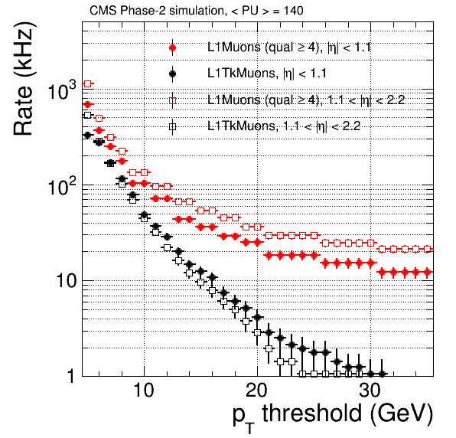
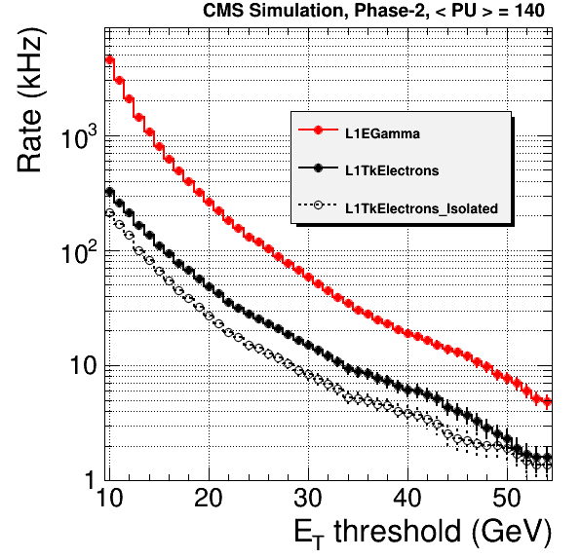
Track Trigger Performances
Track trigger will reduce rates through
  High momentum resolution of leptons - sharp thresholds
  Isolation for e/γ/μ/τ - reduce background
  Association of particles to same primary or secondary vertex - reduce combinatorial effect of PU in multi-particle/jet triggers
Gain ∼ 10 for lepton triggers - will allow maintaining low trigger thresholds
Lepton trigger rate
reduction by a factor 5 to 10 with improved ECAL L1 granularity and L1 Trackings
Notes:
Track Trigger Performance: muons Sharpens (!) turn-on curve, improves efficiency
For a threshold of ~ 20 GeV, rate of single muon trigger can be reduced by a factor of O(10)
Track Trigger Performance: electrons Efficiency exceeds 90% in central region
Match with Track Trigger plus track-based isolation retains good efficiency with rate reduction of O(10

Slide 22
Performance Studies: L1 Menu Studies
Goal: maintain overall physics performance + acceptance of L1 Trigger Upgrade TDR (e.g. thresholds near the end of run 1)
  Study a sample menu using ~70% of bandwidth
    Not included: any prescaled trigger (minbias, triggers with lower thresholds), triggers involving forward calorimeter, MET/MHT, three lepton triggers, other acceptance, diagnostic and calibration triggers.
  Compensate by increasing found total rate by 30%
Benchmark conditions: 140PU
  Use Minbias Sample with PU = 140
  Assume bunch spacing at 25 ns: L ~ 5.6 E34
Use Tracking Trigger
  Assume “perfect” performance
High PU Conditions: 200 PU
  Use private production of 200 PU events
  Assume bunch spacing at 25 ns: L ~ 8 E34
Uncertainties: Need Safety factor of at least 1.5
  Simulation uncertainty
  Readout underachievement
  Realistic Tracking Trigger performance

Slide 23
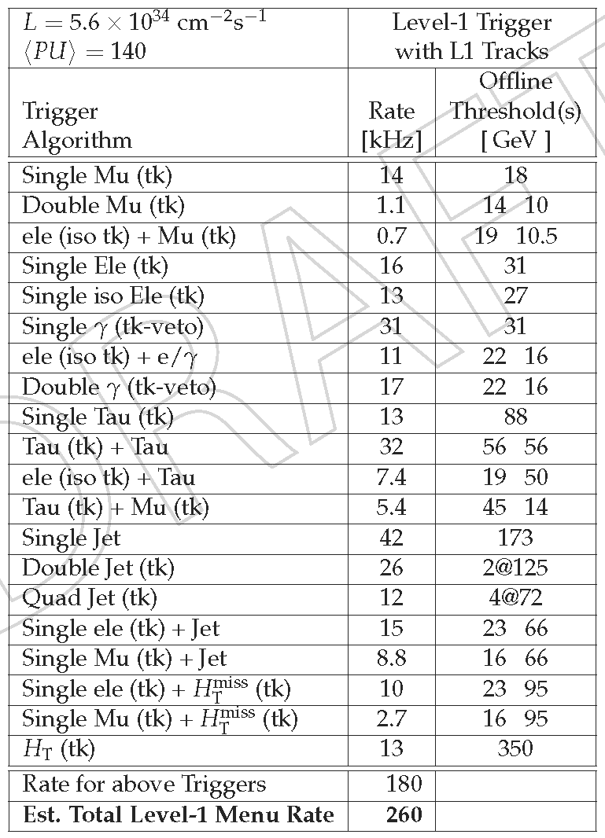

L1 Trigger Menu at 140 PU with L1 Tracking Trigger
Goal: maintain overall physics performance + acceptance of L1 Trigger Upgrade TDR (e.g. thresholds near the end of run 1)
  Study a sample menu using ~70% of bandwidth
  Compensate by increasing found total rate by 30%
Uncertainties: Need Safety factor of at least 1.5
  Simulation uncertainty
  Readout underachievement
  Realistic Tracking Trigger performance
Menu w/o Tracking Trigger produces a total rate of 1.5 MHz at 140 PU
  Tracking trigger provides factor of 5.5 reduction to 260 kHz →
  w/ 1.5 safety factor: 390 kHz
  Use 500 kHz as benchmark
Menu w/Tracking Trigger produces total rate of 500 kHz at 200 PU
  w/ 1.5 safety factor: 750 kHz
  w/o track trig., approach 4 MHz!
    (6 MHz w/safety!)
Menu with L1 Track Trigger
Warning: this menu is just a sample table only for evaluating bandwidth

Slide 24
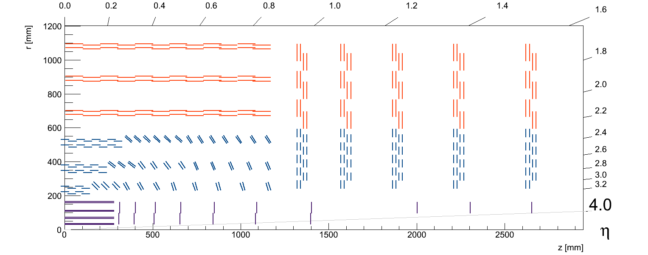
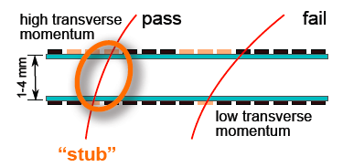
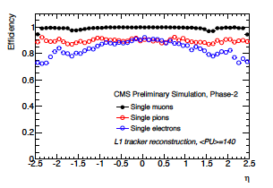
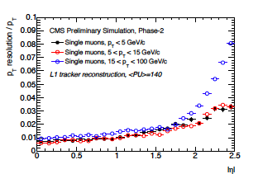
Phase 2 Tracker & Track Trigger
Outer Tracker, new Pt modules
3/5 Pixelated layers/disks
Strip/Strip modules SS
Macro Pixel/Strip modules PS
Z measurement
Inner Tracker,
new Disks to η=4
Pixel modules
Pixel Area 1.6m² Barrel + 2.0m² Disk
Possible pixel size ~ 50x50 - 25x100mm²
R&D on planar n-in-p or 3D sensors?
CMS Si Tracker as it could be in 2025
Powerful concept to implement tracks in hardware trigger
2 sensor modules to select track “stubs” of p_{T} ≥ 2GeV for trigger readout (40MHz)
Strip-Strip (SS) in outer layers and Macro Pixel-Strip (PS) in inner (z meas.)
Notes:
Qualitative requirements were used to develop optimized designs!
Radiation tolerance.
3000 fb⁻¹ for Outer Tracker – Maintain possibility of replacing inner parts of the Pixel detector
Introduce a map of expected integrated fluence (1 MeV neq)
Increased granularity
Occupancy ~1%
Improved two-track separation
Small pixels…
Reduced material in the tracking volume
As good as we can
Robust pattern recognition
Seeding capabilities in Outer Tracker
Contribution to Level-1 trigger
p_{T} modules in Outer Tracker
Extended tracking acceptance
Up to about η=4
To be justified in Physics chapter
Add clarification on L1 rate and Latency
Current design optimized for 140 <PU> @ 500 kHz (with margin)
Up to 12.5 μs latency
Can enhance further (with some complications and penalties) – under discussion
PIXEL DETECTORS
Introduce basic concepts
Thinner silicon with smaller pixels
Possibly 3D silicon in the innermost regions
65 nm CMOS chosen as candidate chip technology
Architecture with “pixel regions” sharing digital electronics
Detector geometry based on Phase-1 layout, with additional disks for the rapidity extension

Slide 25
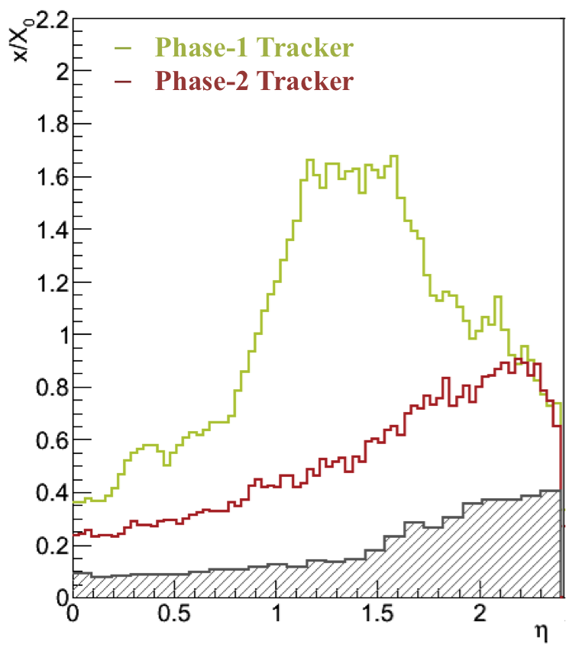
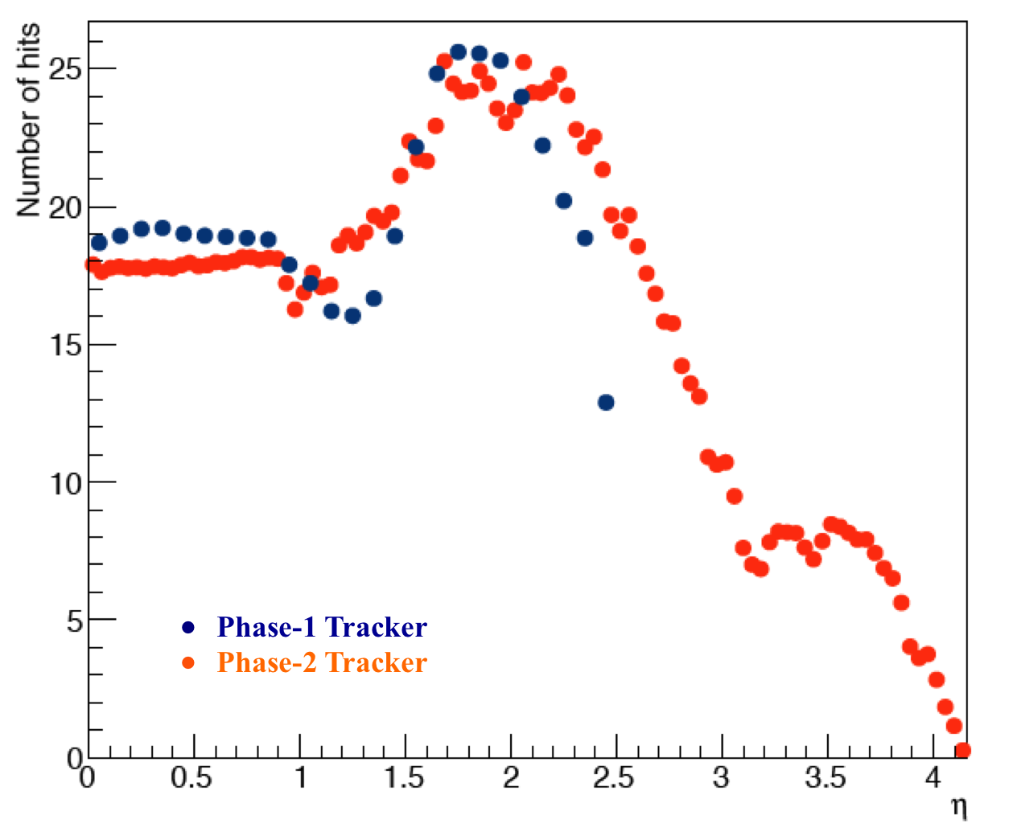
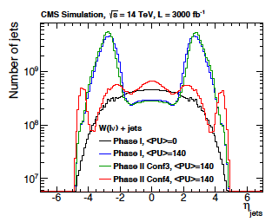
Phase 2 Tracker conceptual design
Lighten up!
  DC-DC powering scheme, CO₂ cooling, low mass assemblies
Reduced material within Tracker Volume
  Improved track p_{T} resolution & reduce rate of γ conversion
  ex. HH -> bbγγ; ttH -> γγ ; H -> µµ - B_{s,d} -> µµ…
Extension of Pixel coverage up to ∣η∣∼ 4
Reduce rate of fake jets due to PU for VBF physics
Allows to separate signal jets (primary vertex) from PU Jets.
Phase 1 Pixel
Jet rate without & with pixel
coverage extension at 140 PU
η

Slide 26
Tracking Performance
0.1
0.1

Slide 27
Radiation @ HL-LHC
  Radiation six times higher than nominal LHC design
  5(7)E34 Hz/cm² ➔ ~ 140 (200) collisions/bunch crossing
HCAL Barrel
> 10 Mrad
HCAL Endcap
ECAL Barrel
ECAL Endcap
η = 3
Longevity studies and simulation for 300 fb⁻¹/y ➔ 3000 fb⁻¹ total
Longevity studies and simulation for 300 fb⁻¹/y ➔ 3000 fb⁻¹ total
Phase 2 Upgrades Strategy:
Maintain performance at extreme PU
Sustain rates and radiation doses

Slide 28
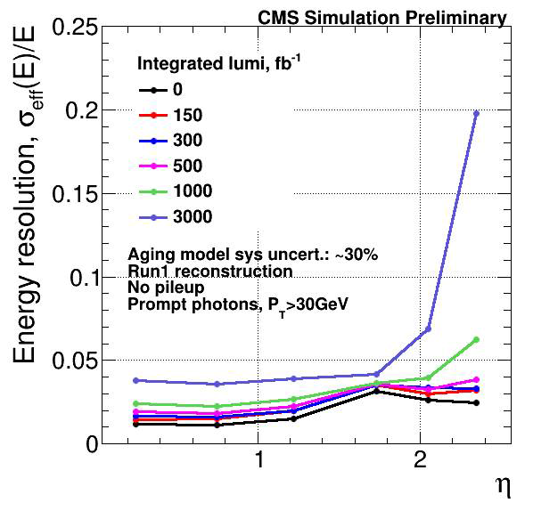
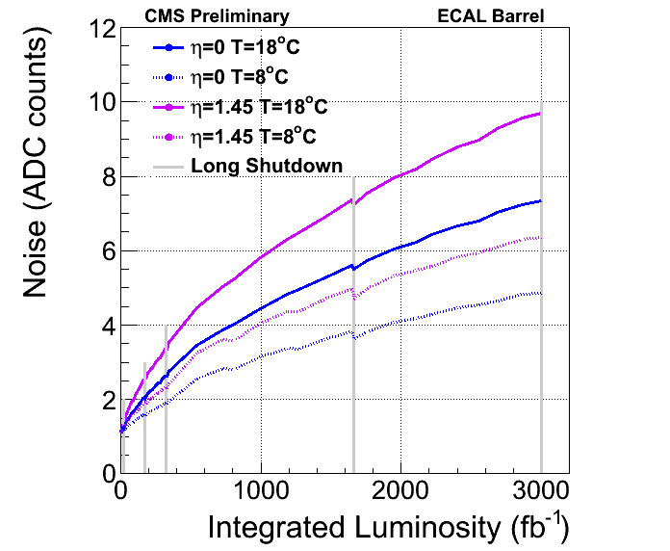
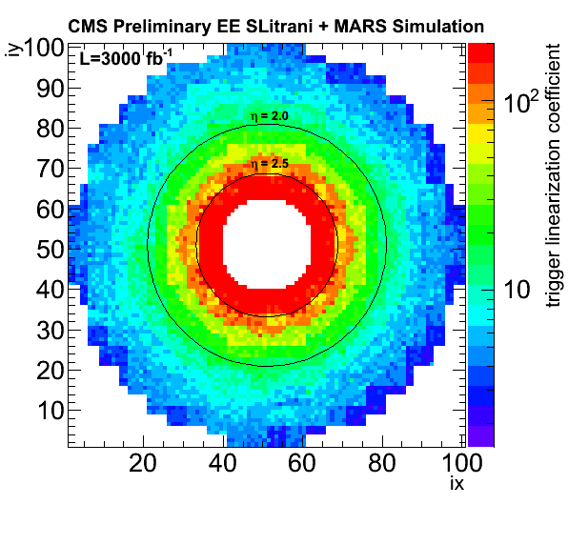
ECAL resolution vs aging
BARREL
ENDCAPS
Extrapolation of the noise in the ECAL Barrel due to the APDs dark current.
Operating the detector at lower T (dotted curve) mitigates the noise.
1 ADC count = 40 MeV in Run 1
Correction to be applied to the EE crystals at the L1 to compensate for light output loss for 3000 fb⁻¹
Energy resolution for unconverted photons calculated from a 5x5 crystal matrix vs η for various aging scenarios.
In the endcaps the dominating factor for aging is the crystal light output loss, while in the barrel the APD noise (at room T) significantly affects the energy resolution from L > 1000 fb⁻¹.

Slide 29
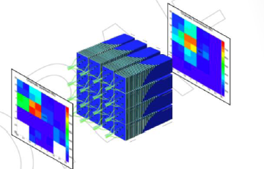
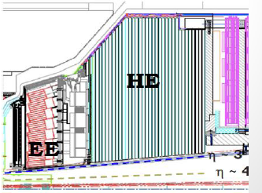
Two Scenarios for Forward Calorimetry
  CMS needs to replace End-cap Electromagnetic and Hadronic calorimeters for Phase 2 due to radiation damage
  Scenario 1 : EE Shashlik + HE re-build
  Maintain present geometry with stand-alone
  ECAL and HCAL
  ECAL Endcap using Shashlik design
  HCAL Endcap re-build as rad-hard with
  higher granularity in η−φ and longitudinal
  Segmentation.
Scenario 2: HGCAL:
  New integrated design as High
  Granularity calorimeter (HGC)
  Particle Flow imaging calorimeter
Notes:
From Jan. to Apr. 2014, a review committee investigated the potential of each concept to fulfill the CMS requirements for:
physics performance;
technical feasibility and integration within the existing CMS;
completion of the project within the anticipated Phase 2 resources and schedule.
Conclusion was that:
Current resources were insufficient to demonstrate three concepts on the required time scale to select final technical solution
The CFCAL concept presented the highest technical and schedule risks
The collaboration has decided to continue studies and R&D* for the EE Shashlik plus HE-rebuild and the High Granularity CALorimeter

Slide 30
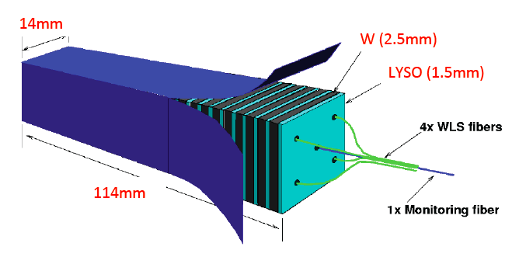
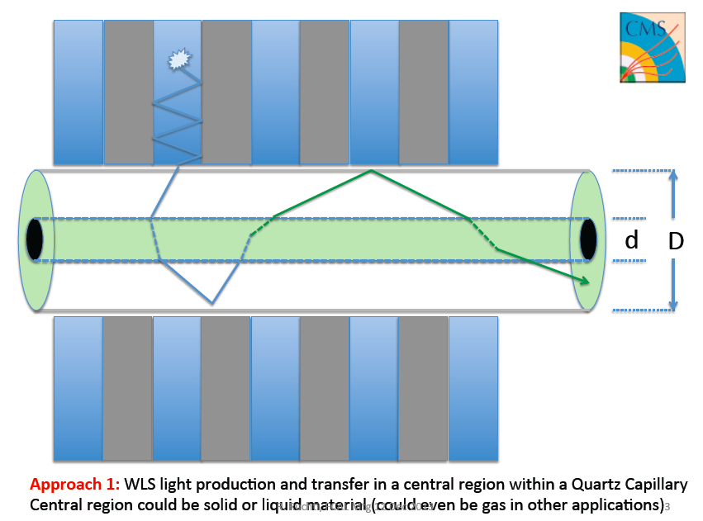
Scenario 1 : Shashlik ECAL
Sampling calorimeter w/out depth segmentation
Rad-hard inorganic scintillator. Best performance with W-absorber and Crystal LYSO
Light readout with 4 WLS capillaries + 1 calibration fiber per module
Readout with GaInP (SiPM) photosensors (rad-hard due to larger band gap)
Good energy resolution ΔE/E = 10%/sqrt(E) + 1%
Very compact ~ 11 cm long and highest light yield
Small Moliere radius (14 mm) provide fine granularity (14 mm²) for pile-up mitigation
WLS

Slide 31
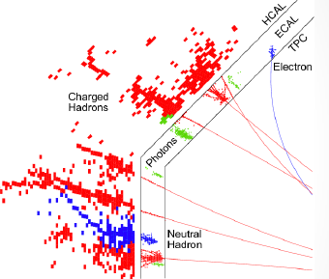
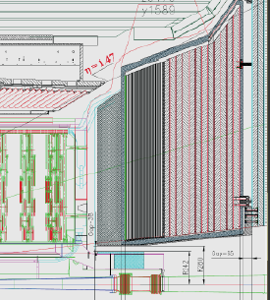
Two Scenarios for Forward Calorimetry
  CMS needs to replace End-cap Electromagnetic and Hadronic calorimeters for Phase 2 due to radiation damage
  Scenario 1 : EE Shashlik + HE re-build
  Maintain present geometry with
  ECAL and HCAL stand-alone
  ECAL Endcap in Shashlik design
  HCAL Endcap re-build as rad-hard with
  higher granularity in η−φ and longitudinal
  segmentation
Scenario 2: HGCAL
  New integrated design as High
  Granularity calorimeter (HGC)
  Particle Flow imaging calorimeter
Notes:
From Jan. to Apr. 2014, a review committee investigated the potential of each concept to fulfill the CMS requirements for:
physics performance;
technical feasibility and integration within the existing CMS;
completion of the project within the anticipated Phase 2 resources and schedule.
Conclusion was that:
Current resources were insufficient to demonstrate three concepts on the required time scale to select final technical solution
The CFCAL concept presented the highest technical and schedule risks
The collaboration has decided to continue studies and R&D* for the EE Shashlik plus HE-rebuild and the High Granularity CALorimeter

Slide 32
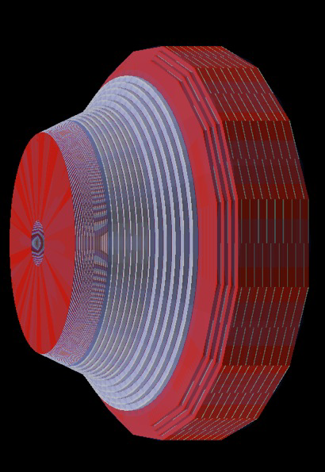
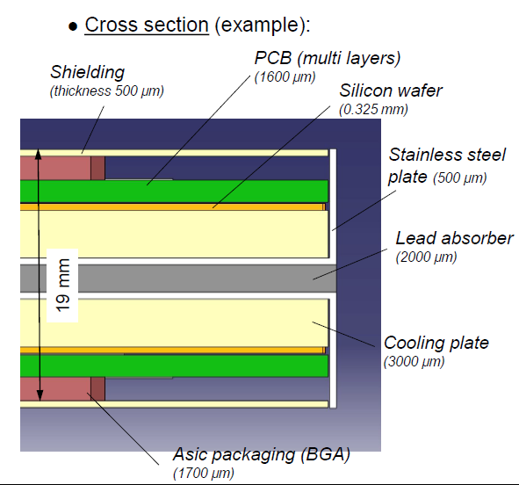
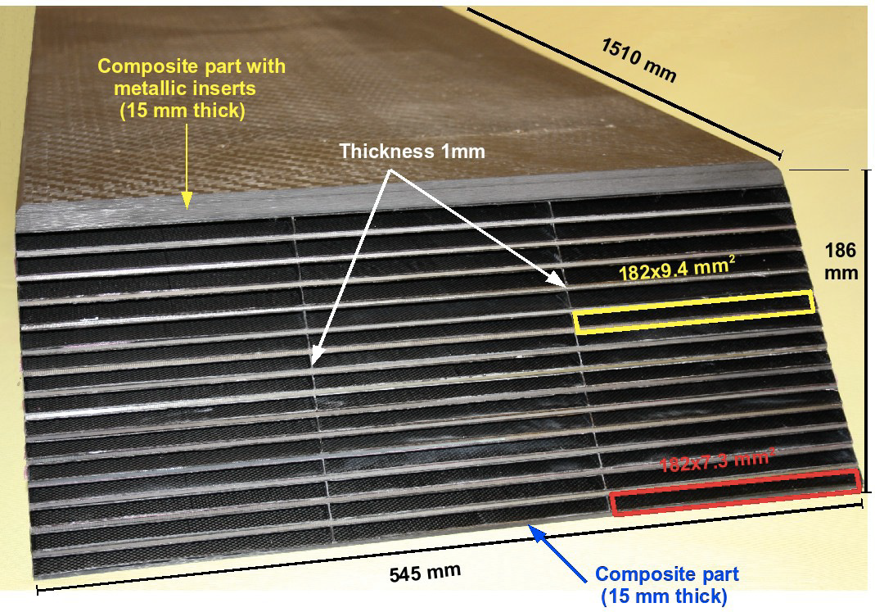
Scenario 2: High Granularity Calorimeter (HGCAL)
High granularity calorimeter based on ILC/CALICE development. Key point : “visualize” energy flow through
Fine granularity and longitudinal segmentation.
  Good resolving power for single particle in very dense jets; Expected e/γ resolution ∼ 20%/sqrt(E) + ≤ 1%
Segmentation:
E-HG: ~33 cm, 25 X_{0,} 1λ, 31 layers. Absorber lead/Cu
H-HG: ~66 cm, 4λ. 12 layers. Absorber brass
E-HG + H-HG: Fine grain pads 0.9 cm² to 1.8 cm²
Back HG as HE re-build 5λ
  With increased transverse granularity
`Adaptation to CMS endcaps
`CALICE ECAL concept

Slide 33
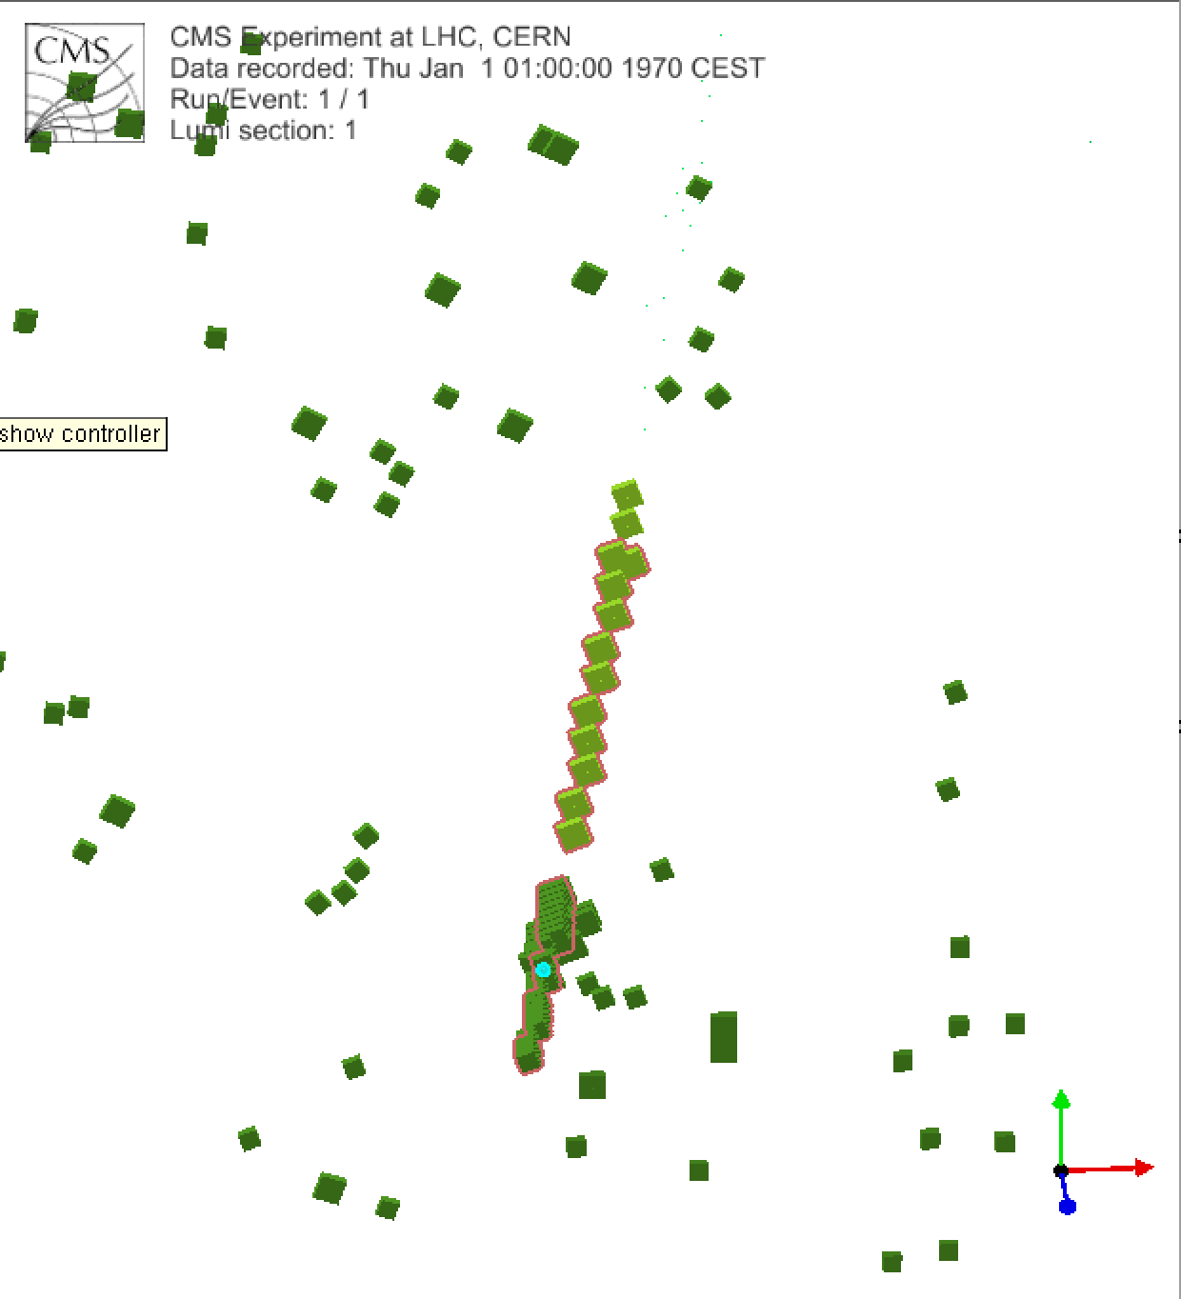
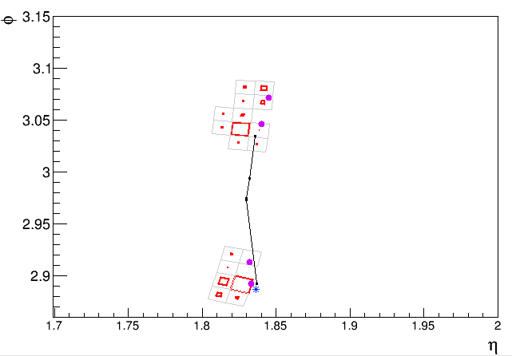


Endcap Calorimetry development
Clustering in Sashlik
First look in HGCAL clustering
Clustering in Sashlik works.
GSF Electrons are reconstructed out of the box
Electron gun
electron cluster
Electron track
Muon cluster in HGCAL using the
Arbor algorithm. Tuning is worked
early brem
Sashlik + HE no PU
HGCAL no PU
τ −> π^{+/−} π⁰
VBF Hττ
τ −> π^{+/−} π⁰

Slide 34
Toward a technical solution for End-cap Calorimetry
  Milestones have been established to allow decision on final technical solution on a timescale of ~beg-mid of 2015:
  Scenario 1 : EE Shashlik + HE re-build :
    Physics performance must be part of the Technical Proposal
    Demonstrate with prototypes that expected performance can be achieved
    Demonstrate radiation tolerant components both for EE Shashlik and HE
Scenario 2: HGCAL:
    Demonstrate benefit of high granularity in physics performance
    Perform engineering studies of critical design aspects
    Confirm Si-Sensor radiation tolerance - in conjunction with tracker R&D
Notes:
From Jan. to Apr. 2014, a review committee investigated the potential of each concept to fulfill the CMS requirements for:
physics performance;
technical feasibility and integration within the existing CMS;
completion of the project within the anticipated Phase 2 resources and schedule.
Conclusion was that:
Current resources were insufficient to demonstrate three concepts on the required time scale to select final technical solution
The CFCAL concept presented the highest technical and schedule risks
The collaboration has decided to continue studies and R&D* for the EE Shashlik plus HE-rebuild and the High Granularity CALorimeter

Slide 35




New forward Muon Detectors
Local trigger primitives ε improved
in every station with redundancy
  Scenarios with/wo ME1/1 segment
Main motivation of Muon forward upgrade
are: redundancy for
trigger improvements and muon reconstruction in the very forward region which is the most difficult region (B-field, highest rates)
Notes:
Triple GEM detector (GE1/1): precision chambers to improve trigger momentum
Selectivity and reconstruction already in late LHC phase 1. Installation in LS2 (2018)
Extended coverage provides muon tag in most difficult forward region eta <3.5
Several tens of kHz expected → GEM technology
Enhance only rehion in muon system without redundancy 1.6 < eta < 2.4
Most difficult region with maximum rate. Re-establish redundancy.
Technology GEM (GE2/1) and improved high – rate RPC (Re3/1, RE4/1)

Slide 36


Physics Motivations for the Technical Proposal
Up to now we have discussed about detector concepts and trigger studies ..
but we need to include proper physics motivations…
Full Sim Production
Delphes Production

Slide 37




Few Preliminary Object Performance Results
Electron Efficiency @ 140 PU
Global Muon Efficiency
B-tag Efficiency

Slide 38





Physics studies foreseen in Technical Proposal
Key physics channels at HL-LHC*
  Higgs properties and rare processes:
  VBF H, ttH, H → µµ/Zγ, HH …
    Standard Model measurements:
    VBS, precision M_{W}, sin²θw,αs, rare processes Bs,d → µµ,
    differential measurements of W, Z, di-boson, top, and Higgs
  BSM direct searches & studies:
    SUSY: Direct stop, chargino/neutralino,
    VBF Dark Matter/stop-sbottom
    Exotica: Z’/W’ - HSCP - DM mono-X
    (Jets, γ, W/Z/H, t)
    …
* ECFA workshop agenda/report https://indico.cern.ch/event/252045/ https://cds.cern.ch/record/1631032
VBS
chargino/neutralino
VBF Dark Matter

Slide 39
Summary on Technical Proposal
We are proceeding with the Technical Proposal edition:
  CWR for Sub-system chapters will start on August 11th
Large effort has been invested to develop new detector geometries, simulation and reconstruction at high PU, still more needed for the TP
  Some preliminary results available
MC simulation campaigns
  re-processing for Phase 1 campaigns on going
    final results expected during Upgrade Week in Sepember
  phase 2 campaign
    Software validation on going, production expected to start by mid Aug
    Final results expected 2nd week of September
  Delphes production ongoing
    Reports from PAGs expected during Upgrade week
CWR for Object and Physics Performance chapters will start on ~Sep 22nd
Final updates, approval & submission to LHCC by mid of October
Open presentation to LHCC in Nov.

Slide 40
Broad-brush planning for Phase 2 completion
2014 | 2015 | 2016 | 2017 | 2018 | 2019 | 2020 | 2021 | 2022 | 2023 | 2024 | 2025
TP
TDR
LS2
LS3
Target to optimize detector designs, validate technical solutions and consolidate costs
Technology R&D
Technical Design
Prototyping
Engineering Design
Pre-series
Construction/Production
Installation Commissioning
R&D funds
CORE funds

Slide 41
Summary & Conclusions
It is time to prepare for High-Luminosity operation in ≥ 2025. Expected to record up to 3000/fb of pp data.
Ageing and radiation damage will require to rebuild the inner tracker and forward detectors. New trigger concepts implemented. Larger bandwidth require upgrade of electronics.
New detectors designed to cope with high rates, high pile-up and radiation
The HL-LHC will allow thorough exploration of the TeV scale with a two-pronged approach
  Precision SM, EWSB & Higgs physics, rare processes
  Direct searches for new physics, including low cross-section
CMS is preparing a program of Upgrades aimed at fully exploiting the HL-LHC physics potential

Slide 42
Back-up slides

Slide 43

TP Performance Studies Schedule

Slide 44

Schedule of the Installations for Phase 1 Upgrades
L1 Trigger Installation
and Commissioning
Pixel Installation
HCAL Barrel and Endcap
Installation
HF Electronics Installation

Slide 45
Run 1 & 2 LHC and HL-LHC
With ~30fb⁻¹ at 6-7TeV no low hanging fruit for New Physics, and yet we know the picture is not complete…
The LHC Run 2, with 300fb-1 at 13~14TeV will open a new window for discovery
Across a mass range crucial for Naturalness
And this is still only scratching the surface
HL-LHC, with 3’000fb⁻¹ at 13~14Tev will bring high intensity frontier physics to the energy frontier
Precision SM, EWSB and Higgs physics
Further extend potential for discovery and characterization of new physics
  Extend mass reach by ~ 1TeV
  Open broad scope for rare, unusual processes
This is Very Challenging: it requires
Precision measurements of
  Leptons (e, μ, τ), γ, Jets, b (c) quarks, MET
Reconstruction of complex event topologies to identify
  W/Z, top, VBF, etc.
Over the full range from low to high p_{T}
  In a very high rate and high pile-up environment

Slide 46

Post-discovery landscape
SUSY?
Higgs Discovery ⇒ Hierarchy problem no longer hypothetical
  Corrections to the Higgs mass appear to want to be at the Planck scale
  Is the universe incredibly fine-tuned?
How do we resolve this issue?
  SM partners especially 3rd generation & EWK Bosons ⇒ Naturalness
  New phenomena related to the true Planck scale being much lower
  …
These are experimentally testable at the LHC
  e.g. naturalness even fine-tuning a bit requires partners at the TeV scale
Dark Matter…. Dark Energy…. ???
Notes:
Higgs must have mass at the weak scale to avoid unitarity violation in WW scattering.

Slide 47

Phase I CMS 4 layer Inner Pixel

Slide 48

Phase I CMS HCAL Read-Out Upgrades
VBF → ττ

Slide 49

Phase I CMS Trigger Upgrades
  Modern FPGAs and µTCA backplane technology for high bandwidth and processing power - new architecture for calorimeter with a full event in one processor
    This allows higher calorimeter granularity and earlier combination of muon systems to provide better precision on trigger objects and more sophisticated selection algorithms
  e, γ and µ isolation and jet finding with PU subtraction
  τ finding with narrower cone
  new algorithms with correlated quantities (e.g. invariant mass…)
MP7 board Virtex 7 and 72 I/O links at 10Gpbs
Demonstrator of Calorimeter trigger in µTCA crate

Slide 50

Phase I CMS Calo Trigger Upgrade
Layer 1 is optimized for backplane connectivity; Layer 2 for front-panel optical bandwidth
Access full granularity ECAL/HCAL Trigger Tower granularity for clustering, isolation etc.

Slide 51


Phase I CMS Muon Trigger Upgrade
The present muon trigger system has separate CSC, DT & RPC muon track finders
Upgrade allows merging of CSC, DT & RPC segments for combined muon track finding
=> Improved robustness and efficiency

Slide 52





Technical Proposal outline and content
Sub-systems
Motivation of upgrades and main requirements
Conceptual designs and technical solutions
System level performance
R&D plans
And discussion of
Radiation environment
Data flow and Processing
Infrastructure and logistics of work in LS3
Cost estimates and organization
We are aiming at a 200 pages document
draft of sub-system chapters is available
https://cms-docdb.cern.ch/cgi-bin/DocDB/ShowDocument?docid=12143

Slide 53
Technical Proposal outline and content
The LHC physics program
Discuss the main HL-LHC program goals and present reach and benefit of collecting 3 ab⁻¹
Overall Detector performance at high pile-up
Show how well we measure electrons, muons, taus, jets, b-jets, missing ET (Tracking & Trigger are presented in sub-system chapters)
Physics performance
Discuss selected analyses which demonstrate detector capability for HL-LHC physics program

Slide 54
Phase II CMS Tracking Trigger
Objective:
  Reconstruct “all” tracks above 2 ÷ 2.5 GeV
  Identify origin along beam axis with ~ 1 mm precision
Tracker modules provide both 40MHz “Level-1 data” and 100kHz “readout data”
  The whole tracker sends out data at each BX
Level-1 data require local rejection of low-pT tracks
  Reduce bandwidth, and simplify track finding @ Level-1
  Threshold of ~ 1÷2 GeV ⇒ data reduction of one order of magnitude or more

Slide 55
Phase II CMS Tracking Trigger
Design modules with p_{T} discrimination: p_{T} modules
  Correlate hits in two closely-spaced sensors to provide vector (stub) in transverse plane: angle is a measure of p_{t}
  Exploit the strong magnetic field of CMS
Level-1 “stubs” are processed in the back-end
  Form Level-1 tracks, p_{T} above 2÷2.5 GeV
  To be used to improve different trigger channels

Slide 56



R&D on Tracker Modules
Light module assembly - validated with FEA - building mock-up
CBC ASIC
130 nm
CO2 cooling
(Pix Phase I)
100kW power
SSA/MPA ASIC
65 nm
Pixel-Strip module
Strip-Strip module
Concentrator ASIC
130 and/or 65 nm
DC-DC conversion
based on pixel Phase 1
GBT 65 nm & Optical Link
low power – compact packaging wo connector
Flex hybrid - Flip-Chip assembly - possibly TSV for inter-chip connection

Slide 57

R&D on Tracker Modules

Slide 58
Preparation for FNAL workshop
Defined scenarios: to motivate the TP
 | Reference (Phase1 Geometry) | Phase 1 @ LS4 | Phase 2 | TTI studies
Pile-UP | 50 | 140 | 140 | 140/200
Tracker | 0 fb-1 | 1000 fb-1 | 0 fb-1 | 0 fb-1
Pixel | 0 fb-1 | 0? | 0 fb-1 | 0 fb-1
HB/EB | 0 fb-1 | 1000 fb-1 | 1000 fb-1 | 1000 fb-1
EE | 0 fb-1 | 1000 fb-1 | 0 fb-1 | 0 fb-1
HE | 0 fb-1 | 1000 fb-1 | 0 fb-1 | 0 fb-1
2014 Technical Proposal Production Information
  https://twiki.cern.ch/twiki/bin/view/CMS/HLTPSTudies2014Production

Slide 59

Detector configuration - currently used for TP Studies
RE 3/1
RE 4/1
Extended Pixel
Ge2/1
Ge1/1
M0
EE Services

Slide 60
Phase 2 L1 Trigger Latency
(preliminary estimate)
Estimate L1 Track Trigger result available 5 μs after interaction occurred.
  L1 Track trigger is a “push” system, not region of interest
Regional processing involves (+2.5 μs ⇒ 7.5 μs) :
  Using tracks to find primary vertex – 0.5 μs
  Associating tracks with the primary vertex – 0.5 μs
  Associating tracks with calorimeter objects
  Associating tracks with and fitting tracks with muon tracks
  Defining track-correlated L1-objects and their characteristics – 0.5 μs
  Using tracks to calculate isolation of calorimeter and muon objects – 0.5 μs.
Global processing involves +(1 μs ⇒ 8.5 μs):
  Global sums, kinematic calculations, correlations between trigger objects, trigger decision logic (incl. trigger rules)
Propagation back to detector front ends (+1 μs ⇒ 9.5 μs)
  38 bx in present system (0.95 μs)
Safety Factor of 30% ⇒ 12.5 μs
  NB: Original Trig. TDR Latency: 127 bx, Run 1: 157 bx (+ 0.8 μs), req’d: 168 bx
    Phase 1 may go longer (e.g. use up to 164 bx)
  Safety factor could be absorbed completely by Track Trigger
Set 12.5 μs as minimum design latency
  Once 6 μs exceeded, 12.5 μs is the next point where consequences
0.5 μs

Slide 61







EE Shashlik beam tests
First test of a 4x4 modules prototype
  364 LYSO crystals (final configuration)
  WLS readout at both ends with SiPMs
  Laser calibration in central fiber
First test of a CeF₃ modules
  10 x (3.1 mm W + 10 mm CeF₃)
  Scintillating fibers readout with PMTs
120 GeV protons
~500 MeV electrons
1 e
2 e
Downstream and upstream signals
Analysis of data in progress
Raw signal (left) and correlation (right)
Analysis of data in progress

Slide 62

HE re-build
HE re-build
  Higher granularity in (η/φ) x 2 & longitudinal & extension towards EE Shashlik (resolution)
  Scintillating tiles in brass with finger WLS to reduce light path (80%)
  Investigating new plastic and liquid
  scintillators or radiation tolerant scintillating
  fibers quartz/glass/crystals doped with Ce3
  for innermost region
Current
New
Irradiation tests
MIP signal in green, blue and liquid-scintillator tiles (Jun. - Jul.)
  square and finger tiles equipped with red/orange WLS fibers
Intend to test total doses from 50 krad to 100 Mrad, with dose rates varying from 2 krad/hr to 5 Mrad/hr
  Two facilities in US: Ann Arbor (γ) and Maryland (γ and neutrons)
  And cross check in Dubna (neutrons) and Kharkov (γ)

Slide 63



High Granularity Calorimeter (HGCAL)
3D measurement of the shower topology
  25 mm Moliere radius (shower narrower before max)
  Expected e/γ resolution ∼ 20%/sqrt(E) + ≤ 1%
Studies and R&D
  Many common R&D areas with Tracker
    Si sensors (similar fluence as in innermost pixel layer)
    Readout and cooling concepts
  Engineering studies
    Module design and thermal properties
    Mechanical design, thermal shield and services
Tiling of 8” hexagonal Si-sensors modules
Moliere radius
Simulation of energy deposit containment 150 GeV e
VBF Jet no PU

Slide 64


Muon upgrade: CSC readout
At the L1-trigger specification review, sub-systems were asked to confirm ability to operate at 200 PU and limitations in latency and L1 accept rates
IN CSC readout, correlation between pre-trigger and L1 accept were not taken into account in the preliminary estimate resulting in a x3 difference in filling of the switch capacitors that store chamber hits
  The readout of the inner rings need replacement for trigger purpose
  Implications: technical (replace CFEB with DCFEB as for ME1/1…), logistics of work in LS & cost are being investigated
L1 review
10³⁵ Hz/cm²
Notes:
CSC FEBs (Front End Board) not presently slated to be replaced in 2020
MC Beam Rates still used in present CSC
L1 accept = 100 Khz
LCT rate : 69 KHZ for CFEB (worse case – ME11)
L1A – LCT coincidennce rate
100 khz x 70 Khz X 75 ns = 0.5 Khz
Digitization time (with 6 ADCs on each CFEB)
8 samples x 16 channels X 6 layes + overhead = 26 microsec
Overuse of SCA = 2.37 * 10 ^-9
But when comparing with the real data taken in 2012 there is a factor 3 difference and in addition there is a

Slide 65


New development: CFEBs in Phase 2
CFEBs are the Cathode Front-End Boards for CSC
CFEBs were replaced by high-rate Digital-CFEB boards in ME1/1
  DCFEBs flash-digitize every strip at 20 MHz, and have a long memory buffer for data storage, and optical data output
Originally thought not necessary, based on uncorrelated pre-trigger*L1A coincidences
  New DAQ rate estimate based on Run 1 (2012) data ~3x expected (i.e. signif. correlation)
  Discussed at length in engineering
  Basic conclusion:
  108 inner chambers ME2/1, 3/1, 4/1 will need CFEB replacement for Phase 2
  360 outer chambers do not

Slide 66
CFEBs in Phase 2: some details
Implications for the CSC group
  There are enough preamp “Buckeye” ASICs to build DCFEBs
  There are not enough comparator (trigger) ASICs
    Discuss with CERN microelectronics group about adapting old CERN design
    Possibility to implement “digital comparator” logic in DCFEB FPGA
  Other elements of the DAQ system (DMB, DDU) will also need replacement for high rate - go to fast optical technology
  Working on more detailed costing
Implications for Technical Coordination
  ~6.5 mos access needed: 4.25 mos for YE2; 2.2 mos for YE3 to install
  22 full working days crane usage, not including RE4 removal/reinstall
  Assumes the YE4 push-back system on both sides (very helpful)
  Space at SX5 for 54 chambers needed for efficient refurbishing
  LS2 might be best time for installation

Slide 67
Status of simulation studies for the TP
A lot of work in progress presented at Fermilab workshop, TP studies meetings, CMS Weeks: https://indico.cern.ch/event/305314/ ; https://indico.cern.ch/category/5353/
  To understand aging, and high PU effects and tune reconstruction:
    b-tagging: primary vertex ID…
    τ-id: primary vertex ID, track vertex association, anti-µ/e discriminators, charge isolation…
    Jet/MET: neutrals weighting before jet clustering, according to topology with respect to primary vertex and PU tracks…
    Global Event Description: extending 2D topology including timing information in RecHit weights…
First results with new samples presented last 2 weeks
On going software implementation and tuning
    New Endcap Calorimeter clustering:
      with finer transverse granularity for EE Shashlik and HE re-build
      with RecHit seeding for HGCal (Pandora/Arbor based)
    Tracker extension link to forward hadron calo. (HF) from 2.4 ≤ η ≤ 4
Schedule extremely tight; we aim to have green light for TP Performance Studies on Sep 17th for LHCC internal presentation; final approval talks during first 2 weeks of October.
Technical Proposal public by mid of October.

Slide 68
Physics studies can now start with new MC samples
For the TP we will study benchmarks demonstrating upgrades performance
Phys. Signal | Tracker & extension | EM Endcap calorimeter | Had. Endcap calorimeter | Fwd muons & extension | Trigger
B _{s,d} → μμ | P_{t} Res. |  |  | P_{t} Res. | Acc.
H → γγ | Acc. | Acc. Res. Tim. |  |  | Acc.
H→ 4e | Acc. Res. | Acc. Res. |  |  | Acc.
H → 4µ | Acc. Res. |  |  | Acc. | Acc.
H → µµ | Acc. Res. |  |  | Acc. | Acc.
VBF H → ττ/ZZ | Jet MET PU Acc. Res. |  | Jet MET PU Acc. Res. | Acc. | Acc.
VBS WW, WZ | Jet MET PU Acc. Res. | Acc. | Jet MET PU | Acc. | Acc.
VVV (3 l) | Acc. | Acc. |  | Acc. | Acc.
HH → bbγγ | Jet PU Acc. Res. | Acc. Res. Tim. | Jet PU |  | Acc.
HH → bbττ | Jet PU Acc. Res. |  | Jet PU Acc. Res. | Acc. | Acc.
SYSY stop | Jet MET PU Acc. |  | Jet MET PU | Acc. (bgd) | Acc.
VBF DM/SUSY | Jet MET PU |  | Jet MET PU |  | Acc.
EWKino WZ/WH | MET PU Acc. | Acc. | Acc. | Acc. | Acc.
Z’ (properties) | MET PU Acc. | Acc. | MET PU | Acc. | Acc.
HSCP | Acc. | Acc. |  | Acc. Tim. | Acc.

Slide 69
TP Cadilines
Cadiline | Title | Contact | Pre-approval | Approval
FTR-14-002 | Tracker | Duccio Abbaneo | June 19 | July 9
FTR-14-003 | Calorimetry | Jeremy Mans | June 27 | July 28
FTR-14-004 | Muons | Jay Hauser | June 27 | July 23
FTR-14-005 | Bril | David Stickland | June 27 | July 16
FTR-14-006 | Trigger/HLT | Wesley Smith | June 27 | July 16
FTR-14-007 | DAQ/Trig Contr | Frans Mejers | June 27 | July 16
FTR -14-008 | Soft & Comp | M. Girone & D. Lange | June 27 | July 23
FTR-14-010 | JetMET | Zhenbin Wu
FTR-14-012 | E/Gamma | Roberto Salerno
FTR-14-014 | Muon | Cesare Calabria
FTR-14-013 | Tau | Pavel Jez
FTR-14-011 | Btag | Meenakshi Narain
FTR-14-001 | Higgs | Paolo Giacomelli
SUS-14-012 | SUSY | Ken Hatakeyama
EXO-14-007 | EXO | Kerstin Hoefner
FTR-14-015 | BPH | Mario Galanti
SMP-14-008 | SMP | Matt Herndon

Slide 70

Announcements
Gather the theory, accelerator and experiments communities to discuss the the LHC future
First workshop in 2013 focused on physics goals, experiments scope, and to identify technology R&D synergies
Emphasis in 2014 on the progress developing theory tools and concepts, accelerator technologies and physics simulations and the common experimental techniques
Preparatory Groups are in place and open to CMS-wide contributions
We invite you to register early at: https://indico.cern.ch/event/315626/

Slide 71
Cost review process for the TP
Phase 2 preliminary estimate in Oct. 2013 RRB document was ~269 MCHF
Profile below is updated according to current HL-LHC schedule
Estimates are being updated and reviewed for the TP
And will be consolidated for the TDRs with final design choices…
Update of profile at Apr. RRB

