Slide 1
EDMS 1404529
Nicolas Chritin EN/MME

Slide 2
Where we are today
Where we want to go
What we need to install
  Frame
  Intermediate table
  2 Modules Assembly
Installation steps
Questions

Slide 3
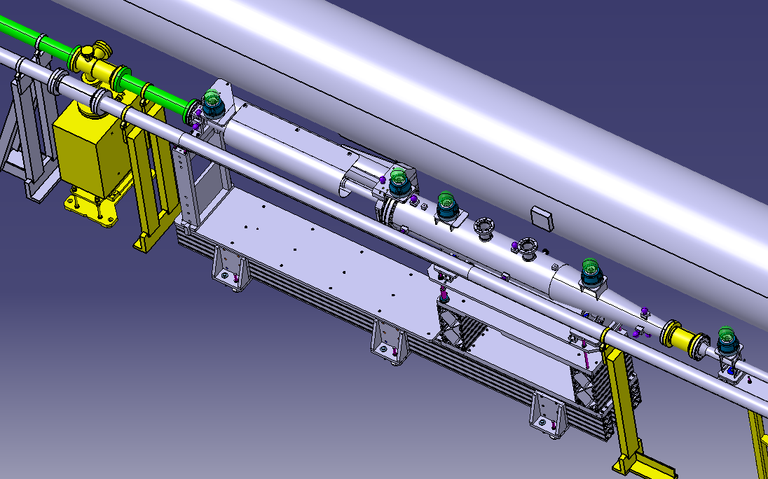
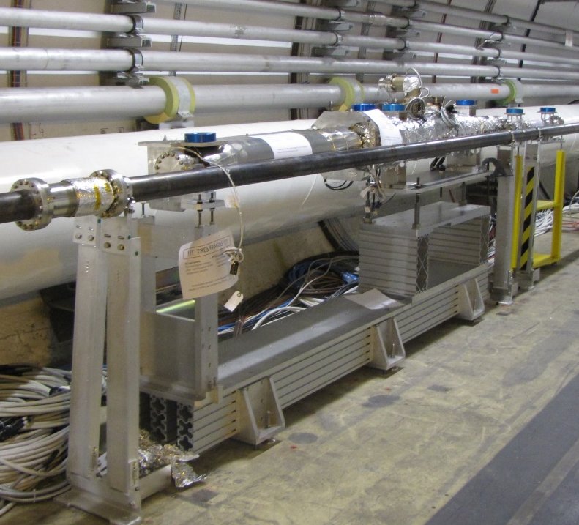
Where we are today:

Slide 4
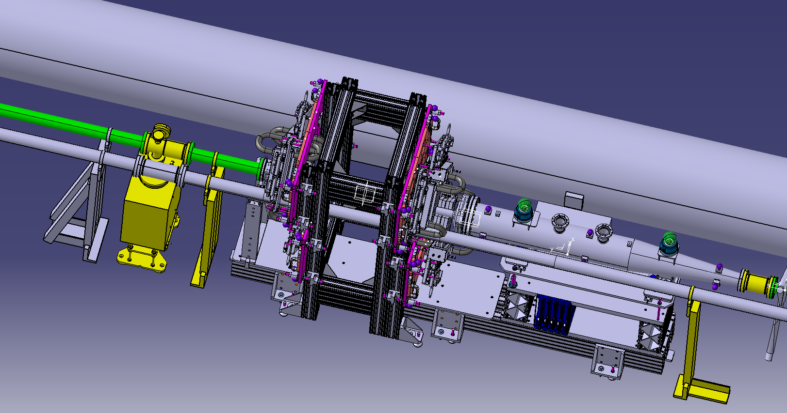
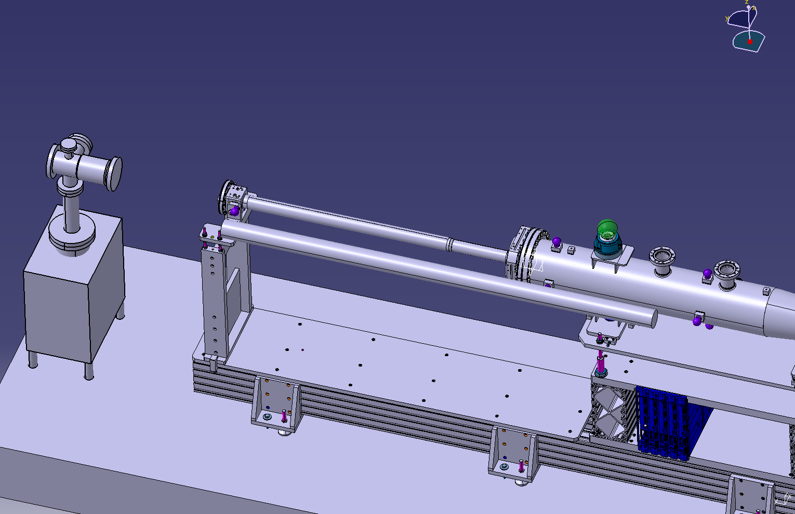
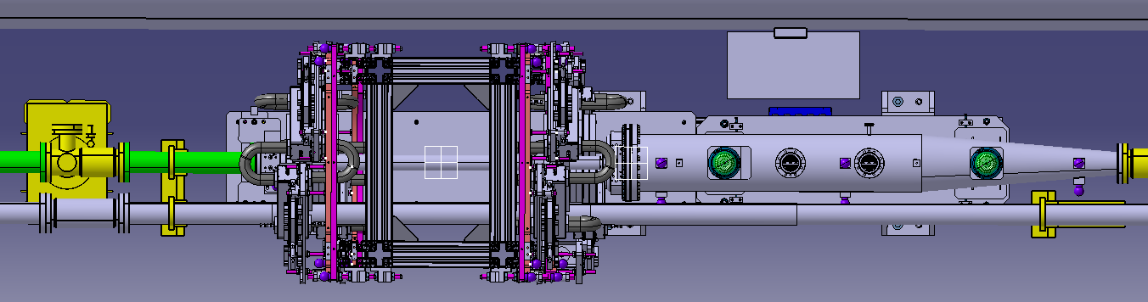
Where we want to go

Slide 5
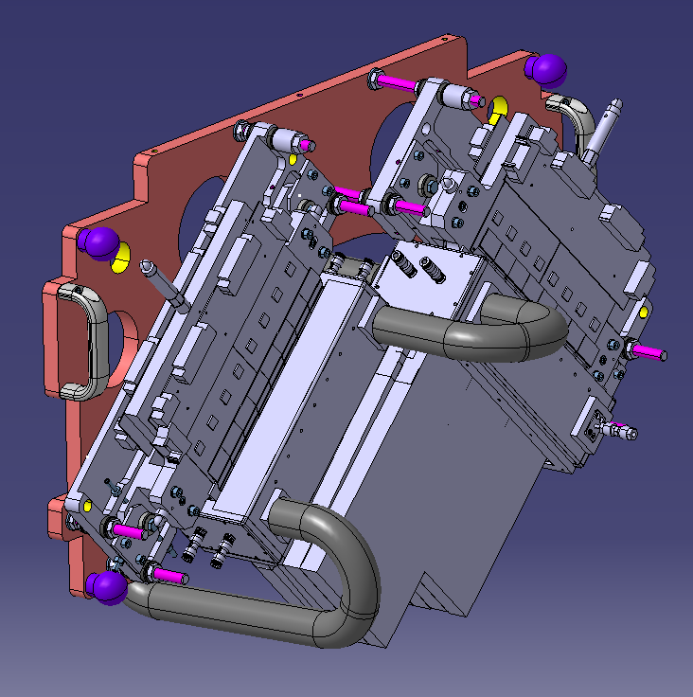
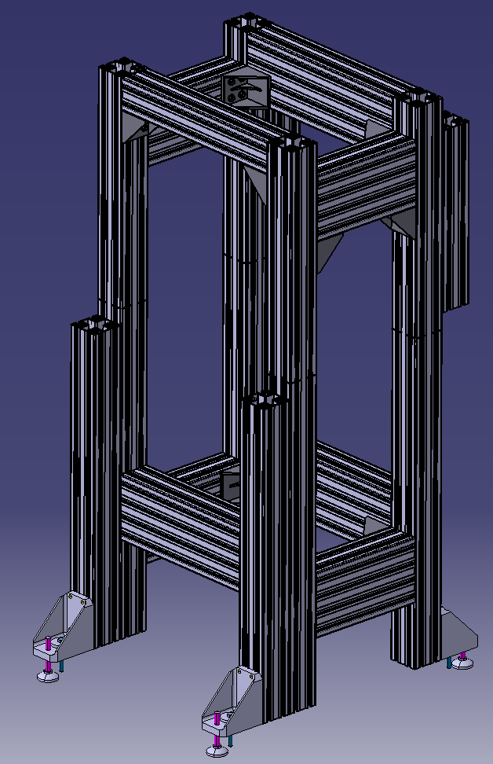
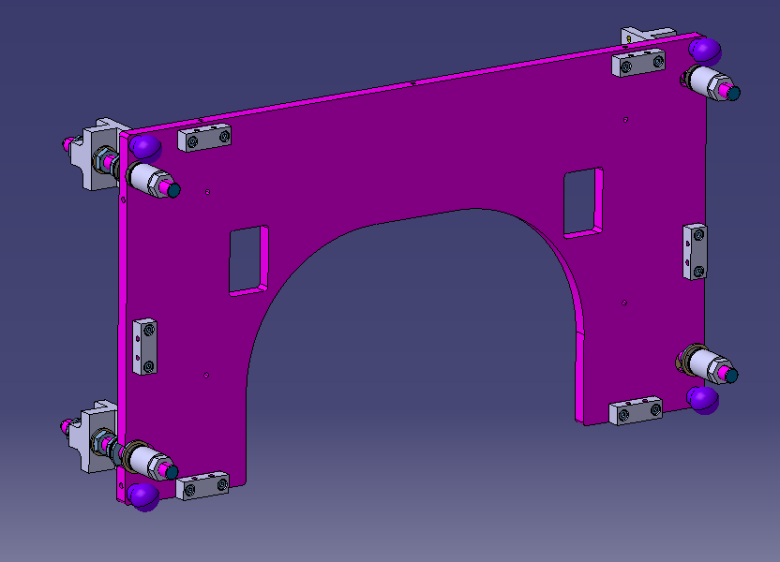
What we need to install:
2 Modules Assembly
(2MA) (4x)
Mass= 25Kg
Frame (1x)
Mass= 150Kg
L= 770, W=800, H= 1760
Intermediate plate (4x) / Mass= 12Kg
L= 500, W= 900

Slide 6
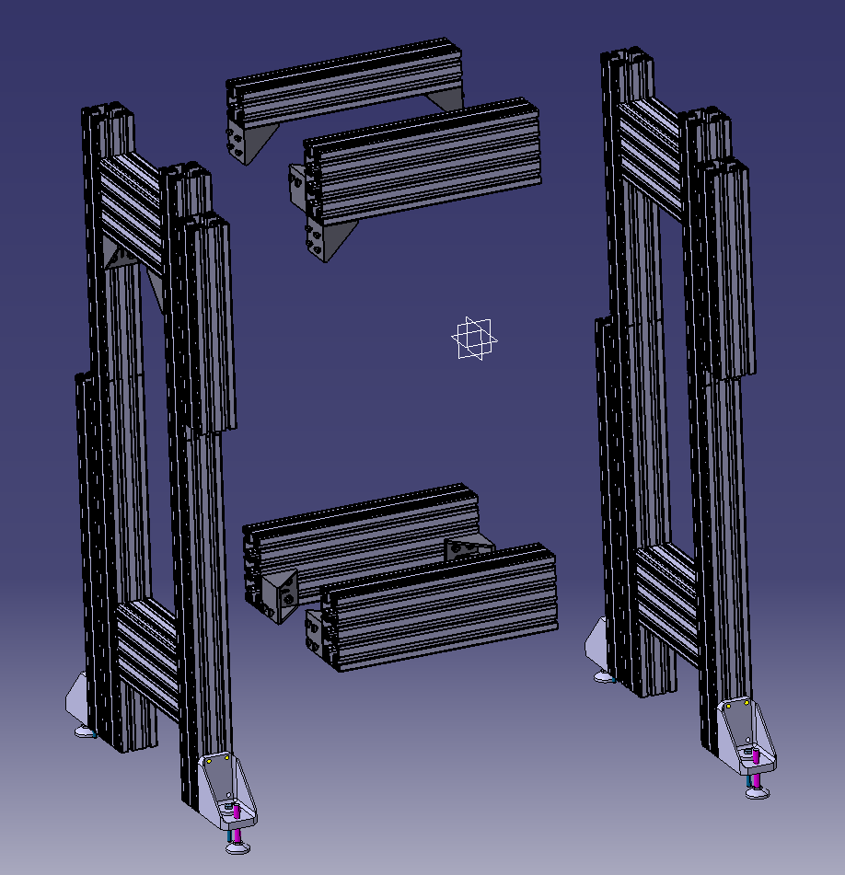
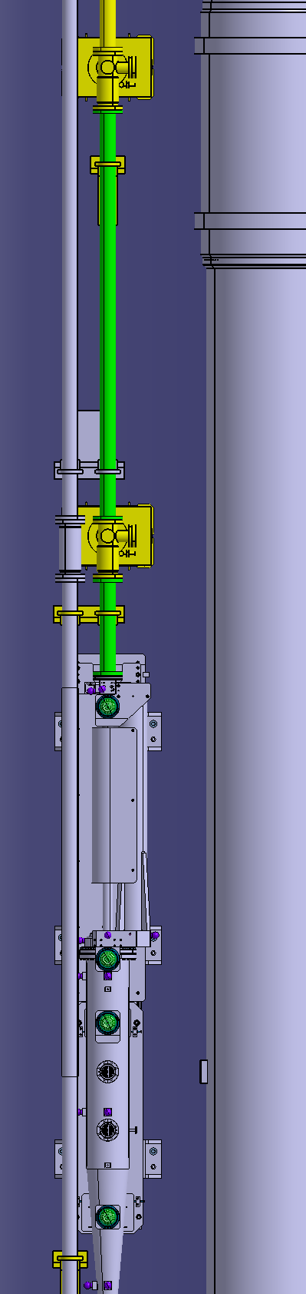
Frame:
50 Kg
(2x)
Beams
10 Kg
(4x)
=> Load to be supported= 150Kg

Slide 7
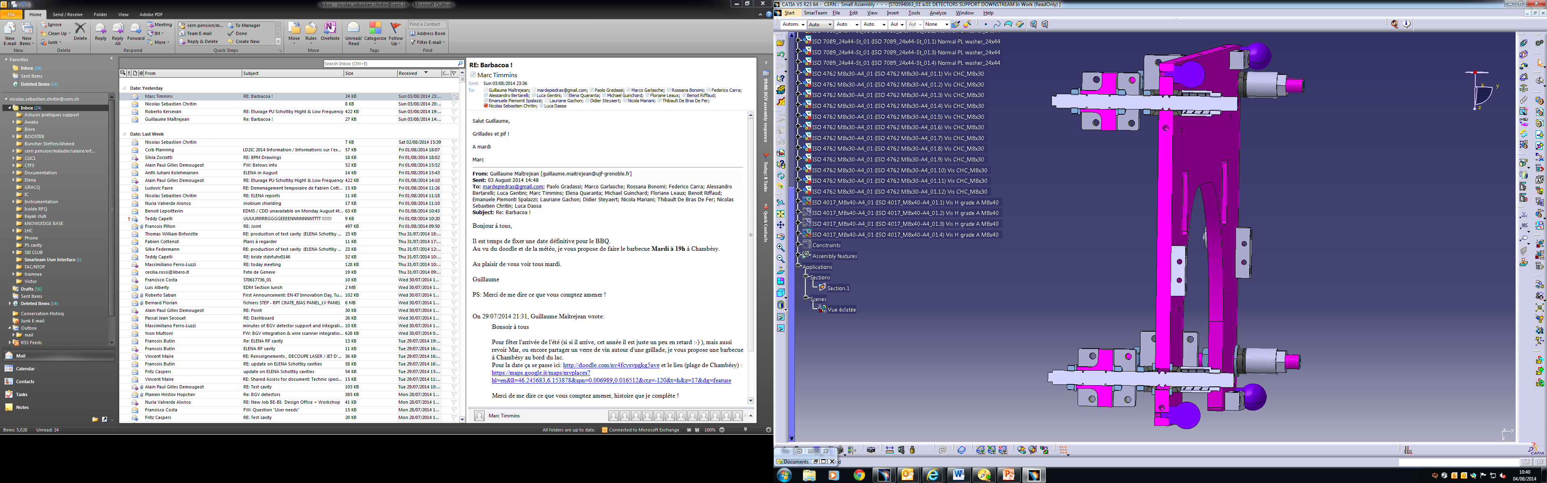
Intermediate plates:
Sphere in H slot
Sphere in adjusted hole
Longitudinal position and perpendicularity /beams
3 points for adjustment
Fourth for stability only
Z= +/-20mm
X and Y= +/-15mm
Metrology
Sphere in large hole

Slide 8
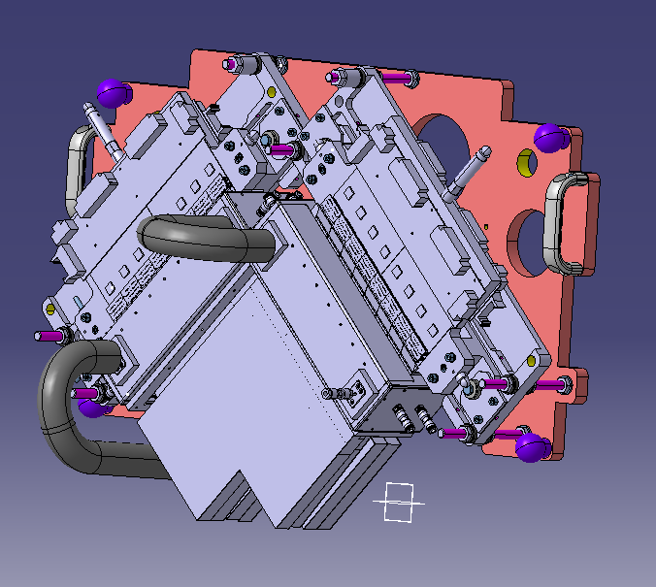
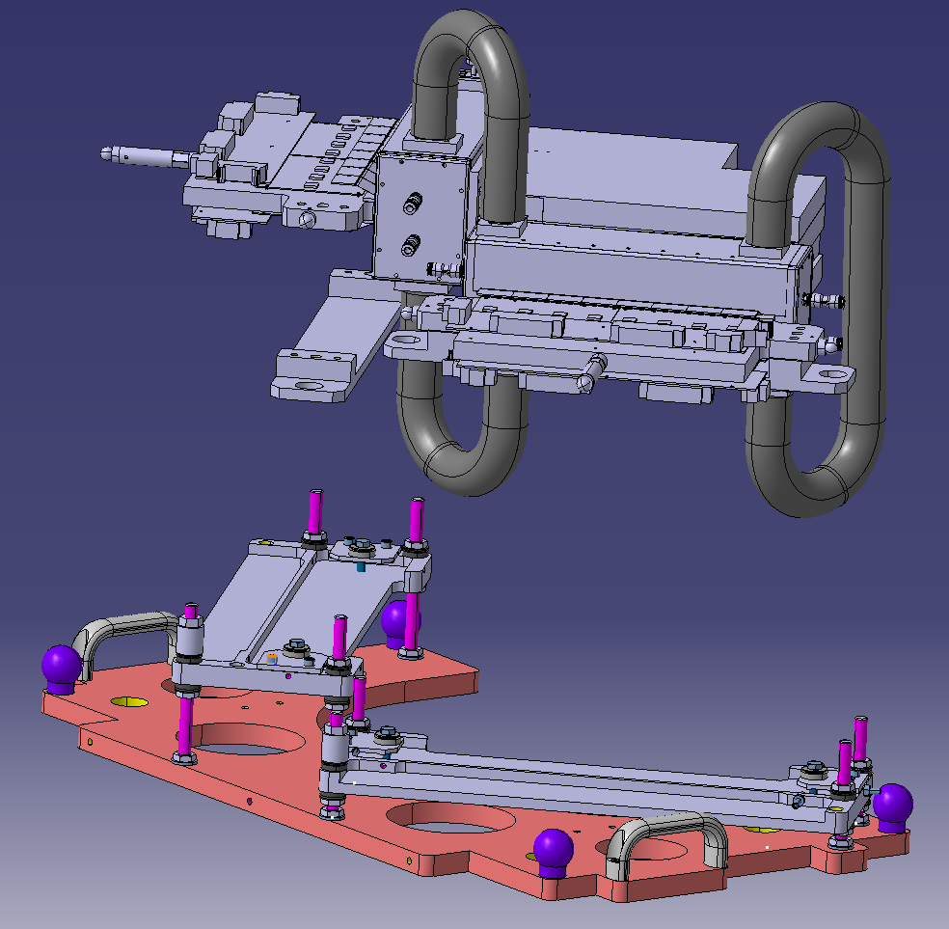
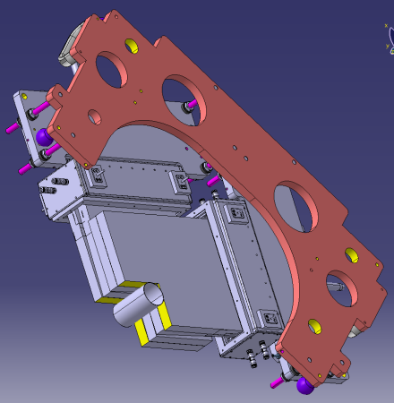
2 Modules assembly:
Yellow surfaces adjusted together
Pre-assembled in lab without hydraulic connections
Dedicated adjustment table included
Metrology

Slide 9
What we need to install: Steps
#1
#3
Steps
#2

Slide 10
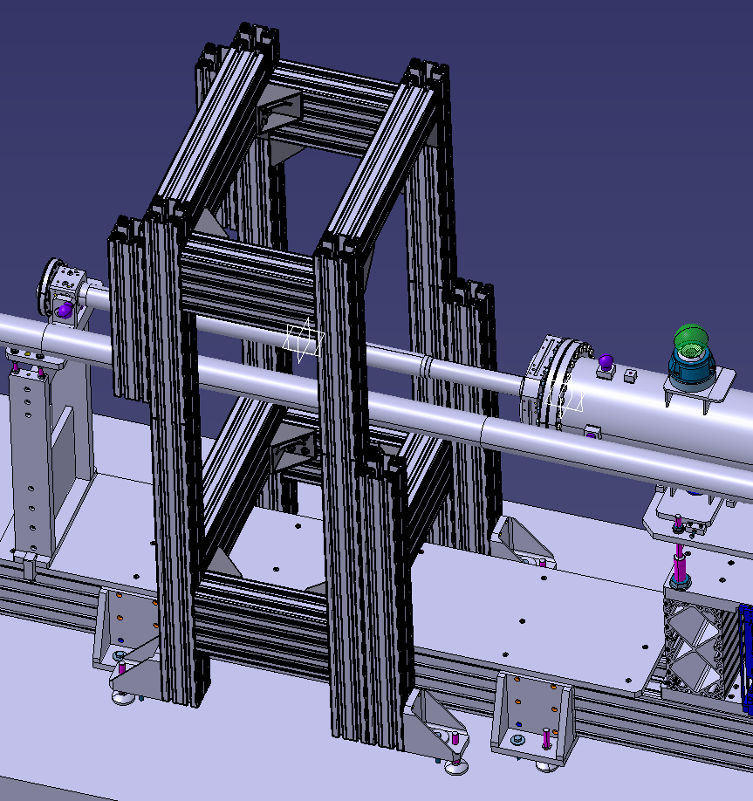
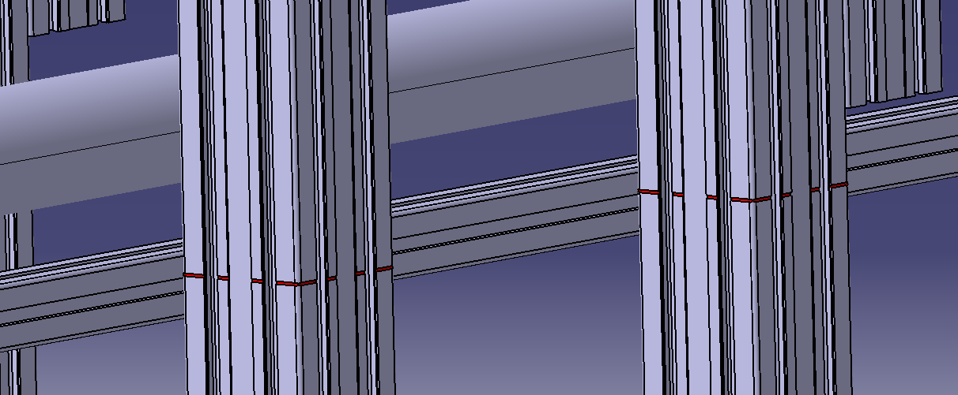
Installation: step #1
Vacuum chamber reinforcement support to be removed
H marks on the frame at the beams level
4 vertical adjustment screws
Longitudinal floor marking essential

Slide 11
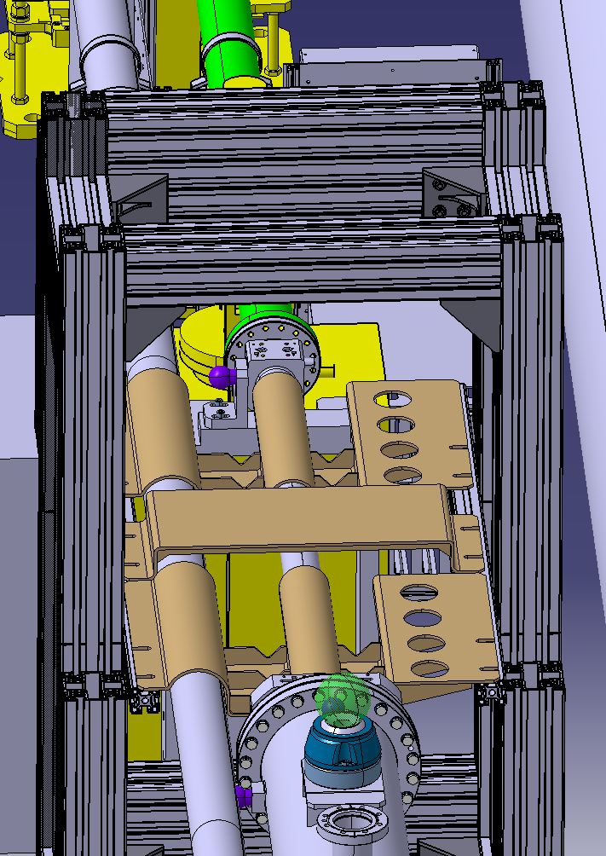
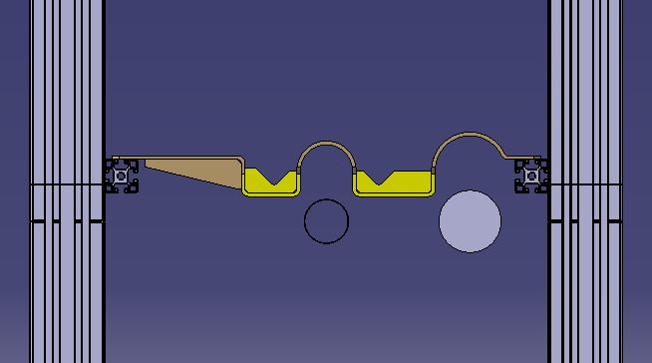
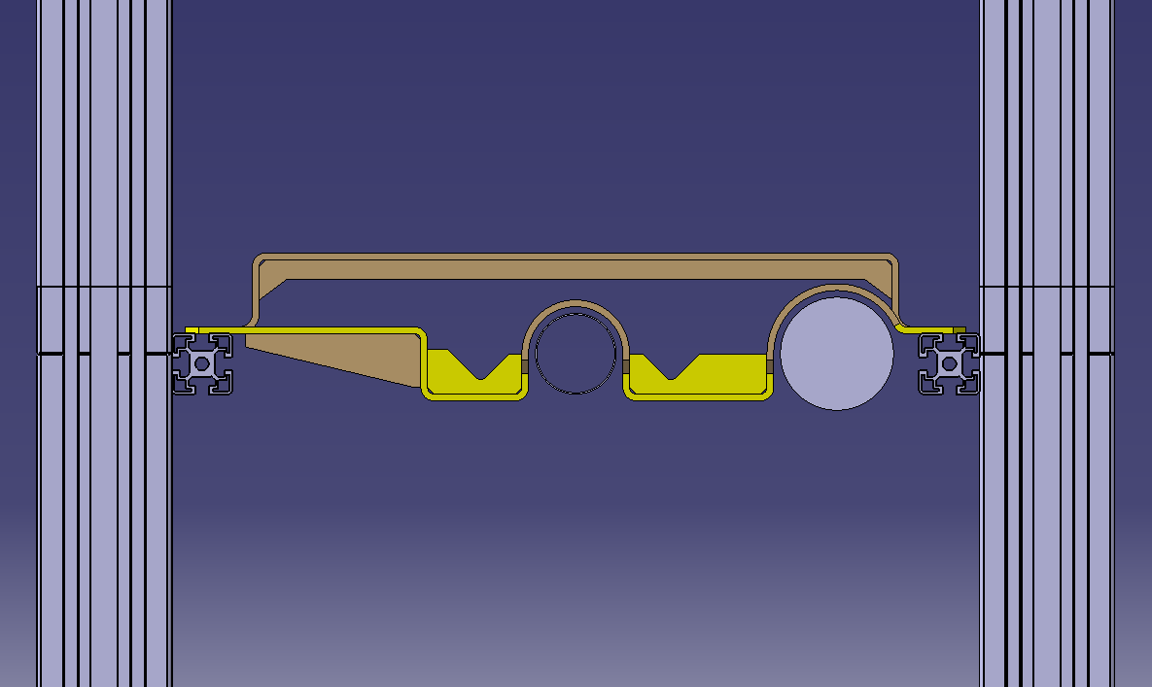
Installation: step #1
2 lateral beams
Protection plate can be helpful to pre-align the frame (+/-2mm)
Final position: 5mm gap with
the vacuum chambers

Slide 12
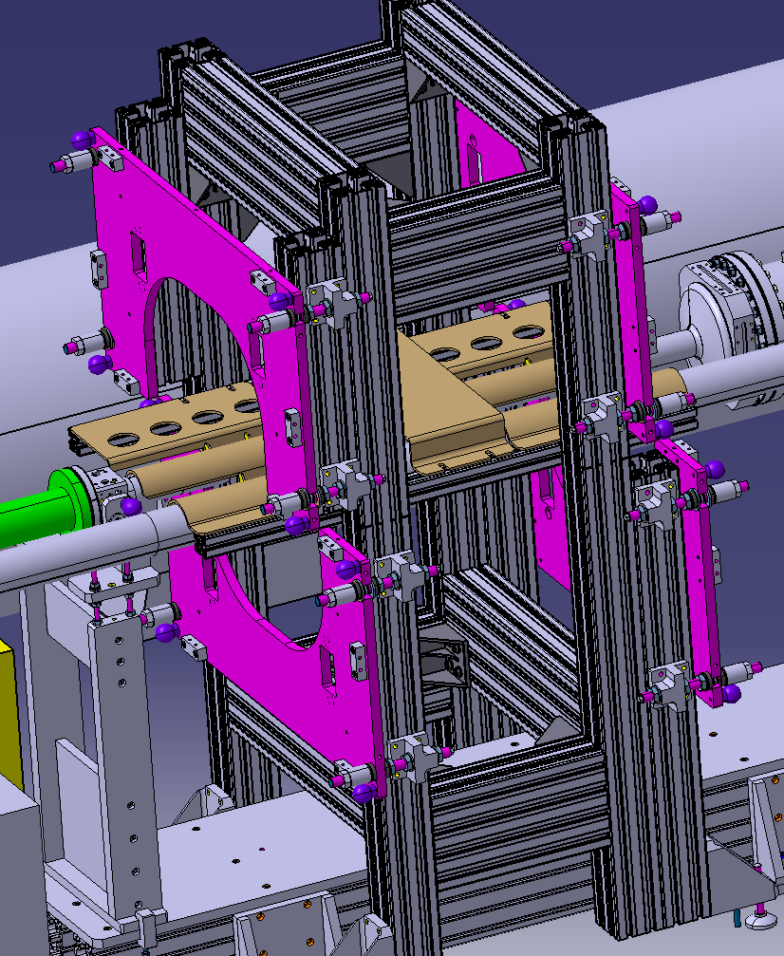
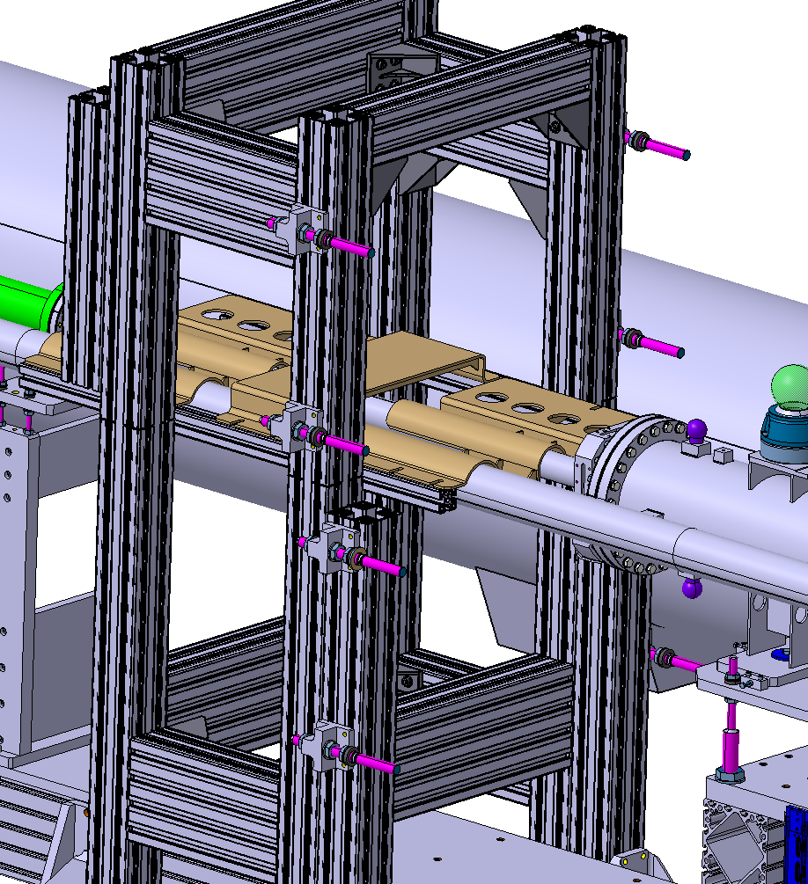
Installation: step #2

Slide 13
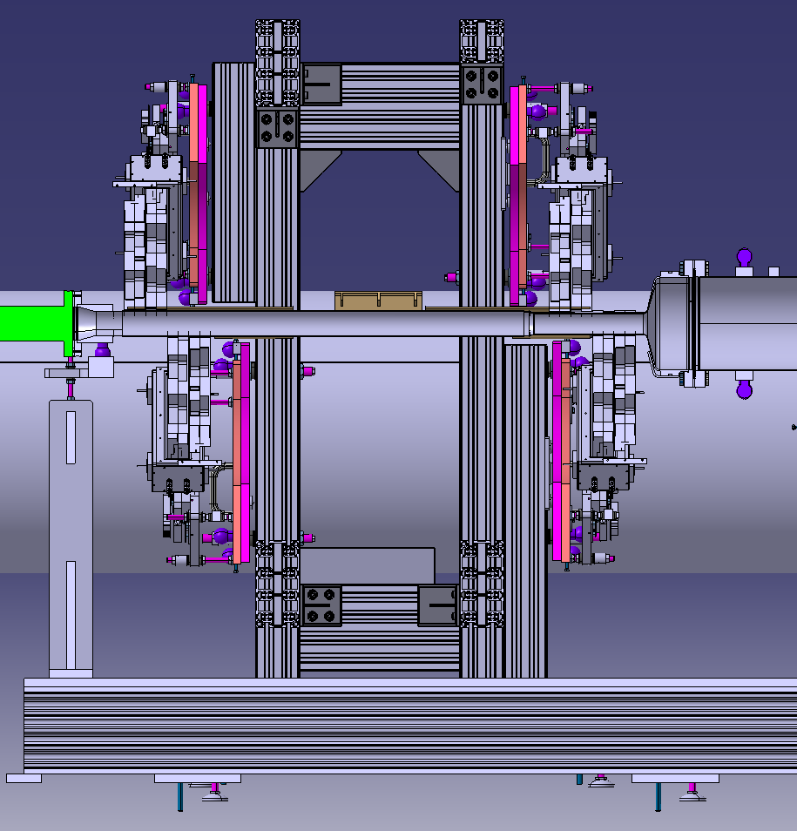
Installation: step #3
2MA assembly sequence proposal
#3
#2
#4
#1

Slide 14
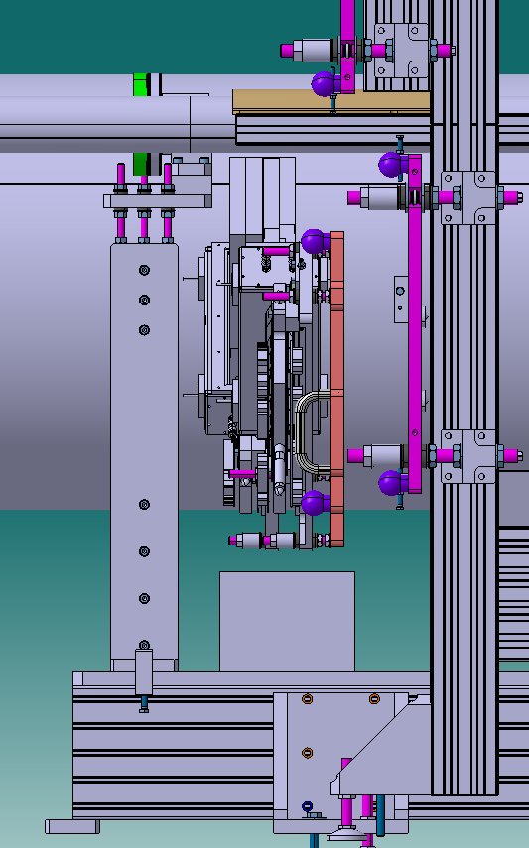
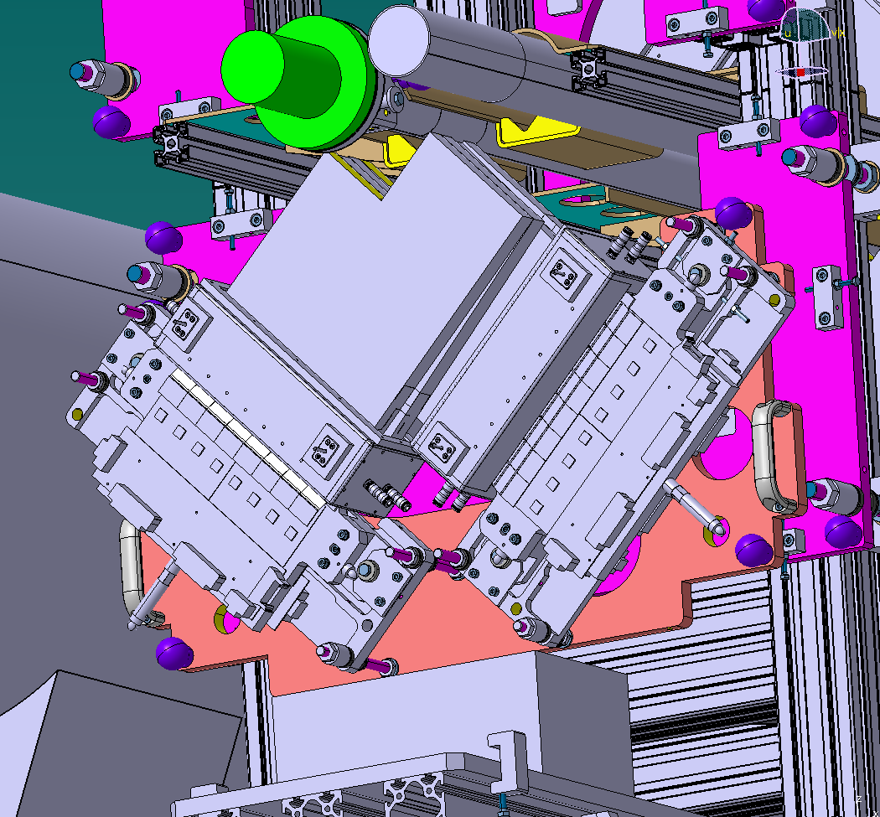
Installation step #3
2MA #1
Jack / useful?

Slide 15
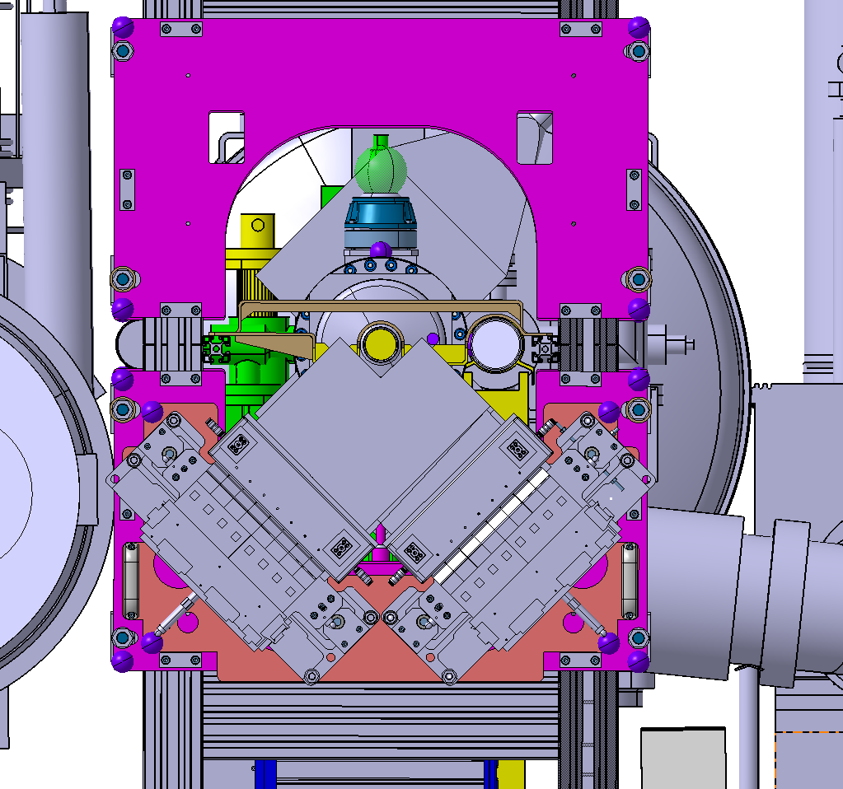
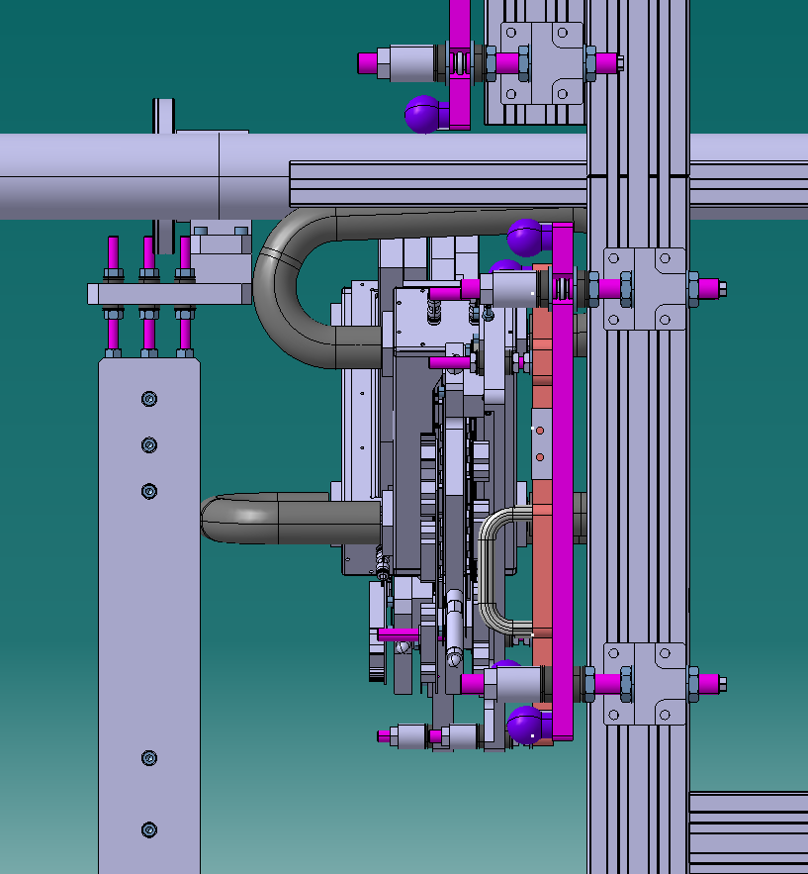
Installation step #3
2MA #1
2MA down by 15mm

Slide 16
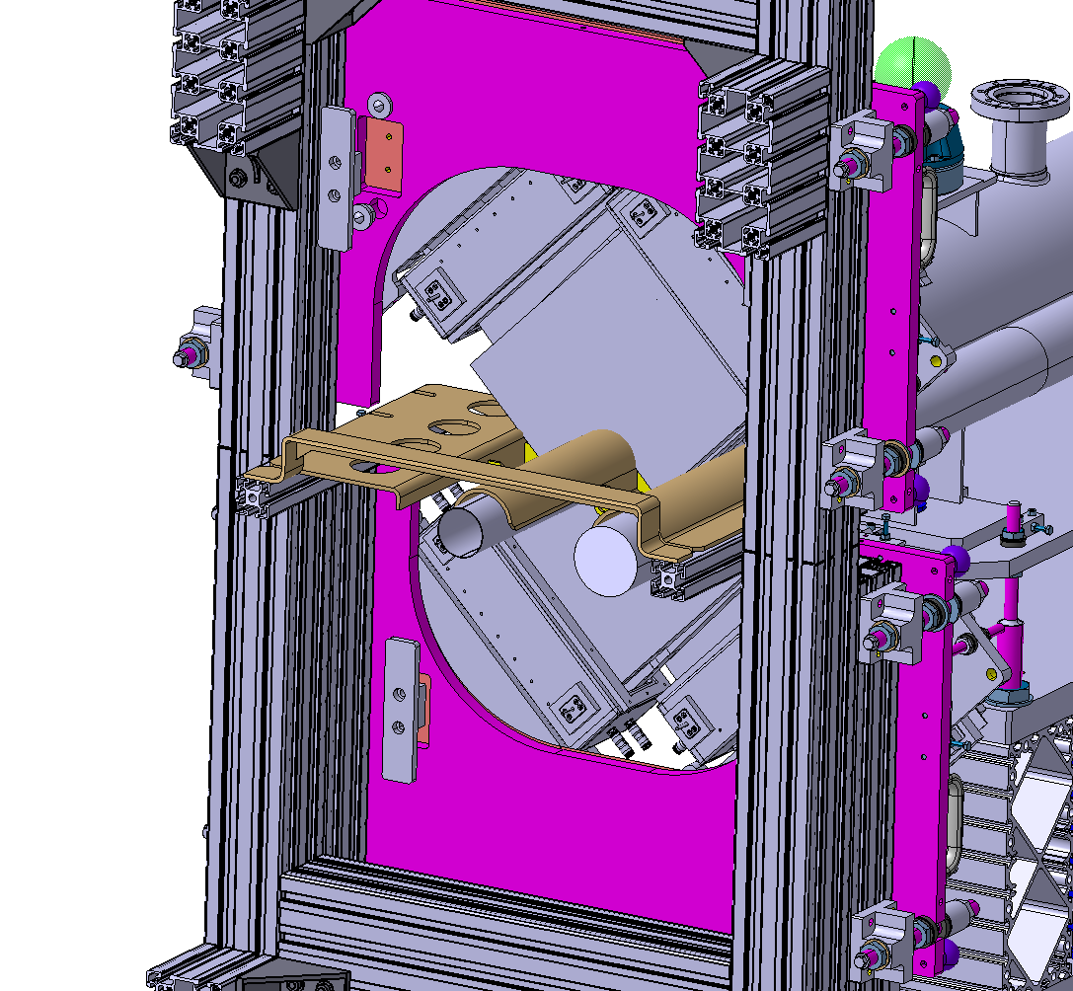
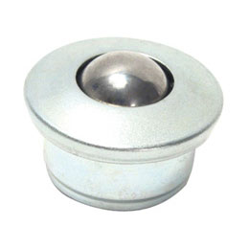
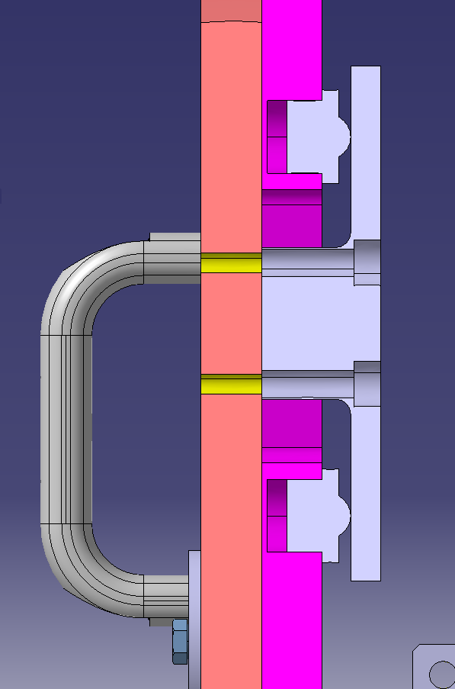
Installation step #3
2MA #1/#2/#3/#4
Spring
Ball unit

Slide 17
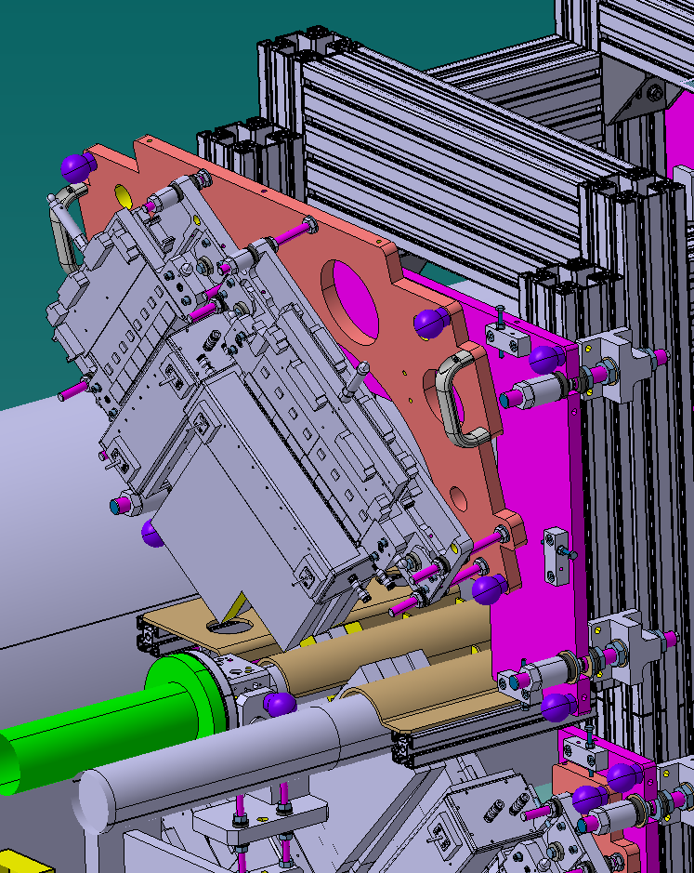
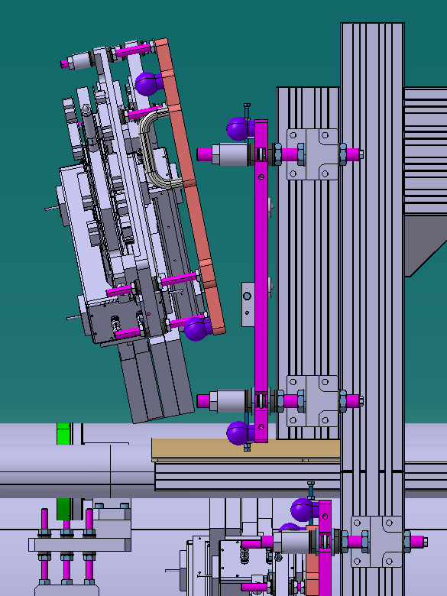
Installation step #3
2MA #2

Slide 18
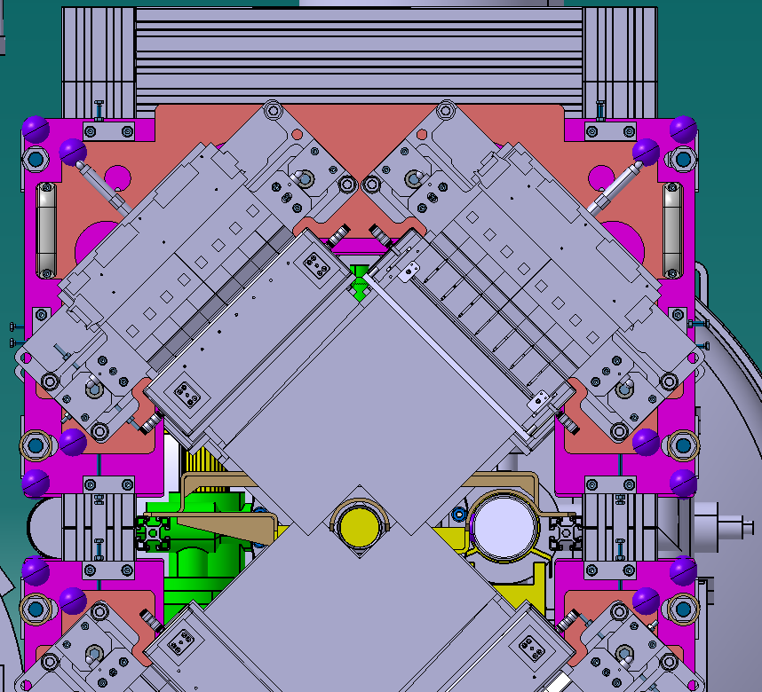
Installation step #3
2MA #2
2MA up by 15mm

Slide 19
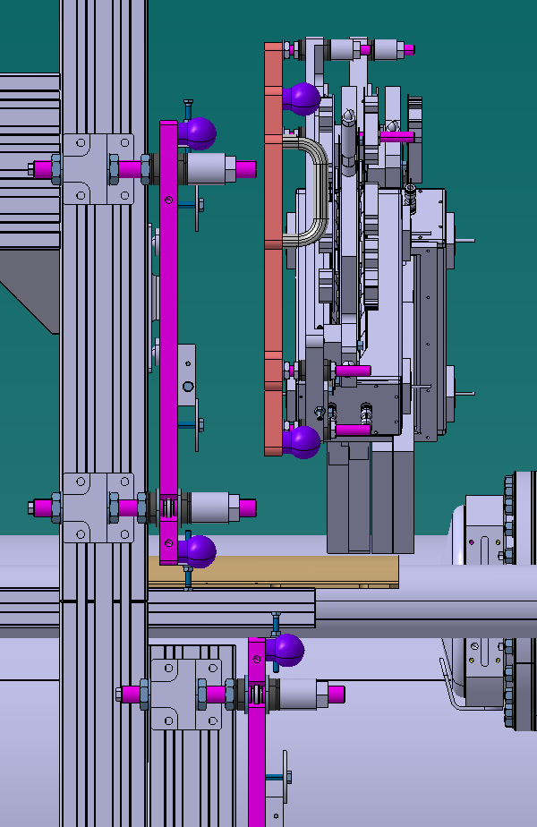
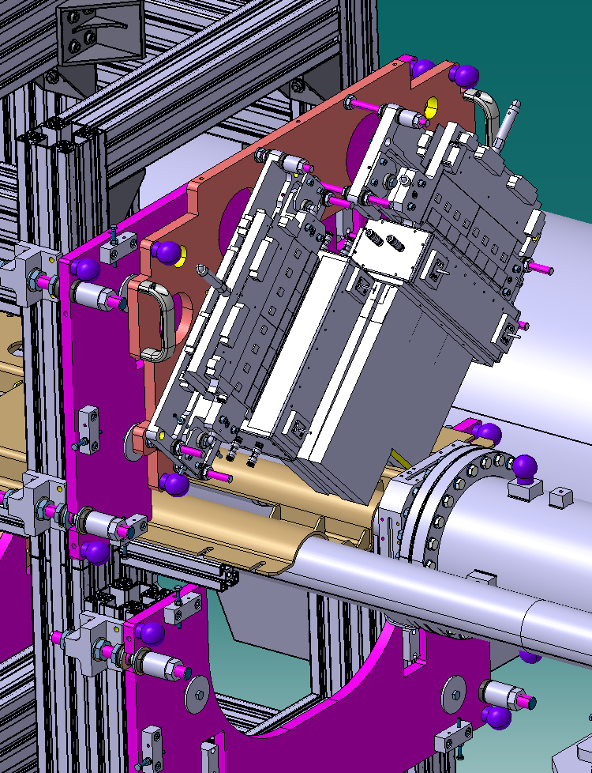
Installation step #3
2MA #3

Slide 20
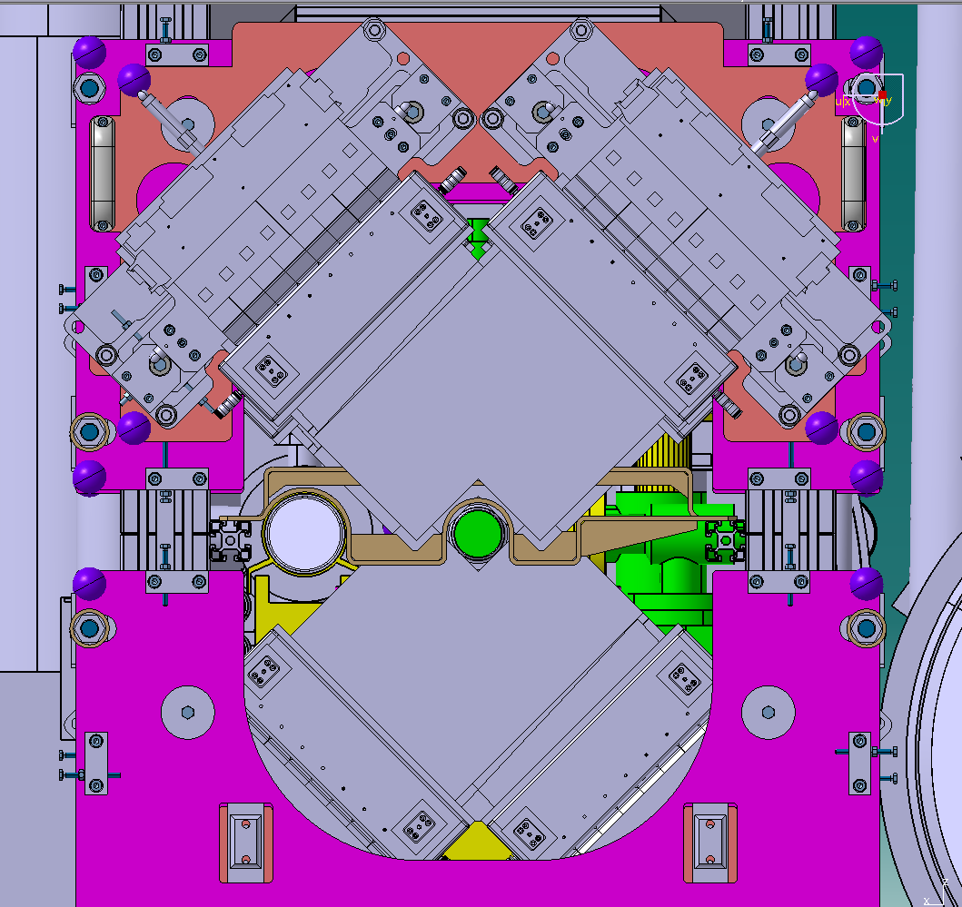
Installation step #3
2MA #3
2MA up by 15mm

Slide 21
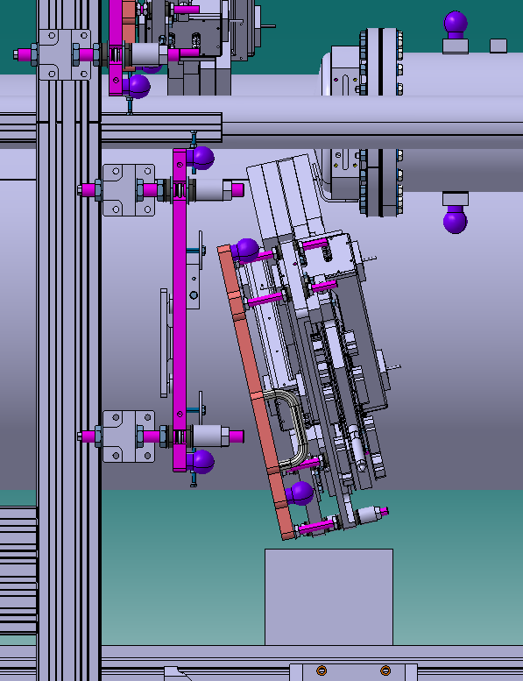
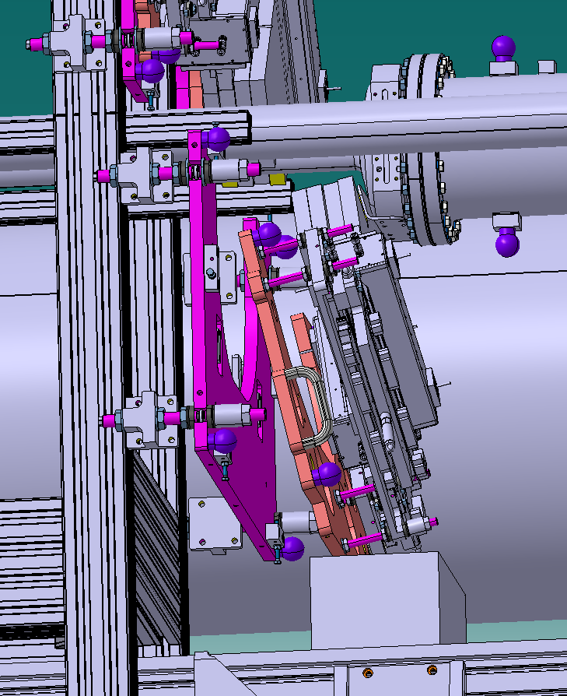
Installation step #3
2MA #4
Window protection
Jack / needed?

Slide 22
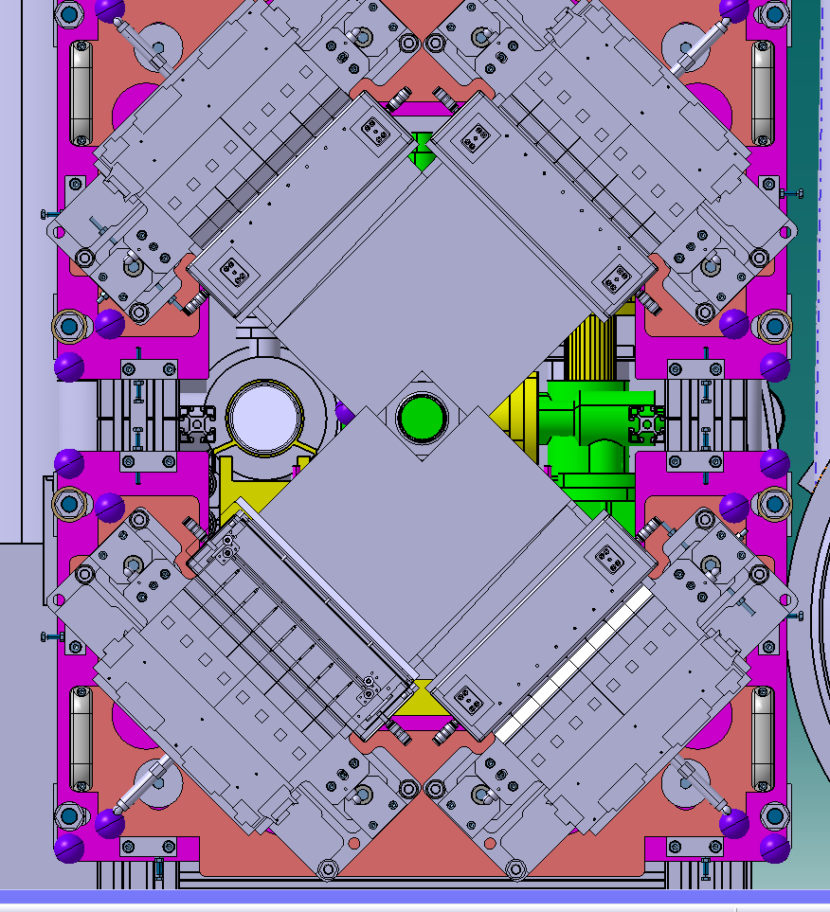
Installation step #3
2MA #4
2MA down by 15mm

Slide 23
Installation step #4: final adjustments:
Make all connections
Perfom all tests
Other?

Slide 24
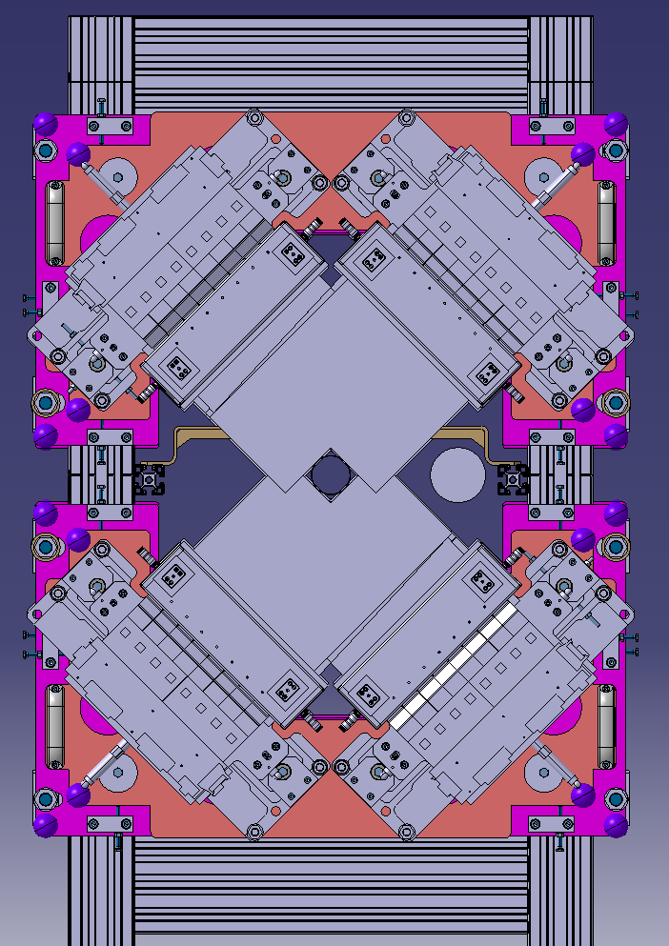
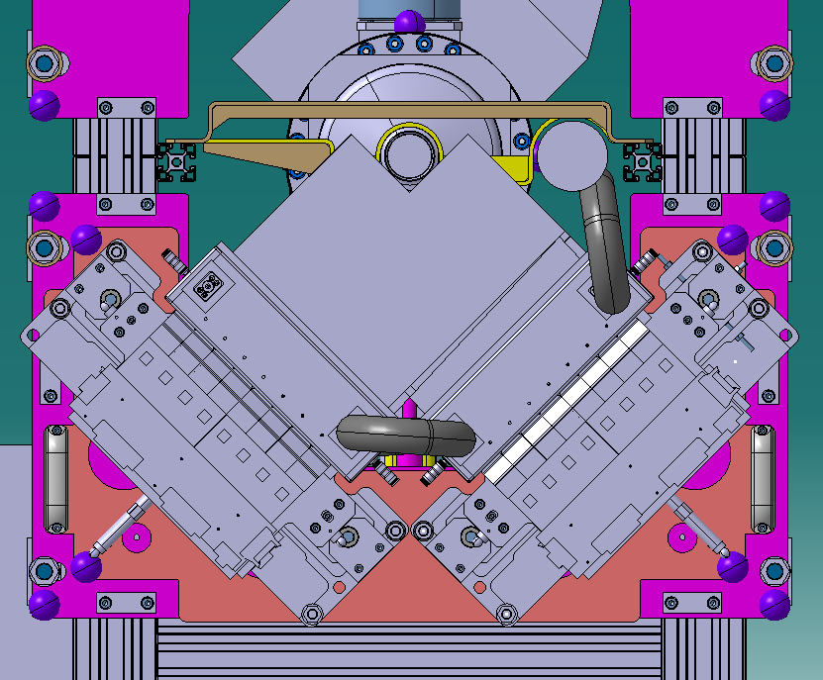
Installation step #4: final adjustments:
Use screws and targets
Use of 0.3mm shims??

Slide 25
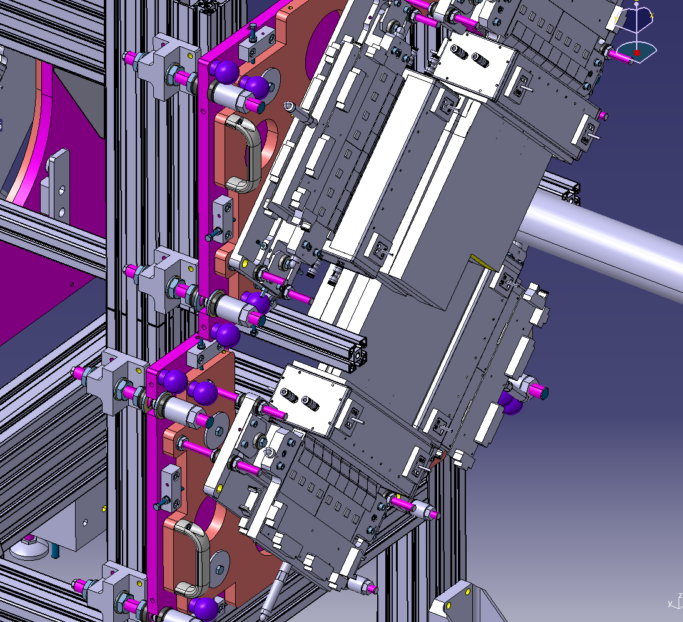
Installation: all 2MA fixing
Definitively fix each 2MA onto its intermediate plate: 4x screws / 2MA
Remove all vacuum chamber protections

Slide 26
Questions?

Slide 27
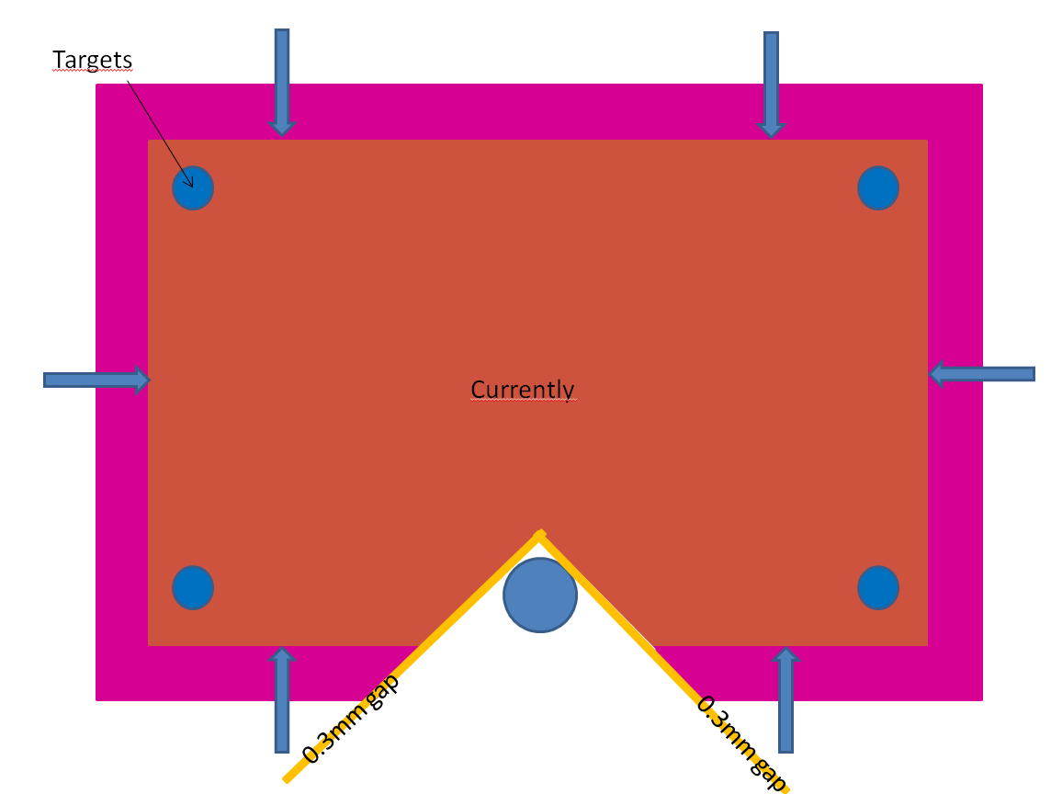
Additionnal slides:

Slide 28
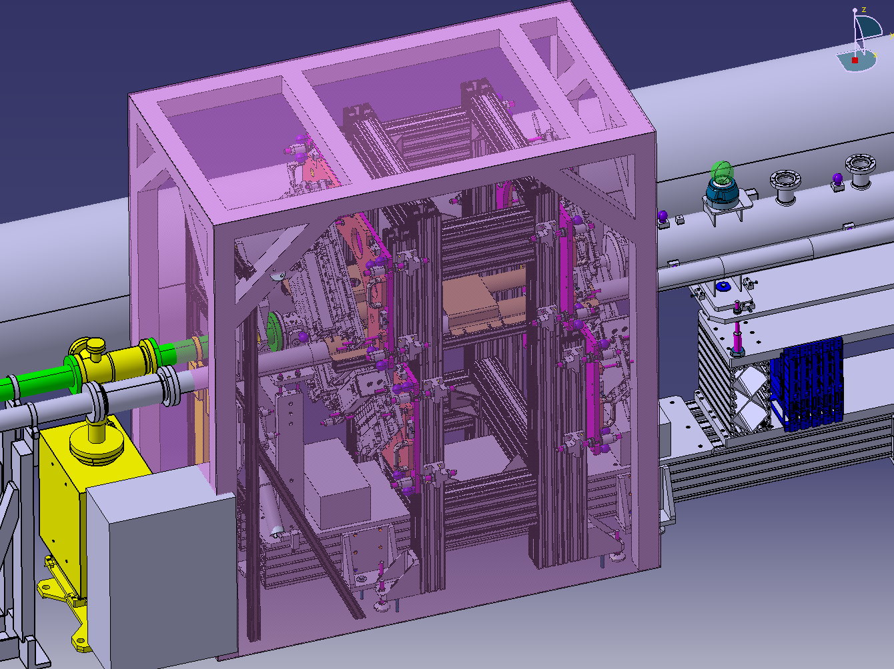
Additionnal slides:
LHCBGVDA0001
ST0546008_01

Slide 29
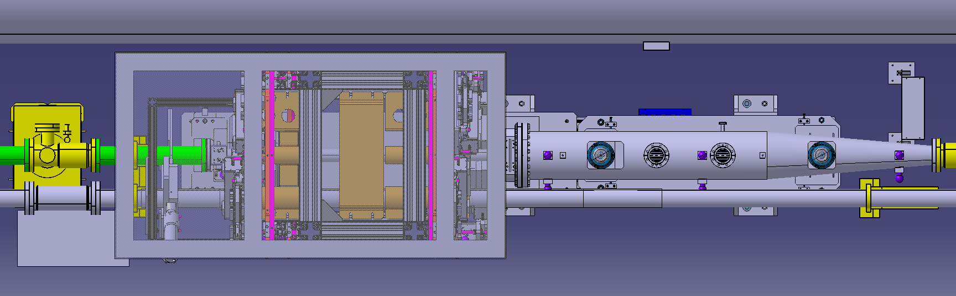
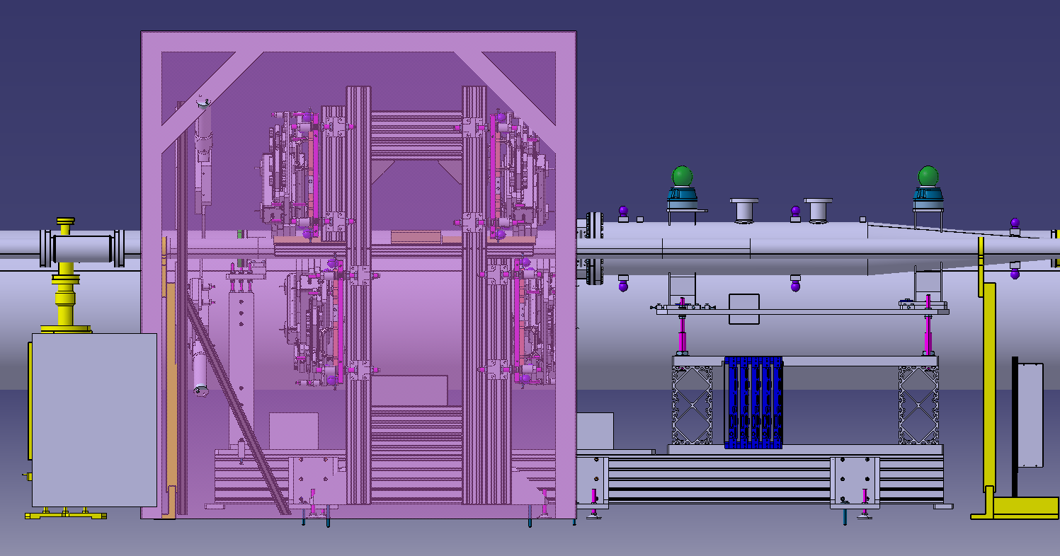
Additionnal slides:

