Slide 1
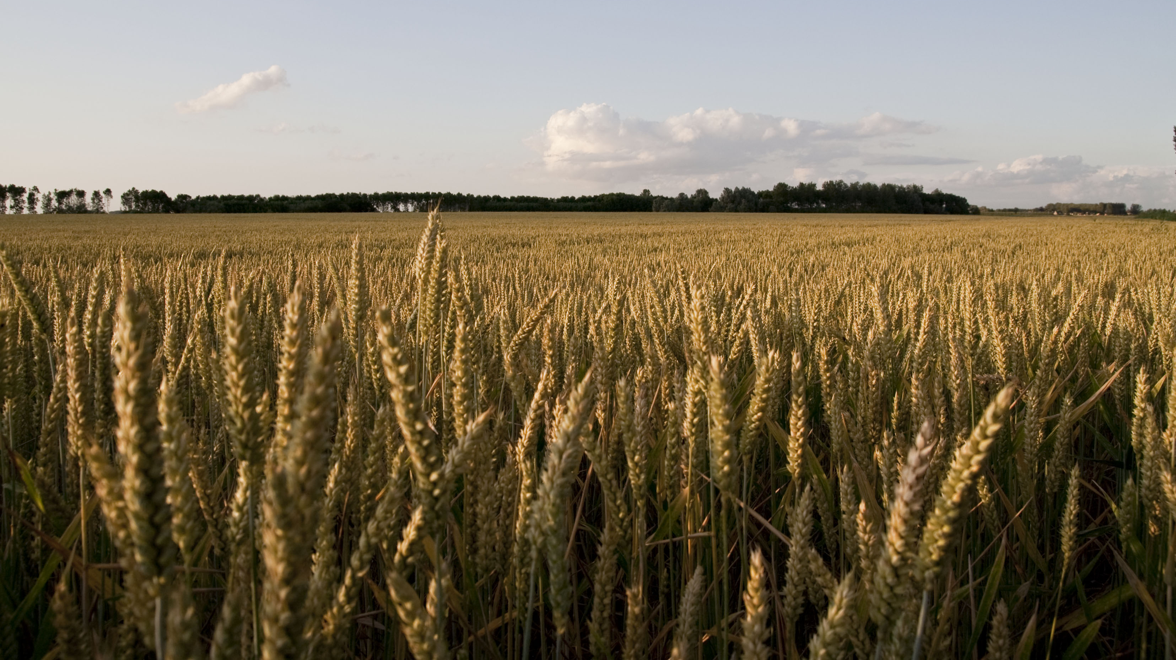
Photo credit:
”Korenveld" by Pieter Bezuijen
http://goesinbeeld.thanq.eu/index.php/Goese-Polder/korenveld

Slide 2

Photo credit:
”Korenveld" by Pieter Bezuijen
http://goesinbeeld.thanq.eu/index.php/Goese-Polder/korenveld

Slide 3
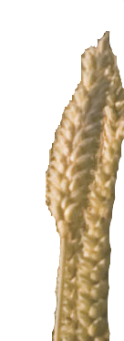
CERN Member States
Photo credit:
”Korenveld" by Pieter Bezuijen
http://goesinbeeld.thanq.eu/index.php/Goese-Polder/korenveld

Slide 4
Photo credit:
”Korenveld" by Pieter Bezuijen
http://goesinbeeld.thanq.eu/index.php/Goese-Polder/korenveld

Slide 5
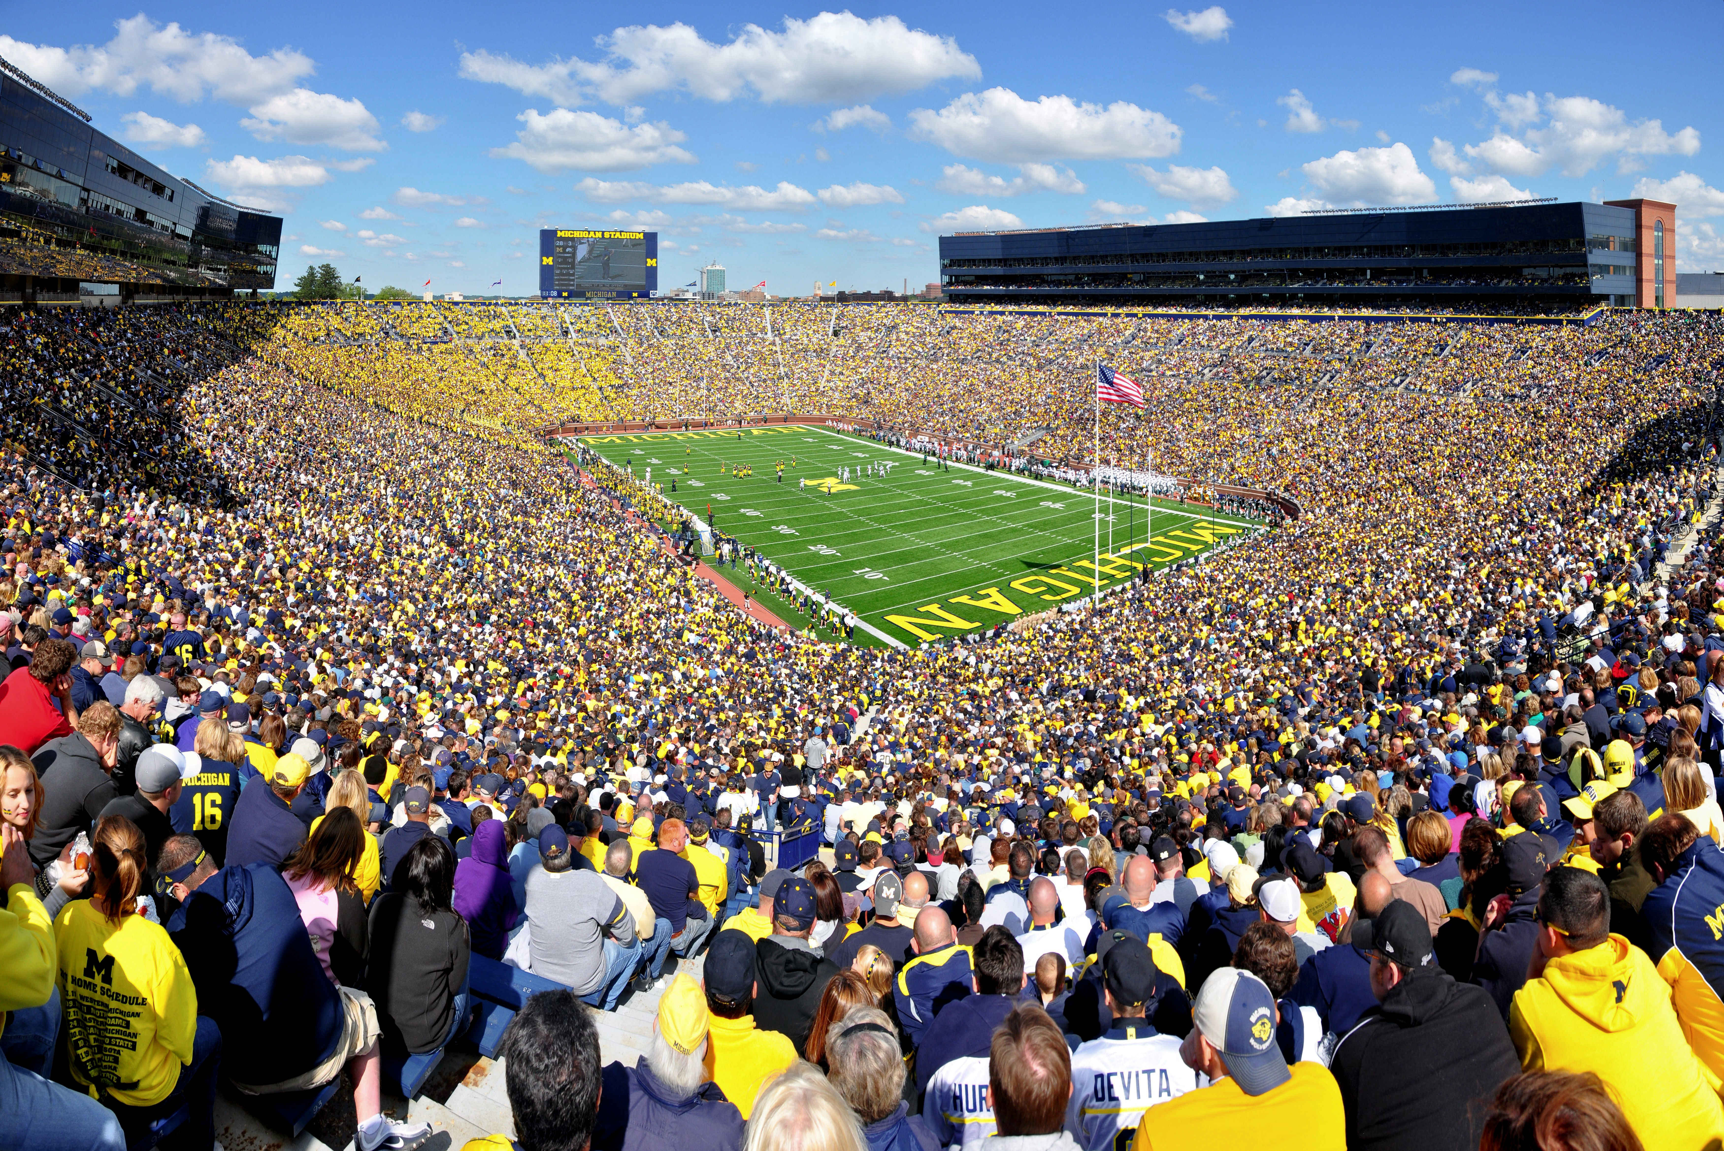
Photo credit:
"Michigan Stadium 2011" by AndrewHorne
CC BY-SA 3.0, http://buff.ly/1sZUk86

Slide 6
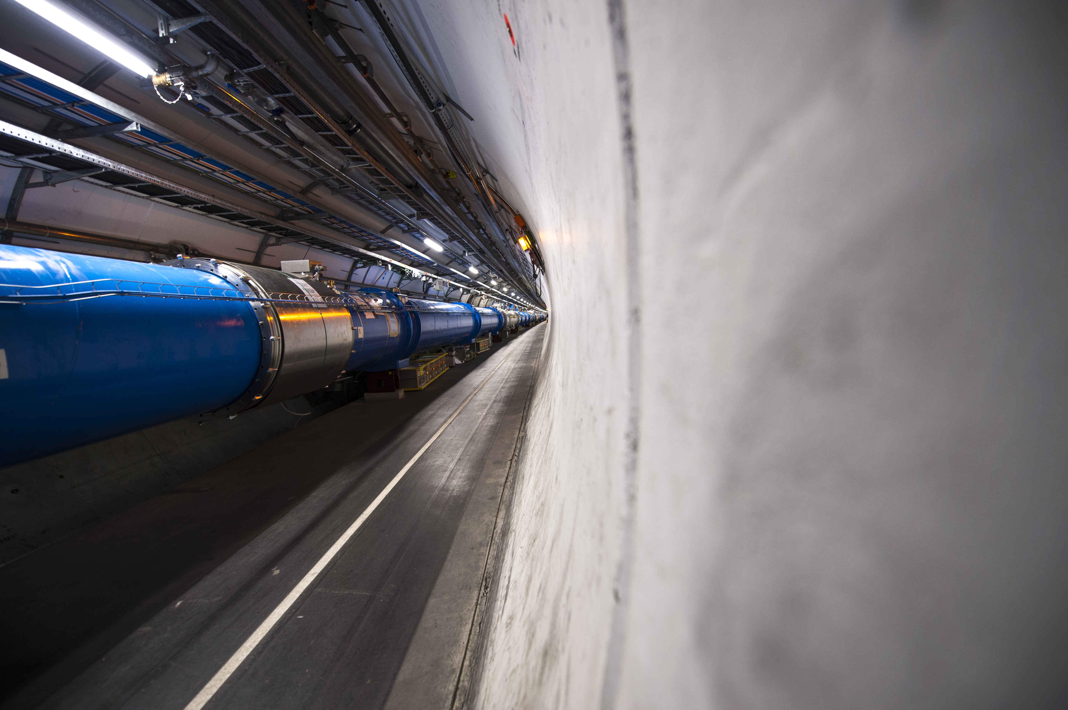
Photo credit:
CERN audiovisual media

