Slide 1
Notes:
Timing: XXX mins

Slide 2
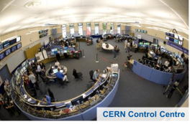
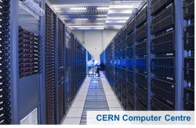
Why SCADA Security
is NOT like
Computer Centre Security
Finding vuln’s is easy ─ finding solutions is the challenge!

Slide 3




Overview

Slide 4
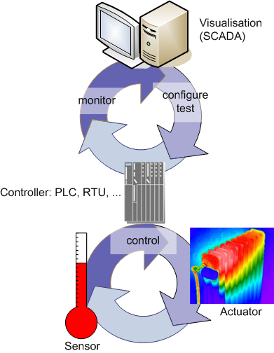
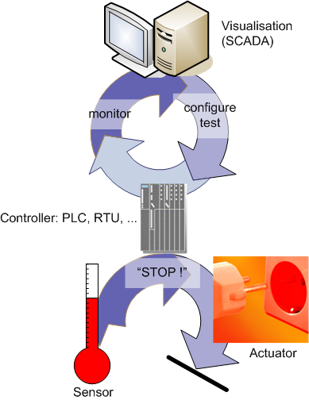
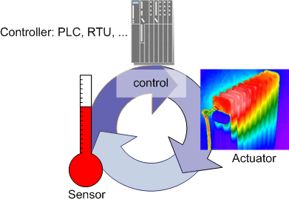
Control System in a Nutshell
Process Control System (PCS)
Safety System

Slide 5
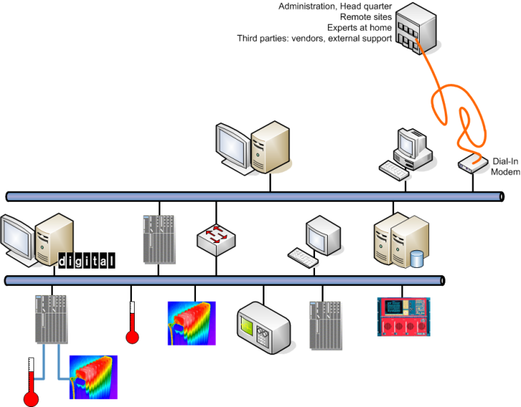
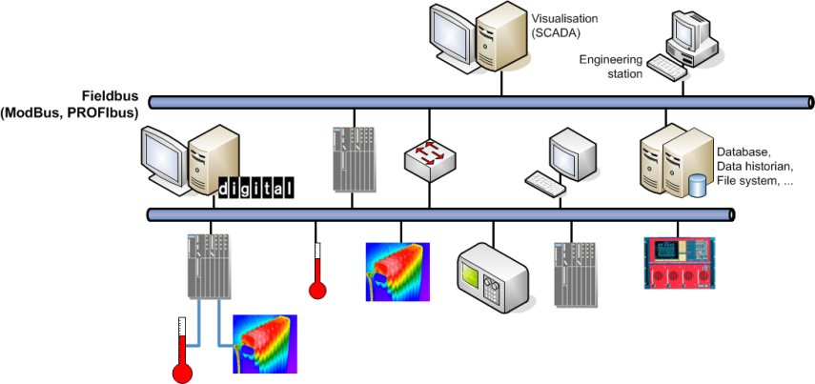
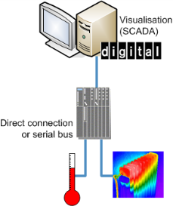
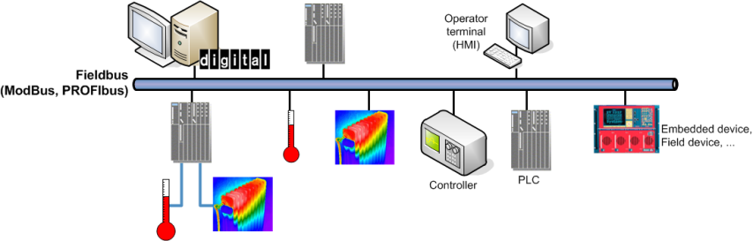
(R)Evolution of Control Systems

Slide 6
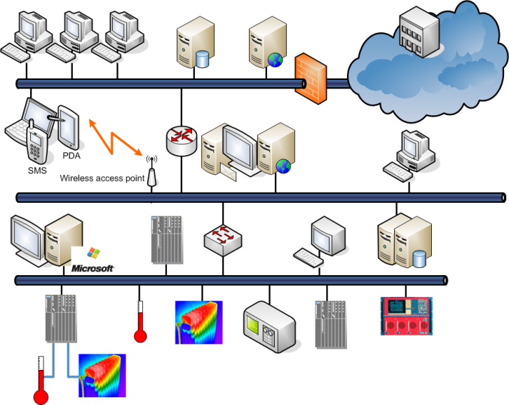
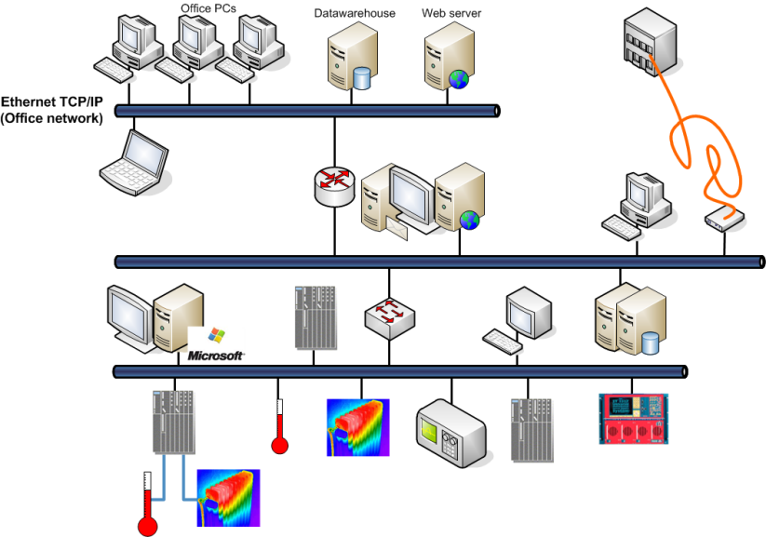
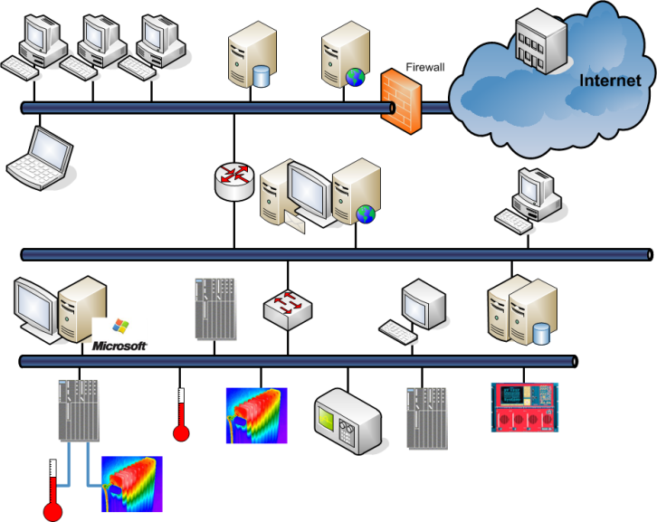
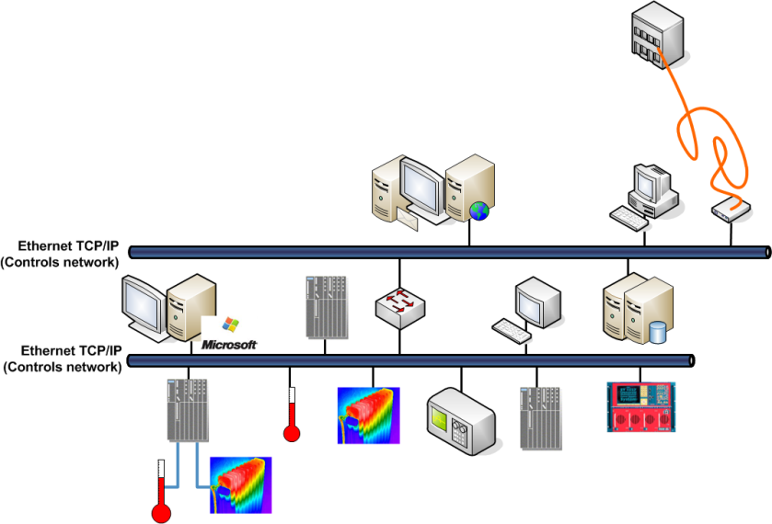
(R)Evolution of Control Systems

Slide 7
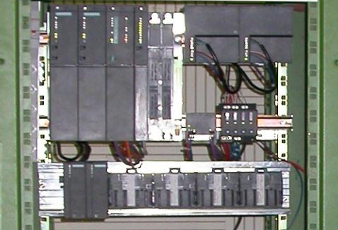
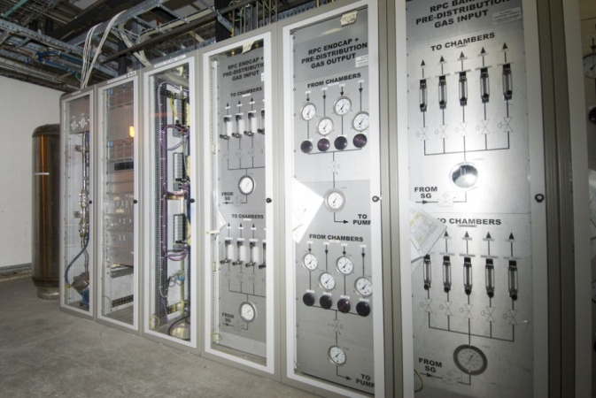
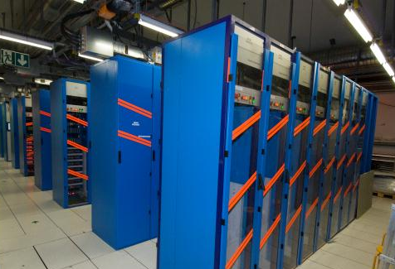
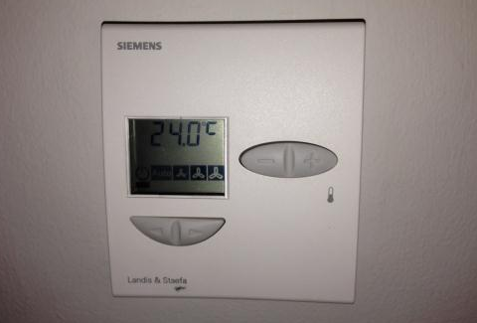
Typical Control Systems & Devices

Slide 8
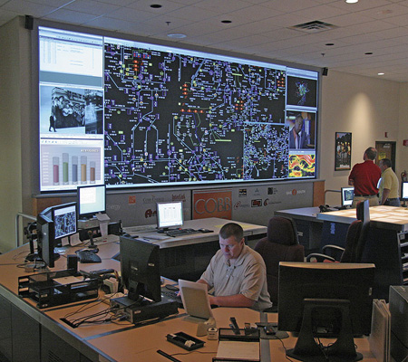
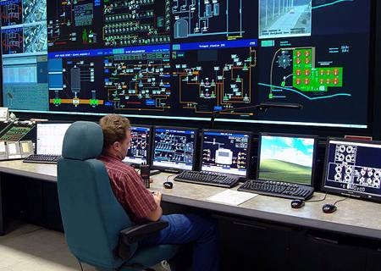
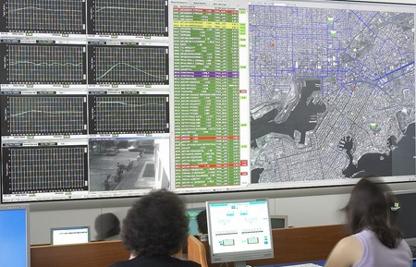
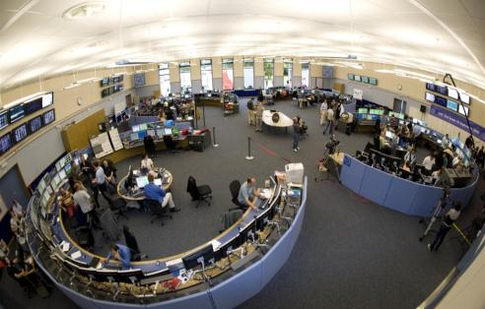
Critical (Cyber-)Infrastructures
COBB County Electric, Georgia
Middle European Raw Oil, Czech Republic
Athens Water Supply & Sewage
CERN Control Centre

Slide 9
Overview

Slide 10
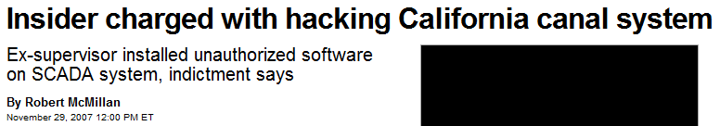

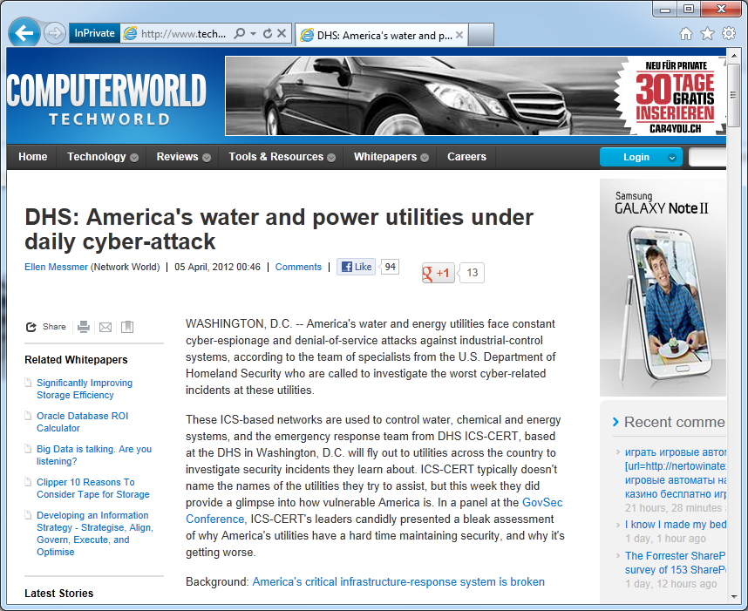

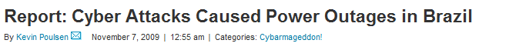

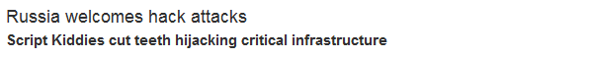
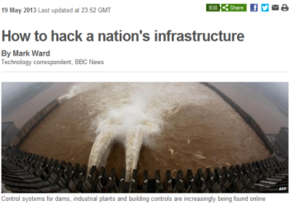
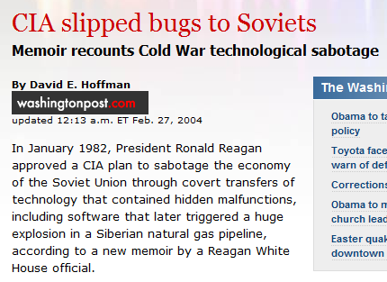

Enter reality

Slide 11
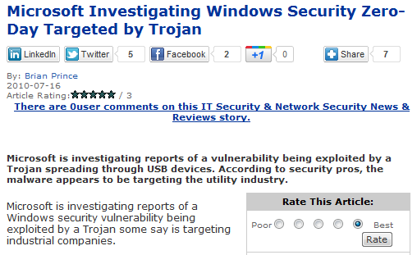

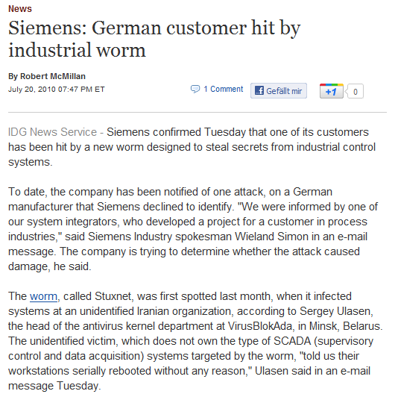

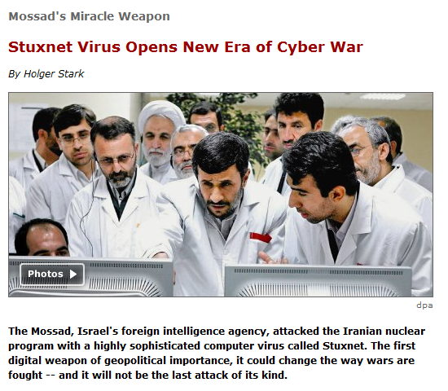

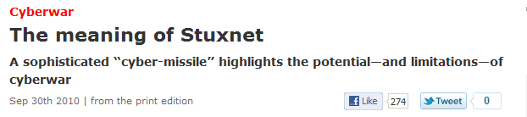
Natanz, we have a problem…

Slide 12
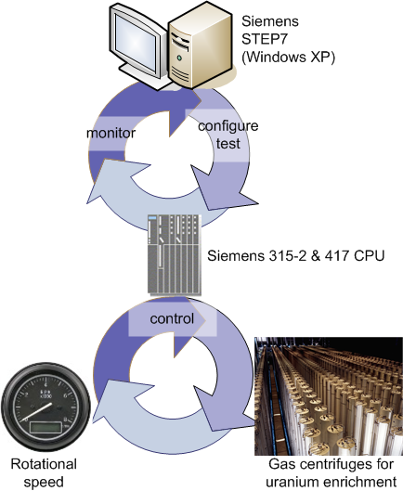


The Workings of Stuxnet (I)
PC-Level:
Infiltration of infected USB stick
into plant by malicious act
or through social engineering.
Compromizing Windows PCs
with 4(!) zero-day exploits
(worth >$100k)
4-5 evolutions starting 6/2009
Infected 100.000 PCs
(60% Iran,10% Indonesia)
Hiding using “rootkit” techno &
two stolen certificates
Infecting other hosts and
establishing connection “home”
So far, nothing new: A standard, but expensive virus!

Slide 13
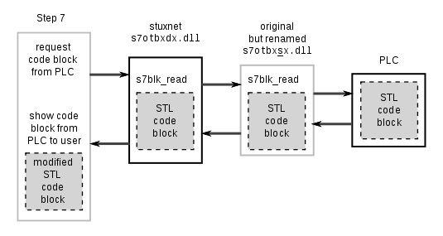
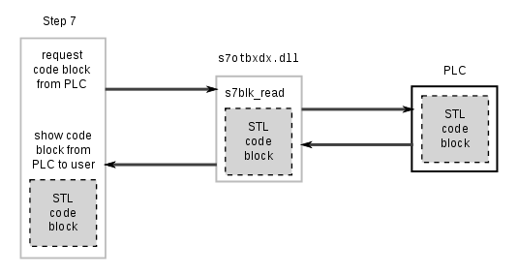
The Workings of Stuxnet (II)
PLC Level:
Checking local configuration for
Siemens PCS7/STEP7/WINCC
If found, copying into local STEP7
project folder (to propagate further).
Replacing S7 communication DLLs
used for exchanging data with PLC
Stuxnet is now the “Man in the Middle”
controlling the communication between SCADA & PLC.

Slide 14
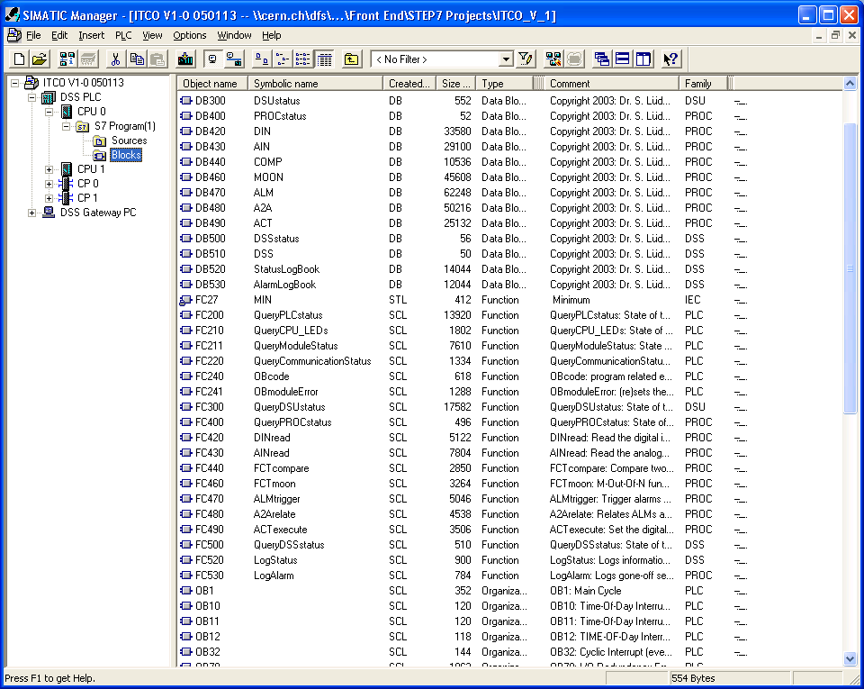

The Workings of Stuxnet (III)
Process Level:
“Fingerprinting” connected PLCs
If right PLC configuration,
downloading/replacing code
(between 17 and 32 FBs & DBs)
GAME OVER: varying rotational speed of centrifuges wearing them out and inhibiting Uranium enrichment.
“Man in the Middle” made SCADA displays look fine.

Slide 15

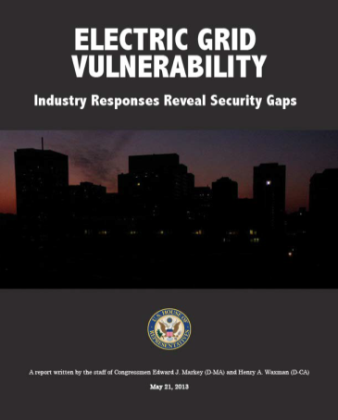
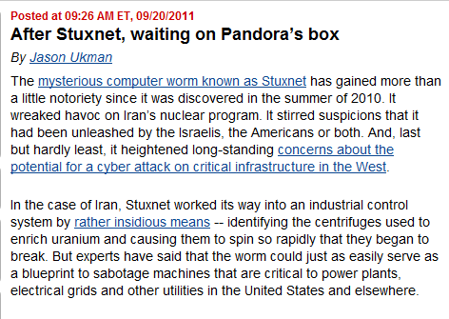
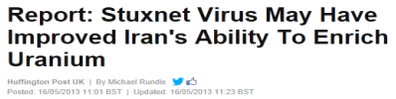
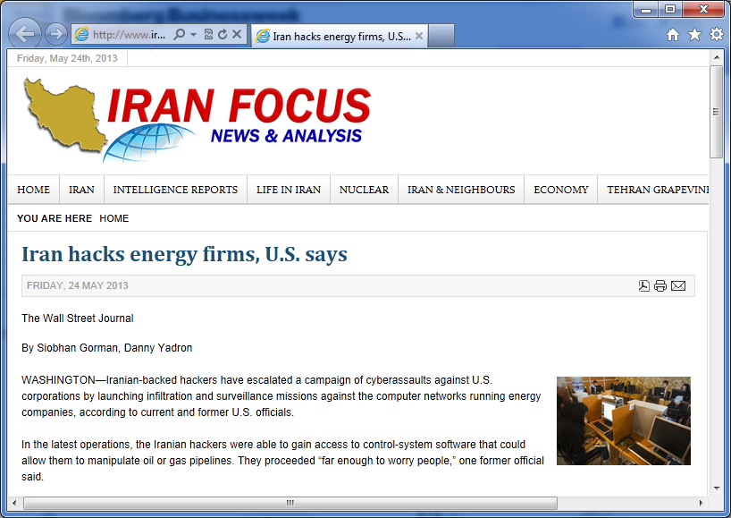
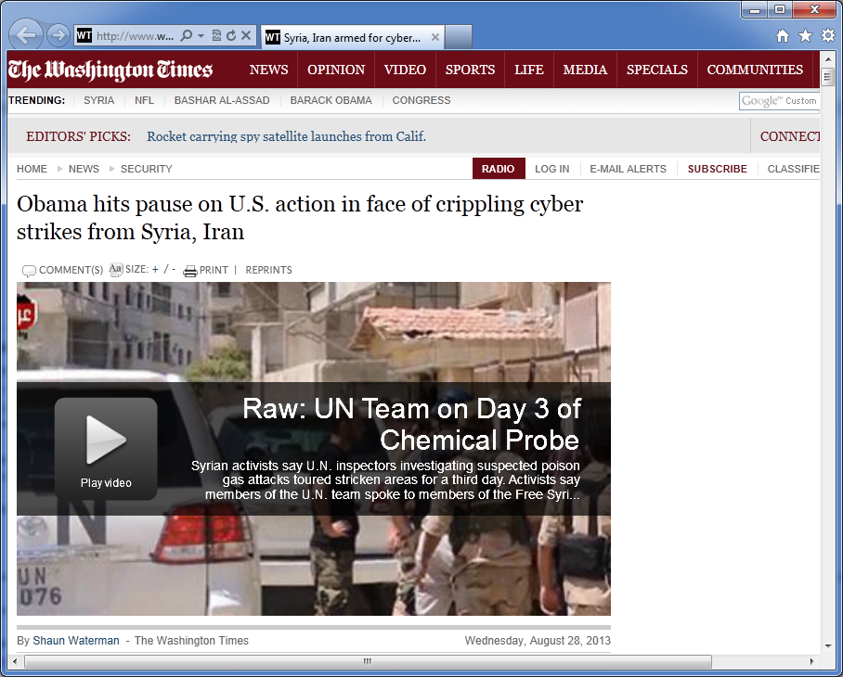

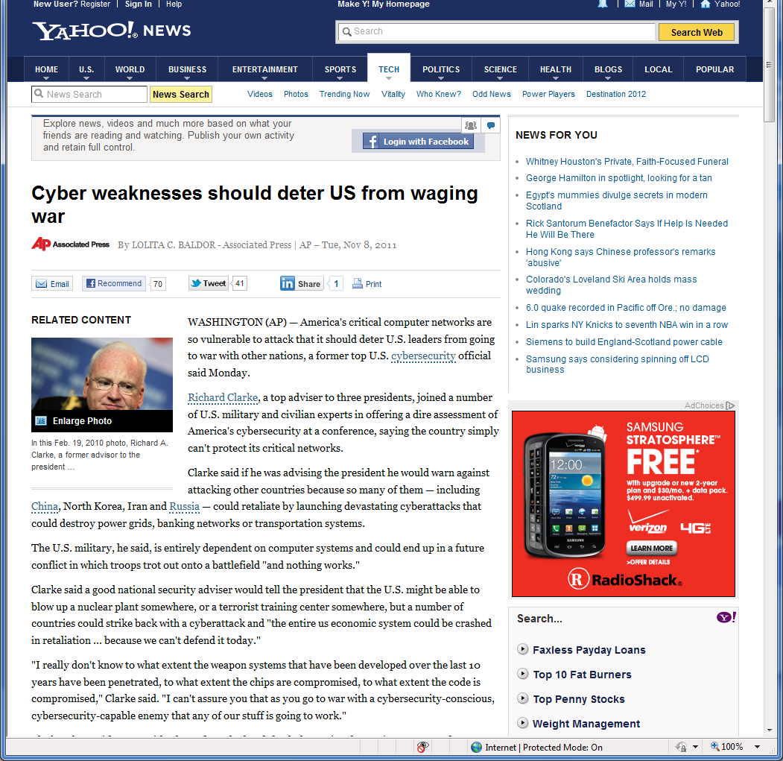

Cyber: Old Game, New Tools

Slide 16
Overview

Slide 17
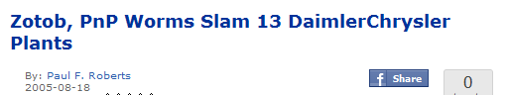
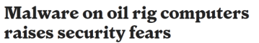


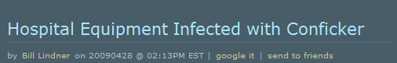
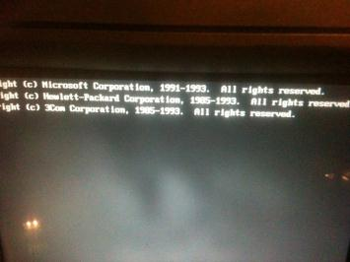
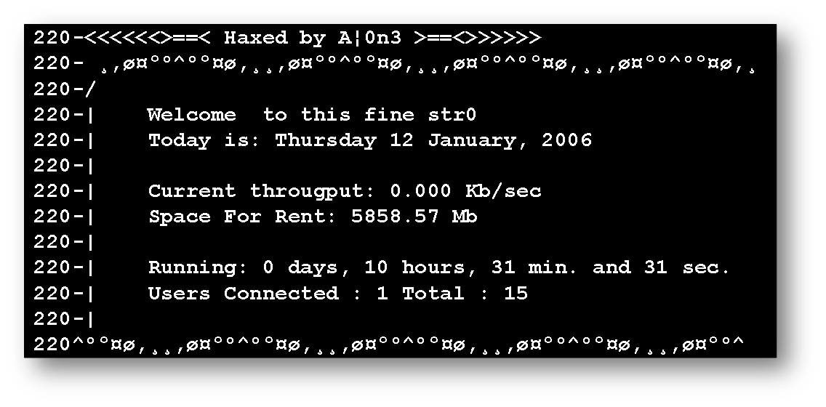

The Lack of Patching

Slide 18
The Problem of Patching
Integrity
S/W development live-cycles
Thorough regression testing
Nightly builds
Full configuration management
Availability
Redundancy & virtualization
Exceptions
“One-offs”; stand-alone systems
Safety!
Needs heavy compliance
testing (vendor & utility)
Potential loss of warranties
& certification (e.g. SIL)
Availability
Rare maintenance windows
Legacy
Old or embedded devices

Slide 19
The Problem of Patching
Integrity
S/W development live-cycles
Thorough regression testing
Nightly builds
Full configuration management
Availability
Redundancy & virtualization
Exceptions
“One-offs”; stand-alone systems
Safety!
Needs heavy compliance
testing (vendor & utility)
Potential loss of warranties
& certification (e.g. SIL)
Availability
Rare maintenance windows
Legacy
Old or embedded devices
Security at CERN has been delegated.
We (work hard to) enable & assist our people
to fully assume that responsibility!
They decide when to install what and where.

Slide 20

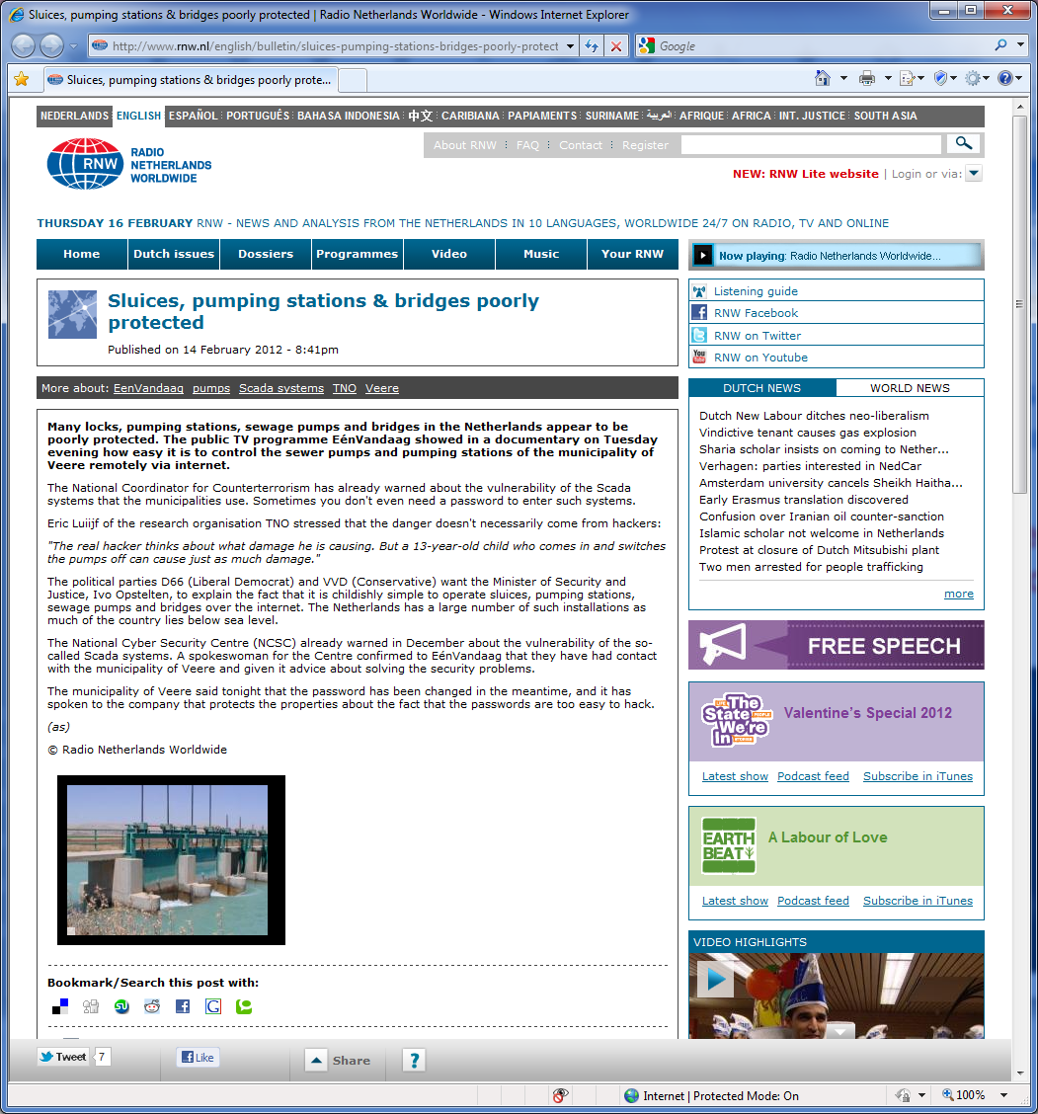
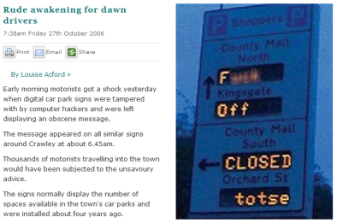
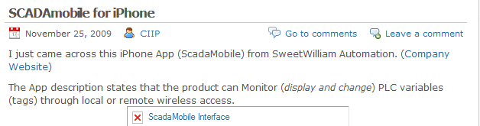
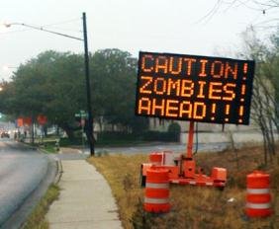

The Lack of Access Controls

Slide 21
The Problem of Access Control
Security
Split of AuthN & AuthZ
SSO, LDAP & AD
Kerberos, x509 & 2-factor AuthN
Laziness
We still deal with people
Password vs. Phishing
Complexity
WLCG: a network of computer centres
Safety!
Access always to be guaranteed
Shared accounts
Encryption too “heavy”
Legacy
Default passwords
Undocumented backdoors
Impossible IdM integration
No ACLs, iptables, etc.

Slide 22

The Problem of Access Control
Security
Split of AuthN & AuthZ
SSO, LDAP & AD
Kerberos, x509 & 2-factor AuthN
Laziness
We still dealing with people
Password vs. Phishing
Complexity
WLCG: a network of computer centres
Safety!
Access always to be guaranteed
Shared accounts
Encryption too “heavy”
Legacy
Default passwords
Undocumented backdoors
Impossible IdM integration
No ACLs, iptables, etc.
CERN strives to bring IT to the plant floor.
CERN IT provides general services.
CERN CERT provides general protections.
CERN controls experts run the show.

Slide 23







The Lack of Robustness

Slide 24
The Problem of Robustness
Robustness
(Externally sponsored)
penetration testing &
vulnerability scanning
Security
Decades of experience
& knowledge
CSIRT: Protection,
detection & response
Responsible disclosure
Robustness
Use-cases and abuse-cases
Not always compliant to standards
No certification (yet?)
Security
Not integral part…
…or through obscurity
Low priority, low knowledge
Unwillingness to share incidents
No laws; too many guidelines

Slide 25

The Problem of Robustness
Robustness
(Externally sponsored)
penetration testing &
vulnerability scanning
Security
Decades of experience
& knowledge
CSIRT: Protection,
detection & response
Responsible disclosure
Robustness
Use-cases and abuse-cases
Not always compliant to standards
No certification (yet?)
Security
Not integral part…
…or through obscurity
Low priority, low knowledge
Unwillingness to share incidents
No laws; too many guidelines
Asset inventories are key to CERN:
Devices, websites, S/W, dependencies.
CERT pen tests everything(we can get hands on).
(IPv6 is our next nightmare.)

Slide 26




SmartMeters: Nothing learned!
Confidentiality:
Customer data available to others
Integrity:
Manipulation of reading data
Misuse of meter as an attack platform
Availability:
Data not available in a timely manner…

Slide 27



Summary
PCS are (still) not designed to be secure.
They fulfil use-cases and abuse cases.
Defence-in-Depth is the key.
Make security part as functionality, usability,
availability, maintainability, performance!
Align Control System Cyber-Security with IT security!
Patch procedures, access protection, robustness,
certification & documentation need significant improvement.
Hack the box!
Buy any PCS on ebay and throw your favourite pen suite at it.
Push vendors & start responsible disclosure
P.S. Why do I have to do due diligence (and bear the costs)
instead vendors shipping out insecure applications/devices?

Slide 28




Literature

